Slide 1
Albumin
Pros v. Cons
Beth Conroy, VMD
12/20/22
Notes:
Hey guys, so I wanted to talk about albumin and the pros/cons associated with giving it.

Slide 2
What is Albumin?
69 kDa protein
Multiple domains with different charges
  Overall negative charge
Many different functions
Notes:
So we have been using albumin more and more in veterinary medicine, but what exactly is it? Well, Albumin is a large, negatively charged, globular protein. It has multiple different binding domains; Some positively charged and some negatively charged, but the overall net charge is negative. This net negative charge is one of the main reasons that Albumin normally cannot make it through the glomerular basement membrane into the urine filtrate, and it also plays a role in colloid oncotic pressure and acid-base balance. Albumin also has many functions which we will talk about shortly.

Slide 3
How and why is it made?
Synthesized in hepatocytes
Half life in circulation is 16-18 hours
Half life of albumin molecule is 18-19 days
Synthesis stimulated by low COP, insulin, thyroxine and cortisol
Notes:
As we all know, albumin is synthesized in the hepatocytes. Once it is made, it is released into circulation and it’s half life in circulation is about 16-18 hours. About 4-5% of albumin in circulation moves from the capillaries to the interstitium per hour, and then is returned to the blood vessels via lymphatics. The median half life of an albumin molecule overall is about 18-19 days.
The primary stimulus for albumin production is not the albumin concentration of the serum, but rather the colloid osmotic pressure, which is sensed by hepatic osmoreceptors in the hepatic interstitium. Secondary stimuli for albumin synthesis include insulin, thyroxine, and cortisol.

Slide 4
Functions
Colloid oncotic pressure
Gibbs Donnan effect
Aids in transport
Influences both hemodynamics and hemostasis
Radical oxygen scavenger
Acid base balance
Endothelial glycocalyx repair
Notes:
Just to briefly touch on some of its many functions. One of the biggest things Albumin helps with is colloid osmotic pressure. Since it is essentially trapped in the intravascular space, it plays a large role in maintaining plasma COP, upwards of 75-80%.
In addition, the negative charge on albumin plays a role in the Gibbs Donnan effect. Essentially, albumin’s negative charge results in the movement of cations, primarily sodium, into the intravascular space, which further increases the osmotic pressure in that compartment.
Albumin also plays a significant role in the transportation of various substances such as fatty acids, various hormones such as thyroxine and cortisol, bilirubin, nitric oxide, cholesterol, various metals, and of course, drugs.
Albumin influences both hemodynamics and hemostasis through it’s binding to nitric oxide and it is able to scavenge multiple radical oxygen species.
Albumin also plays a role in acid base balance. Because it is negatively charged, albumin acts as a weak acid. In hypoalbuminemia, the decreased amount of the anionic albumin will result in an increased anion gap, an increased base excess, and a subsequent metabolic alkalosis.
Finally, albumin has a significant role in the maintenance of the endothelial glycocalyx. As everyone knows, the endothelial glycocalyx is made of GAGs and proteoglycans, and forms a barrier between the intravascular space and the endothelium. The glycocalyx itself has a net negative charge and typically repels negatively charged molecules. As I’ve stated a few times now, albumin does have a net negative charge, however because it is a large protein with a blend of positively and negatively charged domains, it binds to the endothelial glycocalyx with its positively charged residues and is thought to play a role in repair of the glycocalyx.
S albumin has been shown to be very important overall. In both human and veterinary patients, hypoalbuminemia has been associated with impaired wound healing, decreased binding of drugs, increased risk of gastrointestinal surgical site dehiscence, and increased patient morbidity and mortality. In 1 study of human patients, the relative risk of mortality increased by 25% to 50% for each 0.25 g/dL decrease in serum albumin. In another meta-analysis of hypoalbuminemia in acute illness in people, for each 10 g/L decrease in albumin, there was a 137% increase in odds of death, a 71% increase in length of hospital stay and an 89% increase in overall morbidity.
So now that we know a bit about Albumin, lets talk about the different types.

Slide 5
Types/Sources of Albumin
Plasma
Human Serum Albumin
Lyophilized Canine Specific Albumin
Notes:
Historically, albumin replacement was largely in the form of large volumes of fresh frozen plasma or with concentrated human albumin products. While plasma is a great product overall, it would take up to 25 mL/kg of plasma to increase serum albumin by 0.5 g/dL. A 2001 study showed that the replacement of albumin was the primary cause for administration of fresh frozen plasma in 63% of cases. Another retrospective study that evaluated trends in use of fresh frozen plasma over 2 decades reported the primary reason for administration of fresh frozen plasma was to treat coagulopathies. But, that same study found that, when fresh frozen plasma was administered to treat hypoalbuminemia, the mean serum albumin concentration actually significantly decreased (17.4 g/L after the administration of fresh frozen plasma vs 21.5 g/L before infusion) after fresh frozen plasma administration. Because of the dilutional effects of such as large volume of plasma required, hospital resource availability, and cost limitations for some clients, the administration of plasma is not an efficient means of albumin supplementation for many patients.
The first albumin transfusions were established by the American military during World War II as part of the bovine and human albumin program. Bovine serum albumin was initially used successfully in trauma victims until 1942, when reports of fatal serum sickness in several soldiers were first reported. After a series of adverse reactions, the bovine transfusion program was discontinued in 1943. At the same time as the development of the bovine program, the military began looking into purification of human serum albumin for transfusion, and the first reported use of HSA in a human patient was a soldier that sustained a polytrauma and was hypotensive. He was resuscitated with albumin, and afterwards had no further episodes of hypotension. After that, administration of albumin in select cases continued. And then in 1942, a navy doctor successfully treated several severely burned patients after the attack at Pearl Harbor. After this, human serum albumin became further refined and it’s use increased, although there was still not a lot of empiric evidence that it provided a benefit over crystalloids, and it is still associated with many possible negative side effects.
And finally we have one of my favorite products, Lyophilized canine specific concentrated albumin. This type of albumin is pooled from healthy donors available from multiple manufacturers. It can be stored at room temperature and is stable for 36 months. The manufacturers recommend reconstitution to 5% to 25% solution using 0.9% NaCl or 5% dextrose in water, then administered within 6 hours or stored refrigerated for up to 24 hours. The manufacturers’ indications for this product are for hypoproteinemia and shock or hypovolemia.

Slide 6
HSA v. CSA
Human Serum Albumin
  Has the most research associated with it
Lyophilized Canine Specific Albumin
  Has less risk of serious reaction
Notes:
Now that we know what it is, how and why it is made, its functions and what types are out there, lets delve into why it is so great. Human specific albumin has been around longer and has more studies associated with it, however now that a lyophilized canine specific albumin product exists, I personally feel that it should be used preferentially over the HSA.

Slide 7
Pros of Albumin
Increase COP and serum albumin concentrations more effectively
  Improves hemodynamics and hemostasis
  Improves acid-base status
  Aids in the repair of the endothelial glycocaylx
It is more cost effective than trying to give plasma to raise the albumin
The canine specific albumin has less risk of serious adverse reaction
Notes:
Increase COP and serum albumin concentrations more effectively
Improves hemodynamics and hemostasis
Improves acid-base status
Aids in the repair of the endothelial glycocaylx
It is more cost effective than trying to give plasma to raise the albumin
The canine specific albumin has less risk of serious adverse reaction

Slide 8
Cons of Albumin
Cost
Risk for hypersensitivity reaction
  Risk is much higher with Human albumin than Canine specific albumin
Risk of fluid overload
Notes:
Now that we’ve discussed some pros of albumin, lets talk about some cons. As previously mentioned, giving albumin may be more cost effective than giving the amount of plasma that would be needed for the same effect, however the canine specific albumin still has a significant cost associated with it – especially for larger dogs.
Another con of albumin is the potential risk for hypersensitivity reactions. Although a number of studies have documented that serum albumin, total solids, and COP can be successfully increased with use of HSA in critically ill dogs, there is a real risk of inciting both immediate and delayed hypersensitivity reactions in dogs. Infusion of human albumin concentrate to healthy and critically ill dogs can induce an acute type 1 hypersensitivity reactions that occurs within minutes to hours of exposure to the antigen but it generally requires prior exposure with subsequent sensitivity. It can also induce a delayed type III hypersensitivity reactions observed 1 to 3 weeks after antigenic exposure. This can result in widespread vasculitis with additional clinical signs of fever, lethargy, joint effusion, polyarthralgia, lymphadenopathy, and urticaric skin lesions and it can be self-limiting or can lead to significant morbidity or mortality.
BUT Despite immune stimulation to HSA in critically ill dogs and cats, the majority of studies that have prospectively and retrospectively evaluated its use have demonstrated significant increases in serum albumin concentration, COP, and blood pressure in critically ill dogs without severe adverse sequelae. Because many of the animals who receive albumin were not responding to more traditional therapies, one could argue that some of the reported signs of reaction could possibly be associated with the critical illness, and not a hypersensitivity reaction at all.
Another con is the risk of fluid overload in a patient, although that can be seen with plasma or any other type of fluid used for resuscitation purposes as well.

Slide 9

39 dogs with septic peritonitis
  22 received HSA 25% (10.2 ml/kg) as a CRI
  17 no HSA but HES & FFP allowed
    No difference in HES/FFP administration between groups
No difference in LOS
Survivors had higher repeat albumins (2.39 g/dl vs 1.97 g/dl)
Patients that received albumin had higher serum albumin
No survival benefit for albumin transfusion?
Notes:
This 2015 retrospective study evaluated the effect of 25% human serum albumin supplementation on albumin level, total protein, COP, LOS, and survival in dogs with septic peritonitis. They had an overall mortality of 53.8%, and found that a higher post-operative albumin level was associated with survival but not length of hospitalization. Somewhat confusingly, higher albumin levels were associated with albumin transfusion, but albumin transfusion itself was NOT associated with survival. In the post hoc analysis, they found that the study would have needed at least 94 dogs to determine an effect of albumin supplementation on survival, so it is possible that this study was just underpowered. However, it may also point to the idea that the dogs whose albumin improved were ultimately the patients that were improving for other reasons and so their albumin improved because their underlying condition was treated more effectively.
Admit alb not different between groups
Survivors had higher TP and COP
41% intestinal FB
18/39 dehisced from previous sx

Slide 10
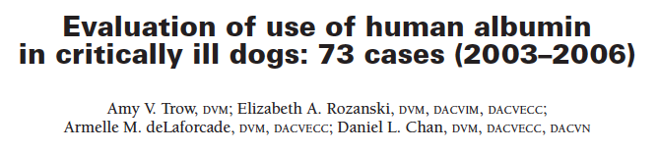
73 critically ill dogs that received 10% HSA
27% had transfusion reactions
  15% delayed
Associated with survival
  Larger albumin transfusion volume (1.7 vs 1.2 g/kg
  Change in albumin concentration (1.3 vs 1.0 g/dl)
  Change in COP (4.0 vs 3.2 mmHg)
Notes:
This retrospective study evaluated critically ill dogs that received human serum albumin, with the goal being to evaluate the transfusions’ effect on serum albumin concentration, COP, TP, and assess the relationships between those variables and outcome. They did find that the patients that received more albumin were more likely to survive, and that the overall change in albumin concentration and COP post-transfusion was associated with survival. However, as there was no comparison group that did not receive albumin, and it was retrospective, so it is hard to say whether giving the HSA had an effect on overall survival.
Additionally, this group documented that 27% of these patients had complications associated with their albumin transfusions, and 3/20 of those were delayed transfusion reactions. Previous studies had shown that dogs that receive HSA can have immediate and delayed hypersensitivity reactions that can be life-threatening, and healthy dogs given human serum albumin have died as a sequela to these reactions.

Slide 11
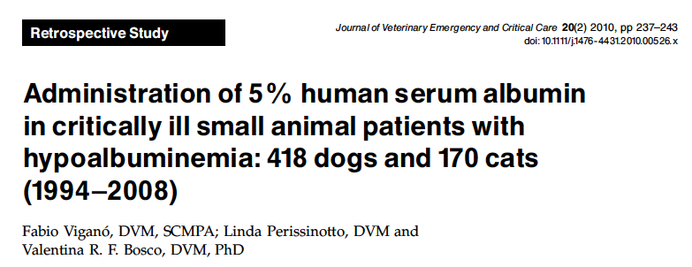
418 dogs & 170 cats
Serum albumin <2.0 g/dl
5% albumin, no other colloids
2 ml/kg/hr over 10 hours every day until a serum concentration of 2 g/dL was reached
  Median number of days: 4 (2-11) for dogs, 3 (2-7) for cats
No serious acute adverse events (anaphylaxis, angioedema, urticaria)
Diarrhea, pyrexia, tremors in 43.5% of dogs and 36.5% of cats
No reactions noted beyond day 3
  No data on delayed reactions
Notes:
One of the biggest study there is examining albumin transfusions reactions is this retrospective study, where they looked back at 418 dogs and 170 cats that received a standardized dose of 5% HSA. These patients received the same dose of HSA every day until their albumin was at least 2g /dl, and so most patients received HSA for multiple days. Surprisingly, there was no evidence of serious acute adverse events, which were defined by the investigators as either anaphylaxis, angioedema, or urticaria, although many of the pets developed diarrhea, pyrexia, and tremors, and 27.8% of dogs and 10.6% of cats had reactions after the first day, although no further reactions were noted after day three. Unfortunately, no follow up data was available so whether or not some of these patients went home to have delayed transfusion reactions is unknown.
Mortality
Dogs: 13.4% died (17/56 euthanized)
Cats: 12.4% died (11/21 euthanized)

Slide 12
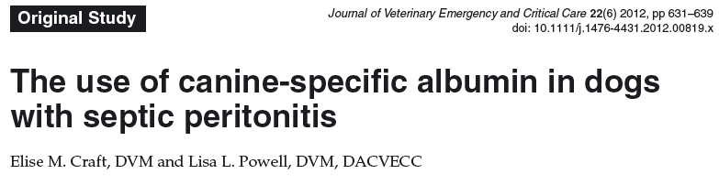
14 dogs with septic peritonitis and hypoalbuminemia (<2.7 g/dl)
Randomized to receive either 5% canine albumin (800mg/kg) or clinician directed therapy
Increased albumin, COP, and BP 2 hours after transfusion in CSA group
Increased albumin at 24 hours in albumin group
Not powered for mortality
Notes:
And finally, the only prospective, randomized trial we have of canine specific albumin in dogs. This was 14 dogs with septic peritonitis that were randomized to receive either 800 mg/kg canine albumin within the first 24 hours of hospitalization, or clinician directed therapy, which could include HES or crystalloids. Dogs receiving CSA could only receive crystalloids as a supplemental fluid during CSA administration, but they were not excluded if they had previously received HES. And their primary endpoints were albumin, COP, and doppler BP.
Two hours after transfusion, the albumin group had higher albumin, higher COP, and higher blood pressure. At 24 hours posttransfusion, the effect on albumin remained but the effects on COP and BP did not, and after 24 hours there was no difference between the groups in terms of serum albumin, either. Overall survival in this population was 80%, which is pretty great for septic peritonitis. Unfortunately, the number of dogs enrolled in the study had to be limited due to the amount of product the company was willing to donate, and it would have required at least 46 dogs to be adequately powered to determine mortality, so conclusions regarding survival cannot really be reached in this population.

Slide 13
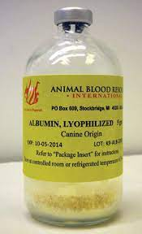
Conclusions
Give Albumin!
Notes:
So in conclusion, if you have a dog that is hypoalbuminemic and you want to correct it, it is strongly recommended to use canine specific albumin rather than human serum albumin due to the potential severe risks associated with it. The use of plasma is only recommended if your patient is coagulopathic because as stated previously, the sheer amount of plasma needed to raise the albumin is preposterous in both volume and cost.

