Slide 1
Part I: Critical Illness-related Corticosteroid Insufficiency
Part II: Hypoadrenocorticism
Board Review 5/30/23

Slide 2
Critical Illness-related Corticosteroid Insufficiency
First described in critically ill people
2008 consensus definition: inadequate cellular corticosteroid activity for severity of the patient’s disease
Most reported clinical manifestation: pressor-resistant hypotension
Formerly called relative adrenal insufficiency
Notes:
CIRCI is a better name because:
Some studies suggest that some critically ill humans benefit from corticosteroid therapy even if they are not adrenally insufficient based on plasma hormone tests
Many patients with CIRCI appear to have impaired responsiveness to cortisol rather than inadequate cortisol production
There is no consensus on what adrenal insufficiency is in the clinical setting
CIRCI is characterized by dysregulated systemic inflammation resulting from inadequate intracellular glucocorticoid-mediated anti-inflammatory activity for the severity of the patient’s critical illness.
CIRCI is associated with increased circulating levels of biological markers of inflammation and coagulation over time, morbidity, length of ICU stay, and mortality. Given the growing body of evidence that CIRCI occurs across a broad spectrum of critical illness, an understanding of the pathogenesis and treatment of CIRCI is important to all critical care providers

Slide 3
CIRCI
Reported most and investigated most thoroughly in humans with septic shock
Also described in people with non-septic critical illnesses
  Cardiac disease and surgery, hepatic failure, trauma, chronic obstructive pulmonary disease
Optimal diagnostic and therapeutic recommendations for CIRCI remain unknown
Notes:
Septic shock: Hypotension despite adequate fluid loading that is due to systemic inflammation from an infectious underlying cause

Slide 4
CIRCI Trials
2002 French Study – Annane trial
2008 CORTICUS – Corticosteroid Therapy of Septic Shock
2018 APROCCHUS – Activated Protein C and Corticosteroids for Human Septic Shock
2018 ADRENAL – Adjunctive Corticosteroid Treatment in Critically Ill Patients with Septic Shock

Slide 5
CIRCI
Effect of Treatment With Low Doses of Hydrocortisone and Fludrocortisone on Mortality in Patients with Septic Shock
  “The French Study” – Annane et al. 2002
  Placebo-controlled, randomized, double-blind, parallel-group trial at 19 ICUs in France
  Objective: To assess whether low doses of corticosteroids improve 28-day survival in patients with septic shock and relative adrenal insufficiency (RAI)
  Patients: 300 adults with septic shock
  Patients treated with hydrocortisone (50 mg IV bolus q6) and fludrocortisone or placebo for 7 days
  Conclusion: Treatment significantly reduced the risk of death in patients with septic shock and RAI without increasing adverse events
Notes:
Mortality rates:
- Patients with RAI, there were 73 deaths (63%) in the placebo group and 60 deaths (53%) in the corticosteroid group.
Time to vasopressor withdrawal:
Patients with RAI, the median time to vasopressor withdrawal was 10 days in the placebo group and 7 days in the corticosteroid group. At 28 days, vasopressor therapy had been withdrawn in 46 patients (40%) in the placebo group and in 65 patients (57%) in the corticosteroid group.
Adverse events
- No significant differences between the 2 groups in the rates related to corticosteroids or vasopressors, or related to ICU invasive procedures
Patients were 18 years or older with
Document site (or at least strong suspicion) of infection
T higher than 100.9 F or lower than 96 F
HR >90 bpm
Systolic BP <90 mmHg for at least 1 hour despite adequate fluid replacement and more than 5 ug/kg of dopamine or current treatment with epinephrine or norepinephrine
UOP <0.5 ml/kg BW for at least 1 hour or ratio of PaO2/FiO2 of less than 280 mmHg
Lactate >2
Need for mechanical ventilation
Short corticotropin test prior to randomization – 250 ug IV bolus → RAI defined by a response of 9 ug/dL or less (difference between highest of the concentrations after the test and those taken before the test)
Randomized within 3 hours of the onset of shock – changed to 8 hours
Excluded patients who received etomidate during the 6 hours proceeding randomization (selective inhibitor of 11 B-hydroxylase)
Results of Mortality distribution:
NONRESPONDERS: At day 28, there were 73 deaths (63%) in the placebo group and 60 deaths (53%) in the corticosteroid group.
RESPONDERS: At day 28, there were 18 deaths (53%) in the placebo group and 22 deaths (61%) in the corticosteroid group.
ALL PATIENTS: At day 28, there were 91 deaths (61%) in the placebo group and 82 deaths (55%) in the corticosteroid group.
Mortality rates:
- Patients with RAI, there were 73 deaths (63%) in the placebo group and 60 deaths (53%) in the corticosteroid group.
Time to vasopressor withdrawal:
Patients with RAI, the median time to vasopressor withdrawal was 10 days in the placebo group and 7 days in the corticosteroid group. At 28 days, vasopressor therapy had been withdrawn in 46 patients (40%) in the placebo group and in 65 patients (57%) in the corticosteroid group.
Adverse events
- No significant differences between the 2 groups in the rates related to corticosteroids or vasopressors, or related to ICU invasive procedures

Slide 6
CIRCI
Hydrocortisone Therapy for Patients with Septic Shock (CORTICUS)
  2008 multicenter, randomized, double-blind, placebo-controlled trial
  499 adults with septic shock
  251 patients received hydrocortisone (50 mg IV q6) and 248 received placebo for 5 days; the dose was then tapered during a 6-day period
  Primary outcome: death among patients who did not have a response to a corticotropin test
  At 28 days, there was no difference in mortality between patient in the two groups who did not have a response to corticotropin or between those who had a response
  In the hydrocortisone group, shock was reversed more quickly than in the placebo group
    There were more episodes of superinfections, including new sepsis and septic shock
Notes:
Reversal of shock was defined as maintenance of a systolic BP of at least 90 mmHg without vasopressor support for at least 24 hours.
Superinfection was defined as a new infection occurring 48 hours or more after the initiation of a study drug.
Etomidate use was not an exclusive criteria.
Found more rapid shock reversal but no survival benefit in patients treated with hydrocortisone regardless of ACTH stimulation test results
Overall, death rate of 34.3% in the hydrocortisone group and 31.5% in the placebo group.
The proportions of patients who underwent reversal of shock were similar among patients who did not have a response to corticotropin.
The duration of time until the reversal of shock was significantly shorter among patients receiving hydrocortisone for all patients.
In the hydrocortisone group, there was an increased incidence of superinfections including new episodes of sepsis or septic shock.

Slide 7
CIRCI
French Study vs. CORTICUS
  Annane study population was sicker
  Annane study enrollment was allowed within 8 hr. of fulfilling entry criteria and 72 hr. in CORTICUS
  Fludrocortisone not given in CORTICUS
  Etomidate used in both studies
  Only 500 patients were enrolled rather than projected 800 in CORTICUS
Notes:
Annane study population was sicker (higher SAPS II scores at baseline, higher rate of mortality in placebo group (61% compared to 32%
Annane study enrollment was allowed within 8 hr. of fulling entry criteria and 72 hr. in CORTICUS
Fludrocortisone not given in CORTICUS (hydrocortisone should provide sufficient mineralocorticoid activity
Etomidate used in both studies (26% of patients in CORTICUS and 24% in Annane study)
Only 500 patients were enrolled rather than projected 800 in CORTICUS – the study lacked power

Slide 8
CIRCI
2018 Annane et al. APROCCHUS Trial: Hydrocortisone plus Fludrocortisone for Adults with Septic Shock
  Multicenter, double-blind, randomized clinical trial
  1241 people with septic shock
  Primary outcome: 90-day all cause mortality
  Steroid treatment improved all cause mortality compared with placebo, regardless of cortisol response to corticotropin
  Treatment was associated with positive secondary outcomes – vasopressor-free and organ failure-free days
  No more serious adverse events than placebo
Notes:
Activated Protein C and Corticosteroids for Human Septic Shock
The 90-day mortality was 43% in the H + F group and 49.1% in the placebo group.
Trial agents were administered for 7 days without tapering.
Patients in APROCCHUS trial were sicker than those in CORTICUS trial (higher SOFA scores, higher SAPS II values, and more likely to be admitted from the medical wards).

Slide 9
CIRCI
2018 ADRENAL Trial: Adjunctive Glucocorticoid Therapy in Patients with Septic Shock
  International, multicenter, double-bind, randomized clinical trial
  3658 people with septic shock
  Primary outcome: death from any cause at 90 days
  No difference in 90-day survival in patients that received hydrocortisone versus placebo
  Patients receiving hydrocortisone had more rapid shock reversal as well as more overall adverse events compared to placebo
Notes:
At 90 days, 27.9% of patients in the hydrocortisone group and 28.8% in the placebo group had died.
Patients assigned to received hydrocortisone had faster resolution of shock than those assigned to the placebo group (median duration 3 days vs. 4 days).
Patients in the hydrocortisone group had a shorter duration of the initial duration of mechanical ventilation than those in the placebo group.
Fewer patients in the hydrocortisone group received a blood transfusion.
Receipt of etomidate excluded patients
No corticotropin testing performed
Continuous infusion of 200 mg hydrocortisone per day for a maximum of 7 days or until ICU discharge or death

Slide 10
Pathophysiology
Cortisol hormone is released from the adrenal glands
  Small amounts in a circadian rhythm
  Larger amounts during times of physiologic stress
Homeostatic functions:
  Regulation of carbohydrate, lipid, and protein metabolism
  Production of catecholamines and function of adrenergic receptors
  Cell membrane stabilization
  Immune modulation

Slide 11
Question #1
Please describe the HPA axis and the three main hormones involved.

Slide 12
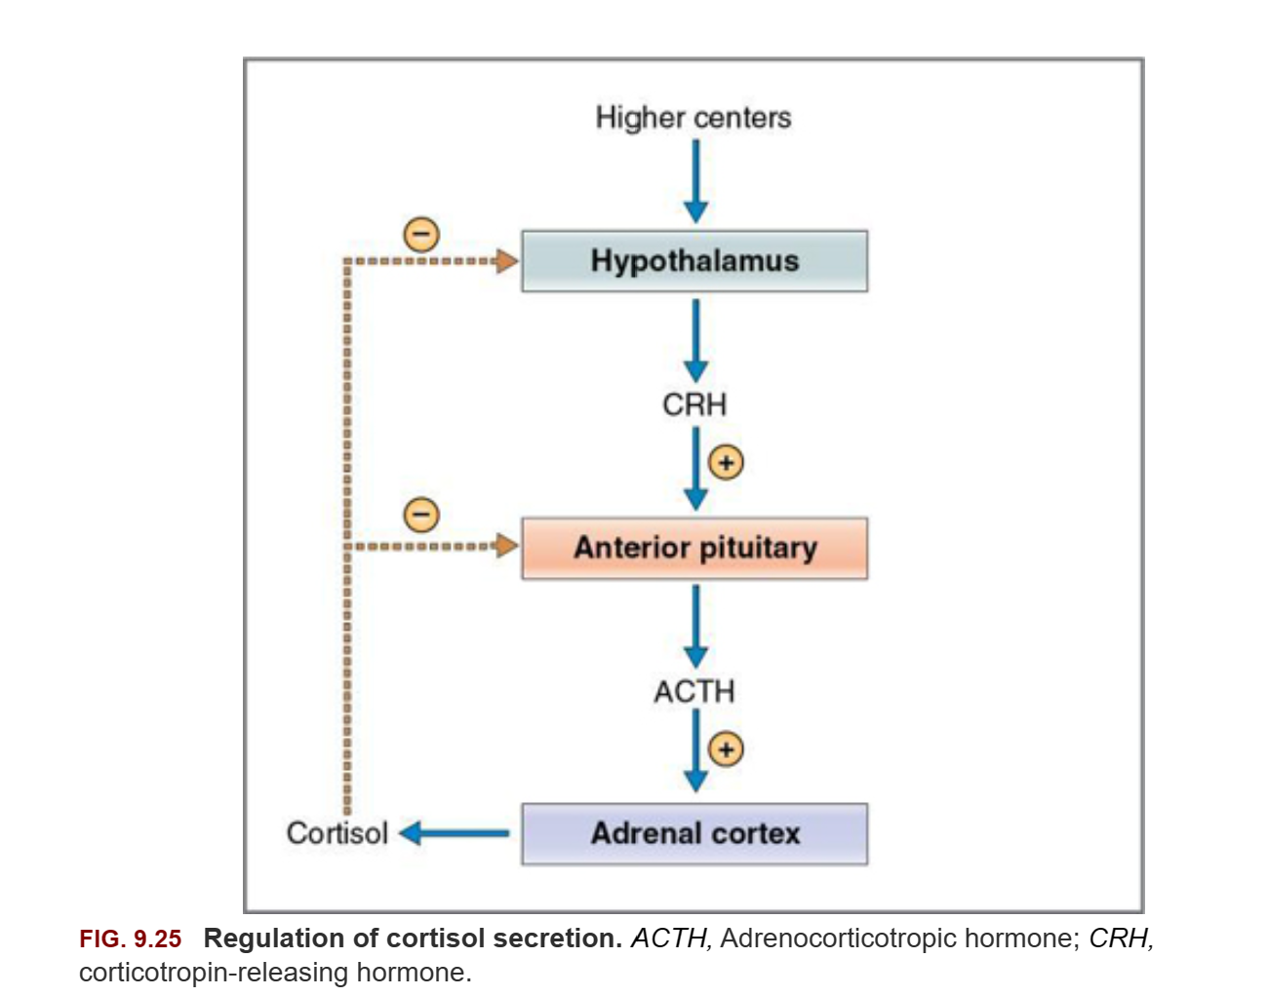
Pathophysiology
Notes:
Serum cortisol determined by hormonal cascade and negative feedback of HPA axis.
Hypothalamus produces CRH (corticotropin releasing hormone) which stimulates the anterior pituitary to release ACTH (adrenocorticotropic hormone).
Hypothalamus derived arginine vasopressin works synergistically with CRH to enhance ACTH secretion.
ACTH in circulation stimulates the zona fasciculata and reticularis of the adrenal gland to synthesize and release cortisol.

Slide 13
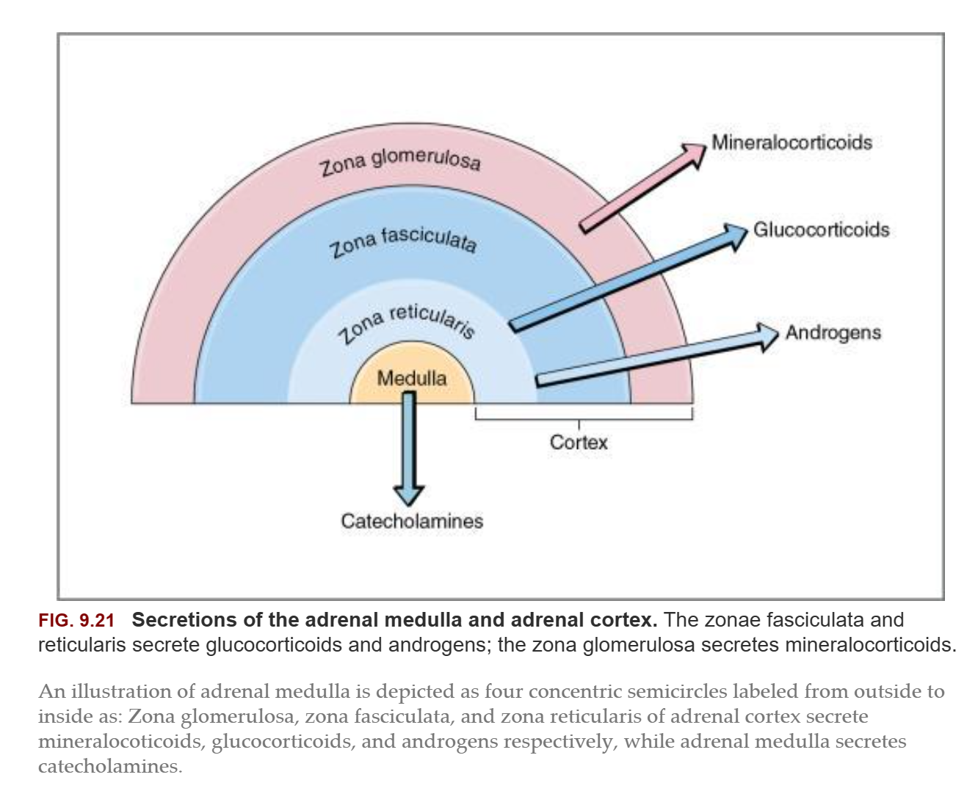
Notes:
ACTH in circulation stimulates the zona fasciculata and reticularis of the adrenal gland to synthesize and release cortisol.
Cortisol has a negative feedback action on the hypothalamus and anterior pituitary gland release of stimulatory hormones.

Slide 14
Question #2
How does cortisol circulate in plasma and affect cellular function?

Slide 15
Pathophysiology
Once in circulation, most cortisol is bound to corticosteroid binding globulin (CBG) and a small fraction is bound to albumin
Cortisol not protein bound is free cortisol
  Free cortisol = biologically active
Free cortisol exerts actions through:
  Genomic pathways
  Nongenomic pathways
Free cortisol enters target cells and binds to glucocorticoid receptor (GR) which translocate to the cell nucleus as a complex
  Acts as transcription factor to alter cell function
Nongenomic effects by intercalating into cell or mitochondrial membranes

Slide 16
Pathophysiology
CIRCI → complex combination of alterations in:
  Cortisol production
  Plasma carriage of cortisol
  Metabolism of cortisol
  Tissue responsiveness to cortisol
Direct trauma, infarction or hemorrhage, or cytokine influence may impair HPA axis function and thereby decrease circulation of cortisol
Multiple medications used in the ICU are known to decrease cortisol production
  Etomidate, ketoconazole, opiates, propofol
Critically ill people often have increased free cortisol concentrations in the face of low ACTH concentrations

Slide 17
Pathophysiology
Dissociation between ACTH and cortisol concentrations in critical illness (high cortisol concentration in the presence of low ACTH concentration) is likely multifactorial
  Cytokines, LPS-bound toll-like receptors, and endothelin drive adrenal cortisol production and release independent of ACTH
  The fraction of cortisol that circulates as free (active) cortisol is increased in critical illness which may inhibit the hypothalamus and pituitary

Slide 18
Pathophysiology
Free cortisol is increased due to:
  Systemic inflammation decreases hepatic synthesis of CBG and albumin production
  Acidemia, hyperthermia, and increased neutrophil activation leads to structural changes in CBG that lower its affinity for cortisol
  Impaired renal and hepatic metabolism of cortisol
    May be linked to increased circulating bile acids
Target tissues may be cortisol resistant
  Glucocorticoid receptor structure and number are altered in sepsis which likely impacts cortisol’s ability to exert genomic effects
Notes:
Hypothesize that pharmacologic doses of glucocorticoids may help normalize GR number and function.

Slide 19
Question #3
What is the most common clinical abnormality in people with septic shock and CIRCI?

Slide 20
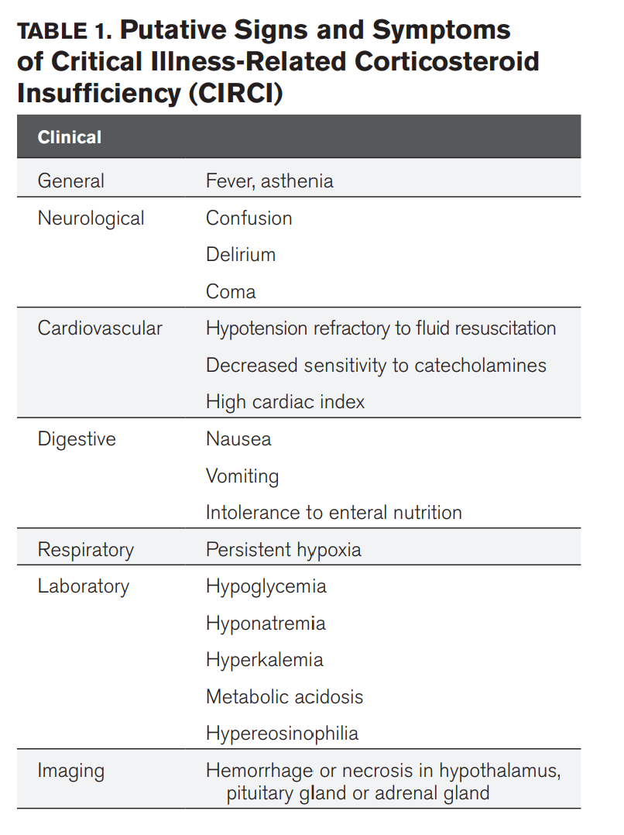
Clinical manifestations
Most common clinical abnormality reported in people with septic shock and CIRCI is pressor-resistant hypotension
Neurological, cardiovascular, digestive, and respiratory system abnormalities may be associated with CIRCI in people
  Difficult to know which are due to primary illness and which may be attributed to CIRCI

Slide 21
Question #4
How does cortisol affect vasomotor tone?

Slide 22
Cortisol’s role in vasomotor tone
Smooth muscle adrenergic receptor expression is modulated by glucocorticoids
Inflammatory conditions induce expression of proinflammatory cytokines that inhibit the expression of genes for receptors for alpha-1 agonists, angiotensin II, and vasopressin
Glucocorticoids
  Decrease proinflammatory cytokine production via inhibition of NF-kβ activity and tend to reverse vascular hypo-reactivity in sepsis
  Suppress production of nitric oxide and prostacyclin
Notes:
Potentiate vascular response to catecholamines
Increased cortisol response → increased arterial sensitivity to norepi → increased vascular resistance
Suppress production of prostacyclin and NO in endothelial cells (vasodilators)
In smooth muscle cells, glucocorticoids enhance agonist-mediated pharmacomechanical coupling

Slide 23
Diagnosing CIRCI in people
Unknown how to diagnose CIRCI
Current clinical guidelines (2017) recommend using either a resting total cortisol or the 250 ug ACTH stimulation test to diagnose CIRCI in people in favor of using the patient’s hemodynamic response to hydrocortisone
Surviving sepsis campaign 2016:
  No mention of resting or ACTH stimulated cortisol testing when considering treatment with corticosteroids for septic shock

Slide 24
Diagnosing CIRCI in dogs and cats
No clinical veterinary studies have been performed to determine how best to identify CIRCI in dogs and cats
Investigation of HPA axis in dogs with sepsis, severe trauma, or GDV
  Investigators performed a 1-hr ACTH stimulation test using 5 ug/kg cosyntropin and found that dogs with delta cortisol ≤ 3 ug/dL were significantly more likely to have received vasopressors than dogs with delta cortisol > 3 ug/dL
Investigation of dogs with systemic inflammation secondary to infection using standard 1-hr 250 ug/dog ACTH stimulation test
  Dogs with an increase in cortisol of ≤ 3 ug/dL were more likely to be hypotensive and had decreased survival compared to those with a delta cortisol > 3 ug/dL
Notes:
It is likely that these findings represent markers of illness severity rather than a true diagnosis of CIRCI.
No recommendations can be made regarding how to make a diagnosis of CIRCI in dogs and cats.

Slide 25
Treating CIRCI in people
Septic shock
  Should corticosteroids be administered among hospitalized adult patients with septic shock?
    Recommendation: We suggest using corticosteroids in patients with septic shock that is not responsive to fluid and moderate- to high-dose vasopressor therapy (conditional recommendation, low quality of evidence).
  What is the recommended dose and duration of treatment among hospitalized adult patients with septic shock treated with corticosteroids?
    Recommendation: If using corticosteroids for septic shock, we suggest using long course and low dose (e.g., IV hydrocortisone < 400mg/day for at ≥ 3 days at full dose) rather than high dose and short course in adult patients with septic shock (conditional recommendation, low quality of evidence).
Notes:
Guidelines for the diagnosis and management of critical illness-related corticosteroid insufficiency 2017

Slide 26
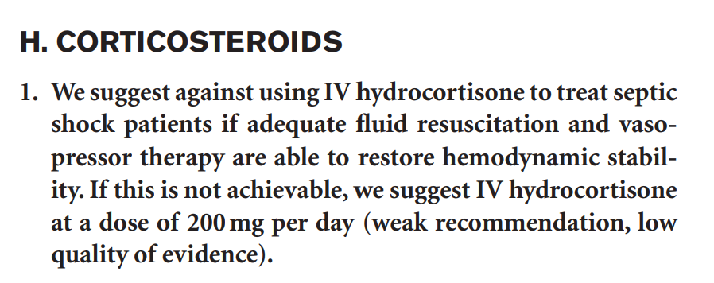
Treating CIRCI in people
2016 Surviving Sepsis Guidelines

Slide 27
Treating CIRCI in people
Unclear whether tapering of hydrocortisone is required in this setting
Fludrocortisone is not recommended in any guidelines – not found to improve survival when used in conjunction with hydrocortisone
Corticosteroids are not recommended for all people with sepsis that are not in septic shock
Notes:
Unclear whether tapering is required – the largest clinical trials in people stopped abruptly

Slide 28
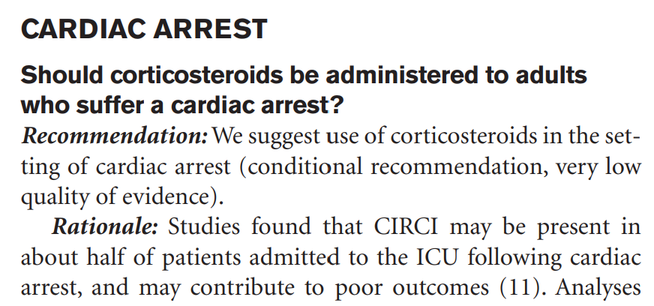
Treating CIRCI in people
Notes:
There is limited evidence for improved survival with good neurological function after administration of methylprednisolone during CPR in people.
There is limited evidence of improved survival with good neurological outcome after administration of hydrocortisone for people who are in shock after return of spontaneous circulation.
No meaningful complications attributable to corticosteroids have been reported in this context.

Slide 29
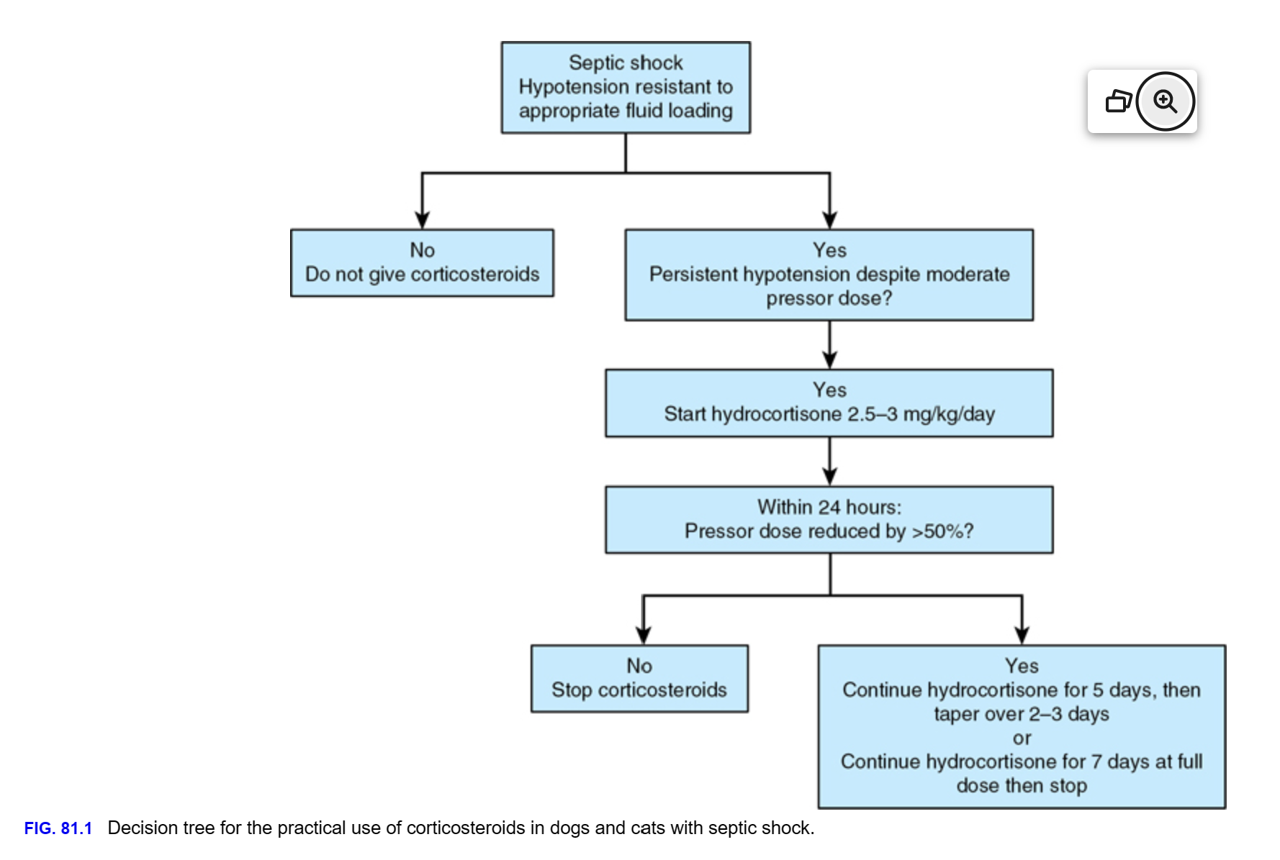
Notes:
Treating CIRCI in dogs and cats
There is little evidence to determine whether dogs and cats with critical illness and persistent hypotension despite fluids and pressors would benefit from low-dosage corticosteroid supplementation.
Cases have been published that report pressor weaning in septic shock after administration of corticosteroids.
There is no clinical evidence in dogs and cats as it pertains to the use of low-dose corticosteroids to treat CIRCI in cardiopulmonary arrest.

Slide 30
Prognosis
Within a week of ICU discharge, ACTH and cortisol increase to supra-normal levels in people
If the patient survives the primary underlying illness, prognosis for return of normal HPA axis is good

Slide 31
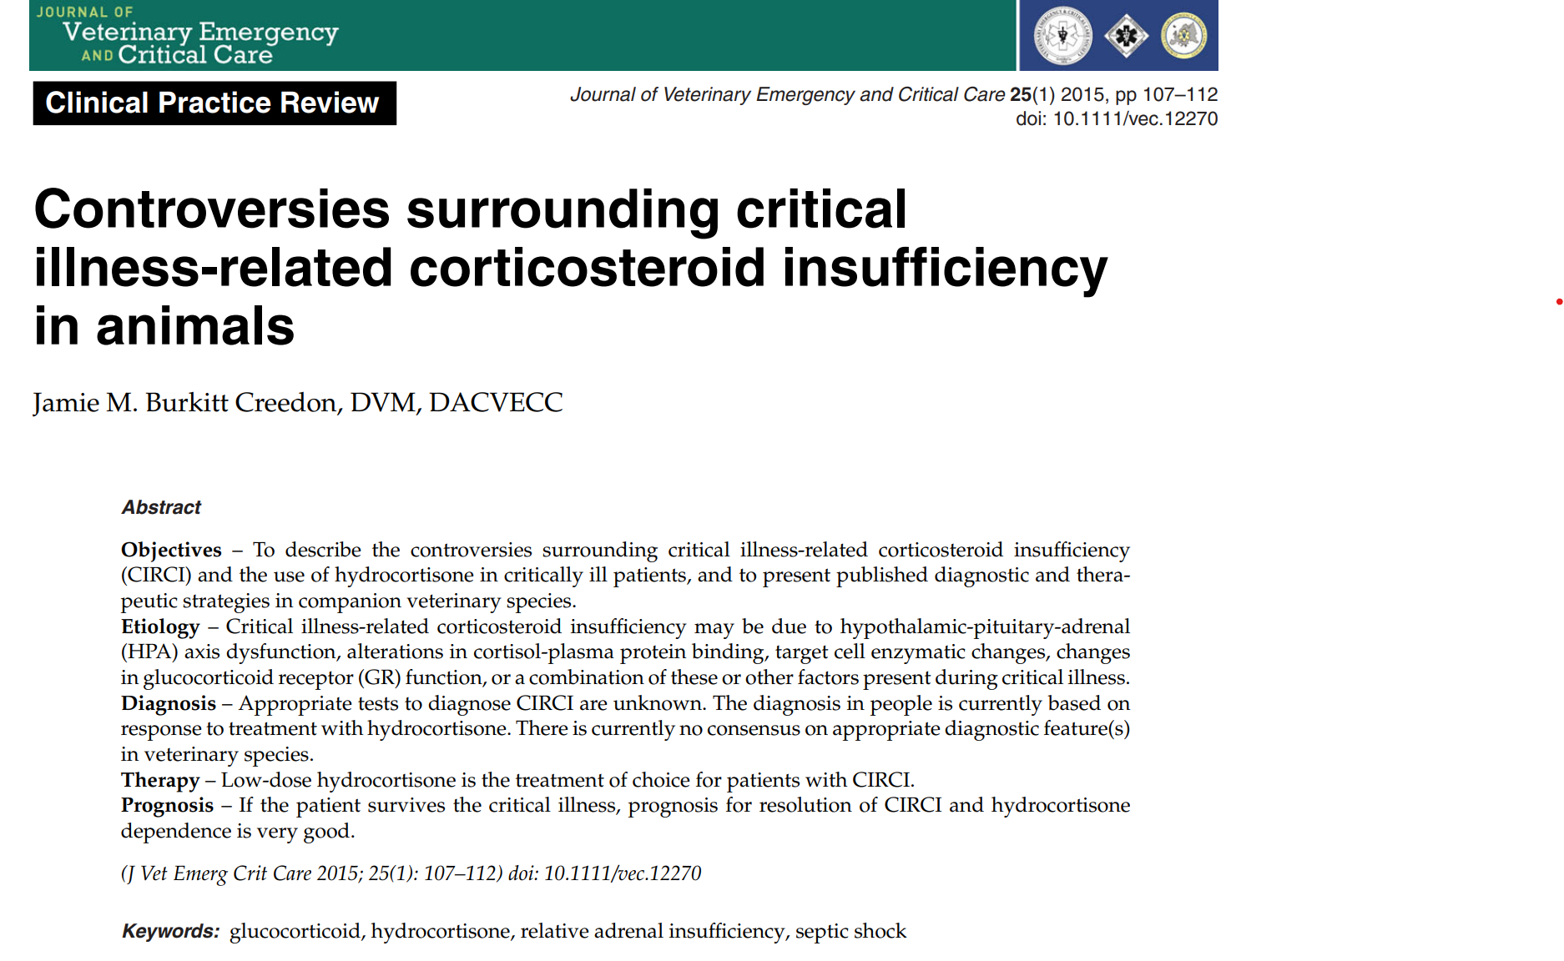
Notes:
There is almost certainly interindividual variation in pathophysiology.
The hypothalamus, pituitary, and adrenal glands may be inhibited or damaged by cytokines, reactive oxygen species, hemorrhage, or other damaging events during septic shock leading to inadequate cortisol production of inadequate response to administered ACTH.
Systemic inflammation inhibits GR-cortisol bindings, impairs translocation to the nucleus, and alters cortisol-dependent gene transcription.
Variety of ways systemic inflammation can potentially affect secretion and biological activity of cortisol makes the precise mechanism of CIRCI difficult to know and complicates definitive diagnosis of the syndrome in an individual.

Slide 32
Treatment
  Low/physiologic/replacement dose is no more than 4.3 mg/kg/day of hydrocortisone
Hydrocortisone has approximately ¼ the potency of prednisone, the daily dose should not exceed ~1 mg/kg/day prednisone equivalent
Glucocorticoid treatment in sepsis should be reserved to patients with fluid-loaded, vasopressor-resistant septic shock

Slide 33
Part II:
Hypoadrenocorticism

Slide 34
Hypoadrenocorticism
Uncommon in dogs, rare in cats
Primary hypoadrenocorticism = Addison’s disease
  Adrenal gland dysfunction
  Atypical primary hypoadrenocorticism – glucocorticoid insufficiency only
Secondary hypoadrenocorticism
  Hypothalamic or pituitary dysfunction
Notes:
Dogs with primary atypical hypoadrenocorticism may go on to develop mineralocorticoid deficiency.
Because aldosterone release is mediated by the renin-angiotensin cascade and serum potassium concentration, patients with secondary hypoadrenocorticism do not typically have the classic electrolyte abnormalities seen in patients with typical primary hypoadrenocorticism.

Slide 35
Hypoadrenocorticism
Dogs:
  Young to middle-aged dogs
  Females more commonly affected than males
  Spayed and neutered > intact
  Average age 4 years (2 months – geriatric)
  Pure breeds most affected: Portuguese water dog, Standard Poodle, Great Dane, Bearded Collie, Westie, Wheaton, Cairn Terrier, Cocker Spaniel, Rottweiler
Cats:
  No sex predisposition
  Nearly all mixed breed cats
  Most young to middle-aged (1 to 14 years)

Slide 36
Hypoadrenocorticism etiology
Cause of naturally occurring primary hypoadrenocorticism unknown in dogs and cats – thought to be immune-mediated
  Other causes: surgical adrenalectomy, infiltration with neoplasia or infection, trauma, hemorrhage, hypoperfusion, iatrogenic (mitotane, trilostane, or ketoconazole)
Secondary hypoadrenocorticism – decreased CRH or ACTH
  Commonly iatrogenic (caused by steroid withdrawal after long-term glucocorticoid therapy)
  Other causes: hypothalamic or pituitary neoplasia, hypophysectomy, immune-mediated hypophysitis, trauma
Notes:
Histopathology of adrenal glands – atrophy, fibrosis, infiltration with leukocytes consistent with prior immune-mediated destruction

Slide 37
Question #5
What blood work abnormalities can be seen with hypoadrenocorticism?

Slide 38
Hypoadrenocorticism clinicopathologic findings
Most common:
  Decrease in Na/K ratio
  Azotemia with inappropriately low USG (<1.030)
  Anemia (mild-to-moderate, non-regenerative)
  Leukogram with higher lymphocyte and lower neutrophil counts than would be expected for the patient’s degree of illness
  Hyperkalemia (almost all)
  Hyponatremia (80% of patients)
Notes:
Patients with secondary hypoadrenocorticism or atypical primary hypoadrenocorticism are less likely to experience crisis because they have adequate aldosterone to maintain intravascular volume and normal electrolyte concentrations.
Normal Na/K ratio is 27:1 to 40:1
Most typical primary hypoadrenocorticism patients have a pretreatment Na/K <28:1
A low Na:K ratio can also be seen with renal failure or postrenal obstruction, severe GI disease, parasitic disease, pregnancy, body cavity effusions, and others.
The inability to appropriately concentrate urine has been attributed to the lack of sodium retention and resultant medullary washout. Renal concentrating ability returns with mineralocorticoid replacement.
The anemia is usually non-regenerative because of the lack of cortisol’s tropism on the bone marrow. GI bleeding can contribute to the anemia.
Other findings: hypoglycemia, hypoalbuminemia, hypocholesterolemia, hypercalcemia, metabolic acidosis
Metabolic acidosis attributed to decreased renal hydrogen ion excretion which is enhanced by aldosterone.

Slide 39
Diagnosis
Definitive: ACTH stimulation test
Endogenous ACTH concentration
Most exogenously administered glucocorticoids interfere with adrenal function testing
Basal cortisol – most common screening test
Notes:
Endogenous ACTH can help differentiate primary and secondary hypoadrenocorticism. Helpful in cases with normal electrolytes. If they have low endogenous ACTH then have secondary hypoadrenocorticism and are unlikely to develop mineralocorticoid deficiency so they should be monitored closely.
Exogenous glucocorticoids can affect baseline cortisol, stimulated cortisol, and endogenous ACTH concentrations.

Slide 40
Treatment
Most important treatment: adequate and appropriate IV fluid therapy
  Balanced electrolyte solution with a lower sodium (130 to 140 mEq/L) rather than 0.9% NaCl
  Lower Na solutions decrease serum potassium concentration faster than 0.9% NaCl despite containing 4 to 5 mEq potassium per liter

Slide 41
Treatment
Hydrocortisone is equipotent mineralocorticoid and glucocorticoid activity
  Potentially more rapid onset mineralocorticoid activity in the emergent patient
Deoxycorticosterone pivalate 2.2 mg/kg SC or IM once
Fludrocortisone 0.02 mg/kg PO q24
  Often causes iatrogenic hyperadrenocorticism at doses still too low to control hyperkalemia

Slide 42
Treatment
Hydrocortisone, prednisone, prednisolone, or dexamethasone
  Hydrocortisone – closest to endogenous cortisol
    1.25 mg/kg IV once, followed by 0.5 to 1 mg/kg IV q6 on tapering schedule

Slide 43
Prognosis
Primary hypoadrenocorticism: very good with lifelong glucocorticoid and mineralocorticoid replacement
Atypical primary hypoadrenocorticism – likely will become aldosterone deficient
Secondary hypoadrenocorticism: well controlled with lifelong glucocorticoid therapy

Slide 44
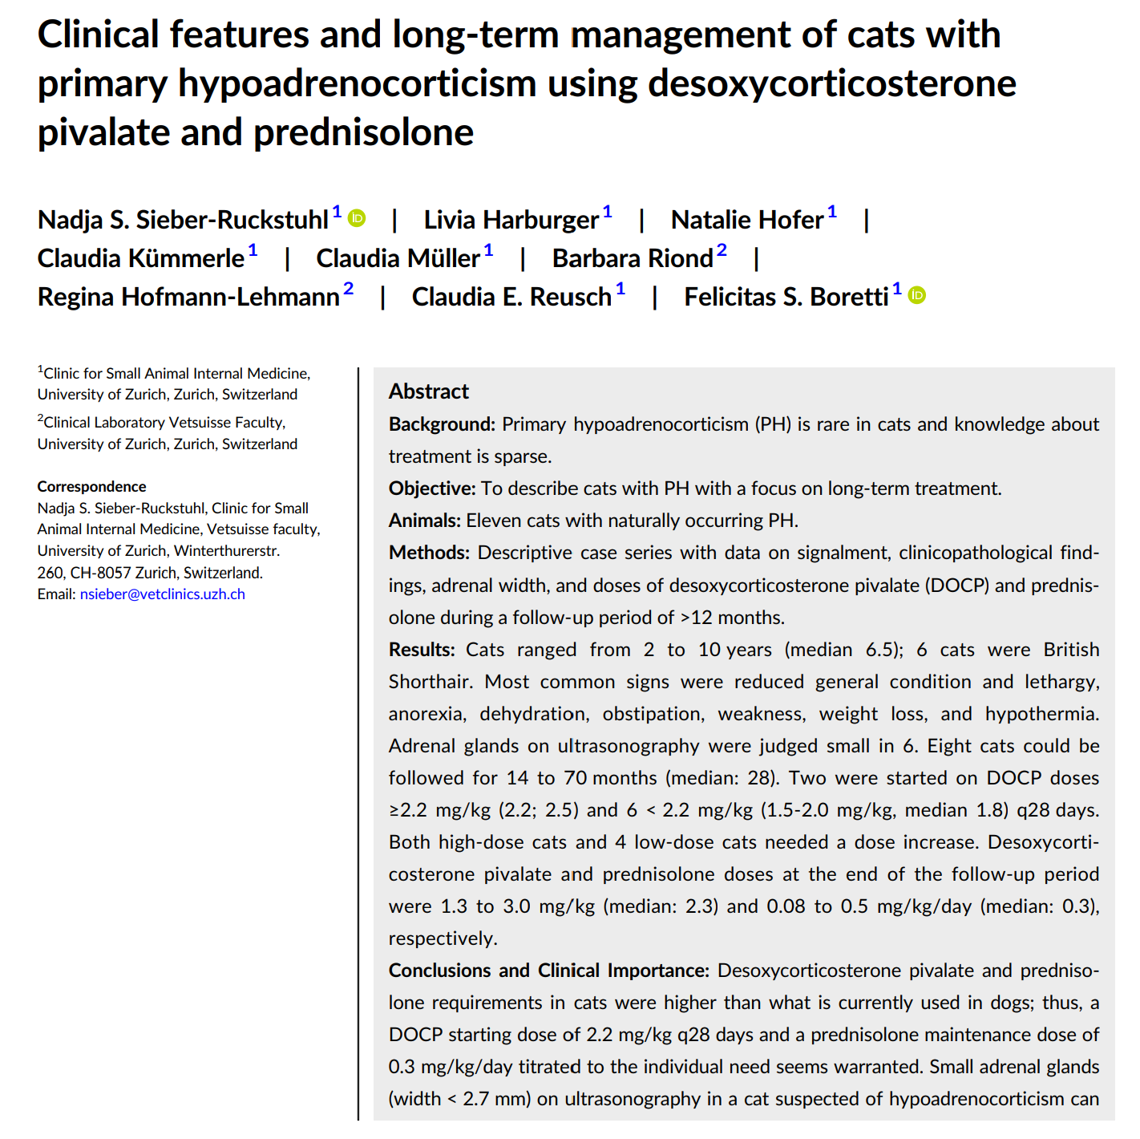
Notes:
Rare in cats, even those presenting with hyperkalemia, hyponatremia, or a low Na/K ratio.
Cats presenting to Zurich between Jan 2010 and June 2021 with naturally occurring PH were enrolled.
A total of 11 cats fit inclusion criteria.
Reported clinical signs by the owners: reduced appetite or anorexia, lethargy, obstipation, weakness, weight loss, vomiting, PU/PD, diarrhea, tachypnea, and empty swallowing.
Physical exam findings: reduced general condition, lethargy, dehydration, hypothermia, lateral recumbency, heart murmur, weak pulses, acute abdomen, tachypnea, and seizure
Most frequent blood work abnormality was hyponatremia (11/11 cats). Hyperkalemia and azotemia were also detected.
The radiologist judged the adrenal glands of 6 cats to be smaller than normal.
DOCP and prednisolone doses used for maintenance were higher than what are typically needed in dogs.
British Shorthair cats were overrepresented in this series.

Slide 45
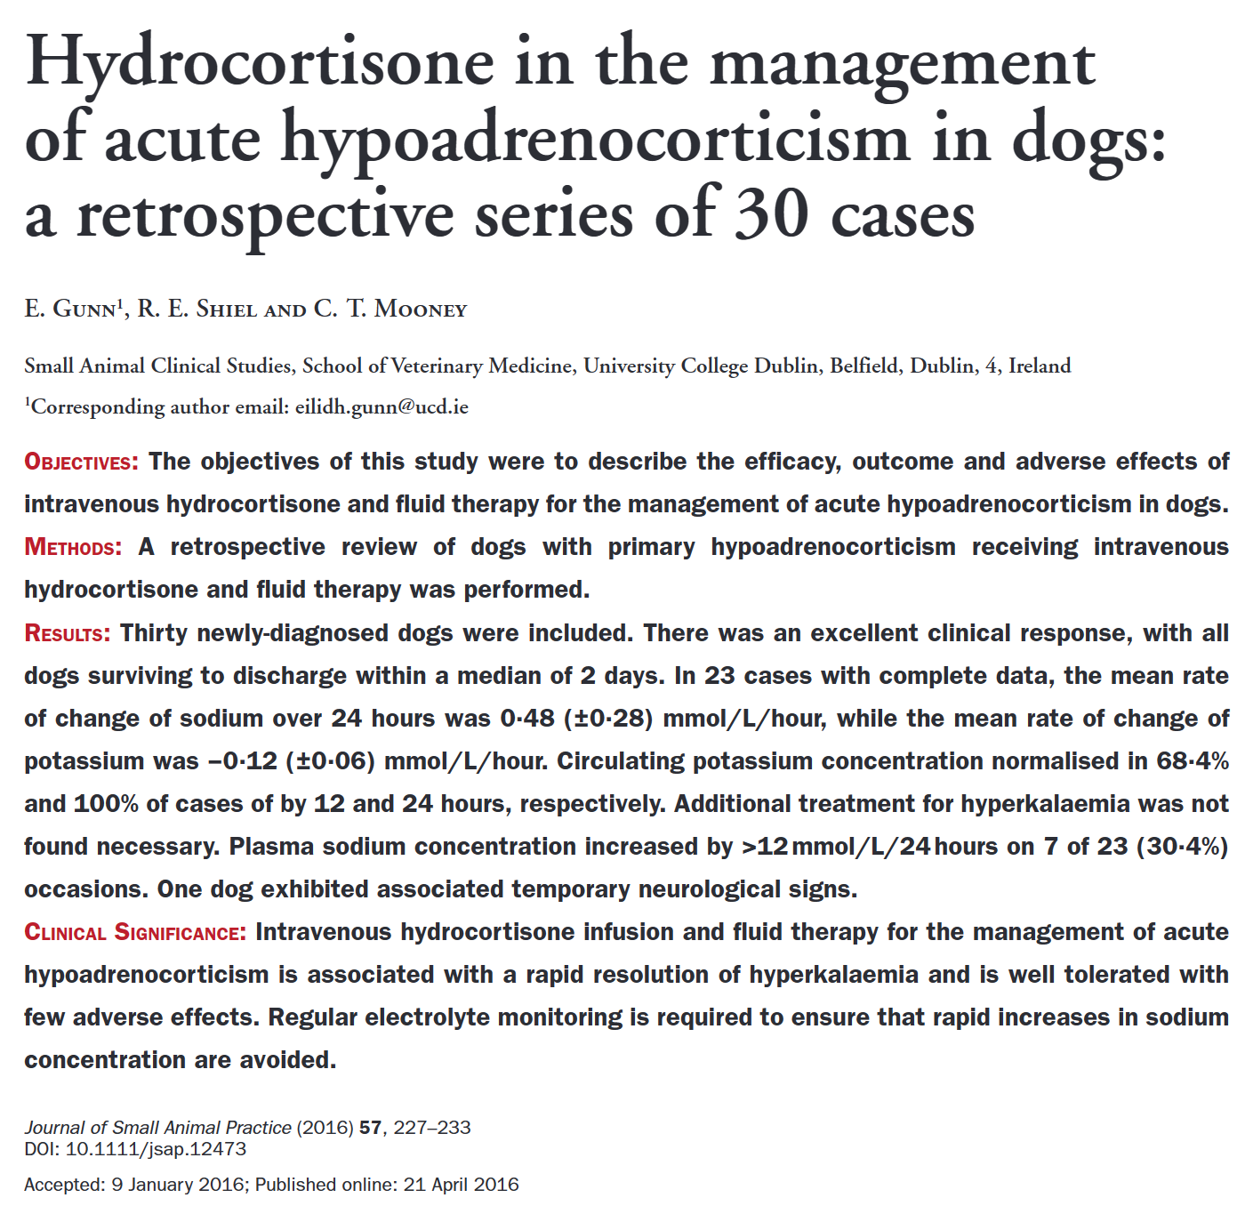
Notes:
Hydrocortisone – synthetic analog of cortisol
Each dog received a dose of 0.5 to 0.625 mg/kg/hr hydrocortisone IV according to the standard hospital protocol. The protocol dictated that 0.9% NaCl be used at an initial IV rate of no more than 7.5 to 10 ml/kg/hr for the first 1 to 2 hours, decreasing to approximately 5 ml/kg/hr thereafter.
30 newly diagnosed dogs were included.
In the cases with hyperkalemia at the start of treatment, the K concentration had normalized in 66.7% at 12 hours and in 100% of cases by 24 hours.
Treatment was well tolerated. Adverse effects were noted in 1 dog. There was a serum sodium concentration rise of 14.5 mmol/L over 14.3 hours (1 mmol/L/hr). The dog developed ataxia, delayed CP, difficulty prehending food and mental dullness. Repeat neurologic exam 1 week later showed dramatic improvement with only mild dysphagia persisting.
Disadvantages of hydrocortisone: it is measured as cortisol and use must be postponed until after completion of ACTH stimulation test
In this study, serum potassium normalized with the use of IV fluids and hydrocortisone alone and no dog required ancillary treatment for the management of hyperkalemia.

