Slide 1
Specifying Multiple Filtering Criteria in SQL
Presented by
Jean M. Pajerek
September, 2021

Slide 2
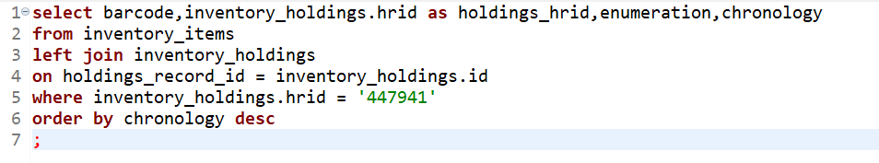
When last we left our heroes …
We had a query that looked like this:

Slide 3
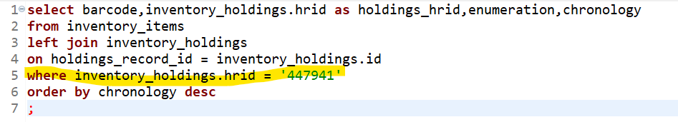
This query has just one limiting criterion, the holdings HRID, which we see in the WHERE statement below.

Slide 4
Recall that the query we wrote last time retrieved item record information associated with a single holdings record. What if we need item record information associated with more than one holdings record? Is there a way to apply several criteria at once?

Slide 5
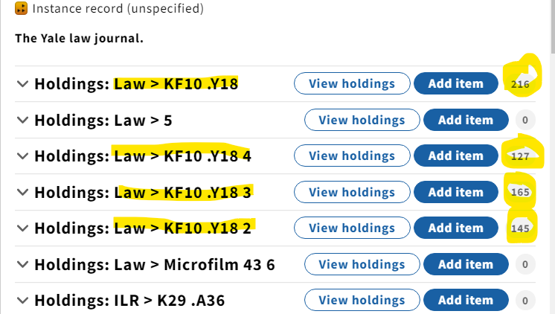
Let’s explore this question by finding an example of an instance record in FOLIO with several holdings records attached to it, to use as a test case. Here’s one:
Notice that Law’s copies 1-4 have dozens of item records associated with them.

Slide 6
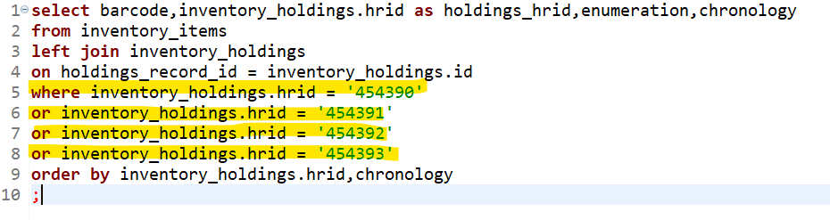
Let’s posit that we want to look at the item record information for Law’s copies 1-4 of the Yale law journal. How do we do that in a single SQL query? One way is to add more criteria using multiple OR statements after the WHERE statement.
The “ORDER BY” statement will sort the results first by holdings HRID, then by item chronology.

Slide 7
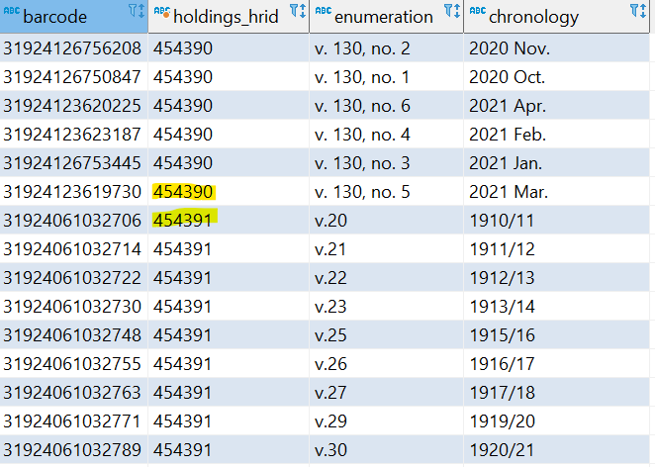
Here are partial results from that query. The data look good, and are sorted as expected. But there’s a problem.

Slide 8
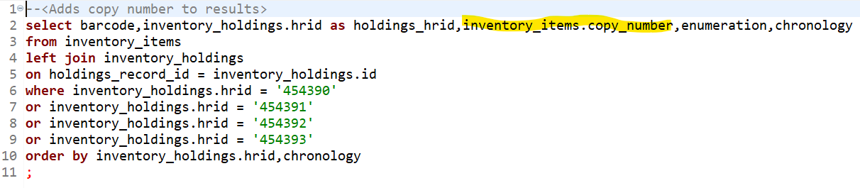
The problem is that we can’t tell which holdings HRID corresponds to which copy number. We need to bring in the copy number from the inventory_items table, by adding it to the SELECT statement:

Slide 9
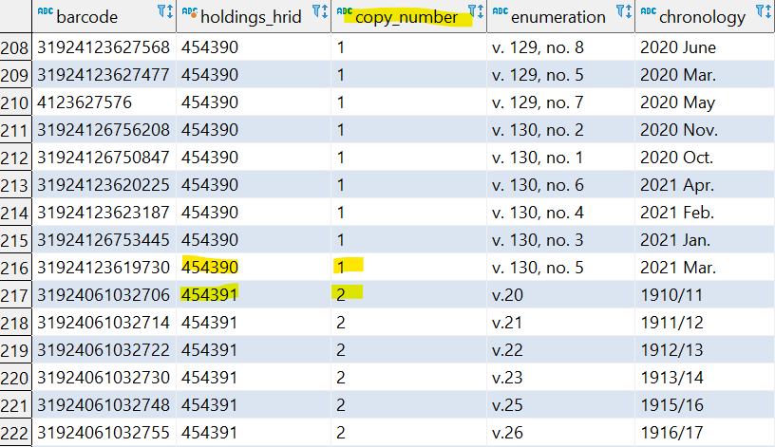
Now it’s clear which holdings HRID corresponds to which copy number.

Slide 10
Let’s think for a minute about what we are using these data for. At the Law Library, we are conducting a mass withdrawal project. I need to know which items are duplicates and which are not. It will be much easier to determine this if we group the results by enumeration or chronology first, THEN by copy number.

Slide 11
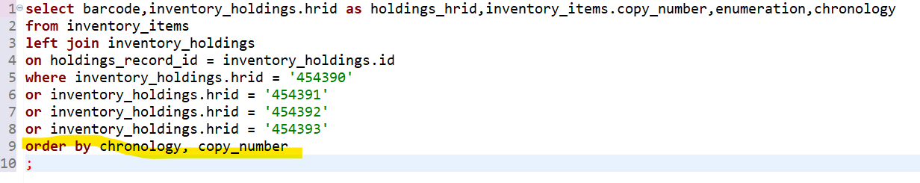
Here’s what that SQL looks like:

Slide 12
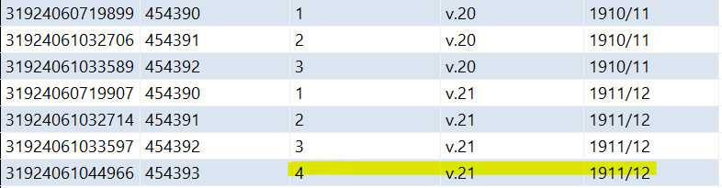
By sorting first on chronology, then on copy number, we’ve made it easier to see that (for example) there are three copies of v. 20, and four copies of v. 21.

Slide 13
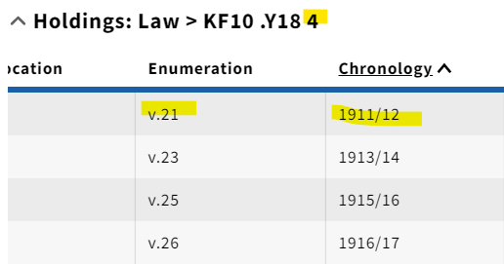
Now is a good time for a reality check! Let’s see if what we see in FOLIO matches our query results.
Looking at the item records associated with copy 4 in the FOLIO user interface, we see that there IS a v. 21, but NOT a v. 20. There is also no copy 4 of volume 22, and this is accurately reflected in our query results.

Slide 14
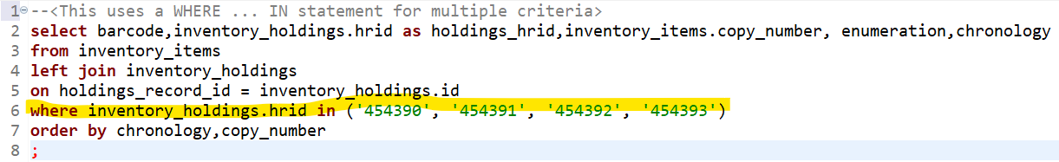
We’ve just learned about one technique for adding multiple filtering criteria to a query. Below is a slightly easier way to produce the exact same results, using a WHERE IN statement.

Slide 15
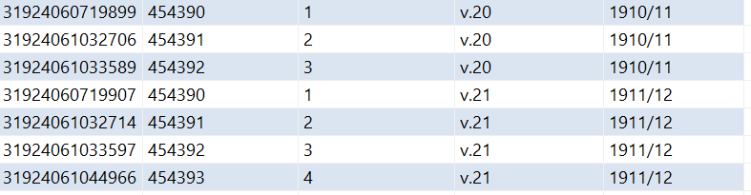
Using a WHERE IN statement saves some typing, and the results are absolutely identical.

