Slide 1
Using Regular Expressions in SQL Queries: an Introduction
Jean M. Pajerek
FOLIO Reporting Users Group
November 28, 2022

Slide 2
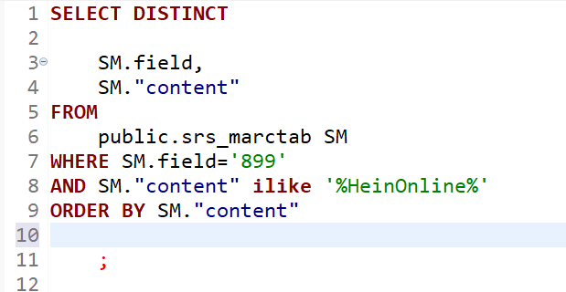
Often, when creating queries in SQL, we use text strings or partial text strings to find the data we need. For example, in this query, we are looking for the text string HeinOnline within the 899 field.

Slide 3
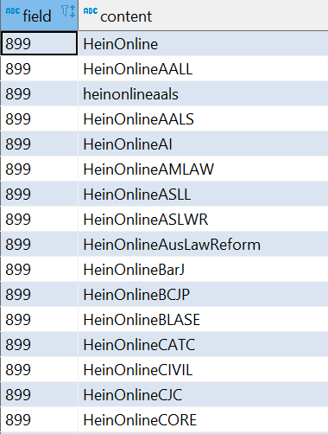
Because of the use of the wildcard character (%) in the WHERE statement, the query retrieves strings that begin with HeinOnline, and that have additional characters as well.

Slide 4
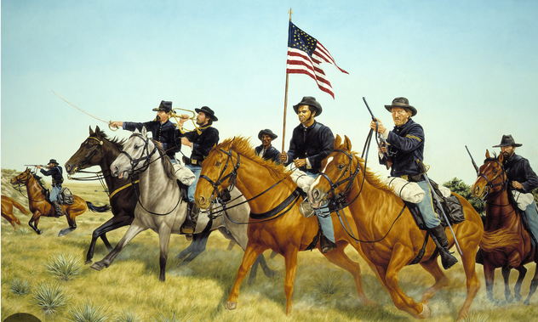
Being able to search for specific literal character strings is often sufficient for what we need to do, but at other times, we need something more powerful.
REGULAR EXPRESSIONS TO THE RESCUE!

Slide 5
Regular expressions, commonly referred to as RegEx, use strings of characters to define a SEARCH PATTERN, rather than a literal text string.
When would we want to search for a PATTERN instead of a literal text string?

Slide 6
Call numbers are an example of data we might want to query that are arranged in patterns.
Most Library of Congress call numbers follow a particular alpha-numeric pattern, although there is a lot of variation among them.
The first part of the call number is an upper-case letter or letters (between one and three letters), e.g. KJC
The initial letter or letters are followed by one or more numerals: KJC1291
After the initial letters and numerals, it’s common to have a space followed by a period, followed by one upper-case letter, followed by at least one numeral (but often several): e.g. KJC1315 .P763

Slide 7
Within this dominant pattern, there are many exceptions and variations that need to be accounted for.
For example, the call number below has three initial letters followed by four digits, but then we see a decimal point followed by another digit. Then we have a period, followed by an alpha-numeric combination, a space followed by another alpha-numeric combination, and a space followed by a year expressed as four digits.
KJC1492.5.T61 A5 1974

Slide 8
When looking at call numbers, how can we account for all these variations and possibilities?
It helps to be VERY familiar with the pattern you need to specify!
Thinking about LC call numbers as being composed of different segments, we know that:
  The first segment consists of between 1 and 3 uppercase letters
  The second segment consists of between 1 and 4 digits, possibly followed by a decimal point, followed by one or more digits (or not)
  It’s also possible to have something like this: KJC1018.A5 C68 2017, where the initial letter/digit combination is followed by a period (as opposed to a decimal point) and another alpha-numeric combination.

Slide 9
Regular expressions are a flexible tool that can overcome many of the limitations of literal text strings. They can be incorporated into SQL queries.
Using regular expressions, we can look for things like:
  Between one and three upper-case letters at the beginning of a string
  Between one and four digits after the letters, optionally followed by a period (or a decimal point; RegEx doesn’t differentiate between them)
  Followed by either no space or exactly one space
  Followed by one upper-case letter OR at least one digit

Slide 10
Consider how much more powerful this is than searching by a literal text string!
RegEx achieves this flexibility and power by using special characters to represent parts of the pattern we have discerned.
For example, in RegEx, \d refers to any digit, 0-9. The backward slash serves to differentiate the digit placeholder from a regular letter “d.”
[A-Z] means any uppercase letter in the alphabet. The brackets are part of the expression.
\. means a period or a decimal point
\s means a space
{ } lets us specify how many of something to look for

Slide 11
Let’s return to our simple call number example.
KJC1315 .P763
If we want to specify this exact call number pattern using RegEx, the regular expression could look like this:
[A-Z]{3}\d{4}\s{1}\.{1}[A-Z]{1}\d{3}

Slide 12
Let’s break this expression down:
[A-Z]{3}\d{4}\s{1}\.{1}[A-Z]{1}\d{3}
Remember that the call number we based the pattern on is:
KJC1315 .P763
[A-Z]{3} – I want exactly three consecutive uppercase letters
\d{4} – I want exactly four consecutive digits
\s{1} – I want exactly one space
\.{1} – I want exactly one period
[A-Z]{1} – I want exactly one uppercase letter
\d{3} – I want exactly three digits

Slide 13
This is fine if you want to find only call numbers that adhere to this precise pattern. But how likely is that?
We can make our original regular expression more flexible and inclusive with just a few tweaks.
Original RegEx: [A-Z]{3}\d{4}\s{1}\.{1}[A-Z]{1}\d{3}
Slightly more flexible RegEx: [A-Z]{1,3}\d{1,4}\s{1}\.{1}[A-Z]{1}\d{1,}
[A-Z]{1,3} - I want one, two, or three uppercase letters
\d{1,4} – I want one, two, three, or four digits
\s{1}\.{1} – I still want one space followed by one period
[A-Z]{1}\d{1,} – I still want one uppercase letter, to be followed by at least one digit and possibly more

Slide 14
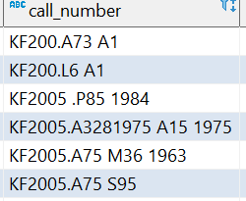
Even the slightly more flexible RegEx is not flexible enough to find and parse all the call numbers we might need to find.
When composed correctly and embedded into an SQL query, RegEx is flexible enough to correctly parse all these differently formatted call numbers:

Slide 15
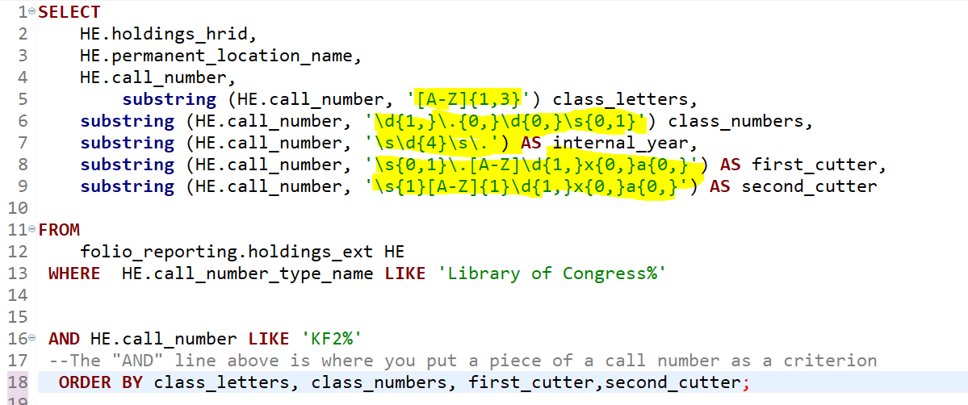
Below is the SQL used to retrieve the results on the previous slide.

Slide 16
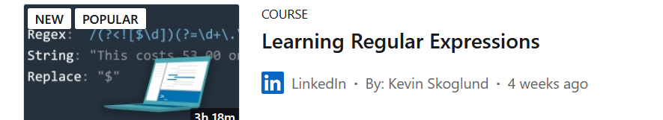
Use of RegEx is not limited to SQL queries!
We have just seen a case study of the power and flexibility of RegEx when used with SQL. As you might imagine, this is just the tip of the RegEx iceberg! In RegEx, as in SQL, there is usually more than one way to achieve the same results.
Linkedin Learning offers a course on Regular Expressions, if you are interested in learning more:

