Slide 1

Welcome, SQL Newbies!

Slide 2
My First SQL* Query
Presented by
Jean M. Pajerek
August 2021
*Structured Query Language

Slide 3

We’ll start by looking at the two (inter)faces of FOLIO data: the user interface (human-friendly) and the Library Data Platform, or LDP (machine-friendly)

Slide 4
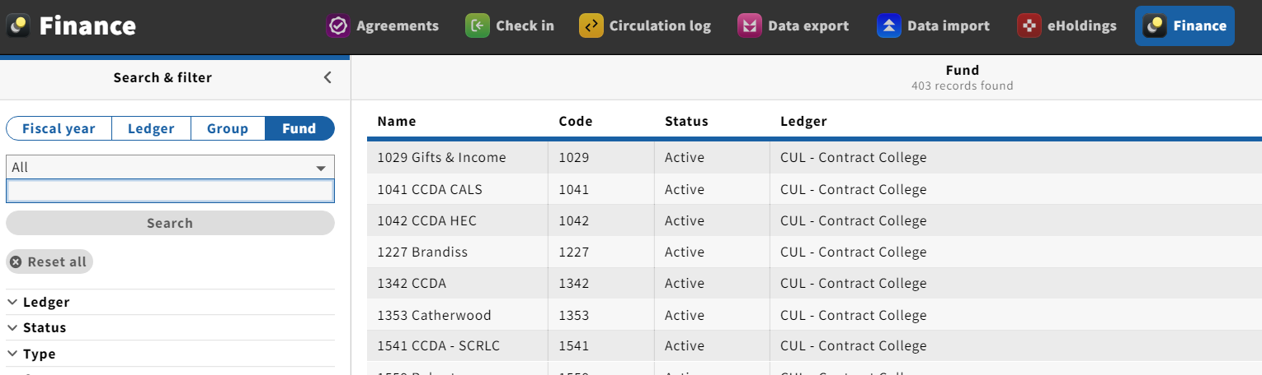
This is what we see when we launch the Finance app and look at the funds.

Slide 5
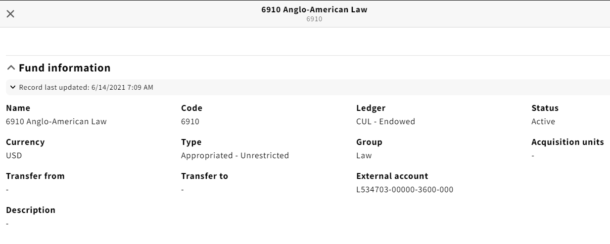
When you look at an individual fund record in the FOLIO Finance app, it presents information related to the fund in a straightforward, labeled display.

Slide 6
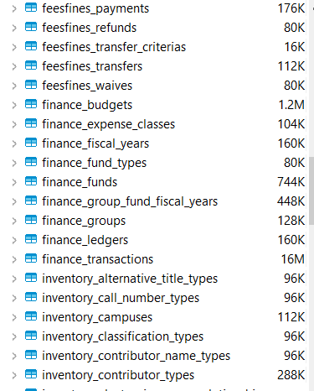
In the Library Data Platform (LDP), FOLIO data are stored in tables, like these listed below in DBeaver.

Slide 7
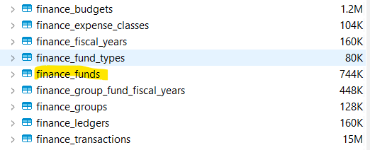
The tables are organized in such a way that related data are stored together in tables, and related tables are grouped together.

Slide 8
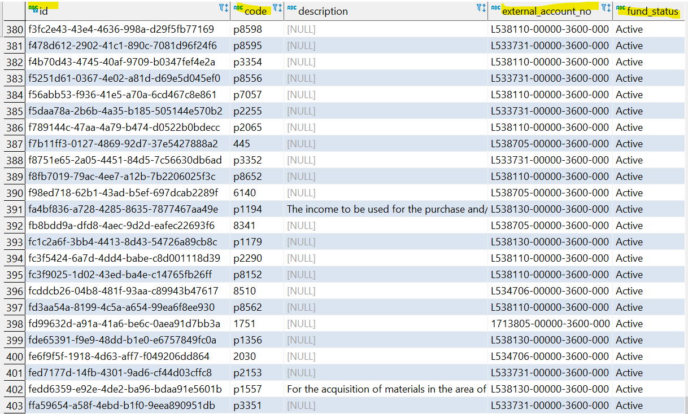
When you open up a table in Dbeaver, it looks like a big spreadsheet. Below is part of the finance_funds table.

Slide 9
The long alpha-numeric string to the left is the fund ID for fund 6910. Fun Fact: You can plug that fund ID number right into the FOLIO user interface (Finance app) and retrieve the record for that fund.

Slide 10
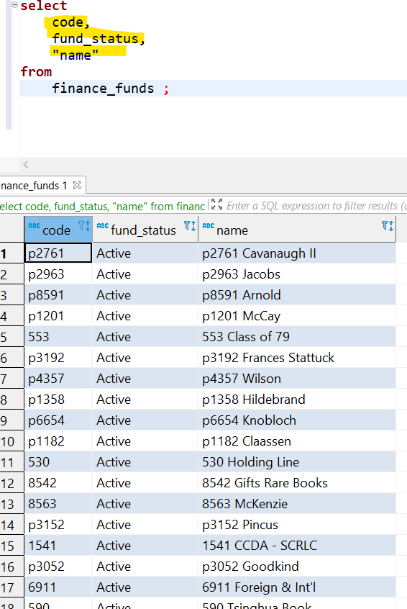
Let’s say that all I want to see from the finance_funds table right now is the fund code, the fund status, and the fund name. To do that, I’m going to write a very simple SQL query.
These are the data points I want, separated by commas.
This is the name of the table from which I am selecting the data points. Note that the query ends with a semi-colon.
After running the query, we see that the
search results are just the three columns
of data I selected from the finance_funds
table.

Slide 11
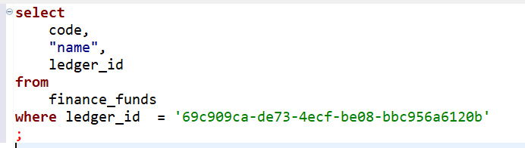
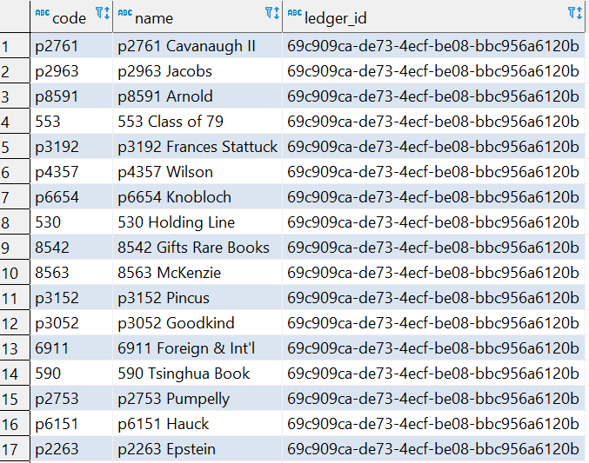
What if I want to limit my list to only the “Endowed” funds? We can tell the LDP to look for a specific ledger ID.
This is the ledger ID for the
Endowed funds, which I have added
to the previous query as a criterion,
using a “where” clause. I also removed
the “fund_status” from the “select”
statement, and added “ledger_id.”

Slide 12
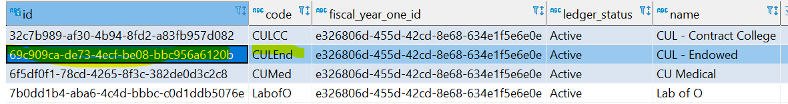
How do we know which ID number to use in our “Where” statement? By looking in the table called finance_ledgers, which has only four rows:

Slide 13
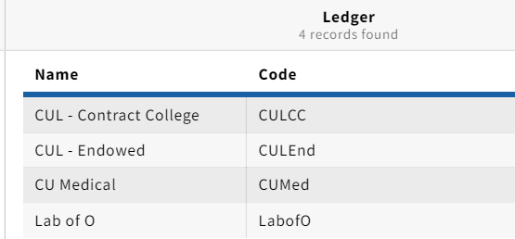
When we look at the ledgers in the Finance app, we see the exact same list of ledgers, without the ID numbers.

Slide 14
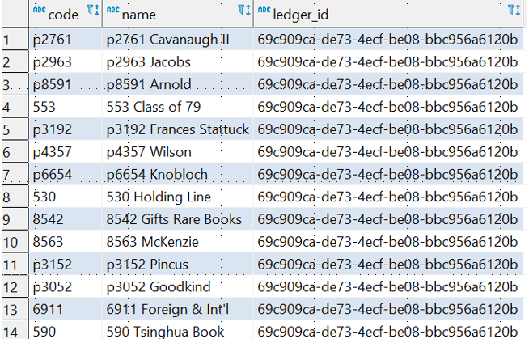
What if I don’t want that long, meaningless ledger ID number in my search results? What if I want my results to display the actual name of that ledger instead of the ledger ID?

Slide 15
This is where things start to get complicated really, really quickly!
The reason things get complicated is that some of the data we want reside in one table, while other data reside in another table.
Specifically, we want the fund code and the fund name from the “finance_funds” table, and the ledger name from the “finance_ledgers” table.
Somehow, we have to connect the two tables that contain the data points we need.

Slide 16
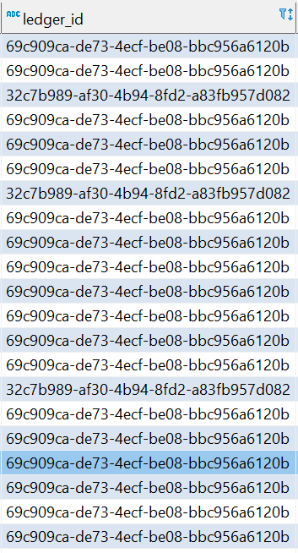
The finance_funds table has a column called “ledger_id,” but it does not tell us the name associated with that ledger ID.

Slide 17
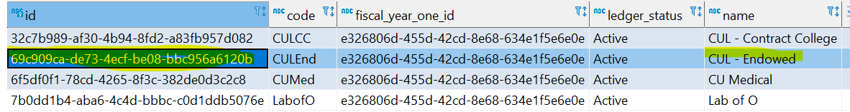
The four-row finance_ledgers table (below) includes BOTH the Iedger ID AND the name associated with it. This means the finance_ledgers table can serve as a “translator” to tell us what the fund IDs in the finance_funds table mean, if we can figure out a way to connect the two tables. We connect the two tables by determining which data point(s) the two tables have in common.

Slide 18
The data point that these two tables have in common is the ledger ID, and that’s what we’ll use to connect them.
Something important to notice is that, in the finance_funds table, the ledger ID is very sensibly called “ledger_id.”
In the finance_ledgers table, this VERY SAME number is referred to simply as “id.” Because this is the “id” column in the ledgers table, it is assumed that this column refers to the ledger id.
We have to give the LDP a little help in recognizing that these are really the same number, even though they are called different names in the two tables.

Slide 19
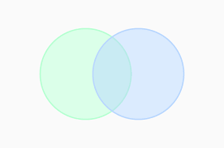
For fans of Venn diagrams
Funds data
Ledgers data
Ledger ID

Slide 20
Our task is further complicated by the fact that both of these tables have a column called “name,” but the information in these columns is completely different.
In other words, we have TWO significant complications:
One is that columns that are named DIFFERENTLY in the two tables refer to the SAME information, that is, the ledger ID.
The other complication is that we have a column in each table with the SAME name (“name”), but the information in the identically-named columns is completely DIFFERENT in the two tables.
In the finance_funds table, the “name” column refers to the names of our funds. In the finance_ledgers table, the “name” column refers to the names of the ledgers we’ve set up.

Slide 21
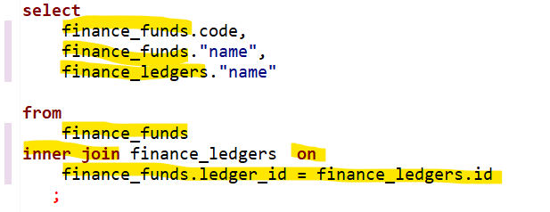
The LDP needs help in sorting this all out. We need to disambiguate these data points in our query so the LDP knows which columns in which tables to look at. In the query below, notice that the source tables for the data points are specifically stated and precede the name of the column we want.
Earlier, we identified the ledger ID as the data point our
two tables have in common. The inner join statement
explicitly states this connection and “joins” the
two tables together.

Slide 22
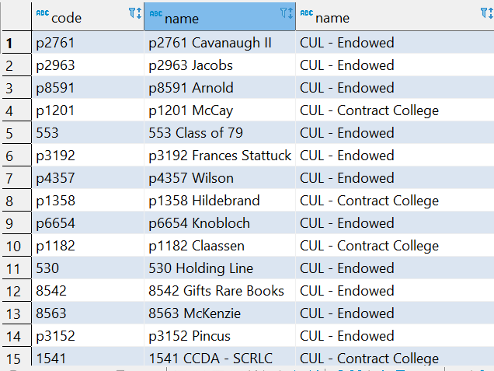
The results of this query are almost exactly what we want!
EXCEPT - it’s not very helpful that the resulting table of results has two columns that are called “name.”

Slide 23
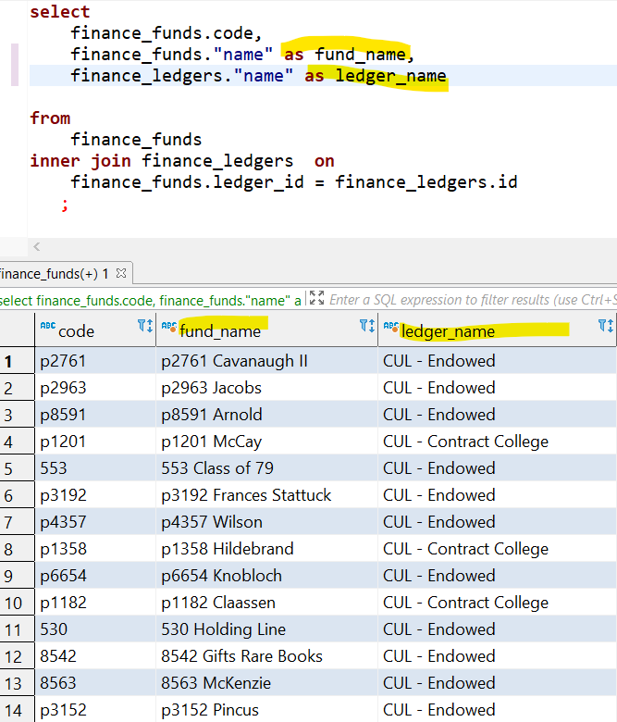
We can use what are called “aliases” to rename the two columns that are called “name” to something more meaningful.

