Slide 1
Intro to Linked Data for Reporting

Slide 2
What is Linked Data?
(a very high level overview)

Slide 3
MARC
“Flat”--one document describes one resource
Text strings represent agents, topics, places, etc.
Not used outside libraries
Linked Data
Statements about Entities, attributes, & relationships (properties)
Identifiers

Slide 4
BIBFRAME
Linked Data vocabulary developed by the Library of Congress
In case you’re curious: BIBliographic FRAMEwork initiative
MARC (MAchine Readable Cataloging) was also developed and is still maintained by the Library of Congress

Slide 5
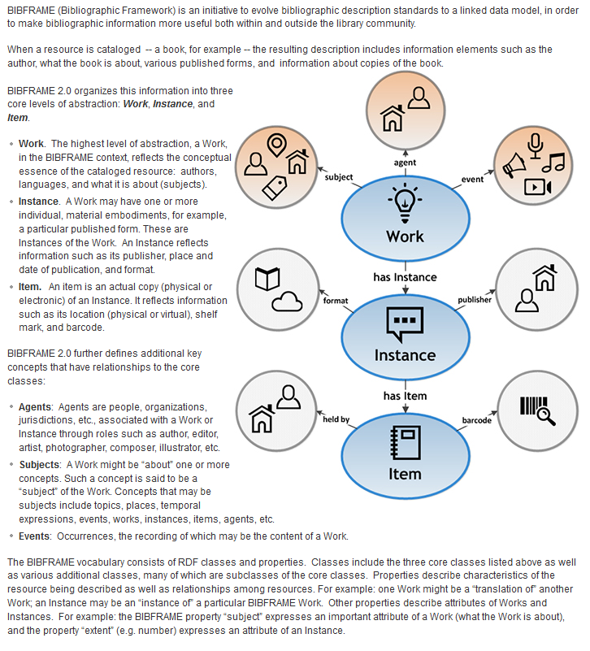
https://www.loc.gov/bibframe/docs/bibframe2-model.html

Slide 6
What does this look like?

Slide 7
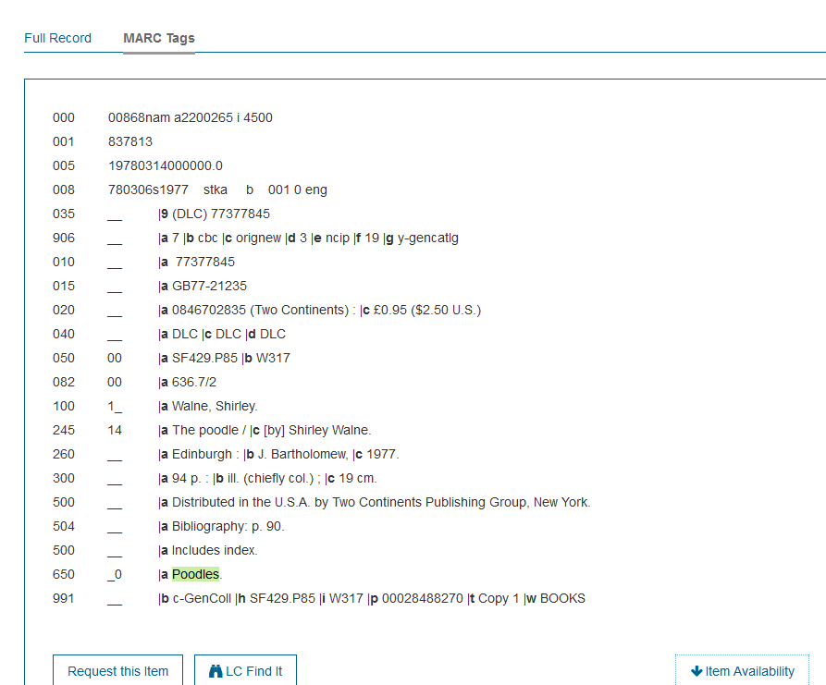
MARC bibliographic record (Library of Congress Catalog)
https://lccn.loc.gov/77377845

Slide 8
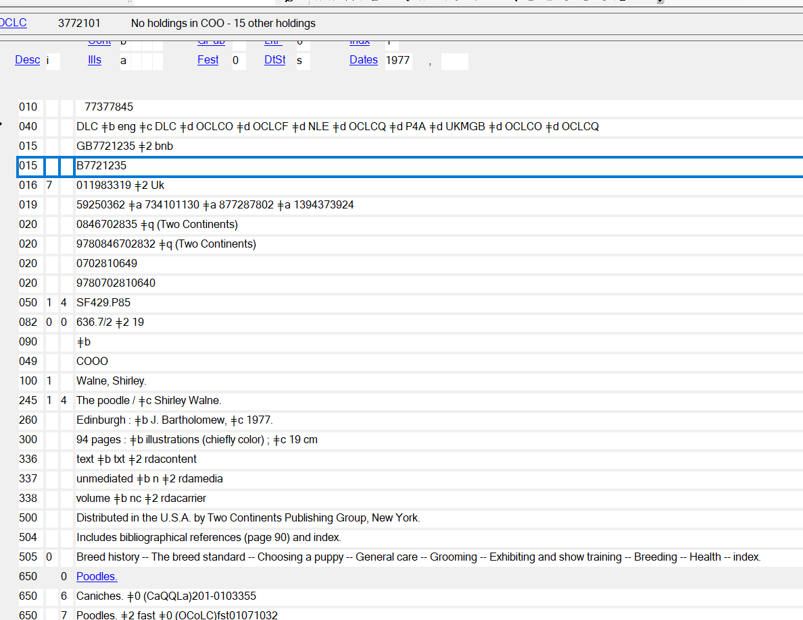
Same record in OCLC

Slide 9
The same information as BIBFRAME

Slide 10
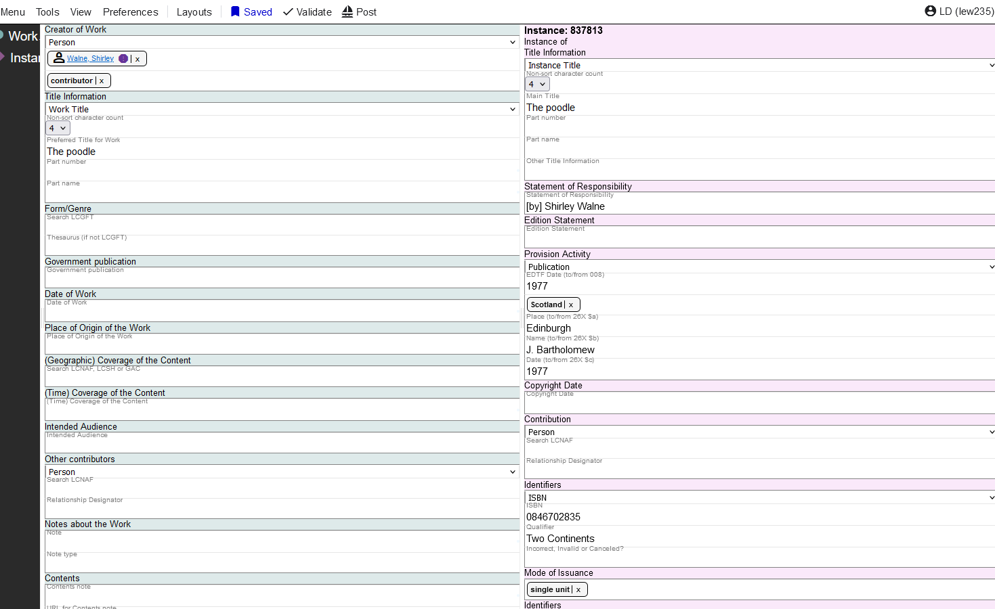

Slide 11
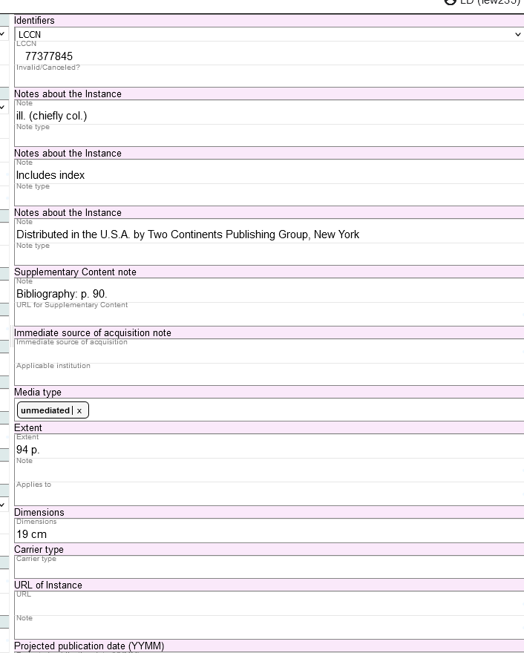

Slide 12
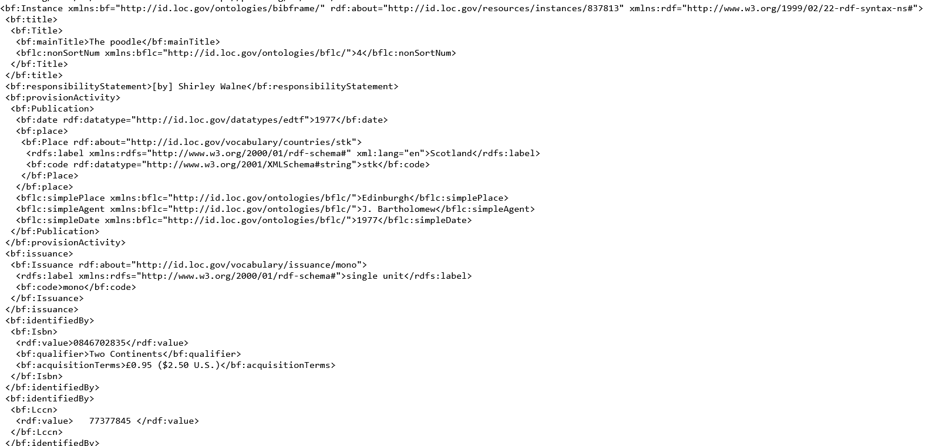
https://bibframe.org/marva/editor/edit/e0095572

Slide 13
Substantive differences
Work / Instance entities
          Can have multiple instances of a single work
          Work data is recorded once
          Entity boundaries better defined than in MARC
          Example: https://bibframe.org/marva/quartz/edit/e1339458
  Identifiers / Labels

Slide 14
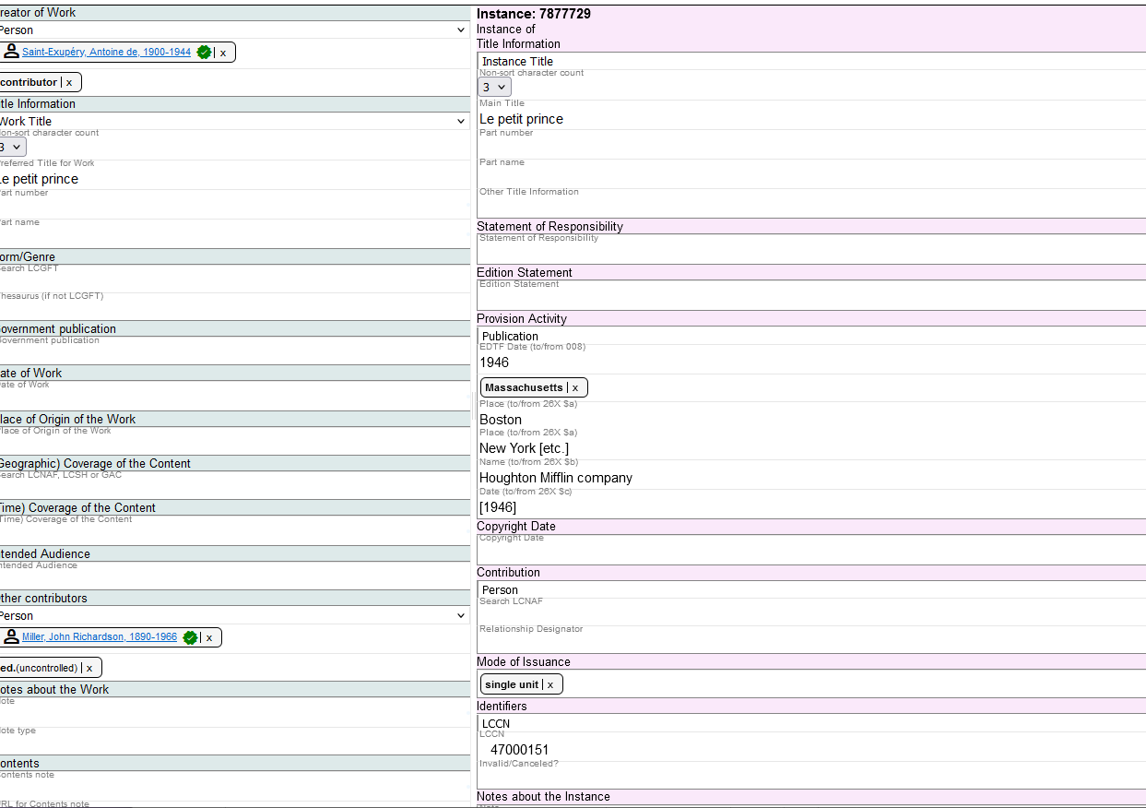

Slide 15
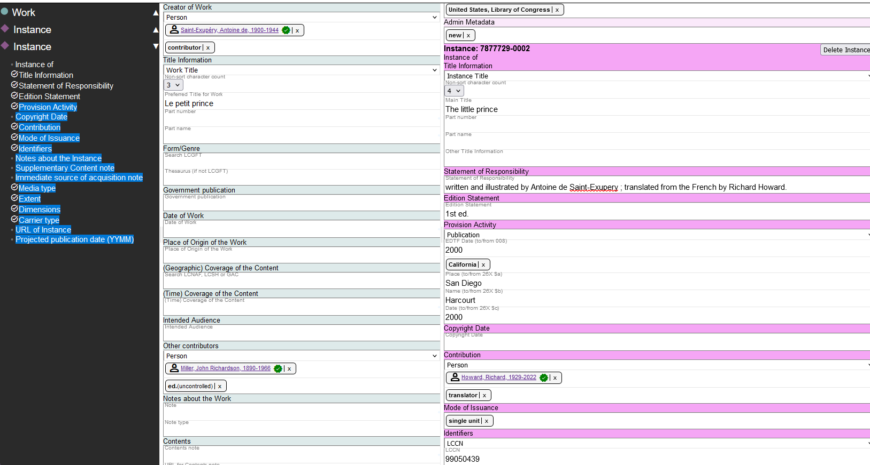

Slide 16
What will this mean for FOLIO and reporting?
FOLIO instance (not the same as BIBFRAME instance), holdings, and items won’t change substantively; queries on this data should not be impacted
Eventually, source data won’t be stored as MARC – any queries based on MARC will need to be reconfigured
We need to find better places to record some data (e.g., administrative data, holdings data currently stored in MARC bibliographic records)

