Slide 1
Metadb Rollout Introductory Training
Jean Pajerek and Sharon Markus
CUL FOLIO Reporting Team
Cornell University Library
Fall 2024

Slide 2

This session will cover:
What is Metadb?
LDP and Metadb Basics
LDP and Metadb Schema Structures
Connecting to Metadb
Comparing SQL queries from LDP to Metadb
Questions

Slide 3

FOLIO Reporting for the Cornell University Library
The Cornell University Library went live with FOLIO and FOLIO Reporting with the Library Data Platform July 1, 2021
EBSCO provides hosting services for Cornell’s FOLIO application database and Cornell’s Library Data Platform (LDP) and Metadb (Test) reporting databases
Cornell converting 300+ queries and 20+ dashboards from LDP to Metadb
Cornell will move to Metadb for Production Reporting Services and will retire its LDP in November 2024

Slide 4
What is Metadb?
Notes:
Can’t have completely exhaustive store of reports, but want people to have a good starting point when they go live

Slide 5

What is Metadb?
Metadb is the evolution of the LDP (Library Data Platform) software running on our reporting database systems
Metadb is similar to LDP in many ways and was the planned next step in developing the reporting database software
Everything you know about the LDP will help you understand Metadb

Slide 6
LDP versus Metadb: Comparison
LDP
Metadb
Extracts, transforms, and loads data from the FOLIO application server to the LDP overnight
Some data elements must be extracted into columns by derived tables
Extracts, transforms, and loads data from FOLIO application server continuously in near real-time
Some data elements must be extracted into columns by derived tables
Most data elements are extracted into columns
Plans to extract all data elements into columns from the JSON
Uses a different organization of the data tables than LDP

Slide 7

LDP versus Metadb: Data Refresh
LDP
Metadb
nightly data update from
FOLIO Application Server
live updates
from FOLIO Application
Server via streaming
data integration
Notes:
LDP - The LDP software provides reporting users with a copy of yesterday's data from the FOLIO application server. Metadb will provide continuously streaming data updates from the FOLIO application server. This will provide reporting users with access to FOLIO data in near real time instead of yesterday's data. While LDP's architecture is limited to running on a single node, Metadb's architecture is horizontal, allowing for linear scaling of data updates. This allows updates to run in parallel within a single Metadb cluster.

Slide 8
Metadb Rollout Plans for the Cornell Library
January 2024
October 2024
LDP Production
(data from FOLIO Prod)
Metadb Test
(data from FOLIO Test)
LDP Production (data from FOLIO Prod)
Metadb Production
(data from FOLIO Prod)
December 2024
Metadb Production
(data from FOLIO Prod)
November 30, 2024
May 2024
LDP Production (data from FOLIO Prod)
Metadb Test
(data from FOLIO Prod)
LDP Production
is
retired
Metadb Production
(data from FOLIO Prod)
Notes:
-Running both LDP and Metadb systems at the same time until November 30, 2024 will allow us to continue to provide uninterrupted reporting services and support while giving reporting users a chance to learn how to use the new system and to convert queries from LDP to Metadb format
-Metadb will show more up-to-date and accurate data than LDP in areas where there is a lot of data entry within one day, such as loans

Slide 9
LDP and Metadb
Schema Structures

Slide 10
LDP and Metadb Schema Structures:
Table Overview

Slide 11
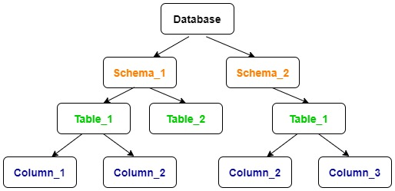
Organizing Data in the Database (S)
Just like most reporting databases, data for both LDP and Metadb are structured as follows:
data are organized into tables
tables are organized into schemas
schemas are like folders on your desktop, keeping related files together
tables have columns showing the contents of each data field

Slide 12
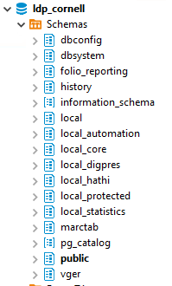
LDP Schemas
In a database, a schema is a group of tables
In LDP, the main schemas we use are organized as follows:
  public: tables with transformed FOLIO data
  history: tables with previous versions of FOLIO records
  folio_reporting: where derived tables get created automatically
  local: sort of a sandbox environment; could be used for non-FOLIO data, custom FOLIO tables, etc.
  access to all schemas: all users log into the LDP using the same “ldp_user” account and have access to see all the schemas as well as to write to specific “local” schemas

Slide 13
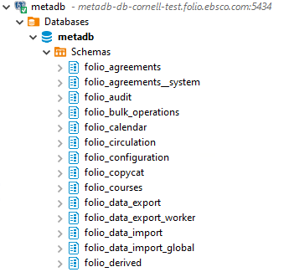
Metadb Schemas
In Metadb, the main schemas we use are organized as follows:
  folio_* schemas:
    Instead of one public schema covering all the FOLIO application tables, there are separate schemas with tables for each FOLIO application.
  folio_derived: where derived tables get created automatically
  folio_source_record.marc__t: schema and table where transformed MARC records are stored in tabular form
  access to all schemas: all users log into Metadb using the same “z_metadbuser_cornell” account and have access to see all the schemas as well as to write to specific “local” schemas

Slide 14
LDP and Metadb Schema Structures:
Current and Historical Tables

Slide 15
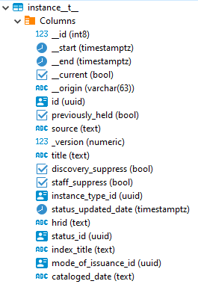
Metadb Schemas: FOLIO Application Historical Schemas
FOLIO application (folio_*) schemas: historical records
  Instead of a history schema, each table has versions that contain all the “historical” records, which include historical and current (all the data). These versions end with “__t__” (four underscore characters).
  For example, in the folio_inventory schema, “instance__t__” has current and historical records.

Slide 16
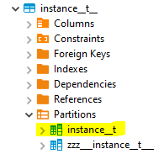
Metadb Schemas: FOLIO Application Current Schemas
FOLIO application (folio_*) schemas: current records
  Each table has versions that contain all the current records. Current versions of tables have specific name formats.
  For example, in the folio_inventory schema, “instance__t” has current records. (Note that there are two underscore characters between “instance” and “t”.)

Slide 17
Table Naming Conventions
LDP | Metadb | Description
public.table | application schema.table__t | table that stores current records
history.table | application schema.table__t__ | table that stores current and historical records

Slide 18
Table Naming Conventions: Example
LDP | Metadb | Description
public.circulation_loans | folio_circulation.loan__t | table that stores current loan records
history.circulation_loans | folio_circulation.loan__t__ | table that stores current and historical loan records

Slide 19
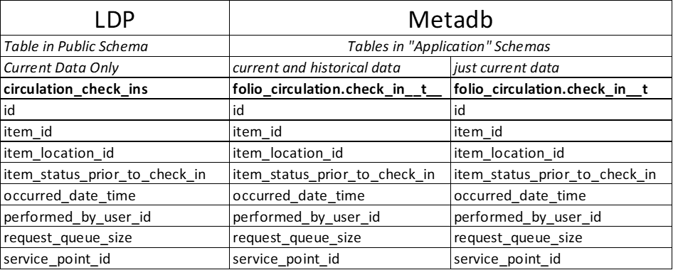
LDP and Metadb: One Table Comparison

Slide 20
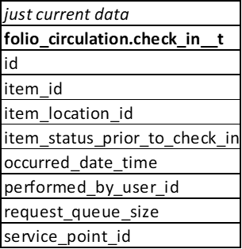
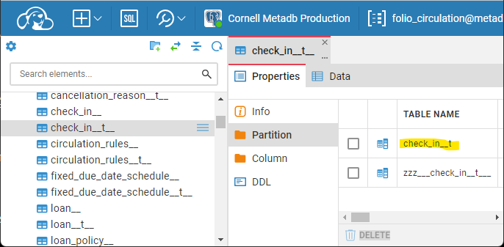
LDP and Metadb: Current Tables in Partition Schemas
Note: The current table check_in__t is contains current data only and is located inside the Partition Schema under the table with current and historical data, check_in__t__

Slide 21
Table Naming Conventions in Metadb
Why use 2 underscores?
Table names in a database must be unique. Because some table names already use one underscore, we must make sure the Metadb tables have unique names, so they are given 2 underscores.
Metadb
SELECT
COUNT (cl.id)
FROM
folio_circulation.loan__t AS cl
;
loan _ _ t

Slide 22

Demo of setting up your
CloudBeaver Connection
to the Metadb reporting database

Slide 23
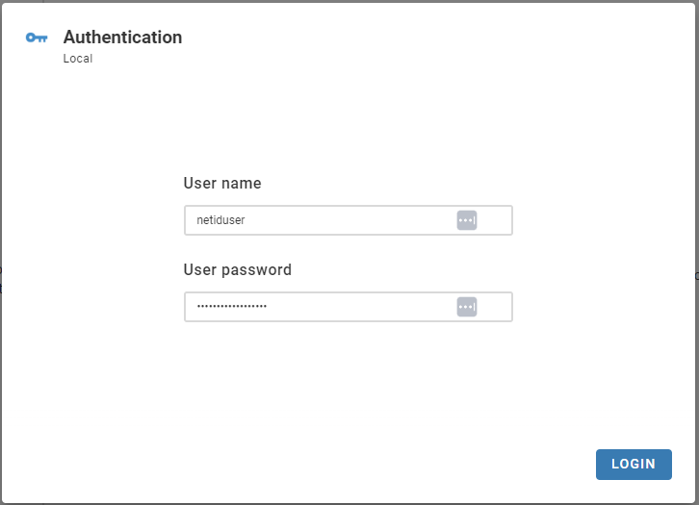
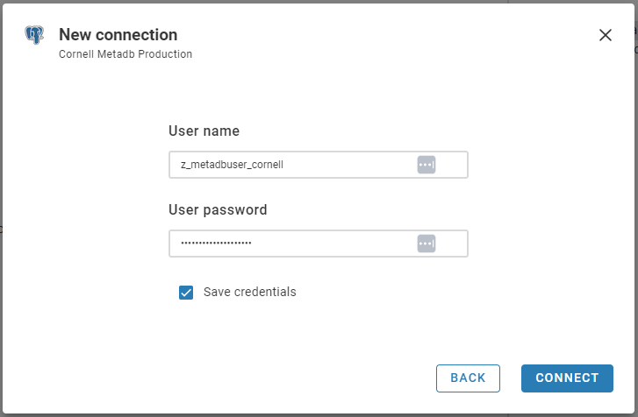
2 Different User Accounts: CloudBeaver and Metadb
Every time you connect to the Metadb reporting database to build and/or run reports, you first log in using your CloudBeaver user name (netiduser) and user password. Next, you set up a connection to the Metadb reporting database using the metadb user name z_metadbuser_cornell and password. Once your metadb reporting database connection is established, you do not need to type in its user name and password again.
CloudBeaver
Metadb

Slide 24
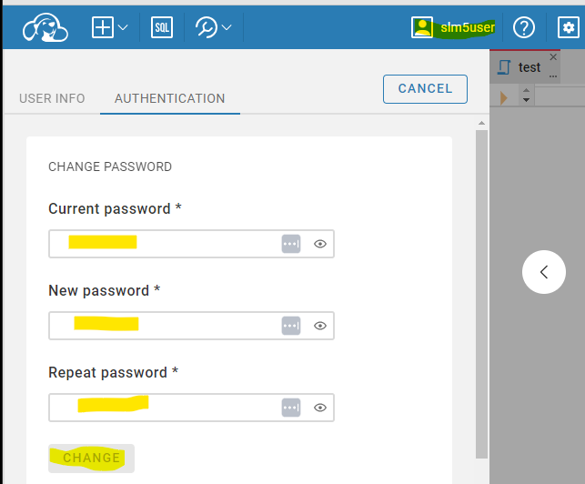
CloudBeaver: Log in and Change Your Password
Open your web browser and go to
44.207.124.201
Enter your user name and temporary password
Click your username in the top right corner of the screen
Click Authentication
Enter your temporary password, your new password, and your new password again
Click Change to change your password

Slide 25
CloudBeaver: Configure Connection to Metadb Reporting Database
Choose New Connection, From a Template
Choose Cornell Metadb Production
Enter the User name
z_metadbuser_cornell
PLEASE NOTE: This User Name and Password is different from what you used to sign onto your personal CloudBeaver account. This is the general user account for access to the Metadb database itself.
Enter the password for this account
Check Save Credentials
Click CONNECT

Slide 26
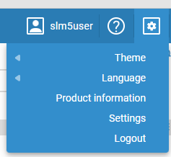
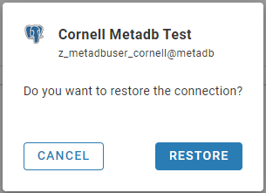
CloudBeaver: Logging Out and Logging In
After you set up your connection to the Metadb reporting database and log out, you may see a prompt to restore your connection the next time you log in. Go ahead and click RESTORE.

Slide 27
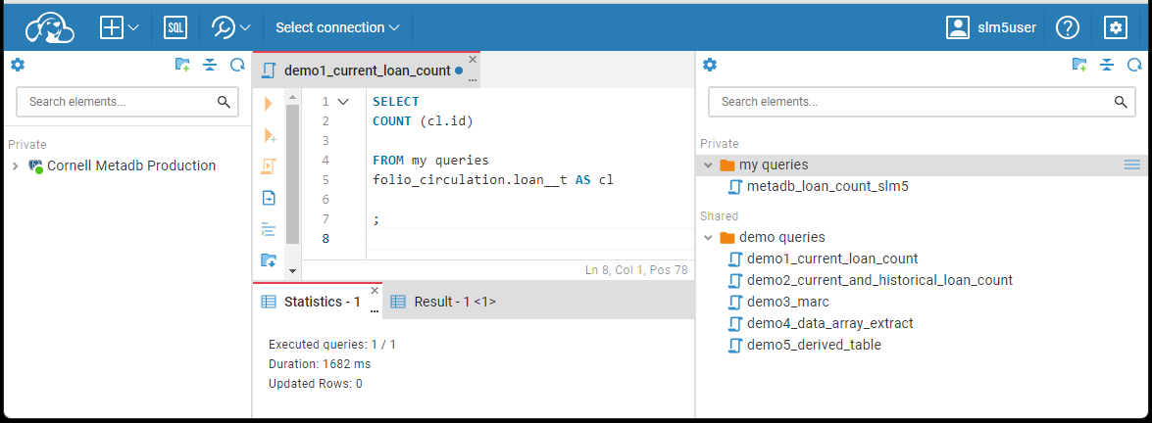
CloudBeaver: Movable Sections
Please be aware that CloudBeaver's interface includes movable sections which can be confusing, especially for new users. These panels can be rearranged unintentionally, disrupting your workflow. The trick is to hover over the lines to find the triangles to open and close the sections. To resize a section of the window, move the line itself to the desired location.

Slide 28
Examples

Slide 29
Example: Getting Current Records from the Current Loan Table
LDP
SELECT
COUNT (cl.id)
FROM
circulation_loans AS cl
;
Metadb
SELECT
COUNT (cl.id)
FROM
folio_circulation.loan__t AS cl
;
loan _ _ t
Notes:
For the LDP, the query gets current loan records on the circulation_loans table
For Metadb, the query gets current loan records on the loan__t table, which is the table that stores the current records with transformed data fields (hence, the “t”)
Note that for Metadb, the table reference must be qualified with the preceding name of the schema in which it is stored
Also note that the transformed tables in Metadb end with 2 underscores and a “t”

Slide 30
Example: Getting Current and Historical Loan Records from the
Loan Table
LDP
SELECT
COUNT (cl.id)
FROM
history.circulation_loans AS cl
;
Metadb
SELECT
COUNT (cl.id)
FROM
folio_circulation.loan__t__ AS cl
;
loan _ _ t _ _
Notes:
For the LDP, the query gets current and historical loan records on the history.circulation_loans table
For Metadb, the query gets current loan records on the loan__t__ table, which is the table that stores the current and historical records with transformed data (hence, the “t”)
Note that for Metadb, the table reference must be qualified with the preceding name of the schema in which it is stored
Also note that the transformed tables in Metadb end with 2 underscores and a “t”

Slide 31

How do I stay informed on FOLIO Reporting topics?
Join the #folio-reporting channel on the CUL Slack project
Bookmark the CUL FOLIO Reporting Confluence site
Join the CUL-REPORT-USERS-L email list (see instructions here)
Attend the FOLIO Reporting SIG (Special Interest Group) meetings at 11am ET on Mondays (see Sharon for calendar invitation)

Slide 32

Acknowledgements
These materials were developed with review, feedback, adapted materials, resources, and support contributed by the following individuals. Many thanks!
Natalya Pikulik, Cornell University
Nassib Nassar, Index Data
Scott Perry, University of Chicago
Stephan Dombeck, Leipzig University
Axel Doerrer, University of Mainz
Vandana Shah, Cornell University
Jean Pajarek, Cornell University
Linda Miller, Cornell University
Joanne Leary, Cornell University
Ann Crowley, Cornell University

Slide 33
Questions?

Slide 34
END

