Slide 1
Load Poll

Slide 2
Start Recording

Slide 3
Metadb Rollout Intermediate Training
Jean Pajerek and Sharon Markus
CUL FOLIO Reporting Team
Cornell University Library
October 28, 2024

Slide 4

This session will cover:
What is Metadb?
LDP and Metadb Basics
Connecting to Metadb
LDP and Metadb Schema Structures
Comparing SQL queries from LDP to Metadb
Questions

Slide 5

FOLIO Reporting for the Cornell University Library
The Cornell University Library went live with FOLIO and FOLIO Reporting with the Library Data Platform July 1, 2021
EBSCO provides hosting services for Cornell’s FOLIO application database and Cornell’s Library Data Platform (LDP) and Metadb (Test) reporting databases
Cornell converting 300+ queries and 20+ dashboards from LDP to Metadb
Cornell will move to Metadb for Production Reporting Services and will retire its LDP on November 30, 2024

Slide 6

LDP versus Metadb: Data Refresh
LDP
Metadb
nightly data update from
FOLIO Application Server
live updates
from FOLIO Application
Server via streaming
data integration
Notes:
LDP - The LDP software provides reporting users with a copy of yesterday's data from the FOLIO application server. Metadb will provide continuously streaming data updates from the FOLIO application server. This will provide reporting users with access to FOLIO data in near real time instead of yesterday's data. While LDP's architecture is limited to running on a single node, Metadb's architecture is horizontal, allowing for linear scaling of data updates. This allows updates to run in parallel within a single Metadb cluster.

Slide 7
Metadb Rollout Plans for the Cornell Library
January 2024
October 2024
LDP Production
(data from FOLIO Prod)
Metadb Test
(data from FOLIO Test)
LDP Production (data from FOLIO Prod)
Metadb Production
(data from FOLIO Prod)
December 2024
Metadb Production
(data from FOLIO Prod)
November 30, 2024
May 2024
LDP Production (data from FOLIO Prod)
Metadb Test
(data from FOLIO Prod)
LDP Production
is
retired
Metadb Production
(data from FOLIO Prod)
Notes:
-Running both LDP and Metadb systems at the same time until November 30, 2024 will allow us to continue to provide uninterrupted reporting services and support while giving reporting users a chance to learn how to use the new system and to convert queries from LDP to Metadb format
-Metadb will show more up-to-date and accurate data than LDP in areas where there is a lot of data entry within one day, such as loans

Slide 8

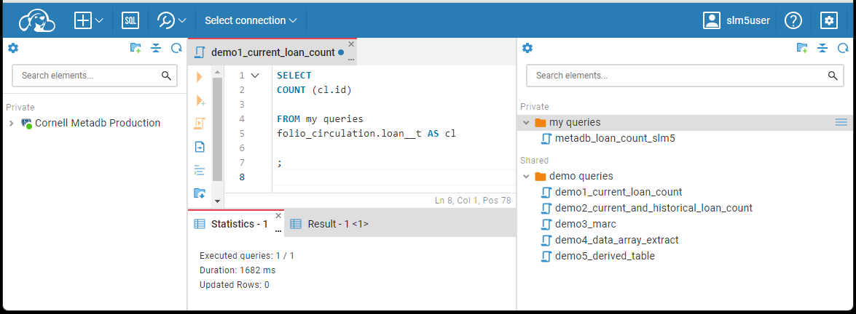
Moving from Virtual DBeaver to CloudBeaver
With Metadb, CUL reporting users will use CloudBeaver instead of Virtual DBeaver to access the reporting database

Slide 9
Setting up your
CloudBeaver Connection
to the Metadb reporting database

Slide 10

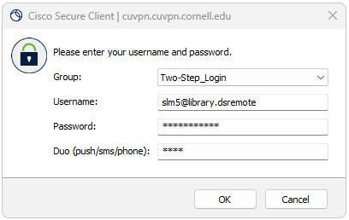
Off Campus Connection Requires VPN Login
If you are connecting to CloudBeaver to use the Metadb reporting database from off campus, you need to first log into VPN (Virtual Private Network).
VPN Login

Slide 11
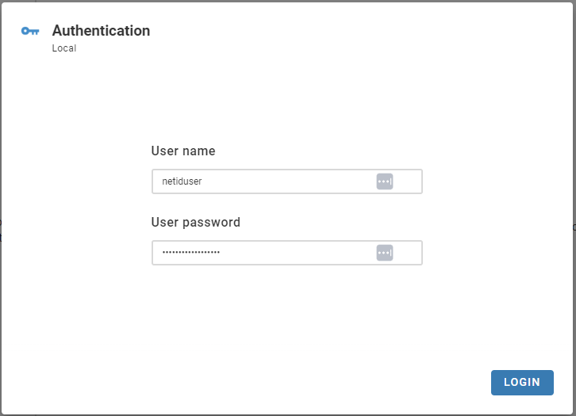
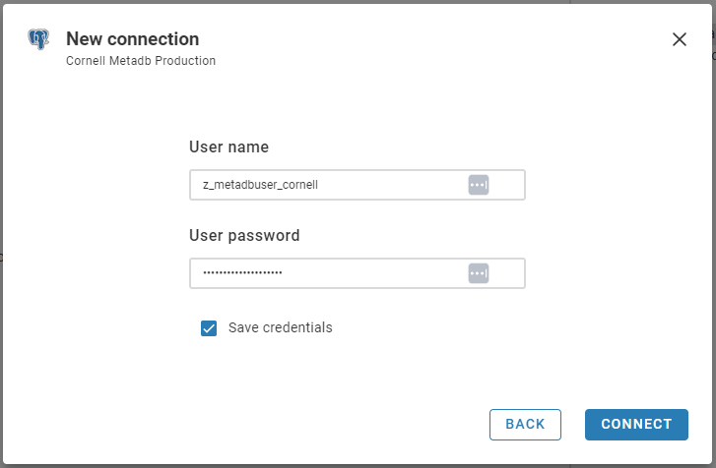
2 Different User Accounts: CloudBeaver and Metadb
Every time you connect to the Metadb reporting database to build and/or run reports, you log in using your CloudBeaver user name (netiduser) and user password. The first time you use your account, you need set up a connection to the Metadb reporting database using the metadb user name z_metadbuser_cornell and password. Once your metadb reporting database connection is established, you do not need to type in the metadb user name and password again.
CloudBeaver
Metadb

Slide 12
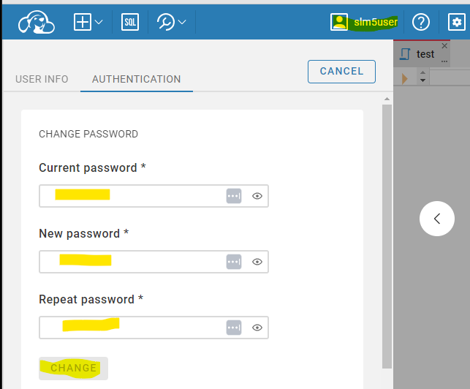
CloudBeaver: Log in and Change Your Password
Open your web browser and go to
44.207.124.201
Enter your user name and temporary password
Click your username in the top right corner of the screen
Click Authentication
Enter your temporary password, your new password, and your new password again
Click Change to change your password

Slide 13
CloudBeaver: Configure Connection to Metadb Reporting Database
Choose New Connection, From a Template
Choose Cornell Metadb Production
Enter the User name
z_metadbuser_cornell
PLEASE NOTE: This User Name and Password is different from what you used to sign onto your personal CloudBeaver account. This is the general user account for access to the Metadb database itself.
Enter the password for this account
Check Save Credentials
Click CONNECT

Slide 14
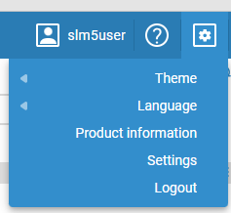
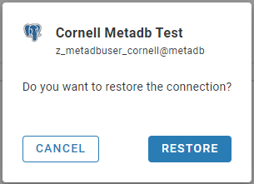
CloudBeaver: Logging Out and Logging In
After you set up your connection to the Metadb reporting database and log out, you may see a prompt to restore your connection the next time you log in. Go ahead and click RESTORE.

Slide 15
CloudBeaver: Movable Sections
Please be aware that CloudBeaver's interface includes movable sections which can be confusing, especially for new users. These panels can be rearranged unintentionally, disrupting your workflow. The trick is to hover over the lines to find the triangles to open and close the sections. To resize a section of the window, move the line itself to the desired location.

Slide 16
LDP and Metadb
Schema Structures

Slide 17
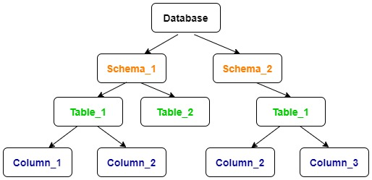
Organizing Data in the Database
Just like most reporting databases, data for both LDP and Metadb are structured as follows:
data are organized into tables
tables are organized into schemas
schemas are like folders on your desktop, keeping related files together
tables have columns showing the contents of each data field

Slide 18
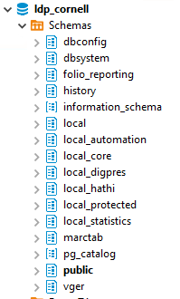
LDP Schemas
In LDP, the main schemas we use are organized as follows:
  public: tables with transformed FOLIO data
  history: tables with previous versions of FOLIO records
  folio_reporting: where derived tables get created automatically
  marctab: schema and table where transformed MARC records are stored in tabular form
  local: sort of a sandbox environment; could be used for non-FOLIO data, custom FOLIO tables, etc.
  vger: read-only legacy data from the Voyager system
  access to all schemas: all users log into the LDP using the same “ldp_user” account and have access to see all the schemas as well as to write to specific “local” schemas

Slide 19
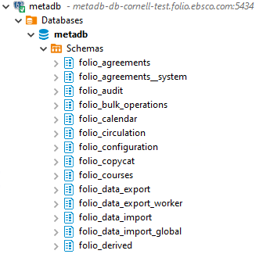
Metadb Schemas
In Metadb, the main schemas we use are organized as follows:
  folio_* schemas:
    Instead of one public schema covering all the FOLIO application tables, there are separate schemas with tables for each FOLIO application. Application schemas include tables with current and historical data (tables with previous versions of FOLIO records).
  folio_derived: where derived tables get created automatically
  folio_source_record.marc__t: schema and table where transformed MARC records are stored in tabular form
  vger: read-only legacy data from the Voyager system
  access to all schemas: all users log into Metadb using the same “z_metadbuser_cornell” account and have access to see all the schemas as well as to write to specific “local” schemas

Slide 20
Local Schemas
Schema | How Schema is Used
local_open | This schema is a sandbox for all users who want to publish a file to a local schema.
local_automation | This schema is for internal use by the Automation Team.
local_core | This schema is for internal use by the Reporting Team.
local_digpres | This schema is used internally by the HathiTrust team.
local_hathitrust | This schema is used internally by the HathiTrust team.
local_protected | This schema is used to store tables with protected data that is used internally by the Reporting Team.
local_shared | This schema is used to store local tables that are in queries used by all reporting users. All users can read the files here, but only reporting team members can post files here.
local_statistics | This schema is used internally by the Assessment and Planning team. All users can read the files here, but only A&P team members can post files here.
Metadb local schema names and permissions modelled on LDP local schemas
Sandbox schema in LDP called "local" is now called "local_open" in Metadb; anyone can use this schemas for testing
Notes:
There is a lot you can do with our FOLIO LDP and Metadb reporting environments. Schemas allow users and user groups to create and share their own user-created local tables of data in the reporting database. User-created local tables serve many purposes, such as bringing in non-FOLIO data to a report and comparing FOLIO inventory with a list of titles from a vendor, to name a few. These are the schemas where local tables are published and used. The schema structure for Metadb is based on the schema structure in LDP.

Slide 21
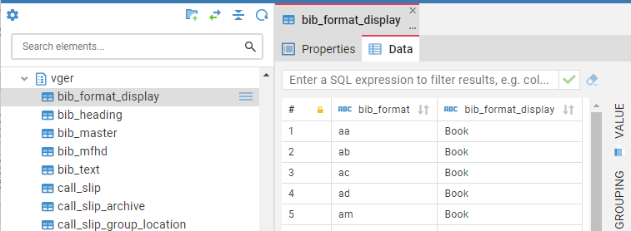
VGER Schema
key read-only legacy data tables from our previous system, Voyager, are available in the VGER schema in the CUL Metadb reporting database
data are frozen in time at June 2021, just before CUL moved from Voyager to FOLIO as its central library data system

Slide 22
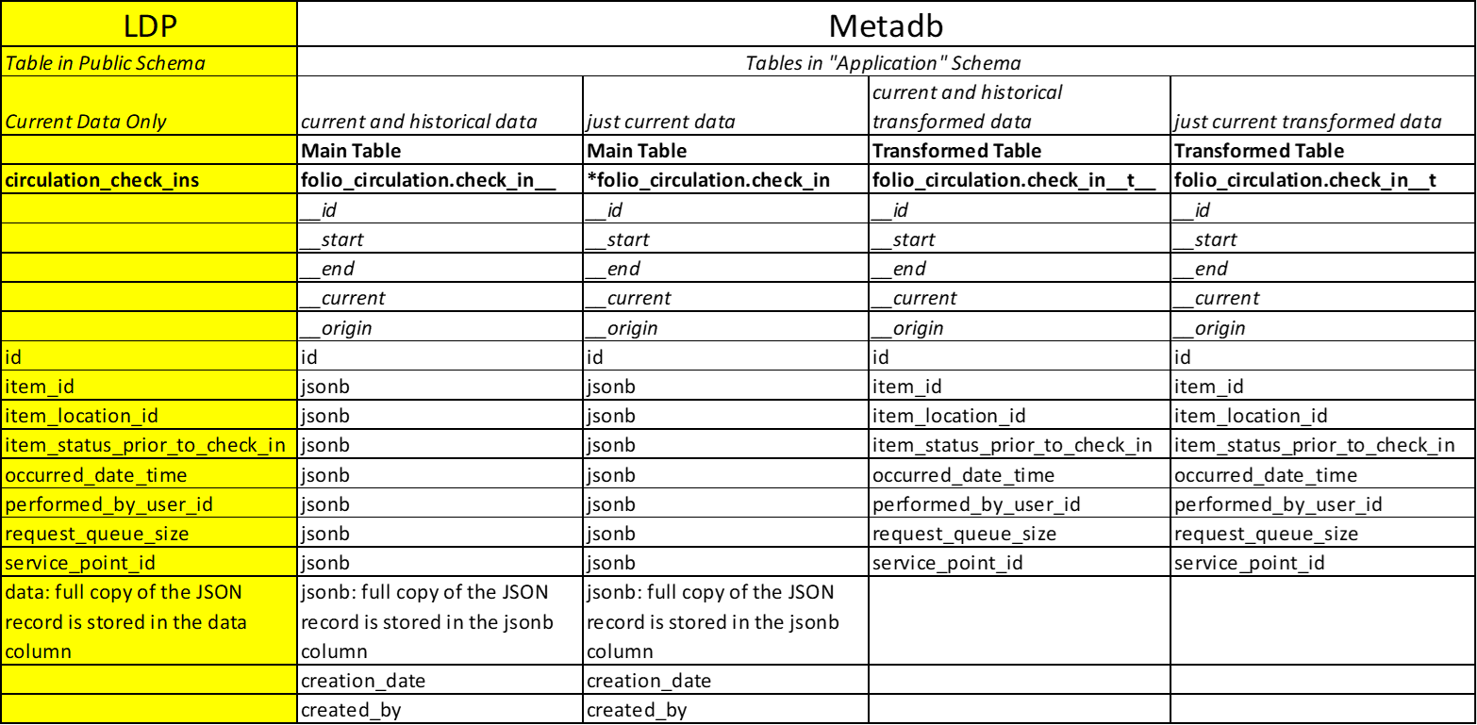
LDP and Metadb: One Table Comparison - All Data Fields
Notes:
These are all the data elements in our table comparison. We’ll break it down section by section to show you how to use these various data elements.

Slide 23
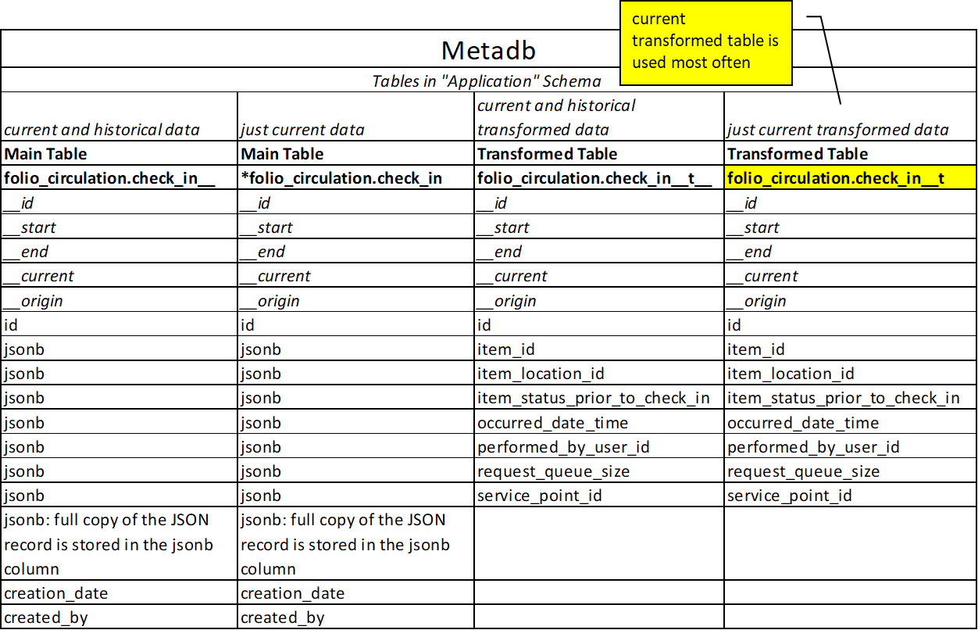

Slide 24
Schema Structures:
Current and Historical with Transformed Data

Slide 25
LDP and Metadb: One Table Comparison - Current and Historical

Slide 26
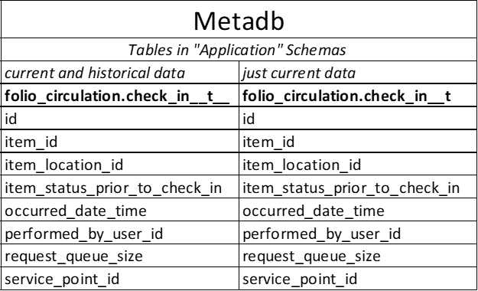
Metadb: One Table Comparison - Current and Historical
Notes:
Okay. We've removed the LDP column so we can focus on Metadb tables only.

Slide 27
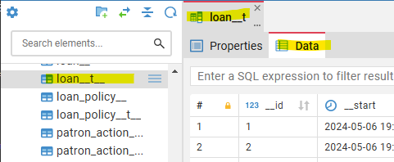
Metadb Schemas: FOLIO Application Current Schemas
FOLIO application (folio_*) schemas: current records
  Each table has versions that contain all the current records. Current versions of tables have specific name formats.
  For example, in the folio_circulation schema, “loan__t” has current records. (Note that there are two underscore characters between “loan” and “t”.)

Slide 28
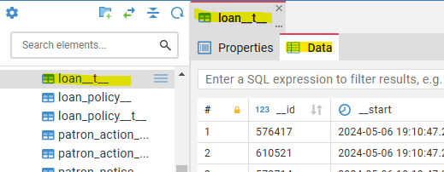
Metadb Schemas: FOLIO Application Historical Schemas
FOLIO application (folio_*) schemas: historical records
  Instead of a history schema, each table has versions that contain all the “historical” records, which include historical and current (all the data). These versions end with “__t__” (four underscore characters).
  For example, in the folio_inventory schema, “loan__t__” has current and historical records.

Slide 29
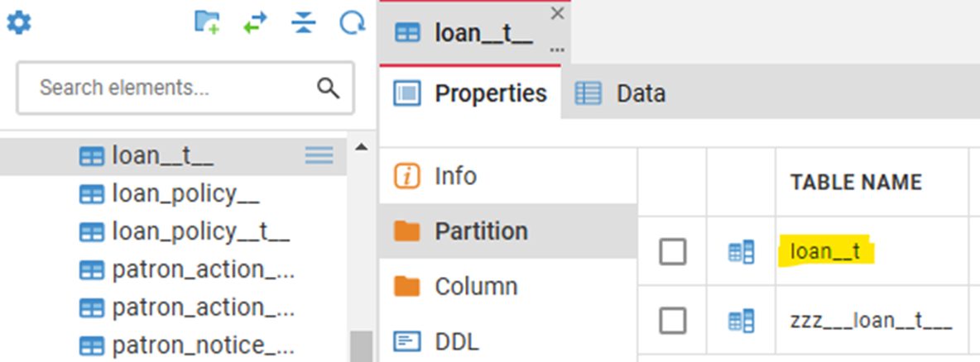
LDP and Metadb: Current Tables in Partition Schemas
Note: The current table loan__t is contains current data only and is located inside the Partition Schema under the table with current and historical data, loan__t__
Don't worry about the "zzz" tables; these are not used in queries

Slide 30
Table Naming Conventions
LDP | Metadb | Description
public.table | application schema.table__t | table that stores current records
history.table | application schema.table__t__ | table that stores current and historical records

Slide 31
Table Naming Conventions: Example
LDP | Metadb | Description
public.circulation_loans | folio_circulation.loan__t | table that stores current loan records
history.circulation_loans | folio_circulation.loan__t__ | table that stores current and historical loan records

Slide 32
Getting Current Records
getting current records from a current transformed table
Metadb
SELECT
COUNT (cl.id)
FROM
folio_circulation.loan__t AS cl
;
loan _ _ t

Slide 33
Getting Current and Historical Records
getting current and historical records from a current and historical table
Metadb
SELECT
COUNT (cl.id)
FROM
folio_circulation.loan__t__ AS cl
;
loan _ _ t_ _

Slide 34
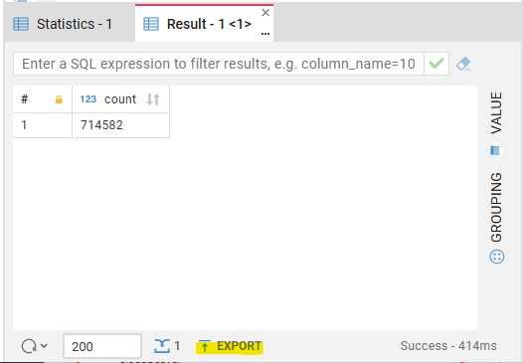
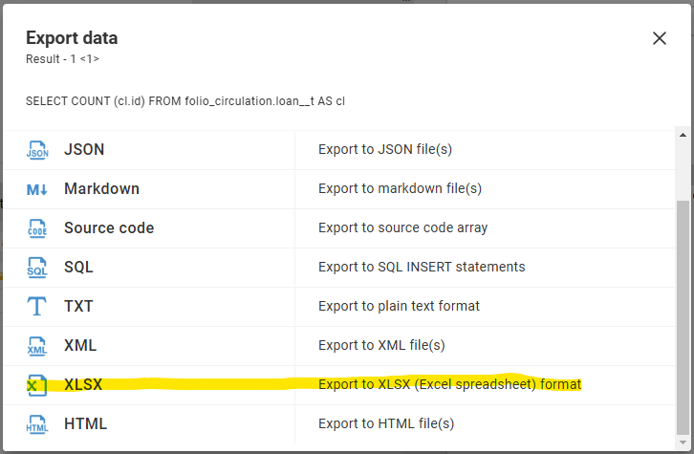
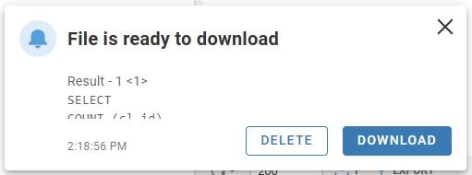
Report Output
CloudBeaver allows you to export your results as Excel files and place them wherever you want on your computer

Slide 35
Fun Poll!

Slide 36
Table Naming Conventions in Metadb
Why use 2 underscores?
Table names in a database must be unique
Because some table names already use one underscore, we must make sure the Metadb tables retain unique names, so they are given 2 underscores
Metadb
SELECT
COUNT (cl.id)
FROM
folio_circulation.loan__t AS cl
;
loan _ _ t

Slide 37
Using Derived Tables

Slide 38
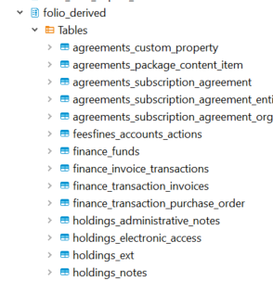
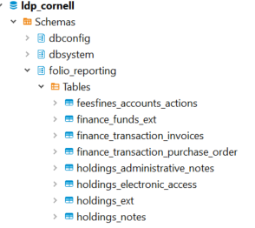
Derived Tables: LDP vs Metadb
LDP
Metadb
only difference is the schema name change from folio_reporting to folio_derived
There are definitely more derived tables in Metadb as we get access to more and more apps data.
Using derived tables can improve performance

Slide 39
Example : Using Derived Tables
SELECT
COUNT(ie.instance_hrid)
FROM
folio_reporting.instance_ext ie
WHERE
mode_of_issuance_name = 'single unit'
AND title ILIKE '%war%'
;
change folio_derived to folio_reporting
no need to use "_ _ t" table because you are pointing to a derived table
this example counts non-serials that have the word “war” in the title
folio_reporting

Slide 40
Are Derived Tables Update Continuously?
Metadb derived tables are not updated continuously
Currently, derived tables are automatically updated once per day, usually at about 10pm ET by default (this is about 3:00 UTC)
Choosing whether or not to use a derived table depends on how up-to-date the data needs to be and how large the dataset is
eventually, we will not need as many derived tables to extract data from the JSON because most data fields will be extracted into columns
we can still use derived tables to make it easier to write queries and to improve performance (e.g. finance transactions table); instead of using 20 tables in your query, you can use a derived table that pulls together all that data

Slide 41
Converting LDP Queries to Metadb

Slide 42
Basic Steps for Converting LDP Queries to Metadb
rename your tables from the LDP public schema to the new application-based schemas and table names
(most often) choose the current, transformed table
(ending in “_ _ t”)
if you used derived tables, rename the schema from folio_reporting to folio_derived
test and evaluate results
Notes:
In these last few slides, we have already covered the most common steps you need to take to covert your LDP queries to Metadb format. To review, the basic steps are...

Slide 43
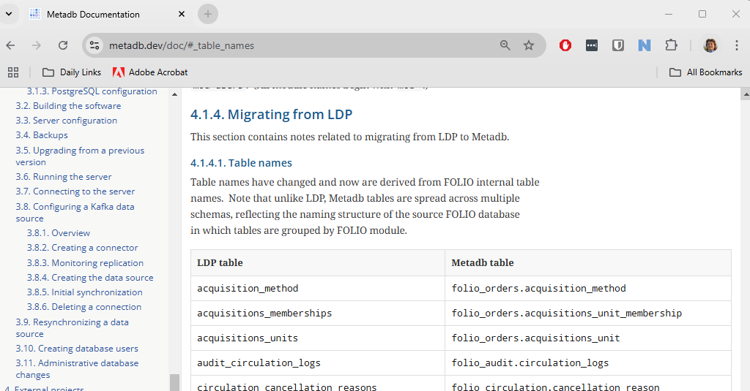
LDP to Metadb Table Conversion Chart
See https://metadb.dev/doc/#_table_names

Slide 44
Converting your LDP query into Metadb format see https://confluence.cornell.edu/display/folioreporting/How+to+convert+LDP+queries+to+Metadb+format

Slide 45
Using MARC

Slide 46
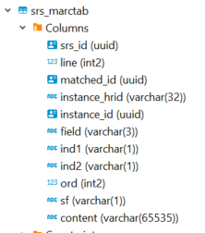
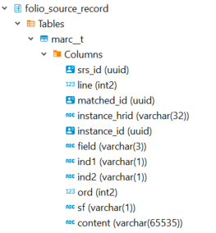
Using MARC tables in Metadb
LDP | Metadb
srs_marc | folio_source_record.marc_records_lb
srs_marctab | folio_source_record.marc__t
srs_records | folio_source_record.records_lb
Good news!
field names in MARC tables are the same in LDP and Metadb
only the schema names and table names are different in Metadb MARC tables

Slide 47
Example: Using MARC
this example finds records with English in the 008 MARC language field
SELECT
sm.instance_id,
sm.field,
substring(sm.content, 36,3) AS language
FROM
folio_source_record.marc__t AS sm
WHERE
sm.field = '008'
AND substring(sm.content,36,3)IN('eng')
LIMIT 10;
marc _ _ t

Slide 48
Schema Structures:
Current and Historical with Untransformed Data (Main Tables)

Slide 49
Data Fields in JSON Array
What if the data field you need cannot be found on the current transformed table?
  review the main table
  extract from JSON (we had JSON data arrays in LDP, too)

Slide 50
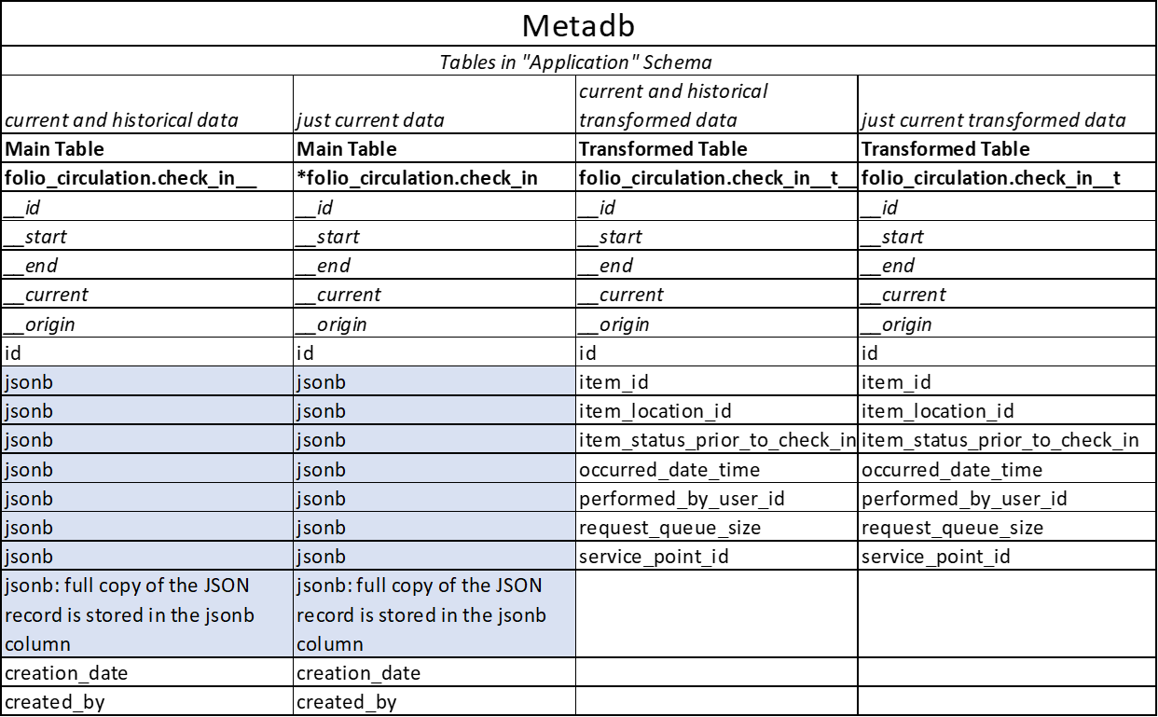
Main Tables Contain JSONB Data Arrays
Notes:
(On this slide, we’ve removed the LDP column so we can just concentrate on Metadb tables.) The main tables contain a copy of all the json fields brought into the database for each table. There is a main table for current and historical records, as well as a main table for current records. You only need these tables when there is a data field in a json data array that you cannot find in the transformed tables. In an upcoming release of the Metadb software, all the fields “locked up” in data arrays will be extracted into columns for ease of use. At this point, there will be no need to use the main tables in your queries.

Slide 51
Extract data field from main (untransformed) current and historical data table JSON array
SELECT jsonb_extract_path_text(hr.jsonb, 'hrid')
AS holdings_hrid, admin_notes.jsonb #>> '{}'
AS administrative_note
FROM folio_inventory.holdings_record__ AS hr
CROSS JOIN LATERAL jsonb_array_elements(jsonb_extract_path
(hr.jsonb, 'administrativeNotes'))
AS admin_notes (jsonb)
WHERE hr.__current IS TRUE
AND hr.jsonb IS NOT NULL
LIMIT 10 ;
JSON data are treated as “schemaless
Notice that the table name does not have _ _ t
Notes:
JSON data are treated as “schemaless,” so there is no need to include the schema in the jsonb extract syntax. Also notice that the table name in the FROM statement does not have the "_ _ t" suffix because it is not a transformed table. To extract JSON arrays, the syntax for Metadb is similar to LDP. A lateral join can be used with the function jsonb_array_elements() to convert the elements of a JSON array to a set of rows, one row per array element. See more examples in the Metadb documentation and on the FOLIO Analytics wiki (referenced on last slide)

Slide 52
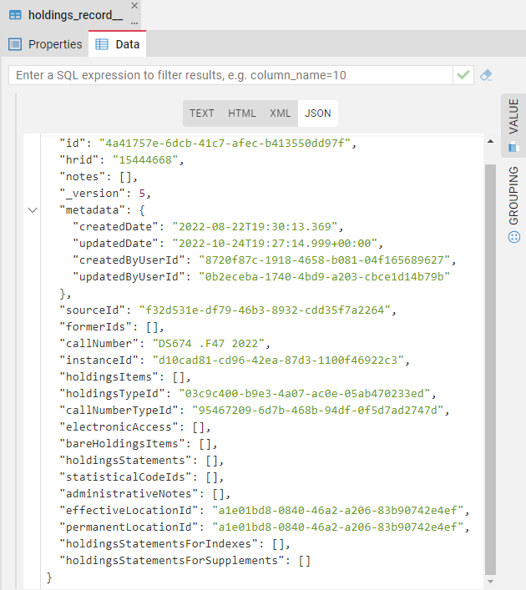

Metadb Data Arrays to be Fully Extracted
Good news!
Metadb software version 1.4 will provide full extraction of data arrays
Notes:
current version of Metadb software is 1.3.5
Metadb v 1.3.5 running on Cornell Metadb
Good news - version 1.4 of Metadb software will include full extraction of all JSON arrays
data fields will be in columns, not data arrays
with version 1.4, extracting data from data arrays via SQL will be unnecessary

Slide 53
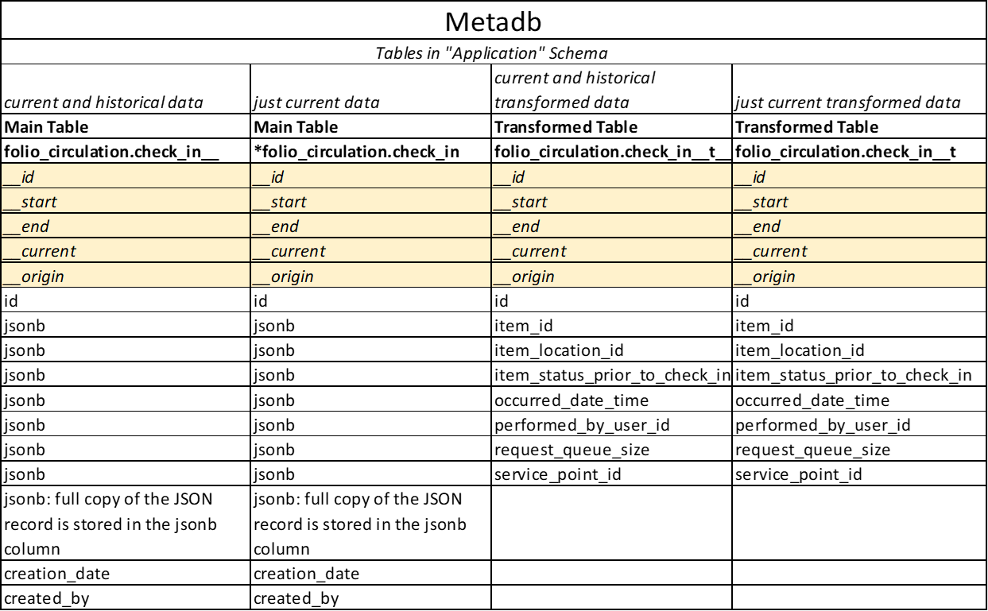
LDP and Metadb: One Table Comparison - Specialized Metadata Fields
specialized metadata fields
Notes:
All metadb tables have these columns. They provide special functionality in your SQL queries, which we can explore in a future session. We use the _ _current metadata field as a filter for current data in the previous example.

Slide 54
Additional Resources
Metadb Documentation from Index Data
  https://metadb.dev/doc/#_user_guide
Metadb Report Samples from Reporting SIG
  https://github.com/folio-org/folio-analytics/tree/main/sql_metadb/report_queries
Metadb Report Samples from Cornell
  https://github.com/cul-it/cul-folio-analytics

Slide 55

How do I stay informed on FOLIO Reporting topics?
Join the #folio-reporting channel on the CUL Slack project
Bookmark the CUL FOLIO Reporting Confluence site
Join the CUL-REPORT-USERS-L email list (see instructions here)
Attend the FOLIO Reporting SIG (Special Interest Group) meetings at 11am ET on Mondays (see Sharon for calendar invitation)

Slide 56

Acknowledgements
These materials were developed with review, feedback, adapted materials, resources, and support contributed by the following individuals. Many thanks!
Natalya Pikulik, Cornell University
Nassib Nassar, Index Data
Scott Perry, University of Chicago
Stephan Dombeck, Leipzig University
Axel Doerrer, University of Mainz
Vandana Shah, Cornell University
Linda Miller, Cornell University
Joanne Leary, Cornell University
Ann Crowley, Cornell University

Slide 57
Questions?

Slide 58
END

