Slide 1
Moving to Metadb
FOLIO Reporting Users Group Presentation
Natalya Pikulik and Sharon Markus
Cornell University
Part One - 1/29/24
Part Two - 2/12/24

Slide 2

Part One
  What is Metadb?
  LDP versus Metadb: Overview
  LDP versus Metadb: Data Refresh
  Metadb Rollout Plans for the Cornell Library
  LDP and Metadb Schema Structures
Part Two
  More about LDP and Metadb Schema Structures
  Writing and Revising SQL queries for Metadb
    Examples

Slide 3
What is Metadb?
Notes:
Can’t have completely exhaustive store of reports, but want people to have a good starting point when they go live

Slide 4
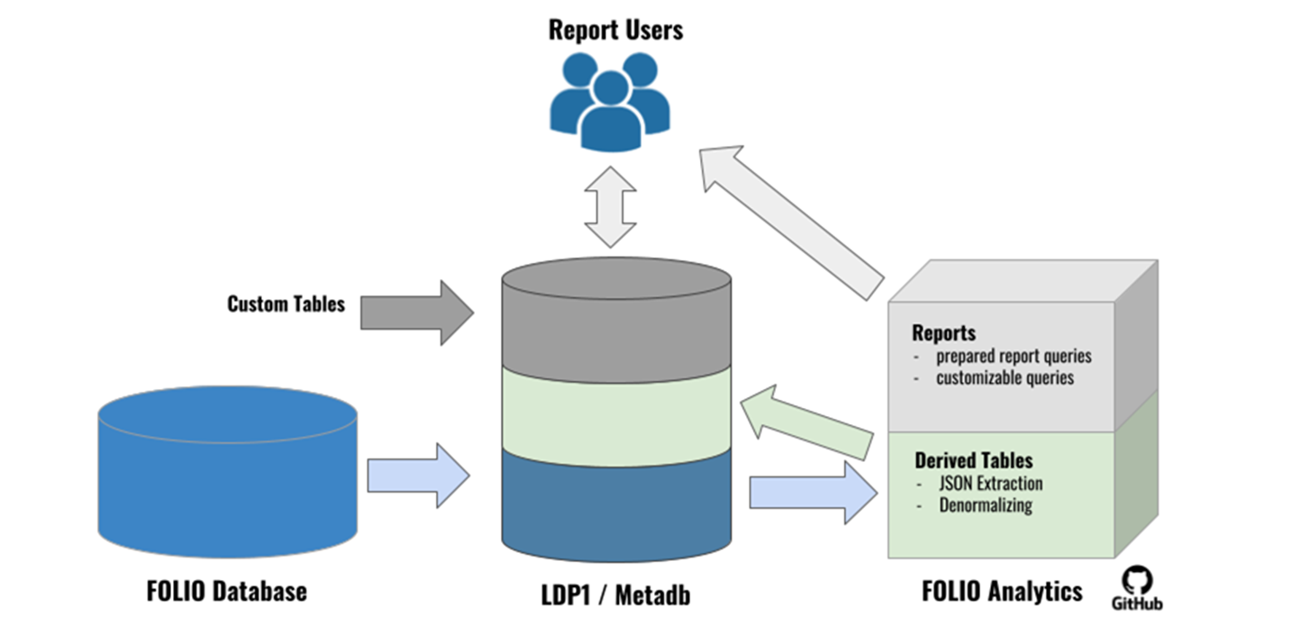
What is Metadb?
Metadb is the evolution of the LDP (Library Data Platform) software running on our reporting database systems
Metadb is similar to LDP in many ways and was the planned next step in developing the reporting database software
*graphic: Axel Dörrer

Slide 5

LDP versus Metadb: Knowledge Transfer
Everything you know about the LDP will help you understand Metadb

Slide 6
LDP versus Metadb: Overview
LDP
Metadb
Extracts, transforms, and loads data from the FOLIO application server to the LDP overnight
Some data elements must be extracted into columns by derived tables
Extracts, transforms, and loads data from FOLIO application server continuously in near real-time
Some data elements must be extracted into columns by derived tables
Most data elements are extracted into columns
Plans to extract all data elements into columns from the JSON
Uses a different organization of the data tables than LDP

Slide 7

LDP versus Metadb: Data Refresh
LDP
Metadb
nightly data update from
FOLIO Application Server
live updates
from FOLIO Application
Server via streaming
data integration
Notes:
LDP - The LDP software provides reporting users with a copy of yesterday's data from the FOLIO application server. Metadb will provide continuously streaming data updates from the FOLIO application server. This will provide reporting users with access to FOLIO data in near real time instead of yesterday's data. While LDP's architecture is limited to running on a single node, Metadb's architecture is horizontal, allowing for linear scaling of data updates. This allows updates to run in parallel within a single Metadb cluster.

Slide 8
Metadb Rollout Plans for the Cornell Library
Click this link for Metadb Rollout Plans
January 2024
July 2024
LDP Production
(data from FOLIO Prod)
Metadb Test
(data from FOLIO Test)
LDP Production (data from FOLIO Prod)
Metadb Production (data from FOLIO Prod)
March 2024
September 2024
LDP Production
(data from FOLIO Prod)
Metadb Test
(data from FOLIO Prod)
Metadb Production (data from FOLIO Prod)
Metadb Test (data from FOLIO Prod)
LDP Production is retired
Notes:
-Running both LDP and Metadb systems at the same time until September 2024 will allow us to continue to provide uninterrupted reporting services and support while giving reporting users a chance to learn how to use the new system and to convert queries from LDP to Metadb format
-FOLIO Test only updated when FOLIO Production moves to a new version, so you will see differences in the data
-FOLIO Production is real data used every day, whereas FOLIO Test is snapshot (copy) of FOLIO Production data taken every few months, so it will not show accurate results
-Metadb Test, once getting data from FOLIO Prod, will show more up-to-date and accurate data than LDP in areas where there is a lot of data entry within one day, such as loans

Slide 9
LDP and Metadb
Schema Structures
Notes:
Can’t have completely exhaustive store of reports, but want people to have a good starting point when they go live

Slide 10
LDP and Metadb Schema Structures:
Table Overview
Notes:
Can’t have completely exhaustive store of reports, but want people to have a good starting point when they go live

Slide 11
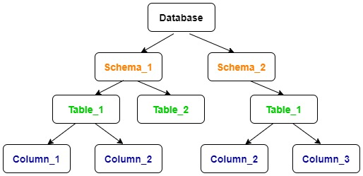
Organizing Data in the Database
Just like most reporting databases, data for both LDP and Metadb are structured as follows:
data are organized into tables
tables are organized into schemas
schemas are like folders on your desktop, keeping related files together
tables have columns showing the contents of each data field
Notes:
Just like any database, for both LDP and Metadb, data are organized into tables, and tables are organized into schemas.

Slide 12
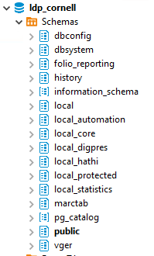
LDP Schemas
In a database, a schema is a group of tables
In LDP, the main schemas we use are organized as follows:
  public: tables with transformed FOLIO data
  history: tables with previous versions of FOLIO records
  folio_reporting: where derived tables get created automatically
  local: sort of a sandbox environment; could be used for non-FOLIO data, custom FOLIO tables, etc.
  access to all schemas: all users log into the LDP using the same “ldp_user” account and have access to see all the schemas as well as to write to specific “local” schemas

Slide 13
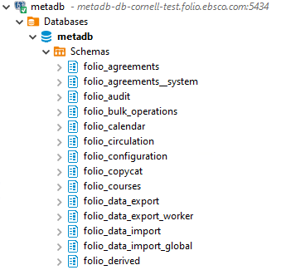
Metadb Schemas
In Metadb, the main schemas we use are organized as follows:
  folio_* schemas: main and transformed tables
    Instead of one public schema covering all the FOLIO application tables, there are separate schemas with tables for each FOLIO application.
  folio_derived: where derived tables get created automatically
  individual schemas: each Metadb user has their own account and has read access to see all the schemas, but individual users are the only ones who can write to their own schemas and to schemas to which they have been granted “write” access

Slide 14
Local Schemas
LDP and Metadb Schemas | How Schemas are Used
local (LDP), local_general (Metadb) | read access for all reporting users; write access for reporting team
local_automation | read/write access for automation team
local_core | read/write access for reporting team
local_digpres | read/write access for HathiTrust team
local_hathitrust | read/write access for HathiTrust team
local_protected | read/write access for reporting team; schema is used to store tables capturing daily updates that cannot be deleted
local_statistics | read/write access for the assessment and planning team
same setup as LDP, but limited read/write access

Slide 15
END PART 1

Slide 16
LDP and Metadb Schema Structures:
Derived Tables
Notes:
Can’t have completely exhaustive store of reports, but want people to have a good starting point when they go live

Slide 17
Derived Tables (N)
A derived table is simply a table created using data from one or more other tables
These make the LDP and Metadb data easier to use by performing common data joins and calculations
The derived tables are created by a set of queries maintained by the Reporting SIG
Execution of these queries is managed behind the scenes through LDP/ Metadb administration so that they run automatically and generate the derived tables in the database

Slide 18
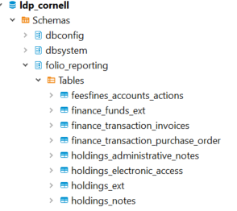
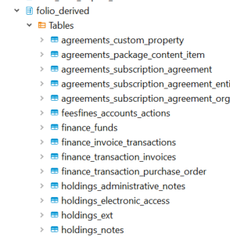
Derived Tables
LDP
Metadb
the only difference is the schema name change from folio_reporting to folio_derived
There are definitely more derived tables in Metadb as we get access to more and more apps data.
Are derived tables always 'current' - it depends!
For performance reasons it is better to use transformed tables
Notes:
*at the moment Metadb derived tables are not updated continuously (adjustable on a schedule)
*Currently, FOLIO "derived tables" are automatically updated once per day, usually at about 3:00 UTC by default.
*if a derived table needs updated data when a query us running that uses that table, Metadb will update that table automatically (planned feature); after that, derived tables will be updated continuously (later feature)
*eventually, we will not need derived tables to extract data from the JSON because all data fields will be extracted into columns
*we can still use derived tables to make it easier to write queries and to improve performance (e.g. finance transactions table); instead of using 20 tables in your query, you can use a derived table that pulls together that data

Slide 19
Derived Tables: Current Status
Metadb derived tables are not updated continuously
Currently, derived tables are automatically updated once per day, usually at about 10pm ET by default
(From Nassib in February 2024) Continuously updated derived tables--implemented in Metadb as a kind of report--are experimental and will be tested in the community
Choosing whether or not to use a derived table depends on how up-to-date the data needs to be and how large the dataset is
eventually, we will not need as many derived tables to extract data from the JSON because most data fields will be extracted into columns
we can still use derived tables to make it easier to write queries and to improve performance (e.g. finance transactions table); instead of using 20 tables in your query, you can use a derived table that pulls together that data

Slide 20
LDP and Metadb Schema Structures:
MARC Tables
Notes:
Can’t have completely exhaustive store of reports, but want people to have a good starting point when they go live

Slide 21
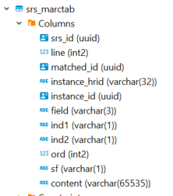
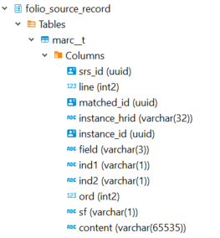
MARC Tables equivalents (N)
LDP
Metadb
Good news!
no changes to field names in the MARC tables
only the schema and table names are different

Slide 22
MARC Tables equivalents
srs_marc - folio_source_record.marc_records_lb
srs_marctab - folio_source_record.marc__t
srs_records - folio_source_record.records_lb
Good news!
no changes to field names in the MARC tables
only the schema and table names are different
LDP
Metadb

Slide 23
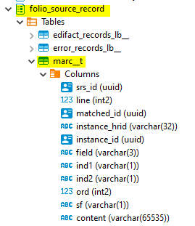
Metadb Schema for MARC
Metadb transforms MARC records from the tables marc_records_lb and records_lb in schema folio_source_record to a tabular form which is stored in a new table, folio_source_record.marc__t
Only records considered to be current are transformed, where current is defined as having state = 'ACTUAL' and an identifier present in 999 ff $i
This transform updates the table folio_source_record.marc__t usually every few hours or so
(to check time of the last update of marc and derived tables: metadb/table_updates)
The MARC transform stores partition tables in the schema marctab. Users can ignore this schema, as all data are accessible via folio_source_record.marc__t
marc_ _ t

Slide 24
LDP and Metadb Schema Structures:
Historical and Current,
Main and Transformed
Tables

Slide 25
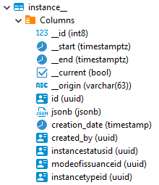
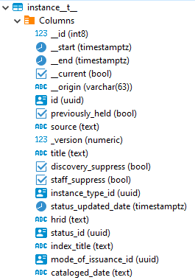
Metadb Schemas: FOLIO Application Historical Schemas (S)
FOLIO application (folio_*) schemas: main and transformed historical records
  Instead of a history schema, each main and transformed table has versions that contain all the “historical” records, which include historical and current (all the data). These versions end with “__” (two underscore characters).
  For example, in the folio_inventory schema, “instance__” is a main table with historical records, and “instance__t__” has transformed data and historical records.

Slide 26
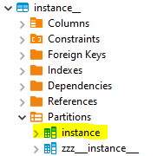
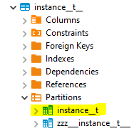
Metadb Schemas: FOLIO Application Current Schemas
FOLIO application (folio_*) schemas: main and transformed current records
  Each main and transformed table has versions that contain all the current records. Current versions of tables have specific name formats.
  For example, in the folio_inventory schema, “instance” is a main table with current records, and “instance__t” has transformed data and current records. (Note that there are two underscore characters between “instance” and “t”.)
  DBeaver issue: current record tables display in the Partitions schema inside the historical record schema

Slide 27
Table Naming Conventions
LDP | Metadb | Description
public.table | application schema.table__t | table that stores current records (transformed for Metadb)
history.table | application schema.table__t__ | table that stores current and historical records (transformed for Metadb)

Slide 28
Table Naming Conventions: Example
LDP | Metadb | Description
public.circulation_loans | folio_circulation.loan__t | table that stores current loan records
history.circulation_loans | folio_circulation.loan__t__ | table that stores current and historical loan records (transformed for Metadb)

Slide 29
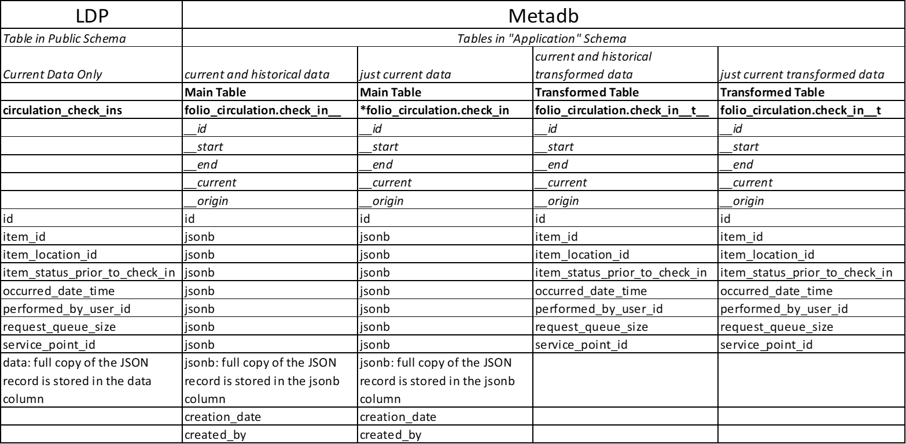
LDP and Metadb: One Table Comparison
Notes:
-show data that are similar in the same row

Slide 30
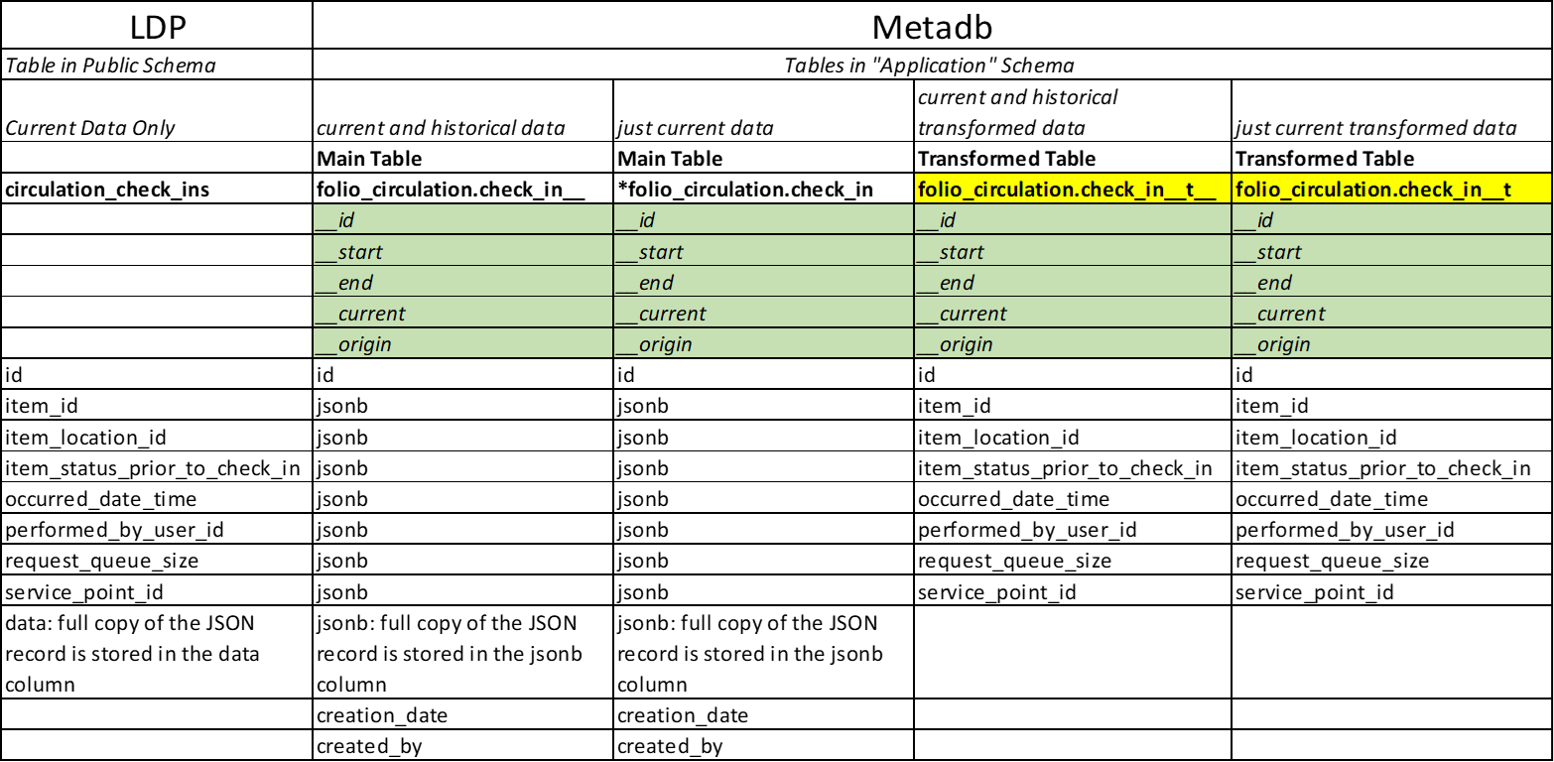
LDP and Metadb: One Table Comparison – Metadb Elements in Every Table
__id, __start, __end, __current and __origin are elements created by metadb that exist in every table

Slide 31
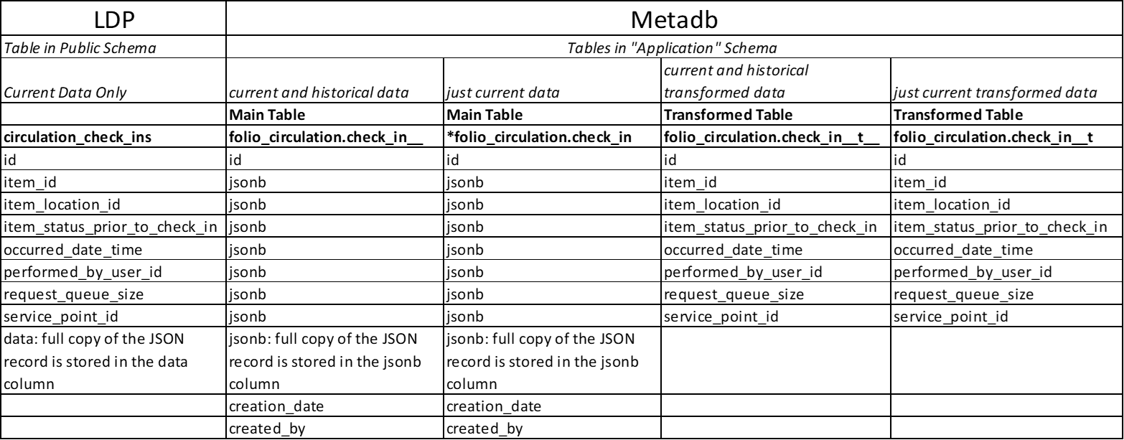
LDP and Metadb: One Table Comparison
Notes:
-show data that are similar in the same row

Slide 32
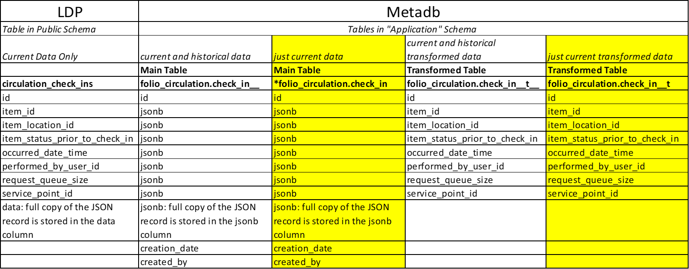
LDP and Metadb: One Table Comparison – Tables with Just Current Data
Notes:
-show data that are similar in the same row
-not all data fields are transformed, so it is sometimes necessary to return to the main table to get to a particular field

Slide 33
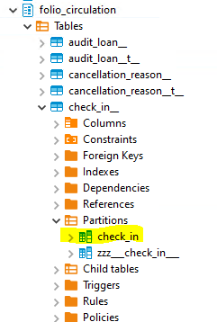
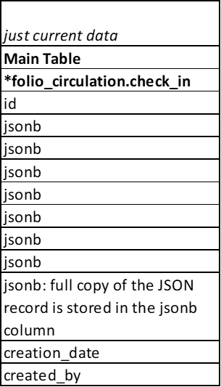
LDP and Metadb: One Table Comparison – Current Tables are Buried
Note: The current Main Table check_in is filtered to contain current data only and is located inside the Partition Schema under the Main Table check_in__
You cannot see its properties due to the way DBeaver displays tables, but you can see its data
Notes:
-show data that are similar in the same row

Slide 34
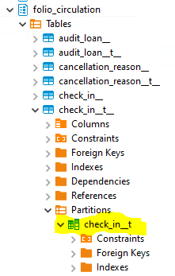
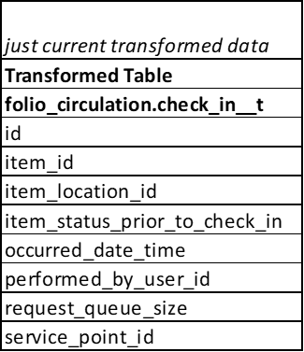
LDP and Metadb: One Table Comparison – Current Tables are Buried
Note: The current Transformed Table check_in__t is filtered to contain current data only and is located inside the Partition Schema under the Transformed Table with current and historical data check_in__t__.
You cannot see its properties due to the way DBeaver displays tables, but you can see its data
Notes:
-show data that are similar in the same row

Slide 35
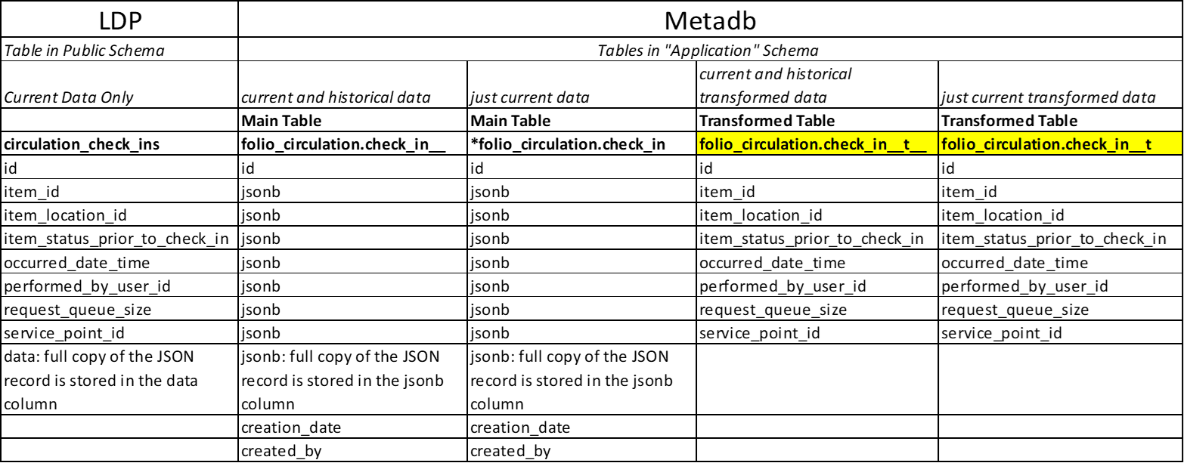
LDP and Metadb: One Table Comparison – Tables Most Often Used

Slide 36
Examples

Slide 37
Table Naming Conventions in Metadb
Why use 2 underscores?
Table names in a database must be unique. Because some table names already use one underscore, we must make sure the Metadb tables have unique names, so they are given 2 underscores.
Metadb
SELECT
COUNT (cl.id)
FROM
folio_circulation.loan__t AS cl
;
loan _ _ t

Slide 38
Example: Getting Current Records from the Current Transformed Loan Table
LDP
SELECT
COUNT (cl.id)
FROM
circulation_loans AS cl
;
Metadb
SELECT
COUNT (cl.id)
FROM
folio_circulation.loan__t AS cl
;
loan _ _ t
Notes:
For the LDP, the query gets current loan records on the circulation_loans table
For Metadb, the query gets current loan records on the loan__t table, which is the table that stores the current records with transformed data fields (hence, the “t”)
Note that for Metadb, the table reference must be qualified with the preceding name of the schema in which it is stored
Also note that the transformed tables in Metadb end with 2 underscores and a “t”

Slide 39
Example: Getting Current Loan Records Using SQL Against the Main Table with Current and Historical Records
LDP
SELECT
COUNT (cl.id)
FROM
circulation_loans AS cl
;
Metadb
SELECT
COUNT (cl.id)
FROM
folio_circulation.loan__ AS cl
WHERE cl.__current IS TRUE
;
loan _ _
_ _ current
Notes:
For the LDP, the query gets current loan records on the circulation_loans table
For Metadb, the query gets current loan records on the loan__t table, which is the table that stores the current records with transformed data fields (hence, the “t”)
Note that for Metadb, the table reference must be qualified with the preceding name of the schema in which it is stored
Also note that the transformed tables in Metadb end with 2 underscores and a “t”

Slide 40
Example: Getting Current and Historical Loan Records from the
Transformed Loan Table
LDP
SELECT
COUNT (cl.id)
FROM
history.circulation_loans AS cl
;
Metadb
SELECT
COUNT (cl.id)
FROM
folio_circulation.loan__t__ AS cl
;
loan _ _ t _ _
Notes:
For the LDP, the query gets current and historical loan records on the history.circulation_loans table
For Metadb, the query gets current loan records on the loan__t__ table, which is the table that stores the historical records with transformed data (hence, the “t”)
Note that for Metadb, the table reference must be qualified with the preceding name of the schema in which it is stored
Also note that the transformed tables in Metadb end with 2 underscores and a “t”
Why 2 underscores? Because some table names use one underscore already, so we must make sure the metadb tables have unique names

Slide 41
Example: Using MARC (N)
LDP
SELECT
sm.instance_id,
sm.field,
substring(sm.content, 36,3) AS language
FROM
srs_marctab AS sm
WHERE
sm.field = '008'
AND substring(sm.content,36,3)IN('eng'))
LIMIT 10
;
Metadb
SELECT
sm.instance_id,
sm.field,
substring(sm.content, 36,3) AS language
FROM
folio_source_record.marc__t AS sm
WHERE
sm.field = '008'
AND substring(sm.content,36,3)IN('eng'))
LIMIT 10
;
marc _ _ t
Notes:
This query pulls MARC records where the field is 008 and positions 35-37 (which indicate language) match 'eng'. This query uses LIMIT 100 to get only the first 100 records, but you can remove that if you need all of them.

Slide 42
Example: Getting Current Records from the Inventory Instances Table
LDP
SELECT
ii.hrid
FROM
inventory_instances AS ii
WHERE
ii.hrid BETWEEN '9300000'
AND '9400000'
;
Metadb
SELECT
COUNT (ii.id)
FROM
folio_inventory.instance__t AS ii
WHERE
ii.hrid BETWEEN '9300000'
AND '9400000'
;
instance _ _ t

Slide 43
Example: Getting Current Instance Records Using SQL Against the Main Table with Current and Historical Records
LDP
SELECT
ii.hrid
FROM
inventory_instances AS ii
WHERE
ii.hrid BETWEEN '9300000'
AND '9400000'
;
Metadb
SELECT
COUNT (ii.id)
FROM
folio_inventory.instance__ AS ii
WHERE
ii.hrid BETWEEN '9300000'
AND '9400000'
AND ii.__current IS TRUE
;
instance _ _
_ _ current

Slide 44
Example: Getting Current and Historical Loan Records from the
Transformed Instance Table
LDP
SELECT
ii.hrid
FROM
inventory_instances AS ii
WHERE
ii.hrid BETWEEN '9300000'
AND '9400000'
;
Metadb
SELECT
COUNT (ii.id)
FROM
folio_inventory.instance__t__ AS ii
WHERE
ii.hrid BETWEEN '9300000'
AND '9400000'
;
instance _ _ t_ _

Slide 45
Example: Extracting from a Data Array
LDP
SELECT
h.hrid AS holdings_hrid,
admin_note.data #>> '{}' AS administrative_note
FROM inventory_holdings AS h
CROSS JOIN LATERAL jsonb_array_elements((data #> '{administrativeNotes}')::jsonb) AS admin_note (data)
LIMIT 100
;
Metadb
SELECT jsonb_extract_path_text(h.jsonb, 'hrid') AS holdings_hrid, admin_notes.jsonb #>> '{}' AS administrative_note
FROM folio_inventory.holdings_record AS h
CROSS JOIN LATERAL jsonb_array_elements(jsonb_extract_path(h.jsonb, 'administrativeNotes')) AS admin_notes (jsonb)
LIMIT 100 ;
Notes:
To extract JSON arrays, the syntax for Metadb is similar to LDP. A lateral join can be used with the function jsonb_array_elements() to convert the elements of a JSON array to a set of rows, one row per array element.
See more examples in the Metadb documentation and on the FOLIO Analytics wiki (referenced on last slide)

Slide 46
Example: Using both a transformed and a non-transformed table
LDP
SELECT
instance.id AS instance_id,
instance.hrid AS instance_hrid,
instance.cataloged_date,
instance.title,
instance.data #>> '{metadata,updatedByUserId}' AS updated_by_user_id,
instance.data #>> '{metadata,updatedDate}' AS updated_date
FROM
inventory_instances AS INSTANCE;
Metadb
SELECT
instance__t.id AS instance_id,
instance__t.hrid AS instance_hrid,
instance__t.cataloged_date :: DATE,
instance__t.title,
jsonb_extract_path_text(instance.jsonb, 'metadata', 'updatedByUserId') :: UUID AS updated_by_user_id,
jsonb_extract_path_text(instance.jsonb, 'metadata', 'updatedDate')::timestamptz AS updated_date
FROM
folio_inventory.instance__t ---CURRENT transformed TABLE
LEFT JOIN folio_inventory.instance ON instance.id = instance__t.id --where "instance" CURRENT main TABLE
--JSON data are treated as "schemaless,"
Notes:
In this example, you are getting instances from the CURRENT TRANSFORMED table, instance__t
Because updated dates are not extracted from the CURRENT TRANSFORMED table,
we extract the updatedByUserId and updatedDate fields from the CURRENT MAIN table json blob
because these fields are not available in any other tables
JSON data are treated as "schemaless," so you do not need to include the schema names in your code to extract these fields

Slide 47
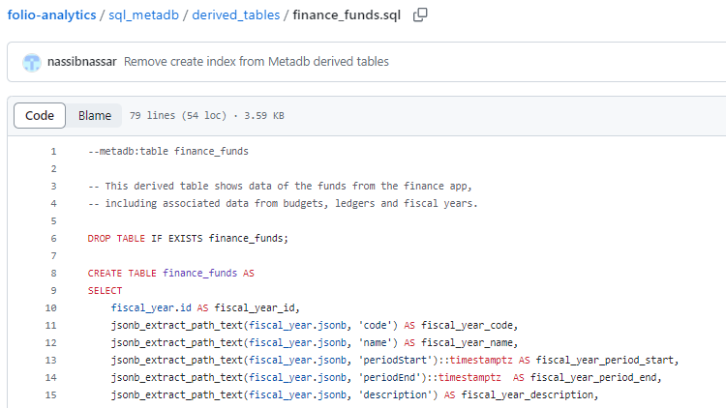
FOLIO Analytics Derived Table Examples
For more examples, or to see how data is extracted from JSON, refer to the FOLIO Analytics derived tables at https://github.com/folio-org/folio-analytics/tree/main/sql_metadb/derived_tables

Slide 48
Metadb documentation: https://metadb.dev/doc/
"Cookbook" documentation on Metadb: https://github.com/folio-org/folio-analytics/wiki/Cookbook:-General
Metadb Resources

Slide 49
Questions?

Slide 50
END

