Slide 1

Respiratory physiology
ECC Board Review
3/22/22

Slide 2
Structure of respiratory system
Airways
  -Conducting zone (air into and out of lungs)
  -Nose, nasopharynx, larynx, trachea, bronchi, bronchioles, terminal bronchioles
  -Warms, humidifies, filters and conducts air
  -Lined with mucous-secreting and ciliated cells that remove particles
  -Contain smooth muscle that has sympathetic and parasympathetic innervation
  -SNS: adrenergic neurons activate B2 receptors on bronchial smooth muscle-> relax airways
  -PNS: cholinergic neuron activate muscarinic receptors-> constrict airways
  -Respiratory zone (lined with alveoli and participate in gas exchange)
  -Respiratory bronchioles, alveolar ducts, alveolar sacs
  -Resp bronchioles are transitional structures: have cilia and smooth muscle, some alveoli off walls
  -Alveolar ducts lined with alveoli, no cilia, little smooth muscle
  -Alveoli: evaginations of walls, rimmed with elastic fibers and lined with epithelial cells (type 1 and 2 pneumocytes)
  -Type 2 pneumocytes synthesize surfactant, can regenerate to type 1
  -Has phagocytic cells called alveolar macrophages
Notes:
Airways subdivided into conducting zone and respiratory zone, fxns differ, structures differ

Slide 3
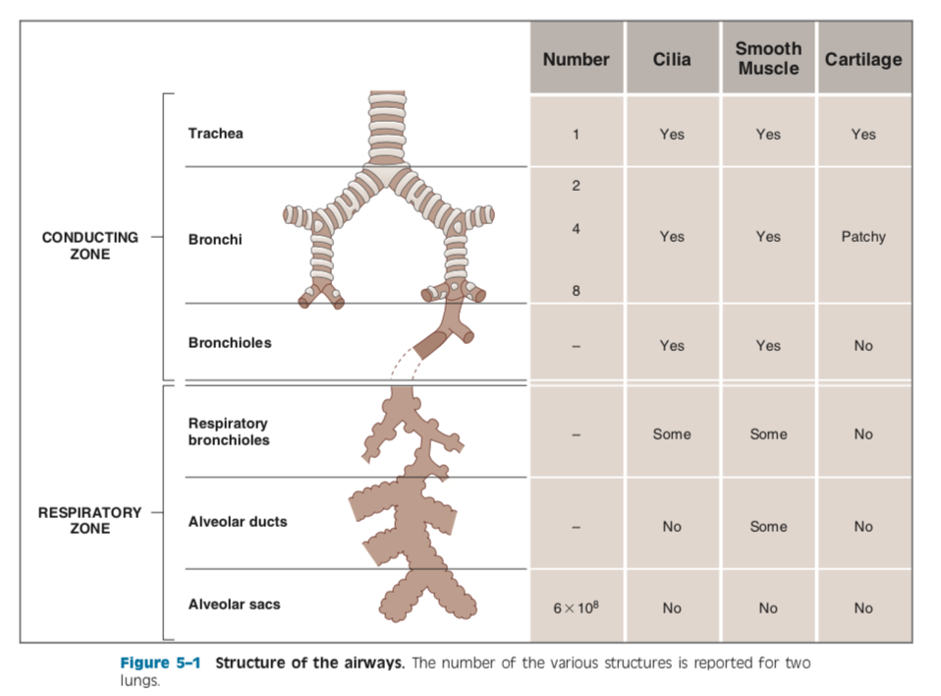

Slide 4
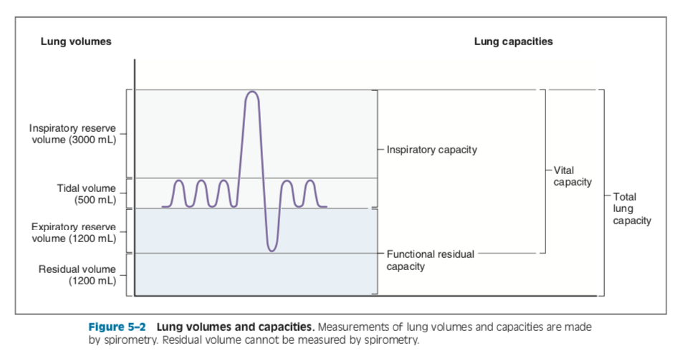
Lung volumes and capacities
Tidal volume: normal quiet breathing
Inspiratory reserve volume: additional volume that can be inspired above tidal volume
Expiratory reserve volume: additional volume that can be expired below tidal volume
Residual volume: volume remaining in lungs after maximal forced expiration
  -can’t be measured on spirometry, typically set by rigidity of chest wall
Inspiratory capacity: TV + inspiratory reserve volume
Functional residual capacity: residual volume + expiratory reserve volume
Vital capacity: inspiratory capacity + expiratory reserve volume
Total lung capacity: all lung volumes (vital capacity + residual volume)
Notes:
Vital capacity: just no functional residual capacity

Slide 5

Question 1

Slide 6
Question 2
If there is increased physiologic dead space, PECO2 will be ____ than PACO2.
A) Equal to
B) Greater than
C) Less than

Slide 7
Question 3
If there is increased physiologic dead space, PECO2 will be ____ than PACO2.
A) Equal to
B) Greater than
C) Less than

Slide 8
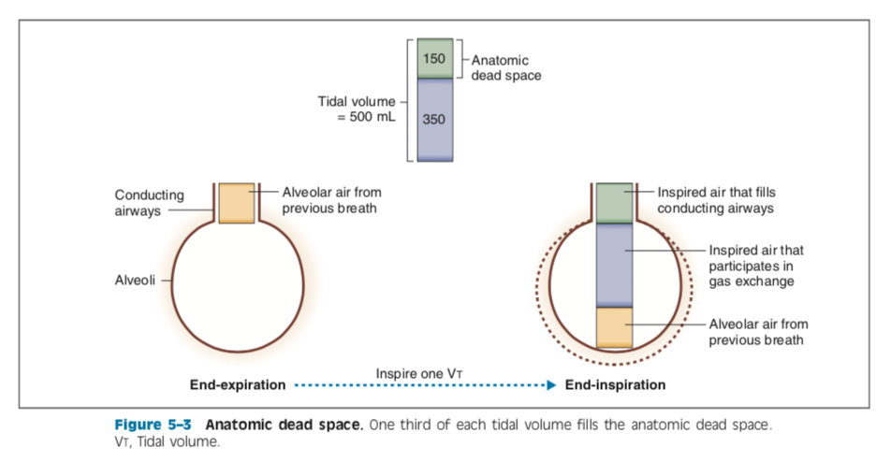
dead space
Dead space: volume of airways and lungs that doesn’t participate in gas exchange
Anatomic dead space:
  -volume of conducting airways (including nose and/or mouth)
  -at end of expiration, conducting airways are filled with alveolar air (what is inspired first in the next TV, won’t undergo further gas exchange)
  -first expired air is dead space air that hasn’t undergone gas exchange, never made it to alveoli
Physiologic dead space:
  -includes anatomic dead space + functional alveolar dead space (ventilated alveoli that doesn’t participate in gas exchange) (ex: PTE)
  -in normal patients, physiologic dead space is nearly equal to anatomic dead space
  -if physiologic dead space 0, then PECO2 will be equal to PACO2
  -if physiologic dead space present, PECO2 will be diluted by dead space air and will be < PACO2 b/c there is essentially no CO2 in inspired air
V_{D}= V_{T} x (PACO2 - PECO2)/PACO2
V_{D}= physiologic dead space (ml)
V_{T}= tidal volume (ml)
PACO2= pco2 of art blood (mmHg)
PECO2= pco2 of mixed expired air (mmHg)
Notes:
Equation states that the volume of physiologic dead space is tidal volume multiplied by a fraction
-fraction represents the dilution of alveolar PCO2 by dead space air (which contributes no CO2)

Slide 9
Ventilation
Can be expressed as minute ventilation or alveolar ventilation (corrects for physiologic dead space)
  -To calculate alveolar ventilation, physiologic dead space needs to be measured
MV= TV x RR
Alveolar ventilation: V_{A} (ml/min)= (V_{T}- V_{D}) x breaths per minute
V_{D}: physiologic dead space (ml)
Alveolar ventilation equation: V_{A} = (Vco2 x K)/ P_{A}co2
V_{A}: alveolar ventilation (ml/min)
Vco2: rate of co2 production (ml/min)
PAco2: alveolar Pco2 (mmHg)
K: constant (863 mgHg)
Rearranged: P_{A}co2= (Vco2 x K)/ V_{A}
-so Pco2 can be predicted if 2 variables are known: 1) rate of CO2 production from aerobic metabolism of tissues and 2) alveolar vent (excretes CO2 in expired air)
  -if CO2 production is constant, PAco2 is determined by alveolar ventilation
Notes:
Alv vent equation describes the inverse relationship b/w alveolar vent and PACO2
Inverse relationship occurs b/c CO2-less air that is inspired creates a driving forces for CO2 diffusion from capillary blood to alveolar gas
-higher the alveolar ventilation, the more CO2 that is pulled from blood and lower the PACO2 and PaCO2

Slide 10
Alveolar gas equation
Used to predict alveolar PO2 from alveolar PCO2
P_{A}O2= P_{I}O2 – P_{A}CO2/R + correction factor
P_{A}O2 : alveolar Po2 (mmHg)
P_{I}O2 : PO2 in inspired air (mmHg)
P_{A}CO2 : alveolar Pco2 (mmHg)
R: resp exchange ratio or resp quotient (CO2 production/O2 consumption) (normal is 0.8)
Correction factor is small and is usually ignored
Alveolar ventilation equation: when alveolar ventilation is halved, PACO2 doubles
  -will also decrease PAO2 b/c less O2 is brought into alveoli
Alveolar gas equation: when alveolar ventilation is halved, P_{A}CO2 is doubled and P_{A}O2 is slightly more than halved
  -b/c normal value for respiratory exchange is 0.8, when alveolar ventilation is halved, the decrease in PAO2 will be slightly greater than increase in PACO2
Notes:
RQ depends on the metabolism of different food sources

Slide 11
Question 3
Is compliance of the lung higher during inspiration or expiration?
Inspiration
Expiration

Slide 12
Question 3
Is compliance of the lung higher during inspiration or expiration?
Inspiration
Expiration

Slide 13
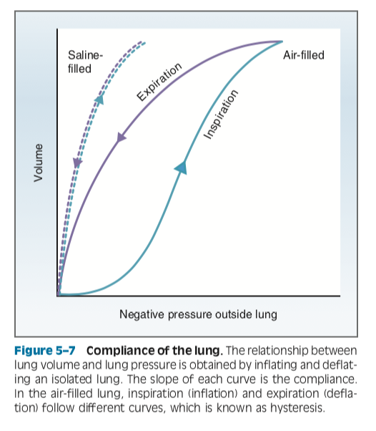
Compliance of lung
Describes the distensibility of system
Change in lung volume for a given change in pressure
Compliance of lungs and chest wall is inversely correlated with their elastic properties (or elastance)
Slope of each limb of P-V loop is compliance of the isolated lung
Slopes of inspiration and expiration are different (phenomenon called hysteresis)
  -for a given outside pressure, volume of the lung is greater during expiration than inspiration (ie compliance higher during expiration)
  -compliance usually measured on expiration limb b/c insp limb is complicated by decrease in compliance at max expanding pressures

Slide 14
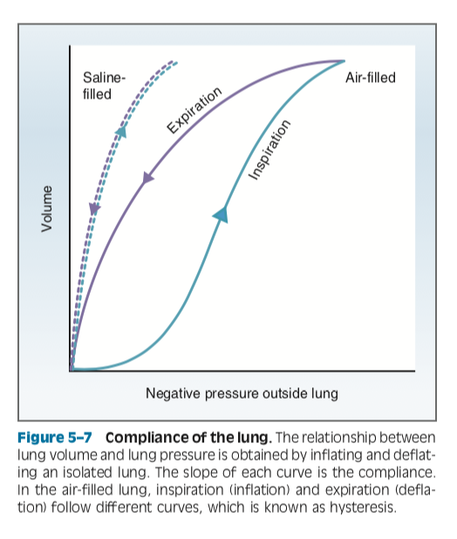
Compliance of lung
Why hysteresis?
  -surface tension at liquid-air interface of air-filled lung
  -liquid lining alveoli creates this interface
  -intermolecular forces b/w liquid is stronger than forces b/w liquid and air molecules
  -insp limb: begins at low lung volume where liquid molecules are closest together
  -lung surface area initially increases faster than surfactant can be added, surface tension high, compliance low (flat curve)
  -exp limb: begins at high lung volume
  -lung surface area decreases faster than surfactant can be removed
Notes:
Role of surface tension is demonstrated by using saline-filled lung (liquid-air interface and thus surface tension, is eliminated)-> same curve for both limbs

Slide 15
Alveoli
Surface tension is created because attractive forces between molecules of liquid is stronger than forces of gas
Molecules of liquid are drawn together to make the smallest surface area (sphere)
Surface tension generates pressure that tends to collapse sphere
Pressure generated by such a sphere is given by the Law of Laplace: P = 2T/r
P: collapsing pressure on alveolus (dynes/cm^2) or pressure required to keep alveolus open
T: surface tension (dynes/cm)
r: radius of alveolus (cm)
Small alveoli are not ideal b/c req more pressure to keep open, but from gas exchange perspective, alveoli need to be as small as possible to increase total surface area: volume
Notes:
pressure tending to collapse an alveolus is directly proportional to the surface tension generated by molecules of liquid lining the alveolus and inversely proportional to alveolar radius

Slide 16
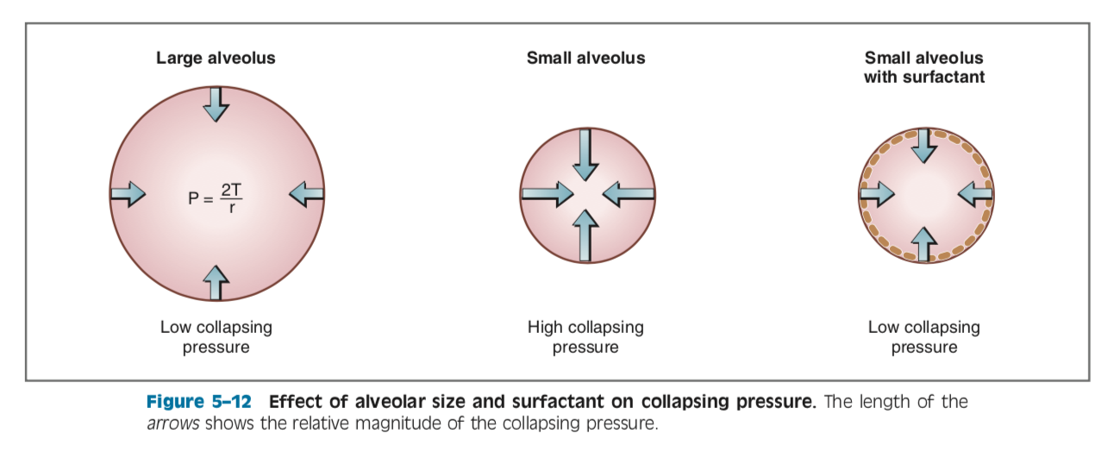
Surfactant
Synthesized by type 2 alveolar cells from fatty acids
Important constituent is DPPC (dipalmitoyl phosphatidylcholine) to reduce surface tension by amphipathic nature of phospholipid molecules
  Hydrophobic on one end, hydrophilic on other
Keeps small alveoli open, increases lung compliance

Slide 17
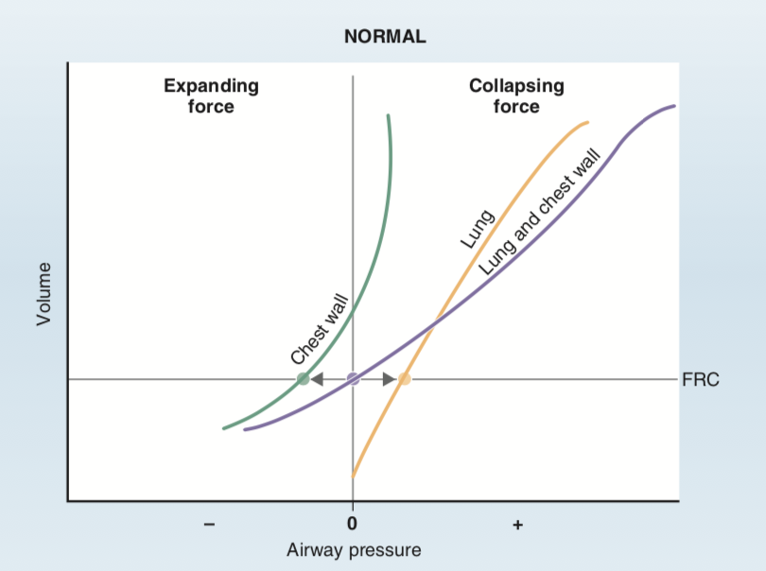
Pressure-volume curves
PV curves can be obtained for lungs, chest wall, and combined system
Slope of curve= compliance
Functional reserve capacity is the volume present in lungs after expiration of a normal tidal breath
  -at FRC, airway pressure is 0, lung-chest wall system is at equilibrium
  -combined curve intersects at airway pressure of 0
When volume is < FRC (subject makes forced expiration)
  -less volume in lungs and collapsing force of lungs is smaller; expanding force of chest wall greater
-combined system “wants” to expand
-airway pressure negative (air flows in)
When volume is > FRC (subject inspires)
-more volume in lungs and collapsing force on lungs is greater,
expanding force on chest wall is smaller
-combined system “wants” to collapse
Notes:
Volume < FRC: collapsing force on lungs is smaller than the expanding force on chest wall
Volume > FRC: collapsing force on lungs is greater than the expanding force on chest wall

Slide 18
airflow, pressure, resistance
Q = Δ pressure /R
Q: air flow (L/min)
Δ pressure: pressure gradient (mmHg or cm H20)
R: airway resistance (cm H20/L/second)
Resistance is determined by Poiseuille’s law (R= 8ηl / πr⁴)
  If radius of airway decreases by factor of 2, resistance doesn’t increase twofold, it increases by 2^4 (or 16-fold)
  Medium-sized bronchi are sites of highest airway resistance
  Would seem like smallest airways would provide most resistance but b/c they are in parallel arrangement, the total resistance is less than the individual resistances
Changes in airway resistance
1. ANS
  PNS cholinergic nerves (muscarinic agonists)-> constrict bronchial smooth muscle-> inc resistance
  SNS adrenergic nerves (B2 receptors)-> relax bronchial smooth muscle-> dec resistance
2. Lung volume: decreased lung volume increases airway resistance
  Interdependence of alveoli: alveoli tend to hold neighbors open by radial traction
3. Viscosity of inspired air
  Not common, but increased gas viscosity increases resistance (deep sea diving)
Notes:
-Q: airflow (Q) is directly proportional to the pressure difference (ΔP) between the mouth or nose and the alveoli and it is inversely proportional to the resistance of the airways (R)
-Changes in airway diameter provide the major mechanism for altering resistance and airflow-> ANS, lung volume, viscosity

Slide 19
Breathing cycle
Rest
  -b/w breathing cycles when diaphragm is at equilibrium (alveolar pressure = atmospheric pressure)
Inspiration
    -diaphragm contracts, thoracic volume increases (volume increase, pressure decrease, gradient drives air flow)
    -uses external intercostal muscles
    -intrapleural pressure becomes more negative b/c as lung volume increases, elastic recoil of lungs increases and pulls more forcefully against intrapleural space, + airway and alveolar pressures become negative
Expiration
  -normally passive process (abdominal muscles and internal intercostal muscles may be used)
  -alveolar pressure becomes positive b/c elastic forces of lungs compress greater volume of air in alveoli
  -when alveolar pressure > atmospheric pressure, air flows out
Forced expiration
    -expiratory muscles make lung and airway pressure more positive
    -lungs and airways stay open b/c transmural pressure is still positive
    -expiration will be rapid and forceful b/c pressure gradient is much greater than normal
Transmural pressure= alveolar pressure– intrapleural pressure
    -for all phases of normal breathing cycle, despite changes in alveolar and intrapleural pressures, transmural pressures across lungs are such that the lungs always remain open

Slide 20
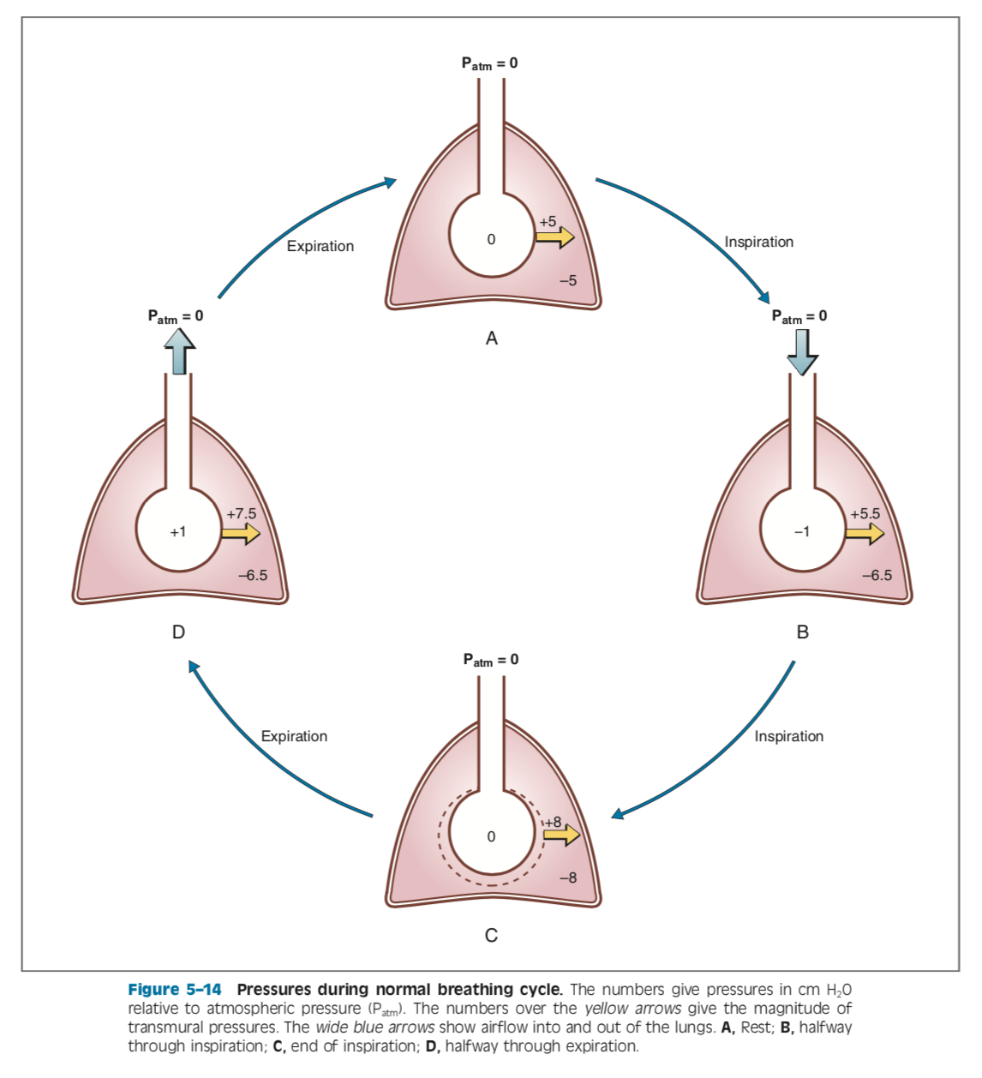
Notes:
-Note that for all phases of the normal breathing cycle, despite changes in alveolar and intrapleural pressures, transmural pressures across the lungs are such that they always remain open.

Slide 21
GAS laws
O2 is transferred from alveolar gas -> pulm capillary blood -> tissues
CO2 is delivered from tissues to venous blood-> pulm capillary blood-> alveolar gas
Boyle’s law (P₁V₁= P₂V₂), special case of general gas law (PV=nRT)
    -At a given temp, product of pressure x volume for a gas is constant
Dalton’s law of partial pressures (P_{x}= P_{B} x F)
-Partial pressure of a gas in mixture is the total pressure x fractional concentration of dry gas
-Relationship for humidified gas: P_{x} = (P_{B} − P_{H2O}) × F
-Ex: barometric pressure is the sum of partial pressures of O₂ (21%), CO₂ (0%), N₂ (79%), H20
P_{x}: partial pressure of gas (mmHg)
P_{B}: barometric pressure (mmHg)
P_{H20}: water vapor pressure at 37C (47 mmHg)
F: fractional concentration of gas (no units)
Notes:
Boyle’s law:
Ex: lung volume increases, pressures in lungs must decrease (driving force for airflow)

Slide 22
GAS laws
Henry’s law (C_{x}= P_{x} x solubility)
    -Used to convert partial pressure to concentration of gas in liquid phase
    -At equilibrium, partial pressure of a gas in liquid phase = the partial pressure in gas phase
-Ex: PAO2 100mmHg, PaO2 will also be 100mmHg
    Cx: concentration of dissolved gas (ml gas/100ml blood)
Px: partial pressure of gas (mmHg)
Solubility: solubility of gas in blood (ml gas/100ml blood per mmHg)
Fick’s law (Vx= (DA x ΔP)/ (Δx)
  -Transfer of gases across cell membranes occurs by simple diffusion
  -For a gas, transfer is proportional to driving force, a diffusion coefficient, and SA available for diffusion; inversely proportional to thickness of membrane barrier
Vx: volume of gas transferred per unit time
D: diffusion coefficient of the gas
A: surface area
ΔP: partial pressure difference of the gas
Δx: thickness of the membrane
Notes:
Henry’s law:
-deals with gases dissolved in solution

Slide 23
question 4
Diffusion of a gas across a membrane by diffusion depends on which factors according to Fick’s law? (Pick all that apply)
A) Partial pressure difference of the gas
B) Thickness of membrane
C) Surface area
D) Concentration difference of the gas
E) Membrane charge
F) Solubility of gas
G) Molecular weight of gas
Notes:
Henry’s law:
-deals with gases dissolved in solution

Slide 24
question 4
Diffusion of a gas across a membrane by diffusion depends on which factors according to Fick’s law? (Pick all that apply)
A) Partial pressure difference of the gas
B) Thickness of membrane
C) Surface area
D) Concentration difference of the gas
E) Membrane charge
F) Solubility of gas
G) Molecular weight of gas
Notes:
Henry’s law:
-deals with gases dissolved in solution

Slide 25
Gas laws
2 points about diffusion of gases
  -1. Driving force is partial pressure difference, not concentration difference
  -2. Diffusion coefficient depends on molecular weight and solubility of gas
      -diffusion coefficient for CO2 is about 20x higher than O2
Lung diffusing capacity (D_{L}): combines diffusion coefficient of gas, SA of membrane (A), thickness of membrane (Δx), and time required for gas to combine with proteins in pulmonary capillary blood (hemoglobin)
  -decreases in fibrosis or pulmonary edema d/t increased diffusion distance
  -decreases in anemia b/c amount of hemoglobin reduced
  -increases in exercise b/c more capillaries are perfused (increased SA)
Notes:
Fick’s law: for gases, rate of transfer is directly proportional to driving force, a diffusion coefficient, and surface area available; it is inversely proportional to thickness of membrane barrier
DL diffusion distance: memb thickness or interstitial volume increases

Slide 26
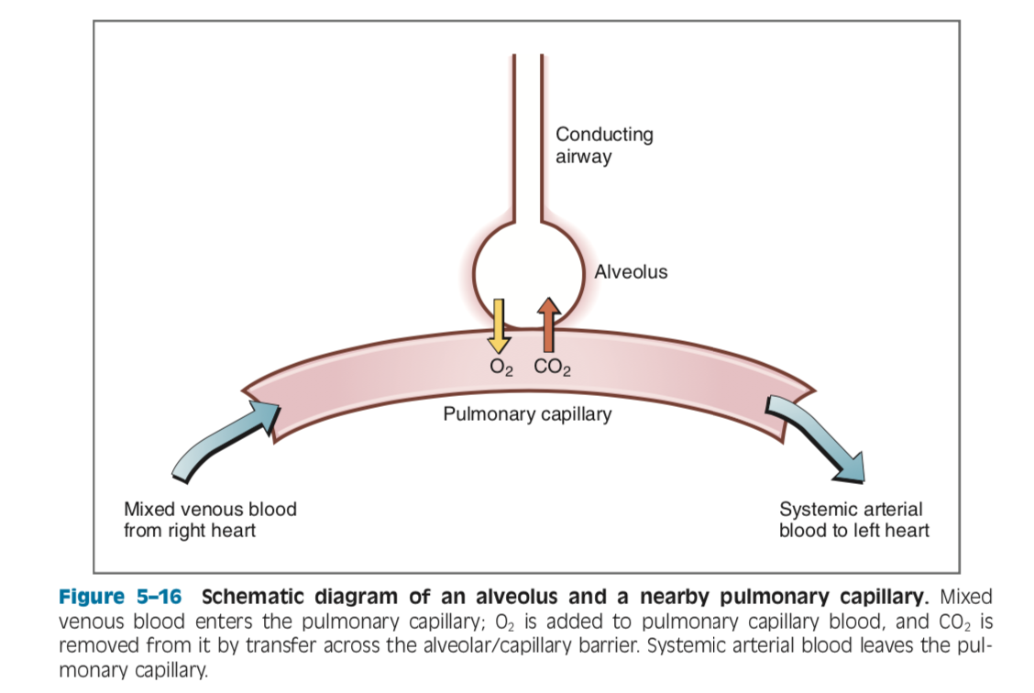
Forms of Gas in solutions
  In solution, gas may be dissolved, bound to proteins, or chemically modified
  Dissolved gas: for a given partial pressure, the higher the solubility of gas, the higher the concentration of gas in solution
    Only dissolved gas contributes to partial pressure
  Bound gas: O2, CO2, and CO are bound to proteins in blood
  Chemically modified gas: Most CO2 in blood is carried as bicarb

Slide 27
Question 5
In normal settings, what determines net O2 transfer from the alveolus to the pulmonary capillary?
A) Ventilatory rate
B) Pulmonary blood flow
C) Fraction of inspired O2
D) Partial pressure of O2

Slide 28
Question 5
In normal settings, what determines net O2 transfer from the alveolus to the pulmonary capillary?
A) Ventilatory rate
B) Pulmonary blood flow
C) Fraction of inspired O2
D) Partial pressure of O2

Slide 29
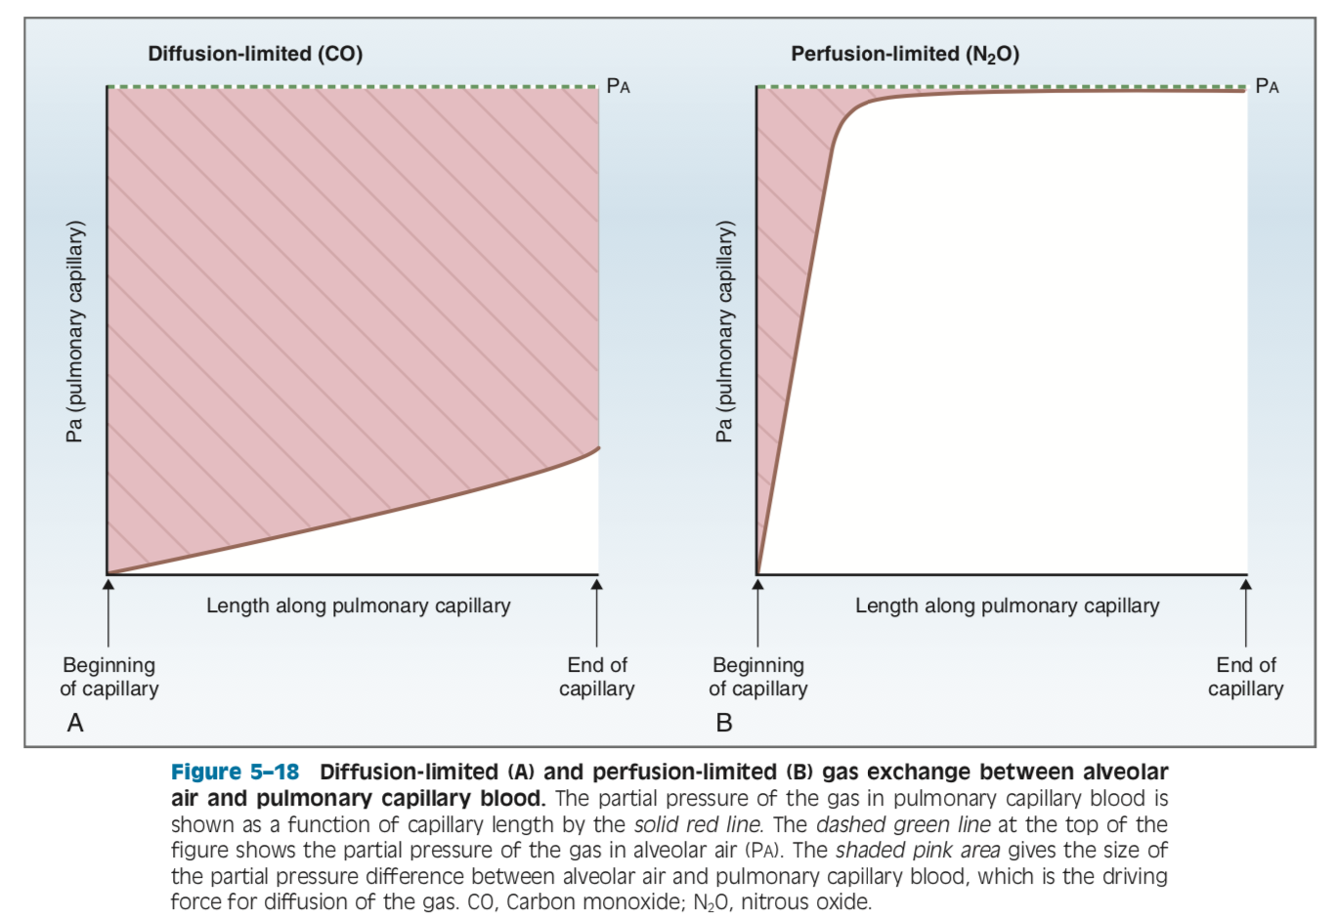
Gas exchange
-diffusion-limited: total amount of gas transported is limited by diffusion process
-as long as partial pressure gradient for gas is maintained, diffusion will continue along capillary
-illustrated by CO, or O2 during strenuous exercise
-perfusion-limited: total amount of gas transported across is limited by blood flow through pulm capillaries
-partial pressure is not maintained
-the only way to inc amount of gas transported is by increasing blood flow
    -illustrated by O2, N2O, and CO2
Notes:
-> Diffusion-limited gas exchange
-partial pressure of CO in alveolar air is constant along capillary
-at beginning of capillary, there is no CO in blood (so there is a large partial pressure gradient and largest driving force)
-Paco begins to rise further down capillary and partial pressure gradient for diffusion decreases
-Paco rises only slightly along capillary however, b/c in capillary blood, CO is bound avidly to hemoglobin (not free in solution producing a partial pressure)
-so since partial pressure is kept low, there maintains a gradient for diffusion along the entire length of capillary
-> Perfusion-limited gas exchange
­ -PAo2 is constant at 100mmHg
-at beginning of cap, Pao2 is 40 mmHg (mixed venous blood)
-large partial pressure gradient that drives diffusion into capillary
-gradient for diffusion is maintained initially b/c O2 binds to hemoglobin (which keeps the free O2 concentration low)
-equilibration of O2 occurs about 1/3 of distance along capillary, and unless blood flow increases, there can be no more net diffusion of O2

Slide 30
Oxygen transport in blood
-Forms of O2 in blood: dissolved (2%) and bound to hemoglobin (98%)
-The percent of heme groups bound to O2 is called percent saturation or oxygen binding capacity
-100% = all 4 heme groups are bound
-When deoxygenated, called deoxyhemoglobin
-For subunits to bind O2, iron in heme moieties must be in ferrous state (Fe2+)
-methemoglobin: if iron is in ferric (Fe3+) state, doesn’t bind O2
-O2 content is the amount of O2 per volume of blood
-O2 content= (O2 binding capacity x % saturation) + dissolved O2
-O2 content: amount of O2 in blood (ml O2/100ml blood)
-O2 binding capacity: max amount of O2 bound to hemoglobin (ml O2/100ml blood) measured at 100% saturation
-this decreases with anemia
-percent saturation: % heme groups bound to O2
-dissolved O2: unbound O2 in blood (ml O2/100ml blood)
-O2 delivery to tissues
-O2 delivery= CO x O2 content
-O2 delivery= CO x (dissolved O2 + O2-hemoglobin)

Slide 31
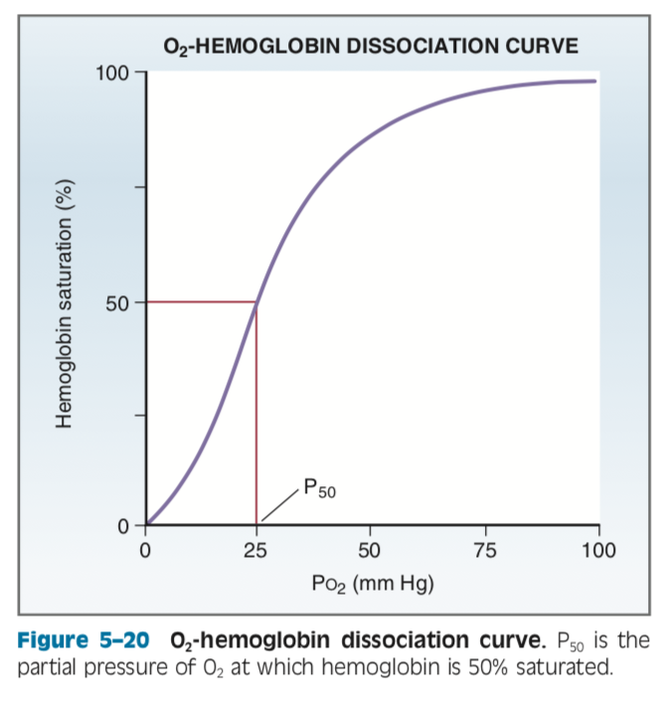
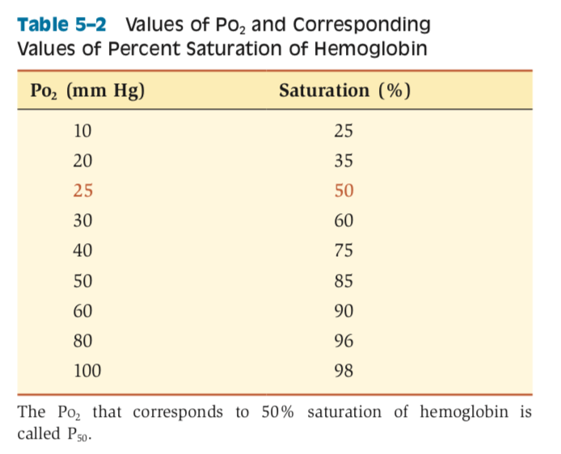
Oxygen-hemoglobin dissociation curve
-Sigmoidal shape= percent saturation of heme sites doesn’t increase linearly as PO2 increases
-steep increase from PO2 0-40 mmHg, levels off b/w 50-100 mmHg
-shape of the steepest portion is a result of change in affinity of heme groups as each successive O2 binds
-binding of first O2 molecule increases affinity for second (called positive cooperativity)
-P50
-the PO2 at which hemoglobin is 50% saturated
-a change in P₅₀ is an indicator for a change in affinity of hemoglobin for O2 (decrease in P50=increase in affinity)

Slide 32
Question 6
A PO2 of 80 mmHg approximates a saturation percentage of what?
A) 80
B) 90
C) 96
D) 98

Slide 33
Question 6
A PO2 of 80 mmHg approximates a saturation percentage of what?
A) 80
B) 90
C) 96
D) 98
Notes:
Quick note:
Pulse ox measure % saturation of arterial blood using 2 diff absorbance characteristics b/w oxy and deoxyhemoglobin

Slide 34
Oxygen-hemoglobin dissociation curve
-Loading and unloading O2
-at highest values of PO2 (arterial blood), affinity of hemoglobin for O2 is highest
-in lungs, PaO2 is 100mmHg, nearly 100% saturated, affinity is highest and O2 is most tightly bound (flat portion of curve)
-high affinity makes sense b/c want to have as much O2 loaded in arterial blood
-relatively less O2 in dissolved form to produce a partial pressure b/c bound to hemoglobin
-keeping PaO2 lower than PAO2 encourages O2 diffusion
-flat portion is from 60-100mmHg (can tolerate decreases in alveolar PO2 to 60mmHg without significantly compromising O2 carried by hemoglobin
-in tissues, PvO2 is approx 40 mmHg, about 75% saturation, and affinity for O2 is decreased
-O2 is not as tightly bound, which facilitates unloading of O2 in tissues
-partial pressure gradient in tissues is maintained in 2 ways:
-tissues consume O2, keeping PO2 low
-lower affinity for O2 ensures O2 will be unloaded more readily from hemoglobin, O2 free in blood creates a partial pressure

Slide 35
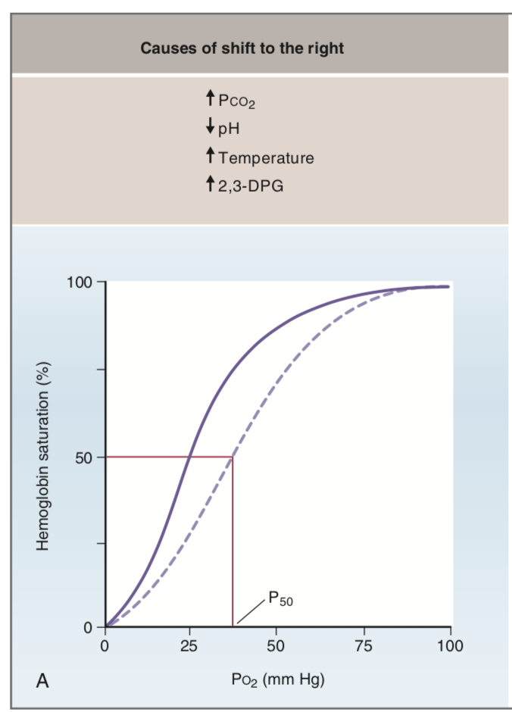
Changes in Oxygen-hemoglobin dissociation curve
-Shifts to R
-occurs when there is a decreased affinity of hemoglobin for O2 (inc in P₅₀, which means that 50% saturation is achieved at higher than normal value of PO2)
-situations when it is advantageous to facilitate offloading of O2 in tissues
-increases in PCO2
-increases in H+ (acidosis)
-decreases in pH
-increases in temp
-increases in 2,3 DPG (a byproduct of glycolysis in RBCs)
Notes:
R shift
-increases in Pco2 and decreases in pH
-metabolic activity of tissues are increased-> inc production of CO2
-inc in tissue PCO2-> inc H+ conc and dec pH
-mechanism helps ensure O2 delivery can meet O2 demand
-effect of PCO2 and pH on dissociation curve is called bohr effect
-increases in temp
-heat produced by working muscle
-curve shifts to provide more O2 to tissue
-increases in 2,3 DPG
-binds to beta chains of deoxyhemoglobin and reduces their affinity for O2
-2,3 DPG production increases under hypoxic conditions (high altitude)-> facilitates delivery of O2 as an adaptive mech

Slide 36
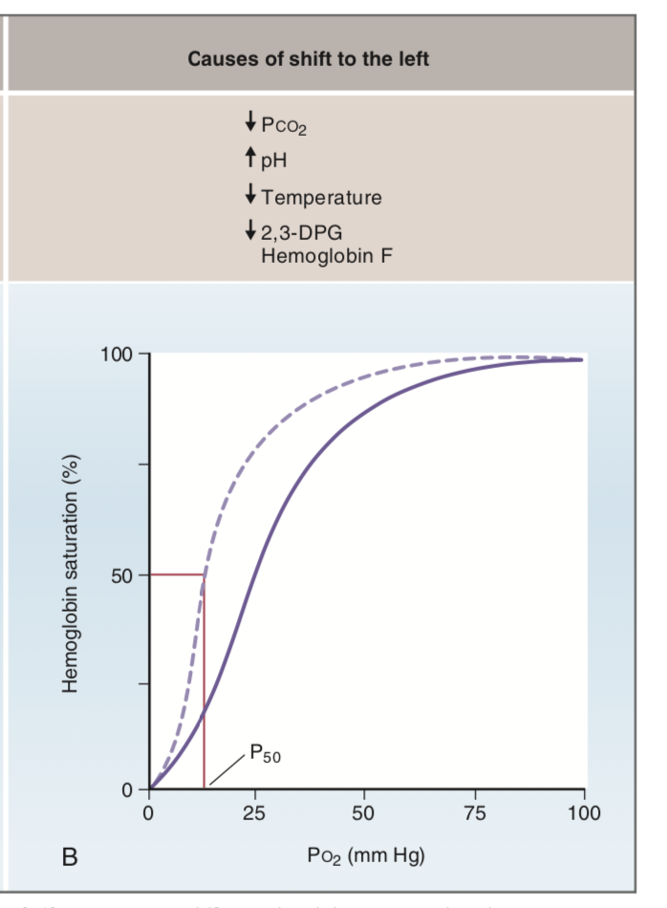
Changes in Oxygen-hemoglobin dissociation curve
-Shifts to L
-inc affinity for O2 (dec in P₅₀, which means 50% saturation occurs at lower Po2)
-unloading of O2 to tissues is more difficult
-dec PCO2 and inc pH
-dec in temperature
-dec in 2,3 DPG
Notes:
Shifts to L
-dec Pco2 and inc pH
-bohr effect again
-dec tissue metabolism, dec production of CO2, dec H+, inc pH
-dec O2 demand, O2 is more tightly bound to hemoglobin
-dec in temp
-dec tissue metabolism, less heat produced
-dec in 2,3 DPG
-also reflects dec tissue metabolism

Slide 37
Question 7
What is the main form of CO2 in the blood?
A) Dissolved
B) Bound to hemoglobin
C) Chemically modified
Notes:
Shifts to L
-dec Pco2 and inc pH
-bohr effect again
-dec tissue metabolism, dec production of CO2, dec H+, inc pH
-dec O2 demand, O2 is more tightly bound to hemoglobin
-dec in temp
-dec tissue metabolism, less heat produced
-dec in 2,3 DPG
-also reflects dec tissue metabolism

Slide 38
Question 7
What is the main form of CO2 in the blood?
A) Dissolved
B) Bound to hemoglobin
C) Chemically modified
Notes:
Shifts to L
-dec Pco2 and inc pH
-bohr effect again
-dec tissue metabolism, dec production of CO2, dec H+, inc pH
-dec O2 demand, O2 is more tightly bound to hemoglobin
-dec in temp
-dec tissue metabolism, less heat produced
-dec in 2,3 DPG
-also reflects dec tissue metabolism

Slide 39
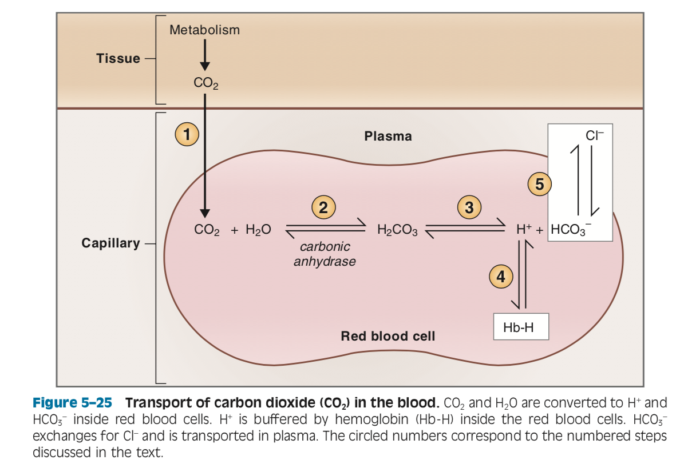
Carbon dioxide transport in blood
Forms of CO2 in blood
  -dissolved CO2 (5%), carbaminogloblin (bound to hemoglobin) (3%), and bicarb (HCO3-) (chemically modified) (>90%)
Carbaminoglobin
  -bohr effect: CO2 binding to hemoglobin reduces affinity for O2 and causes R shift of curve
  -haldane effect: O2 binding to hemoglobin reduces affinity for CO2
  -mutual effects make sense b/c in tissues as CO2 is produced and binds, hemoglobin affinity for O2 is decreased and releases O2 in tissues more readily
Bicarbonate
  -CO2 + H20 <-> H2CO3 <-> H+ + HCO3-
  -high concentration of carbonic anhydrase in RBCs; reaction is driven to R by mass action as CO2 diffuses to RBC from aerobic tissue metabolism
  -H+ stays in RBC, buffered by deoxyhemoglobin; HCO3- transported to plasma in exchange for Cl- (to maintain charge balance via band 3 protein)
  -reaction happens in reverse in the lungs
Notes:
Carbaminoglobin: CO2 binds to terminal amino groups to proteins; when bound to hemoglobin, called carbaminoglobin (at a different site than O2 binds to hemoglobin)
Bicarb:
-tissues produce CO2 from aerobic metabolism, diffuses across membranes into RBCs
-H2CO3 dissociates into H and HCO3

Slide 40
Pulmonary blood flow
Regulated primarily by altering resistance of arterioles
Hypoxic vasoconstriction: decreases in PAO2 causes vasoconstriction
  -adaptive mech; reduces pulm blood flow to poorly ventilated areas where blood flow would be “wasted”
  -fails if pulmonary disease is widespread (will cause inc pulm arterial pressure)
  -if PAO2 reduced to values b/w 70-100mmHg, vascular tone is minimally affected
  -but if PAO2 < 70 mmHg, will get vasoconstriction
Other vasoactive substances (TXA2, prostacyclin I2, leukotrienes)
  -TXA2-> local vasoconstrictor
  -Prostacyclin I2-> local vasodilator
  -Leukotrienes-> airway constriction
Lung volume
  -increase lung volume-> crushes alveolar vessels (capillaries) but pulls open extra-alveolar vessels (arteries/veins)
  -at low lung volumes, effect on extra-alveolar vessels dominate
  -as lung volume inc, extra-alveolar vessels are pulled open (as intrapleural pressure becomes more negative)
  -at high lung volumes, effect on alveolar vessels dominates
  -even higher volume, alveolar vessels are crushed by inflated alveoli
Notes:
Hypoxic vasoconstriction: initially seems counterintuitive but is an adaptive mechanism
-mech not fully understood: believed that hypoxia causes depolarization of vascular smooth muscle cells, ca entry and contraction
-NO synth in the endoth cells can offset hypoxic vasoconstriction
Lung volume:
Total pulm vascular resistance is the sum of alveolar and extra-alveolar resistances, so the effect depends on which effect is larger

Slide 41
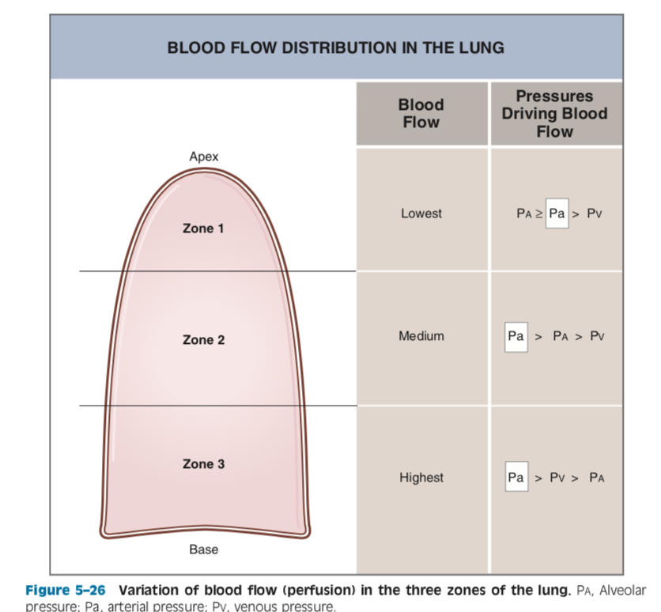
Distribution of pulmonary blood flow
Gravity-dependent: blood flow lowest at apex of lung (pulm arterial hydrostatic pressure less at apex)
Zone 1: arterial pressure may be lower than alveolar pressure
  -if Pa<PA, pulm capillaries will be compressed-> reduce local blood flow
  -usually, art pressure will be just high enough to prevent this, but low flow
  -if art pressure dec or alv pressure inc (PPV), PA>Pa and vessels will close
Zone 2: Pa is higher in zone 2 and higher PA
  -compression of capillaries not an issue but blood flow driven by arterial and
  alveolar pressure
Zone 3: increased art and venous pressure, both now higher than
alveolar pressure
-blood flow driven by difference b/w art pressure and venous pressure
-blood flow highest, greatest number of capillaries open
Notes:
Zone 1:
Scenario question if art pressure dec or alv pressure inc: will be ventilated but not perfused-> become part of physiologic dead space
More evident in a person who stands upright

Slide 42
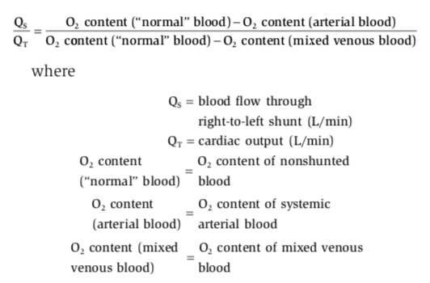
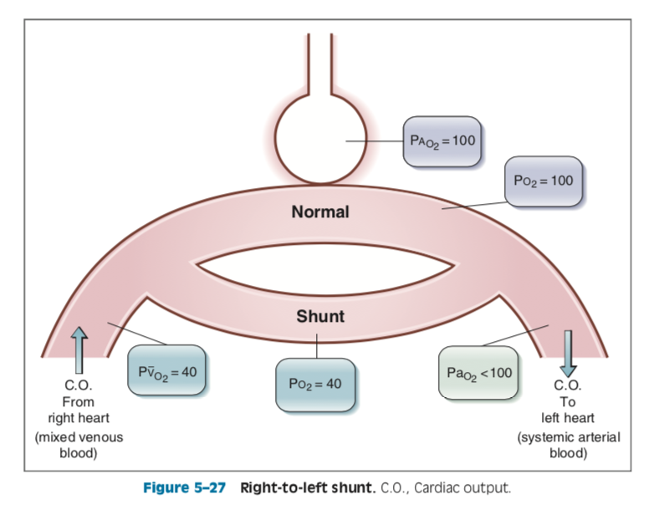
shunts
Physiologic shunt: about 2% of CO normally bypasses alveoli
  -bronchial and coronary blood flow
L to R shunts (more common)
  -do not cause hypoxemia; PO2 in blood will be elevated
R to L shunts
  -hypoxemia always occurs
  -usually doesn’t cause appreciable increase in PaCO2 b/c central chemoreceptors are sensitive and will inc RR
  -blood flow through a R to L shunt can be calculated with shunt fraction equation
Notes:
L to R: PDA, traumatic injury
-pulm blood flow is higher, oxygenated blood added to R heart without going systemic

Slide 43
Question 8
Can hypoxemia caused by R to L shunts be corrected with supplemental oxygen?
Yes
No

Slide 44
Question 8
Can hypoxemia caused by R to L shunts be corrected with supplemental oxygen?
Yes
No
Can’t be corrected by supplemental oxygen no matter how high the PAO2 b/c the shunted blood never goes to lungs to be oxygenated

Slide 45
V/Q ratios
Normal V/Q
  -normal 0.8 (alveolar vent is 80% of the value for pulmonary blood flow) (avg for the entire lung)
Distribution in the lung
  -V/Q is uneven in the 3 zones, variations have consequences for Pao2 and Paco2 in blood leaving those zones
  -zone 1 lowest perfusion and ventilation, zone 3 highest
V/Q defect results in abnormal gas exchange
  -dead space (V/Q = infinity): ventilation of lung regions that aren’t perfused
  -no gas exchange possible b/c no blood to receive
  -ex: pulm embolism
  -alveolar gas has same composition as inspired air: PAO2 150 PAco2 0
  -high v/q: high vent relative to perfusion, usually b/c blood flow is decreased
-pulm capillary blood has high PO2 and low PCO2
  -low v/q:
-low ventilation relative to perfusion
-pulm capillary blood has low PO2 and high PCO2
  -right to left shunt (v/q = 0): perfusion of lung regions that are not ventilated
-gas exchange not possible
-ex: airway obstruction, R to L cardiac shunts
-pulm capillary blood has same composition as mixed venous blood: Pao2 40, paco2 46
Notes:
Distribution in lung:
-Regional variations in ventilation are not as great as regional variations in perfusion, so V/Q highest in zone 1, lowest in zone 3

Slide 46
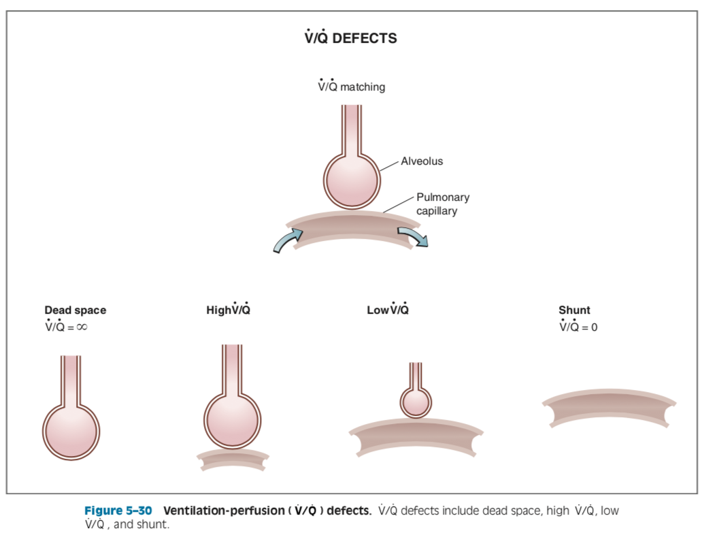
PaO2=
PaCO2=
Notes:
Dead space: PAO2= PIO2, PACO2 = PICO2
High V/Q: high PaO2, low PaCO2
Low V/Q: low PaO2, high PaCO2
R to L shunt: Pao2= PvO2, PaCO2=PvCO2

Slide 47
Control of breathing
4 components: 1) chemoreceptors for O2, CO2, and H+; 2) mechanoreceptors in lungs and joints; 3) control centers for breathing in brainstem (medulla and pons), 4) resp muscles
Voluntary control from cerebral cortex can temporarily override brainstem
Brainstem control: 3 brainstem centers
  -medullary respiratory center (reticular formation)
  -has 2 groups of neurons: inspiratory and expiratory center
  -insp center controls basic rhythm for breathing by setting freq of insp; receives input from peripheral chemoreceptors and lung mechanoreceptors
  -exp center normally inactive but activated during exercise
  -apneustic center (lower pons)
  -stimulation causes abnormal breathing pattern w/ prolonged inspiratory gasps, followed by brief expiratory movement
  -pneumotaxic center (upper pons)
  -this center turns off inspiration (limits size of tidal volume and resp rate)

Slide 48
Control of breathing
Chemoreceptors
  -most important sensory info: PaO2, PaCO2, arterial pH
  -central chemoreceptors (medulla)
  -very sensitive to changes in pH of CSF
  -most important for minute-to-minute control of breathing
  -inc in pH -> dec in RR (hypoventilation)
  -CO2 is permeable, enters CSF-> in CSF, CO2 converted to H+ and HCO3- -> dec pH-> signals insp center to inc RR
  -> goal of central chemoreceptors is to keep arterial PCO2 within normal range
  -peripheral chemoreceptors
  -peripheral chemoreceptors for O2, CO2, and H+ in carotid bodies located at bifurcation of common carotid arteries and in aortic bodies above and below aortic arch
  -info is relayed to DRG via CN 9, 10 -> change in breathing rate
  -dec in arterial PO2
  -relatively insensitive to changes in PO2 (but respond dramatically when PO2 < 60, so if b/w 60-100 RR is constant)
  -inc in arterial PCO2 (effect less important than PO2 detection)
-also less important than detection of PO2 changes by central chemoreceptors
  -dec in arterial pH
-this effect is independent of changes in arterial PCO2, so in metabolic acidosis, peripheral chemoreceptors will directly inc vent rate
Notes:
Other receptors
-lung stretch receptors, joint and muscle receptors, irritant receptors, and juxtacapillary receptors

Slide 49
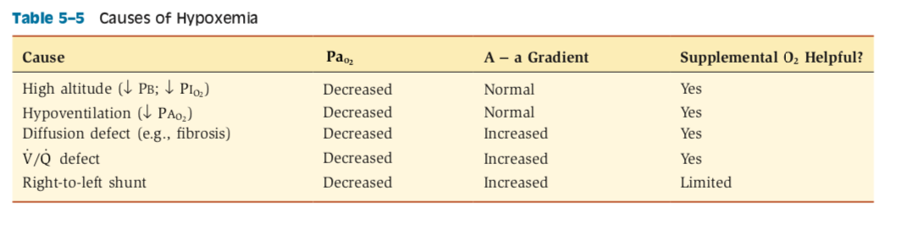
Hypoxemia and hypoxia
Hypoxemia: dec in PaO2
Hypoxia: dec O2 delivery to, or utilization by, tissues
  -hypoxemia is one cause of tissue hypoxia, but not the only cause

Slide 50
Hypoxemia
1. low PIO2 ( PI02= FIO2 x Pb):
-A-a gradient normal
    -supplemental O2 raises arterial PO2 by raising inspired and alveolar PO2
2. hypoventilation:
-causes hypoxemia by decreasing alveolar PO2 (less fresh inspired air is brought to alveoli)
-equilibration of O2 is normal, A-a gradient is normal
-supplemental O2 raises arterial PO2 by raising alveolar PO2
3: diffusion defects (eg pulmonary edema):
-causes hypoxemia by inc diffusion distance or dec SA for diffusion
-equilibration of O2 is impaired, A-a gradient is increased
-supplemental O2 raises arterial PO2 by raising alveolar PO2 and increasing driving force for O2 diffusion
4: v/q defects:
-always cause hypoxemia and increased A-a gradient
-usually involve multiple abnormalities: regions of dead space, high vq, low vq, and shunt
-high v/q regions have high PaO2, low v/q regions have low PaO2
-high v/q regions can’t compensate b/c blood flow to those regions are low and contributes little to total blood flow
-low v/q regions have the highest overall effect on PO2 of blood leaving lungs
-supplemental oxygen can be helpful mainly b/c raises the PO2 of low v/q regions where blood flow is highest
5: R to L shunts (cardiac shunts, intrapulm shunts):
-always cause hypoxemia and inc A-a gradient
-supplemental oxygen has limited effect in raising Pao2 b/c can only raise PO2 of normal non-shunted blood (shunted blood continues to have dilutional effect)
-ability of supplemental O2 to raise Pao2 will depend on size of shunt
-another feature in tx is that supplemental O2 will never correct the A-a gradient (in fact, A-a gradient increases b/c PAo2 increases faster than PaO2)

Slide 51
Question 10
What are the 4 causes of hypoxia?

Slide 52
Hypoxia
O2 delivery is CO x O2 content of blood
  -CaO2 (ml O2/dl blood)= (1.36 x [Hb] x SaO2) + (PaO2 x 0.0031)
  -O2 content mainly determined by amount of O2-hemoglobin
Causes of hypoxia
  -dec in CO (blood flow)
  -hypoxemia is a major cause d/t decreased Pao2 reducing percent saturation of hemoglobin
  -anemia
  -cytotoxic: carbon monoxide (CO occupies binding sites on hemoglobin)
Notes:
-1.34 (dog) also ok for huffner factor= ml maximum oxygen that can be carried in a gram of hemoglobin
-sao2 is a decimal
-0.0031 is the solubility of oxygen in blood

