Slide 1
Pulmonary Thromboembolism
Board Review
12/21/2021
Bathilda Lake, DVM
Notes:
Hi everyone! Today, I am going to be talking about pulmonary thromboembolisms.

Slide 2

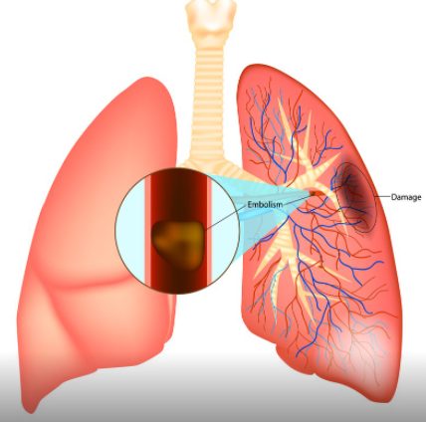
What is a PTE?
Obstruction of the pulmonary vascular bed by a blood clot
From the right side or venous circulation versus in situ
Notes:
So what is a pulmonary thromboembolism or PTE? It is an obstruction of the pulmonary vascular bed by a blood clot. There are other types of obstructions that can occur secondary to fat, septic emboli, metastatic neoplasia, and parasites, however, for right now we are going to be concentrating thromboembolism. Typically, PTEs are secondary to thrombus material traveling from the venous circulation or right side of the heart that goes into the pulmonary vasculature causing an obstruction of blood flow. In certain cases, pulmonary thrombosis can also occur in situ. Causes of in situ thrombosis are pulmonary hypertension, heartworm disease, or other disorders of the pulmonary vasculature.

Slide 3
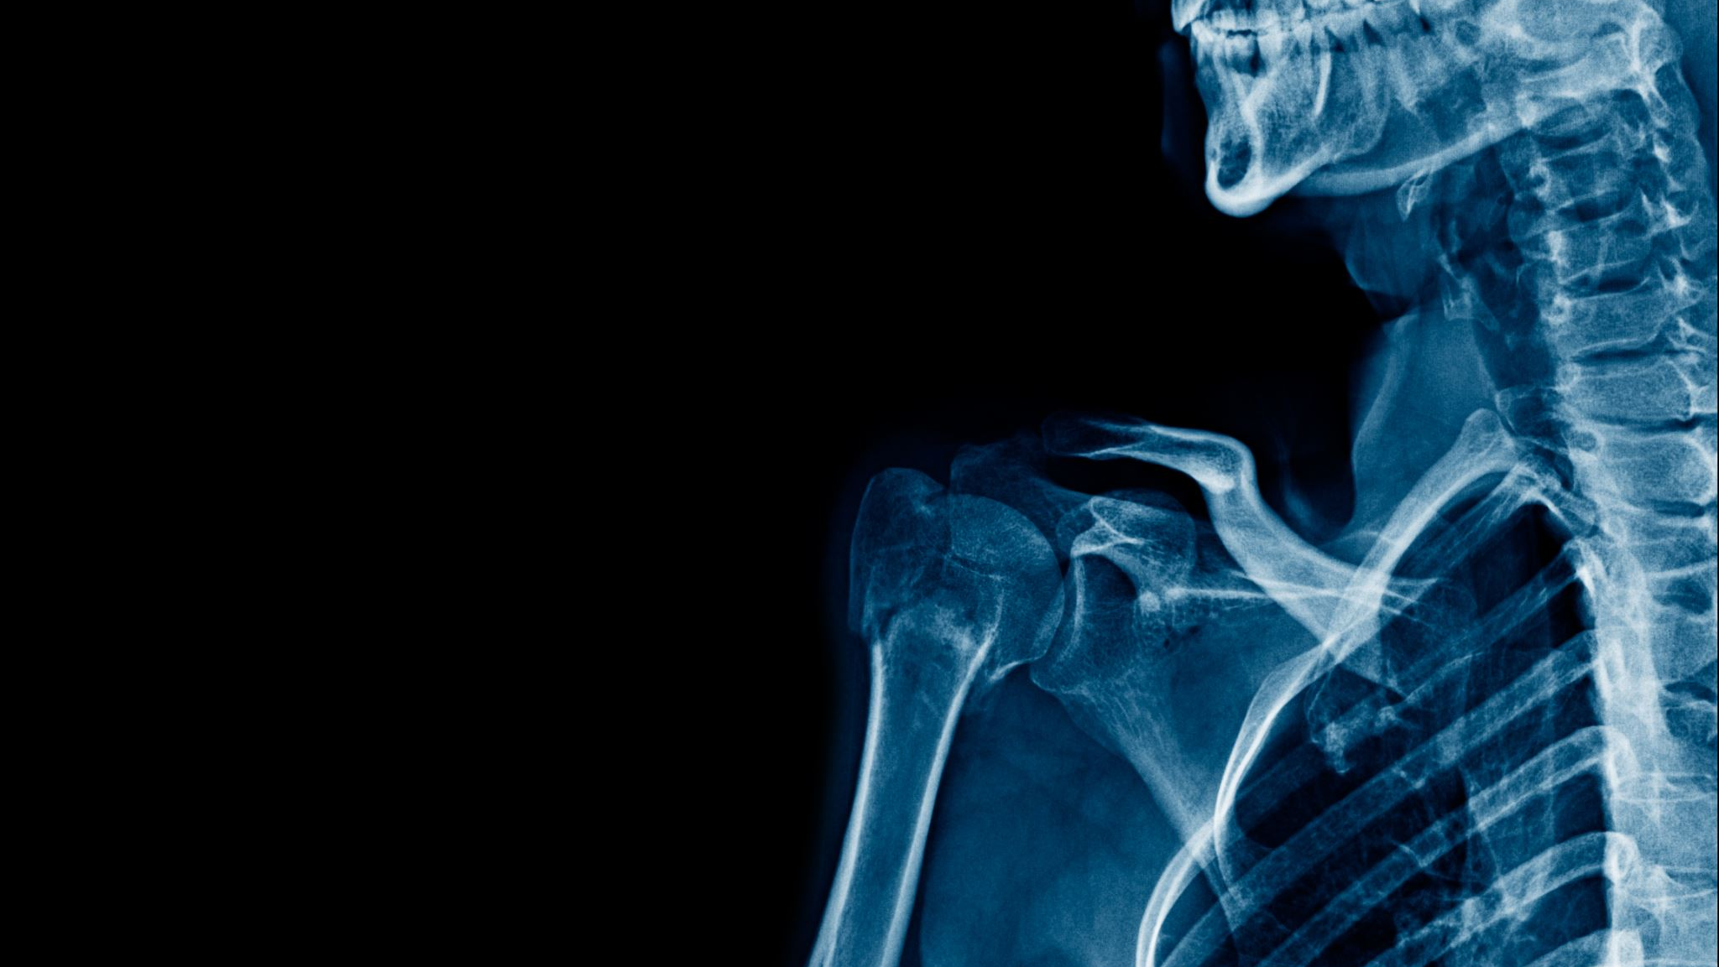
Pathophysiology
Obstruction→ vasoactive mediators → vasoconstriction → ↑ pulmonary vascular resistance → ↑ pulmonary arterial pressure → ↑ right ventricular pressure → ↓ stroke volume → ↓ cardiac output → hypotension
↓ blood flow to one area of the lung= high V/Q → ↑ blood flow to other areas of the lungs= low V/Q → hypoxemia
Hyperventilation → cytokine and inflammatory mediator release → bronchoconstriction
↑ blood flow → ↑ hydrostatic pressure → ↑ microvascular permeability → pulmonary edema
Pulmonary edema + atelectasis → decreased compliance
Notes:
PTEs are associated with diseases that result in a hypercoagulable state such as systemic inflammation, protein losing nephropathy, immune mediated hemolytic anemia, hyperadrenocorticism, cardiomyopathies, traumatic brain injuries, and neoplasia. There are other factors that can contribute to hypercoagulable states such as treatment with glucocorticoids. The pulmonary vasculature is unique and can accommodate big changes in blood volume while keeping vascular resistance constant. PTEs cause an obstruction in pulmonary vasculature which causes a release of vasoactive molecules -> vasoconstriction -> increased pulmonary vascular resistance -> increased pulmonary arterial pressure -> increased right ventricular pressure and in severe cases this can lead to decreased stroke volume, decreased cardiac output and which results in hypotension. There is decreased blood flow to one area of the lung, so high V/Q, which leads to increased blood flow to other areas of the lung which is a low V/Q which is how PTEs cause hypoxemia. Hyperventilation then occurs due to the low V/Q and this results in hypocapnia and hypoxemia. This causes platelet aggregation and release of cytokine and inflammatory mediators resulting in bronchoconstriction. Pulmonary edema is caused by the increased blood flow causing increased hydrostatic pressure. This increases microvascular permeability and allows for pulmonary edema to develop. Pulmonary edema in addition to atelectasis results in decreased compliance.

Slide 4
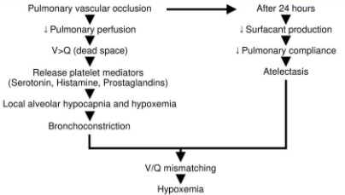
Notes:
I thought this was a good picture that outlines the pathophysiology as well. Again, you have pulmonary vascular occlusion that leads to decreased pulmonary perfusion, increased V/Q, release of vasoactive mediators, local alveolar hypocapnia and hypoxemia, bronchoconstriction, which all results in V/Q mismatch and hypoxemia. After 24 hours, there is also a decrease in surfactant production, and that in combination with atelectasis and pulmonary edema leads to decreased pulmonary compliance which further adds to V/Q mismatch and hypoxemia.

Slide 5
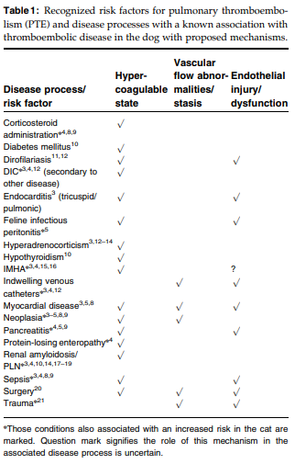
Risk factors
Notes:
Goggs published a stat of the art review in 2009 in JVECC on pulmonary thromboembolism. On the right of the slide is the list of risk factors associated with PTEs. The table shows how each risk factor affects Virchow’s triad.

Slide 6
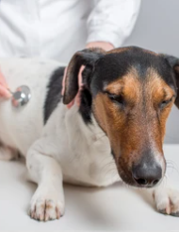
Clinical signs
Respiratory distress
Tachypnea/dyspnea
Lethargy
Altered neurological status
Cough
Syncope
Hemoptysis
Notes:
Depending on how big of a PTE will results in varying clinical signs. Most dogs, will have a respiratory component or respiratory distress. Interestingly, in humans, one of the more common signs is chest pain which would be difficult to appreciate in our veterinary patients. In humans, up to 20% have altered mental states and in one study in dogs, 1/3 of the dogs had an abnormal neurological status. It is thought that PTE might cause transient hypoxemia or cerebral ischemia to the brain.

Slide 7
Diagnosis
Screen for risk factors/underlying disease
ABG
Chest radiographs
Coagulation profiles
TEG
Pulmonary angiography
Cardiac evaluation
CT pulmonary angiography
Notes:
When it comes to diagnosing PTEs this can become complicated and difficult to obtain a definitive diagnosis. Here is a list of diagnostics that we will go through next and how they are helpful in diagnosing PTE in dogs and cats. The first diagnostics, is screening tests such as CBC, chemistry profiles, and urinalysis. This is more to look for the underlying disease or risk factors associated with PTEs more than diagnosing the PTE itself.

Slide 8
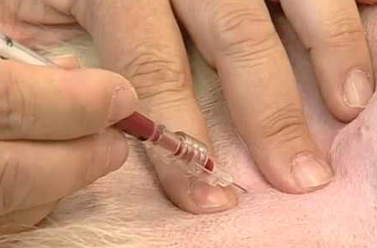
Arterial blood gas
Respiratory alkalosis
Hypoxemia (80%), hypocapnia (47%), and increased A-a gradient (100%)
Notes:
On arterial blood gas evaluation, a respiratory alkalosis can be seen due to the hyperventilation and subsequent hypocapnia. The three biggest findings associated with PTEs is hypoxemia, hypocapnia, and increased A-a gradient. Johnson et al. looked at 29 dogs with pulmonary thromboembolism and should that 80% were hypoxemic, 47% hypocapnic, and 100% had increased A-a gradients on arterial blood gas analysis. In humans, using ABGs to diagnose PTEs are controversial. There are some patients with PTEs with no abnormalities on their ABG as the degree of hypoxemia is directed correlated with the extent of the PTE. Hypoxemia caused by PTEs are not always oxygen responsive. It the hypoxemia is caused mostly by V/Q mismatch, then it should be oxygen responsive. If not, then this suggests intrapulmonary shunting from pulmonary edema or pulmonary infarction.

Slide 9
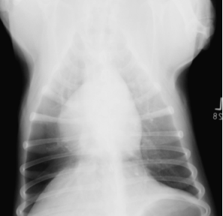
Chest radiographs
Alveolar to interstitial infiltrates
Wedge/triangular shaped
Enlarged PA/cardiomegaly
Pleural effusion
Westermark sign
Normal thorax
Notes:
In my experience, when a patient presents or goes into acute respiratory distress, chest radiographs are typically performed at some point to evaluate for the underlying cause. With PTEs, chest radiographs can be challenging because with small PTEs there may not be any radiographic abnormalities. Chest radiographs can also help rule out other causes of tachypnea. Pulmonary infiltrates are the most common finding with alveolar to interstitial infiltrate in one area or can be in multiple areas. The infiltrates usually indicate edema, atelectasis, hemorrhage, or infarction. Typically, the infiltrates will have indistinct borders. The classic wedge or triangular shaped infiltrate that we have all heard of usually occurs due to an area of infarction which has more distinct borders and is usually pleural based. An enlarged PA and cardiomegaly can be seen. Pleural effusion can also occur secondary to PTEs. The Westermark sign is a rare finding that represents an area of radiolucency due to reduced blood flow.

Slide 10
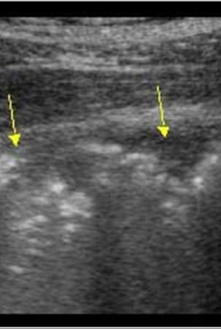
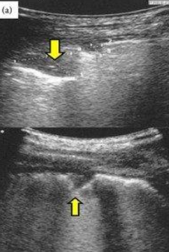
POCUS
Pleural based, well-demarcated, hypoechoic triangular or rounded consolidations
≥0.5 cm
Notes:
In these modern times, we perform a lot of point of care ultrasound exams. So can you diagnose PTE on POCUS? You can! I personally have never done this before, but PTE appear as pleural based, well-demarcated, hypoechoic triangular or rounded consolidations that are at least 0.5 cm in size. Since we are looking at the margins of the lungs, POCUS is only really good at detecting PTEs that occur in the periphery and probably less sensitive for PTEs that occur more centrally.

Slide 11
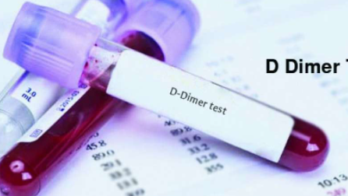
Coagulation profiles
PT/PTT
Antithrombin
FDPs and D-dimers
Notes:
PT/PTT is a questionable test to help diagnose PTE. Most of the studies in veterinarian medicine are retrospective and the associated between abnormal coagulation times and PTE are inconsistent. Antithrombin activity can be reduced during states of hypercoagulability as it is an inhibitor of coagulation and can be decreased due to consumption. It can also be decreased due to loss through the kidneys or PLN. Unfortunately, antithrombin activity is not a widely available test so it is not performed very often. FDPs and d-dimers are another commonly used test performed when there is a suspicion of a PTE. Remember that d-dimers are degradation of crosslinked fibrin and FDPs are degradation products of both fibrin and fibrinogen. So d-dimers can only occur after thrombus formation. There are limitations to d-dimers as if they are performed and the clot has not begun to break down, d-dimers could be normal. It also depends on when you pull for d-dimers as they can peak at certain times after the PTE occurs. There are also other diseases that can result in higher d-dimer levels so it is not 100% accurate. In humans, d-dimers can help rule out a large pulmonary emboli in 93% of cases and 50% in smaller emboli. Since dogs have a robust hyperfibrinolytic system and are not humans, it is unknown how these percentages correlate to our patients. FDPs are less sensitive and not as commonly used. There was an experimental study in dogs and showed that after induction of a PTE, d-dimers significantly increased at 30 minutes post-embolism and remained significantly greater than control for 24 hours. Peak d-dimer concentration was 2 hours post-embolization.

Slide 12
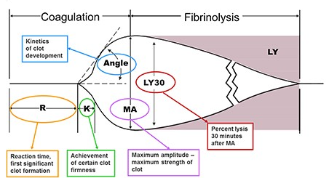
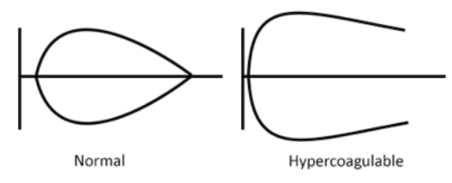
TEG
Shorter R and K times
Steeper alpha angle
Larger maximal amplitudes
Notes:
TEG may not be able to directly diagnose a PTE, but it can demonstrate if a patient is currently in a hypercoagulable state. As a quick reminder, the four factors that are evaluated to assess for hypercoagulability is R time which is your intrinsic pathway, K time which is the speed of clot development, MA or maximum clot strength, and alpha angle which is the clot formation rate. In hypercoagulable states, there is a shorter reaction and clot formation times, or your R and K times; steep alpha angles, and larger maximal amplitudes. TEG is a test that is becoming more popular but is still not widely available in most hospitals. There also needs to be more studies performed validating the test in each specific disease process and how it correlates to clinical medicine. Again, using TEG when diagnosing PTEs only tells you about the underlying state of the coagulation system and does not specifically diagnose the PTE itself.
Reaction time (R time): intrinsic pathway
Clot formation time (K time): speed of clot development
Maximal amplitude (MA): maximum clot strength
Alpha angle: clot formation rate

Slide 13
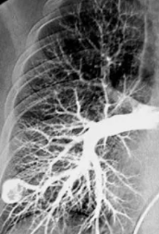
Pulmonary angiography
Requires a special catheter
Selective versus Nonselective
Notes:
Pulmonary angiography used to be the gold standard in diagnosing PTEs in humans, until CT became the new gold standard. Although I have never performed pulmonary angiography, I did read that it is still widely used to diagnose PTEs in small animals. I do wonder if this was popular back in the day when pulmonary arterial catheters were placed more frequently to measure CVPs. Pulmonary angiography is performed by rapidly injecting contrast into the pulmonary artery through a pulmonary arterial catheter. Then a radiographs is taken afterwards and allows for visualization of the pulmonary arterial tree. The picture on the left is a human pulmonary angiography which is so pretty! Intraluminal filling defects, abrupt pulmonary arterial termination, or complete absence of arterial branches (which is called pruning) are all abnormalities consistent with a diagnosis of PTE. This is considered a selective pulmonary angiography and does require the placement of a pulmonary arterial catheter which typically requires some level of sedation to place which might not be the best of patients in respiratory distress. There is another type of pulmonary angiography that is nonselective and uses a large bore jugular catheter to inject contrast. Nonselective pulmonary angiography is less sensitive as there is dilution of the contrast and superimposition of the vascular structures.

Slide 14
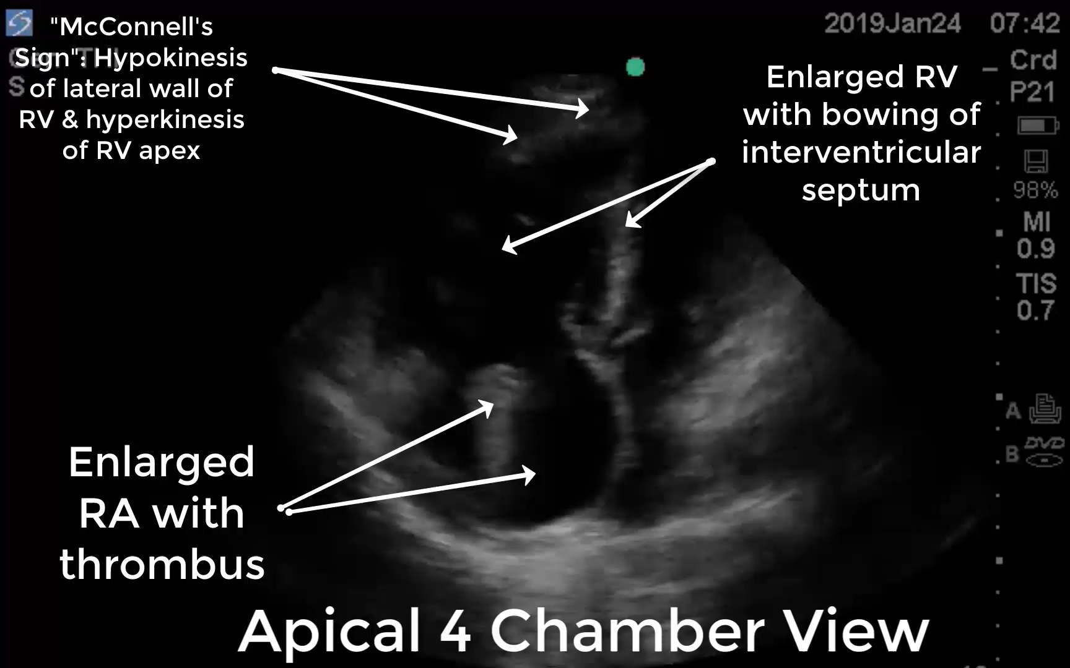
Cardiac evaluation
ECG: sinus tachycardia
Echocardiogram:
  RV dilation and hypokinesis- McConnell’s sign
  Septal flattening
  Pulmonary hypertension
  RV hypertrophy
Notes:
Cardiac evaluation includes ECG and echocardiography. In small animals, ECG does not hold great diagnostic utility in diagnosing a PTE. Generally ECG changes are rarely reported with PTEs. The most common abnormalities seen is a sinus tachycardia which is most likely secondary to sympathetic stimulation. In severe cases with myocardial hypoxia or cardiac hypertrophy, ST segment depression or slurring can be seen. RV compromise also occurs in severe cases and causes right axis deviation, increased S wave amplitude, increased T wave amplitude and tall narrow p waves. Echocardiography is more useful when diagnosing a PTE. The use has been well documented in humans and aims to identify RV outflow tract thrombosis and the cardiovascular consequences of PTE. Again, echo is not perfect and there are a subset of patients that will have normal echos and still have a PTE. The more common findings on echo that support the diagnosis of a PTE are RV dilation and hypokinesis, septal flattening and paradoxical septal motion, diastolic left ventricular impairment, pulmonary arterial hypertension, and RV hypertrophy. The RV dilation and hypokinesis is also called the McConnel signs which is suggestive of a PTE in humans. As mentioned, there are times where a thrombus can actually be visualized on echo as well. The degree of RV impairment is directly correlated to the extent of the PTE. Although there are not a lot of studies evaluating echocardiograms in dogs with PTE, it is a non-invasive test that can provide information that can help support the diagnosis of a PTE. On the right side is a video of these findings. So first, the McConnel sign which usually looks as if the apex of the RV is bouncing up and down while the rest of the RV remains still. You can see the enlarged RV with bowing of the intraventricular septum, and lastly and enlarged RA with the thrombus identified.

Slide 15
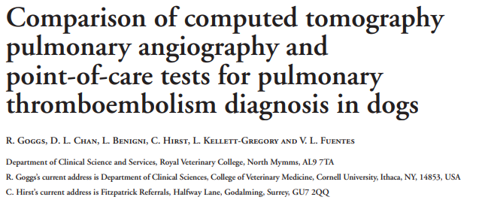
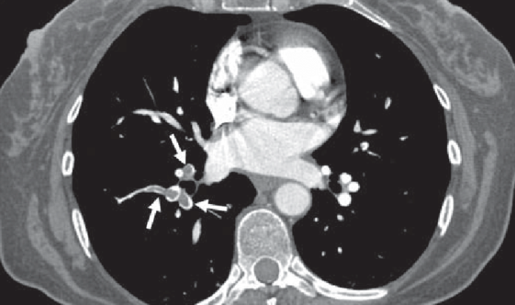
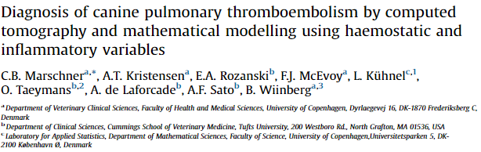
CT pulmonary angiography
Notes:
Lastly, CT pulmonary angiography! This is now considered the gold standard in diagnosing PTEs in humans. It has both a high sensitivity and specificity. It is excellent at identifying main, lobar, or segmental pulmonary arterial thrombi and less sensitivity at subsegmental thrombi in humans. Benefits to performing a CT angio is that it is rapid, allows for a diagnosis, and can also assess for other differentials and rule out other causes of respiratory signs. It also can be done using a peripheral IV catheter and does not require a special or invasive catheter. However, the downsides are that you need a CT scanner, typically requires some level of sedation, and a breath hold is needed as well to perform the scan. Goggs published yet another study on using CT angio for diagnosing PTEs and compared it to other diagnostics. He found that it is feasible and safe to perform CT angios under sedation in these dogs. Interestingly, elevated d-dimers were not associated with evidence of PTE on CT angio, but only half of the dogs enrolled in the study had d-dimers measured so larger studies need to be performed to evaluate this finding. Another more recent study, also looked at diagnosis of PTE in dogs and found that CT angio should be considered the gold standard in dogs. This study also demonstrated that TEG does not always show a hypercoagulable state. This study also did not report any significant complications and again, supported that CT angios can be safely performed in these dogs. In the picture on the left, shows PTEs in a human women who underwent a CT angio.

Slide 16
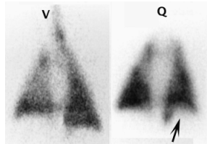
Other diagnostics
Troponins
V/Q scanning
MRI
Notes:
Troponins are most sensitive in indicating myocardial cell injury. Unfortunately, there are no studies in small animals evaluating troponins in dogs with PTEs. In humans, troponins can provide prognostic value. Humans with PTE and elevated troponins are at high risk of short term death. Nuclear medicine and V/Q scanning is another diagnostic that can be done to diagnose PTE. This diagnostics has been somewhat phased out now that we have CT and CT angio available and is not widely performed anymore. On the right is a picture of what the V/Q scanning looks like- I thought it was just a cool imaging modality that I had no previously heard of! MRI is another imaging modality that is not really used in veterinary medicine for diagnosis of PTE and is still limited in human medicine. Further studies and investigation still needs to happen before MRI is recommended to diagnose a PTE.

Slide 17
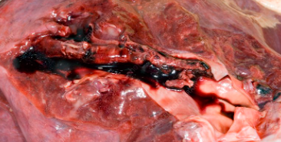
Postmortem diagnosis
50% reduction in clot volume in the first 3 hours
D-dimer and leukocytosis were significant associated with post mortem evidence of thrombosis
Notes:
I think we have all had cases that go into respiratory failure and die or that acutely die, and we all think… I bet it was a thromboembolic event! So I wanted to briefly talk about how easy it is to prove if your patient died from a clot based on post-mortem results. There was a study done a long time ago in 1973 in experimental dogs and showed that there is a 50% reduction in clot volume in the first 3 hours post mortem. In addition, this study also showed that with heparinization, only 34% of the clot volume remains at 3 hours. A more recent study out of JVECC in 2016 compared TEG to evidence of postmortem thrombosis. They concluded the d-dimers and WBC count were both significantly higher in dogs with evidence of thrombosis. Since necropsies, rarely happen within 3 hours of death, postmortem exams are also limited in their ability to be able to diagnose thrombosis or specifically PTEs.

Slide 18
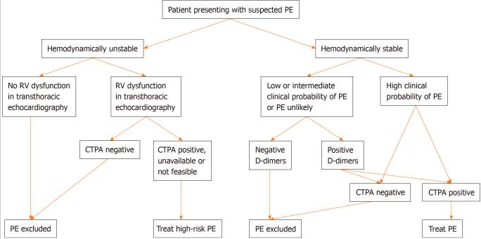
Notes:
I thought that this was a great flow chart on how they diagnose PTEs in humans. This is out of the World Journal of Cardiology, New guidelines for the diagnosis and management of pulmonary embolism.

Slide 19
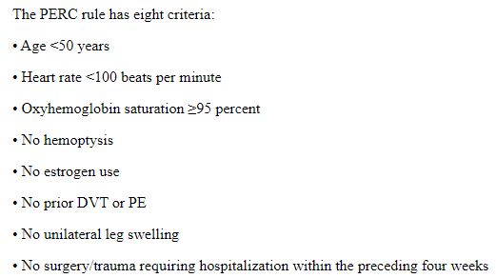
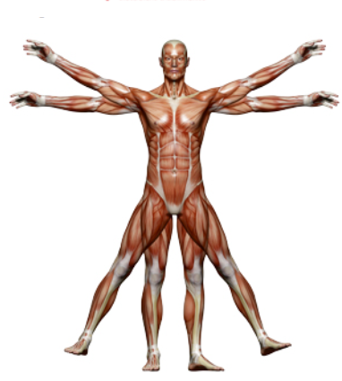
Humans
Notes:
In humans, deep vein thrombosis is a big risk factor that can lead to a PTE. Since our small animals don’t seem to suffer from DVTs and since it is veterinary medicine, our studies are limited. Interestingly, in humans, there is a scoring system called the Well’s criteria that classifies the probability of a PTE into high, moderate, or low probability. There is also a pulmonary embolism rule out criteria that helps EDs triage these patients and which ones need urgent imaging. I have those criteria shown above.

Slide 20
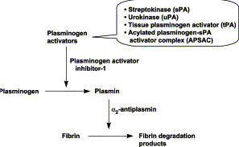
Treatment
Thrombolysis
Anticoagulants
Antiplatelet agents
Anti Xa
Massive or submassive PTE
tPA or streptokinase
Complication- hemorrhage
Notes:
Now that we have extensively talked about that diagnostics that can be performed to diagnose a PTE, lets talk about treatment! First, we are going to talk about thrombolytic agents. These are not commonly used in veterinary medicine but are in humans. In humans, thrombolysis is indicated with massive PTEs. These would be PTEs that are causing hypotension or cardiogenic shock. It should also be considered with submassive PTEs that have evidence of right ventricular enlargement or hypokinesis. There are two major agents that can be used. First is tPA or tissue plasminogen activator which is the agent of choice. It catalyzes the conversion of plasminogen to plasmin. Streptokinase is another thrombolytic agent. Streptokinase promotes cleavage of arginine/valine bond in plasminogen causing formation of plasmin and fibrin degradation. The biggest complication of using thrombolytics is hemorrhage. In veterinary patients, these agents are rarely used and there is sparce data on their use. There are also no good guidelines on how to use thrombolytics in veterinary medicine.

Slide 21
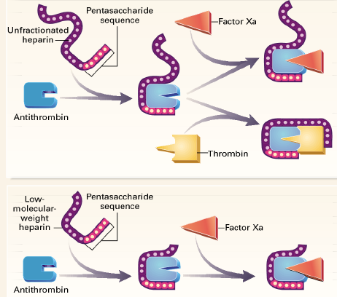
Treatment
Thrombolysis
Anticoagulants
Antiplatelet agents
Anti Xa
Prevent further growth of embolus and future emboli
Unfractionated heparin, low molecular weight heparin
Complication- hemorrhage
Notes:
Next are anticoagulants. The goals of anticoagulant therapy in patients with PTE is to prevent further growth of the embolus while waiting for the fibrinolytic system to break down the clot and to prevent future emboli. Heparins, including unfractionated and low molecular weight, can be used. Remember that unfractionated heparin binds to antithrombin and increases antithrombin inhibition of factor Xa and IIa. Low molecular weight heparins bind to antithrombin as well, but the length of the molecule is shorter so there is less inhibition of IIa. Anticoagulation is the mainstay treatment in humans with PTEs, but there is limited data in veterinary medicine in the guidance as to when to use anticoagulants. Again, the most significant complication is hemorrhage when using these agents. I think that if I had enough support to diagnose a PTE or a CT angio that shows a PTE, I would consider using anticoagulants. I think it would also depend on the case and the potential underlying cause as well. In Gogg’s state of the art review, there is a wonderful, colorful table with all the agents, doses, treatment considerations, and the reference for each recommendation.

Slide 22
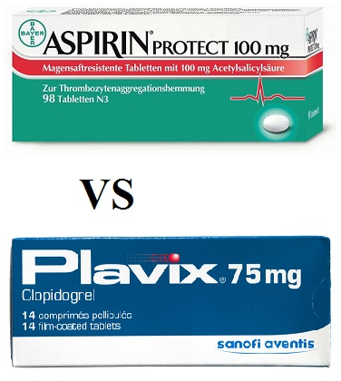
Treatment
Thrombolysis
Anticoagulants
Antiplatelet agents
Anti Xa
Aspirin or clopidogrel
Used long term
Notes:
Antiplatelet agents are commonly used when thromboembolic events are suspected. The two most common medications used in veterinary medicine are aspirin and clopidogrel. As a reminder, aspirin irreversibly inhibitors COX-1 which reduced thromboxane synthesis. Clopidogrel irreversibly inhibits the binding of ADP to the P2Y12 receptor which inhibits ADP mediated activation of GP IIb/IIIa complex resulting in decreased platelet aggregation. These agents are usually prescribed for long term maintenance or used prophylactically, however, are not also used in the acute phases of a PTE depending on the severity of the PTE. There are injectable antiplatelet agents, however, their use in veterinary medicine is unknown.

Slide 23
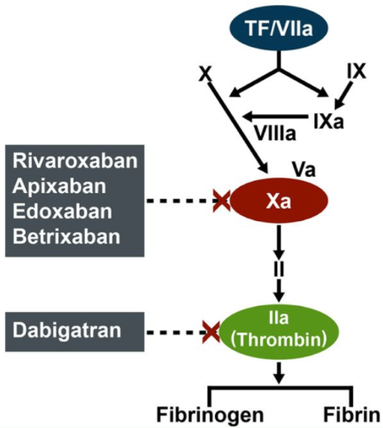
Treatment
Thrombolysis
Anticoagulants
Antiplatelet agents
Anti Xa
Rivaroxaban or Apixaban
Better than heparin?
Notes:
More recently, is the use of oral Anti-Xa agents has been explored. These are rivaroxaban or apixaban, among others. These are still relatively new in veterinary medicine and there are no studies evaluating their use in treatment of PTE. In humans, there is evidence that anti-Xa might be superior to heparins in certain cases. The most recent consensus on treatment of PTE in humans suggest that this is now the treatment of choice. Anti Xa agents have a more predictable pharmacokinetics and mitigate the limitations of heparin sometimes having sub-therapeutic doses which is found when monitoring these drugs.

Slide 24
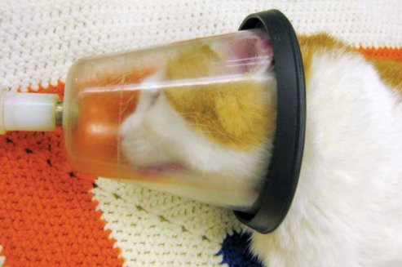
Treatment
Oxygen supplementation
No IV fluid bolus
Notes:
Lastly, there are supportive treatments that should be instituted as well. Supplemental oxygen is probably the biggest. Supplemental oxygen can help reverse the V/Q mismatching and diffusion impairment. Do not give an IV fluid bolus as it can over distend the RV and worsen cardiac output.

Slide 25
Prognosis
Depends on the underlying cause and severity of the PTE
Use the CURATIVE guidelines for prophylaxis of thromboembolic disease
Associated with significant morbidity and mortality
Notes:
As we all know, the prognosis for PTE is dependent on the underlying cause and severity of the PTE. There are the established CURATIVE guidelines which should be used and if possible prophylaxis of thromboembolic disease should be used. In humans, PTE has been associated with significant morbidity and mortality. In a human paper I read, it stated that 30% of untreated patients with pulmonary embolism die, while only 8% die after timely therapy.

Slide 26
Questions?

