Slide 1
Approaches to Acid Base
Jamie Selman, DVM

Slide 2
Concept of Acidity
Concept of Acidity = an acid is a proton donor and a base is a proton acceptor
HA is an acid and A⁻ is a base:
HA ⇔ H⁺ + A⁻
H⁺ = protons in aqueous solutions

Slide 3
Why H+
Present at one-millionth the concentration of other electrolytes
H+ ions are highly reactive and the loss or gain of H+ affects protein structure and function
H+ must be kept constant to prevent changes to enzyme function and cellular structure

Slide 4
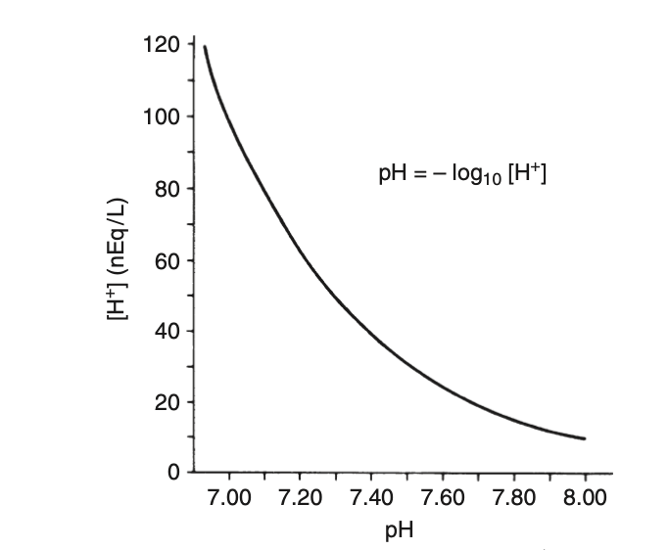
Concept of pH
pH = -log₁₀[H+]
Inverse relationship between pH and [H+]
pH and [H+] vary exponentially

Slide 5
Henderson-Hasselbalch Equation
  Law of mass action = the velocity of a reaction is proportional to the product of the concentrations of the reactants
  HA ⇌ A⁻ + H⁺
  The ratio of rate constants can be combined into a single constant, Ka, called the equilibrium constant
  K = [H+][A-]/[HA]
  To express [H⁺] as pH, take the negative log₁₀ of both sides of the previous equation.
  pH = pKa + log([A-]/[HA])
  OR
  pH = pKa + log([conjugate base]/[weak acid])
pKa = the -log dissociation constant
Big pKa = weak acid, little dissociated
Small pKa = strong acid, largely dissociated
The ionization of an acid is an indication of the strength of the acid
Notes:
HA ⇌ A⁻ + H⁺

Slide 6
Concept of Buffering
Buffer = is a compound that can accept or donate protons (H+) and minimize change in pH.
  Bicarbonate (the primary buffer system of ECF)
  Nonbicarbonate buffers (primary buffer of ICF)
    Proteins, inorganic, and organic phosphates
  H2O + CO2 ⇌ H2CO3 ⇌ H+ HCO3
  pH = 6.1 + log ([HCO3-]/0.03 x pCO2)
    6.1 = pKa
    0.03 = solubility coefficient for partial pressure of CO2
TAKEAWAY = pH is a function of the ratio between HCO3- concentration and pCO2

Slide 7
Body Regulation of Acid Base
Chemical buffering
  “Acute” response - Immediate titration of intracellular and extracellular buffers, resulting in an initial change in plasma HCO3-
  “Chronic” response - kidneys alter net acid excretion and bicarbonate reabsorption; takes 2-5 days
Changes in Alveolar minute ventilation

Slide 8
Renal Regulation of HCO3-
Kidneys maintain normal ECF HCO3- by reabsorbing all filtered HCO3- and regenerate HCO3- that has been titrated during daily production of acid
  Sources of acid in the body
    oxidation of sulfur containing cationic amino acids
    Hydrolysis of organic phosphate diesters (phospholipids and anucleic acids).
  Source of base
    Metabolism of anionic amino acids
    Oxidation of other organic ions like lactate or citrate
Kidneys regenerate HCO3- by excreting phosphate and ammonium salts
  NH3 passively diffuses through luminal membrane of the tubular cell into tubular fluid, then H+ derived by dissociation of carbonic acid could combine with NH3 to form NH4+

Slide 9
Cece, 6 month old year old female intact Rat Terrier
Hx: Owners found Cece on the side of the road 7 days ago, 3 days ago she started vomiting and passing large amounts of liquid diarrhea
PE: Dull, 6-8% dehydrated, BCS 2/9
Diagnostics:
  Parvo snap positive
  BP: 136/74
  Fecal floatation: many hookworms and roundworms
pH | 7.28 | 7.32-7.38
pCO₂ | 40 | 38-46
HCO3⁻ | 15 | 20-25
BE | -6.8 | (-4) – 0
AG | 20 | 17-24
Na⁺ | 141 | 145-151
K⁺ | 3.4 | 3.9-5.1
Ca⁺⁺ | 1.42 | 1.18-1.37
Cl⁻ | 110 | 110-119
Glu | 102 | 60-120
Lactate | 1.6 | <2.0
Notes:
Can we characterize Cece’s VBG and explain the acid base disturbance. Does it make sense for Cece’s concurrent illness?
Uncompensated metabolic acidosis
In some diseases of the small intestine, increased delivery of ileal contents to the colon may overwhelm the considerable capacity of the colon for reabsorption of fluid and electrolytes. As a result, severe acute small bowel diarrhea may cause loss of HCO3-

Slide 10
Metabolic acidosis
Can be due to two causes:
  Excess acid
  Loss of buffer (base)
Most common acid-base disturbance in dogs and cats
Loss of HCO3- rich fluid usually occurs via the GI, but can also occur via kidneys

Slide 11
Base Excess
H2O + CO2 ⇌ H2CO3 ⇌ H+ HCO3
BE = equilibrates blood to normal CO2 (40 mmHg) so its a better measure of acidosis
BE represents the extra base present in the sample when the CO2 is normalized
More reliable measure of the metabolic acid-base balance of the patient

Slide 12
Jeff, 3 year old MN Bernese Mountain Dog
Hx: Vomiting, anorexia, PU/PD
PE: Painful on palpation of kidneys, subjectively enlarged
Diagnostics:
  Urine pH: 7.4
  USG: 1.006
  Urine culture: positive for E-coli
  Creatinine: 1.2
  AXR: possible radioopaque urolith
pH | 7.12 | 7.32-7.38
pCO₂ | 31.9 | 38-46
HCO3⁻ | 10.5 | 20-25
BE | -19 | (-4) – 0
AG | 22 | 17-24
Na⁺ | 169 | 145-151
K⁺ | 3.2 | 3.9-5.1
Ca⁺⁺ | 1.54 | 1.18-1.37
Cl⁻ | 110 | 110-119
Glu | 111 | 60-120
Lactate | 1.4 | <2.0
Notes:
Metabolic acidosis with compensatory respiratory alkalosis with normal AG

Slide 13
Renal Tubular Acidosis
Hyperchloremic metabolic acidosis caused by either decreased HCO3- reabsorption or defective acid excretion with normal GFR
Distal Renal Tubular acidosis (type 1)
  Increased urine pH (>6.0) in the presence of acidosis
  Diagnosed by an ammonium chloride tolerance
Proximal Renal Tubular acidosis (type 2)
  Appropriate urine pH with metabolic acidosis
Notes:
Rare in animals
Nephrolithiasis (usually calcium phosphate stones), nephrocalcinosis (resulting from alkaline urine pH and decreased urinary
citrate concentration), bone demineralization (resulting from loss of bone buffer stores during chronic acidosis), and urinary potassium wasting with hypokalemia are features of distal RTA in human patients.
Other abnormalities of proximal tubular function typ- ically accompany impaired HCO3 reabsorption in prox- imal RTA, and these include defects in glucose, phosphate, sodium, potassium, uric acid, and amino acid reabsorption. This combination of proximal tubular defects is known as Fanconi syndrome.
The diagnosis of proximal RTA is made by finding an acid urine pH (<5.5 to 6.0) in the presence of hyperchloremic metabolic acidosis and a normal GFR but an increased urine pH (>6.0) and increased urinary fractional excretion of HCO3 (>15%) after plasma HCO3 concentration has been increased to normal by alkali administration. If present, the detection of other defects in proximal tubular function (e.g., glucosuria with normal blood glucose concentration) establishes the diagnosis.
Distal RTA has been reported in two cats with pyelo- nephritis caused by Escherichia coli.

Slide 14
Secretional metabolic acidosis (normal AG)
Diarrhea
Renal tubular acidosis
Carbonic anhydrase inhibitors
Ammonium chloride - NH4+ converted in the liver to urea and H+
Infusion of Cationic Amino Acids
Posthypocapnic metabolic acidosis
Dilutional acidosis
Hypoadrenocorticism – aldosterone enhances sodium reabsorption through collecting duct and increases H+ secretion
Notes:
Diarrhea
Renal tubular acidosis TA pg 257 (hyperchloremic metabolic acidosis caused by either decreased HCO3- reabsorption (proximal RTA), or defective acid excretion (distal RTA) in the presence of a normal GFR
Carbonic anhydrase inhibitors - acetazolamide, decrease proximal tubular reabsorption of HCO3- in the kidneys by noncompetitive inhibition of luminal and cellular carbonic anhydrase
Ammonium chloride (NH4+ converted in the liver to urea and H+)
Infusion of Cationic Amino Acids- Metabolism of cationic amino acids (e.g., lysine, arginine, histidine) results in production of Hþ as the NH4+ from these amino acids is converted to urea in the liver.
Posthypocapnic metabolic acidosis -
Dilutional acidosis - Dilutional acidosis refers to a decrease in plasma HCO3 concentration that occurs when extracellular volume is expanded using an alkali-free chloride-containing solu- tion such as 0.9% NaCl.
Hypoadrenocorticism - Aldosterone increases renal tubular lumen negativity by enhancing sodium reabsorption in the collecting duct and secondarily increases hydrogen ion secretion. It also directly stimulates Hþ secretion by increasing the activity of the luminal Hþ-ATPase pump in the medullary collecting duct.

Slide 15
Noelle, 11 YO FS Boxer
Hx: Noelle has been losing weight and PU/PD over the past 4 months. She has been eating well but the past 3 days has been anorexic
PE: Dull, BCS 2/9, immature cataracts OU
Diagnostics:
  Urine sediment: many cocci and rods
  Blood smear: subjective inflammatory leukogram with left shift
pH | 7.296 | 7.32-7.38
pCO₂ | 23.6 | 38-46
HCO3⁻ | 11.6 | 20-25
BE | -11 | (-4) – 0
AG | 31 | 17-24
Na⁺ | 139 | 145-151
K⁺ | 3.8 | 3.9-5.1
Ca⁺⁺ | 1.21 | 1.18-1.37
Cl⁻ | 104 | 110-119
Glu | 581 | 60-120
Lactate | 4.8 | <2.0

Slide 16
DKA
Overproduction of acetoacetic acid and hydroxybutyrate due to deficiency of insulin and excess release of glucagon
Shift the liver from its normal role in esterification of fatty acids into triglycerides to beta oxidation of fatty acids into ketoacids
Gain of acid

Slide 17
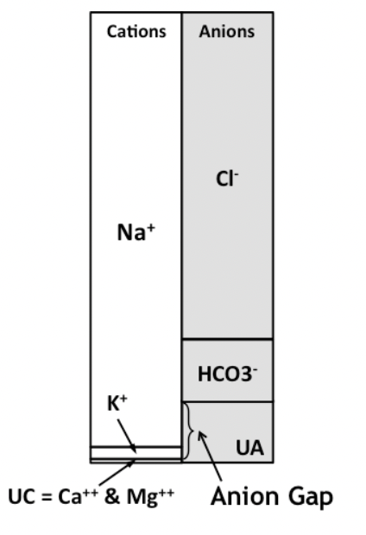
Anion Gap
Electroneutrality is always maintained in the blood
Commonly measured cations – commonly measured anions
(Na⁺ + K⁺) + UC = (Cl⁻ + HCO3⁻) + UA
Unmeasured cations – calcium, magnesium
Unmeasured anions – normal plasma proteins (such as albumin)
AG = UA – UC
AG = (Na + K) – (Cl + HCO3)

Slide 18
Differentials for increase AG (titrational metabolic acidosis)
Lactic acidosis (acid = lactic acid)
Diabetic ketoacidosis (acid = ketoacids)
Uremic acidosis (acid = sulfates and phosphates)
Exogenous acid ingestion (examples = ethylene glycol and salicylates)
Other
  Salicylate intoxication
  Metaldehydate intoxication
  Cardiac Arrest and Cardiopulmonary Resuscitation
  Lymphosarcoma
Decrease in AG?
  Hypoalbuminemia

Slide 19
Jamie, 6 YO FS Mini Australian Shepherd
Hx: Completely normal, here to re-establish collection of normal range values in healthy dogs
PE: Perfect angel
Dx:
  Arterial blood gas
pH | 7.67 | 7.32-7.38
pCO₂ | 16 | 38-46
pO2 | 130 | 95-109
HCO3⁻ | 22 | 20-25
BE | -1 | (-4) – 0
AG | 22 | 17-24
Na⁺ | 148 | 145-151
K⁺ | 3.9 | 3.9-5.1
Ca⁺⁺ | 1.22 | 1.18-1.37
Cl⁻ | 113 | 110-119
Glu | 101 | 60-120
Lactate | 0.97 | <2.0

Slide 20
Sampling errors
Dilution with heparin – low pH, low pCO2, low HCO3
Exposed to room air – low pCO2, high pH, high pO2 high
Sample allowed to stand at room air for 15-30 minutes - CO2 increases, pH decreases – decreased glucose, increase lactate (attributed to glycolysis by WBC, RBC, PLT)

Slide 21
Katie, 11 year old female spayed Chihuahua
Hx: Katie has been anorexic for 24 hours (very unusual) and will vomit after drinking for the past 48 hours
PE: 7-8% dehydrated with dry mm, and skin tent; tense cranial abdomen
Diagnostics:
  AXR: severe fluid and gas distension of stomach
pH | 7.46 | 7.32-7.38
pCO₂ | 42 | 38-46
HCO3⁻ | 27 | 20-25
BE | 2 | (-4) – 0
AG | 22 | 17-24
Na⁺ | 137 | 145-151
K⁺ | 2.9 | 3.9-5.1
Ca⁺⁺ | 1.21 | 1.18-1.37
Cl⁻ | 99 | 110-119
Glu | 130 | 60-120
Lactate | 4.8 | <2.0
Notes:
Corrected chloride = (normal sodium/measured sodium) x measured Chloride
Corrected chloride = 148/137 x 99 = 106
Chloride is the major extracellular anion, found together with sodium. Chloride is important for osmolality and acid-base balance. Because chloride is found in a 1:1 ratio with sodium (although is slightly lower than sodium in plasma), changes in chloride should always be interpreted with sodium. Changes in free water and the gain or loss of chloride and sodium are the major mechanisms for a change in chloride concentration.
A loss or gain of free water and/or a loss or gain of electrolyte-rich fluids will change sodium and chloride concentrations proportionally. For example, a secretory diarrhea results in excessive loss of sodium and chloride with respect to free water (“gain of free water”) in intestinal secretions combined with water retention secondary to stimulation of antidiuretic hormone (ADH) from hypovolemia (due to loss of fluid with diarrhea).
A selective loss or gain of chloride in excess of sodium will result in disproportional changes in sodium and chloride and indicates that there is an acid-base disturbance. This is because chloride acts essentially as an “acid”. By Stewart’s acid-base principles, chloride is a strong anion, an independent variable. So if chloride is gained or lost in excess of sodium, it indicates a metabolic acidosis (“gain” of an acid) or alkalosis (“loss of an acid”), respectively.
To determine if a change in chloride is due to free water or an acid-base disturbance, we need to correct the chloride, i.e. modify the results to take into account changes in sodium (which reflects free water). This can be done in two ways and requires a reference interval for both electrolytes (i.e. this cannot be done for those species in which reference intervals are not available):

Slide 22
Corrected chloride
Corrected chloride = (normal sodium/measured sodium) x measured Chloride
Corrected chloride = 148/137 x 99 = 106
Chloride found in a 1:1 ratio with sodium and should always be interpreted with sodium

Slide 23
Gastric Fluid Loss
Loss of gastric fluid can result in marked increases in plasma HCO3- concentration
  Large amounts of chloride and H+ lost in vomitus
Chronic vomiting of stomach contents is the most common cause of metabolic alkalosis
Pyloric obstruction increases gastrin secretion and further gastric acid secretion
To maintain ECFV, the kidneys must reabsorb sodium by all available mechanisms
Ongoing loss of chloride
  Kidneys must reabsorb sodium in exchange for hydrogen and potassium ions (instead of chloride) = more severe metabolic alkalosis
  Aldosterone mediates this = more secretion of potassium

Slide 24
Metabolic alkalosis
Chloride responsive
  Vomiting of stomach contents
  Diuretic therapy
  Posthypercapnia
Chloride resistant
  Primary hyperaldosteronism
  Hyperadrenocorticism
Alkali administration
  Oral administration
Miscellaneous
  Refeeding after fasting
  Severe potassium or magnesium deficiency
Notes:
Chloride responsive
Vomiting of stomach contents - When a dog or cat vomits stomach contents, water is lost along with large amounts of HCl and small amounts of potassium and sodium. In the clinical setting, persistent vomiting of stomach contents leads to fluid and electrolyte losses (Hþ and Cl > Naþ and Kþ), and anorexia prevents adequate dietary intake of electrolytes. In patients with pyloric obstruction, gastrin secretion is enhanced, and gastric acid secretion is stimulated further.
Diuretic therapy - Diuretics cause approximately equal losses of sodium and chloride in the urine, but the concentration of chloride in ECF is less than that of sodium by approximately 35 mEq/L. Thus, these drugs may cause chlorideresponsive metabolic alkalosis by a disproportionate loss of chloride in urine and creation of a relative chloride deficit in ECF.
Posthypercapnia - Blood pH increases rapidly when PCO2 is suddenly reduced in patients with chronic hypercapnia.
Chloride resistant (rare in dogs and cats)
Primary hyperaldosteronism - In primary hyperaldosteronism, increased secretion of aldosterone, usually by an adrenocortical tumor, results in sodium retention, volume expansion, hypernatremia, mild to moderate hypertension, potassium deficiency, hypokalemia, and metabolic alkalosis resistant to chloride administration. Stimulation of distal nephron Naþ-Hþ and Naþ-Kþ exchange by excess mineralocorticoids is probably the most important pathophysiologic feature of primary hyperaldosteronism
Hyperadrenocorticism - A high rate of secretion of cortisol and other corticosteroids, could be responsible for hypernatremia, hypokalemia, and metabolic alkalosis in adrenal-dependent hyperadrenocorticism.
Alkali administration
Oral administration – oral administration of sodium bicarbonate or other organic anions (such as lactate, citrate, gluconate, acetate) or cation exchange resin with nonabsorbable alkali (such as a phosphate binder)
Miscellaneous
Refeeding after fasting - unknown mechanism
Severe potassium or magnesium deficiency

Slide 25
Response of the body to metabolic alkalosis
Kidneys more effective in excreting an alkaline load than an acid load
  Happens rapidly and effectively
  Metabolic alkalosis can persist if renal excretion of HCO3- impaired
Of the administered HCO3-, 1/3 titrated by intracellular buffers.
The decrease in [H+] stimulates chemoreceptors = decrease in alveolar ventilation
  Hypoxemia

Slide 26
Tomas, 12 year old MN Yorkshire Terrier
Hx: Occasional goose honking cough that typically resolves with mild sedation; the last 2 hours has not been able to settle down
PE: intermittently cyanotic mm, marked inspiratory effort
Dx:
  Bilateral B-lines caudodorsally
pH | 7.28 | 7.32-7.38
pCO₂ | 56 | 38-46
pO2 | 55 | 95-109
HCO3⁻ | 27 | 20-25
BE | 1 | (-4) – 0
AG | 22 | 17-24
Na⁺ | 148 | 145-151
K⁺ | 3.9 | 3.9-5.1
Ca⁺⁺ | 1.22 | 1.18-1.37
Cl⁻ | 115 | 110-119
Glu | 101 | 60-120
Lactate | 2.7 | <2.0
Notes:
Appropriately compensating??

Slide 27
Causes of Respiratory Acidosis
Acute respiratory acidosis - sudden and severe primary parenchymal airway, pleural, chest wall, neurologic or disease.
Chronic respiratory acidosis - sustained hypercapnia
  alveolar hypoventilation
  abnormal respiratory drive
  abnormalities of the chest wall and respiratory muscles
  increased dead space
Large airway obstruction
Respiratory center depression
Increased CO2 production with impaired alveolar ventilation
Neuromuscular disease
Restrictive extrapulmonary disorders
Intrinsic pulmonary and small airway disease
Ineffective mechanical ventilation
Marked obesity (Pickwickian syndrome)
Notes:
- Large airway obstruction
- Respiratory center depression
- Increased CO2 production with impaired alveolar ventilation
- Neuromuscular disease
- Restrictive extrapulmonary disorders
- Intrinsic pulmonary and small airway disease
- Ineffective mechanical ventilation
- Marked obesity (Pickwickian syndrome)

Slide 28
Respiratory Acidosis and the body’s response
CO2 production > elimination via the lung
Respiratory failure leading to alveolar hypoventilation
Increase in CO2 concentration shifts H2O + CO2 ⇌ H2CO3 ⇌ H+ HCO3- to the right
HCO3- and and H+ concentrations slightly increase within 10 minutes

Slide 29
Sam, 4 year old FS MBD
Hx: 2-3 week history of intermittent vomiting, acute increase in respiratory effort
PE: tachypneic, moderately increased respiratory effort
Dx:
  TXR: air bronchograms right middle lung lobe consistent with aspiration pneumonia
  AXR: moderate diffuse gastroenteropathy
pH | 7.45 | 7.32-7.38
pCO₂ | 29 | 38-46
pO2 | 72 | 95-109
HCO3⁻ | 17 | 20-25
BE | 1 | (-4) – 0
AG | 22 | 17-24
Na⁺ | 148 | 145-151
K⁺ | 3.9 | 3.9-5.1
Ca⁺⁺ | 1.22 | 1.18-1.37
Cl⁻ | 115 | 110-119
Glu | 101 | 60-120
Lactate | 2.7 | <2.0

Slide 30
Causes of Respiratory Alkalosis
Alveolar ventilation > what is required to eliminate the CO2 produced by metabolic processes
Hyperventilation
  Hypoxemia
  Stimulation of stretch and nociceptive receptors
    Stretch receptors in tracheobronchial tree
    Nociceptive receptors in epithelium of small airways
Hypoxemia (stimulation of peripheral chemoreceptors by decreased oxygen delivery)
Pulmonary disease (stimulation of stretch/nociceptors independent of hypoxemia
Centrally mediated hyperventilation
Muscle mechanoreceptor Overactivity
Overzealous mechanical ventilation
Situations causing fear, pain, or anxiety

Slide 31
Jess, 4 year old FS Pit bull
Hx: Owners believe that Jess may have gotten into an unknown amount of Aspirin (acetylsalicylic acid). She vomited once which contained a few pills
PE: Tachypneic, otherwise unremarkable
pH | 7.32 | 7.32-7.38
pCO₂ | 24 | 38-46
HCO3⁻ | 13 | 20-25
BE | -7 | (-4) – 0
AG | 28 | 17-24
Na⁺ | 144 | 145-151
K⁺ | 3.6 | 3.9-5.1
Ca⁺⁺ | 1.2 | 1.18-1.37
Cl⁻ | 111 | 110-119
Glu | 87 | 60-120
Lactate | 4.5 | <2.0
Notes:
Is this an expected compensation??

Slide 32
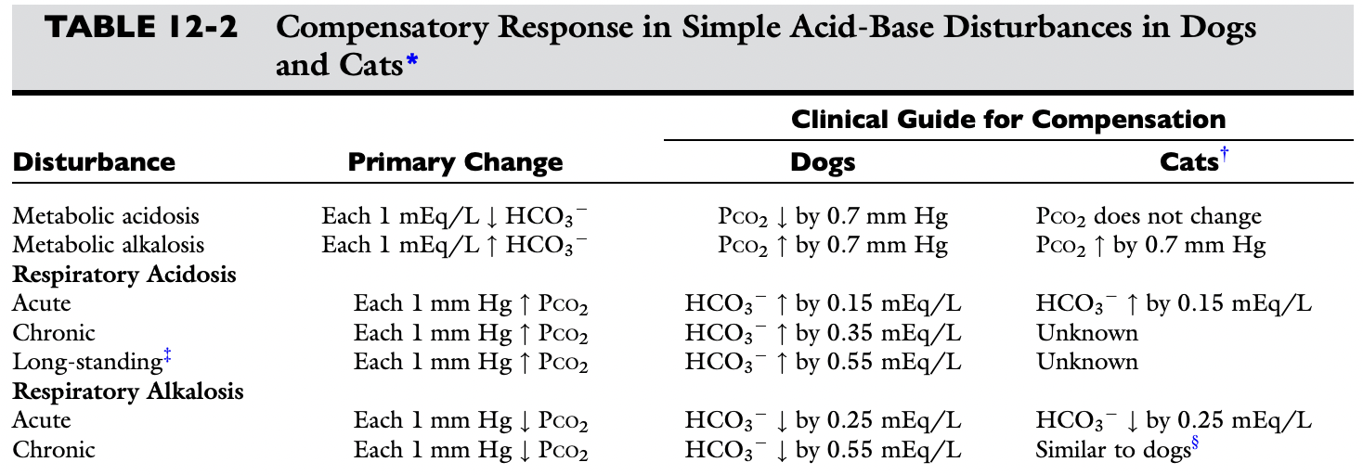
Expected compensatory response in simple acid base disturbances

Slide 33
What type of acid base disorder is this??
The expected compensation is estimated assuming PCO2 = 42 and HCO3⁻= 23 as midpoint values
Change in HCO3 = midpoint HCO3 – patient HCO3 = 23 – 13 = 10
Knowing that for each mEq/L decrease in [HCO3-] in a metabolic acidosis, PCO2 decreases 0.7, the expected compensatory change in PCO2 is estimated as:
  PCO2 expected = midpoint pCO2 – change in pCO2
  Expected change in pCO2 = Change in HCO3- x 0.7 = 10 x 0.7 = 7
  pCO2 expected = midpoint pCO2 - expected change in pCO2 = 42-7 = 35
  Margin of error is +/- 2 (anywhere from 33-37)
BUT the CO2 = is much lower at 24, so there must also be a concurrent respiratory alkalosis
Notes:
Mixed acid-base disturbance characterized by metabolic acidosis and respiratory alkalosis.
Aspirin (acetylsalicylic acid) is hydrolyzed to salicylic acid (pK’a 1⁄4 3.0) in the liver. Salicylate intoxication is uncom- mon in small animal practice and is an example of a mixed acid-base disturbance characterized by metabolic acidosis and respiratory alkalosis. Salicylate intoxication in anesthetized, spontaneously breathing dogs resulted in a mixed respiratory alkalosis and metabolic acidosis.218 The stimulation of ventilation is caused by a direct effect of salicylate on the medullary respiratory center. Salicylate also uncouples oxidative phosphorylation in mitochondria, and the associated disturbances in carbohydrate metabolism lead to metabolic acidosis characterized by an increased anion gap associated with accumulation of lactic acid, ketoacids, and other organic acids.

Slide 34
Mixed acid base
Two or more separate primary acid-base abnormalities
  primary increase or decrease in one component (PCO2 or HCO3) is associated with a predictable change in the same direction in the other component
  Lack of appropriate compensation is evidence of a mixed acid base disorder
Patients with long-standing conditions may have a simple acid-base disorders
  Higher risk of developing a mixed acid-base disturbance when the disease progresses, when they develop complications, or when they are treated with drugs that interfere with acid-base status

Slide 35
Counterbalancing Mixed Acid Base Disorders
Respiratory acidosis and metabolic alkalosis
  Pulmonary edema and diuretics
  Gastric dilation and volvulus
Metabolic acidosis and metabolic alkalosis
  Gastric dilatation-volvulus
  Renal failure with vomiting
  Vomiting and lactic acidosis
  Renal failure and loop diuretics
  Diabetic ketoacidosis with vomiting
  Severe canine babesiosis caused by B. canis rossi Liver disease (hypoproteinemia, diuretics, vomiting, RTA, and impaired metabolism of lactate)
Respiratory alkalosis and metabolic acidosis
  Hypoadrenocorticism-like syndrome in dogs with gastrointestinal disease
  Septic shock
  Salicylate toxicity
  Heat stroke
  Gastric dilatation-volvulus
  Liver disease (RTA and impaired metabolism of lactate)
  Pulmonary edema with hypoxemia or low cardiac output Parvovirus gastroenteritis and sepsis
  Severe exercise
  Acute tumor lysis syndrome
  Severe canine babesiosis caused by Babesia canis rossi
  Cardiopulmonary resuscitation (only in arterial blood)
Notes:
Patients with mixed disorders comprised of primary problems with an offsetting effect on pH may have a normal, low, or high pH. When pH is abnormal, however, because of the counterbalancing effect of the second primary disorder, changes tend not to be pronounced.

Slide 36
Additive Mixed Acid Base Disorders
Respiratory Acidosis and Metabolic Acidosis
  Hypoadrenocorticism-like syndrome in dogs with gastrointestinal disease
  Cardiopulmonary arrest Severe pulmonary edema
  Thoracic trauma with hypovolemic shock
  Low cardiac output heart failure with pulmonary edema
  Advanced septic shock (V/Q mismatch)
  Gastric dilatation-volvulus
  Acute tumor lysis syndrome
  Gastrointestinal endoscopy
  Venom or neurotoxic poisons
Respiratory Alkalosis and Metabolic Alkalosis
  Gastric dilatation-volvulus
  Hyperadrenocorticism with pulmonary thromboembolism
  Respirator-induced mixed alkalosis (correction of PCO2 too rapidly)
  Congestive heart failure and diuretics
  Hepatic disease and diuretics, vomiting, or hypoproteinemia
  Severe canine babesiosis caused by Babesia canis rossi
  Parvovirus gastroenteritis and sepsis
Hyperchloremic and High-Anion Gap Metabolic Acidosis
  Renal failure and resolving diabetic ketoacidosis
  Diarrhea complicating high-anion gap acidosis
  Severe canine babesiosis caused by Babesia canis rossi
Mixed High-Anion Gap Acidoses
  Diabetic ketoacidosis and renal failure
  Diabetic ketoacidosis and lactic acidosis
  Ethylene glycol intoxication with lactic acidosis
  Uremic acidosis and other high-anion gap acidosis
Mixed Normal-Anion Gap Metabolic Acidosis
  Fluid therapy with fluids rich in chloride (e.g., lactated Ringer’s solution, 0.9% NaCl) in a patient with hyperchloremic acidosis
  Diarrhea and parenteral nutrition
Notes:
Mixed disorders composed of primary problems with an additive effect on pH always have abnormal pH. Depending on the combination of primary problems, the pH can be dangerously high or low and requires immediate attention

Slide 37
Triple Disorders
Metabolic Acidosis, Metabolic Alkalosis, and Respiratory Acidosis
  Low-output heart failure with pulmonary edema and diuretics
  Gastric dilatation-volvulus
Metabolic Acidosis, Metabolic Alkalosis, and Respiratory Alkalosis
  Low-output heart failure with pulmonary edema and diuretics
  Gastric dilatation-volvulus
  Parvovirus gastroenteritis (vomiting, diarrhea, and sepsis)
  Severe canine babesiosis caused by Babesia canis rossi
Notes:
Triple disorders occur whenever a respiratory disturbance complicates a mixed metabolic acidosis and metabolic alkalosis.

Slide 38
Strong Ion Approach
Also known as the Stewart approach
pH is not simply determined by the [H+] and [HCO₃–] but involves interactions of other variables

Slide 39
DEPENDENT AND INDEPENDENT VARIABLES
Dependent variables:
  H⁺
  OH–
  HCO₃–
  CO₃²⁻
  HA (weak acid)
  A– (weak anions)
Independent variables:
  pCO₂
  ATOT (total weak non-volatile acids)
  SID (net Strong Ion Difference)
Notes:
Dependent variables are thought of as internal to the system; their values depend on the values of the independent variables and reflect the behaviour of the equilibrium reactions in the system. The independent parameters control acidity ([H+]) in arterial or venous plasma.

Slide 40
pCO2
Same as in HH

Slide 41
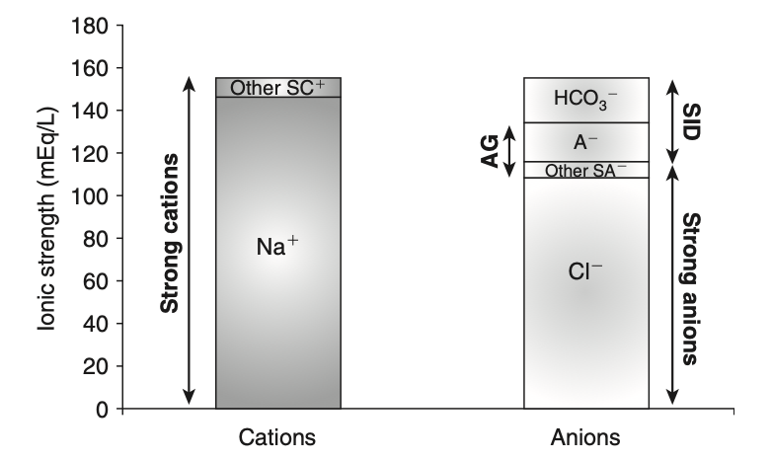
SID
Ions in plasma
  Nonbuffered ions (strong ions or strong electrolytes)
  Buffered ions
  STRONG CATIONS – STRONG ANIONS = SID
Notes:
The influence of strong ions on pH and [HCO3 ] can always be summarized in terms of the SID. Changes in SID of a magnitude capable of altering acid-base balance usually occur as a result of increasing concentrations of Na+, Cl-, SO42-, or organic anions or decreasing concentrations of Na+ or Cl-. An increase in SID (by decreasing [Cl] or increasing [Naþ]) will cause a strong ion (metabolic) alkalosis, whereas a decrease in SID (by decreasing [Naþ] or increasing [Cl], [SO42], or organic anions) will cause a strong ion (metabolic) acido- sis.
Gamblegram of normal plasma showing cations: sodium (Naþ), and other strong cations (SCþ) in one column, and anions: chloride (Cl), other strong anions (SA), net charge of nonvolatile buffers (A), and bicarbonate (HCO3) in the
second column

Slide 42
SID cont
Strong ions are those ion that dissociate completely at the pH of interest in a particular solution at pH 7.4
  strong cations: Na⁺, K⁺, Ca²⁺, Mg²⁺
  strong anions: Cl^{-﻿} and SO₄²⁻
Strong Ion Difference (SID) is the difference between the concentrations of strong cations and strong anions.
  SID = [strong cations] – [strong anions]
  apparent SID = SIDa = (Na⁺ + K⁺ + Ca²⁺ + Mg²⁺) – (Cl– – L-lactate – urate)
  Abbreviated SID = (Na⁺) – (Cl–)
increased SID (>0) leads to alkalosis (increase in unmeasured anions)
decreased SID (<0) acidosis

Slide 43
[Atot]
ATOT = total plasma concentration of inorganic phosphate, serum proteins and albumin (weak non-volatile acids)
  Change in concentration directly effects pH
How does Atot change?
  increase in plasma albumin, phosphate, or globulin concentrations
  decrease in plasma albumin, phosphate, or globulin concentrations.
Notes:
ATOT = total plasma concentration of inorganic phosphate, serum proteins and albumin (weak non-volatile acids)

Slide 44
NONVOLATILE BUFFER ION ALKALOSIS
(decresed atot)
Hypoalbuminemia
ATOT = total plasma concentration of inorganic phosphate, serum proteins and albumin
Notes:
Phosphate is quantitatively the second most important component of [Atot] and nor- mally is present in plasma at a low concentration (<4 mmol/L). Therefore hypophosphatemia is not a clinically important cause of nonvolatile buffer ion (metabolic) alkalosis. Globulin is quantitatively the third most impor- tant component of [Atot]; however, decreases in plasma. globulin concentration usually accompany decreases in plasma albumin concentration. In other words, nonvola- tile buffer ion alkalosis in dogs and cats is usually due to hypoalbuminemia.

Slide 45
NONVOLATILE BUFFER ION ACIDOSIS
(increased atot)
Hyperphosphatemia
ATOT = total plasma concentration of inorganic phosphate, serum proteins and albumin
Notes:
Hyperphosphatemia, especially if severe, can cause a large increase in [Atot], leading to metabolic acidosis (see Box 13-1). Although extremely rare, an increase in albumin concentration also can lead to metabolic acidosis. Usually water deprevation. The most important cause of hyperpho- sphatemic acidosis is renal failure.

Slide 46
Disorders of SID
Decreased SID results in a strong ion (metabolic) acidosis, whereas an increase in SID results in a strong ion (metabolic) alkalosis.
Changes in
  Increase in strong anions relative to strong cations
  Decrease in strong anions relative to strong cations
  Change in the change in extracellular fluid volume with no change in strong anions relative to strong cations.
  SID = [strong cations] – [strong anions]
  apparent SID = SIDa = (Na⁺ + K⁺ + Ca²⁺ + Mg²⁺) – (Cl– – L-lactate – urate)

Slide 47
SID Alkalosis
Increase in SID
  Na+ increase
  Cl- decrease
  Free water defecit
Concentration alkalosis (increase in sodium)
  Free water loss
  Hypotonic fluid loss
Hypochloremic alkalosis (increase in corrected chloride)
  Excessive gain of sodium relative to chloride
  Excessive loss of chloride relative to sodium

Slide 48
SID Acidosis
Decreases in SID
  Na+ decrease
  Cl- increase
  Increased concentration of other strong anions
Dilutional acidosis (decrease Na)
  With Hypervolemia (gain of hypotonic fluid)
  With Normovolemia (gain of water)
  With Hypovolemia (loss of hypertonic fluid)
Hyperchloremic Acidosis (increase corrected chloride)
  Excessive Loss of Sodium Relative to Chloride
  Excessive Gain of Chloride Relative to Sodium
  Chloride Retention
Organic acidosis (increase in unmeasured strong anions)
  Uremic Acidosis
  Toxicities
Notes:
Administration of 0.9% NaCl is a common cause of hyperchloremic acidosis in hospitalized patients and is the classic example of strong ion acidosis.

Slide 49
Chloride (in strong ion approach)
Chloride is the most important extracellular strong anion. Increases in chloride lead to metabolic acidosis by decreasing SID, whereas decreases in chloride cause metabolic alkalosis by increasing SID
The contribution of [Cl] to changes in base excess (BE) and [HCO3 ] can be estimated by calculating the chloride gap, the chloride/sodium ratio, and the sodium-chloride difference

Slide 50
Chloride
Chloride gap = Cl (normal) – Cl (corrected) or
Cl- gap = [Cl(normal)] – [Cl (patient) x Na (normal)/Na(patient)]
Values greater than 4 mEq/L are associated with hypochloremic alkalosis, whereas values less than -4 mEq/L are associated with hyperchloremic acidosis.

Slide 51
Ok so why use this method??
Advantages
  acknowledgement of the importance of other factors controlling pH
  diminishes the importance of the HCO₃– ion which is just a dependent variable
  based on physicochemical principles
  provides elegant explanations for phenomena such as the acidosis induced by normal saline administration
Criticisms
  complex!
  SID only reflects plasma (whereas SBE reflects the whole body and the influence of Hb)
  SID is calculated from multiple measurements, leading to accumulation of measurement error
  lack of clinical correlation to validate the benefit
  standard base excess accuracy has been well validated and accepted in clinical correlation

Slide 52
THE END!
Thank you!

