Slide 1

Hyperthermia and Hypothermia
Jessica Sands, DVM
Small Animal Emergency and Critical Care (ECC) Resident
January 4th, 2022

Slide 2
Agenda
Hyper and hypothermia
  Pathophys
  Treatment

Slide 3
Hyperthermia

Slide 4
Pathophysiology

Slide 5
Homeostasis
Body heat normally produced primarily by muscles
Hyperthermia results from
  Increased heat production (exertional)
  Decreased heat dissipation (environmental AKA classic)

Slide 6
Acclimatization
Adaption to warmer climate occurs over at least 2 weeks
  Upregulation of RAAS -> salt conservation -> plasma volume expansion
  Upregulation in sweat glands (less important in small animals where panting, not sweating, is primary mechanism of heat dissipation)
    Decreased salt concentration in produced sweat

Slide 7
Protective mechanisms in hyperthermia
Heat dissipation
Acute phase response
Production of intracellular heat shock proteins

Slide 8


Slide 9




Mechanisms of heat dissipation
Conduction
Convection
Evaporation
Radiation
https://i.chzbgr.com/full/6725125/h3F699D47/just-few-adorable-doggos-in-the-sploot-position
https://m.media-amazon.com/images/I/619BS7fqJeL._AC_SX466_.jpg
https://cdn.psychologytoday.com/sites/default/files/styles/article-inline-half/public/field_blog_entry_images/2017-11/screen_shot_2017-11-08_at_9.49.22_am.png?itok=oBK_qRZh
https://marvel-b1-cdn.bc0a.com/f00000000236212/www.oldmotherhubbard.com/wp-content/uploads/2021/01/Capture-1024x678.jpg

Slide 10
Heat Dissipation
Hyperthermia results in peripheral vasodilation to optimize convection and radiation
  Shunts blood away from viscera (most importantly, the GIT)
Panting to promote evaporation

Slide 11
Acute Phase Response
Inflammatory response primarily mediated by IL-1 and IL-6
Shunting of blood from GIT -> ischemia -> breakdown of mucosal barriers -> bacterial translocation (LPS) and worsening inflammatory response
  Leukocyte and endothelial activation -> activation of coagulation, inhibition of fibrinolysis

Slide 12
Heat Shock Proteins
Act as protein chaperone and protect against protein denaturization
Regulation of blood pressure via baroreceptor regulation
Conditions result in decreased expression of heat-shock proteins
  Increased age
  Lack of acclimatization
  Inherited conditions

Slide 13
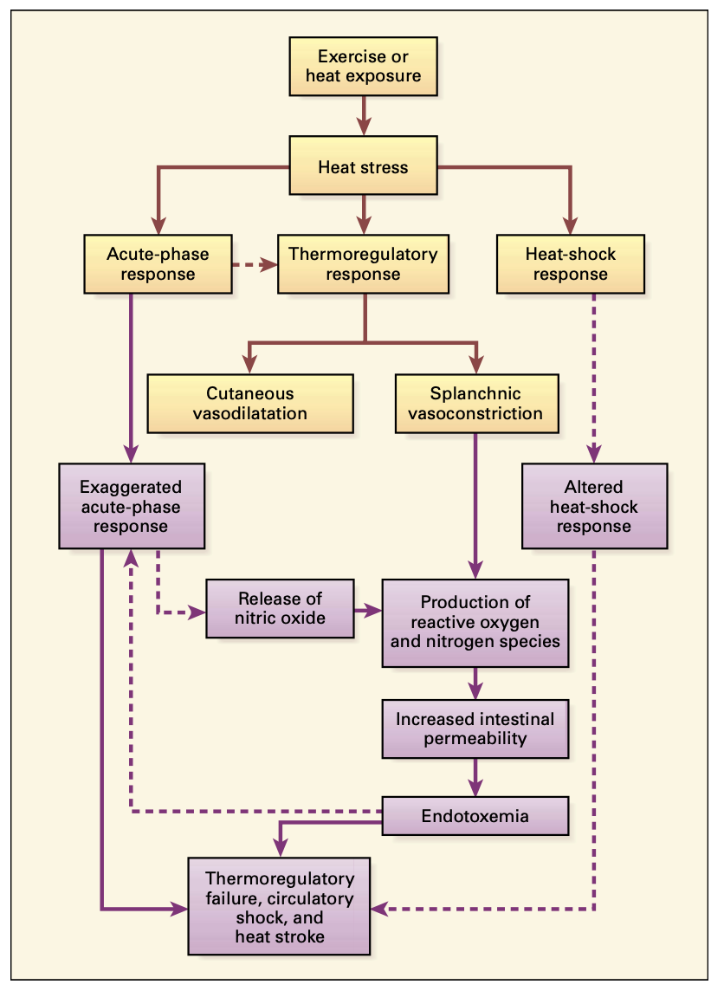

Slide 14
Heat-induced illness
Heat Cramp
Na and Cl depletion causing muscle spasm
Heat exhaustion
Fatigue, weakness, muscle tremors, vomiting, and diarrhea
Heat stroke
“Hyperthermia associated with a systemic inflammatory response leading to a syndrome of multiorgan dysfunction in which encephalopathy predominates.”
Bouchama et al 2002

Slide 15
Important Temperature Thresholds
Critical Thermal Maximum: The temperature and duration of exposure needed to cause cellular damage
  42–43 1C (107.6–109.4 1F): breakdown of intestinal mucosa and release endotoxins in primates
  41.5- 42.0 1C (106.7–107.61F): apoptosis of cultured mammalian lymphoid tissue (thymus, LN, spleen) and intestinal mucosa
    Sustained temp for 8h= thermal maximum in humans
  43.1C (109.41F) and up: Protein (enzyme) denaturization and uncoupling of oxidative phosphorylation
  45-50C (113-122F): cellular necrosis within 5 minutes

Slide 16
Coagulopathy
Direct thermal damage of endothelial surface layer
  Exposes TF and activates the extrinsic pathway
Decreased protein C and antithrombin promote hypercoagulable state
Higher temperatures promote increased fibrinolysis
  Increased D dimers, decreased plasminogen
Fibrinolysis (but not coagulation) normalizes with resolution of hyperthermic state

Slide 17
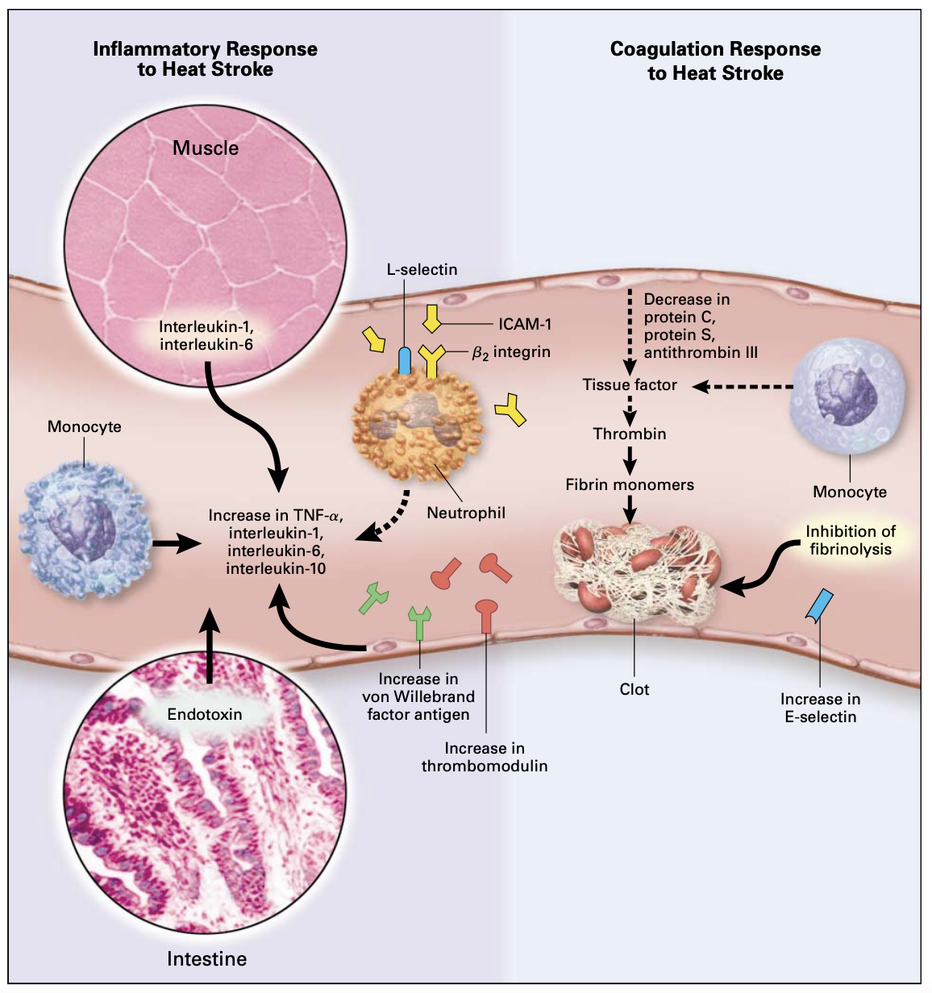

Slide 18
Clinicopathologic Changes
Increased nRBCs
  Suspected due to direct thermal damage to bone marrow
Hypoglycemia and azotemia
  Refractory hypoglycemia and progressive azotemia despite therapy associated with worse outcome in Drobatz retrospective (1996)
  Hypoglycemia less commonly seen in human heat stroke cases

Slide 19


Slide 20
Treatment

Slide 21


Slide 22
Treatment
Active cooling
  Targeting rate of cooling (rectal temp) of >0.08C/min
  Optimizing convection and radiation with cool water bath and fans
  IVF
Discontinue active cooling when body temp= 103 to prevent rebound hypothermia
Some evidence in human medicine that NSAIDs may be beneficial
  Upregulation of heat shock proteins if used prophylactically

Slide 23
Ice water?
Published standard of care for human exertional hyperthermia is cold water emersion and massage of muscles to maintain peripheral perfusion
Recent reviews and meta-analysis concluded that adequate cooling was achieved with temperate water baths with no significant differences in rates of temperature change between temperate and ice temperatures Douma et al 2020, Truxton et al (2017)

Slide 24

Alcohol?
Concerns for combustion if defibrillation is needed
Reports of human intoxication from inspired alcohol in poorly ventilated settings (Garrison et al , Senz et al)
No clinical studies of efficacy when applied to paw pads
https://www.halifaxhumanesociety.org/zupload/library/29591/-60269-700x500-0.jpg?ztv=20201203160843

Slide 25
Other Hyperthermic Emergencies

Slide 26
Malignant Hyperthermia
Result of defect in skeletal muscle Ca channel due to ryanodine receptor mutation (RyR1 gene)
Most commonly seen due to inhaled anesthetics and succinylcholine
  Non-genetic variation also in hops toxicosis
Treat with active cooling and dantrolene
  Dantrolene showed no benefit when used in classic and exertional hyperthermia
Notes:
Rosenberg H, Pollock N, Schiemann A, Bulger T, Stowell K. Malignant hyperthermia: a review. Orphanet J Rare Dis. 2015 Aug 4;10:93. doi: 10.1186/s13023-015-0310-1. PMID: 26238698; PMCID: PMC4524368.

Slide 27
Hops toxicosis
Notes:
Rosenberg H, Pollock N, Schiemann A, Bulger T, Stowell K. Malignant hyperthermia: a review. Orphanet J Rare Dis. 2015 Aug 4;10:93. doi: 10.1186/s13023-015-0310-1. PMID: 26238698; PMCID: PMC4524368.

Slide 28


Slide 29
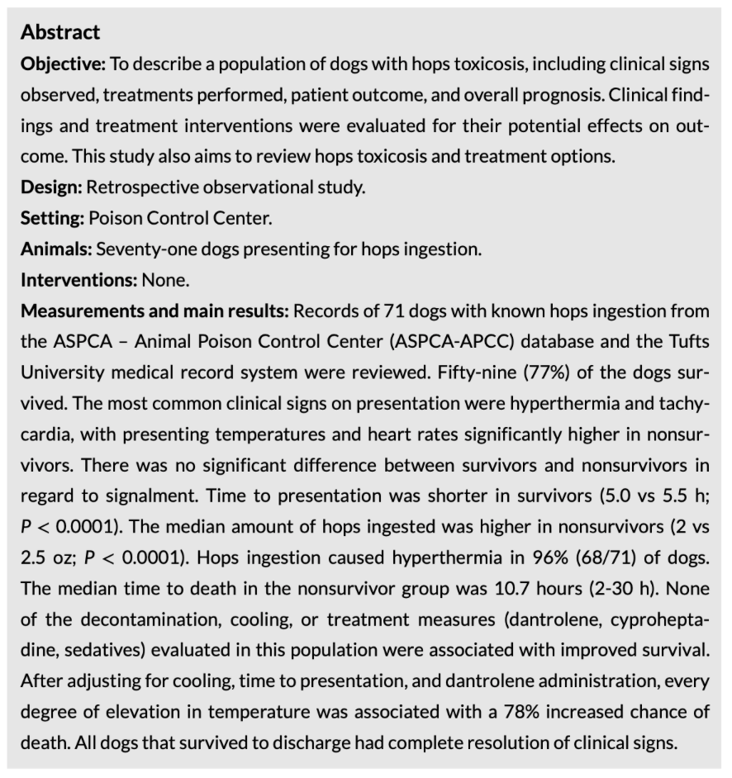
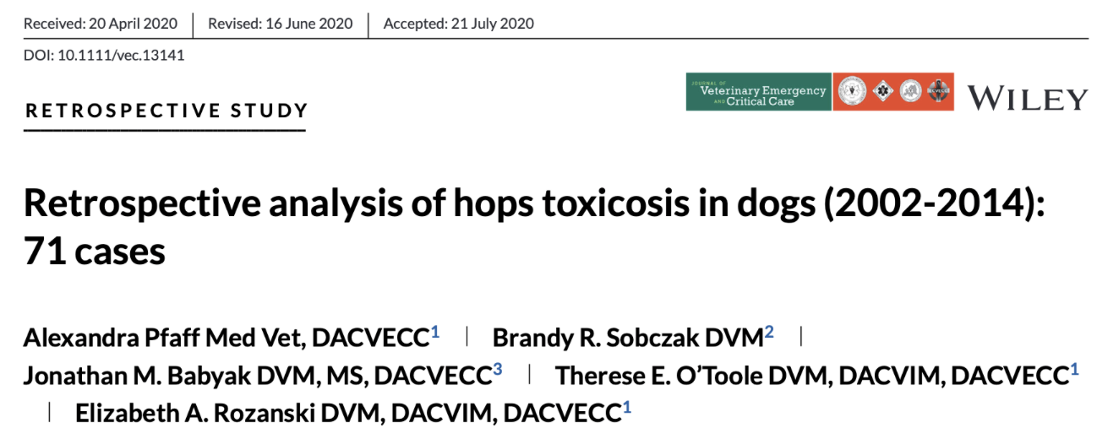
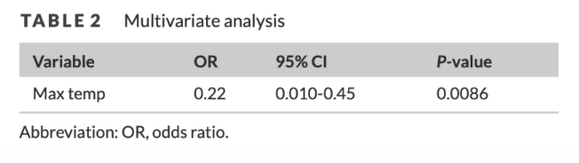
Hops toxicosis
Controlled
Notes:
Rosenberg H, Pollock N, Schiemann A, Bulger T, Stowell K. Malignant hyperthermia: a review. Orphanet J Rare Dis. 2015 Aug 4;10:93. doi: 10.1186/s13023-015-0310-1. PMID: 26238698; PMCID: PMC4524368.

Slide 30
Hypothermia

Slide 31
Pathophysiology

Slide 32
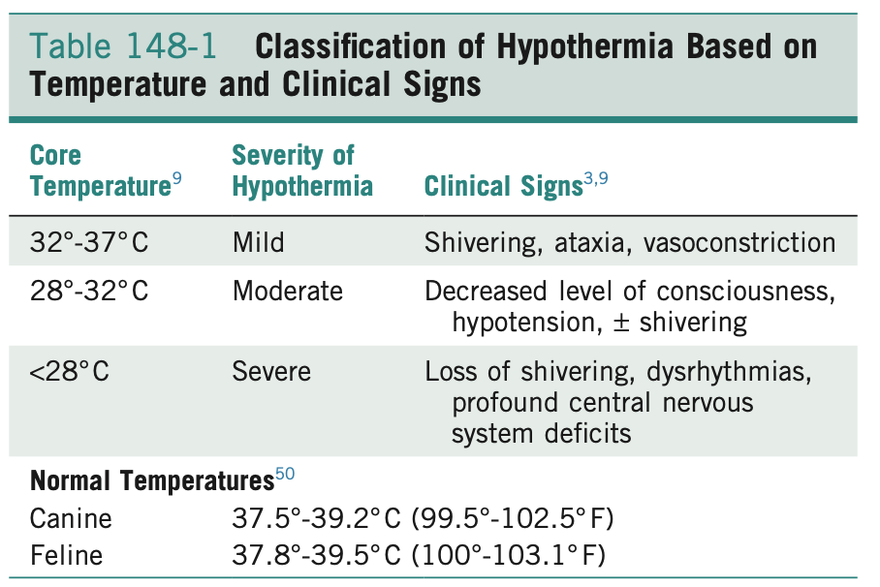
Definitions
Core body temperature <37C (98.6F)
  Primary: Due to exposure to cold environmental temperatures
  Secondary: Due to underlying pathology (trauma/disease/surgery) or as side effect of drugs
Sub-classified by severity of temperature

Slide 33
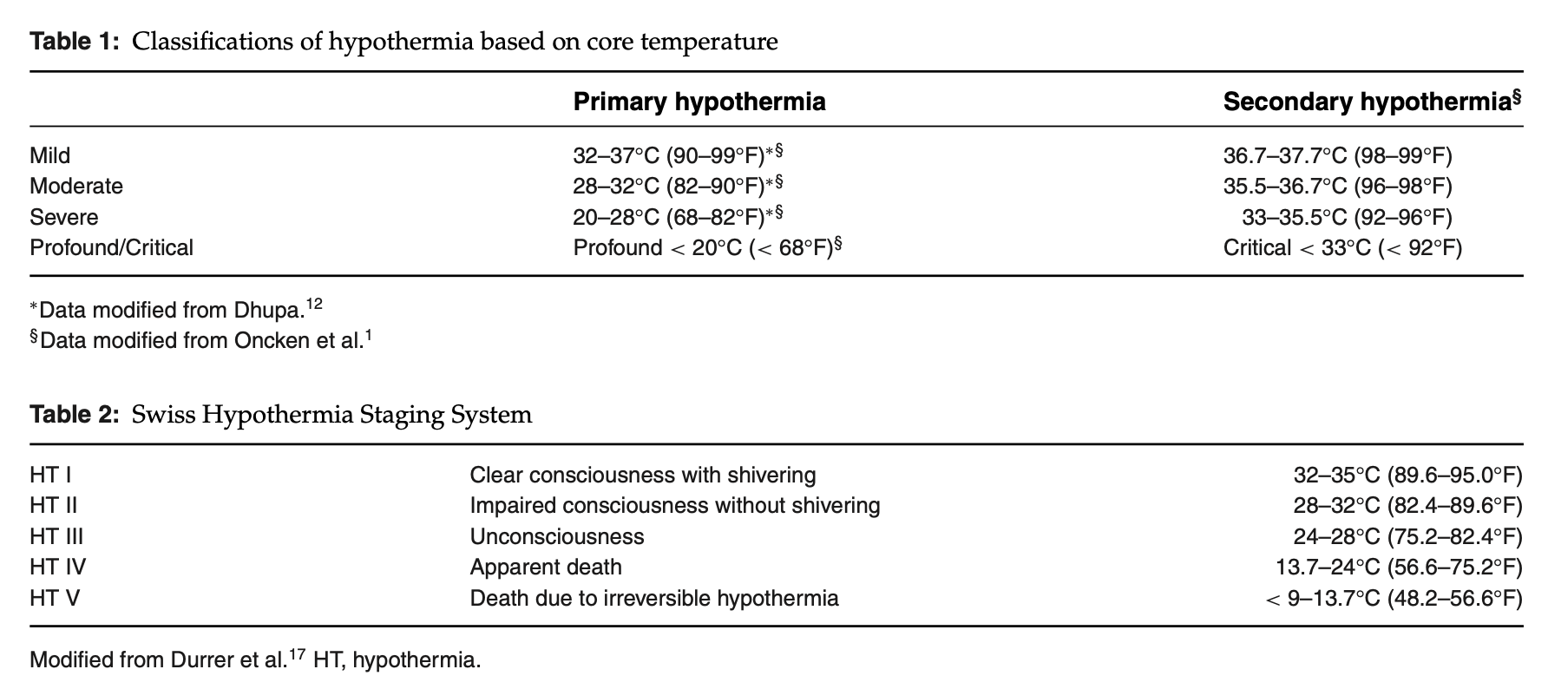

Slide 34
Depressed metabolic state
Cardiovascular state
  Initial vasoconstriction to reduce radiative heat loss from extremities and tachycardia due to sympathetic stimulation
  Progresses to bradycardia due to decreased depolarization of pacemakers

Slide 35


Slide 37
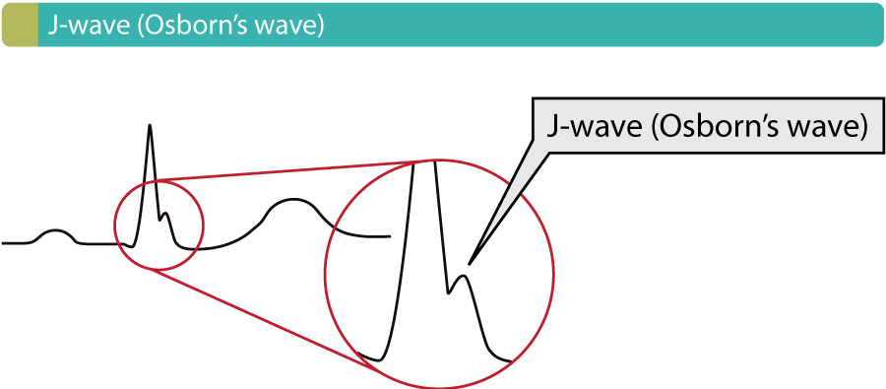
Depressed metabolic state
Cardiovascular state
  Initial vasoconstriction to reduce radiative heat loss from extremities and tachycardia due to sympathetic stimulation
  Progresses to bradycardia due to decreased depolarization of pacemakers
    NOT atropine responsive
  Prolonged cardiac conduction resulting in wide QRS complexes
    J Waves seen in human medicine, less commonly documented in vetmed
  Atrial fibrillation is the most commonly documented arrythmia in severe hypothermia
    Can progress to ventricular fibrillation with decreasing temps
    Non-responsive to defibrillation at low temps
  Arrythmias normally resolve with normalization of body temp
https://ecgwaves.com/wp-content/uploads/2016/09/ecg-osborn-j-wave-syndrome-brugada-early-repolarization-hypothermia.jpg

Slide 38
Depressed metabolic state
Neurologic state
  Mild
    Ataxia, shivering, seeking shelter
  Moderate
    Loss of shivering reflex, hyporeflexia
    Decreased mentation due to decreased cerebral blood flow
      6-7% decreased blood flow for every 1C drop in temp below 28C (83F)
  Severe
    Cerebral edema due to decreased blood flow/ischemia
    Increased tolerance of ischemia due to decreased metabolic demand in hypothermia

Slide 39
Depressed metabolic state
Renal and volume state
  Cold diuresis: increased renal perfusion secondary to fluid shifts secondary to peripheral vasoconstriction
  Progressive (moderate to severe) hypothermia causes decreased ADH activity
  Volume loss with concurrent cardiovascular changes results in severe shock state

Slide 40


Slide 41
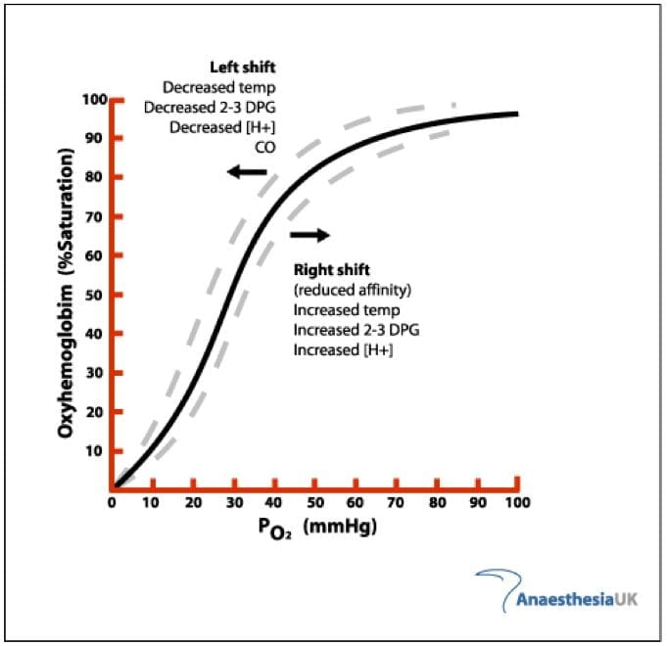
Depressed metabolic state
Respiratory
  Decreased CO2 production secondary to depressed metabolic state leads to decreased minute ventilation
  Left shift of the oxygen-Hb saturation curve at 30C (86F)
    Concurrent decreased metabolic requirements of tissues
    Peripheral tissue hypoxia occurs due to decreased oxygen delivery and increased blood viscosity due to volume loss
https://litfl.com/wp-content/uploads/2019/01/Hb-O2-dissociation-curve.jpg

Slide 42
Coagulopathy
Hypothermia directly inhibits clotting enzymes in vivo
  Hard to measure clinically as PT/aPTT are generally run at room temp
Sequestration of platelets in spleen/liver at low temps
  Decreased platelet function at low temps
    Decreased vWF, TXA2 and platelet granule secretion

Slide 43
Treatment

Slide 44
Rewarming
Targeted rewarming rate of 0.5-2C/hr
Techniques
  Passive external rewarming: best in mild hypothermia when patients are shivering
    Ex: blanket around patient
  Active external rewarming: best in moderate/severe hypothermia with no shivering
    Ex: Bair hugger, hotdog, hot waterbottles
  Active core rewarming: Best in moderate to severe cases of hypothermia
    Ex: warmed (40-42C) IVF, Warmed inspired air
    Ex: Peritoneal and/or pleural lavage

Slide 45
Rewarming Complications
Rewarming shock:
  Rewarming leads to peripheral vasodilation and relative hypovolemia
Rewarming acidosis:
  Most common when extremities warmed before core
  Return of cold blood with high lactate loads to the core

Slide 46
Therapeutic hypothermia

Slide 47
Clinical uses of hypothermia
Post-arrest state: mild hypothermia (32-34C (89-93.2F)) is neuroprotective
  Prevents cellular injury due to suppression of destructive enzymes and ROS and decreased apoptosis
  Use supported by 2012 RECOVER guidelines

Slide 48
References
Adami, Chiara, Shannon Axiak, Karina Raith, and Claudia Spadavecchia. " Unusual perianesthetic malignant hyperthermia in a dog". Journal of the American Veterinary Medical Association 240.4 (2012): 450-453. <https://doi.org/10.2460/javma.240.4.450
Bouchama A, Knochel JP. Heat stroke. N Engl J Med. 2002 Jun 20;346(25):1978-88. doi: 10.1056/NEJMra011089. PMID: 12075060.
Brodeur, A. Wright, A, Cortes, Y. Hypothermia and targeted temperature management in cats and dogs. JVECC 2017 doi: 10.1111/vec.12572
Douma MJ, Aves T, Allan KS, Bendall JC, Berry DC, Chang WT, Epstein J, Hood N, Singletary EM, Zideman D, Lin S; First Aid Task Force of the International Liaison Committee on Resuscitation. First aid cooling techniques for heat stroke and exertional hyperthermia: A systematic review and meta-analysis. Resuscitation. 2020 Mar 1;148:173-190. doi: 10.1016/j.resuscitation.2020.01.007. Epub 2020 Jan 22. PMID: 31981710.
Drobatz KJ, Macintire DK. Heat-induced illness in dogs: 42 cases (1976-1993). J Am Vet Med Assoc. 1996 Dec 1;209(11):1894-9. PMID: 8944805.
GARRISON RF. Acute poisoning from use of isopropyl alcohol in tepid sponging. J Am Med Assoc. 1953 May 23;152(4):317-8. doi: 10.1001/jama.1953.63690040001007. PMID: 13044524.

Slide 49
References
Johnson S, McMichael, M. White, S. Heatstroke in small animal medicine: a clinical practice review . JVECC 2006 https://doi.org/10.1111/j.1476-4431.2006.00191.x
Pfaff A, Sobczak BR, Babyak JM, O'Toole TE, Rozanski EA. Retrospective analysis of hops toxicosis in dogs (2002-2014): 71 cases. J Vet Emerg Crit Care (San Antonio). 2021 Sep 9. doi: 10.1111/vec.13141. Epub ahead of print. PMID: 34498796.
Rosenberg H, Pollock N, Schiemann A, Bulger T, Stowell K. Malignant hyperthermia: a review. Orphanet J Rare Dis. 2015 Aug 4;10:93. doi: 10.1186/s13023-015-0310-1. PMID: 26238698; PMCID: PMC4524368.
SENZ EH, GOLDFARB DL. Coma in a child following use of isopropyl alcohol in sponging. J Pediatr. 1958 Sep;53(3):322-3. doi: 10.1016/s0022-3476(58)80219-x. PMID: 13576384.
Silverstein and Hopper SACCM 2e 2015
Truxton TT, Miller KC. Can Temperate-Water Immersion Effectively Reduce Rectal Temperature in Exertional Heat Stroke? A Critically Appraised Topic. J Sport Rehabil. 2017 Sep;26(5):447-451. doi: 10.1123/jsr.2015-0200. Epub 2016 Aug 24. PMID: 27632869.

