Slide 1
Gastrointestinal Disease
TOXINS, ULCERS, and HEMMORHAGE OH MY

Slide 2
Gastrointestinal Hemorrhage

Slide 3
pollev.com/jamieselman011 or text JAMIESELMAN011 to 22333

Slide 4
What is the most common cause of gastrointestinal hemorrhage in dogs and cats?
Ulcers
Coagulopathies
H. Pylori infection
Vascular Abnormalities

Slide 5
Etiology
Ulcers
Coagulopathies
Vascular Abnormalities
Notes:
The severity of GI hemorrhage associated with ulcers varies with the degree and extent of mucosal erosion
Related to the size of the arterial defect and the diameter of the artery

Slide 6
Physiology Review
Secretory cells of stomach
Cell | Secretes | Function
Parietal Cell
Chief Cell
G Cell
Mucous Cells

Slide 7
Physiology Review
Cell | Secretes | Function
Parietal Cell | Intrinsic Factor, HCL | Acidifies gastric contents IF essential for absorption of B12 HCL initiates digestion
Chief Cell
G Cell
Mucous Cells

Slide 8
Physiology Review
Cell | Secretes | Function
Parietal Cell | Intrinsic Factor, HCL | Acidifies gastric contents IF essential for absorption of B12 HCL initiates digestion
Chief Cell | Pepsinogen | Neutralize gastric mucosa and initiate digestion
G Cell
Mucous Cells

Slide 9
Physiology Review
Cell | Secretes | Function
Parietal Cell | Intrinsic Factor, HCL | Acidifies gastric contents IF essential for absorption of B12 HCL initiates digestion
Chief Cell | Pepsinogen | Neutralize gastric mucosa and initiate digestion
G Cell | Gastrin | Stimulates H+ secretion
Mucous Cells

Slide 10
Physiology of gastrointestinal ulceration
Review
Cell | Secretes | Function
Parietal Cell | Intrinsic factor, HCl | Acidifies gastric contents IF essential for absorption of B12 HCL initiates digestion
Chief Cell | Pepsinogen | Neutralize gastric mucosa and initiate digestion
G Cells | Gastrin | Stimulates H+ secretion
Mucous Cells | Mucus, HCO3-, pepsinogen | Mucus protects gastric mucosa from corrosive effects of HCL and lubricates gastric contents HCO3- and pepsinogen neutralize gastric mucosa

Slide 11
What are the cells that stimulate HCL secretion from parietal cells?
Histamine → bind to H2 receptors → activate adenylate cyclase and increase cAMP → activates protein kinase A → increases secretion of H+
Ach → released from vagus nerves and binds to muscarinic receptors on parietal cells
  Also indirectly increases histamine release
Gastrin → secreted into circulation and delivered back to stomach → binds to CCKb

Slide 12
Pepsinogen Secretion
Pepsinogen secreted by chief cells and mucus cells
When the PH of gastric contents is lowered by H+ secreted from parietal cells, pepsinogen is converted to pepsin, beginning the process of protein digestion
In the gastric phase of H+ secretion, vagal stimulation is the most important stimulus for pepsinogen secretion

Slide 13
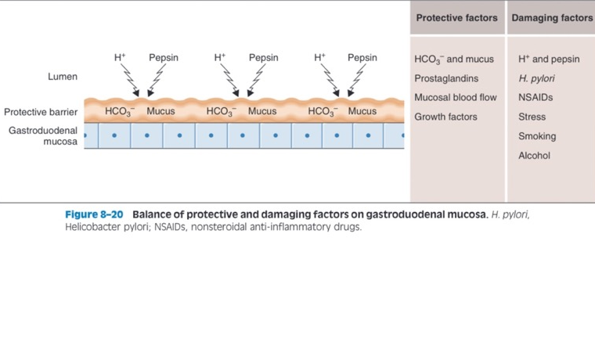
Gastroduodenal mucosa
Notes:
H. pylori, smoking, or alcohol tend not to be damaging factors in our dogs and cats

Slide 14
Peptic Ulcer Disease
Mucus prevents the gastric mucosal epithelium from coming into contact with acidic gastric contents and the digestive enzyme pepsin
  Mucus forms a gel like protective barrier between cells and gastric lumen
  Gastric epithelial cells produce HCO3- which get trapped in mucus
  If acid penetrates mucous it is neutralized by HCO3-
Peptic ulcer disease is an ulcerative lesion of the gastric or duodenal mucosa
  Caused by erosive and digestive action of H+ and pepsin on mucosa
  Must have:
    Loss of protective mucus barrier
    Excessive H+ and pepsin secretion
    Combination of the two

Slide 15
Which of the options below are protective factors of the gastrointestinal mucosa?
H+
Pepsin
Mucus
HCO3-
Growth factors
A and B
B and D
C, D, and E

Slide 16
ULCERATION
Drugs
  NSAIDs*
  Glucocorticoids
Systemic and metabolic disease
  Hepatic disease*
  Uremia
  Pancreatitis
  Hypoadrenocorticism
Ischemic events
  GDV
  Mesenteric volvulus
  Mesenteric thrombosis
  Intussusception
Neurologic disease
  Head trauma
  IVDD
Foreign bodies
Fungal infections
  Pythium
  Histoplasma
Bacterial infections
  Salmonella
  Clostridium spp
  Campylobacter
  Helicobacter?
Notes:
Most common risk factor NSAIDs and hepatic disease
In humans it is NSAIDs and h. pylori

Slide 17
ULCERATION
Parasitic infections
  Hookworms
  Whipworms
  Coccidia
Viral infections
  Parvovirus
  Coronavirus
Algal infections
  Protothecosis
Stress of critical illness
  Major surgery
  Hypovolemia
  Sepsis
Gastrointestinal neoplasia
  Lymphoma
  Adenocarcinoma
  Leiomyoma
  Leimyosarcoma
  Hemangioma
Systemic neoplasia
  Mastocytosis
  Gastrinoma
Misc
  IBD
  Polyps
  Idiopathic eosinophilic masses
  HGE
Notes:
Neoplasia is a more common risk factor for cats
Systemic mastocytosis, gastrinoma, intestinal lymphoma, and adenocarcinoma are the most commonly reported tumors
IBD nay be a an important non neoplastic cause for both dogs and cats
Stress ulcers are more common in humans but have been reported after hypovolemia and surgery but the true incidence of stress induced ulcers has not been determined
I am going to go over some of the pathogenesis of ulcer creation, but not all
Some are self explanatory, such as disease processes that cause hypovolemia leading to direct ischemia of the GI mucosa leading to ulceration
Others that are self explanatory are neoplasias that directly invade the mucosa and the blood supply

Slide 18
Uremia
Peters et. Al, 2005, J of Internal med
  Retrospective study of 28 uremic patients that had post-mortem’s performed
  Dogs with renal failure had a higher prevalence of gastric histopathologic changes than with the control group
    Edema, vacuolization, mineralization
    1 patient had gastric ulceration
Pathophysiology unclear in human studies
  Increased gastric acid
  H. pylori colonization
  Increased gastrin concentration due to decreased excretion
In veterinary literature most commonly reported in the fundus
Notes:
Conclusion was that gastric ulceration with uremia is not in common in dogs as it is in people

Slide 19
Hepatic Disease
The liver inactivates some forms of gastrin
Hypergastrinemia has been implicated in the pathogenesis of gastric ulceration associated with hepatic disease
Hepatic damage may cause release of gastric secretagogues (promotes secretion of gastrin)
Most commonly duodenal ulcers but can see pyloric antrum

Slide 20
NSAIDs and steroids
NSAIDs
  Inhibition of prostaglandin synthesis via inhibition of cyclooxygenase
  Prostaglandins influence or mediate
    Mucus and HCO3- secretion
    Mucosal blood flow
    Epithelial cell turnover and repair
    Mucosal immunocyte function
  Topical irritant properties
    Ion trapping allows accumulation of NSAIDs in epithelial cells
    NSAID can decrease hydrophobicity of mucus layer in stomach
    Neutrophils can be attracted to mucus capillaries where they form thrombi and obstruct capillaries
  - Ulcerations most seen in pyloric antrum
Steroids
  High doses of steroids inhibit prostaglandin synthesis via inhibition of phospholipase
  Inhibits gastric alkaline response
  Reduces mucosal blood flow, reducing ability of GI mucosa protective factors
  Ulcers often seen with other predisposing factors
Notes:
The causes of the ulcerogenic effects of NSAIDs in the stomach are thought to be twofold. The first is the ability of these drugs to suppress prostaglandin synthesis.
Gastrointestinal mucosal defense mechanisms are influenced or mediated by prostaglan- dins, including mucus and bicarbonate secretion, blood flow, epithelial cell turnover and repair, and mucosal immunocyte function
The second mechanism of action is the topical irritant properties of NSAIDs. Epithelial damage may be related in part to ion trapping, a phenomenon that allows accumulation of NSAIDs in these cells, and in part to the ability of NSAIDs to decrease the hydrophobic- ity of the mucous layer in the stomach (the primary barrier to damage induced by acid). Most NSAIDs have been shown to impair gastric mucosal microcirculation and cause gastric mucosal damage. After NSAID administration, neutrophils can be attracted to muco sal capillaries, where they form thrombi and obstruct capillaries.

Slide 21
Hypoadrenocorticism
Glucocorticoids have important influence on the epithelial integrity and vascular permeability and can act as trophic (growth) factors for the GI mucosa
Possible that lack of glucocorticoids predisposes to mucosal erosions and ulcers
Notes:
Trophic means encouraging growth

Slide 22
Bacterial Infections
Associated with colonization of GI mucosa and likely subsequent enterotoxin or endotoxin release
H. Pylori
  Directly colonizes gastric mucus, attaches to gastric epithelial cells, and releases cytotoxins that break down the protective mucous barrier and underlying cells
Notes:
Salmonella
Clostridium spp
Campylobacter
Helicobacter?

Slide 23
Gastrinoma (Zollinger-Ellison Syndrome)
Highest rates of H+ secretion
Usually a tumor in the pancreas that secretes large quantities of Gastrin
  Increase H+ secretion by parietal cells
  Increased parietal cell mass
Delivery of excess H+ to duodenum overwhelms buffering capacity of HCO3- and produces ulcer

Slide 24
IBD/PLE
Inflammation or loss of protective mucus GI barrier
Diseases most associated with PLE
  Lymphocytic plasmacytic
  Eosinophillic
  Granulomatous inflammatory bowel disease
  Lymphangectasia
  GI fungal disease
  Diffuse neoplasia

Slide 25
HGE or AHDS
Disease of unknown cause
Typically affects young to middle age, small breed dogs
Suspected causes
  Abnormal immune response to bacteria
  Bacterial endotoxin
  Dietary indiscretion
  C. perfringens
Peracute onset of clinical signs that can progress rapidly without appropriate intervention
  Hemorrhagic diarrhea
  Vomiting
  Anorexia
  Increase in PCV (splenic contraction and hemoconcentration)
  Normal, slightly increased, or slightly decreased TS
    GI loss of serum proteins
    Redistribution of body water into vascular space

Slide 26
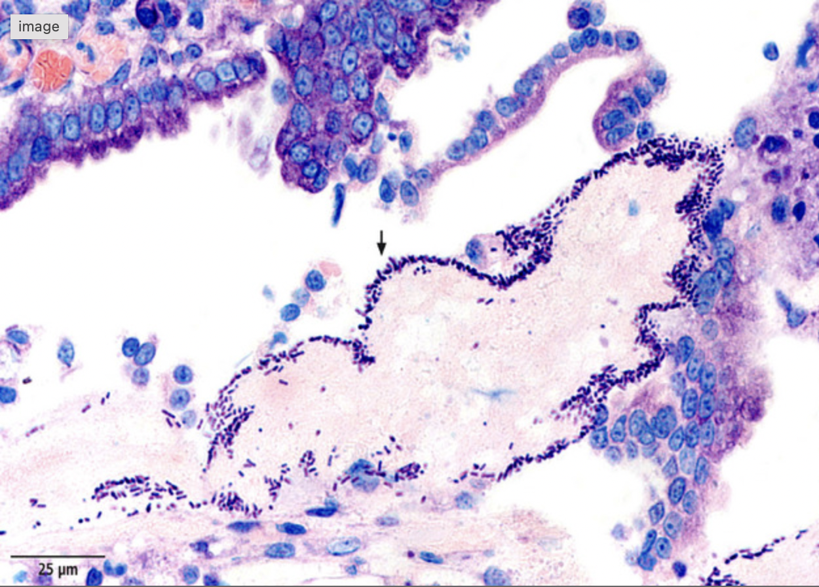
HGE/AHDS
Histopathology of GI tract from 10 dogs with HGE (Unterer et. Al 2013)
  Acute mucosal necrosis of SI and colon (10/10)
  Neutrophilic inflammation of SI and colon (10/10)
  Rod shaped bacteria adhered to necrotic mucosal surfaces (9/10)
Enterotoxins most logical explanation for destructive mucosal lesions
Notes:
- No lesions in stomach, that’s why its called AHDS now; but vomiting is often part of disease process; maybe hematemesis can be explained by duodenal inflammation

Slide 27
What is/are the most common causes of ulcerative disease in dogs?
Bacterial colonization of gastric mucosa
Neoplasia
Hepatic disease
NSAIDs
Uremia

Slide 28
Coagulopathies
Rodenticide toxicity (coumadin like)
DIC
Coagulation factor deficiencies
Thrombocytopenia
Notes:
Not as common in cats as a cause of GI bleed
Thrombocytopenia is the most common of this list

Slide 29
Vascular anomalies
Very few reports in veterinary literature
Only consider when all other causes have been ruled out

Slide 30
HISTORY
Owners may report clinical signs
  Hematemesis
  Hematochezia
  Melena
  Bleeding from other sites if coagulopathy
Differentials
  Hemorrhage of nasal cavity or oral pharynx (hematemesis)
  Activated charcoal, metronidazole, pepto-bismol, diets high in iron (melena)
History of NSAID administration

Slide 31
PHYSICAL EXAM
Some patients will present in shock
Abdominal palpation
  Pain
  Nausea
  Masses or FB
  Abdominal distension or fluid wave
Rectal exam
  Frank blood
  Melena
  Masses
Notes:
With extensive hemorrhage, vomiting, diarrhea, or ulcer perf, some patients will present in a state of shock resulting from blood loss, hypovolemia, endotoxemia, or sepsis
Tachycardia, Thready peripheral pulses, Prolonged CRT, Pale mucous membranes
Resuscitative measures should be performed immediately before continuing on with remainder of localization and specific therapies are initiated

Slide 32
Localization of GI bleed
Upper GI lesion
  Hematemesis
  Melena
Lower GI lesion
  Hematochezia
Notes:
Important because the cause, diagnostic tests, and therapies may vary
Upper GI hemorrhage seems to be more severe
Lower GI lesion such as large intestinal, rectal, or anal hemorrhage
Delayed GI transit time and retention of blood in the colon could result in melena associated with a lower GI tract lesion
Severe intestinal hemorrhage can act as a cathartic, significantly decreasing GI transit time resulting in hematochezia with an upper GI bleed

Slide 33
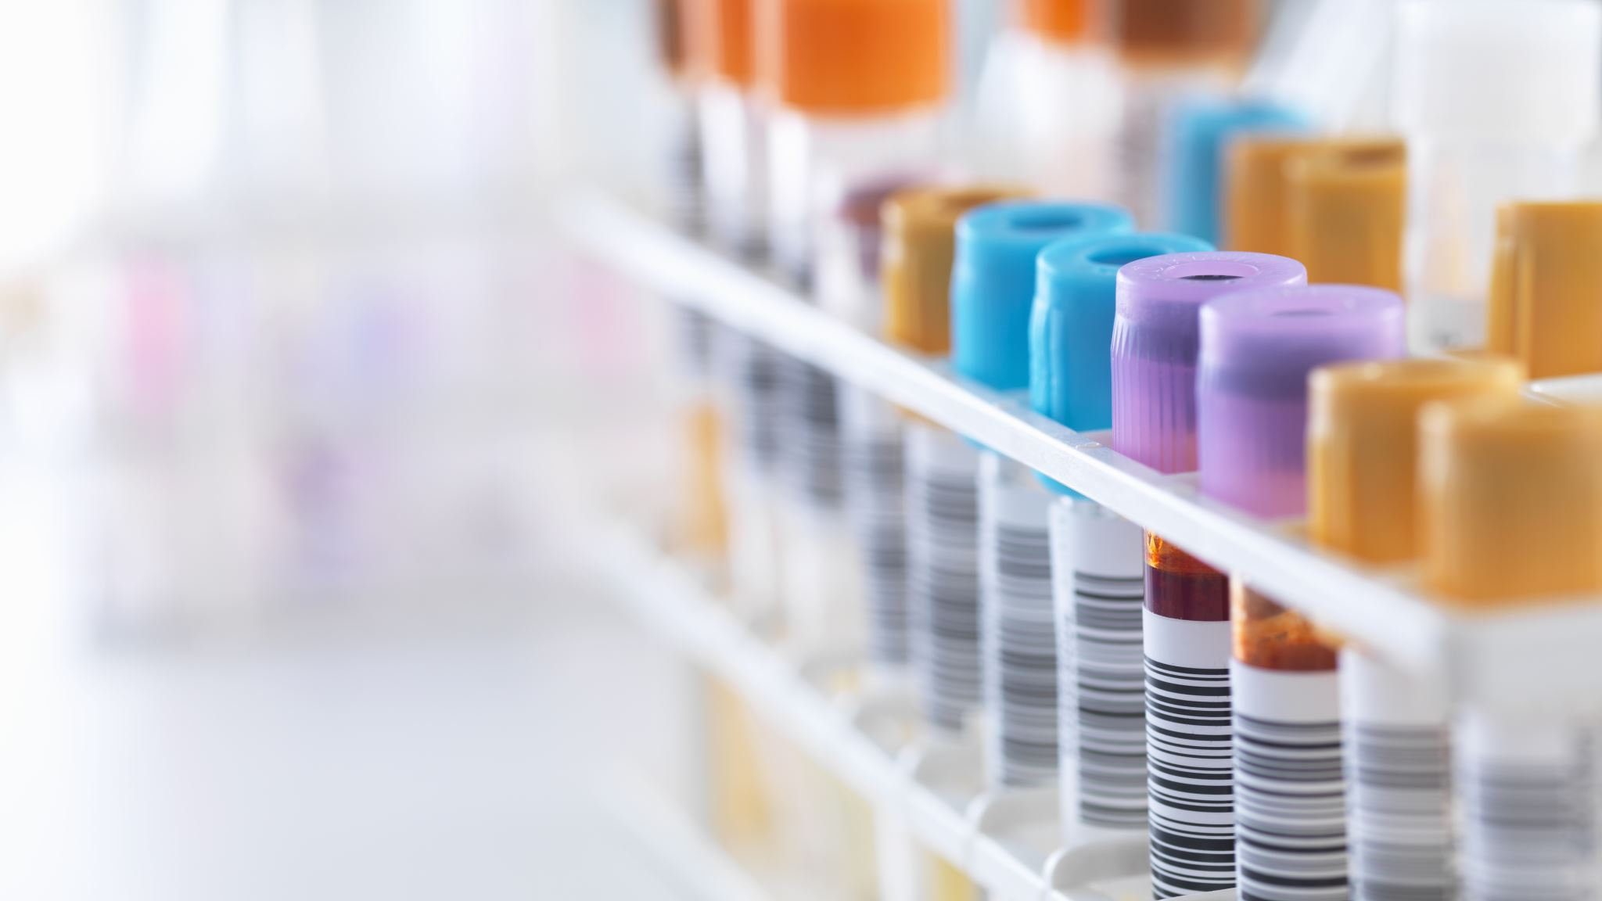
Diagnostic Tests to Detect GI Hemorrhage
Notes:
Link that thing where you type in answers
-

Slide 34
DIAGNOSTIC TESTS FOR DETECTION
CBC
  Chronic: microcytic hypochromic anemia
  Acute: normocytic normochromic anemia
CHEMISTRY
  Discordant azotemia
Fecal occult
  Rely on peroxidase activity of hemoglobin
  Feed meat-free diet for 72 hours
  Negative doesn’t rule out bleed
Ddx for discordant azotemia
  Fever
  Burns
  Infections
  Starvation
  Administration of glucocorticoids
Ddx for positive fecal occult
  Diet with red meat, fish, fruits, or vegetables
  Peroxidase producing bacteria in GI tract
Notes:
Discordant azotemia explained by volume depletion and intestinal absorption of proteins including digested blood, into the circulatory system
Diseases resulting in increased protein metabolism also may result in an increased BUN to creatinine ratio
In cases where significant GI bleeding is suspected, can pass NG tube to aspirate GI contents to confirm and localize the bleed; may cause discomfort or false negative results

Slide 35

DIAGNOSTIC TESTS TO IDENTIFY ETIOLOGY

Slide 36
DIAGNOSTIC TESTS FOR ETIOLOGY
Coagulation profile
CBC/CHEM + lytes
Resting cortisol or ACTH stim testing
Gastrin levels
  Recurrent GI ulceration
  Cases that fail medical management
If infectious disease suspected
  Fecal smear
  Culture
  Parvovirus testing
Notes:
Coagulation profile
Rodenticide or clotting factor deficiencies
May detect prolonged bleeding times that are not the direct cause of GI hemorrhage
CBC/CHEM + lytes
Rule out ITP, common cause of moderate to severe GI hemorrhage in dogs
Elevated crit in a patient with acute hemorrhagic diarrhea with a relatively normal protein is suggestive of AHDS/HE
Biochemical markers of hepatic and/or renal disease may be evident (ALP/ALT, tbilli; BUN, creat, phos)
Resting cortisol or ACTH stim testing
Rule out hypoadrenocorticism as a cause for GI bleeding if other causes cannot be found
Abdominal radiographs or abdominal ultrasound
Endoscopy

Slide 37
IMAGING
Radiographs
  Foreign bodies
  Masses
  Free air
Ultrasonography
  In addition to above
  Intestinal wall structure and thickness
  Defect of crater in intestinal wall
  Used serially to assess response to therapy and need for surgery
Endoscopy
  Most sensitive test for upper GI hemorrhage
  Provides diagnosis, therapeutic, prognosis
  Direct visualization of mucosa
  Biopsies for histology and culture
  Disadvantages
    Anesthesia
    Limitation to proximal GI and colon
    Iatrogenic ulceration
    Worsening GI hemorrhage
Notes:
Pneumoperitoneum is suggestive of GI perforation if no recent surgery
Contrast radiographic study may identify gastrointestinal mucosal defects, it has largely been replaced by AUS and endoscopy
Endoscopy can be therapeutic to retrieve GI foregin bodies

Slide 38
If these diagnostic tests fail
Abdominal exploratory surgery
Scintigraphy using technetium-labeled RBCs
  Aid in localization
Arteriography
  GI vascular abnormalities
Notes:
- If there is significant ongoing loss and these previous therapies fail, other diagnostics documented are

Slide 39
TREATMENT

Slide 40
Treatment goals
Stabilize cardiovascular system
Control ongoing hemorrhage
Treat existing ulcers
Prevent bacterial translocation
Identify and address underlying cause
Notes:
Because of the vast causes of GI hemorrhage, therapy directed at underlying cause is variable
Also important to address concurrent disease that may exacerbate GI hemorrhage (such as a uremic patient on NSAIDs)

Slide 41
Name some treatments for GI ulceration/hemorrhage
Poll everywhere

Slide 42
BLOOD PRODUCTS
Address any potential shock with appropriate fluid resuscitation
Transfusion if necessary
  Hematocrit at which a transfusion is necessary depends on
    Degree and rate of blood loss
    Hemodynamic status
    Initial and subsequent hematocrits
    Concurrent illness
    Severity of clinical signs
  If patient displays clinical signs secondary to decrease in O2 delivery
    Tachycardia
    Hyperlactatemia
    Tachypnea
  Serial hematocrit reveal decrease despite therapy
Patients that need blood products in treatment protocol have a fair to poor prognosis (29-45%)
Notes:
Guidelines regarding when to transfuse patients with GI hemorrhage that are anemic but cardiovascular stable are not well establish in vet medicine
Most GI ulceration/hemorrhage is self limiting and the prognosis varies with the underlying cause; however patients that need blood products as a component of therapy have a much worse prognosis

Slide 43
Additional therapies
Discontinue medications known to cause ulcers unless essential
Fresh frozen plasma
  Primary coagulopathy
  Exacerbated by a secondary coagulopathy
Vincristine
  Releases platelets from bone marrow
  Function of platelets?
GI protectants
  Acid inhibitors
    H2 receptor antagonists
    Proton pump inhibitors
  Mucosal binding agents
    sucralfate
  Synthetic prostaglandins
    Misoprostol
Antiemetics
Analgesics
Antibiotics
Notes:
At one time saline gastric lavage was recommended but its not proven to slow hemorrhage and all it does it cause discomfort and rapidly decrease body temp
Aka pred is essential for an ITP or for cushing’s
Reasonable to give GI protectants with hematemesis and/or melena, as ulcers are the most common cause of GI hemorrhage in dogs, and GI protectants have a wide safety margin
Intraluminal gastric acid neutralizers may slow GI hemorrhage by promoting mucosal homeostasis
Be careful when administering oral medication in critically ill patients
absorptions of oral medications questionable if GI hypoperfusion present
Also take into consideration if your patient is vomiting
What is the best therapy?
Unknown
There is a paper that shows that famotidine, omeprazole, pantoprazole significantly suppress gastric acid secretion in dogs, but ranitidine sucks
Misoprostol not typically used but may provide additional benefit in the case of NSAID toxicity

Slide 44
Antibiotics in GI Hemorrhage
Risk of bacterial translocation
  Significant GI hemorrhage
  Suspect mucosal barrier compromise
  Sepsis
Antibiotic choice
  Blood and urine cultures when able
  Broad spectrum
Notes:
- Not necessary in cases where GI mucosal barrier compromise not suspected such as ITP; recent study shows antibiotic use did not change outcome

Slide 45
When medical management fails
Endoscopic hemostasis
  Injecting epinephrine or 98% alcohol through sclerotomy needle into base of ulcer
  Endoclips
  Endoscopic cautery
  Fibrin/thrombin injections
Surgery
  Pre-existing surgical disease
  Patients at risk for exsanguination or perforation
Human studies
  Percutaneous angiography and embolization
  Upper GI endoscopy can identify the source of bleeding in 95% of cases and endoscopic therapy is effective in 80-90% of patients
  Active arterial bleeding or visualization of clot associated with high risk of rebleeding
Notes:
Endoscopic hemostasis used in human medicine

Slide 46
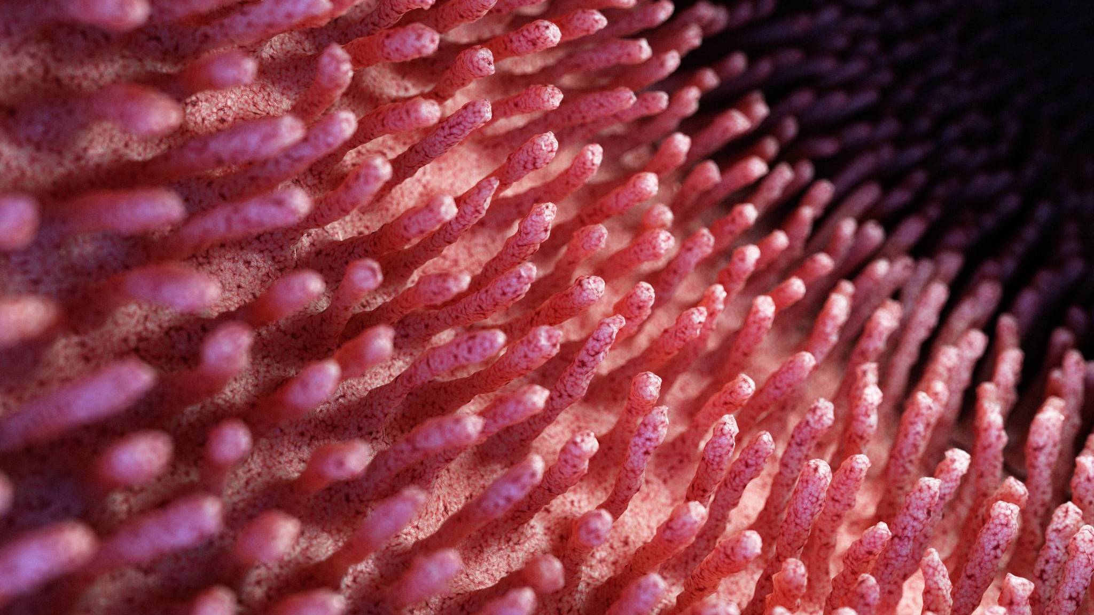
Gastrointestinal Toxins
Notes:
There’s a whole bunch; lets name some

Slide 47
Toxic Plants
There are so many!
Decontamination and supportive care
Many toxic plants cause vomiting, but some cause delayed vomiting
Resource for specific treatment when necessary
  Small Animal Toxicology, Chapter 27, Household and Garden Plants
  Table 27-1, pages 372-396

Slide 48
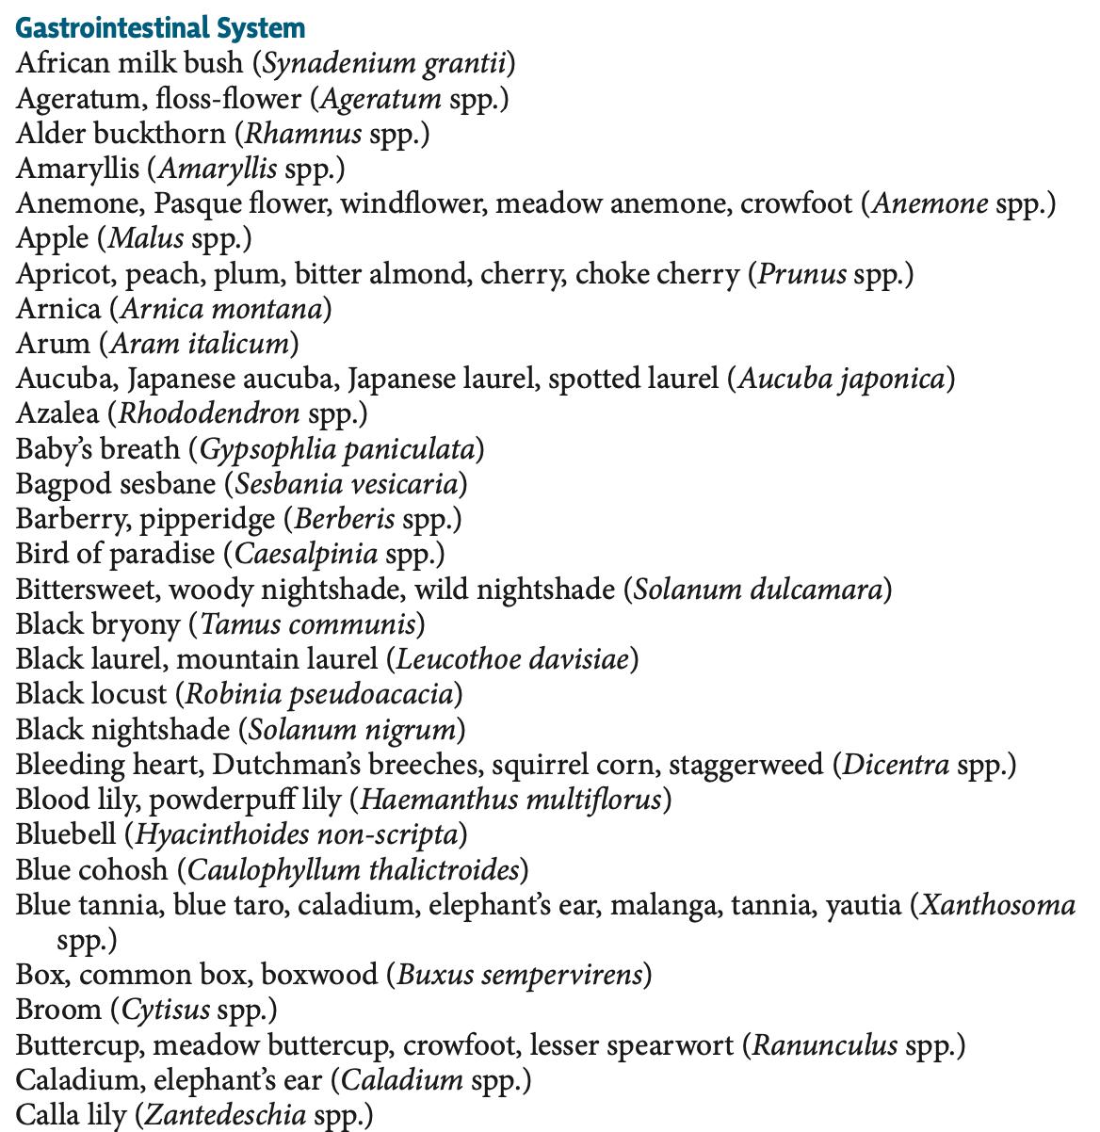
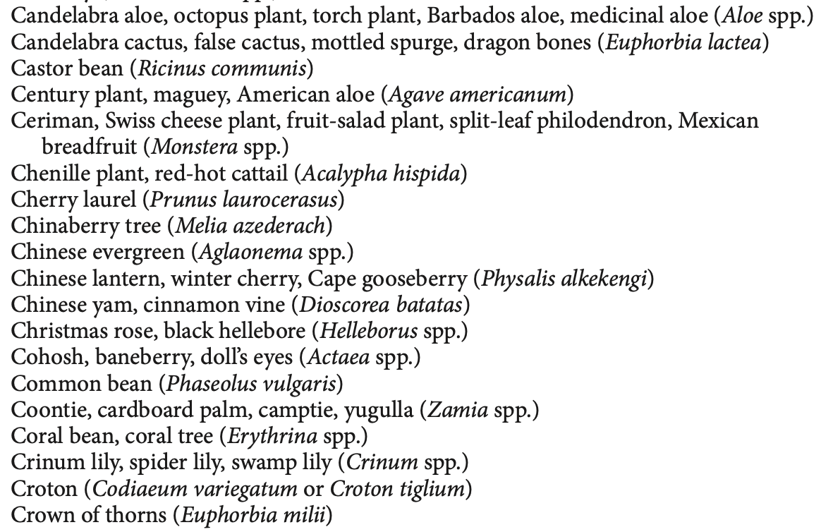
Notes:
There are so many toxic plants its impossible to go over all of them
A large proportion of them cause vomiting

Slide 49
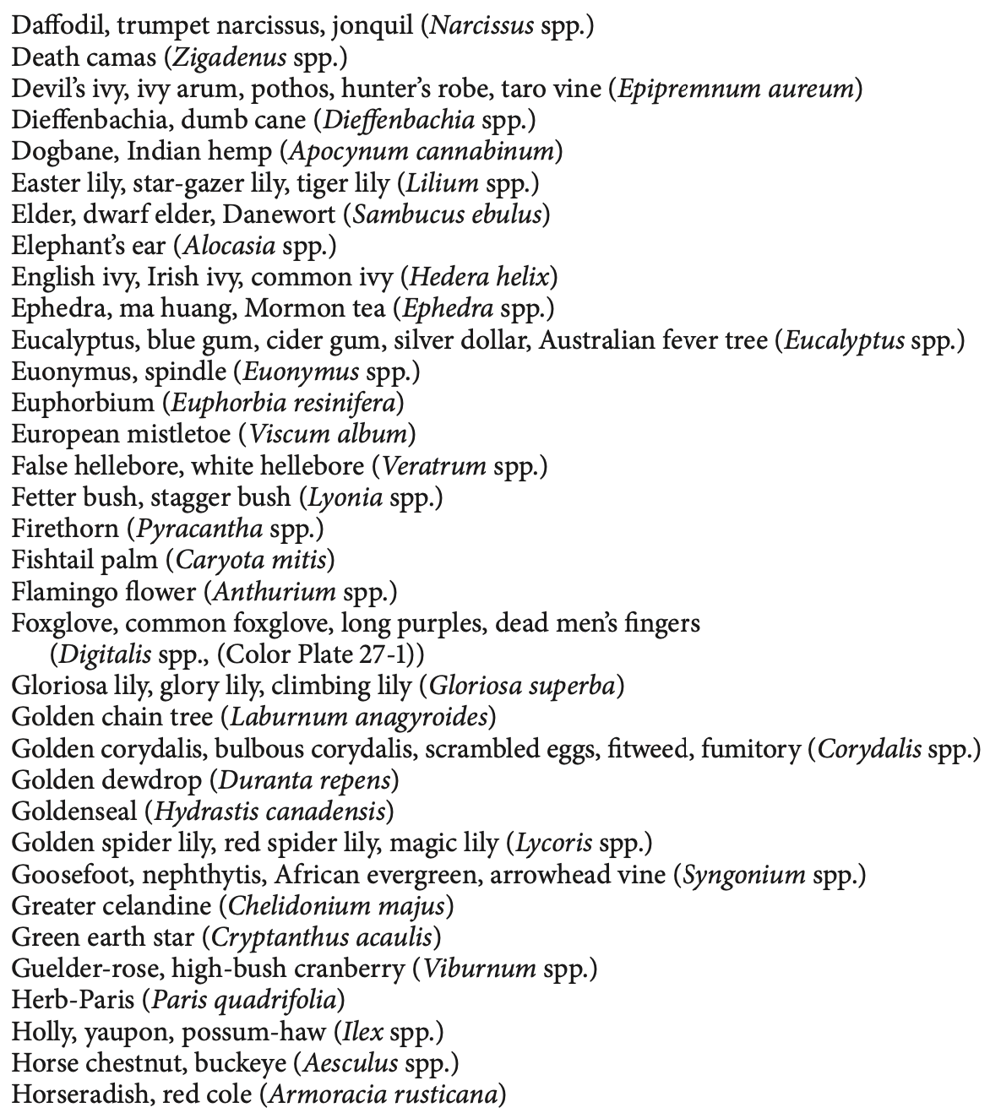
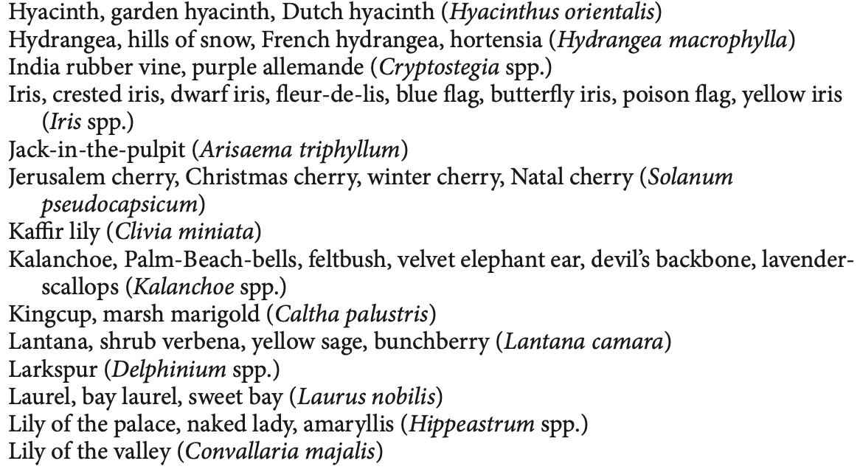

Slide 50
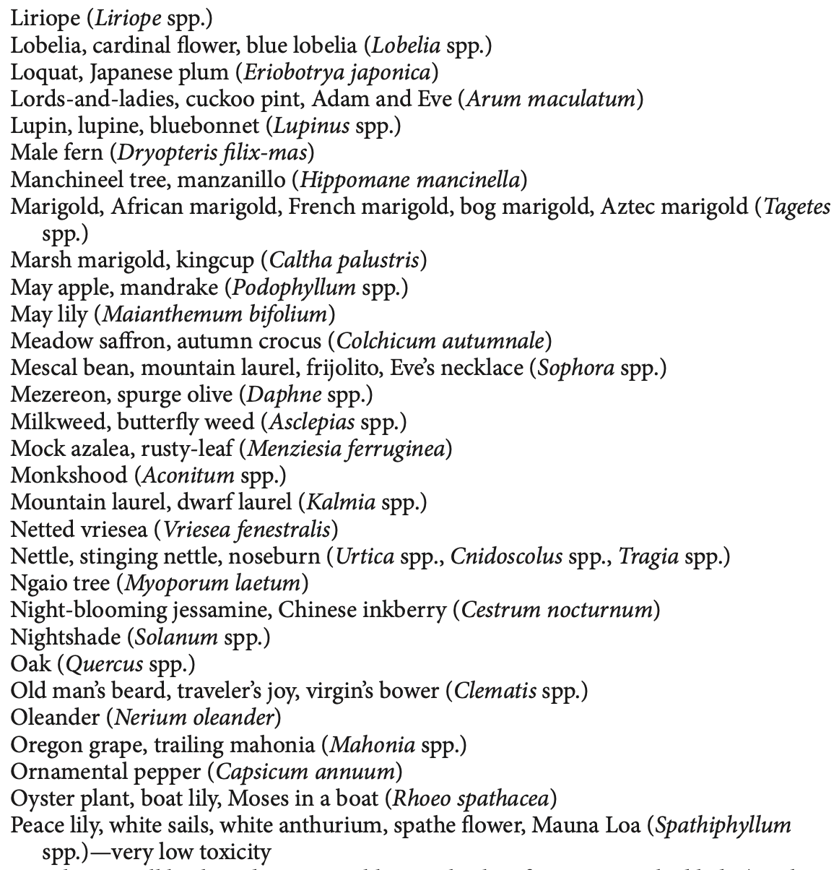
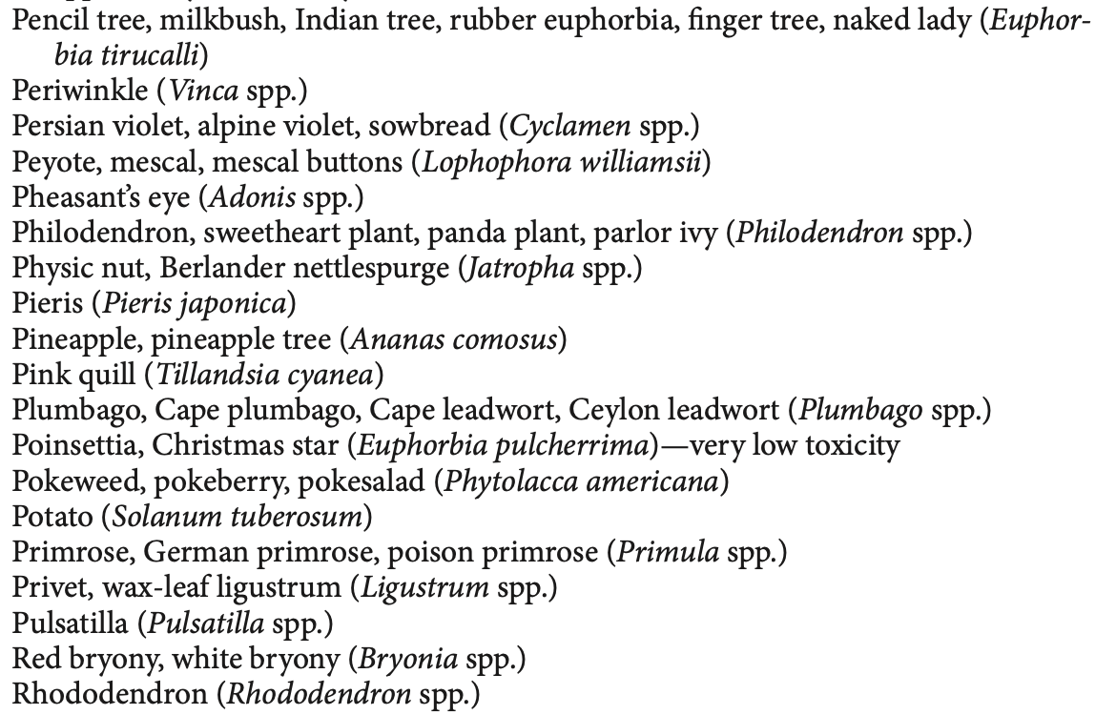

Slide 51
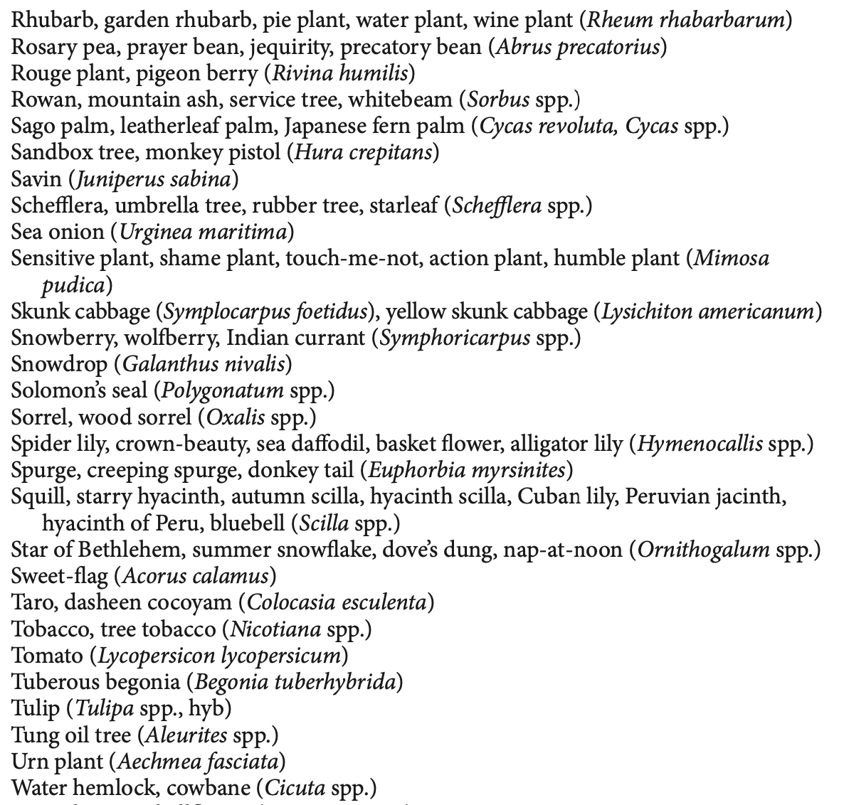
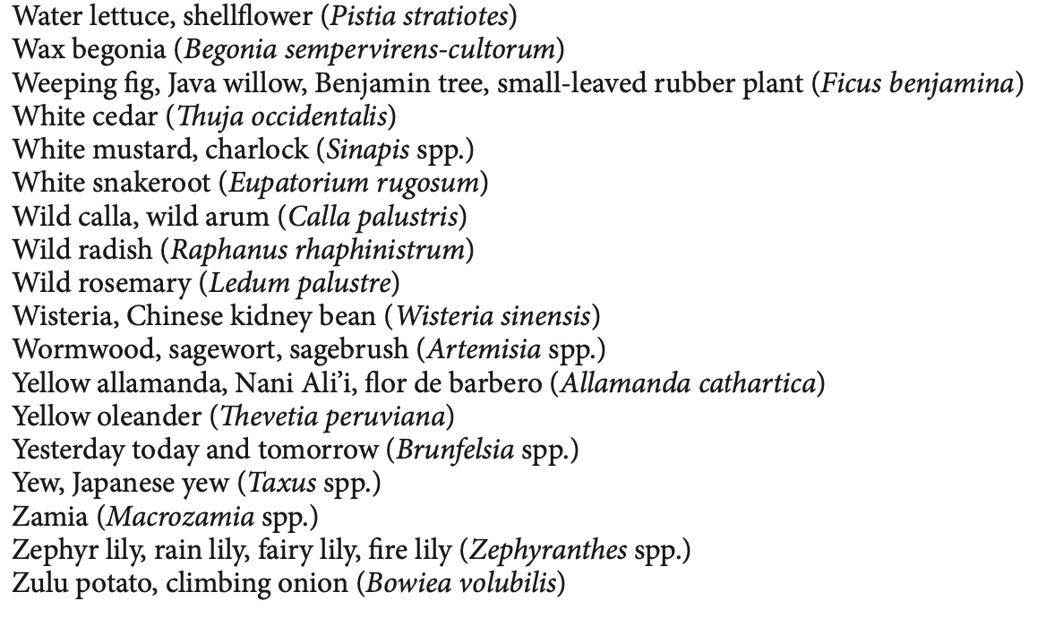

Slide 52
Toxin and clinical signs | MOA | Treatment
Amitraz → hypersalivation, lethargy, ataxia, bradycardia, vomiting, dyspnea, hypothermia, tremors, and seizures | Unknown, alpha 2 adrenergic activity | Stabilization, decontamination (emesis or bathing), yohimbine or atipamezole
Arsenic --> severe gastrointestinal distress (vomiting, diarrhea, GI hemorrhage), signs associated with dehydration | Absorbed readily through GI mucosa → accumulates in liver, spleen kidney, GI tract, lungs → congestion, edema, hemorrhage in all visceral organs (especially GI tract) affected due to increased permeability of capillaries | Aggressive fluid therapy and chelation with dimercaprol
Organophosphates and Carbamates → muscarinic signs (including emesis and diarrhea), nicotinic signs, CNS signs | OP interfere with metabolism of acetylcholine at cholinergic sites | Decontamination, atropine sulfate, 2-pyridine aldoxime methyl chloride, diazepam, and respiratory support
Notes:
Organophosphates - Muscarinic signs include salivation, lacrimation, urination, defecation, miosis, bronchospasm, bradycardia, and emesis. Nicotinic signs include muscle tremors, ataxia, weakness, and paralysis. Central nervous system signs can range from severe depression to hyperactivity and seizures.

Slide 53
Toxin and clinical signs | MOA | Treatment
Christmas trees, Amaryllis, Christmas cactus, mistletoe, English holly, evergreen trees → Vomiting, depression and lethargy | Amaryllis –alkaloids act on NK-1 receptor Christmas cactus – irritation from leaves Evergreen - mechanical irritation or irritation from terpenes or essential oils | Decontamination, supportive care, appropriate anti-emetics
Nicotine → vomiting, excitement, tremors, or convulsions; descending paralysis with high doses | Nicotine stimulates the emetic chemoreceptor trigger zone and can result in vomiting; nicotine mimics Ach | Decontamination, supportive care, acidification of urine
Iron → gastrointestinal distress, shock, and cardiovascular collapse | Iron acts as a free radicals which can initiate autooxidation of PUFAs → gross erythema or necrosis of GI mucosa, hepatic swelling, systemic edema or hemorrhage, and damage to hepatocytes or vascular epithelium | Gastric decontamination, supportive care, and chelation therapy.

Slide 54
Toxin and clinical signs | MOA | Treatment
Copper → vomiting, diarrhea, inappetence, depression, lethargy | Hepatocellular necrosis; directly cytotoxic to hepatocytes and RBCs | Supportive care
Cyanide → vomiting, hyperpnea, tachycardia, cardiac arrythmias, seizure, coma, apnea | Inhibits oxidative phosphorylation resulting in tissue hypoxia | Decontamination, supportive care, O2, hydroxocobalamin
DEET → hypersalivation, vomiting, hyperexcitability, tremors, ataxia, seizures | Unknown | Supportive
Diethylene glycol → depression, vomiting, diarrhea, anuric renal failure | Metabolites likely responsible for toxicosis and direct damage of kidneys | Supportive care, dialysis
Grapes → vomiting, anorexia, diarrhea, lethargy, abdominal pain, oliguria, and subsequent anuria | Possibly tartaric acid → hypovolemic shock and renal ischemia | Gastrointestinal decontamination and aggressive fluid therapy for up to 72 hours

Slide 55
Toxin and clinical signs | MOA | Treatment
Rosemary → nausea, vomiting, and possibly diarrhea, hypotension, renal injury, CNS effects if large amounts | Direct irritation of mucosa from essential oils | Decontamination, supportive care, pressors
Lead → gastrointestinal disturbances and nervous system dysfunction | Lead mimics or inhibits many cellular actions of calcium and alters calcium flux across membranes; alterations in synaptic transmission at the NMJ of visceral smooth muscle can lead to altered intestinal motility and tone leading to lead colic | Removal of the source, chelation therapy, gastrointestinal protectants, and seizure control
Lillies → lethargy, vomiting, anorexia, and polyuria followed by anuria, weakness, and death | Unkown | Decontamination, fluid diuresis, supportive care, dialysis

Slide 56
Toxin and clinical signs | MOA | Treatment
Macadamia nuts → weakness, depression, vomiting, ataxia, hind limb paresis/paralysis, joint and muscle pain, and joint swelling | Unknown | Supportive and symptomatic care
Mercury → anorexia, nervous dysfunction, renal dysfunction, gastrointestinal signs, shock, and death | Directly cytotoxic to GI tract, lungs, kidneys | Decontamination, supportive care, and chelation
Metronidazole → anorexia, vomiting, ataxia, tremors, peripheral neuropathies, and seizures | Enters susceptible organisms → reduced to polar compound → disrupts DNA and nucleic acid synthesis | Withdrawal of drug, supportive therapy, diazepam
Mushrooms (Muscarine) → gastrointestinal distress | Cholinergic/Muscarinic overstimulation | Decontamination, gastrointestinal support, atropine

Slide 57
Toxin and clinical signs | MOA | Treatment
NSAIDs → vomiting, depression or stupor, diarrhea, anorexia, ataxia or incoordination, bloody stool and melena, polyuria, polydipsia, tachypnea, and panting | Direct inhibition of cyclooxygenase → decreasing production of prostaglandin and thromboxane; many NSAIDs undergo enterohepatic recycling or are difficult to excrete | Emetics, gastric aspiration and lavage, activated charcoal, intravenous fluid diuresis, correction of acidemia, gastric acid reducers, sucralfate, misoprostol, blood transfusions, hemoglobin-based oxygen- carrying solutions, or surgery
Paraquat (herbicide) → severe gastrointestinal distress: abdominal pain, vomiting, and diarrhea, oral-esophageal-gastrointestinal ulceration may be present | Oral absorption → participates in cyclic reduction/oxidation and generation of free radicals | Decontamination (questionable due to mucosal ulcerations) and supportive care, charcoal hemoperfusion, anti-oxidants; High mortality rates due to pulmonary involvement
Pesticides → vomiting | Various | Supportive care
Notes:
COX – 1 responsible for physiologic mechanisms expressed in most tissues such as synthesizing prostaglandins
COX-2 is an enzyme that is rapidly induced at the site of inflammation and is responsible for the production of proinflammatory prostaglandins
Most NSAIDs (including ibuprofen) are nonselective COX inhibitors, thus contributing to gastrointestinal and renal side effects
NSAIDs undergo enterohepatic recycling or are difficult to excrete
This is why we don’t give most NSAIDs like ibuprofen to dogs when they are safe in people
The causes of the ulcerogenic effects of NSAIDs in the stomach are thought to be twofold.46 The first is the ability of these drugs to suppress prostaglandin synthesis.
Gastrointestinal mucosal defense mechanisms are influenced or mediated by prostaglan- dins, including mucus and bicarbonate secretion, blood flow, epithelial cell turnover and repair, and mucosal immunocyte function
The second mechanism of action is the topical irritant properties of NSAIDs. Epithelial damage may be related in part to ion trapping, a phenomenon that allows accumulation of NSAIDs in these cells, and in part to the ability of NSAIDs to decrease the hydrophobic- ity of the mucous layer in the stomach (the primary barrier to damage induced by acid).46 Most NSAIDs have been shown to impair gastric mucosal microcirculation and cause gas- tric mucosal damage.47 After NSAID administration, neutrophils can be attracted to muco- sal capillaries, where they form thrombi and obstruct capillaries.

Slide 58
Toxin and clinical signs | MOA | Treatment
Corrosive cleaning products → hematemesis, abdominal pain, polydipsia, epiglottic edema with secondary respiratory distress, and possible shock | Acidic products produce a localized coagulative necrotic lesion; alkaline products immediate liquefactive necrosis on contact, deeper and more penetrating | Immediate dilution of the exposure with milk or water, corticosteroids, analgesia, antibiotics, supportive care
Ricin → diarrhea, abdominal pain, anorexia, and vomiting with or without blood, seizures | Inhibition of protein synthesis; Damages endothelial cells (unknown mechanism) - fluid and protein leakage, tissue edema | Decontamination and supportive care
Xylitol → vomiting, hypoglycemia, ataxia, collapse, seizures | Unknown hepatic injury; xylitol converted to glucose and ultimately glycogen, releases insulin | Decontamination, supportive care, dextrose supplementation, liver protectants
Zinc → gastrointestinal distress and hemolytic anemia | Cause of hemolytic anemia Unknown; vomiting is caused by corrosive/caustic properties of zinc salts | Removal, supportive care, RBC transfusions
Notes:
Alkaline cleaning products such as drain cleaner or toilet bowl cleaner:
Corticosteroids, because they decrease fibroblastic activity and inflammation, have been recommended to reduce stricture from circumferential alkali burns. Steroid treatment should be started within the first 48 hours and be accompanied by prophylactic antibiotic therapy. Analgesics are often indicated for pain control

Slide 59
Toxin and clinical signs | MOA | Treatment
Zinc phosphide (rodenticide) → vomiting, generalized lethargy, diarrhea, retching, hematemesis, bloody diarrhea, tremors, seizures, abdominal discomfort and pain, and death | Phosphine combines with gastric mucosa surface moisture to produce direct physical irritant injury to the gastrointestinal and respiratory mucosal surfaces, in addition to causing oxidative injury to the parenchyma. | Decontamination while decreasing possibility for phosphine release, supportive and symptomatic treatment

Slide 60
How does NSAID therapy lead to mucosal ulceration?
Inhibition of prostaglandin synthesis via inhibition of phospholipase
Inhibition of prostaglandin synthesis via inhibition of cyclooxygenase
Promotes increase of gastrin secretion
Topical irritation of gastric epithelium

Slide 61
Citations
Boysen, RS, Chapter 119 - Gastrointestinal Hemorrhage, Editor(s): Deborah C. Silverstein, Kate Hopper, Small Animal Critical Care Medicine (Second Edition), W.B. Saunders, 2015, Pages 630-634.
Costanzo, LS, Chapter 8 – Gastrointestinal Physiology, Editor: Linda S. Costanzo, Physiology (Fifth Edition), W.B. Saunders, 2014, Pages 349-356.
Hauck, C., Schmitz, S. S., Burgener, I. A., Wehner, A., Neiger, R., Kohn, B., Rieker, T., Reese, S., & Unterer, S. (2020). Prevalence and characterization of hypoadrenocorticism in dogs with signs of chronic gastrointestinal disease: A multicenter study. Journal of Veterinary Internal Medicine, 34(4), 1399–1405. https://doi.org/10.1111/jvim.15752
Mazaki-Tovi, M., Segev, G., Yas-Natan, E., & Lavy, E. (2012). Serum gastrin concentrations in dogs with liver disorders. Veterinary Record, 171(1), 19. https://doi.org/10.1136/vr.100627
Peters, R. M., Goldstein, R. E., Erb, H. N., & Njaa, B. L. (2005). Histopathological Features of Canine Uremic Gastropathy: A Retrospective Study. J Vet Intern Med, 19, 315–320.
Peterson ME, Talcott PA. Small Animal Toxicology (Third Edition), Elsevier, 2013.
Stanton, M. E., & Bright, R. M. (1989). Gastroduodenal Ulceration in Dogs. Journal of Veterinary Internal Medicine, 3(4), 238–244. https://doi.org/10.1111/j.1939-1676.1989.tb00863.x
Trotman, TK. Chapter 117 - Gastroenteritis, Editor(s): Deborah C. Silverstein, Kate Hopper, Small Animal Critical Care Medicine (Second Edition),W.B. Saunders, 2015, Pages 622-626.
Unterer, S., Busch, K., Leipig, M., Hermanns, W., Wolf, G., Straubinger, R., Mueller, R., & Hartmann, K. (2013). Endoscopically Visualized Lesions, Histologic Findings, and Bacterial Invasion in the Gastrointestinal Mucosa of Dogs with Acute Hemorrhagic Diarrhea Syndrome. Journal of Veterinary Internal Medicine, 28(1), 52–58. https://doi.org/10.1111/jvim.12236
Notes:
S

Slide 62

Any questions?

