Slide 1
Coagulation Testing
Beth Conroy, VMD
December 2, 2021

Slide 2
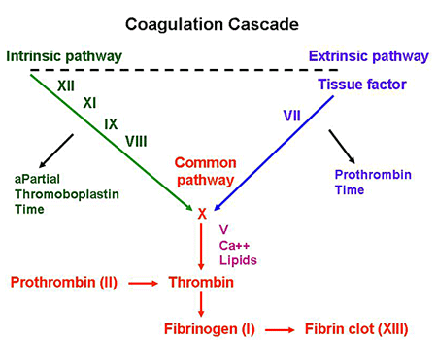
Coagulation Cascade
https://www.stepwards.com/?page_id=866
Notes:
First, I wanted to remind us about the important coagulation cascade which we conveniently reviewed a few days ago. As you can see on the left of the diagram, we have the intrinsic pathway which is comprised of factors 12, 11, 9 and 8 which then becomes the common pathway. On the right side of the diagram, we have the extrinsic pathway which which starts with tissue factor (or factor 3) and factor 7, which also then becomes the common pathway. As you can see, the common pathway starts with factor 10 and factor 5, which together cleaved prothrombin to thrombin which then in turn cleaves Fibrinogen to fibrin.
As you can also see on this diagram, when you test aPTT, you are testing the intrinsic pathway and when you test PT, you are testing the extrinsic pathway. Since we all have a fairly decent grasp about those basic tests, I figured we’d move on and discuss the more complex types of coagulation testing.

Slide 3
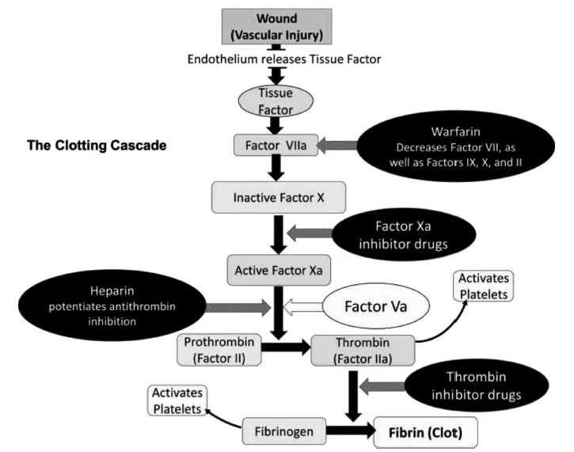
https://veteriankey.com/anticoagulant-antiplatelet-and-hemostatic-drugs/
Notes:
But first I wanted to incorporate a few diagrams which help us visualize exactly where the medications we prescribe affect the clotting cascade. As you can see, Warfarin decreases factor 7 as well as factors 9, 10 and 2. A little bit below that, you’ll see the Factor Xa inhibitory drugs such as rivaroxaban or xarelto and apixaban or eliquis affect Factor X. On the left, you’ll see heparin listed which potentiates antithrombin inhibition and finally on the bottom right, you have the thrombin inhibitor drugs like dabigatran or Pradaxa which are not as common in veterinary medicine yet.

Slide 4
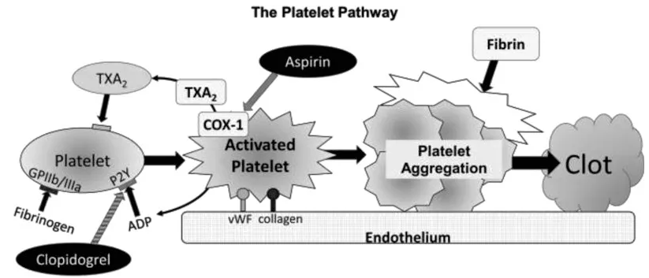
https://veteriankey.com/anticoagulant-antiplatelet-and-hemostatic-drugs/
Notes:
This next diagram shows where different medications will affect the platelet pathway. So you’ll see clopidogrel listed which as we know is an inhibitor of platelet activation and aggregation through the irreversible binding of its active metabolite to the P2Y12 class of ADP receptors on platelets. And this diagram also lists aspirin which irreversibly inhibits COX 1 and therefore thromboxane synthesis.

Slide 5
TEG/ROTEM
Notes:
So the first type of testing I will be discussing is the TEG or ROTEM.

Slide 6
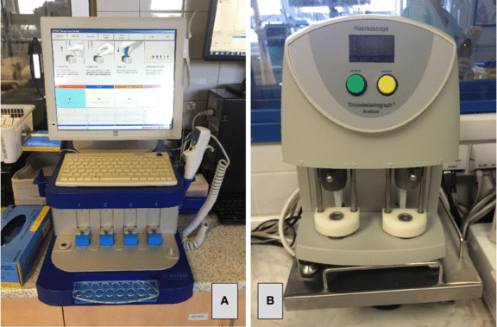
What are the differences between them?
https://www.frontiersin.org/articles/10.3389/fmed.2015.00062/full
Notes:
In case you don’t already know, TEG stands for Thromboelastography and ROTEM stands for Rotational ThromboElastoMetry and both are tools of assessing whole blood clotting. Both take a small amount of whole blood (no more than 1ml) at body temperature (37º) and add it to a heated sample cup. A pin is then suspended into the cup, and then some sort of rotation takes place. One of the main differences between the two machines is which portion of the machine is spinning. With ROTEM, a pin is inserted into the sample cup and then the PIN is spun until the test is done. With TEG, the sample cup itself is the thing that is rotating. The tracing that we see is a measure of the impediment that is caused within the cup while a blood clot forms.
Once the blood is recalcified (adding calcium only for native or unactivated samples) or an activator is added (more common), small amounts of thrombin are generated. This small amount of thrombin then activates platelets, which flip their membranes exposing phosphatidylserine which supports assembly of coagulation factor complexes and amplifies and propagates thrombin generation. Once larger amounts of thrombin are formed, thrombin cleaves fibrinogen to form fibrin. Then the measurements begin.

Slide 7
Activators
The sample can be run without an activator (native) or with an activator that triggers clotting.
  Results from native blood generally indicate contact activation (contact with the cup), with activation of FXII and the intrinsic pathway of secondary hemostasis.
  Results are more variable with native than activated blood, hence most investigators use an activator, although the type of activator and amount used varies between studies.
Activators can either stimulate the extrinsic (i.e. a cell-based PT) or intrinsic (i.e. a cell-based APTT) pathways of hemostasis.
Results obtained from different activators (or activator concentrations) are not comparable.
Notes:
So as mentioned in the previous slide, a sample can be run without an activator which is called a native sample, or an activator that triggers clotting can be added. Results from native samples generally indicate contact activation, so contact with the cup, and then activation of factor 12 and the intrinsic pathway. When the sample is run as a native sample, results are typically more variable than with activated blood. This is why many reseachers will use an activator, however the type and amount of the activator can vary between studies. Activators can either stimulate the extrinsic pathway or the intrinsic pathway and results obtained from different activators or different concentrations of activators are not comparable. One downside to using activators, is that they may mask the effects of anti-platelet drugs like aspirin, or they can potentially shorten the time to clot formation and have higher clot strength due to more robust thrombin generation than non-activated samples.

Slide 8
Types of activators
Tissue factor
Kaolin (hydrated aluminum silicate)
Ellagic acid
Notes:
So now that we’ve touched on activators in general, I figured I’d list a few of them. Certainly the most common ones are the top two, Tissue factor and Kaolin. When tissue factor is used, it typically has to be diluted to 1:50,000 which potentially introduces a source of variability for TEG analysis. As I’m sure you know, that by adding tissue factor, you are stimulating the test via the extrinsic pathway. Another commonly used activator is kaolin or hydrated aluminum silicate. This activator initiated coagulation via the contact activator pathway and stimulates the test via the intrinsic pathway. The nice thing about using kaolin, is that they make ready to use kaolin vials to make its use convenient and consistent, thereby removing the potential variability or human error. Lastly, I saw mention of an activator called Ellagic acid (el-lagic acid), which is also used to stimulate the test via the intrinsic pathway.

Slide 9
Nomenclature
TEG:
R: Reaction time
K: Kinetics
Alpha angle
MA: Maximum amplitude
CLT: Clot lysis time
ROTEM:
CT: Clotting time
CFT: Clot formation time
Alpha angle
MCF: Maximum clot firmness
LOT: Lysis onset time
LT: Lysis time
LY30: Lysis Index at 30 minutes
ML: Maximum lysis
Notes:
Another small difference between TEG and ROTEM is what their different measurements are called. As you can see, I have them listed side by side to help with the comparison. So first, we have R time or reaction time. This is the time from the start of the test until the tracing reaches an amplitude of 2mm. This is most correlated with the CT or clotting time for the ROTEM. Next we have K or kinetics which is the time from the amplitude of 2mm, reaching an amplitude of 20mm. This most correlates with CFT or clot formation time. After that, we have the alpha angle which is the slope of the amplitude line from 2mm-20mm. Maximum amplitude is the maximum clot strength which is the same as maximum clot firmness.
And finally the lysis portion is where we have some different values come into play. For the TEG we have CLT or clot lysis time which is the time taken for the amplitude to decrease by 2mm after reaching MA. For the ROTEM, there is LOT or lysis onset time which is the time taken for the amplitude to decrease by 15% of the maximum clot firmness. Then there is LT or lysis time which is the time taken for the amplitude to decrease by 10% of the maximum clot firmness. LI 30 is the lysis index at 30 minutes or the % drop in amplitude when measured 30 minutes after reaching maximum clot firmness and finally ML or maximum lysis or the minimum amplitude achieves at the end of the test run time.

Slide 10
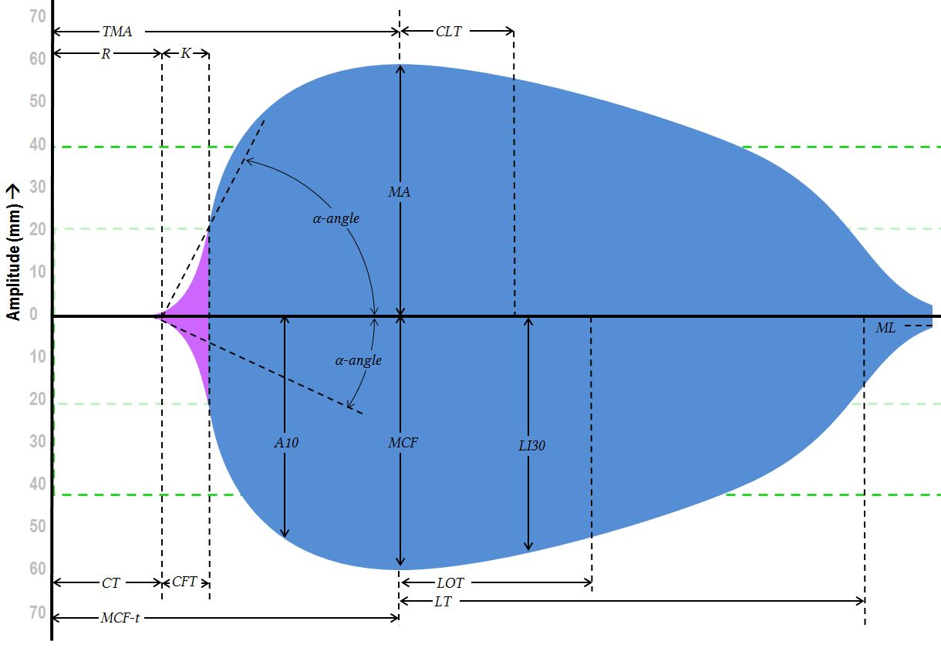
https://derangedphysiology.com/main/required-reading/haematology-and-oncology/Chapter%20120/viscoelastic-tests-clotting-function-teg-and-rotem
Notes:
So this was the image that helped compare where exactly each measurement was taken from, but it was very busy, so instead I just included (next page)

Slide 11
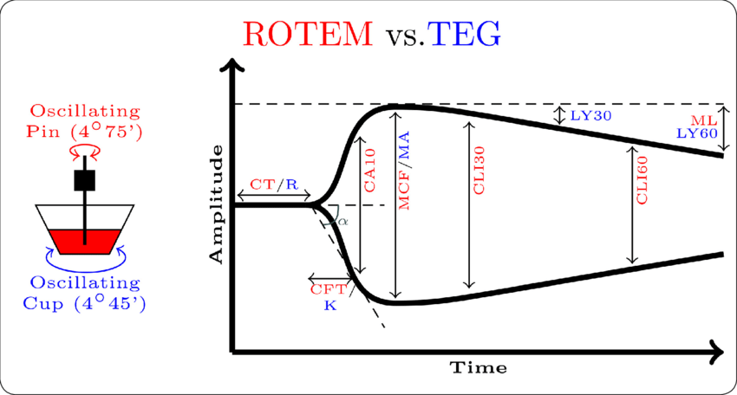
https://www.gratisoa.org/journals/index.php/COGO/article/view/1837
Notes:
This diagram which is simpler. Essentially this diagram breaks it down by color. Anything ROTEM related is red and anything TEG related is blue. On the left, you can see the for ROTEM, the pin is what is oscillating and for the TEG it is the sample cup that is oscillating. The diagram on the right just shows the different measurements in relation to each other.

Slide 12
Advantages of TEG/ROTEM
Helps us diagnose/assess coagulopathy in patient
  Including hypercoagulability and hyperfibrinolysis
Discriminates between coagulopathy due to thrombocytopenia and coagulopathy due to low fibrinogen
Guide transfusion strategy
Prediction and/or reduction in mortality
Notes:
So some of the advantages to using TEG or ROTEM are that it can help us diagnose or assess coagulopathies in our patients including assessing for hypercoagulabilty and hyperfibrinolysis which we haven’t been able to assess otherwise. It also allow us to be able to discriminate between a coagulopathy due to thrombocytopenia or a coagulopathy due to low fibrinogen. It can help guide our transfusion therapy which can help us tailor treatment more to the patient and help us preserve resources. And finally, is can help predict and/or reduce patient mortality.

Slide 13
Disadvantages of TEG/ROTEM
Training
Timing
Does not identify warfarin or most NOACs
We don’t always know what to do with the information we get from it
Notes:
Now of course, there are also some downsides to it as well. First, performing the tests requires staffing that is trained to use the machines and it can take time that we can otherwise use transfusing the patient, etc. There were a few documents that I read that stated that TEG and ROTEM had a fast turnaround time, however the few times I have assisted with them, they can take about an hour to run. Another downside to this test is that they cannot identify warfarin or most noval oral anticoagulants - essentially the machine just gives you a nonspecific finding of a long R time. Finally, and this doesn’t necessarily pertain to just TEG/ROTEM, but we don’t always know what to do with the information that we are given by the test.

Slide 14
Limitations
Reaction time thought to reflect coagulation factors primarily
Rate of clot formation and strength of clot will be affected by platelet number and function, fibrinogen concentration and coagulation factor activity
  Example: Severely thrombocytopenic animals (PLT < 30k) are expected to have a hypocoaguable tracing
Fibrinogen:
  High fibrinogen: can affect clot strength (higher/increased MA) and to a lesser extent, K (decreased) K and α (increased)
  Low fibrinogen will cause decreased clot strength (low MA), increased K, and decreased alpha angle
Hematocrit
  High HCT leads to hypocoagulable tracings
  Low HCT lead to hypercoagulable tracings
Notes:
Some limitations of using TEG/ROTEM, come into view when we discuss what factors affect portions of the test. Reaction Time is thought to reflect coagulation factors primarily whereas Clot Formation Time and Maximum Clot Strength will be affected by platelet number and function, fibrinogen concentration and coagulation factor activity. Another thing to note is that these results are difficult to interpret without knowledge of the fibrinogen concentration, platelet counts or HCT for the reasons just mentioned. An increased fibrinogen can increase clot strength or MA as well as it can decrease K time and increase the alpha angle. When you have decreased fibrinogen, the opposite can be seen. Hematocrit also affects the results as a high hematocrit leads to a hypocoagulable tracing as there is reduced clot formation and strength, and vice versa for a low hematocrit.

Slide 15
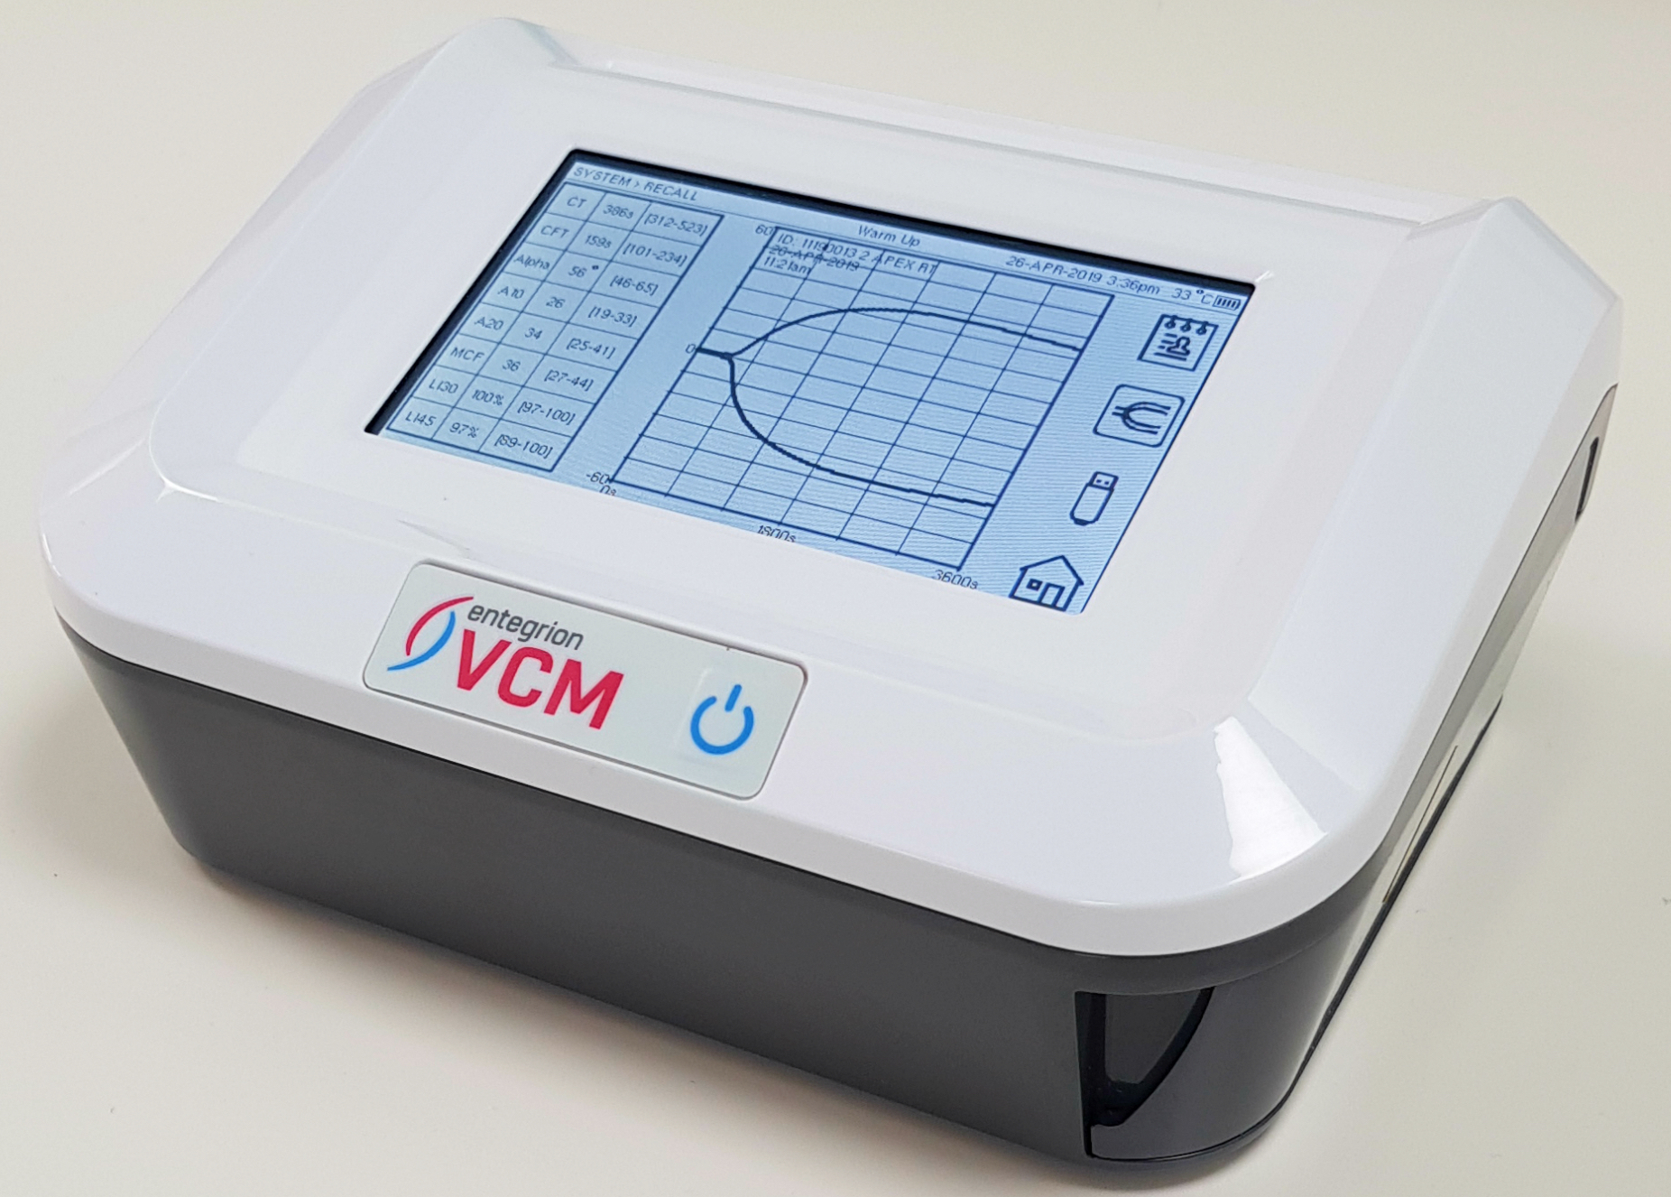
VCM: Viscoelastic Coagulation Monitor
https://vcmvet.com/
Notes:
Since we touched on the larger viscoelastic machines, I figured I should touch on the smaller portable one which is also known as the VCM.

Slide 16
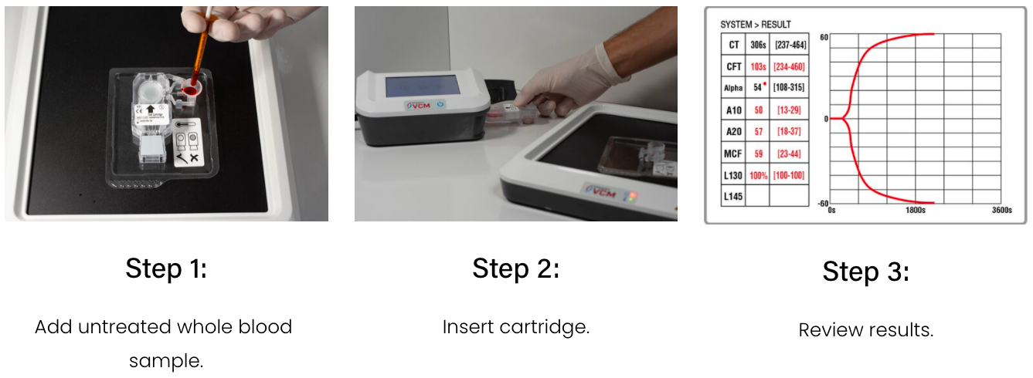
How it works - super simple
https://vcmvet.com/
Notes:
So it is actually very easy to operate. There is a hot plate that the cartridges sit on and there is a small color changing dot to let you know when the cartridge is ready to use. When it is, you add a small sample of fresh whole blood to the sample well and then insert the cartridge into the machine. The machine reads and reports results in live time over the next hour.

Slide 17
Advantages of VCM
Good correlations with TEG and ROTEM
Does not require advanced skill set
Can take it bedside if needed
Notes:
Some advantages to utilizing this machine are that per a few publications I found, there is relatively good correlation between the VCM and TEG/ROTEM. It is very simple to use and doesn’t require an advanced skill set and you can actually bring the machine to the patient if need be.
Establishment of normal reference intervals in dogs using a viscoelastic point-of-care coagulation monitor and its comparison with thromboelastography → DOI: 10.1111/vcp.12926
Performance Evaluation of a New Point of Care Viscoelastic Coagulation Monitoring System in Major Abdominal, Orthopaedic and Vascular Surgery → DOI: 10.1080/09537104.2019.1704719

Slide 18
Disadvantages of VCM
Rigid closed system
Takes 1 hour to run
Can only run 1 sample per machine at a time
Notes:
Some downsides to using this machine are that it is a closed system, meaning that the cartridges are pre-prepped, so you cannot add your own activators in. It does take an hour to run and as far as I know, you can only run 1 sample per machine at a time.

Slide 19
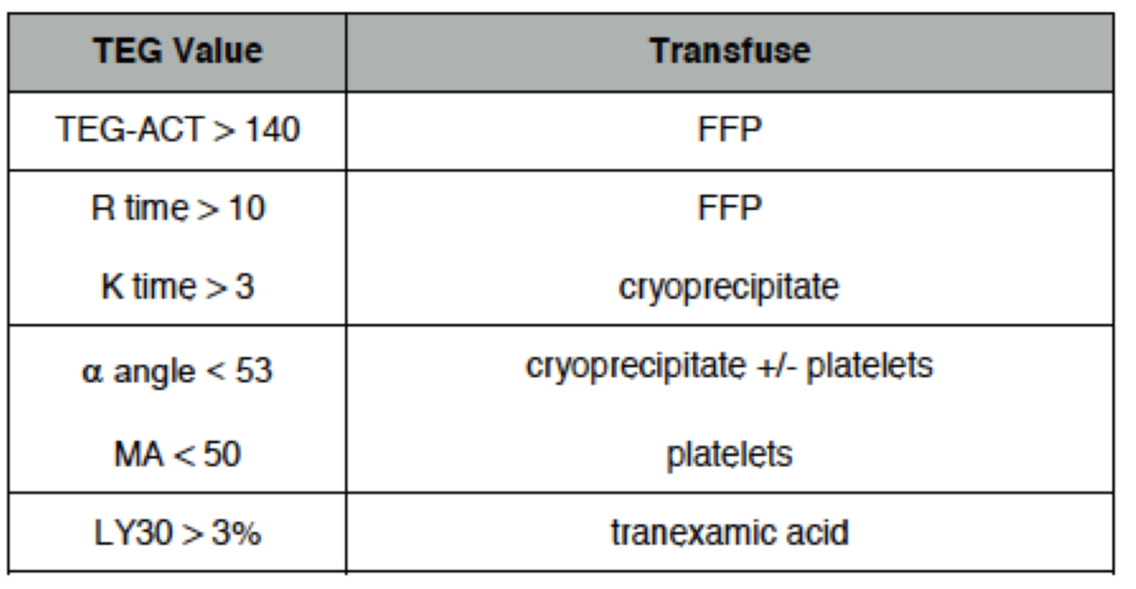
What to treat with?
http://www.emdocs.net/thromboelastogram-teg-five-minute-primer-emergency-physician/#gallery-5

Slide 20
PFA: Platelet Function Analysis
Notes:
Next we will be discussing platelet function analysis.

Slide 21
Light transmission platelet aggregation on platelet rich plasma (LTA)
Assesses in vitro platelet-to-platelet clump formation aka the aggregation
Tests the amount of light that can pass through a sample of PRP following addition of an agonist
During the assay, the PRP after the addition of agonist becomes clearer because of the precipitation of platelet aggregates.
To the PRP sample, different agonists are added to stimulate different platelet activation pathways, obtaining information about the several features of platelet function.
Notes:
So the first type of platelet function analysis that we will discuss is light transmission platelet aggregation on platelet rich plasma or LTA. This test was designed in the 1960’s and has been used as the gold standard platelet function test since. This test assesses in vitro the platelet-to-platelet clump formation in a glycoprotein (GP) IIb/IIIa-dependent manner, ie, the aggregation, the most important function of platelets. The assay is based on the amount of light that can be transmitted through the dense sample of PRP after the addition of the exogenous platelet agonist. During the assay, once the agonist is added, the PRP becomes clearer because of the precipitation of platelet aggregates. This determines an increase in light transmission through the plasma sample. The device records the rate and maximal percentage of this increase from 0% (maximal optical density of PRP) to 100% (no optical density of autologous platelet-poor plasma) by a photometer. This signal is then converted automatically in a graphic curve that parallels the increase in light transmission during the platelet aggregation. To the PRP sample, different agonists are added to stimulate different platelet activation pathways, obtaining information about the several features of platelet function.

Slide 22
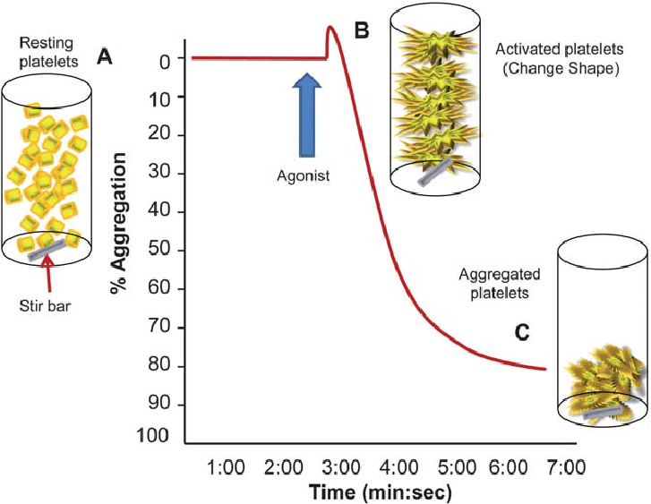
https://www.researchgate.net/figure/Platelet-function-testing-light-transmission-aggregometry-The-light-aggregometer_fig1_51746965
Notes:
I added this diagram to help make sense of the test. So on the left side if the diagram, you have your initial PRP sample where as you can see on the graph, no light can be detected. You then add the agonist and stimulate the platelets to aggregate thereby allowing more light to be transmitted.

Slide 23
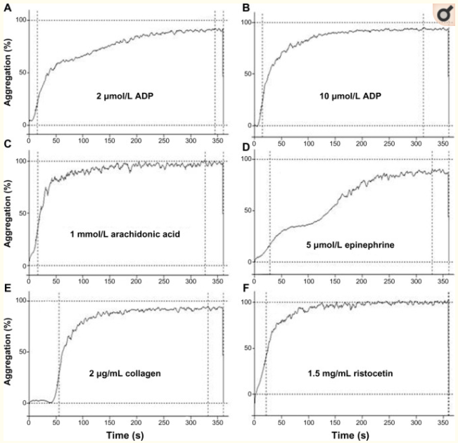
https://pubmed.ncbi.nlm.nih.gov/25733843/
Notes:
These are LTA tracings from a healthy human patient in response to different agonists. They look different than the diagram on the previous page because the y axis has % aggregation listed from 0-100 whereas the previous page had it listed from 100% to 0.

Slide 24
Commonly used agonists for LTA
ADP
Arachidonic Acid
Collagen
Epinephrine
  not ideal for canine samples
Less common:
  Thrombin receptor activating peptide (TRAP)
  Thromboxane A2 (TXA2) mimetic U46619
  Calcium ionophore A23187
  Ristocetin
Notes:
Next I wanted to touch on commonly used agonists for LTA. We have things like ADP, arachidonic acid, collagen, and epinephrine (which has been shown not to work for canine samples) and then a few less common ones like TRAP or thrombin receptor activating peptide, thromboxane A2 (TXA2), calcium ionophore and ristocetin which is an antibiotic that facilitates the binding of Von Willebrand Factor (VWF) to the glycoprotein Ib/IX/V complex. Different doses or concentrations of ristocetin are used which allows one to investigate both increased and decreased sensitivity to ristocetin.

Slide 25
Advantages of platelet function analysis: LTA
Historical gold standard diagnostic method
Flexible
  Different platelet pathways investigated
Sensitive to anti-platelet therapy
Notes:
The advantages of light transmission aggregation are that it is the historical gold standard method. It is a very flexible test, meaning that you can use a wide variety of agonists to help investigate the different pathways. And it is sensitive to anti-platelet therapies.

Slide 26
Disadvantages of platelet function analysis: LTA
Manual sample processing
Pre- and analytic variables
High sample volume due to the need to create PRP
Time-consuming
Notes:
Although light transmission aggregation is accepted as the most important and complete assay that clinical laboratories can perform to diagnose platelet function disorders, there are some disadvantages to it. First, it requires manual sample processing and the laboratory staff need to have a high degree of skill, experience, and expertise in performing and interpreting platelet function. Next, LTA may be affected by different conditions like the type of anticoagulant used, if there is lipid in the plasma, sample hemolysis, or low platelet count, and by different procedural conditions like differences in the preparation of the PRP, or use of different concentrations of agonists. And finally, since it can be affected by so many different things, it is recommended that the results obtained by light transmission aggregation be confirmed by further specific tests.

Slide 27
Platelet Function Analysis: PFA-100
Simulates the in vivo conditions of endothelial damage in a capillary vessel
Citrate anticoagulated blood is passed under high shear through an opening cut in a collagen-coated membrane
As the platelets encounter the agonists, they aggregate and seal off the membrane, resulting in decreased blood flow that is detected by the analyzer
The time taken to form a platelet plug and seal off the membrane is called the closure time, which is dependent on vWf and normal platelet function
Notes:
Another type or platelet function analysis I wanted to mention is a machine called the PFA-100. This machine is a point-of-care instrument used to assess platelet function and to detect low concentration (or dysfunction) of vWF as it can simulate the in vivo conditions of endothelial damage in a capillary vessel. Essentially, citrated anticoagulated blood is passed under high shear through an opening in a collagen-coated membrane, which is impregnated with either ADP or epinephrine, which act as agonists for the platelets. As the platelets encounter the agonists, they aggregate and seal off the membrane, resulting in decreased blood flow that is detected by the analyzer. The time taken to form a platelet plug and seal off the membrane is called the closure time, which is dependent on vWf and normal platelet function. Some different diseases this machine has been able to detect with the ADP channel are dogs with vWD, Glanzmann’s thrombasthenia and Bassett Hound thrombopathia as these result in abnormally long closure times. Normal closure times are seen with anticoagulant rodenticide toxicosis since it specifically affects primary hemostasis. Similar to the LTA agonists, the epinephrine channel does not appear to work in the dog. Ultimately, this machine can be used as a screening tool for thrombopathia in a bleeding animal with normal platelet counts and screening coagulation assays, instead of the buccal mucosal bleeding time since it is far more standardized and less subject to inter-observer variability, however the specific instrumentation is required.

Slide 28
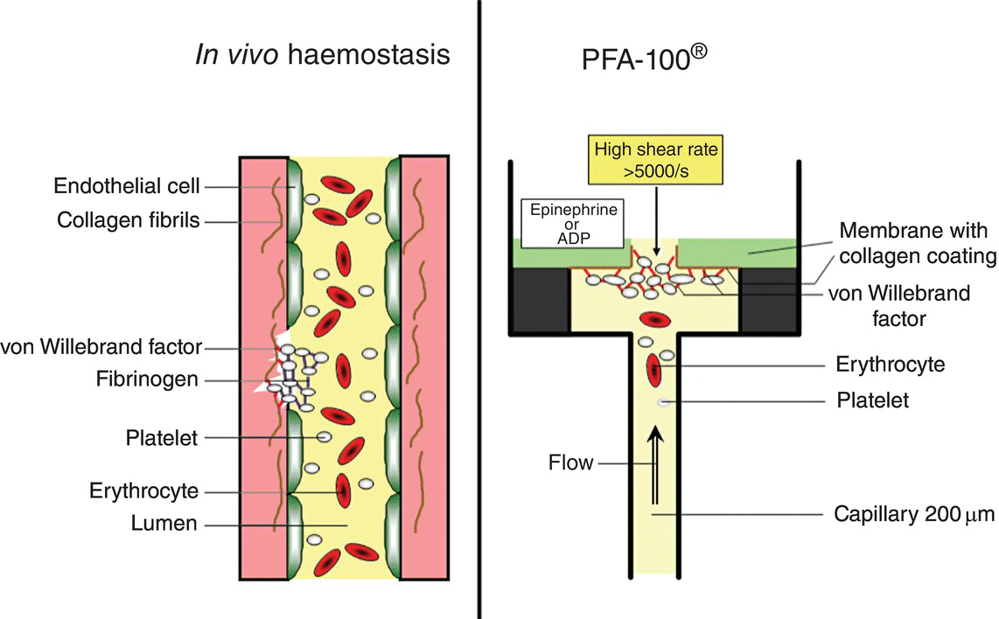
https://thoracickey.com/shear-stress-based-platelet-function-tests/#R_c11-fig-0001
Notes:
So this is another diagram I found to help show what is happening during this test. On the left, you have a traumatized capillary with a platelet plug forming on the left wall. On the right, you have the PFA-100 which moves the blood under sheer conditions through the agonist coated membrane by use of a constant vacuum which mimics the pressure in a capillary in the body.

Slide 29
Advantages of the PFA-100
In vitro standardized bleeding time
Easy, quick point of care test
Sensitive to severe platelet defects
Notes:
Some advantages to the PFA-100 system are that it helps standardize the bleeding times as it tries to reproduce normal conditions and removes the variability of a buccal mucosal bleeding time. It is a fairly easy and rapid test to perform and it can detect severe platelet defects.

Slide 30
Disadvantages of the PFA-100
Rigid closed system
Platelet count – HCT-dependent
Not sensitive to platelet secretion defects
Notes:
Some disadvantages are that it is another rigid closed system, so you must use their cartridges and cannot attempt with different agonists. Another disadvantage is that the PFA-100 is sensitive to many variables that influence platelet function thereby prolonging the CT as well as low platelet count and hematocrit, conditions associated with thrombocytopathies. It has also been recommended that the PFA system be employed as a screening tool integrated into a panel of existing tests.
However, this assay is characterized by a high negative predictive value, so when a normal CT result is found in a suspected platelet disease, further platelet function testing should not be performed

Slide 31
Limitations of platelet function analysis: PFA-100
Insensitive to drug-induced thrombopathia
  Aspirin and non-steroidal anti-inflammatory agents
Closure times are affected by hematocrit
  Animals with anemia have long closure times
  Animals with high hematocrits could have short closure times
Notes:
Some limitations of the PFA-100 system are that it is insensitive to drug-induced thrombopathia. Several studies have also demonstrated that the collagen/ADP cartridge is relatively insensitive to the effect of P2Y12 receptor blocker treatment. This might be attributed to the relatively high local concentration of collagen and ADP in the cartridge, which may not allow clopidogrel to inhibit the formation of the platelet plug. Furthermore, since the assay is highly affected by the levels of von Willebrand factor (vWF) and hematocrit, high vWF levels might mask the inhibitory effects of clopidogrel because the shear stress will lead to instant binding of vWF to glycoprotein (GP)IIb/IIIa. Another limitation is that closure times are affected by hematocrit. Animals with anemia will have longer closure times and animals with higher hematocrits could have shorter closure times.

Slide 32
Anti-Factor Xa Testing
Notes:
Now lets move onto antifactor Xa testing

Slide 33
Anti-Xa Testing
Used for monitoring patients on Low Molecular Weight Heparins [LMWHs], Unfractionated Heparin [UFH] and the Direct Oral Anticoagulants [DOACs] that have anti-Xa activity
Patient citrated platelet poor plasma which is then mixed with a known amount of Factor Xa
Depending upon the degree of Xa inhibition, the residual Xa is assayed
The residual Xa activity is inversely proportional to the concentration of heparin or DOAC in the plasma sample and may be quantitated from the relevant calibration curve
Notes:
The plasma Anti-Xa assay is a functional test that is used for monitoring patients on Low Molecular Weight Heparins [LMWHs], Unfractionated Heparin [UFH] and the Direct Oral Anticoagulants [DOACs] that have anti-Xa activity. UFH is commonly monitored by means of the PTT but in some cases the PTT can underestimate or overestimate the degree of anticoagulation induced by the UFH and the measurement of a plasma anti-Xa level may provide a more accurate assessment of anticoagulation. The tests involves obtaining citrated platelet poor plasma [PPP] from the patient which is then mixed with a known amount of Factor Xa. Depending upon the degree of Xa inhibition [and this is related directly to the UFH/LMWH concentration] the residual Xa is assayed using either a clotting-based Factor X assay or more commonly by using a chromogenic substrate specific for Factor Xa. A curve is constructed by adding known amounts of LMWH or UFH to plasma (which provides a source of Antithrombin although some assays may add exogenous Antithrombin) and then adding a fixed amount of Factor Xa. This results in the formation of an inactive Anti-Thrombin-Xa complex and the residual Xa is measured using either a clotting-based assay or a chromogenic assay. The residual Xa activity is inversely proportional to the concentration of heparin or DOAC in the plasma sample and may be quantitated from the curve.
The DOACs that inhibit Factor Xa - Apixaban or Rivaroxaban, can be measured using a similar approach as their concentration is inversely proportional to the residual Xa concentration and the residual plasma levels of Factor Xa can be determined by comparing the result with a reference curve generated from calibration standards that are specific for each medication and from which the medication concentration can then be derived.

Slide 34
Anti-Xa: Two Methods
Chromogenic Assay
Clotting-based Assay
Notes:
The chromogenic Assay is tests a plasma sample from a patient on either UFH, a LMWH or a DOAC is incubated with Factor Xa. The Xa is inactivated by the Antithrombin-Heparin complex or DOAC and residual Xa is assayed using a chromogenic substrate specific for Factor Xa. A curve is constructed using dilutions of the relevant heparin, heparinoid or DOAC that is added to a normal plasma pool.
The clotting-based Assay is similar to the chromogenic assay but the anti-Xa activity is measured by performing an PTT-based Factor X assay on each dilution rather than using a chromogenic substrate. A curve is constructed by using serial dilutions of a known concentration of the relevant heparin i.e. the heparin the patient is receiving or DOAC. The clotting time for each of these heparin concentrations is determined with the FX assay. The clotting times for each plasma dilution are then plotted with the clotting times on the linear axis and the heparin or DOAC concentration on the Log axis.
Reference ranges for anti-Xa levels depend on the anticoagulant in use, the type, dose, schedule and indication. When an patient is not taking heparin or a DOAC, the anti-Xa concentration should be zero or undetectable.
When it is used as to monitor LMWHs, anti-Xa levels are usually ordered as a 'peak' test. It is collected 3-4 hours after a LMWH dose is given, when the concentration of LMWH in the blood is expected to be at its highest level. Random and “trough” anti-Xa tests may also be ordered when there are concerns that a LMWH may be accumulating e.g. in renal failure.
When the anti-Xa level is used to monitor a DOAC, the recommendations regarding the time to check peak and trough levels depend upon the DOAC in use.

Slide 35
Case Examples
Notes:
Ok, so now we will move into some case examples. I will let you know in advance, that the tracings we will use are from the VCM as that is what we have access to at CUVS.

Slide 36
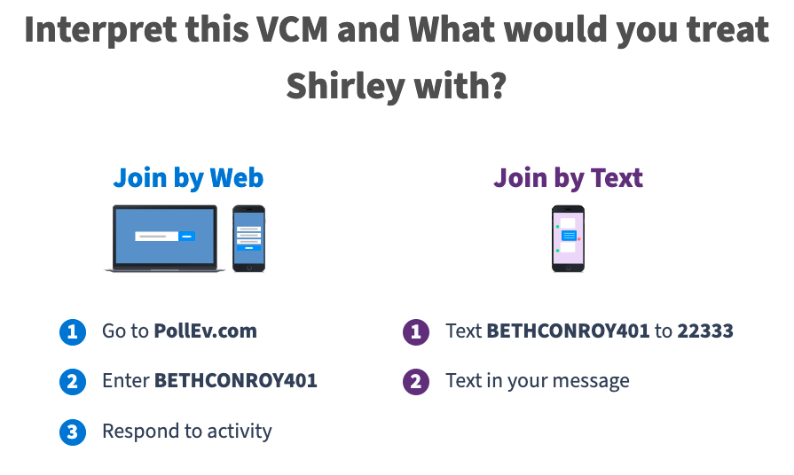
Poll Everywhere Information

Slide 37
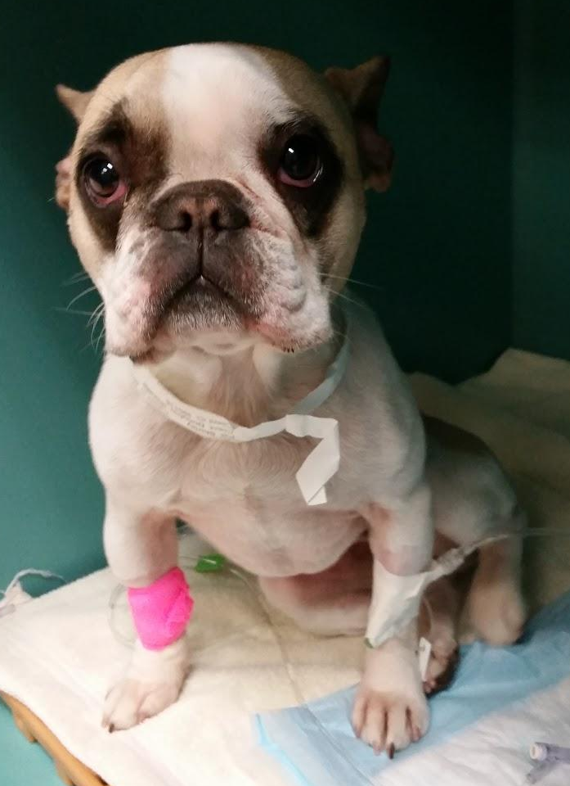
Case Examples #1: Shirley
2 year old spayed female French Bulldog
PC: Vomiting
Hx: Mushroom Ingestion day prior to presentation
Presenting ALT 541
24 hours later: ALT >10,000

Slide 38
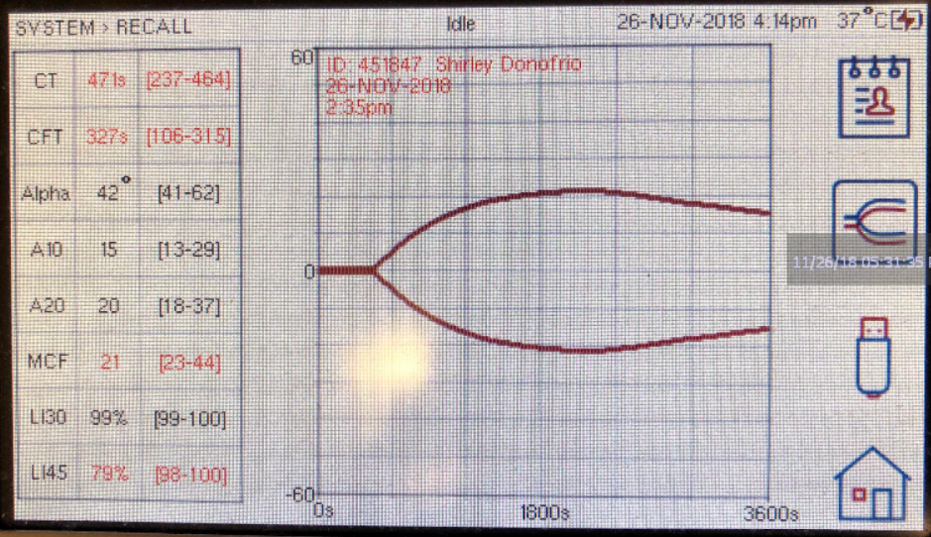
Case Examples #1: Shirley’s Initial VCM

Slide 39
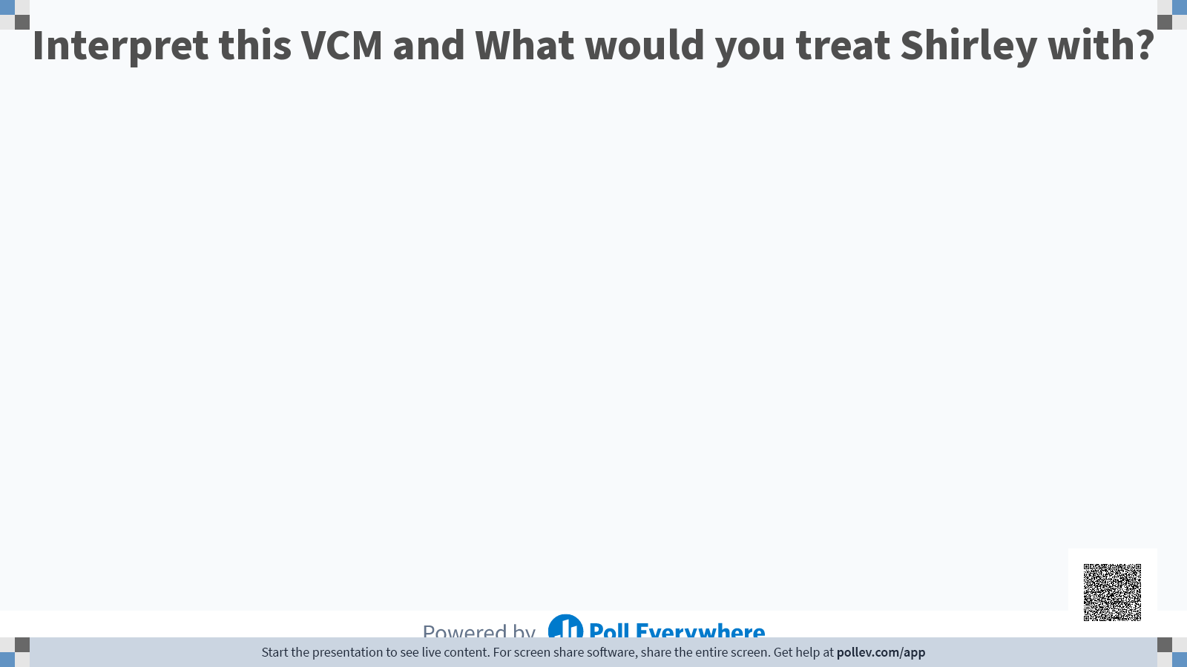
Notes:
CT and CFT prolonged → Hypocoagulable
MCF and LI45 decreased → Hyperfibrinolytic

Slide 40
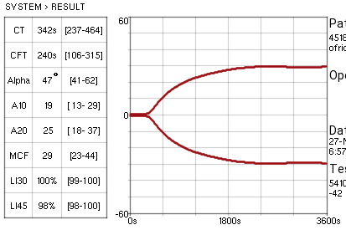
Case Examples #1: Shirley’s VCM After Treatment
Notes:
Shirley was treated with N-acetylcysteine at a standard dose, Vitamin K, fresh frozen plasma and aminocaproic as a bolus of 50mg/kg IV over 1 hour, then as a CRI at 15mg/kg/hr

Slide 41
Case Examples #2: Holly
9 year old spayed female mixed breed dog
PC: New onset seizures (second presentation in 24 hours)
  Hx: Mammary cancer, Hx hemoabdomen/splenectomy 5 days prior to presentation
    Received massive transfusion (3 double units pRBC and 2 double units of FFP peri-operatively)
BW:
  HCT 29.8
  WBC 20.97
  PLT 970
CBC (the next day) sent to Idexx: PLT 1537

Slide 42
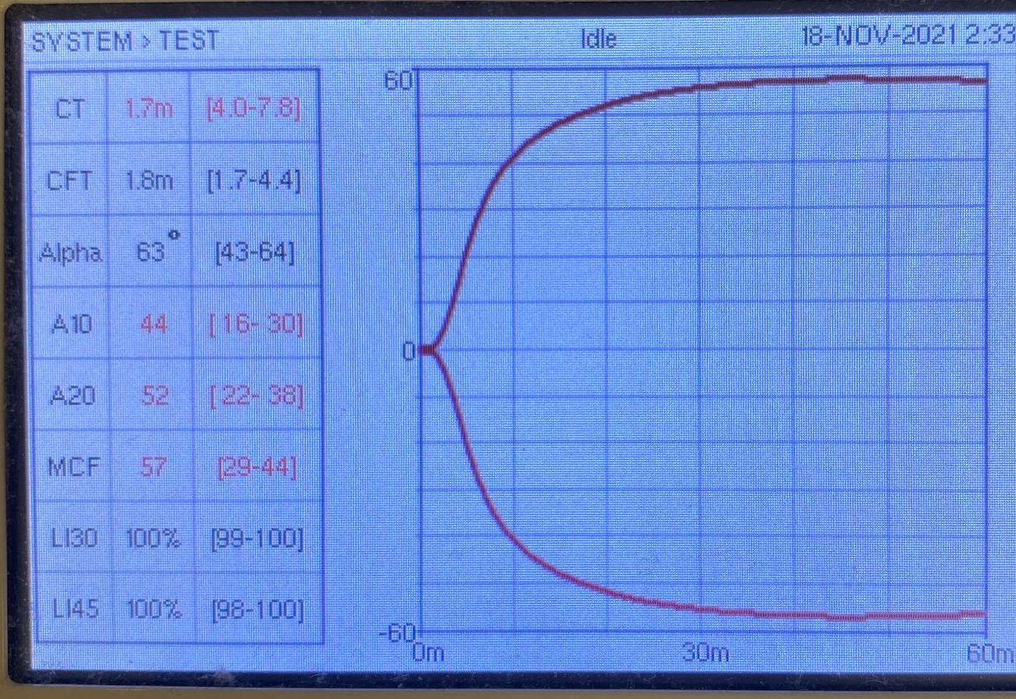
Case Examples #2: Holly’s VCM
Notes:
CT, A10, A20, MCF all elevated → Hypercoagulable

Slide 43
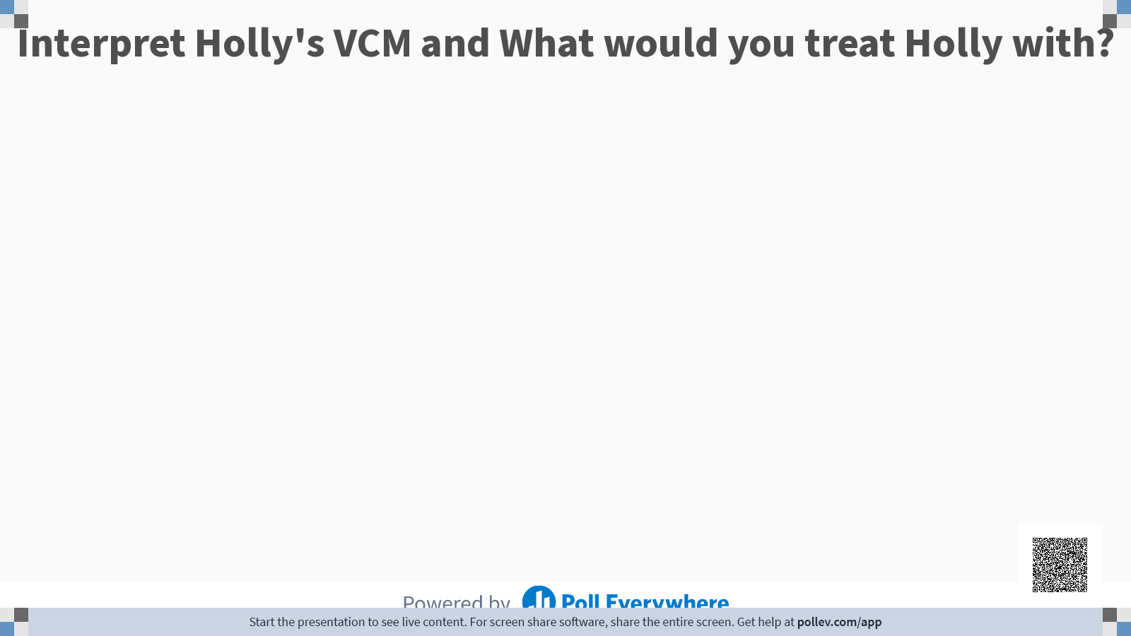
Notes:
CT, A10, A20, MCF all elevated → Hypercoagulable

Slide 44
Case Examples #3: Arlo
2 year old castrated male Cavalier King Charles Spaniel
PC: Bilateral epistaxis, hematemesis, hematochezia
No known hx of toxin ingestion
BW:
  PCV/TP: 76%, 9.8 g/dL
  CBC: Hct 66.6%, WBC 9.33K/uL, neuts 1.97K/uL, lymphs 5.89 K/uL, monos 1.45K/uL, platelets 160K/uL with increased MPV
CXR: Cranioventral interstitial to alveolar pulmonary pattern. This is prioritized to represent pulmonary hemorrhage, presumably from the coagulopathy

Slide 45
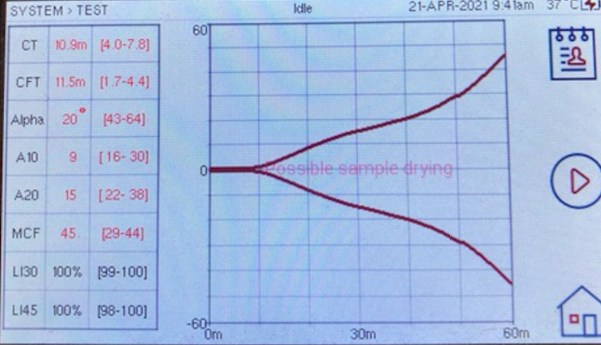
Case Examples #3: Arlo’s Initial VCM
Notes:
CT and CFT prolonged, alpha angle decreased → Hypocoagulable
Diagnosis: Septic shock and secondary DIC from Hemorrhagic Gastroenteritis/AHDS

Slide 46
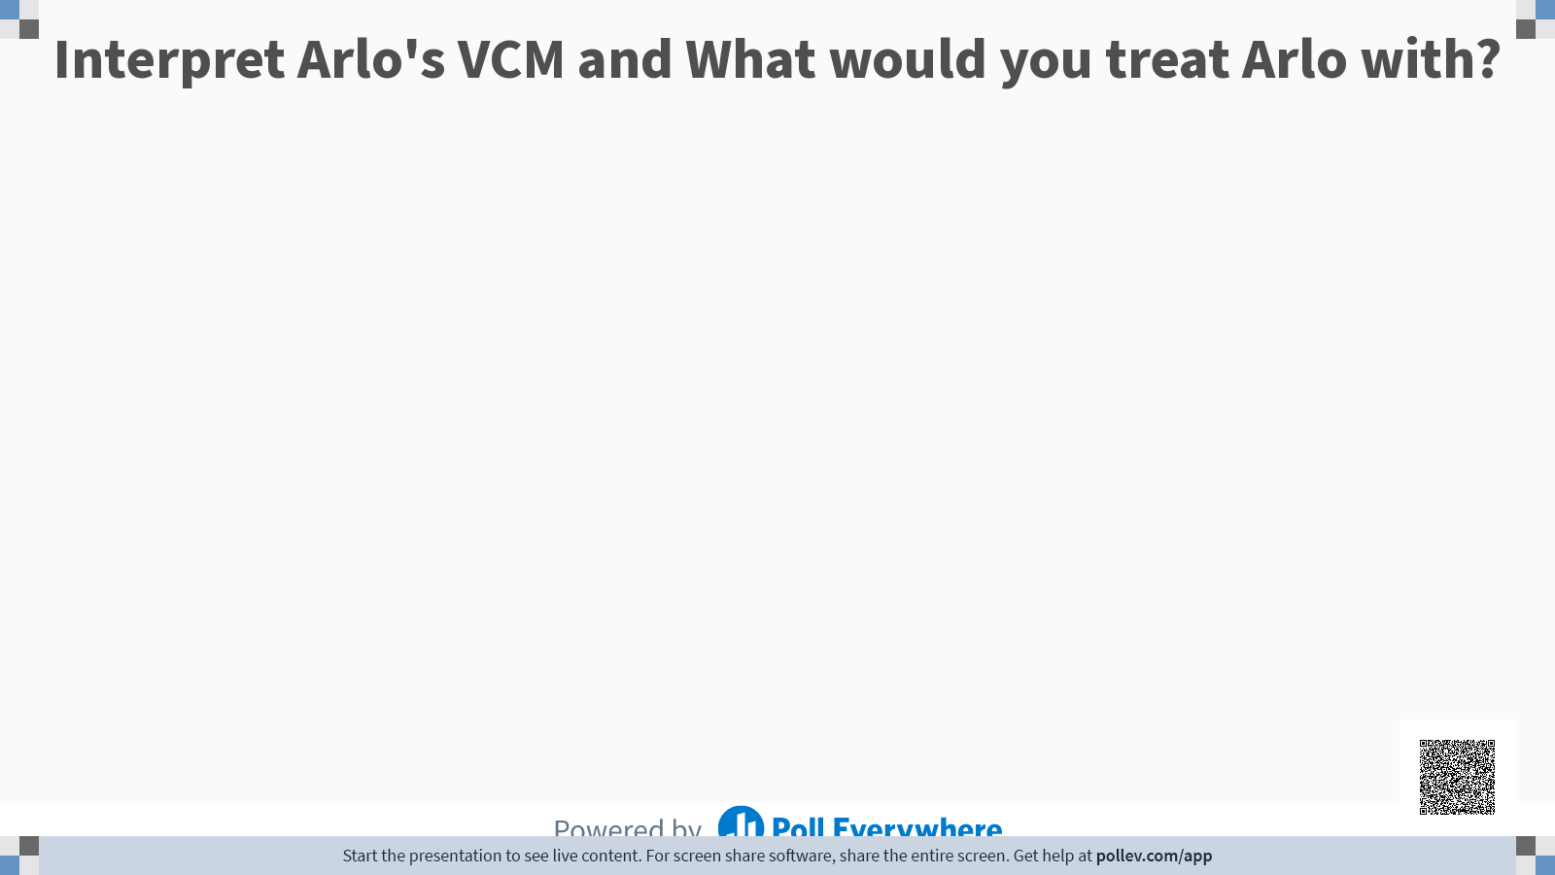
Notes:
CT and CFT prolonged, alpha angle decreased → Hypocoagulable
Diagnosis: Septic shock and secondary DIC from Hemorrhagic Gastroenteritis/AHDS

Slide 47
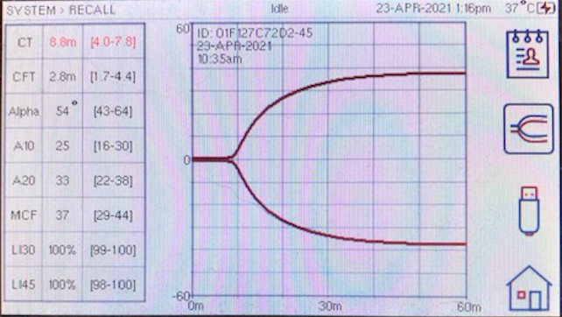
Case Examples #4: Arlo’s VCM After Treatment
Notes:
Treated with 3 units of FFP along with crystalloids, norepinephrine as well as additional supportive care

Slide 48
Case Examples #4: Pepita
13 year old spayed female Miniature Pinscher mix
PC: Inability to use her left hindlimb for 5 weeks
  Has seen multiple vets and has tried numerous therapies (abx, pain meds, NSAIDs, etc)
PE: Patient in severe respiratory distress
  Wheezing with marked expiratory push

Slide 49
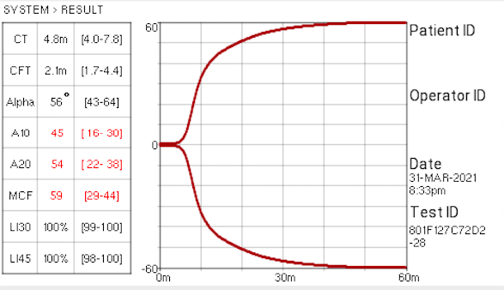
Case Examples #4: Pepita’s VCM
Notes:
Increased clot strength → Hypercoagulable

Slide 50
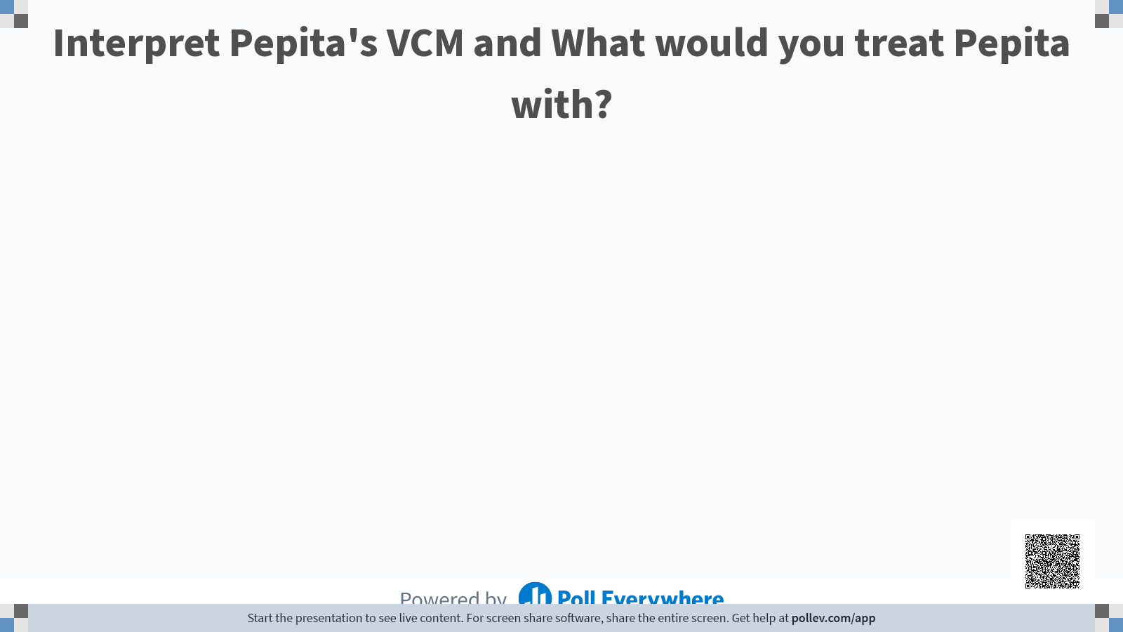
Notes:
Increased clot strength → Hypercoagulable with no specific underlying diagnosis. She was ultimately euthanized due to progressive respiratory distress

Slide 51
Case Examples #5: Iggy
10 year old castrated male English Shepherd
PC: Waxing/waning right forelimb lameness and axillary/ventral thoracic swelling/edema with bruising
PE: Marked ecchymosis along right forelimb, extending across ventral sternum and ventral abdomen

Slide 52
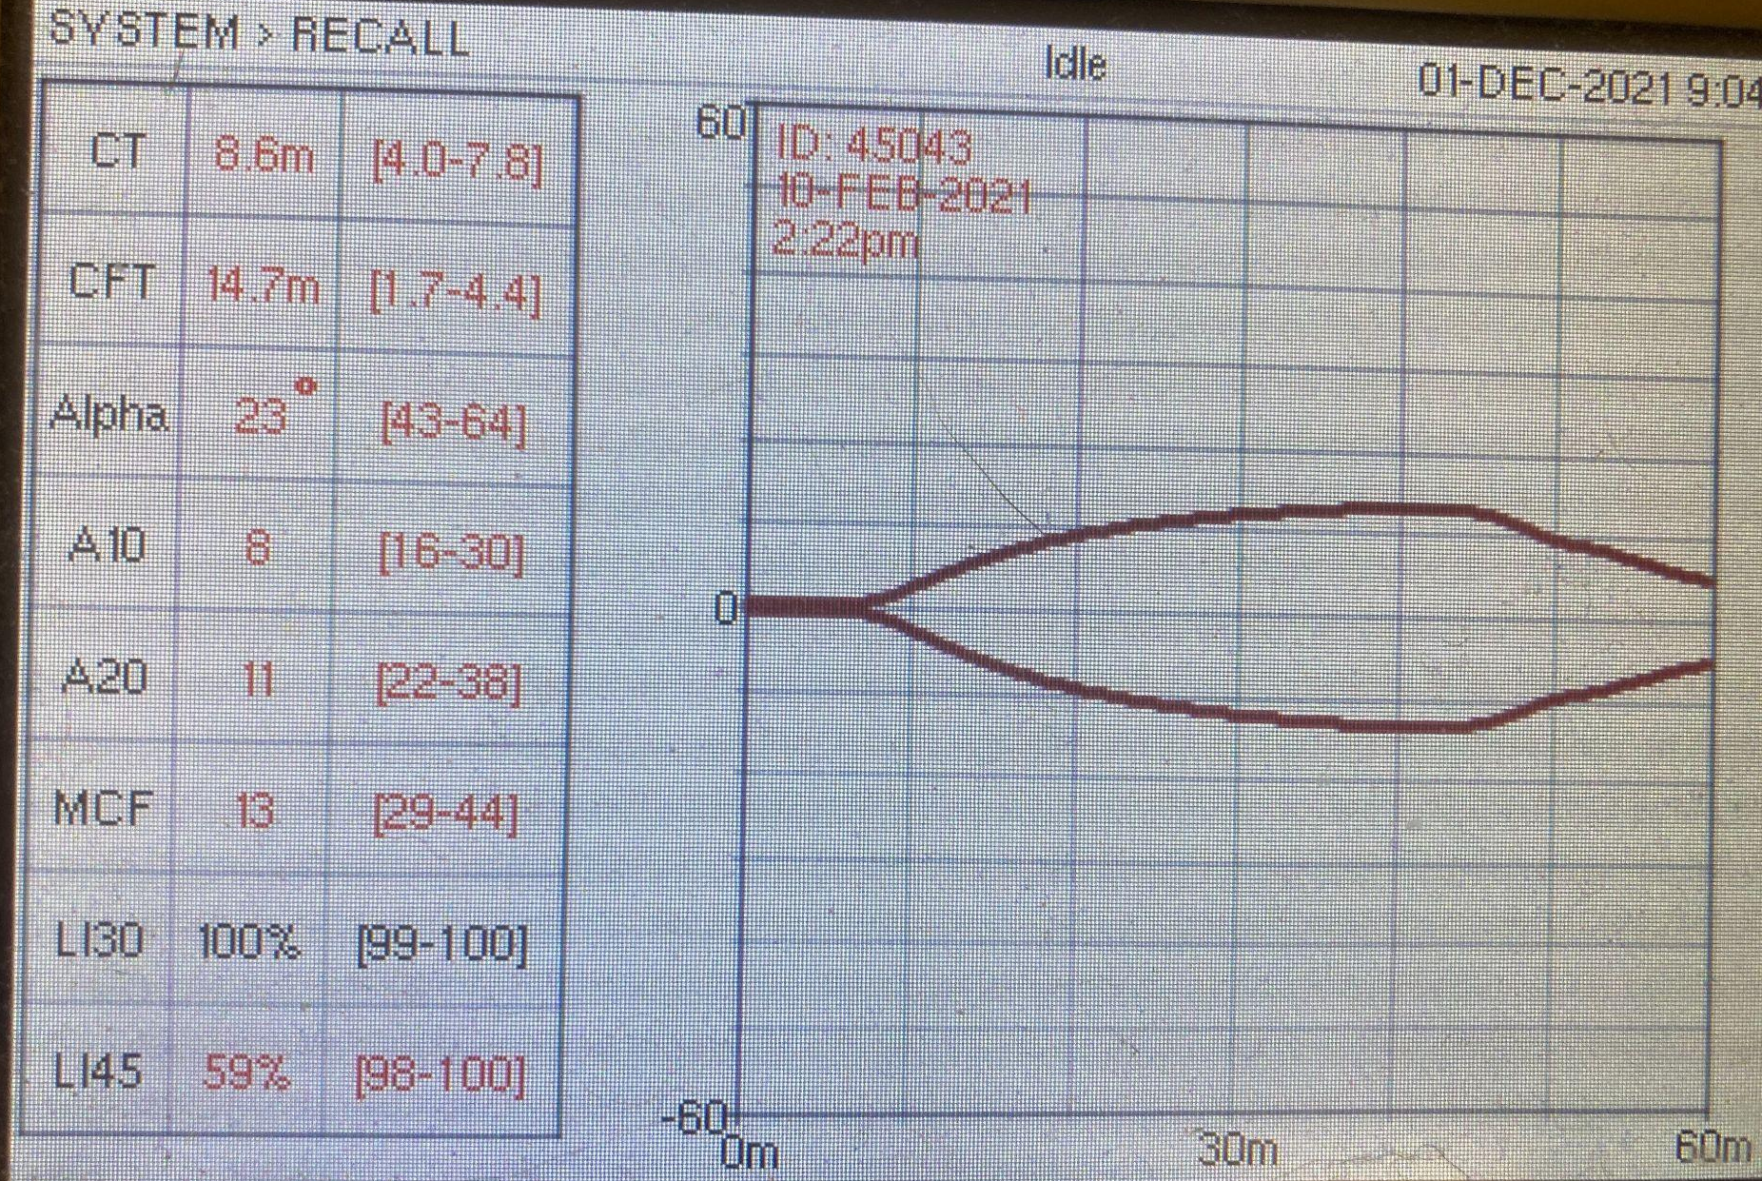
Case Examples #5: Iggy’s VCM
Notes:
Hypocoagulable and hyperfibrinolytic

Slide 53
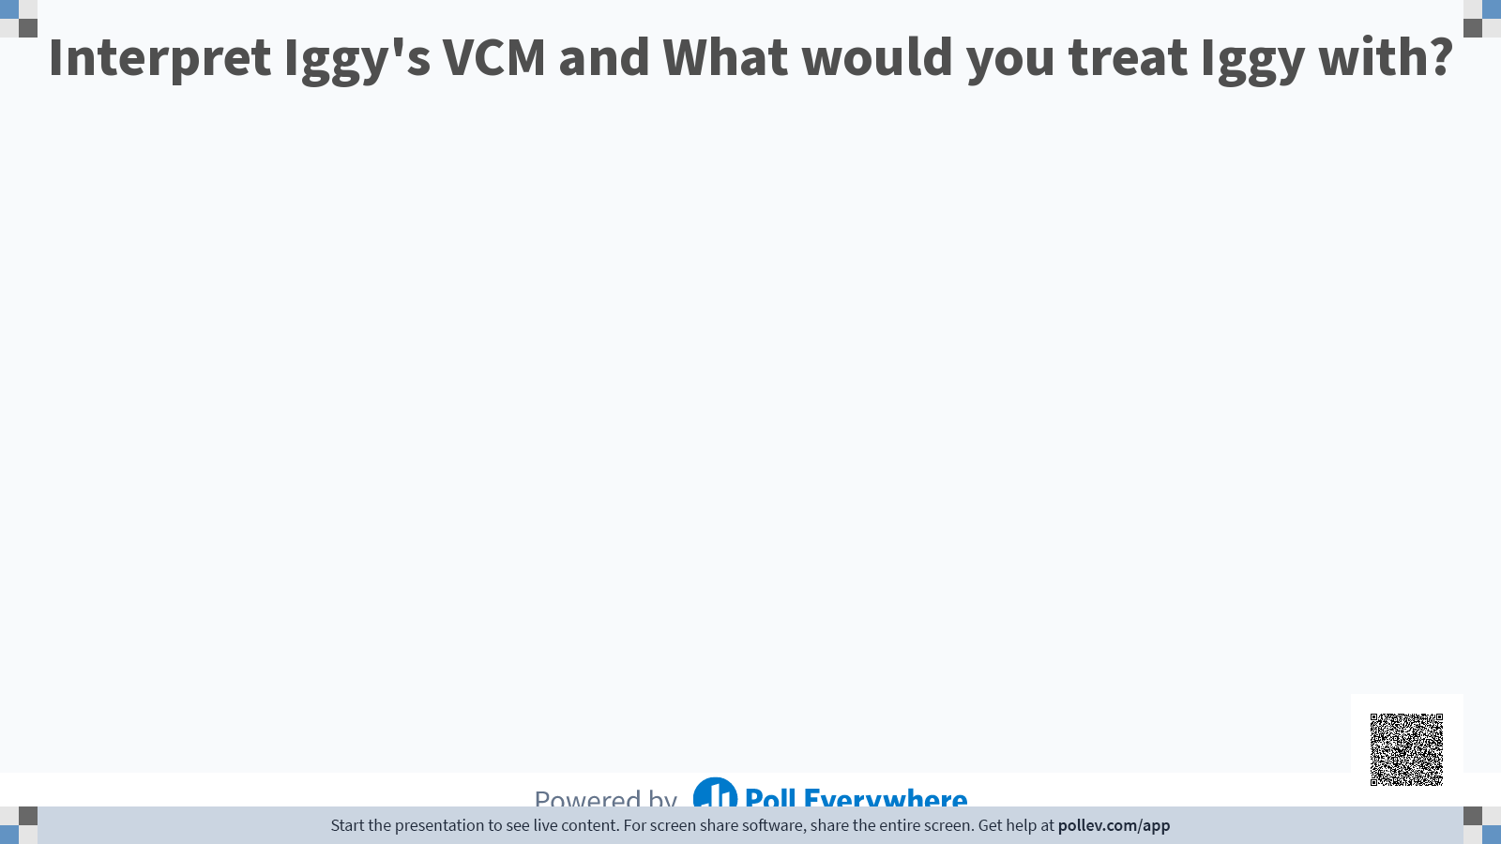
Notes:
Hypocoagulable and hyperfibrinolytic - Iggy was ultimately diagnosed with metastatic neoplasia and was sent home for quality time

Slide 54
Case Examples #6: Sybil’s VCM
12 year old spayed female Tabby
PC: Profound anemia
PE: bruising noted around left xiphoid area and large bruise over left thoracic wall with focal bruising over left jugular vein (from presumptive venipuncture)
BW:
  PT: >100 seconds
  PTT: >300 seconds

Slide 55
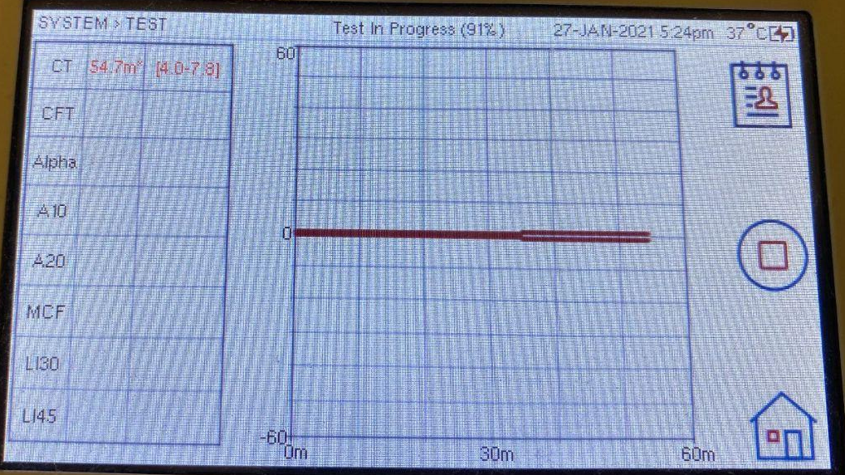
Case Examples #6: Sybil’s VCM
Notes:
Severely prolonged CT - severely hypocoagulable

Slide 56

Notes:
Severely prolonged CT - severely hypocoagulable
Ultimate diagnosis: Malignant multinodular intrahepatic cholangiocellular carcinoma (biliary carcinoma) with pulmonary metastasis

Slide 57
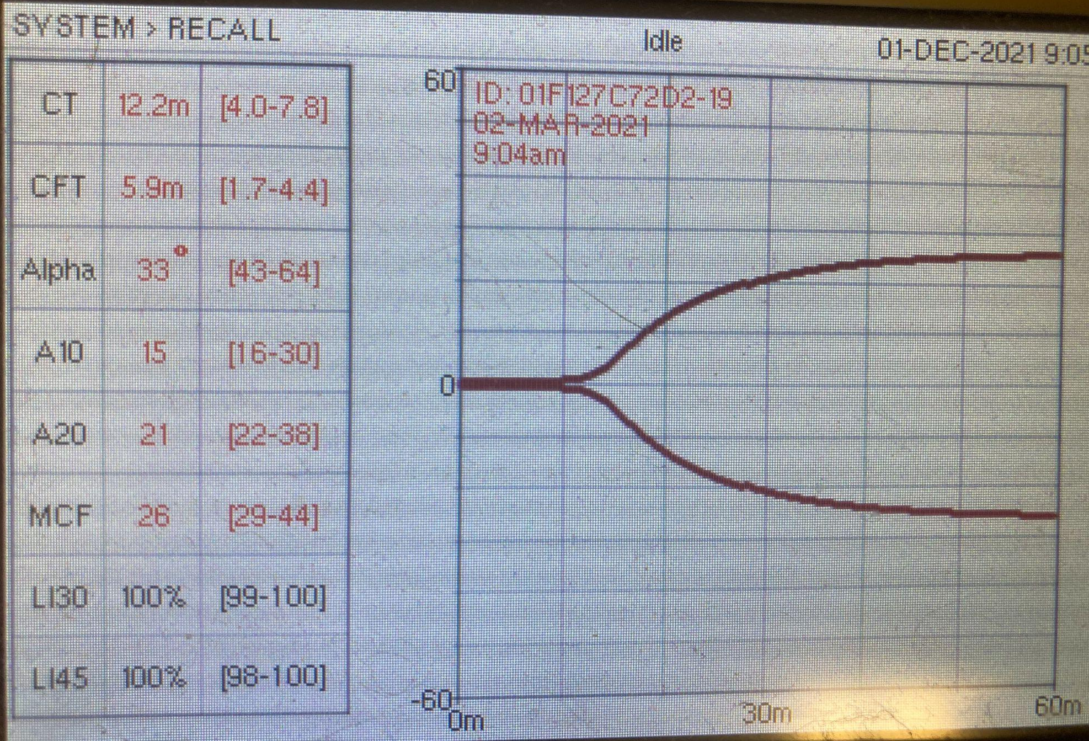
Interpret This VCM (1)!
Notes:
CT and CFT prolonged as well as decreased alpha angle and MCF → Hypocoagulable

Slide 58
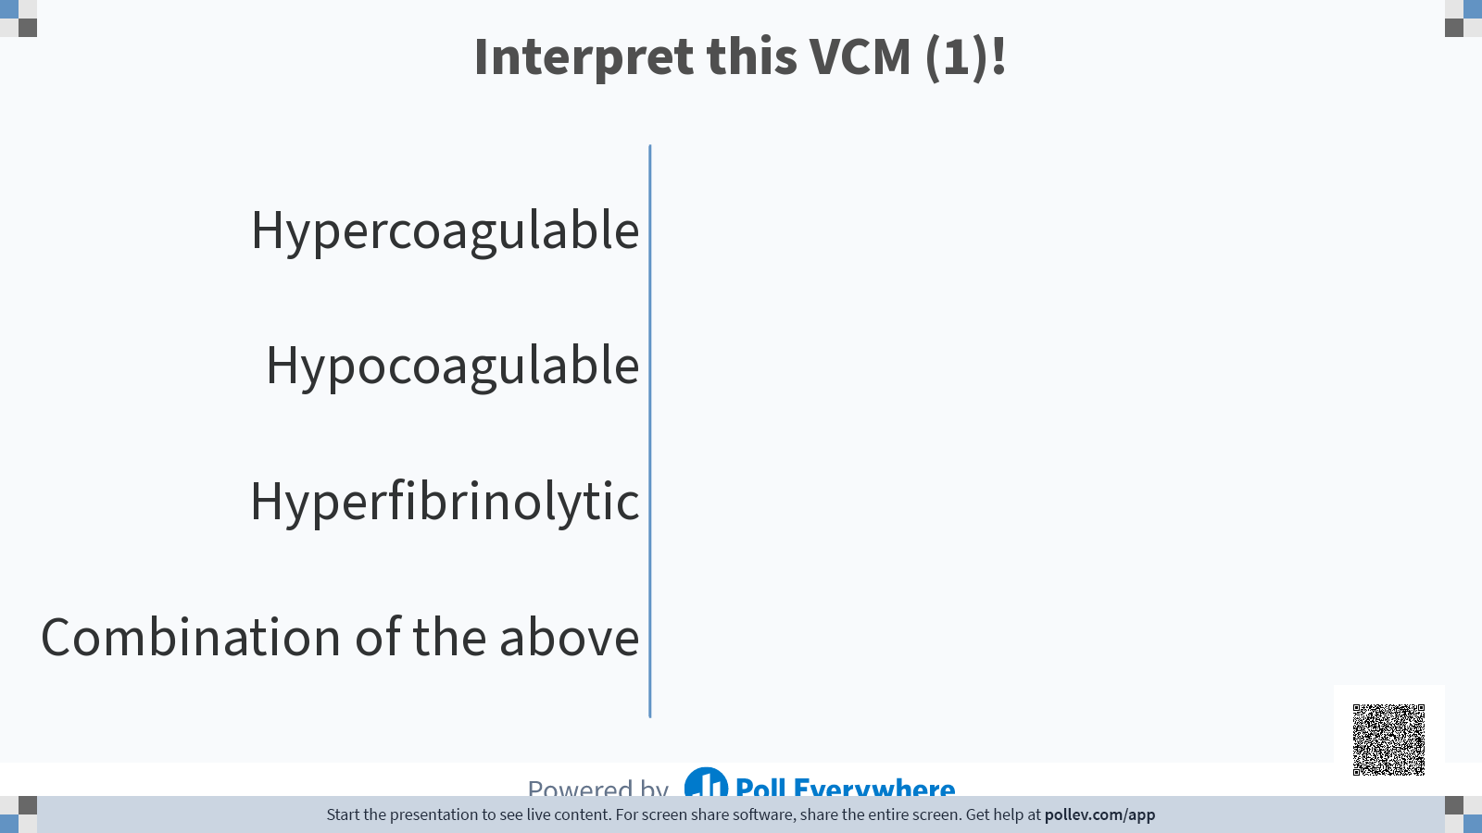
Notes:
CT and CFT prolonged as well as decreased alpha angle and MCF → Hypocoagulable

Slide 59
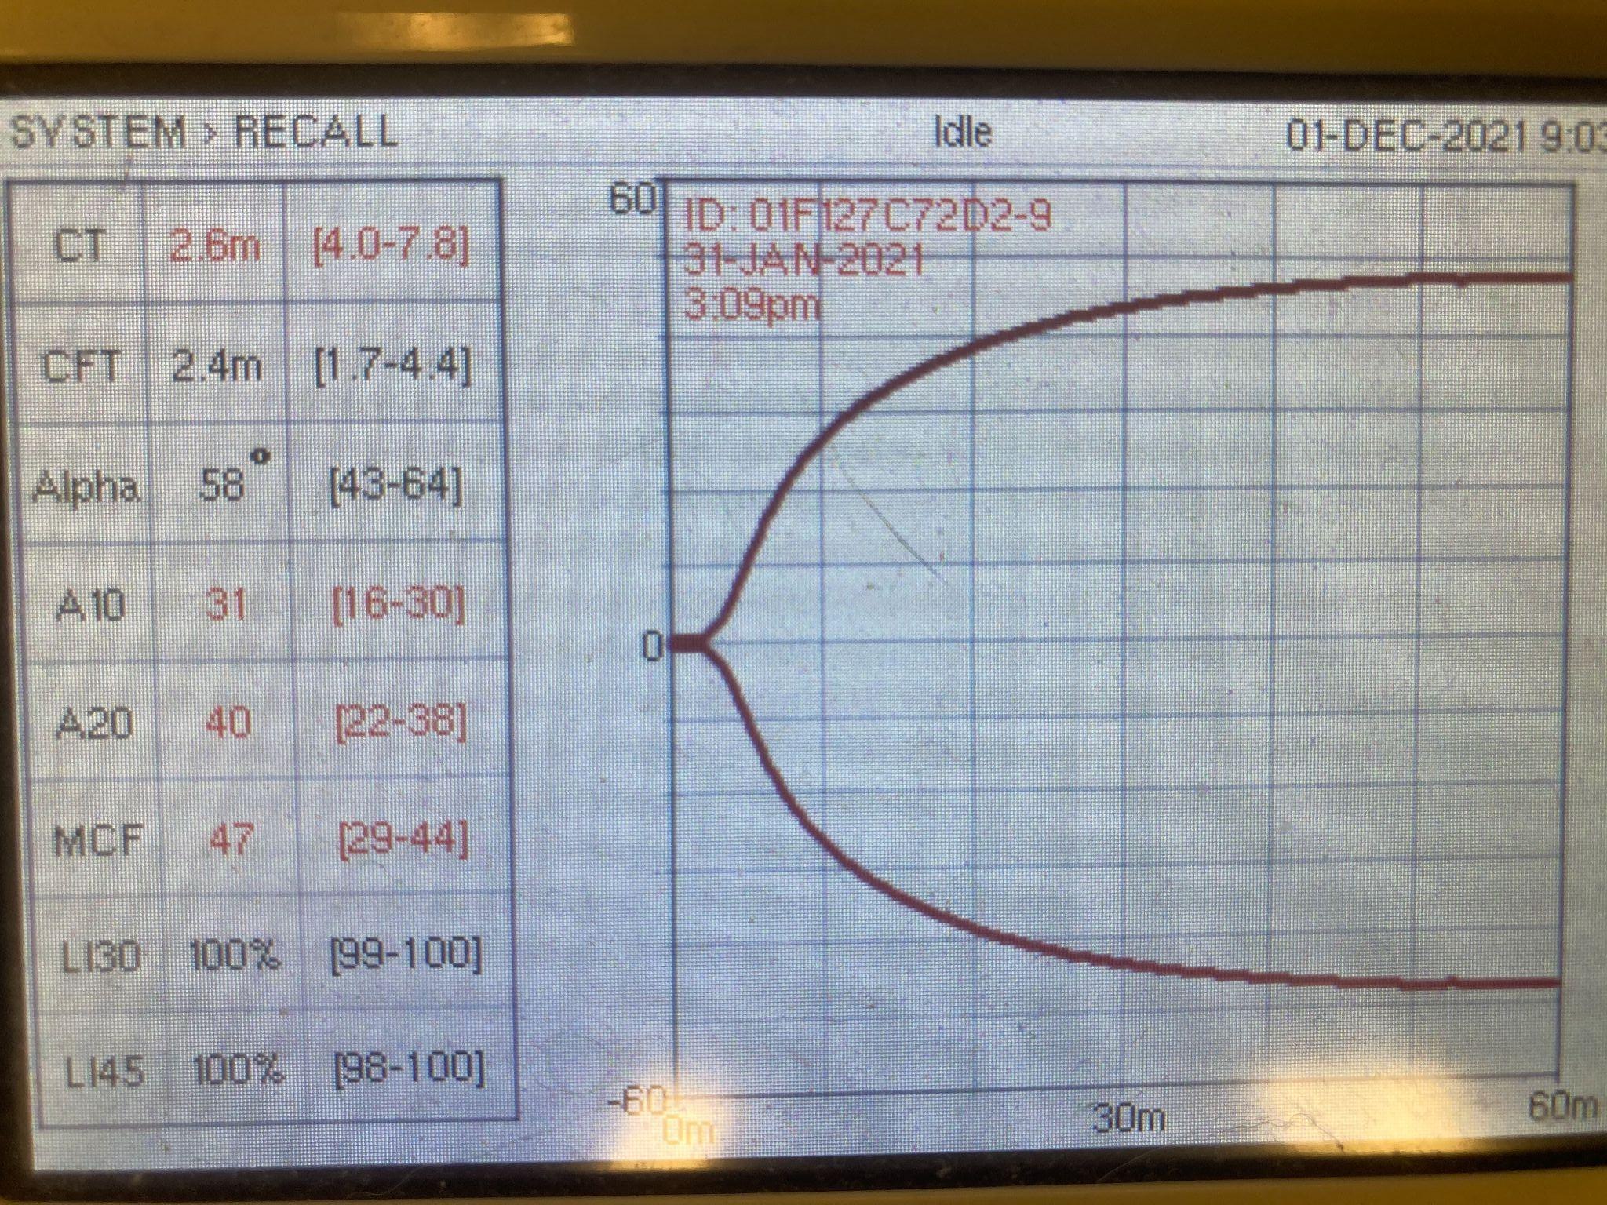
Interpret This VCM (2)!
Notes:
Short CT and increased MCF → Hypercoagulable

Slide 60

Notes:
Short CT and increased MCF → Hypercoagulable

Slide 61
References
Anti-Xa Assays. (2021). Retrieved 1 December 2021, from https://practical-haemostasis.com/Miscellaneous/anti_xa_assays.html
Banerjee, A., Blois, S. L., & Wood, R. D. (2011). Comparing citrated native, kaolin-activated, and tissue factor–activated samples and determining intraindividual variability for feline thromboelastography. Journal of Veterinary Diagnostic Investigation, 23(6), 1109–1113. https://doi.org/10.1177/1040638711425595
Clancey N, Burton S, Horney B, Mackenzie A, Nicastro A, Côté E. Evaluation of platelet function in dogs with cardiac disease using the PFA-100 platelet function analyzer. Vet Clin Pathol. 2009 Sep;38(3):299-305. doi: 10.1111/j.1939-165X.2009.00138.x. Epub 2009 Apr 6. PMID: 19392759.
Drug monitoring – eClinpath. (2021). Retrieved 1 December 2021, from https://eclinpath.com/hemostasis/tests/heparin-monitoring/
Paniccia, R., Priora, R., Liotta, A. A., & Abbate, R. (2015). Platelet function tests: a comparative review. Vascular health and risk management, 11, 133–148. https://doi.org/10.2147/VHRM.S44469
Viscoelastic tests of clotting function (TEG and ROTEM) | Deranged Physiology. (2021). Retrieved 1 December 2021, from https://derangedphysiology.com/main/required-reading/haematology-and-oncology/Chapter%20120/viscoelastic-tests-clotting-function-teg-and-rotem#:~:text=In%20fact%20the%20main%20difference,develops%20as%20the%20blood%20clots.

