Slide 1
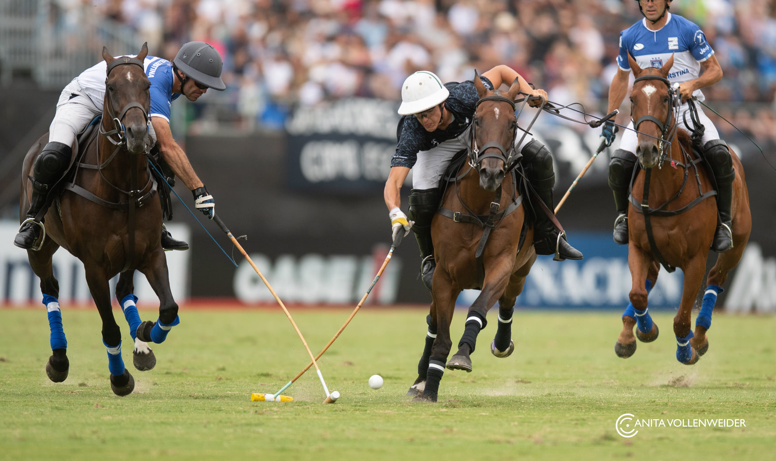
Cardiovascular
Physiology
Tomas Boullhesen-Williams
Cornell University

Slide 2
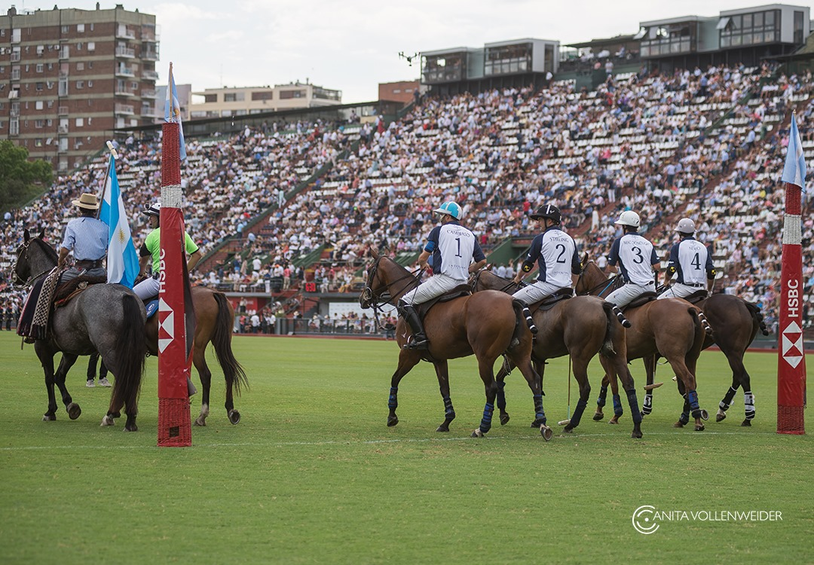
1. Hemodynamics

Slide 3
1. Circuitry
Arteries
  Thick-walled vessels
  Extensive elastic tissue
  Contain stressed volume (under high pressure)
Arterioles
  Site of higher resistance to flow
  α1 adrenergic receptors
  Less commonly β2 → dilation
Capillaries
  nutrient exchange
Veins and venules
  Less elastic tissue than arterioles
  Large capacitance
  Largest % of blood (unstressed volume)
  Increase in sympathetic tone via α1

Slide 4

1. Velocity of flow
Q= Rate of displacement of blood per unit time
  v=Q/A
    V = velocity of flow (cm/s) – rate of displacement of the blood per unit time
    Q = flow (mL/s) – volume flow per unit of time
    A = Cross sectional area (cm2) – A=$π$ r²
The total blood flow at each level of blood vessel is the same and it is equal to the cardiac output
The velocity though varies - highest in aorta and lowest in capillaries

Slide 5
1. Relationship between blood flow, Pressure and Resistance
Flow determined by two factors:
  ∆ Pressure between the two ends of the vessel → drives the flow
  Resistance to the flow → impedes the flow
Ohm’s law
Q = ∆P / R
    The magnitude of flow directly related to the ∆P
    Direction of the flow determined by direction of the gradient
    R:
      Inversely related to flow
      Major mechanism for changing blood flow

Slide 6

1. Resistance to flow
Poiseuille’s equation
R= 8ƞl/ $π$ r^4
    $Ƞ$ = viscosity
    L = length of the vessel
    R = radius raised to the fourth power
R is directly proportional to ƞ
R is directly proportional to length of vessel
Most importantly, inverse to the fourth power of the radius
  I.e.: if the radius of the vessel decreases by one-half, resistance increases by 16-fold! (2^4)

Slide 7
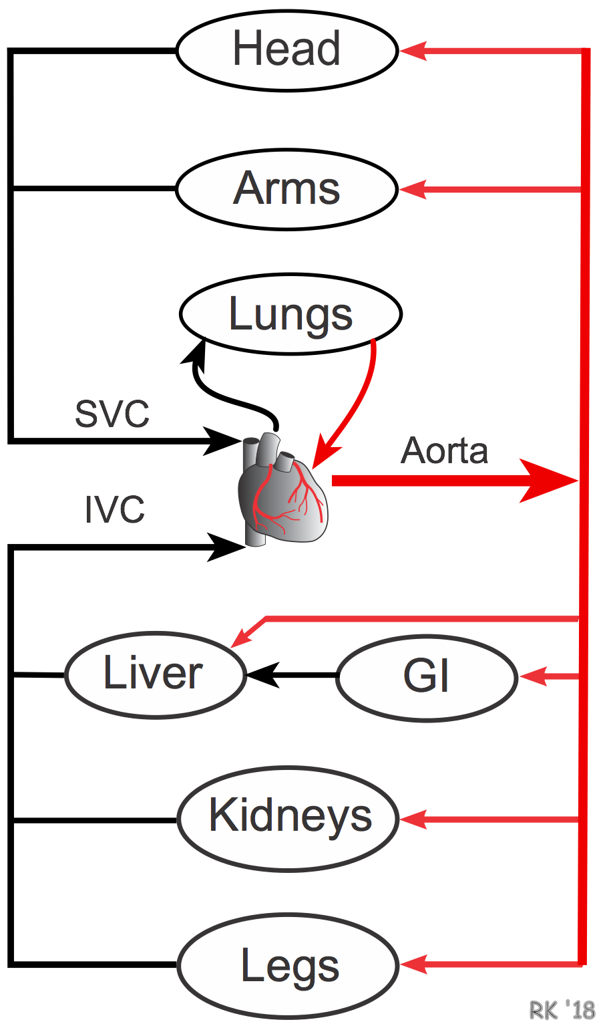
1. Series vs parallel resistances
The arrangement of the vessels influences the R
1) Series arrangements:
  The total R of the system is equal to the sum of individual resistances
  R_{T} = R_{A} + R_{a} + R_{c} + R_{v} + R_{V}
  Flow is the same at each level of the system
  Pressure decreases progressively as blood flows through each component
    Q = ∆P / R
In this arrangement R_{T} is always greater than individual resistances

Slide 8
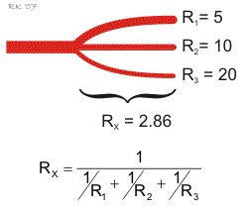

1. Series vs parallel resistances
2) Parallel arrangements
  As you add vessels in a parallel arrangements the overall R decreases
  R_{T} is always less than any component
    The flow through each organ is a fraction of the total blood flow
Effect of this arrangement: no loss of P in each of the major arteries
  MAP in each major artery will be almost same as MAP in aorta
If the R of one of the segments increases, R_{T} increases

Slide 9
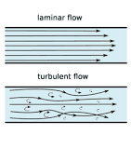
1. Laminar flow and Reynolds number
Normal blood – laminar flow
  Smooth parabolic profile of velocity within a blood vessel
  The V of flow is zero at the wall and maximal at the center
Irregularities – turbulent flow
Reynolds number: Nr = ρdv / ƞ
p= blood density, d = diameter, v = velocity of flow, n = viscosity
Used to predict whether flow will be laminar or turbulent
  Nr < 2000 flow will be laminar
  Nr > 2000 - turbulent

Slide 10
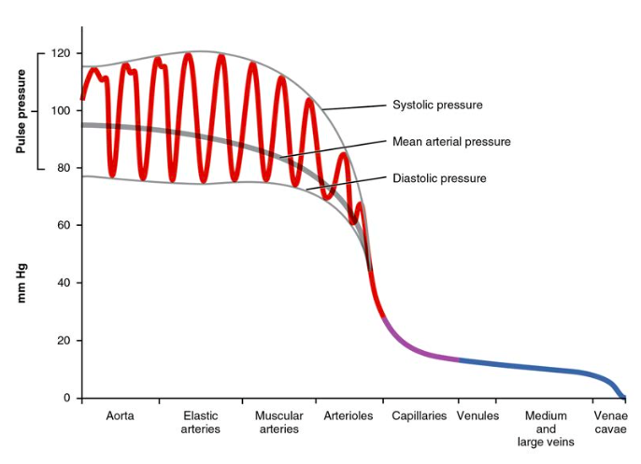
1. Pressures in the CV system
BPs are not equal throughout the CV system
  ∆P is driving force
Arteries – high P due to high V and low C
Arterioles - most significant decrease in P (mean P 30 mmHg) – high resistance segment
Capillaries - P even lower - frictional R to Q and filtration of fluid out of vessels
Venules and veins - P drops even more - high C
Cava – 4 mmHg
RA - 0 - 2

Slide 11
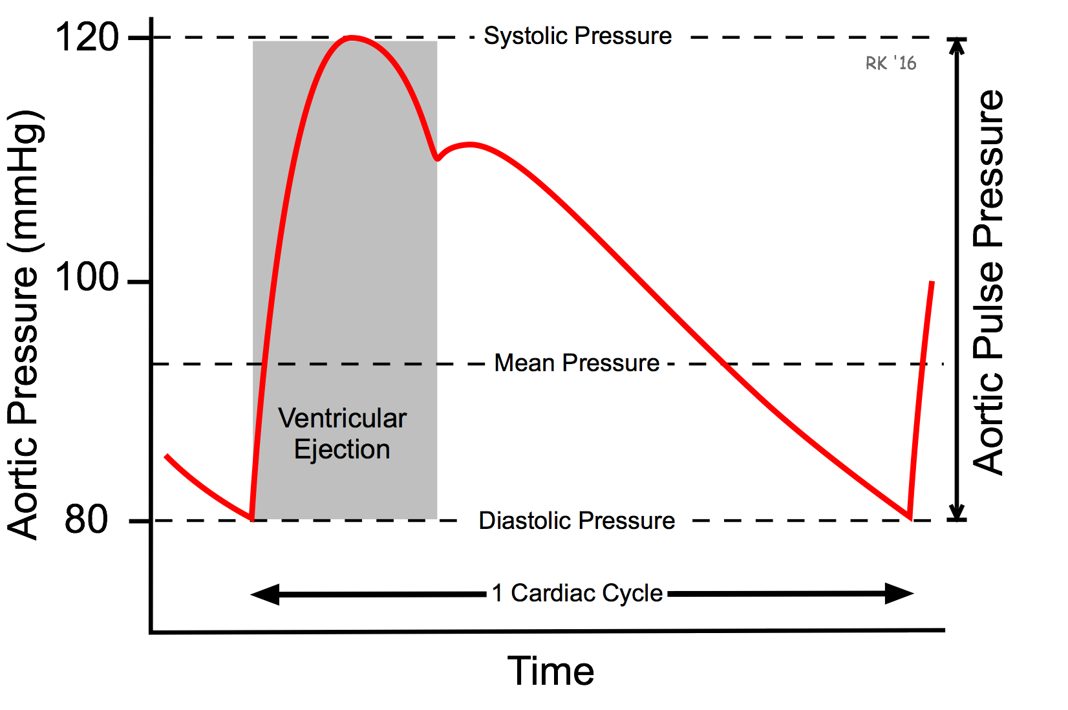
1. Pressures in the CV system
DBP
  Lowest arterial P in cardiac cycle
  Reflects the P in the arteries during ventricular relaxation
SBP
  Highest reading during the cycle
  Dicrotic notch (or incisura) – closure of aortic valve
    Brief period of retrograde flow of blood toward the valve, briefly decreasing the aortic P

Slide 12
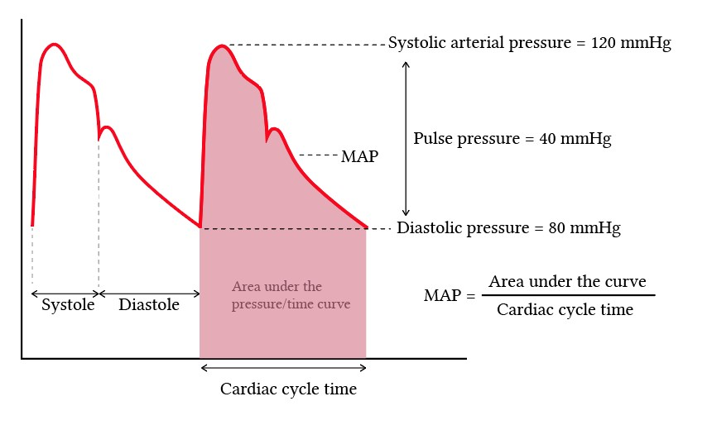
1. Hemodynamics - Pressures in the CV system
PP
  Difference between SBP and DBP
  If all other factors are equal, the magnitude of the PP reflects the SV
  (C=V/P)
    Assuming C is constant, BP will depend on the volume the artery contains
MAP
  Average pressure in a complete cardiac cycle
  (MAP = DBP + 1/3 PP)
  Greater fraction of time of each cycle is spent in diastole
Pulmonary circulation
  Low pressure system
  Q on the left is same as Q on the right
  R is way lower

Slide 13
1. Mean arterial blood pressure
Why do we care about MAP so much?
Blood flow to the tissues is thought to be most closely related to the MAP
  Bloodstream spends only a short period of time at the systolic peak
The pressure regulated by arterioles is the MAP
  By the time it reaches the distal arterioles, flow is no longer pulsatile
  Pressure is dampened windkessel effect
    SBP and DBP are therefore meaningless at the level of the arteriolar vascular bed
It appears to be related to survival (septic shock)

Slide 14
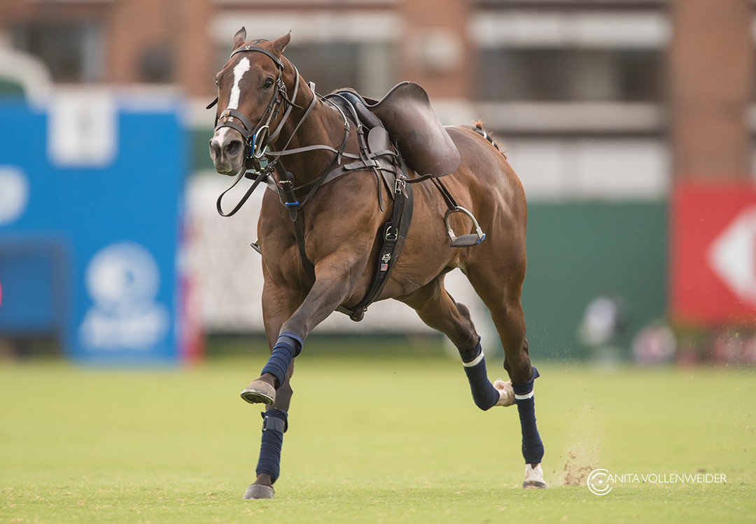
Cardiac Electrophysiology
2. Cardiac Electrophysiology

Slide 15
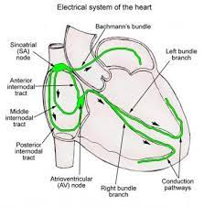
2. Cardiac Electrophysiology
SA node: natural pacemaker
Atrial internodal tracts and atria
  right and left atrial internodal tracts
AV node: slow conduction
Bundle of His - left and right branches
Purkinje fibers - Extremely fast conduction

Slide 16
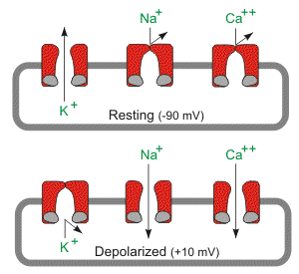
2. Cardiac Electrophysiology
Membrane potential determined by:
  Their conductance to ions
  Concentration gradient for the permeant ions
Membrane potential at rest is -85 mV
Determined primarily by K⁺
  g_{K+} at rest is high and the resting membrane potential is close to the K⁺ equilibrium potential
Conductance to Na⁺ is low
Na⁺ K⁺ ATPase maintains gradient across cell membrane

Slide 17
2. Cardiac Electrophysiology
Change in potential can be due to:
Change in the electromechanical gradient for an ion
    Ion will flow into or out to reestablish equilibrium and this current will alter membrane potential
Change in conductance to an ion
    Na⁺ conductance increases during action potential, Na⁺ flows in down its gradient
    Membrane potential is briefly driven toward the Na⁺ equilibrium

Slide 18
2. dV/dT
Rate of rise of upstroke dV/dT
  Rate of change of membrane potential as function of time (V/s)
Depends on resting membrane potential
  It is greatest when resting potential is most negative
    Voltage dependent inactivation gates are open
    Many Na⁺ channels are available for upstroke
  When membrane is relatively depolarized
    Fewer Na⁺ channels are available
It also correlates with the size of the current

Slide 19
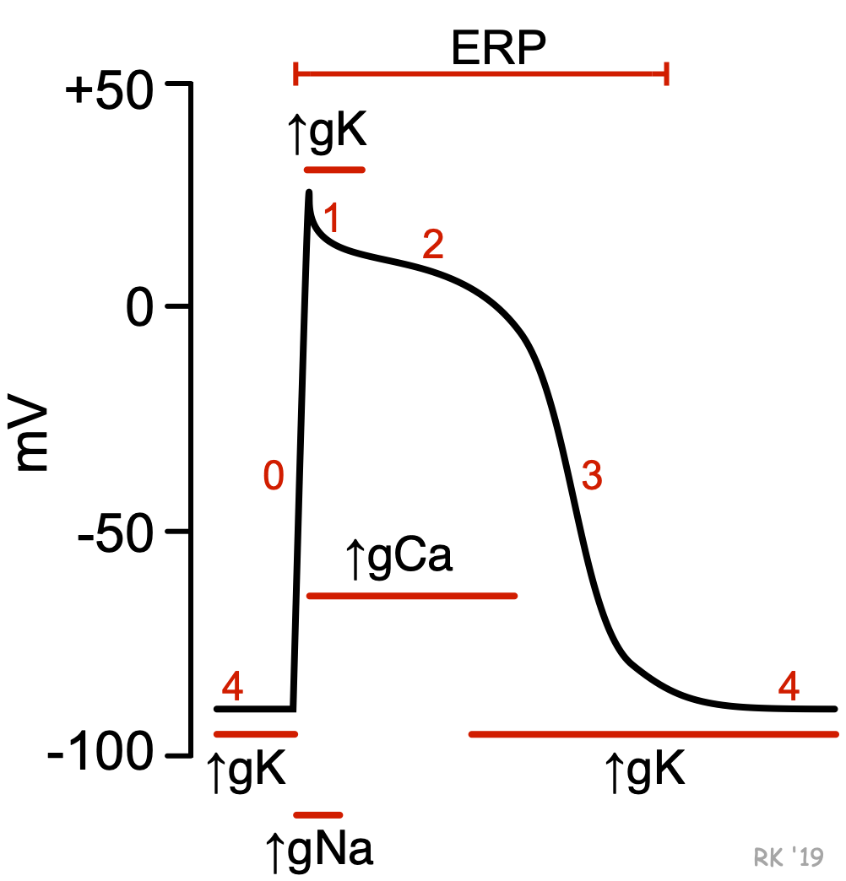
2. Non-pacemakers
Phase 0: Rapid depolarization (upstroke)
Transient increase in gNa⁺ - I_{Na+}
Inactivation gates of Na⁺ channels start to close in response to action potential
Na⁺ channels are open briefly and then they close
gK⁺ and gCa²⁺ are low
  Ca²⁺ channels open when voltage is -40 mV

Slide 20
2. Cardiac Electrophysiology – Non-pacemakers
Phase 1: Initial repolarization
gNa⁺ decreases, channels close
gK⁺ is high - outward current of K⁺ – tries to repolarize
gCa²⁺ is high – L-tye Ca²⁺ channels open

Slide 21
2. Cardiac Electrophysiology – Non-pacemakers
Phase 2: Plateau
Long period -150-200 ms of relatively stable, depolarized membrane potential
gCa²⁺ high - inward flow of Ca²⁺ (slow inward current)
I_{Ca2+} is balanced by outward K⁺ flow – membrane potential remains stable (no net current)
I_{Ca2+} initiates the release of more Ca²⁺ from intracell stores for excitation-contraction coupling
  (Ca²⁺ -induced-Ca²⁺ release)
  Contraction occurs

Slide 22
2. Cardiac Electrophysiology – Non-pacemakers
Phase 3 – repolarization
gK⁺ increases
Inactivation of Ca²⁺ channels – g_{Ca2+} decreases
Repolarization brings the membrane potential close to K⁺ equilibrium potential
K⁺ outward flow decreases

Slide 23
2. Cardiac Electrophysiology – Non-pacemakers
Phase 4 – Electrical diastole
The membrane fully repolarized (-85mV)
Membrane is stable, inward and outward currents are equal
gK⁺ is high
gNa⁺ and gCa²⁺ very low

Slide 24
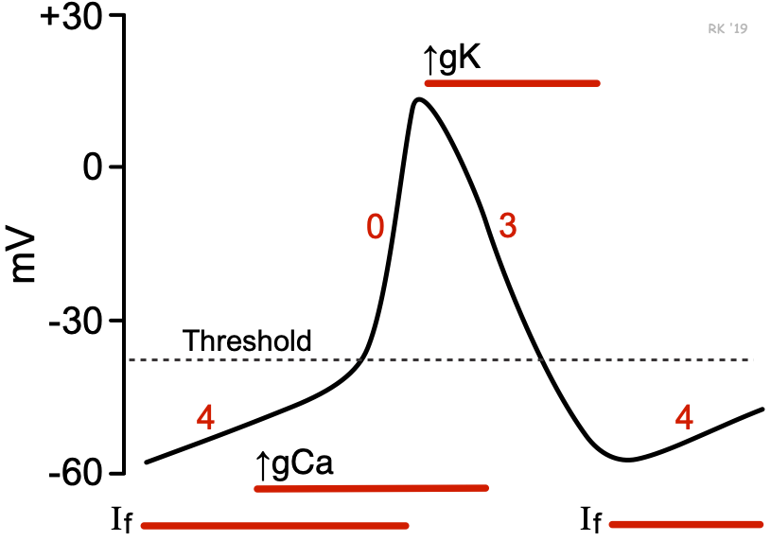
2. Cardiac Electrophysiology - Pacemakers
Automaticity
Unstable resting membrane potential
No sustained plateau
No fast Na⁺ channels present
Phase 0 – upstroke
gCa²⁺ increases – inward current via L-type channels
Not as rapid as in the other types of cardiac tissue
Phase 1 and 2 are absent
Phase 3 – repolarization
gK⁺ increases - outward flux of K⁺ - repolarizes the membrane potential to -60

Slide 25
2. Cardiac Electrophysiology - Pacemakers
Phase 4 – Spontaneous depolarization or pacemaker potential
  Longest portion of action potential
  Accounts for the automaticity
Slow depolarization produced by opening of Na⁺ channels and I_{Na+} (funny current I_{f})
  I_{f} turned on by the repolarization from the preceding action potential
I_{f} and slow depolarization bring the membrane potential to threshold
  Ca²⁺ channels are opened for the upstroke

Slide 26
2. Latent pacemakers
Tissue with capacity for spontaneous depolarization
  AV node, bundle of His and Purkinje fibers
The pacemaker with the fastest rate of phase 4 repolarization controls the rate
SA - shortest action potential duration (shortest refractory period) → recover faster and ready to fire again
  When SA node drives the HR, the latent pacemakers are suppressed – Overdrive suppression
Latent pacemakers only drive the HR if SA node is suppressed
Ectopic pacemakers develop when
SA node is removed, destroyed or suppressed by drugs – or due to vagal stimulation
Intrinsic rate of a latent pacemakers becomes faster
Conduction of action potential from SA node is blocked

Slide 27
2. Cardiac Electrophysiology
Conduction velocity
  Speed at which action potential propagates:
    AV node: 0.01-0.05 m/s
    Purkinje fibers: 2-4 m/s
Determines how long it takes for action potential to spread
220 ms from SA to ventricles
    Conduction through AV node requires almost half of the total conduction time
    Ensures ventricles do not activate too early

Slide 28
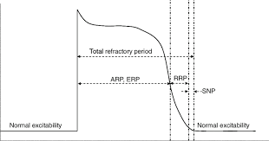
2. Cardiac Electrophysiology
Absolute or effective refractory period:
  Cell is refractory to fire again
  No matter how large a stimulus
  Most Na⁺ channels are closed and unavailable to carry inward current
Phases 1,2,3 and beginning of 4
Concludes when cell has repolarized to -50 mV
Relative RP:
  beings at the end of ARP and continues until the cell membrane has almost fully repolarized
  During RRP, even more Na⁺ channels have recovered
    Possible to generate a second action potential - a greater than normal stimulus is required

Slide 29
2. Cardiac Electrophysiology
Supranormal period:
  Follows RRP
  Beings when the membrane potential is -70 mV and continues until it is -85 mV
  The cell is more excitable than normal
  A lot of Na⁺ channels are being recovered - making it easy to fire

Slide 30
2. Cardiac Electrophysiology
Positive chronotropic effects:
Norepinephrine - Via β₁
  Increase in I_{f} - Increases the rate of phase 4 depolarization - SA node fires more frequently
  Increase in I_{Ca} - more functional Ca²⁺ channels
Negative chronotropic effects:
Acetylcholine – via M₂
  Decreases I_{f} – decreasing the rate of phase 4 depolarization
  Increases g_{K} of K⁺-Ach channels - hyperpolarizes the maximum diastolic potential so nodal cells are further from threshold potential
  Decrease in I_{Ca} - more depolarization is required to reach threshold

Slide 31
2. Cardiac Electrophysiology
Dromotropic effects
Sympathetic:
  Increases I_{Ca} (increases vD/vT) - increased conduction velocity
Parasympathetic:
Decrease I_{Ca2+}
Increase I_{K+-Ach}
ERP is prolonged

Slide 32
3. Cardiac muscle contraction

Slide 33
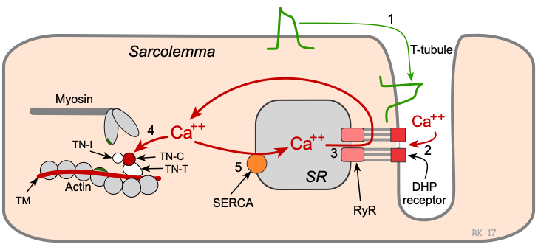
3. Cardiac muscle contraction
Action potential leads to I_{Ca2+} into cell via L-type channels
Ca²⁺ induces release of more Ca²⁺ by binding to ryanodine receptors of SrR (Ca²⁺ –induced Ca²⁺ release)
Ca²⁺ binds to troponin C
Tropomyosin is moved out of the way and exposes actin binding site for myosin
Cross-bridges form and then they break – thick and thin filaments move past each other – tension is achieved
Relaxation – Ca²⁺ is reaccumulated in SrR via Ca²⁺ ATPase, and pumped out of cell via Ca²⁺ -Na⁺ ATPase

Slide 34
3. Cardiac muscle contraction
Two factors determine how much Ca²⁺ is released from the intracell stores:
  The amount of Ca²⁺ previously stored
  Size of the I_{Ca2+}
The magnitude of the contraction is proportional to the intracellular concentration of Ca²⁺

Slide 35
3. Autonomic system on contractility
Sympathetic NS:
+ inotropism - Via β₁ – phosphorylation of 2 proteins:
  Sarcolemmal Ca²⁺ channels
    Increase I_{Ca2}⁺ during phase 2 - increased the amount of Ca²⁺ released by ScR
  Phospholamban
    Stimulates Ca²⁺ ATPase in ScR - increases the uptake of Ca²⁺ by ScR – 2 effects:
      Causes a faster relaxation (briefer contraction)
      Increases the amount of Ca²⁺ stored for release on the next beat
Parasympathetic NS:
- inotropism - Via M₂
Decreases I_{Ca2+} - decrease the amount of Ca²⁺ released from ScR

Slide 36
3. Relationship between HR and contractility
As HR increases there is going to be:
  More action potentials per unit time
  More Ca²⁺ that enters the cell during the plateau
If the increase in HR is caused by catecholamines, the size of I_{Ca2}⁺ also increases
  The ScR accumulates more Ca²⁺ for subsequent release
Two examples of this phenomenon:
Positive staircase effect (Bowditch staircase):
HR doubles, the tension developed on each beat increases in a stepwise fashion to a maximal value
The very first beat shows no increase in tension because the extra Ca²⁺ has not accumulated yet
Subsequent beats effect becomes evident
Post extrasystolic potentiation:
An extrasystolic beat is generated by a latent pacemaker – the tension developed on the next beat is higher than normal

Slide 37
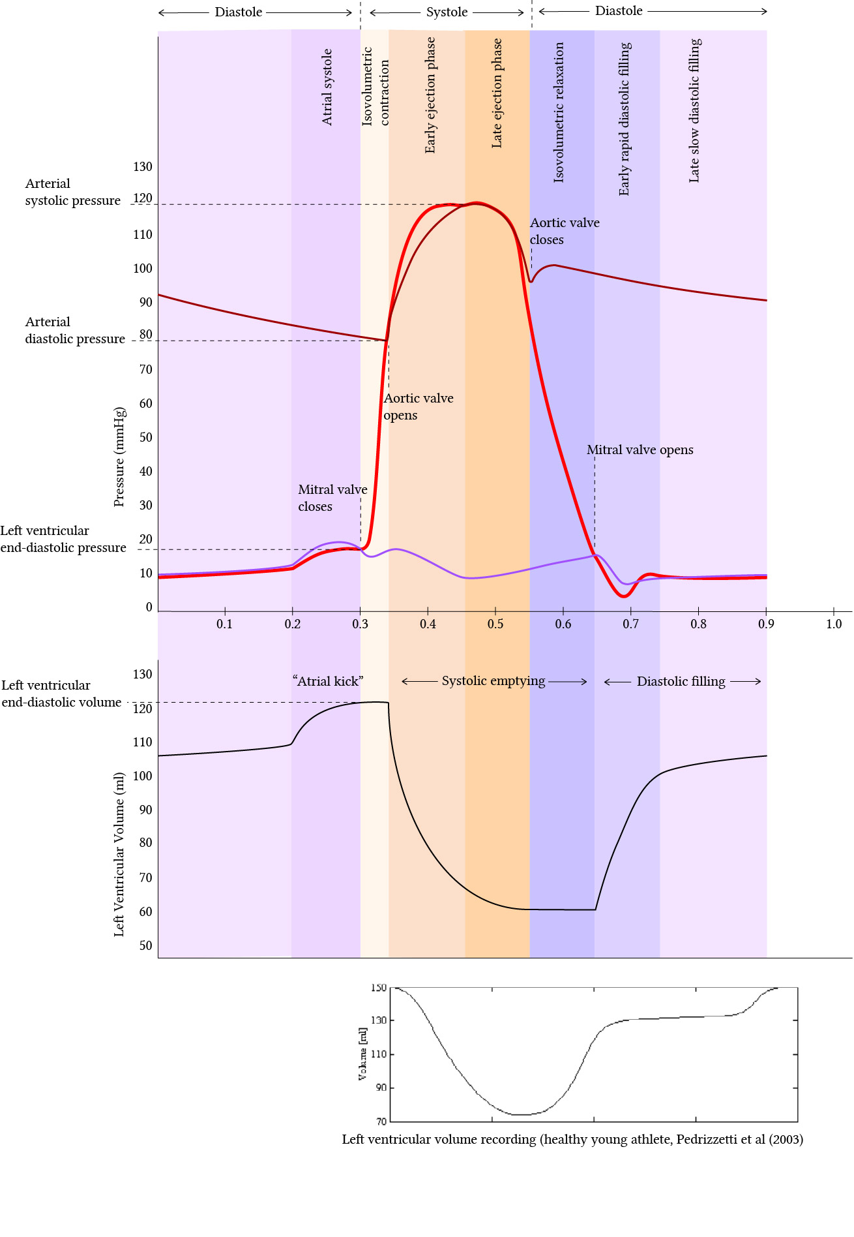
Rapid ventricular ejection
Early ejection phase
LV continues to contract, and aortic valve opens
End of ST segment or beginning of T wave
Aortic P high
LV P high
LA P slowly increases as blood returns from lungs
LV volume drops
Venous pressure peaks
Atrial systole:
Atrial depolarization and contraction
Preceded by P wave on EKG
Aortic P low
LV P low
Increase in LA pressure
AV valves are open and is filling with blood
Reflected as A wave on venous pressure
S4 in cases of LV hypertrophy
Ends with closure of MV
Isovolumetric contraction:
Begins during QRS complex – electrical activation of the ventricles
Aortic P low
LV pressure increases dramatically but volume remains constant (valves closed)
LA P low
When LV pressure exceeds LA, mitral valve closes
S1
Reduced Ventricular ejection
Late ejection phase
Ventricles begin to repolarize
T wave
Aortic P drops
LV pressure falls
LA pressure continues to increase as blood returns from lungs
Rapid ventricular/diastolic filling
Ventricular pressure falls and Mitral valve opens
Aortic P going down
LV P low
LA P goes down as LA is emptying
LV volume goes up
Ventricular pressure remains low as the V is very compliant
Venous P goes down
Isovolumetric relaxation
Ventricles are fully repolarized and aortic valve closes
End of the T wave
Aortic P higher that LV P so valve closes
LV pressure decreases dramatically
All valves are closed cause LV P is higher than LA P
S2
Reduced/late diastolic filling (Diastasis)
Longest phase of the cardiac cycle
Aortic P goes down
LV P same as LA P
LV volume going up
End of diastole

Slide 38
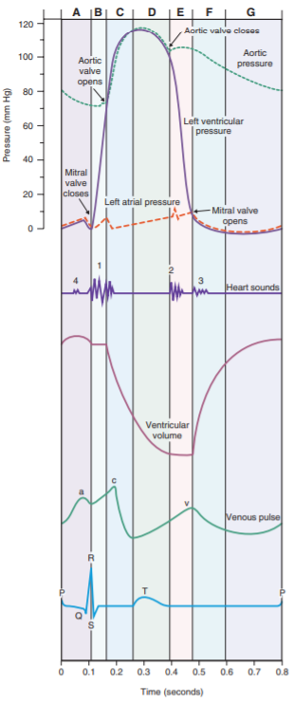
Venous Pressure curve
Isovolumetric relaxation
Ventricles are fully repolarized and aortic valve closes
LA pressure is building up before MV opens
LV pressure decreases dramatically
Atrial systole:
Atrial depolarization and contraction
Increase in LA pressure
Rapid ventricular ejection
Early ejection phase
LV continues to contract, and aortic valve opens
LA P slowly increases as blood returns from lungs
Venous pressure peaks

Slide 39
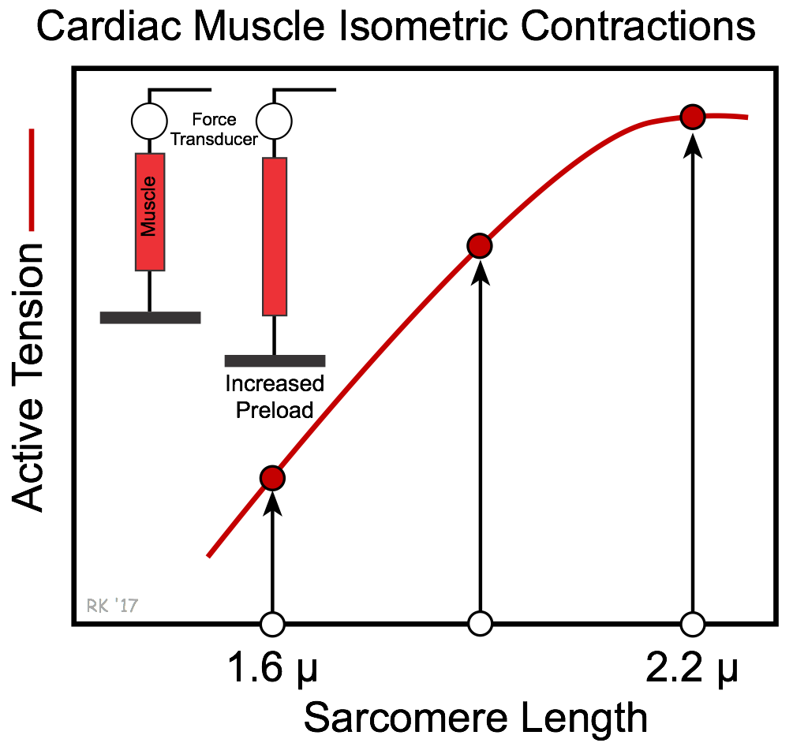
3. Length-Tension relationship
If muscle contracts at low resting sarcomere lengths the amount of active tension developed is relatively small
By increasing fiber length:
  Greater overlap between thick and thin filaments
  Greater sensitivity of troponin C to Ca²⁺
  Increased release of intracellular Ca²⁺
The maximal active tension achieved when sarcomere length is about 2.2 microns (L_{max})
  The tension of a single fiber corresponds to the pressure developed by the LV

Slide 40
3. Cardiac muscle contraction
Stroke Volume
  Volume ejected on one ventricular contraction
  SV = End-diastolic volume – End-systolic volume
Ejection fraction
  Effectiveness of the ventricles in ejecting blood
  Fraction of the end-diastolic volume that is ejected in one stroke volume
  Normally 55%

Slide 41
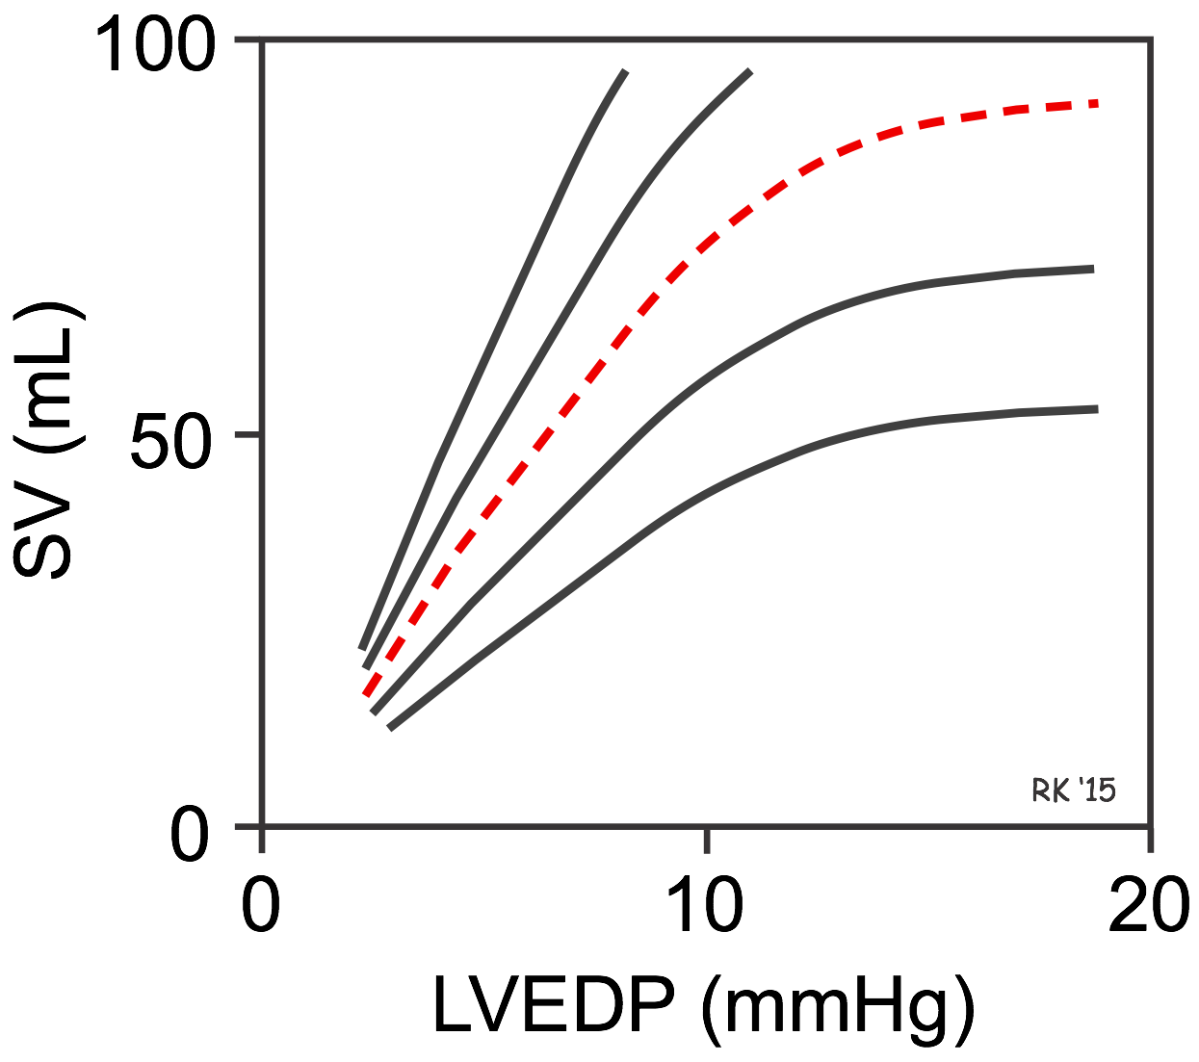
3. Frank-Starling’s law
“The volume of blood ejected by the ventricle depends on the volume present in the ventricle at the end of diastole”
  End diastolic volume depends on venous return
    Therefore, SV and CO correlate directly with venous return
  The volume the heart ejects equals the volume the heart receives
  In a steady state CO equals venous return

Slide 42
3. Cardiac work and myocardial O₂ consumption
Stroke work – work heart performs with each beat
  SV x aortic pressure
  Minute work or power = Work per unit time
  Cardiac work 2 components = volume work (CO) x pressure work (aortic pressure)
Myocardial O₂ consumption MVO₂ = CBF × (CaO₂ − CvO₂)
  Cardiac muscle high O₂ consumption
  Correlates directly with cardiac minute work
    Pressure work is a large percentage of the total cardiac energy consumption
    Myocardial O₂ consumption correlates poorly with CO – the largest percentage of the O₂ consumption is for pressure work, which is not CO

Slide 43
3. Cardiac muscle contraction - Cardiac work
In pathologic conditions (aortic stenosis, hypertension)
  O₂ consumption is extremely high
  LV must develop extremely high pressures to pump blood against the stenotic aortic valve, even though CO is reduced
  As a result → LV thickens
Thickness increase can be explained by Law of Laplace
  P= 2HT/r
  Pressure, H thickness, T tension, r Radius
  The greater the H, the greater the P developed
  Ventricular wall thickness will increase in response to an increase in P

Slide 44
3. Fick’s principle
CO can be measured based on the assumption that CO of the left side = CO of the right side
Conservation of mass
  In a steady state
    Rate of consumption of O₂ = the amount of O₂ leaving the lungs in the pulmonary vein minus the amount of O₂ returning to the lungs in the pulmonary artery
    These values can be measured
The amount of O₂ in the pulmonary veins is pulmonary blood flow x O₂ content of venous blood - same for the arterial side
O₂ consumption = CO x O₂ pulmonary vein – CO x O₂ pulmonary artery

Slide 45
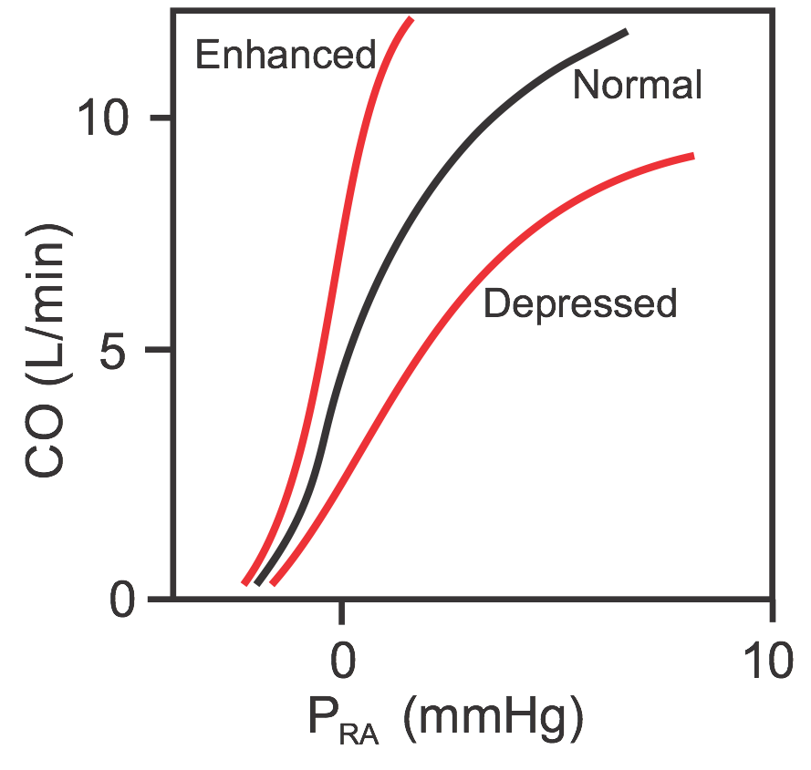
3. Cardiac function curve
Plot of relationship between CO of LV and RA pressure
P_{RA} related to venous return, end diastolic volume and length
As venous return increases
  P_{RA} increases
  End diastolic volume
  End diastolic fiber length increase
In a steady state:
  The volume the LV ejects as CO equals the volume it received in venous return

Slide 46
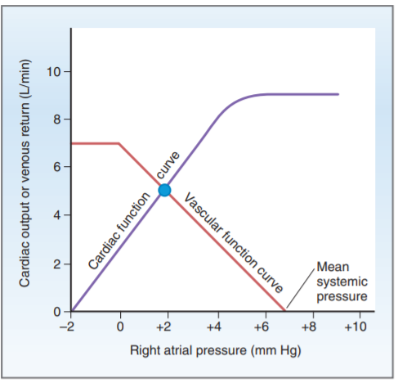
3. Vascular function curve
Depicts the relationship between venous return and P_{RA}
  Venous return to the heart is driven by a pressure gradient
  The lower the P_{RA}, the greater the gradient, the greater the return
  Flat portion of the curve - P_{RA} is negative - veins collapse - no return to the heart
By combining the curves, we can see the interaction between CO and V return
The point of intersection is called unique operating point or equilibrium point
At this point – CO = V return

Slide 47
3. Mean Systemic Pressure
MSP
Value for P_{RA} at which venous return is zero
Vascular function curve intersects the x axis
  It is the P measured throughout the CV system if the heart stopped beating
  There is no P gradient, no blood flow

Slide 48
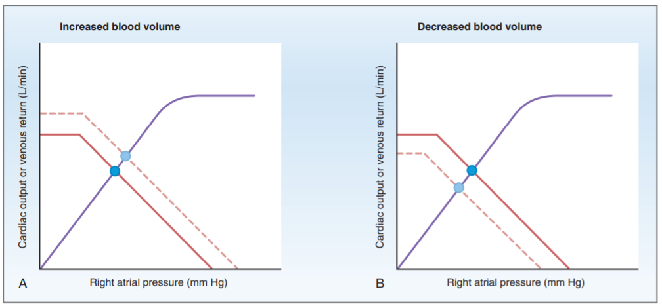
3. Vascular function curve - Volume
Factors that affect MSP:
  Blood volume
    By increasing the amount stressed volume
    When the amount of stressed volume increases, MSP increases
  Distribution of the blood
    Affects the distribution between stressed and unstressed volume
    Stressed volume increases and MSP increases

Slide 49
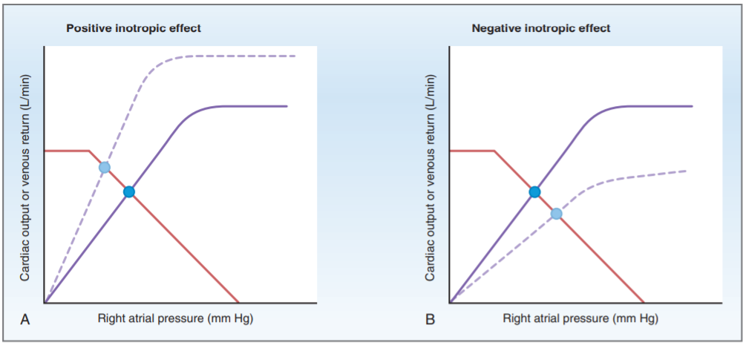
3. Vascular function curve - Inotropism
  Increase in contractility – increase in SV and CO
  Curve is shifted upward and left
  CO is increases and P_{RA} is decreased
  The decrease in P_{RA} reflects that more blood is ejected from heart (lower V in RA) as a result of higher contractility
Opposite effect
P_{RA} will be higher since less blood is ejected from the heart w each beat

Slide 50
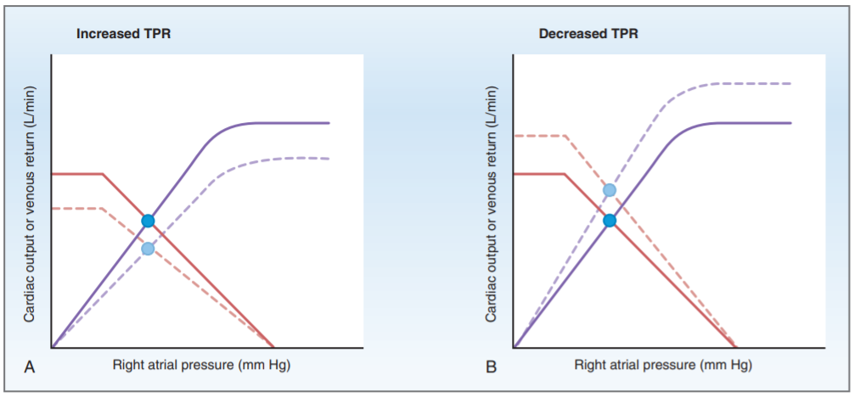
3. Vascular function curve - Resistance
Increase in TPR – vasoconstriction – affects both curves
Increase in afterload – decrease CO
  Cardiac curve shifts downward
Less blood returns to the heart for a given RA pressure – venous return is decreased
  Vascular curve rotates counterclockwise

Slide 51

4. Regulation of arterial blood pressure

Slide 52
4. Regulation of Arterial Blood Pressure
MAP – driving force for blood flow
  MAP = CO x TPR
Parallel arrangement of arteries off the aorta allows all organs to see the same MAP
Regulated by:
  Baroreceptor reflex
  RASS

Slide 53
4. Baroreceptor reflex
Minute by minute regulation
Receptors carotid sinus and aortic arch
  Carotid sinus receptors respond to increases or decreases in BP
  Aortic arch only to increases in BP
Mechanoceptors – sensitive to pressure or stretch
Increases in BP
  Stretches the receptor
  Increase in firing rate in afferent
Very sensitive to the rate of change in BP
  Relevant in chronic hypertension – new set point

Slide 54
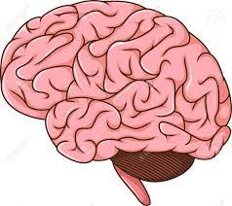
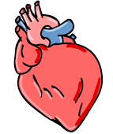
4. Baroreceptor reflex
Nucleus tractus solitarius
↓ of sympathetic tone
↑ BP
IX and X
CV centers (in pons and medulla)
Vasoconstrictor center
Cardiac accelerator center
Cardiac decelerator center
Decreases sympathetic input:
  Decrease HR
  Decreased contractility
  Venular dilation – increased unstressed volume
  Arteriolar dilation – decreased TPR
X
Decrease CO
(MAP = CO x SVR)

Slide 55
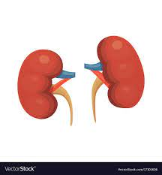
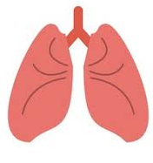
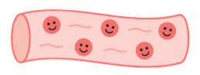
4. RAAS system
AT₁ receptors
↓ renal perfusion
↓BP
Mechanoreceptors in afferent arteriole
Adrenal cortex: aldosterone
↑ ENaCs on principal cells of kidney
Pro-renin
↑ osmolarity
Na⁺-H⁺ pump in PCT
renin
Increases thirst and stimulates ADH
↑ aquaporins in CD (V2) and vasoconstriction (V1)
Angiotensinogen
Angiotensin II
Arterioles
Vasoconstriction
Angiotensin I
Angiotensin-converting enzyme (ACE)
(MAP = CO x SVR)

Slide 56
4. Peripheral chemoreceptors
Carotid and aortic bodies
High blood flow
Sensitive to PaO₂ and PaCO₂
When PaO₂ ↓ → ↑ afferent firing that activate sympathetic vasoconstrictor centers
  Skeletal muscle, renal and splenic vascular beds
  ↑ in ventilation that ↓ parasympathetic outflow to the heart ↑ HR

Slide 57
4. Central chemoreceptors
Brain intolerant to ↓ in blood flow
Chemoreceptors in medulla
  Very sensitive to CO₂/pH - less sensitive to O₂ changes
Ischemia → pCO₂ ↑ - ↑ sympathetic outflow
Arteriolar vasoconstriction → increase in TPR → blood flow is redirected to the brain
This response brings BP ↑
  Even to life threatening levels (Cushing’s reflex)
ICP ↑ (tumor) → compression of arteries → ↓ CBF → ↑ pCO₂ → ↑ sympathetic firing → ↑ CBF → ↑ ICP

Slide 58
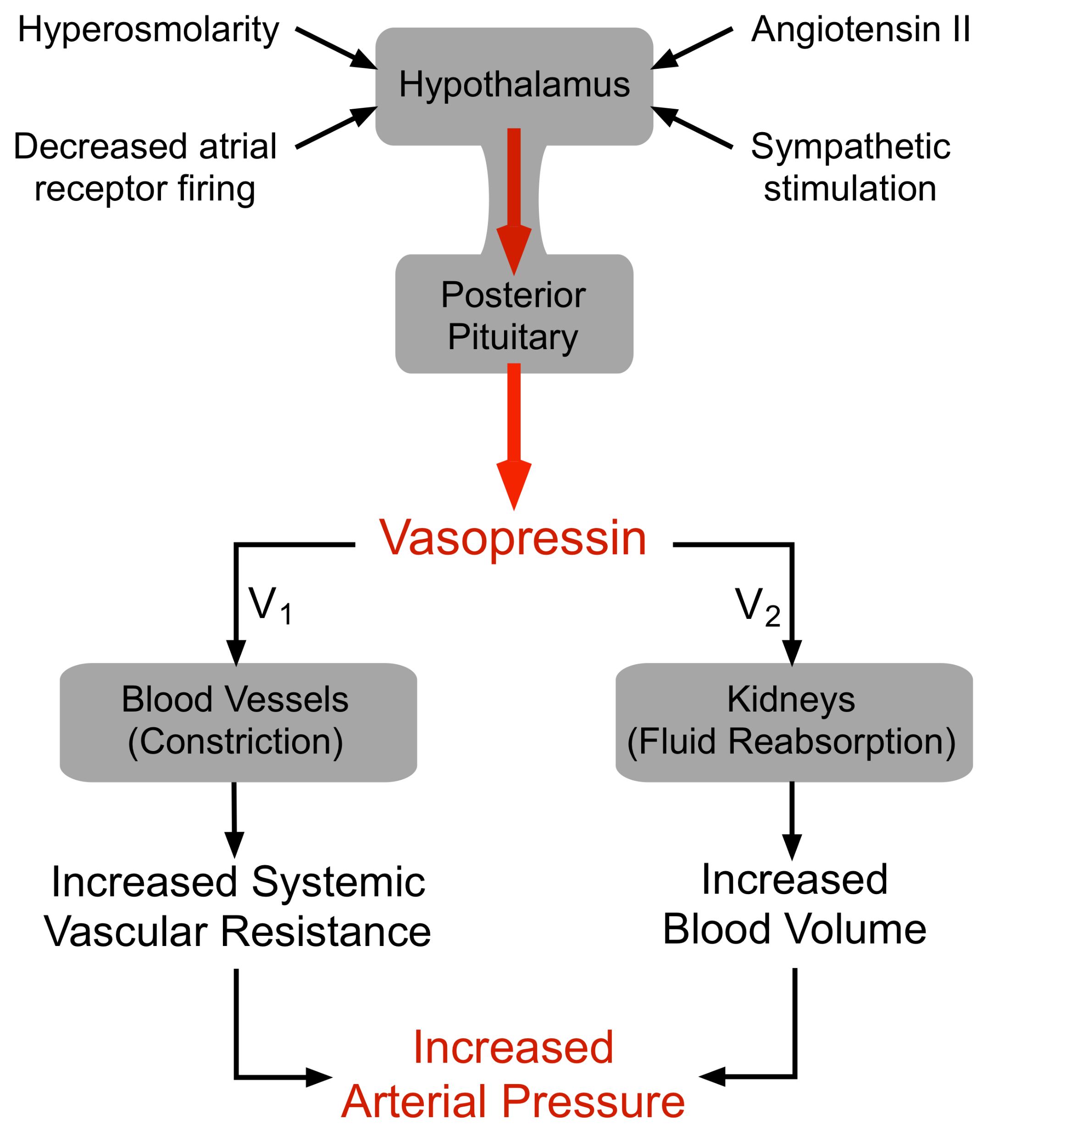
4. Antidiuretic Hormone
Fluid osmolarity
In response to 2 stimuli:
↑ serum osmolarity
↑ in blood volume and BP
2 receptors:
V₁ – present in smooth muscle → vasoconstriction → ↑ TPR
V₂ – principal cells in CD → ↑ AQ1 → H2O reabsorption

Slide 59
4. Low pressure baroreceptors
Located in veins, atria and pulmonary arteries
Sense the change in blood volume – fullness of the CV system
Return blood volume back to normal
ANP: secreted from atria in response to overload → ANPr in smooth muscle
  vasodilation → decreased TPR
  ↑ natriuresis and H₂O excretion
Inhibition of ADH
Inhibition of sympathetic vasoconstriction in renal arterioles:
  Vasodilation
  ↑ Na⁺ and H2O excretion

Slide 60
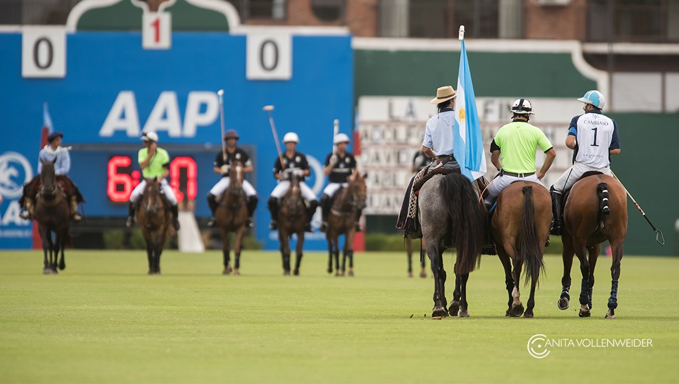
5. Microcirculation

Slide 61
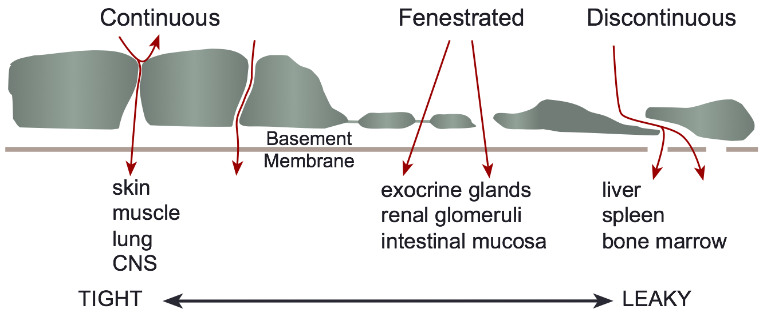
5. Microcirculation
Exchange of nutrients
Exchange of solutes and gases occurs by simple diffusion
Some solutes travel through the cells, some between them
Lipid soluble substances O₂ and CO₂ → diffuse through cells
Water soluble water itself, ions, glucose → cleft between cells
Fluid will flow by osmosis across a membrane if the membrane has aqueous pores and if there is a pressure difference

Slide 62

5. Microcirculation
Starlings' equation:
Jv = Kf [(Pc-Pi) – ($π$_{C} – $π$_{i})]
Fluid movement (J) determined by net P across the wall
  Magnitude of movement determined by hydraulic conductance (water permeability)
J fluid movement ml/min
K hydraulic conductance water permeability – varies amongst capillaries
Modified equation incorporating EG:
Jv = Lp S [ (P_{c} - P_{i}) - σ($π$_{esl} - $π$_{b}) ]

Slide 63

Thanks!
Sources:
Physiology, Costanzo
www.cvphysiology.com
www.derangedphysiology.com
Ph credit: Ana Wollenweider

