Slide 1
The Cardiac Cycle, Hemodynamic Waveforms, Monitoring Cardiac Output
Jamie Selman, DVM

Slide 2
The Cardiac Cycle

Slide 3
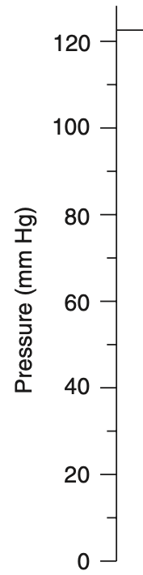
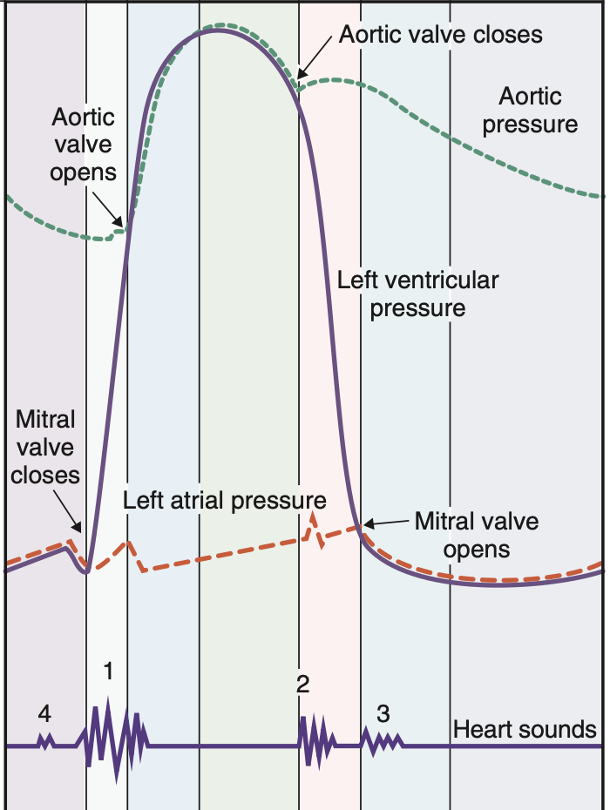
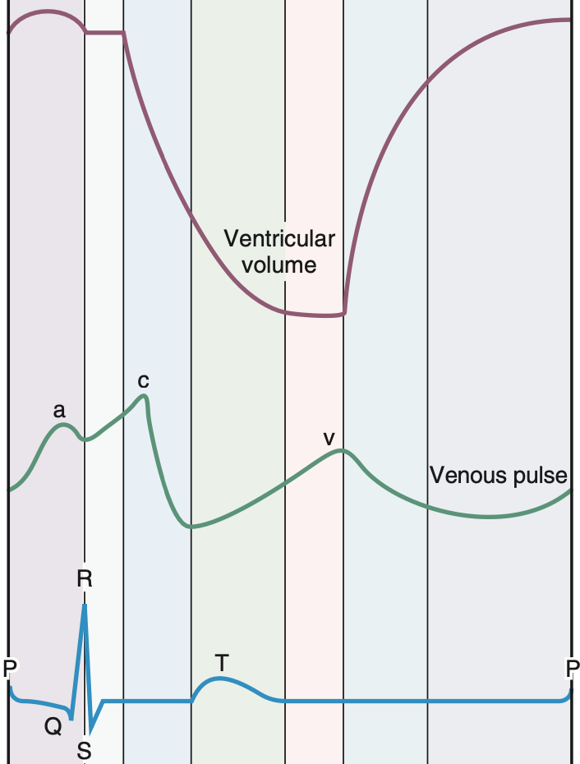
A B C D E F G
A B C D E F G
Time (seconds)
Time (seconds)
Notes:
This illustration is the cardiac cycle. It is divided into seven phases, which are represented by each letter and divided by each of the vertical lines. The ECG is at the very bottom which represents the electrical events that happen during one cycle. This illustration is meant to be read vertically, one phase at a time, with the ECG as as time marker. The other lines that are plotted include the left ventricular pressure and volume, aortic and and left atrial pressures, venous pulse, and heart sounds. The cardiac cycle begins with the depolarization and contraction of the atria.

Slide 4
Atrial Systole (A)
Atrial contraction
P wave marks depolarization and precedes atrial contraction
Increase in left atrial pressure → reflected back into veins → appears as a wave on on venous pulse line
Mitral valve open → ventricle filling even before systole
Atrial systole → increase in ventricular volume → increase in ventricular pressure
S4 = atrial contraction
Notes:
Atrial systole is atrial contraction. It is preceded by the P wave on the ECG which marks depolarization of the atria. Contraction of the left atrium increases pressure in the atrium and reflects back into the vens which appears as a wave on the venous pulse line as the “a wave”. As the atrium is filling, the ventricle is relaxed so the mitral valve is open and the ventricle is filling with blood which increases ventricular volume, then as the atria contracts the ventricular volume increases even more, which is evident on the ventricular pressure and ventricular volume lines. The fourth heart sound, which corresponds with atrial systole, is not usually heard. In animals with ventricular hypertrophy it can be heard because it’s the sound of blood hitting a non compliant or “stiff” ventricle.

Slide 5
Isovolumetric Ventricular Contraction (B)
Starts during the QRS complex
Left ventricle contracts → increase in left ventricular pressure
Ventricular pressure increases dramatically, ventricular volume remains the same
Left ventricular pressure > left atrial pressure → mitral valve closes
S1 = closure of AV valves (mitral and tricuspid)
Notes:
Phase B begins during the QRS complex and is characterized by left ventricular contraction which corresponds to a dramatic increase in the ventricular pressure. The ventricular volume remains the same because all valves are closed and there is no additional filling through mitral valve or ejection through aortic valve. As soon as the left ventricular pressure is greater that the left atrial pressure the mitral valve will close. The first heart sounds is made by the closing of the AV valves. This can occasionally be a split heart sound because the mitral valve closes before the tricuspid valve. This can be exacerbated to the point where the split is heard during bundle branch blocks or pulmonary hypertension.

Slide 6
Rapid Ventricular Ejection (C)
Ventricle continues to contract and reaches highest pressure
Ventricular pressure > aortic pressure → aortic valve opens
Pressure gradient drives blood from ventricles into aorta
Ventricular volume decreases, aortic pressure increases
During this phase atrial filling begins → left atrial pressure increases as blood returns from pulmonary circulation
End of this phase = end of ST segment or beginning of T wave
Notes:
Ventricles continue to contract and the ventricular pressure reaches its highest value. As the ventricular pressure becomes higher than the aortic pressure, the aortic valve opens and blood is rapidly ejected into the aorta. This is driven by the pressure gradient between the left ventricle and the aorta. The majority of stroke volume is ejected from the ventricle so ventricular volme decreases and aortic ppressure increases. During this phase, atrial filling begins and left atrial pressure slowly increases as blood returns to the left heart from the pulmonary circulation. This new blood will be ejected from the heart in the next cycle. The end of this phase coincides with the end of the ST segment or the beginning of the T wave.

Slide 7
Reduced Ventricular Ejection (D)
Ventricles repolarize
T wave on ECG
Ventricular pressure falls
Ventricular volume and pressure falls as aortic valve is still open
Aortic pressure decreases because blood leaving aorta faster than ventricular blood is entering
Left atrial pressure continues to increase as blood fills atria
Notes:
During reduced ventricular ejection, the ventricles begin to repolarize, which corresponds to the T wave on the ECG. The ventricular pressure is falling because ventricles are no longer contracting. The aortic valve is open so the blood continues to leave the ventricle and go into the aorta, however it is at a reduced rate. The aortic pressure is decreasing even though blood from the ventricles is entering the aorta because blood is going into arterial circulation faster than it is moving from the ventricle to the aorta. The left atrial pressure continues to increase as blood returns to the left heart from the lungs.

Slide 8
Isovolumetric Ventricular Relaxation (E)
After the ventricles are fully repolarized
Left ventricular pressure decreases dramatically
Left ventricular pressure < aortic pressure → aortic valve closes
S2 = aortic and pulmonic valves closing
Dicrotic notch on aortic pressure curve = aortic valve closes
Ventricular volume is constant because all valves closed
Notes:
Isovolumetric ventricular relaxation begins after ventricles are fully repolarized, marked by the end of the T wave. Because the left ventricle is relaxed, the left ventricular pressure decreases dramatically. When the left ventricular pressure falls below the aortic pressure, the aortic valve closes. The aortic valve closes slightly before the pulmonic valve but these valves closing is the second heart sound. When the aortic valve closes, the aortic pressure curve causes a “blip” called the dicrotic notch. All valves are closed, so no blood is being ejected from the ventricle and volume is constant.

Slide 9
Rapid Ventricular Filling (F)
Ventricular pressure drops to lowest level → mitral valve opens
Ventricle fills with blood → ventricle volume increases rapidly
Ventricular pressure remains low as ventricle is relaxed
S3 = flow of blood from atria to ventricle
  Not heard except with non compliant ventricles
Aortic pressure decreases
Notes:
When ventricular pressure falls to the lowest level, the mitral valve opens and the ventricle fills with blood from the left atrium, increasing the ventricular volume rapidly. Ventricular pressure will remain the same because the ventricles are relaxed and compliant. Rpid flow of blood from atria to ventricles produces the third heart sound which is again only heart in heart disease where the ventricles are non compliant. During this phases and next the aortic pressure decreases as blood is continuing to distribute throughout arterial circulation.

Slide 10
Reduced Ventricular Filling (G)
Longest phase of cardiac cycle
Ventricular filling at slower rate
Increases in heart rate decrease or eliminate time available for this phase
Notes:
Reduced ventricular filling is the longest phase of the cardiac cycle and is characterized by ventricular filling at a much slower rate. Atrial systole marks the end of this phase, and this is where ventricular volume equals end diastolic volume. Changes in heart rate alter the time available for ventricular filling. Increases in heart rate reduce time before next P wave and reduce or even eliminate time available for ventricular filling. If heart rate is fast enough ventricular filling is compromised, end diastolic volume is compromised, and stroke volume is ultimately reduced

Slide 11
Check in Questions
What phase does the mitral valve open?
What phase does the aortic valve open?
What phases do the ventricular pressure drop?
What is the longest phase of the cardiac cycle?
Notes:
What phase does the mitral valve open?
Atrial systole (a)
What phase does the aortic valve open?
Rapid Ventricular Ejection (C)
What phases do the ventricular pressure drop?
Reduced Ventricular Ejection (D)
Isovolumetric Ventricular Relaxation (E)
What is the longest phase of the cardiac cycle?
Reduced Ventricular Filling (G)

Slide 12
Hemodynamic Waveforms
Notes:
Hemodynamic monitoring includes monitoring of basic physical examination parameters, continuous ECG, continuous blood pressure, central venous pressure, central venous oxygen saturation, lactate clearance and and base deficit, as well as more advanced forms including pulmonary artery pressure monitoring, and mixed venous oxygen saturation. In this section we are going to focus on hemodynamic waveforms which include invasive blood pressure monitoring, central venous pressure monitoring, and pulmonary artery pressure monitoring.

Slide 13
Continuous ECG
Continuous, hands-off access to the heart rate and rhythm
Arrythmia monitoring
Notes:
We’ve previously gone over ECGs so I will not get into specifics but ECG is an easy form of monitoring that can be helpful in our very sick populations of patients or patients that we are worried may have arrythmias that need treatment or monitoring. There are obviously standard or telemetric ECG systems available for use

Slide 14
Blood Pressure Monitoring
Tailored fluid therapy
Essential for vasopressor therapy
Hypotension = systolic < 90
= MAP < 60
MAP = diastolic + (systolic - diastolic)/3
Dogs
Systolic 150 +/- 20
Diastolic 105 +/- 10
Mean 85 +/- 10
Cats
Systolic 125 +/- 10
Diastolic 90 +/- 10
Mean 105 +/- 10
Notes:
Arterial blood pressure monitoring is essential in critical care. It is commonly used to help tailor fluid therapy to the patient’s needs, especially when we are combining it with physical exam parameters, urine output, or even central venous pressure.
Mean arterial pressure is calculated by subtracting systolic from diastolic, dividing by 3, then adding to diastolic pressure. Hypotension is defined by less than 90 systolic or less than 60 systolic. Some causes of hypotension of course include decreased cardiac output secondary to reduced circulating volume, myocardial failure, or arrythmias; OR secondary to decreased systemic vascular resistance due to peripheral vasodilation secondary to sepsis or SIRS. Hypertension can either be primary, which is rare, or secondary which is often due to kidney injury or failure. Hyperthyroidism, DM, cushings, a pheochromocytoma, or some medications can also cause hypertension.

Slide 15
Noninvasive Blood Pressure Monitoring
Inflation of cuff to occlude arterial flow, followed by measurement of pressure at which flow returns
Easy to use
Prone to error
Doppler
Oscillometric
High-definition ocillometry (HDO)
Notes:
Blood pressure monitoring can be divided into noninvasive and invasive methods.
Noninvasive blood pressure is based on inflation of a cuff that occludes arterial flow which is then followed by a measurement of the pressure at which the flow returns. It is technically easy to use but both doppler and oscillimetric monitoring can be prone to user error especially with cuff size. A cuff that is too tight will read high and a cuff that is not tight enough will read low.
Doppler reads the systolic blood pressure but in cats it is thought to read 10-15 mmHg lower so is more correlated with MAP. It is commonly used in animals that are smaller and useful in patients with hypotension or arrythmias.
Oscillimetric monitoring detects blood pressure by detecting pressure changes when the cuff inflates and deflates and the peak amplitude of oscillations during deflation equal the mean arterial pressure. This means that systolic and diastolic values are calculated by the machine. Some studies have shown that this method is not really comparable to direct arterial blood pressure monitoring and definitely wouldn’t match validation criteria for humans. However, it’s easy to use and its not invasive.
A new modality for blood pressure monitoring is high definition ocillometry, which is reported to have advantages over in accuracy over typical oscillimetric units because it performs real time analysis of arterial wall oscillations to obtain pressure wave amplitudes so that systolic and diastolic pressures are calculated instead of measured. However, recent studies don’t really show good correlation with other blood pressure monitoring but there needs to be more studies comparing it to direct arterial blood pressure monitoring.

Slide 16
Photoplethysmography
Notes:
Just a quick aside on photoplethysmography…This is a device that will attach onto the human finger or the patient’s tail and the cuff is inflated and deflated and if it is fast enough to maintain a constant volume the cuff pressure will equal intraarterial pressure. It allows for a real time display of the cuff pressure and therefore intraarterial pressure. It has been found to be accurate in dogs and cats but hasn’t really come into common use.

Slide 17
Invasive Blood Pressure Monitoring
Gold standard
Continuous monitoring of systolic, diastolic, and mean pressures.
Display monitor allows for observation of pressure changes and trends
Arterial sampling
Used in high risk or critically ill patients
Possibility for error
Risks
Notes:
Invasive or direct arterial blood pressure monitoring is considered gold standard for veterinary and human patients both awake and anesthetized. It can be performed after inserting an arterial catheter that’s connected to a transducer and a monitoring allowing for continuous monitoring of systolic, diastolic, and mean pressures. The waveform produced can help for observation of pressure changes and trends, and the catheter can also be used for arterial sampling to run bloodwork.
Invasive blood pressure monitoring is incredibly useful, but it should only be used in patients that would benefic from continuous blood pressure such as anesthetized patients with anesthetic risk or critically ill patients. It should not be used in active, healthy dogs because there is risk of hemorrhage from placement, the patient removing it themselves, or from detachment from the arterial line.
Although this is considered gold standard, there can still be erroneous results, especially if non-compliant tubing is used, if the catheter is lodged against the arterial wall, if there is a clot, if there re air bubbles, or if the catheter becomes kinked. Errors in the system can result in waveforms being dampened, which can make systolic falsely low and diastolic falsely high.
Risks of arterial catheter placement include hematoma, infection, thrombosis, and necrosis of tissue distal to catheter. Necrosis is more likely in cats that have a catheter placed for longer than 6-12 hours. The line and catheter need to be heparinized every hour.

Slide 18
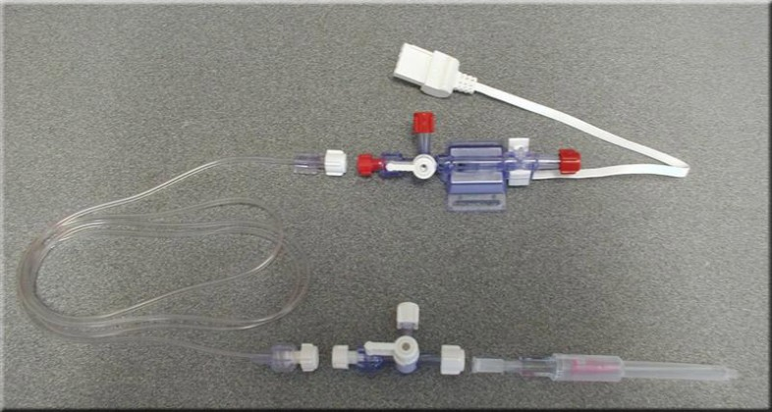
Invasive Blood Pressure Monitoring
Notes:
Once you attach the arterial catheter, its connected to semi-rigid tubing that was primed with heparinized saline. The fluid bag is pressurized to 300 mmHg to prevent backwards flow. The tubing is then connected to a pressure transducer which is connected to a cable and mounted on a board that is at the level of the patient’s heart. The pressure transducer will convert the pressure changes into an electrical signal that is carried to the monitor and displayed as a pressure waveform.

Slide 19
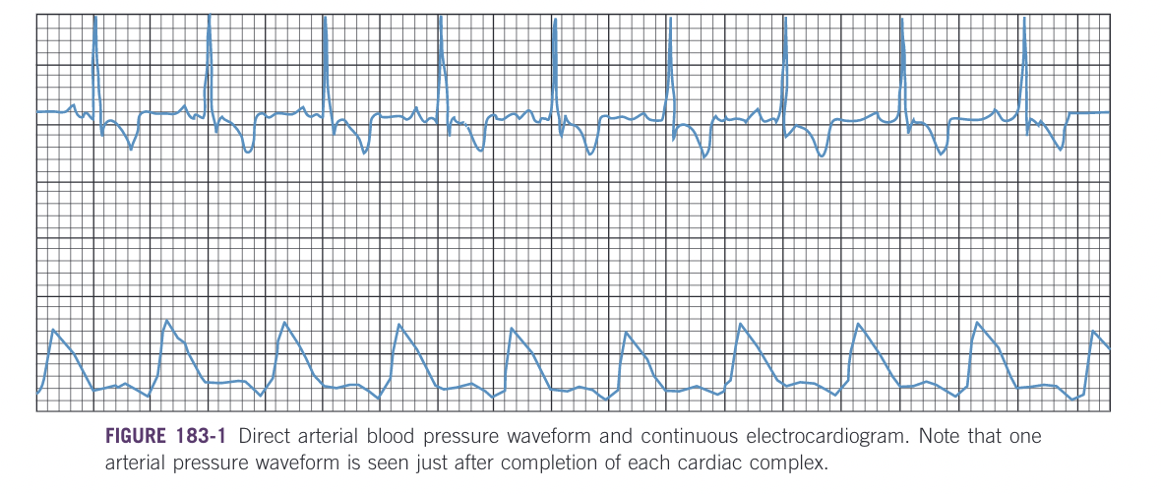
Direct arterial pressure waveform with ECG
Notes:
This waveform as seen above shows the peak systolic pressure, the dicrotic notch, and the diastolic pressure. The dicrotic notch as we discussed before is created by the closure of the aortic valve. Some monitors can also display numeric values for systolic, diastolic, and mean pressures. As you see here above, the pressure waveform is matched up to the ECG, if there is an arrythmia that is contributing to low pressures it can be treated.

Slide 20
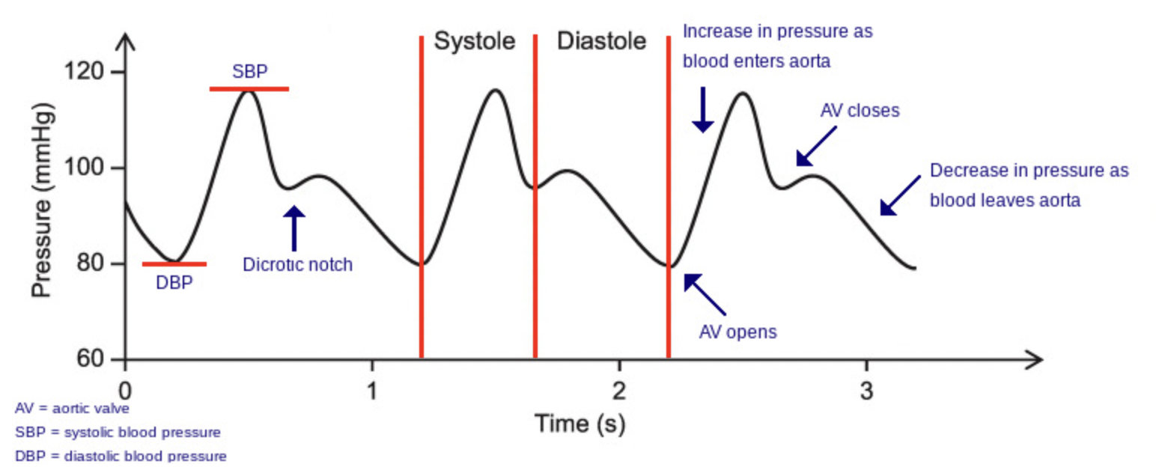
Arterial Waveform
Notes:
This is another diagram showing the peak systolic and diastolic blood pressures and where the AV valves open and close, and where the aorta closes – again that’s the dicrotic notch

Slide 21
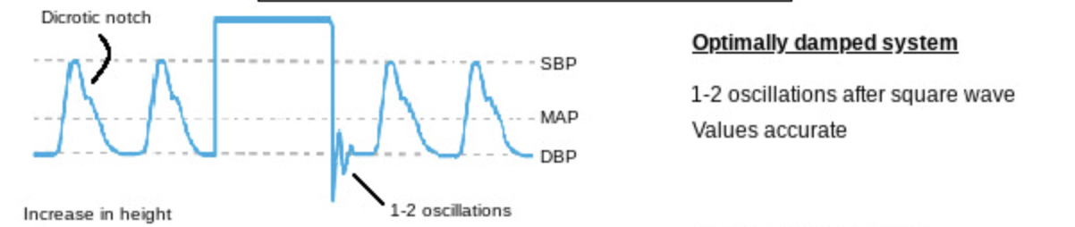
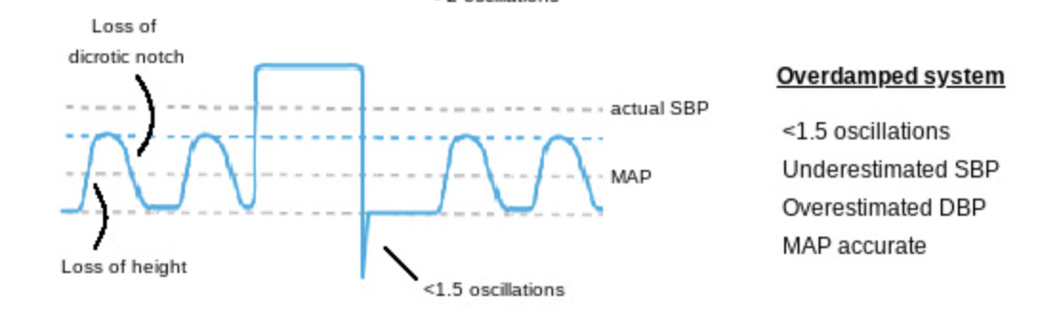
Dampened waveform
Notes:
This diagram shows what happens when a catheter begins to fail and you start seeing dampened waveforms which are on the bottom compared to an optimal waveform which is on the top.

Slide 22
Telemetric Blood Pressure Monitoring
Surgical implantation of transmitting device
Placed subcutaneously and fed into femoral artery
Currently being used experimentally in feline and canine patients
Allow for free patient movement
Notes:
There are telemetric continuous blood pressure units available that are placed surgically into the femoral artery. This is currently being used experimentally in dogs and cats and may be a good option in the future as it can allow for free patient movement and is less stressful.

Slide 23
Central Venous Pressure
CVP = hydrostatic pressure in the intrathoracic vena cava
Approximately equal to right atrial pressure
Right atrial pressure equal to right ventricular end diastolic pressure (tricuspid open)
  Used to estimate right ventricular end diastolic volume
  Relationship between current blood volume and blood volume capacity
  Measures ability of heart to pump blood that is returned to it
Notes:
Central venous pressure is the hydrostatic pressure in the intrathoracic vena cava. It is approximately equal to the right atrial pressure. When the tricuspid valve is open, the right atrial pressure is equal to the right ventricular end diastolic pressure. So, the right atrial pressure is used to estimate right ventricular end diastolic volume. The value helps to identify the relationship between the current blood volume and what the blood volume capacity should or could be. It also measures the ability of the heart to pump blood that is returned to it.

Slide 24
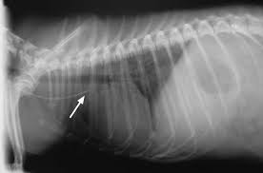
CVP Monitoring
Hypovolemic patients, septic shock, heart disease, renal disease (oliguric, anuric)
16/19 gauge jugular catheter or femoral vein catheter
Tip of catheter in cranial or caudal vena cava
Connected to 3-way stopcock via noncompliant tubing and to pressure transducer
Double lumen or triple lumen catheter
Notes:
Patients that would benefit from CVP monitoring are hypovolemic patients, patients in septic shock, patients that have heart disease, or renal disease – especially with oliguric or anuric kidney injury. A jugular catheter is placed and the goal is to have the tip of the catheter be just outside of the right atrium in the cranial or caudal vena cava. Placement should be confirmed via fluoro or radiographs. A study in cats shows that a femoral vein catheter placed into the abdominal vena cava is also accurate. The catheter is hooked up to a 3 way stopcock via non compliant tubing and a transducer, just like the arterial catheter. If this jugular catheter is to be used for continuous pressure monitoring a double or triple lumen catheter should be used so that we can sample and administer fluid products through the same catheter.

Slide 25
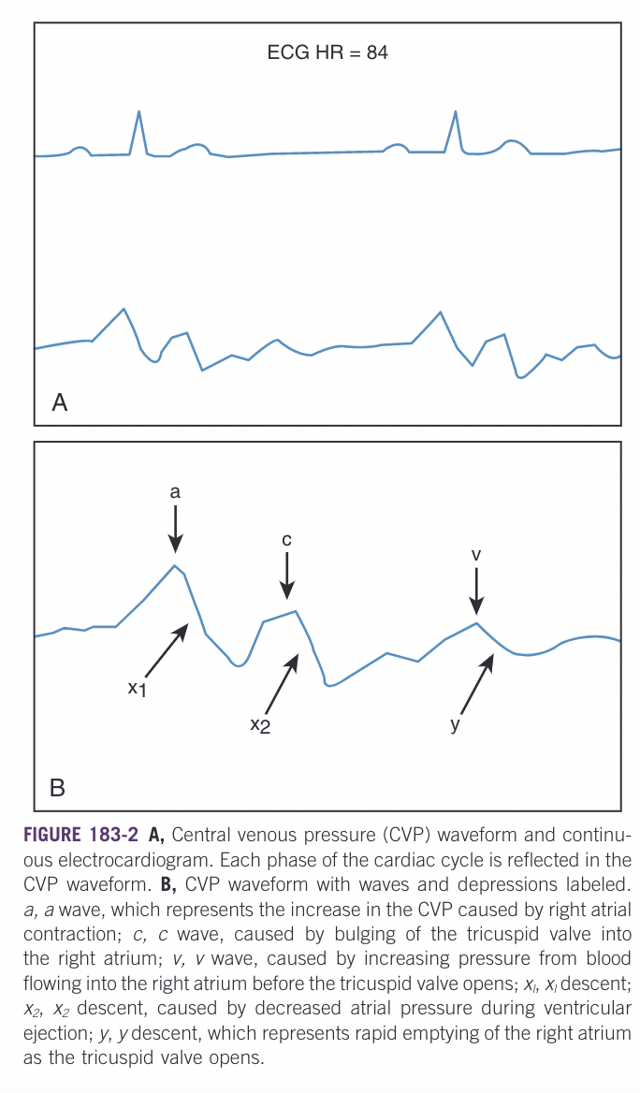
CVP Monitoring
Normal range for mean CVP is 0 to 5 cm H2O but varies
Notes:
The normal range for CVP is 0 to 5 cm water but varies between individual animals and can vary based on patient position. So while it is important to maintain the patient’s position, the zero reference point should be either at the level of the manubrium if the patient is in lateral or at the point of the shoulder if the patient is in sternal recumbency. Because of the variation trends in the CVP is more important than any one reading.
The CVP varies throughout the respiratory and cardiac cycles since the CVP reflects the right atrial pressure. During inspiration, intrathoracic pressure decreases, and CVP falls; and vice versa during exhalation. Positive pressure ventilation will reverse this pattern.
So as we can see here there are variations in the CVP during a cardiac cycle. There are three positive waves and three negative waves.

Slide 26
CVP Waveform
a – right atrial contraction
x – ventricular ejection
c – right ventricular contraction
v – blood flow into the right atrium
y – tricuspid valve opens, atrium empties
Notes:
The a wave is the increase in CVP because of right atrial contraction. The c wave is caused by bulging of the tricuspid valve into the right atrium which increases right atrial pressure as the right ventricle contracts. The x decent is caused by the decrease in right atrial pressure during ventricular ejection. The v wave is caused by increasing pressure from blood flowing into the right atrium before the tricuspid valve opens. And finally the y descent is the rapid emptying of the right atrium when the tricuspid valve opens and blood flows into the right ventricle.

Slide 27
CVP Interpretation
Low CVP (<0 cm H20)
  Hypovolemia due to fluid loss
  Vasodilation secondary to decreased peripheral venous resistance
High CVP (>10 cm H20)
  Volume overload
  Right sided heart failure
  Significant pleural effusion
Notes:
Evaluations of the waveform can help detect abnormalities in each part of the cardiac cycle. For example, a large c wave is seen with tricuspid regurgitation. Low CVP can be caused by hypovolemia secondary to fluid loss or vasodilation secondary to decreased peripheral venous resistance. High CVP can be seen in volume overload, right sided heart failure, or significant pleural effusion. if there is a concerning or questionable reading you can give a test bolus, if the patient is hypovolemic the CVP wont change but if the patient is euvolemic the pressure will increase and return to baseline within 15 minutes. If the patient is hypervolemic there will be a larger increase in pressure with a slower return to baseline.
The risks of central venous pressure monitoring are low and are the same as placing a normal jugular catheter incluing coagulopathies, thromboemobolic disease, or risk for increased intracranial pressure. The biggest limitation of CVP monitoring is that it measures the pressures in the right side of the heart instead of the left side. Pressures in the left side of the heart are more helpful when it comes to guiding fluid therapy but their measurement requires a pulmonary artery catheter, which we will talk about now! The central catheter is an easier option compared to the pulmonary artery catheter which is pricier, riskier, more difficult to place, and more time consuming.

Slide 28
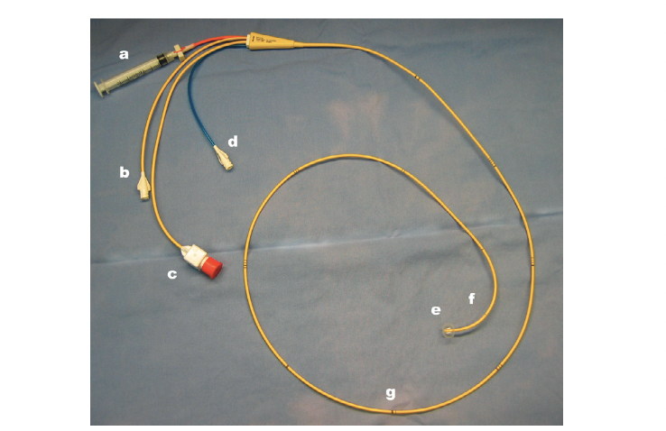
Pulmonary Artery Catheter
Catheter placed in jugular vein, through right atrium and ventricle, and into the pulmonary artery
Allows for measurement of systolic, diastolic, and mean PAP
If equipped with a balloon, the pulmonary wedge pressure can be measured
Significant risks associated
Swan-Ganz Catheter
Notes:
So the pulmonary arterial catheter is placed in the jugular vein…it is then advanced through the right atrium, the right ventricle, and then into the pulmonary artery. It can be placed with fluoro with by monitoring pressures which we will talk about shortly. It allows for measurement of systolic, diastolic, and mean pulmonary artery pressures. If it is equipped with a balloon at the end a pulmonary wedge pressure can be measured. Risks of placing a catheter include arrythmias, damage to tricuspid and pulmonic valves, ruptured of the pulmonary artery, and pulmonary thromboembolism. In a large study of critically ill human patients, placing a pulmonary arterial catheter was associated with increased 30 day mortality, increased cost of healthcare, and a longer hospital stay.

Slide 29
Indications
Cardiac output measurement
Mixed venous blood sampling
  Normal SVO2 >75%
Notes:
The use of pulmonary arterial catheters for cardiac output measurements and mixed venous blood sampling is sort of controversial in human medicine due to the high risk benefit ratio. There was a review of randomized clinical trials that evaluated the impact of monitoring systems on outcomes in critically ill patients and the review showed that the majority of studies showed no change in mortality in patients that had treatment guided buy PAC monitoring compared to patients that didn’t. There is not a consensus for pulmonary arterial catheter use in vet med. For us, these catheters are mostly used in research for thermodilution measurement of cardiac output, which we will talk about later. In theory PAP values are useful for treatment of cardiogenic shock as well as guiding fluid, vasodilator, and ionotropic therapies. Blood sampling from the pulmonary artery gives us a mixed venous oxygen saturation. Changes in this value reflect systemic oxygen balance. Normal mixed venous oxygen saturation is greater than 75%.

Slide 30
Pulmonary arterial pressure
Left atrial pressure equals left ventricular diastolic pressure, when the mitral valve is open
PAP, PAWP used for determining volume status
  Normal mean PAWP in dogs is 5 to 12 mmHg
  Normal mean PAP in dogs is 8 to 20 mmHg
  Low – volume depletion
  High – volume overload or cardiac dysfunction
Other parameters
  Right atrial pressures
  Cardiac output
  Cardiac index
  Stroke volume index
  Pulmonary vascular resistance
  SvO2
Notes:
When the mitral valve is open, left atrial pressure equals the left ventricular pressure end diastolic pressure. This pressure is the best measure of left ventricular preload and the is best predictor of pulmonary edema secondary to fluid overload. So, PAP (pulmonary arterial pressure) and PAWP (pulmonary wedge pressure) can be used for accurate fluid volume status determination. The normal PAWP in dogs is 5 to 12 mmHg and low PAWP signals volume depletion and high PAOP signals volume overload or cardiac dysfunction.
Additional parameters that can be measured with a Swan-Ganz catheter are right atrial pressures and cardiac output using thermodilution (which we will talk about a bit later). Other values can be calculated including cardiac index, stroke volume, stroke volume index, and pulmonary vascular resistance. Some catheters will even be equipped with an oximeter that will help you measure central venous arterial oxygen saturation.

Slide 31
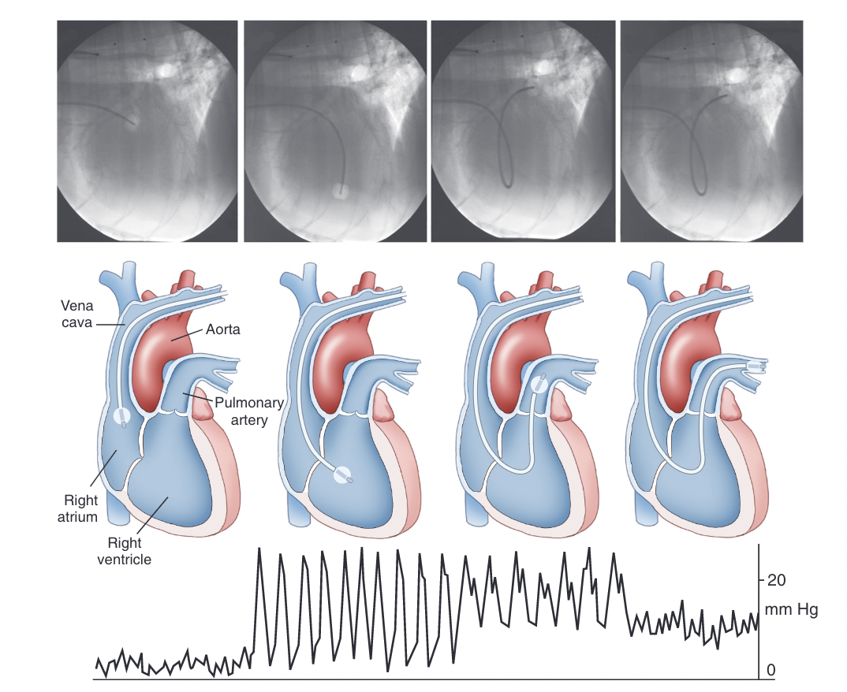
Pulmonary arterial catheter
Notes:
So like I mentioned before, the pulmonary artery catheter can either be placed via fluoroscopic guidance or by monitoring the pressure tracing attached to the catheter. The RA pressure tracing is the same as the CVP tracing, the RV tracing the mean diastolic pressure is higher, and the PA tracing has an increased diastolic pressure because we have gone through the pulmonary valve. Once the catheter is in the pulmonary artery and occluded with the balloon, the waveform changes and the mean pulmonary pressure is lower than the mean pulmonary artery pressure.

Slide 32
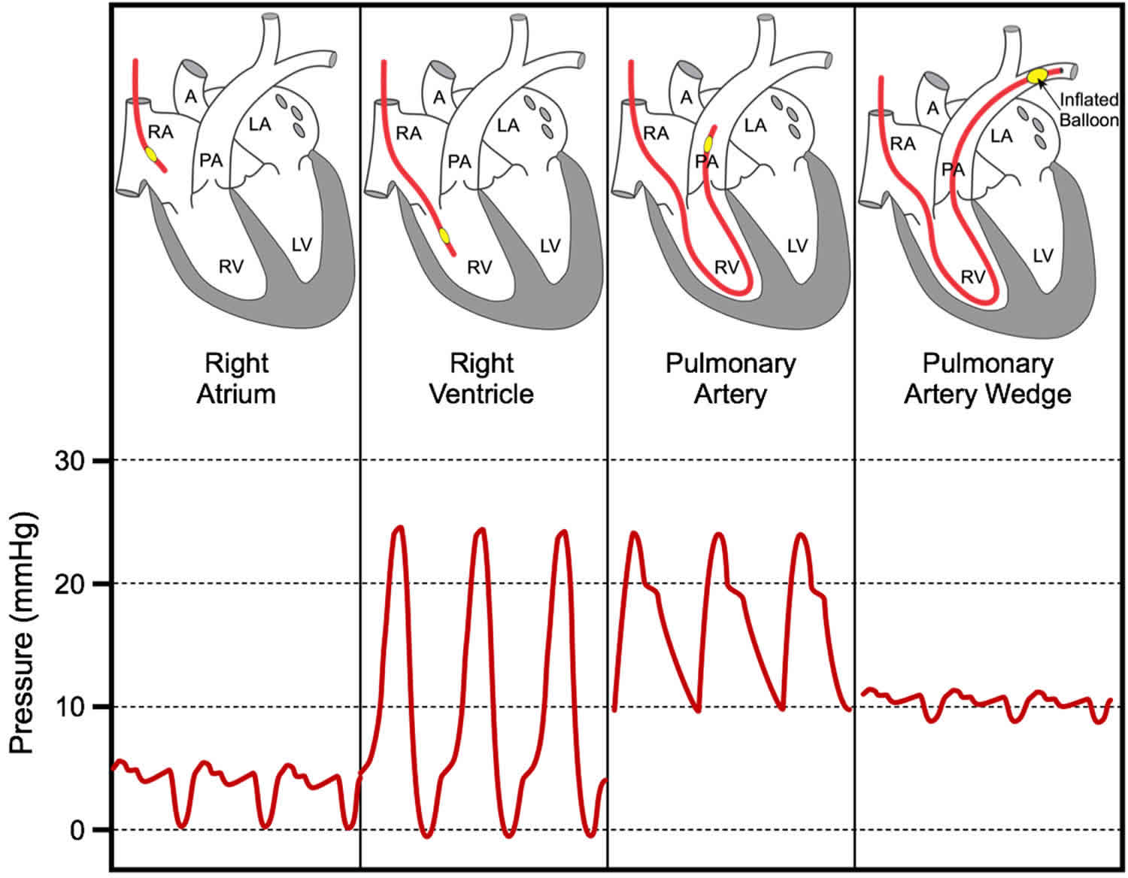
Notes:
This is in humans

Slide 33
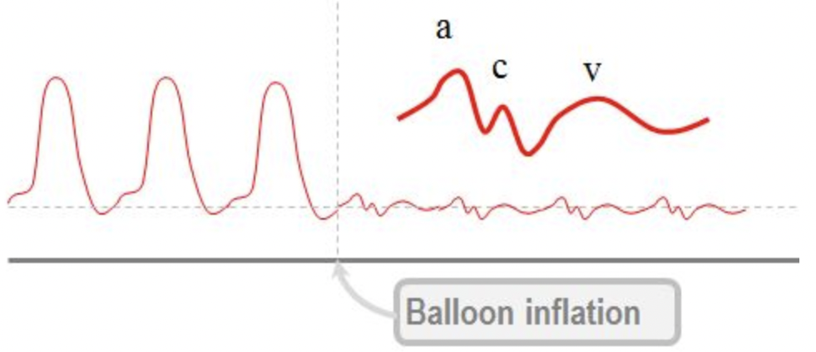
PAWP
a – left atrial contraction
c – mitral valve closure
v – left ventricle closure
Notes:
So the pulmonary wedge pressure can be obtained with the balloon at the end of the catheter is inflated in the distal branch of the pulmonary artery. Inflation of the balloon eliminates pulmonary arterial pressure created by blood flow, and the measured pressure reflects just the left atrial filling pressure as it equilibrates across the pulmonary capillary bed.
So in this picture you can see the difference between the pulmonary artery pressure versus after the balloon is inflated showing the pulmonary wedge pressure. You can also see that the waveform is practically identical to the CVP waveform with instead the a wave representing left atrial contraction, the c wave represents mitral valve closure and the bulging of those leaflets into the atrium which increases pressure, and then the v wave which represents left ventricular contraction
If you were going to hook up continuous PAWP monitoring it would be the same as described for CVP monitoring. Once the PAC is placed, risks include thrombolic or embolic events, distal cathter migration, or infection. Routine anticoagulants are not routinely administered.

Slide 34
Check in question
What does each letter on this waveform represent?
Notes:
This is the waveform made by the central venous catheter that measures right atrial pressure.
a – right atrial contraction
x – ventricular ejection
c – right ventricular contraction
v – blood flow into the right atrium
y – tricuspid valve opens, atrium empties

Slide 35
Monitoring Cardiac Output
Notes:
Monitoring cardiac output is a common practice in human anesthesia and critical care. It is used as a marker of oxygen delivery to tissues and can identify patients at high risk of significant morbidity, mortality or both. It is also used in guiding treatment, primarily for fluid resuscitation and the use of vasoactive and inotropic drugs.

Slide 36
Cardiac Output
Cardiac Output is the total volume of blood ejected per unit time
CO = stroke volume x heart rate
CO = volume ejected per minute (mL/min)
SV = volume ejected in one beat (mL)
SV = end diastolic volume – end systolic volume
HR = beats per minute
Normal CO = 120-200 mL/kg/min
Notes:
In the cardiovascular system, obviously the heart is the pump that generates force to distribute blood to the tissues via the blood vessels. The vasculature is elastic so the force generated by the heart is stored and applied to flowing blood throughout the cardiac cycle which we previously talked about. The volume of blood transferred to the systemic circulation over time is the cardiac output.
Normal values of cardiac output for dogs and cats is 120-200 mL/kg/min
Cardiac output is important because it measures cardiovascular function. When combined with measurements of O2 content in blood, it can help to determine whole body oxygen delivery and guide decision making for therapeutic intervention.

Slide 37
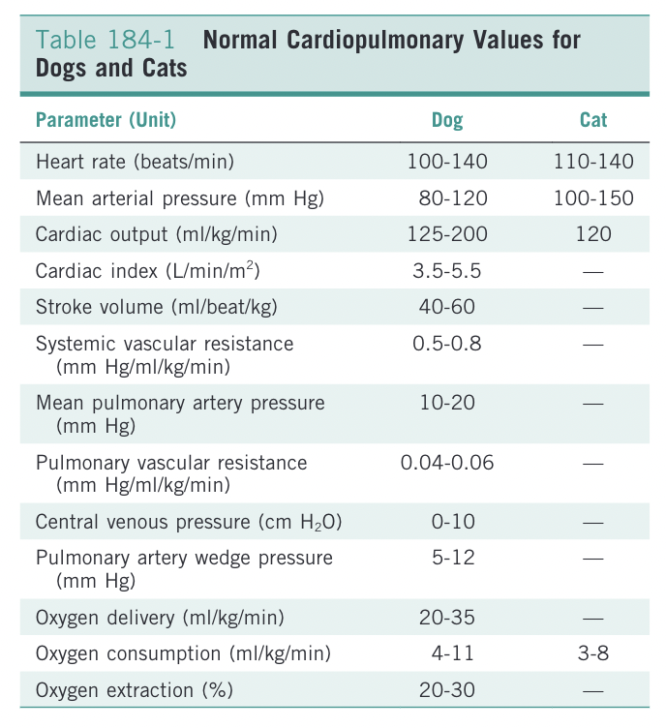
Notes:
I put this chart in for you guys to reference later if you wanted! This is from Silverstein.

Slide 38
Indications
Physical exam findings
  CRT, pulses, mentation
Hemodynamic monitoring
  …previous section
Critically ill patients
  Sepsis, shock, SIRS, MODS, etc
  Contraindications in cardiovascular status
  Compensatory mechanisms present
Notes:
The findings on our physical exam can give us generic information about oxygen delivery and cardiac output such as slow CRT, weak pulses, or poor mentation. An individual patient’s PE may correlate poorly with more direct measures of cardiac output but could be more reliable when assessed in sequence during a patient’s hospital stay. However if a patient’s physical exam doesn’t change this does really give any reliable indicator of cardiovascular status until the patient compensatory mechanisms fail.
In most cases, physical exam and basic hemodynamic monitoring is adequate in guiding us to make decisions about patient care. However, in some critically ill patients more direct assessment of cardiac output is essential for case management. Patients with these complex disease states such as sepsis, septic, shock, SIRS, MODS, or other disease processes may have compromised cardiovascular or pulmonary status with opposing physical exam or basic monitoring findings. The example that Silverstein gives is a septic patient with capillary leakage with low blood pressure which suggests that additional fluid therapy is necessary but is so edematous that it makes you want to back off on fluids. Treatment of patients like this would benefit from additional cardiac output monitoring.

Slide 39
Invasive Methods
Notes:
First we will talk about invasive methods of measuring cardiac output

Slide 40
Fick Oxygen Consumption Method
Gold standard
Fick principle – total uptake of a substance by the peripheral tissues is equal to the product of the blood flow to the peripheral tissues and the arteriovenous concentration difference (gradient) of the substance
Essentially, what went in minus what came out must equal what was left behind
Notes:
The Fick Oxygen consumption method is considered the gold standard of measuring cardiac output and relies on the Fick principle which states that the total uptake of a substance by the peripheral tissues is equal to the product of the blood flow to the peripheral tissues and the arteriovenous concentration difference (gradient) of the substance. Essentially, we are measuring what went in minus what came out must equal what was left behind

Slide 41
Fick Oxygen Consumption Method
CO = O₂ consumption/arteriovenous O₂ content difference
O2 consumption – measuring O2 concentration difference in the inhaled air and the exhaled air collected from the patient over time (3 minutes)
Arteriovenous O2 difference - can be determined by measuring oxygen content of both an arterial and a mixed venous sample. Mixed venous samples are obtained from the pulmonary artery.
O₂ content = ([Hb] x 1.36 x SO₂) + (0.003 x PO₂)
Notes:
These are the formulas for determining cardiac output via that Fick consumption method. Essentially you take the oxygen consumption divided by the arteriovenous oxygen content difference, which requires a sample of arterial blood, and a sample of mixed venous blood from the pulmonary artery. This of course requires a pulmonary arterial catheter. I’ve listed the formula for oxygen content of blood here.

Slide 42
Drawbacks
  Patient needs to be intubated
  Not a continuous real time measure of cardiac output
  Not reliable if patient is not stable during the entire three minutes
  Invalid if significant shunting of blood
Notes:
The drawbacks of using the fick oxygen consumption method are that the patient needs to be intubated, its not a continuous real time measurement of cardiac output, the measurement is not reliable if patient is not hemodynamically stable during the entire three minutes where oxygen consumption is measured, and this whole process becomes invalid if there is any shunting of blood within the lungs or the heart.

Slide 43
Carbon Dioxide Rebreathing Methods
CO = CO2 elimination by the lungs/arteriovenous CO2 difference
OR
CO = Difference in CO2 elimination and end tidal CO2/difference in arterial CO2 between baseline and rebreathing phase
Notes:
Now if were getting into specifics, there are two different ways to utilize the Fick equation to determine cardiac output. The first method is the complete rebreathing technique and the second is the partial rebreathing technique. The first equation requires breath holding. There is a monitor called the “NICO” monitor that is developed for the second equation which is the partial rebreathing technique. The monitor is hooked up to O2 flow and a carbon dioxide sensor and has an adjustable dead space breathing loop and a Y piece. The monitor then controls a valve that diverts gas through the breathing loop during the rebreathing phase. I don’t know if this is a commonly used piece of equipment but I would imagine its really only used for patients on the vent or patients under anesthesia.

Slide 44
Indicator Dilution Method
Exogenous indicator injection into patient’s mixed venous blood via PA catheter
Dilution of indicator followed until the original concentration peak associated with injection and a secondary peak due to recirculation are observed
The concentration of the indicator is plotted against time and the area under the curve is calculation
CO = amount of indicator/area under the curve
Thermodilution
Lithium ion dilution
Notes:
The indicator dilution method is an adaptation of the Fick method using in theory easier collected patient samples. The indicator of choice is often thermal energy. Pulmonary artery catheters, such as Swan Ganz catheters can be equipped with thermocouple that gives continuous measurements of blood temperature. Basically, from what I understand, a known volume of saline, which is the indicator, is injected into the right atrium, and then the thermocouple is used to dilute the cool sample into the warmer blood volume, and the dilution is measured in the pulmonary artery. This is called thermodilution.
There is also something called lithium ion dilution where there is an electrode for lithium ions that is placed in the arterial bloodstream via an arterial catheter and then the dilution is recorded when lithium chloride is injection into the venous circulation. This might be a less invasive method because it doesn’t require a pulmonary artery catheter, but it still does require an arterial and a venous catheter.

Slide 45
Noninvasive or Minimally Invasive Methods
Notes:
There are also less invasive ways to calculate cardiac output

Slide 46
Transesophageal Echocardiography
Measurement of blood velocity using doppler frequency shifts
Aortic diameter using echocardiography
Notes:
You can use transesophageal echocardiography to track cardiac output via measurement of blood velocity using doppler frequency shifts as well as measuring aortic diameter with echocardiography. In theory, to obtain quantifiable cardiac output these findings should be calibrated with something like thermodilution.

Slide 47
Thoracic Electrical Bioimpedance
Electrodes are applied to the thorax that measure and apply voltage
Changes in thoracic blood volume detected and computer algorithm determines stroke volume and cardiac output
Notes:
In this method, electrodes, much like you would see with an ECG are applied to the thorax superficially that measure and apply voltage. Changes in thoracic blood volume detected and computer algorithm determines stroke volume and cardiac output. This method may be more ideal for humans that have a more uniformly sized thorax.

Slide 48
Pulse contour analysis
Analysis of arterial pressure waveforms
Algorithm dependent monitoring
PiCCO
PiCCO plus
FLoTrac
PulsCO/LidCO
Notes:
An additional form of noninvasive cardiac output monitoring is pulse contour analysis, which is the analysis of the arterial pressure waveform. It is algorithm dependent and allows real time determination of cardiac output. Some computer systems available are PiCCO, PiCCO plus, or Flowtrac. The initial calibration requires calibration with a central venous catheter and an arterial catheter prior to use and some even require calibration every 8 hours. It is a very labor intensive system and is not though to be as accurate as thermodilution.

Slide 49
https://www.ncbi.nlm.nih.gov/books/NBK556127/figure/article-17843.image.f3/?report=objectonly
https://www.vasg.org/direct_arterial_pressures.htm
https://www.ncbi.nlm.nih.gov/books/NBK556127/
https://vetfolio-vetstreet.s3.amazonaws.com/af/c32b4041f211e1b04e0050568d3693/file/PV0112_Reems_CE%20rev.pdf
https://healthjade.net/pulmonary-capillary-wedge-pressure/
https://derangedphysiology.com/cicm-primary-exam/required-reading/cardiovascular-system/Chapter%20807/assumptions-upon-which-rests-validity-pulmonary-artery-wedge-pressure-measurement
Chapter 183, 184, and 202 of Small Animal Critical Care Medicine – eds Silverstein and Hopper

