Slide 1

heart failure
Samantha Davis, DVM

Slide 2
Definition
The pathophysiologic state in which the heart is unable to pump sufficient blood to meet the metabolic demands of the tissues while maintaining normal arterial and venous pressures

Slide 3
HEART Failure
Elevated venous filling pressure → increased pressure in LA → increased capillary hydrostatic pressure causes exudation of fluid from pulmonary or systemic capillary beds → pulmonary edema (“backward” heart failure)
Right sided- systemic venous congestion vs left sided- pulmonary venous congestion, biventricular
Poor CO → inadequate blood to arterial system→ poor tissue perfusion (“forward” heart failure)
Notes:
Pulmonary venous pressure exceed 25 mmHg

Slide 4
Causes of heart failure
Underlying cardiac disease that causes:
Systolic dysfunction- contractility failure
Diastolic dysfunction- impaired LV or RV filling
Ventricular overload- volume: ventricle ejects greater SV with each beat, pressure: ventricle ejects SV at a higher systolic pressure
Arrhythmias
Notes:
1. DCM- cardiomypathy
2. Thick LV- poor myocardial relxation, decreased compliance, low EDV
3. PDA, MMVD and 4. Stenosis, (SAS) or high arterial pressure

Slide 5
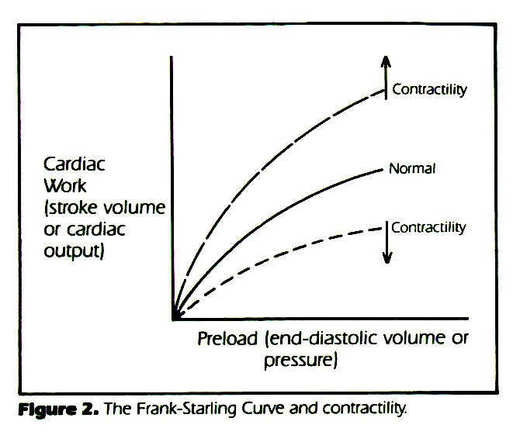
Frank starling mechanism
Notes:
SV increases as a response to increased blood in the ventricles-- more SV = increased contractility
More blood is returned to the heart (increased pre load,) more ventricular wall stretch, greater contraction force (the stretched wall recoils back its original size more forcefully), that recoil is going to push blood with more force
At a point the curve plateaus then declines, Disease relationship is depressed down and to the right so even though there is greater pre load the contraction is less vigorous, less CO

Slide 6
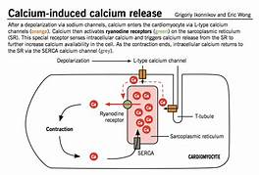
Calcium ions
Notes:
Systole: Ca ions enter the myocardial cell through the L type Ca channel, Ca activates the ryanodine receptors on the SR- triggers Ca release binds to troponin C and sarcomere contraction, then relaxation and Ca ions are sequestered back to SERCA

Slide 7
hemodynamics
Cardiac output → normal to decreased
Arterial blood pressure→ normal to decreased
Vascular resistance → increased
CVP→ increased
Pulmonary artery pressure→ increased (L-CHF)

Slide 8
Compensation
Chronic activation to support CO and BP:
Sodium retention
Arterial and venous constriction
Diverting blood flow away from skeletal muscle, skin, GIT and kidneys
Activation of inflammatory and growth promoting systems

Slide 9
SNS
Plasma catecholamines release when CO and BP are low
Norepinephrine and epinephrine increase heart rate, cardiac output, contractility and increased blood flow to vital centers
In animals with heart disease, venous constriction leads to increased venous return (preload → increased venous pressures → congestion
Chronic activation leads to adrenergic receptor downregulation, persistent tachycardia, increased myocardial oxygen demand, and myocyte necrosis and cardiac and vascular remodeling
Also stimulates RAAS
Notes:
In human CHF patients increased plasma levels of NE, correlate with severity of CHF and are inversely related to survival- unpublished data to suggest this is the same in dogs but samples are difficult to obtain and measure

Slide 10
RAAS
Major stimuli for the release of the renin from the juxtaglomerular apparatus include β₁-adrenergic stimulation, decreased effective renal perfusion, and reduced sodium reabsorption by the renal tubules
Renin converts angiotensinogen to angiotensin I which is rapidly converted to angiotensin II via ACE
Local tissue RAAS systems in brain, heart, blood vessels and adrenal glands → inflammation, fibrosis and hypertrophy
AT-II effects mediated by ARBs- vasoconstriction, promotes Na and water retention and stimulates aldosterone production
Notes:
Angiotensin-1 receptors,

Slide 11
RAAS
Aldosterone release also mediated by hyperkalemia, and ACTH
Binds to mineralocorticoid receptor in the distal collecting ducts to absorb Na and waste K
When AT II and aldosterone are elevated for a prolonged period, vascular and ventricular remodeling occur on top of previous cardiac injury from underlying disease
Catecholamines, ET-1 and AVP also stimulate aldosterone release

Slide 12
Natriuretic peptides
Myocardial tissue produces hormones ANP and BNP- due to stretch or stress of myocardial tissue
CNP in the brain and endothelium- inducing local relaxation of vascular smooth muscle and inhibiting vascular remodeling
Counterregulatory system to RAAS and SNS: directly inhibit renin and aldosterone
Act via the NPR-A to promote natriuresis and diuresis by inhibiting tubular sodium transport inner medullary collecting duct
Mediates vasorelaxation of systemic and pulmonary arterioles to decrease vascular resistance
Notes:
A type natriuretic peptide receptor , N terminal fragments are removed more slowly

Slide 13
Natriuretic Peptides
Significant increases in ANP and BNP in humans in CHF
Felines: Plasma BNP levels elevated more than 10-fold distinguished cats with heart failure from control cats better than plasma ANP levels, which were increased 4- to 5-fold
Plasma BNP concentrations do not increase markedly until the later stages of heart failure in dogs with DVD, and the magnitude of the change is less than that observed in cats and humans

Slide 14
Endothelin
NO, prostacyclin and endothelin modulate vascular tone
Proendothelin→ ET-1, ET-2, ET-3 via ECE
ET-1 causes vasoconstriction of smooth muscle, increases in myocardial contractility, and aldosterone secretion (inhibit renin)
Increased NO downregulates the production of ET-1
Chronic stimulation and persistently elevated ET-1 levels cause proliferation and hypertrophy of vascular smooth muscle and myocardial hypertrophy
Notes:
Increased plasma concentrations of ET-1 in humans with CHF, correlate inversely with survival

Slide 15
AVP
Hypovolemia, AT-II and SNS stimulate AVP release
Reacts with V1A receptors in the heart and vasculature and causes increase in SVR when reduction in BP is detected by baroreceptors
V2 receptors in the kidney causes retention of free water
Inappropriate increase in AVP, may be due to reduction in arterial pressure sensed by baroreceptors which outweighs the osmoreceptor response
This causes impaired excretion of free water

Slide 16
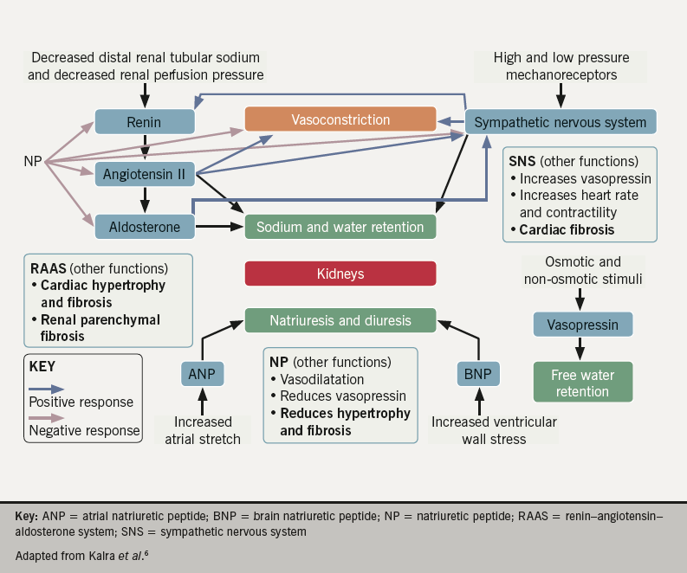

Slide 17
Cardiac remodeling
Dilation of the atria or ventricles
Myocyte hypertrophy
Necrosis and apoptosis of the myocytes
Fibrosis
Myocardial oxygen and substrate delivery is decreased → ischemic injury
Notes:
All these changes occur to maintain SV

Slide 18
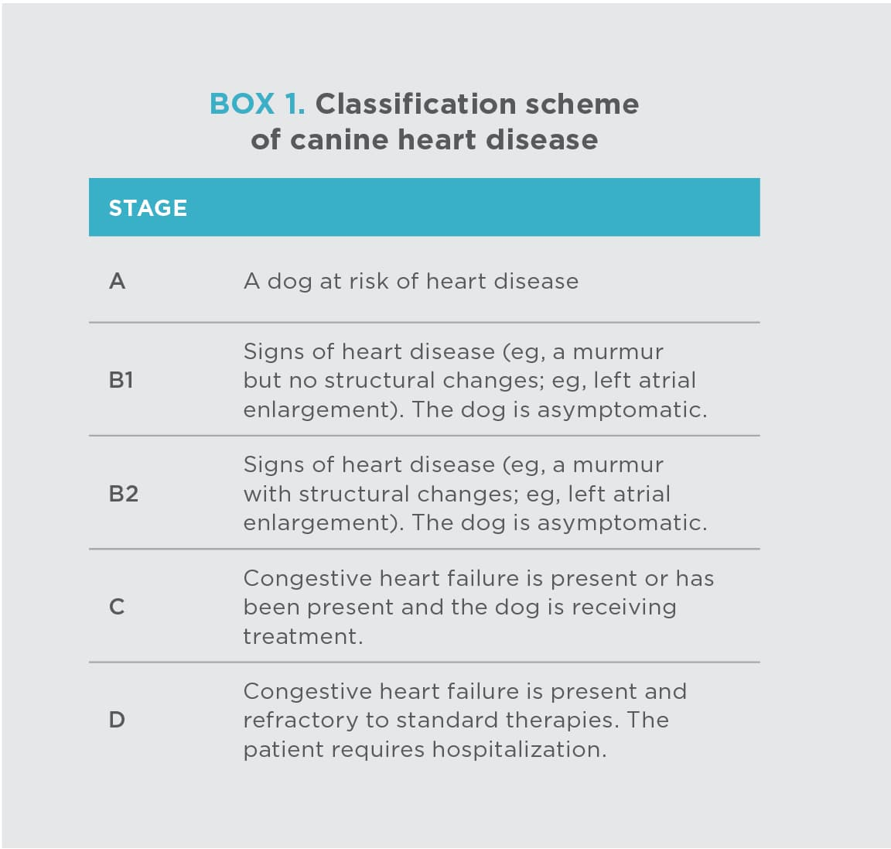

Slide 19
Stage C and D
Stage C denotes dogs with either current or past clinical signs of heart failure caused by MMVD. It is important to note that some dogs presented with heart failure for the first time may have severe clinical signs requiring aggressive treatment (eg, with additional afterload reducers or temporary ventilatory assistance) that more typically would be reserved for those patients refractory to standard treatment (see Stage D below).
Stage D refers to dogs with end-stage MMVD, in which clinical signs of heart failure are refractory to standard treatment (defined later in this consensus statement). Such patients require advanced or specialized treatment strategies to remain clinically comfortable with their disease, and at some point, treatment efforts become futile without surgical repair of the valve.

Slide 20
Common Signs
Increased respiratory rate and effort
Coughing
Exercise intolerance
Abdominal distension
Weakness
Syncope
Depression, lethargy

Slide 21
Diagnostics
CXR
Echocardiogram
ECG
BP
CBC/chemistry vs PCV/TS and renal panel

Slide 22
Biomarkers
Reimann, et al (2016) CRP in 184 dogs with different stage of MMVD, mildly increased in dogs with CHF, increased with increasing la:ao ratio and LVIDD
Peres Rubio (2020) increased expression of pro-inflammatory cytokines in human HF, C reactive protein and TNF- α, 29 dogs
Higher KC-like, CRP and haptoglobin in Stage D dogs vs Stage A dogs
Lower PON-1 (cardioprotective) in Stage D vs Stage A dogs, lower in dogs with DCM than MMVD
Notes:
Evaluated panel of inflammatory biomarkers in dogs in various stages of HF and correlate with echo changes

Slide 23
Biomarkers
NT pro BNP: Fox et al (2011) Cats with >100 pmol/L likely have underlying cardiomyopathy
Machen et al (2014) Positive POC ELISA increased likelihood of moderate or severe OcHD by a factor of 4.8 vs. those that tested negative.
PREDICT: risk factors in first time CHF d/t MMVD, NT pro BNP>1500 pmol/L was a significant independent risk factor for development of CHF
Notes:
NT pro BNP – increased wall stress, troponin I and T- cardiomyocyte damage

Slide 24
Medications
Positive ionotropes: improve contractility and reduce preload, increase Ca influx into cardiomyocytes
Diuretics: reduce preload and intravascular pressure, mobilize edema
Vasodilators: reduce afterload (arterial vasodilation) or preload (venous)
Beta blockers: antagonize beta effects
Notes:
1. shift FS curve upward (improved CO) 2. shift FS curve to the left (decreased pre load) 3. arterial – shift curve upward, venous- shift curve left

Slide 25
Positive ionotropes
Digoxin- SV increases and sensitizes baroreceptor function (increases vagal tone)- slows HR, inhibits the NaK pump which increases intracellular Na and activates the Na-Ca exchanger which increases cytosolic Ca
Indications: CHF Stage D , CHF with afib
Contraindications: complex ventricular arrhythmias, bradyarrhythmia, renal dysfunction
Adverse effects: anorexia, vomiting, AV block, junctional tachycardia
Dose: 0.0055-0.11 mg/kg PO q 12 hrs, target serum levels 0.8 -1.2 ng/ml
Notes:
Impaired systolic function- DCM, Cardiogenic shock and heart failure

Slide 26
Positive ionotropes
Dobutamine: synthetic catecholamine, B adrenergic agonist- strong B1 adrenergic in the myocardium, weak B2 and alpha-1, vasodilatory
Generate higher intracellular concentration of cAMP and increase opening of L-type Ca channels
Increased CO and arterial BP
Dose: 2.5- 20 mcg/kg/min CRI IV, increase by 1-2 mcg/kg/min as needed q 30 mins to hit target BP
Adverse effects: tachycardia, premature complexes, seizures

Slide 27
Positive ionotropes
Pimobendan: Ca sensitizer of sarcomeric proteins and PDE III inhibitor with arterial and venous vasodilator properties
Acute and chronic HF
Dose: 0.25-0.3 mg/kg PO q 12 hrs
Contraindications: dynamic ventricular outflow obstruction
Minimal adverse effects

Slide 28
Positive ionotropes
Dopamine: dopaminergic agonist, B adrenergic agonist, at high doses alpha agonist, increase HR and vasoconstriction
Norepinephrine: B adrenergic agonist, alpha agonist, B1> α > B2, potent vasoconstrictor
Epinephrine: B adrenergic agonist, alpha agonist, B1=B2 > α

Slide 29
Diuretics
Loop diuretics- block the NaK2Cl symporter in the thick LOH which increases urinary losses or Na, K, Cl, water and H ions
Loop diuretics are carried via renal blood flow to the proximal nephron and secreted in the plasma filtrate then to the LOH
If renal blood flow is impaired delivery of the drug may be decreased which is why high initial doses are used
Furosemide is highly bound to albumin, so in hypoalbuminemic patients it is less available to the kidney
Examples: furosemide and torsemide
Adverse effects: PU/PD, lowers BP, plasma volume depletion, azotemia and electrolyte depletion
Notes:
High ceiling diuretic- higher dose will help more
Diuretic resistance – excessive neurohormonal activation, decreased enteral drug absorption, poor CO

Slide 30
Diuretics
Thiazides block the NaCl symporter- inhibits Na, Cl and water reabsorption in the distal tubule
Hydrochlorothiazide- 1-2 mg/kg PO q 12-24 hours
Adverse effects: PU/PD, lowers BP, plasma volume depletion, pre-renal azotemia and electrolyte depletion

Slide 31
Diuretics
Spironolactone: steroid compound, aldosterone antagonist – blocks aldosterone receptors in the heart, kidney and other tissues
Exerts effect in the most distal segment of the renal tubule
Weak diuretic effects
Potassium sparing action and anti-fibrotic effects in the heart and kidneys
Adverse effect: hyperkalemia
Dose: 1 mg/kg PO q 12 hrs

Slide 32
Vasodilators
Nitrovasodilators: nitroglycerin and sodium nitroprusside
Increase formation of NO or stimulate formation of cGMP which is a second messenger for NO
This inhibits the calcium myosin light chain kinase interaction in vascular smooth muscle which limits vasoconstriction
Nitroglycerine dilates systemic veins and venules- causing blood to pool away from the lungs
Sodium nitroprusside: venous and arterial dilator, lowers systemic BP- added when pulmonary edema is life threatening
Adverse effects: hypotension, reflex tachycardia

Slide 33
Vasodilators
Hydralazine: arteriole dilator via formation of NO and increase in cGMP in vascular smooth muscle
Reduces ventricular afterload
Less rapid onset and ease of dosing so used less than nitrovasodilators
Adverse effects: hypotension, reflex tachycardia

Slide 34
Vasodilators
CCB: impede calcium entry across the L type calcium channel in vascular smooth muscle causing arterial vasodilation
This leads to reduced SVR and decreased arterial BP- decrease systemic hypertension
High BP impairs left sided heart function in heart failure, so decreasing BP should improve SV
Amlodipine 0.05 -0.1 mg/kg PO q 12-12 hours
Adverse effect: hypotension

Slide 35
vasodilators
ACEi: Inhibit RAAs by blocking ACE that converts angiotensin I to angiotensin II
This will reduce serum aldosterone levels, limit sodium retention, potassium loss, protect cardiac muscle, kidneys and vessels from RAAS induced injury and downregulate the SNS
Enalapril, benazepril, lisinopril
Less potent than CCB in reducing systemic hypertension
Adverse effects: azotemia, hyperkalemia

Slide 36
Beta blockers
Decreases SA node discharge (chronotropy), decreased conduction across myocardium (dromotropy), decreases myocardial contractility (ionotropy), decreases myocardial relaxation (lusitropy) and excitability of cardiac pacemakers (bathmotropy)
Selective (B1 blockade) non selective (B1 and B2 blockade)
Adverse effects: weakness, bradycardia, hypotension and worsening effusions
Atenolol 0.2-1 mg/kg PO q 12 hrs (B1)

Slide 37
Anti thrombotics
Anti platelet aggregators, indicated in cats with smoke and atrial enlargement
Plavix: MOA: ADP receptor antagonist which irreversibly binds to P2Y12 receptor
Dose: 18.75 mg PO q 24 hrs
Aspirin: MOA: Irreversible blockade of COX-1 that occurs on the surface of the platelet
Dose: 81 mg PO q 48-72 hrs

Slide 38
Medication recs
QUEST: benazepril vs pimobendan- survival times in dogs with CHF due to MMVD→ pimo prolongs time to sudden death, euth or tx failure by 4.2 months
EPIC: pimobendan in dogs with pre-clinical MMVD to delay onset of CHF, cardiomegaly and grade III HM or higher→ delays time to onset (placebo 766 days vs pimo 1228 days)
BESST: efficacy of benazepril, spiro and lasix in dog with CHF due to MMVD vs benazepril and Lasix alone-→ yes! 77.8% vs 86.4% reached endpoint
DELAY: use of ACEi in dogs with preclinical MMVD (Stage B2) → no! does not delay time to CHF vs placebo
Notes:
BESST: % of dogs reaching cardiac endpoint before day 360 (euth or death due to cardiac reasons, recurrence PE, Lasix > 8 mg/kg/day or non auth cardiac drugs
DEALY: primary end point was time to cardiac death or onset HF

Slide 39
Medication recs
CARPODIEM: efficacy of oral torsemide vs Lasix in dogs with CHF from MMVD→ torsemide non inferior to Lasix and less than half as likely to experience death, euth or study withdrawal
PROTECT: benefit of pimo to delay CHF or sudden death in Dobermans with pre clinical DCM→ yes! MCT placebo 466 days vs MST 623 dys
FAT CAT: 75 cats that survived CATE, Plavix significantly reduced likelihood of recurrent CATE vs aspirin and longer median time to recurrence (433 days vs 199 days)
Notes:
CARPODIEM: decreased PE and cough, no worsening dyspnea or exercise intolerance at day 14

Slide 40
Typical In hospital Therapy
Furosemide – 2 mg/kg IV or IM hourly until normal RR/RE or reached 8 mg/kg in 4 hours or CRI 0.66 -1 mg/kg/hr after bolus- always free water access!
Pimobendan 0.25 to 0.3 mg/kg po q 12 hrs
Supplemental oxygen
Tap if needed
Sedation: consider butorphanol or acepromazine
Consider ACEi, dobutamine, etc
Stage D- add torsemide, MV ?

Slide 41
prognosis
Beaumier, et al (2018) Survival time is expected to be between 6 and 14 months in dogs with MMVD after CHF develops
The median duration between the diagnosis of stage C and advanced heart failure was 163 days, and the median survival time after the diagnosis of advanced heart failure was 281 days (∼9 months), with a range of 3–885 days
Variable based on underlying disease process, comorbidities and finances

Slide 42
references
SACCM
Sisson DD. Neuroendocrine evaluation of cardiac disease. Vet Clin North Am Small Anim Pract. 2004 Sep;34(5):1105-26. doi: 10.1016/j.cvsm.2004.05.005. PMID: 15325472.
Keene BW, Atkins CE, Bonagura JD, Fox PR, Häggström J, Fuentes VL, Oyama MA, Rush JE, Stepien R, Uechi M. ACVIM consensus guidelines for the diagnosis and treatment of myxomatous mitral valve disease in dogs. J Vet Intern Med. 2019 May;33(3):1127-1140. doi: 10.1111/jvim.15488. Epub 2019 Apr 11. PMID: 30974015; PMCID: PMC6524084.
Franchini A, Abbott JA, Tyrrell W, Rosenthal S, Lahmers S, Menciotti G, Crosara S, Häggström J, Borgarelli M. Predictors of reoccurrence of congestive signs within 180 days after successful treatment of the first episode of congestive heart failure in dogs with myxomatous mitral valve disease. J Vet Cardiol. 2021 Apr;34:112-119. doi: 10.1016/j.jvc.2020.11.005. Epub 2021 Feb 6. PMID: 33706221.
Summerfield NJ, Boswood A, O'Grady MR, Gordon SG, Dukes-McEwan J, Oyama MA, Smith S, Patteson M, French AT, Culshaw GJ, Braz-Ruivo L, Estrada A, O'Sullivan ML, Loureiro J, Willis R, Watson P. Efficacy of pimobendan in the prevention of congestive heart failure or sudden death in Doberman Pinschers with preclinical dilated cardiomyopathy (the PROTECT Study). J Vet Intern Med. 2012 Nov-Dec;26(6):1337-49. doi: 10.1111/j.1939-1676.2012.01026.x. Epub 2012 Oct 18. PMID: 23078651; PMCID: PMC3546380.

Slide 43
references
Rubio CP, Saril A, Kocaturk M, Tanaka R, Koch J, Ceron JJ, Yilmaz Z. Changes of inflammatory and oxidative stress biomarkers in dogs with different stages of heart failure. BMC Vet Res. 2020 Nov 10;16(1):433. doi: 10.1186/s12917-020-02650-7. PMID: 33167963; PMCID: PMC7654180.
Reimann MJ, Ljungvall I, Hillström A, Møller JE, Hagman R, Falk T, Höglund K, Häggström J, Olsen LH. Increased serum C-reactive protein concentrations in dogs with congestive heart failure due to myxomatous mitral valve disease. Vet J. 2016 Mar;209:113-8. doi: 10.1016/j.tvjl.2015.12.006. Epub 2015 Dec 22. PMID: 26831162.
Reynolds CA, Brown DC, Rush JE, Fox PR, Nguyenba TP, Lehmkuhl LB, Gordon SG, Kellihan HB, Stepien RL, Lefbom BK, Meier CK, Oyama MA. Prediction of first onset of congestive heart failure in dogs with degenerative mitral valve disease: the PREDICT cohort study. J Vet Cardiol. 2012 Mar;14(1):193-202. doi: 10.1016/j.jvc.2012.01.008. Epub 2012 Feb 25. PMID: 22366568.
Hogan DF, Fox PR, Jacob K, Keene B, Laste NJ, Rosenthal S, Sederquist K, Weng HY. Secondary prevention of cardiogenic arterial thromboembolism in the cat: The double-blind, randomized, positive-controlled feline arterial thromboembolism; clopidogrel vs. aspirin trial (FAT CAT). J Vet Cardiol. 2015 Dec;17 Suppl 1:S306-17. doi: 10.1016/j.jvc.2015.10.004. PMID: 26776588.

Slide 44
References
Boswood A, Häggström J, Gordon SG, Wess G, Stepien RL, Oyama MA, Keene BW, Bonagura J, MacDonald KA, Patteson M, Smith S, Fox PR, Sanderson K, Woolley R, Szatmári V, Menaut P, Church WM, O'Sullivan ML, Jaudon JP, Kresken JG, Rush J, Barrett KA, Rosenthal SL, Saunders AB, Ljungvall I, Deinert M, Bomassi E, Estrada AH, Fernandez Del Palacio MJ, Moise NS, Abbott JA, Fujii Y, Spier A, Luethy MW, Santilli RA, Uechi M, Tidholm A, Watson P. Effect of Pimobendan in Dogs with Preclinical Myxomatous Mitral Valve Disease and Cardiomegaly: The EPIC Study-A Randomized Clinical Trial. J Vet Intern Med. 2016 Nov;30(6):1765-1779. doi: 10.1111/jvim.14586. Epub 2016 Sep 28. PMID: 27678080; PMCID: PMC5115200.
Häggström J, Boswood A, O'Grady M, Jöns O, Smith S, Swift S, Borgarelli M, Gavaghan B, Kresken JG, Patteson M, Ablad B, Bussadori CM, Glaus T, Kovacević A, Rapp M, Santilli RA, Tidholm A, Eriksson A, Belanger MC, Deinert M, Little CJ, Kvart C, French A, Rønn-Landbo M, Wess G, Eggertsdottir AV, O'Sullivan ML, Schneider M, Lombard CW, Dukes-McEwan J, Willis R, Louvet A, DiFruscia R. Effect of pimobendan or benazepril hydrochloride on survival times in dogs with congestive heart failure caused by naturally occurring myxomatous mitral valve disease: the QUEST study. J Vet Intern Med. 2008 Sep-Oct;22(5):1124-35. doi: 10.1111/j.1939-1676.2008.0150.x. Epub 2008 Jul 11. PMID: 18638016.
Beaumier A, Rush JE, Yang VK, Freeman LM. Clinical findings and survival time in dogs with advanced heart failure. J Vet Intern Med. 2018 May;32(3):944-950. doi: 10.1111/jvim.15126. Epub 2018 Apr 10. PMID: 29635788; PMCID: PMC5980388.

Slide 45
references
Borgarelli M, Ferasin L, Lamb K, Bussadori C, Chiavegato D, D'Agnolo G, Migliorini F, Poggi M, Santilli RA, Guillot E, Garelli-Paar C, Toschi Corneliani R, Farina F, Zani A, Dirven M, Smets P, Guglielmini C, Oliveira P, Di Marcello M, Porciello F, Crosara S, Ciaramella P, Piantedosi D, Smith S, Vannini S, Dall'Aglio E, Savarino P, Quintavalla C, Patteson M, Silva J, Locatelli C, Baron Toaldo M. DELay of Appearance of sYmptoms of Canine Degenerative Mitral Valve Disease Treated with Spironolactone and Benazepril: the DELAY Study. J Vet Cardiol. 2020 Feb;27:34-53. doi: 10.1016/j.jvc.2019.12.002. Epub 2020 Jan 10. PMID: 32032923.
Coffman M, Guillot E, Blondel T, Garelli-Paar C, Feng S, Heartsill S, Atkins CE. Clinical efficacy of a benazepril and spironolactone combination in dogs with congestive heart failure due to myxomatous mitral valve disease: The BEnazepril Spironolactone STudy (BESST). J Vet Intern Med. 2021 Jul;35(4):1673-1687. doi: 10.1111/jvim.16155. Epub 2021 May 24. PMID: 34028078; PMCID: PMC8295662.
Besche B, Blondel T, Guillot E, Garelli-Paar C, Oyama MA. Efficacy of oral torasemide in dogs with degenerative mitral valve disease and new onset congestive heart failure: The CARPODIEM study. J Vet Intern Med. 2020 Sep;34(5):1746-1758. doi: 10.1111/jvim.15864. Epub 2020 Aug 7. PMID: 32767627; PMCID: PMC7517836.
Keene BW, Atkins CE, Bonagura JD, Fox PR, Häggström J, Fuentes VL, Oyama MA, Rush JE, Stepien R, Uechi M. ACVIM consensus guidelines for the diagnosis and treatment of myxomatous mitral valve disease in dogs. J Vet Intern Med. 2019 May;33(3):1127-1140. doi: 10.1111/jvim.15488. Epub 2019 Apr 11. PMID: 30974015; PMCID: PMC6524084.

