Slide 1
Antiplatelet and anticoagulant Drugs
Samantha Davis, DVM

Slide 2
Review
Common medications
MOA
Indications for use

Slide 3
Primary hemostasis
Endothelial injury-→ Subendothelial collagen exposure
vWF exposed and binds to platelets via GPIb receptor
Platelet shape change
Alpha granules release: P selectin, thrombospondin, fibrinogen
Dense granules release Ca++, ADP, ATP, serotonin and histamine
ADP and TXA2 activate more platelets
Platelets aggregate and bind to each other via fibrinogen receptor GPIIb/IIIa

Slide 4
Platelet receptors
G protein coupled receptors
P2Y1 and PY2Y12- ADP, platelet shape and granule secretion
PAR1 and PAR4- Thrombin
TP-Thromboxane
Integrin receptors recognize collagen and fibrinogen – GPVI
These all act to activate the fibrinogen receptor- GPIIb/IIIa

Slide 5
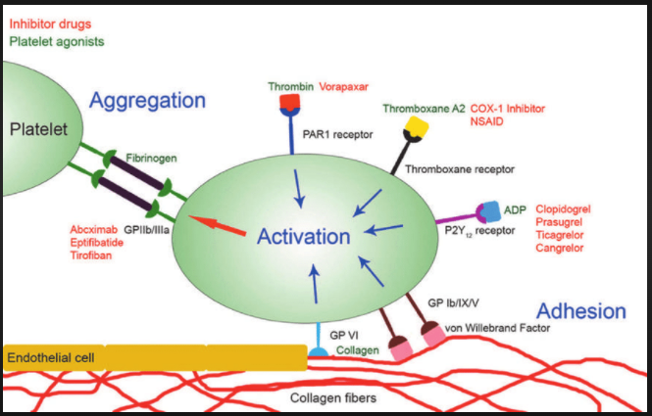

Slide 6
Antiplatelet drugs
Aspirin, acetylsalicylic acid
MOA: Irreversible blockade of COX-1 that occurs on the surface of the platelet
Necessary for catalyzing AA pathway and creating TXA2 which recruits and activates platelets
Platelets cannot manufacture additional copies of COX, so the blockade persists for the lifespan of the platelet (~6 days)
Subset of dogs may not show platelet aggregation in response to TXA2, variable response in cats

Slide 7
Antiplatelet drugs
Clopidogrel (Plavix), Prasugrel (Effient) - Thienopyridines
MOA: ADP receptor antagonist which irreversibly binds to P2Y12 receptor
Decreases the release of procoagulant molecules from platelet granules
Pro-drug that is transformed via hepatic P450 enzymes
Possible resistance due to variability in P450 enzyme activity

Slide 8
Nucleoside analogs
Inhibit effects of ADP on platelet aggregation
Reversible inhibition of P2Y12 receptor
No evidence of use in veterinary patients

Slide 9
Fibrinogen receptor antagonist
Abciximab (ReoPro)
Acts as a non-competitive inhibitor of GPIIb/IIIa so platelets cannot bind to each other
IV only
Prevent downstream microthrombi in people with percutaneous coronary intervention

Slide 10
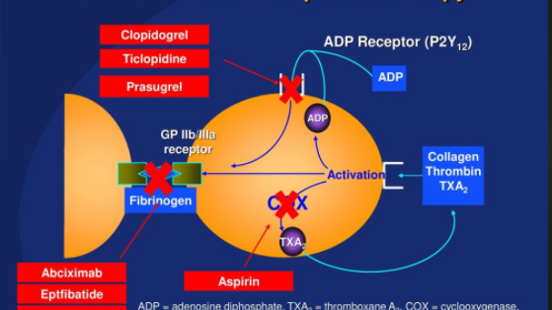

Slide 11
Indications for use
Arterial thrombosis- form under high shear conditions, platelet rich
Commonly used in FATE
CURATIVE:
- Dogs: Plavix may be more effective than ASA
- Cats: Recommend Plavix

Slide 12
Monitoring
Aspirin: Consider platelet aggregometry
Clopidogrel: No guidelines

Slide 13
Dosages
Clopidogrel
- Dog: 1.1-3 mg/kg PO q 24 hrs, loading dose can be considered (4-10 mg/kg)
- Cat: 18.75 mg/per cat PO q 24 hrs
Aspirin
  Dog: 5 mg/kg PO q 24 hrs
  Cat: 81 mg/per cat PO q 48-72 or 5 mg/kg q 48 hrs

Slide 14
Changes to therapy
Prior to surgery
  Low to moderate risk: discontinue 5-7 days prior
  High risk: 24 hours prior
Post op
  Low to moderate risk: no recommendation unless evidence of thrombosis, then 24 hours
  High risk: restart in 24 hours if no evidence of bleeding
General
  Can be discontinued following thrombus resolution
  In patients with underlying conditions that predispose to thrombi, should be continued indefinitely

Slide 15
Secondary hemostasis
TF is exposed on the platelet surface and binds to VIIa → VIIa
This steps activates X which complexes with V to make the pro-thrombinase complex
This complex activates II and creates the thrombin spark
IIa activates platelets and XI, V, and VIII
Tenases (IX+VIII and III+VII) activate X → II which creates the thrombin burst
Thrombin activates soluble fibrinogen to insoluble fibrin (Ia) and those molecules spontaneously polymerize and form a mesh
II activates XIII to cross link the fibrin mesh

Slide 16
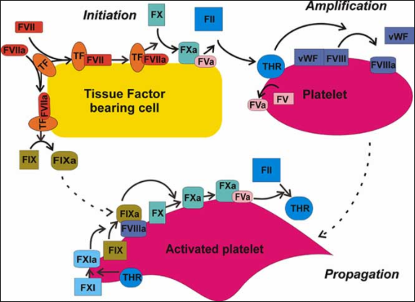

Slide 17
Unfractionated heparin
Heterogenous mixture of glycosaminoglycans with molecular weights ranging from 5,000-30,000 Da
1/3 of the molecules contain the pentasaccharide sequence needed to bind AT
MOA: binds to AT potentiates its effects and causes release of TFPI (tissue factor pathway inhibitor)
Higher molecular weight chains inactivate IIa and Xa (ratio 1:1)
Lower molecular weight chains only bind IIa, but still have affinity for Xa (ratio 4:1)
Highly protein bound, low activity with low AT concentrations

Slide 18
LMW Heparin
Dalteparin, Enoxaparin
Contain heterogenous distribution of glycosaminoglycans with average molecular weights (5000 Da)
About 25-30% of the molecules have the pentasaccharide that binds AT
Primarily inactivates Xa
Not highly protein bound- more bioavailable
Primary excretion via the kidneys

Slide 19
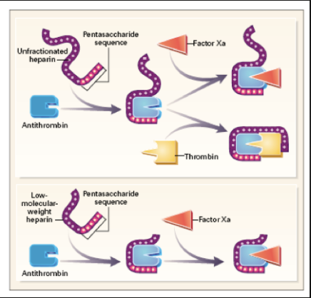

Slide 20
Anti-10a medications
Rivaroxaban, Apixiban
MOA: direct inhibitor of Xa
80% bioavailability in humans
In human studies apixaban can also inhibit platelet aggregation through prevention of IIa

Slide 21
Direct thrombin inhibitors
Dabigatran, lepirudin, bivalirudin
Small molecules that bind to thrombin- both fibrin bound and circulating
Do not require AT
No published studies in veterinary patients

Slide 22
Vitamin K antagonist
Warfarin
MOA: inhibits the activity of Vitamin K reductase which is necessary to reduce Vitamin K epoxide back to its active form, Vitamin K cannot be recycled and rapidly depletes along with the dependent coagulation factors (II,VII,IX,X)
Vitamin K also needed to produce protein C and S → pro-coagulant effect
Highly protein bound
Adverse effect: severe bleeding

Slide 23
Indications
Venous thrombosis: form in low shear conditions, typically fibrin rich
Commonly used in IMHA, PLN, pancreatitis, PTE, sepsis
CURATIVE:
LMWH vs UFH: LMWH recommended in dogs and cats due to positive safety profile and more predictable bioavailability
Anti 10a: Insufficient evidence for use in dogs and cats but should be used instead of Warfarin
Combination therapy: Anti platelet drugs and LMWH can be used together in dogs with high risk of VTE

Slide 24
Monitoring
UFH:
  Dogs: Anti 10a assay, target is 0.35-0.7 U/ml or aPTT
  Cats: Same, no strong evidence
LMWH: Anti 10a assay, target 0.5-1 U/ml 2-4 hours post dose
Rivaroxaban: No guidelines

Slide 25
Dosages
UFH:
- Initial bolus 100 U/kg IV, 480-900 U/kg/24 hours CRI
- 150-300 U/kg SQ q 6 hrs
- Cat: 250 U/kg SQ q 6 hrs
LMWH:
- Dalteparin: Dogs- 100-175 U/kg SQ q 8 hrs, Cats-75 U/kg SQ q 6 hrs
-Enoxaparin: Dogs- 0.8 mg/kg SQ q 6 hrs, Cats:0.75-1 mg/kg SQ q 6 hrs
Rivaroxaban: Dogs- 1-2 mg/kg/day PO, Cats- 0.5-1 mg/kg/day PO

Slide 26
Changes to therapy
UFH should be weaned and not stopped abruptly
LMWH: no weaning necessary
  Possible rebound hypercoagulation: elevated thrombin production and decreased TFPI
Anti 10a: consider weaning

Slide 27
Thrombolytics
Indications: venous thrombosis, PTE, ischemic stroke, renal infarction
Only effective on recently formed clots
Adverse effects: bleeding, re-perfusion injury

Slide 28
Streptokinase
Thrombolytic agent
MOA: combines with plasminogen to form an activator complex that converts plasminogen to plasmin (circulating and bound to fibrin)
Plasmin degrades fibrin, fibrinogen, plasminogen and factors
Produced by streptococci- can cause antigenic stimulation

Slide 29
Urokinase
Thrombolytic agent
Produced from the renal tubular epithelium
Similar activity to streptokinase, but more fibrin specific
HMW and LMW fractions
LMW fraction shows greater binding to the lysine-plasminogen form which accumulates within thrombi
Glutamate plasminogen → lysine plasminogen during thrombolysis

Slide 30
TPA
Thrombolytic agent
Primary activator of plasmin
High affinity for fibrin, which causes plasminogen→ plasmin within thrombi

Slide 31
ACA, TXA
Antifibrinolytic drugs- reversibly block the lysine binding sites on plasminogen so it cannot bind to fibrin
Indications: hemorrhage, major surgery
ACA: synthetic lysine analogue, competitively inhibits plasminogen activation
TXA: synthetic lysine analogue, competitively inhibits plasminogen activation, at high concentrations is a non-competitive inhibitor of plasmin
CRASH-2 trial: TXA reduced mortality in trauma patients with hemorrhage or significant risk of, if given within 3 hours

Slide 32
References
Goggs R, Blais MC, Brainard BM, Chan DL, deLaforcade AM, Rozanski E, Sharp CR. American College of Veterinary Emergency and Critical Care (ACVECC) Consensus on the Rational Use of Antithrombotics in Veterinary Critical Care (CURATIVE) guidelines: Small animal. J Vet Emerg Crit Care (San Antonio). 2019 Jan;29(1):12-36. doi: 10.1111/vec.12801. PMID: 30654421.
Brainard, B.M. Chapter 167 Antiplatelet drugs. In: Small Animal Critical Care Medicine. D Silverstein, K Hopper eds. Elsevier. 2015. pp 877-882
Brainard, B.M and Dixon-Jimenez, A. Chapter 168 Anticoagulants. In: Small Animal Critical Care Medicine. D Silverstein, K Hopper eds. Elsevier. 2015. pp 882-889
Hogan, D.F. Chapter 169 Thrombolytic agents. In: Small Animal Critical Care Medicine. D Silverstein, K Hopper eds. Elsevier. 2015. pp 889-893
Borchers, A. Chapter 170 Hemostatic drugs. In: Small Animal Critical Care Medicine. D Silverstein, K Hopper eds. Elsevier. 2015. pp 893- 898

