Slide 1
Antimicrobial Use Guidelines for Treatment of Respiratory Tract Disease in Dogs and Cats
Antimicrobial Guidelines Working Group of the International Society for Companion Animal Infectious Diseases

Slide 2
Feline Upper Respiratory Tract Disease

Slide 3
Feline URT
Clinical signs - serous to mucopurulent ocular and nasal discharge, epistaxis, sneezing, conjunctivitis
Acute or chronic (+/- 10 days)
Etiology - Herpesvirus or calicivirus associated upper respiratory infection
Secondary bacterial infections
Does mucopurulent discharge = bacterial component?
Notes:
Secondary bacteria - Staphylococcus, Streptococcus, Pasteurella multocida, E. coli, anaerobes cultured
Chlamydia felis, Bordetella bronchiseptica, Strep canis, Strep equi zooepidemicus, mycoplasma have been isolated via PCR without viruses - implicated in primary bacterial infection role
Soft suspicion for bacterial infection when discharge is mucopurulent but viral or fungal agents can induce that as well

Slide 4

Diagnosis - Feline URT
Helpful
History
PE - otic, nasal, ocular exam, thoracic auscultation
FeLV/FIV
Period of observation
Unhelpful
IH cytology
Aerobic culture and sensitivity
Mycoplasma culture, PCR
Molecular diagnostics for viruses
Notes:
History - vaccinations, presence/exposure to other cats, indoor/outdoor, contact with shelter, cattery, kennel, veterinary hospital, health of other cats in contact, health of humans, exposure to dogs that may have kennel/grooming/vet hospital recent contact (B. bronchiseptica), foreign body contact potential including plants, history of recent stress for herpes flareup
PE - ocular, oral, otic exam, thoracic auscultation
FeLV/FIV screening - both associated with lymphoma which can induce URTD via immunosuppression
Serous discharge - no abx, most likely uncomplicated viral infection
Acute bacterial URI based on discharge without evidence of URTD via history or PE - period of observation ranging from a total extent of 10 days or worsening after 5-7 days
IH cytology of discharge - limited value
Aerobic culture and sensitivity difficult to interpret - Chlamydia, Mycoplasma need a special culture media, and a positive culture may just be a commensal and not pathogenic
Difficult to interpret molecular diagnostics for feline herpesvirus, calicivirus, and chlamydia felis in individual cats - this is more of a helpful tool in shelter medicine for cattery outbreaks

Slide 5
Treatment - Feline URT
Observation
Threshold for ABX - fever, lethargy, anorexia + mucopurulent discharge
Empiric first line ABX - doxycycline (10mg/kg/day) 7-10 days
MOA? Cidal or Static?
Alternative - amoxicillin 22mg/kg PO BID, amoxicillin-clavulanate 12.5mg/kg PO BID
Longer duration of treatment to clear Chlamydia felis carrier state potentially
Notes:
Some cats with mucopurulent nasal discharge can maintain a normal appetite and energy level - can have spontaneous resolution of illness within 10 days without ABX.
ABX should then be considered for cats who are clinically affected beyond their mucopurulent discharge
Doxycycline is a good first choice because it is well tolerated in cats. Most bordetella bronchiseptica is susceptible in vitro when compared to beta lactams or sulfonamides, and it also covers against Mycoplasma, Chlamydia spp, and other commensals that can become opportunistic.
MOA - time-dependent bacteriostatic antibiotics that inhibit protein synthesis by reversibly binding to 30S ribosomal subunits of susceptible organisms, thereby preventing aminoacyl transfer-RNA binding to those ribosomes. (gram positive, gram negative, mycoplasma, rickettsia, chlamydia, protozoa)
Keep in mind esophageal strictures - follow with water/food
Alternative - amoxicillin when chlamydia, mycoplasma are not highly suspected. Escalation would be amoxicillin + clavulanate

Slide 6
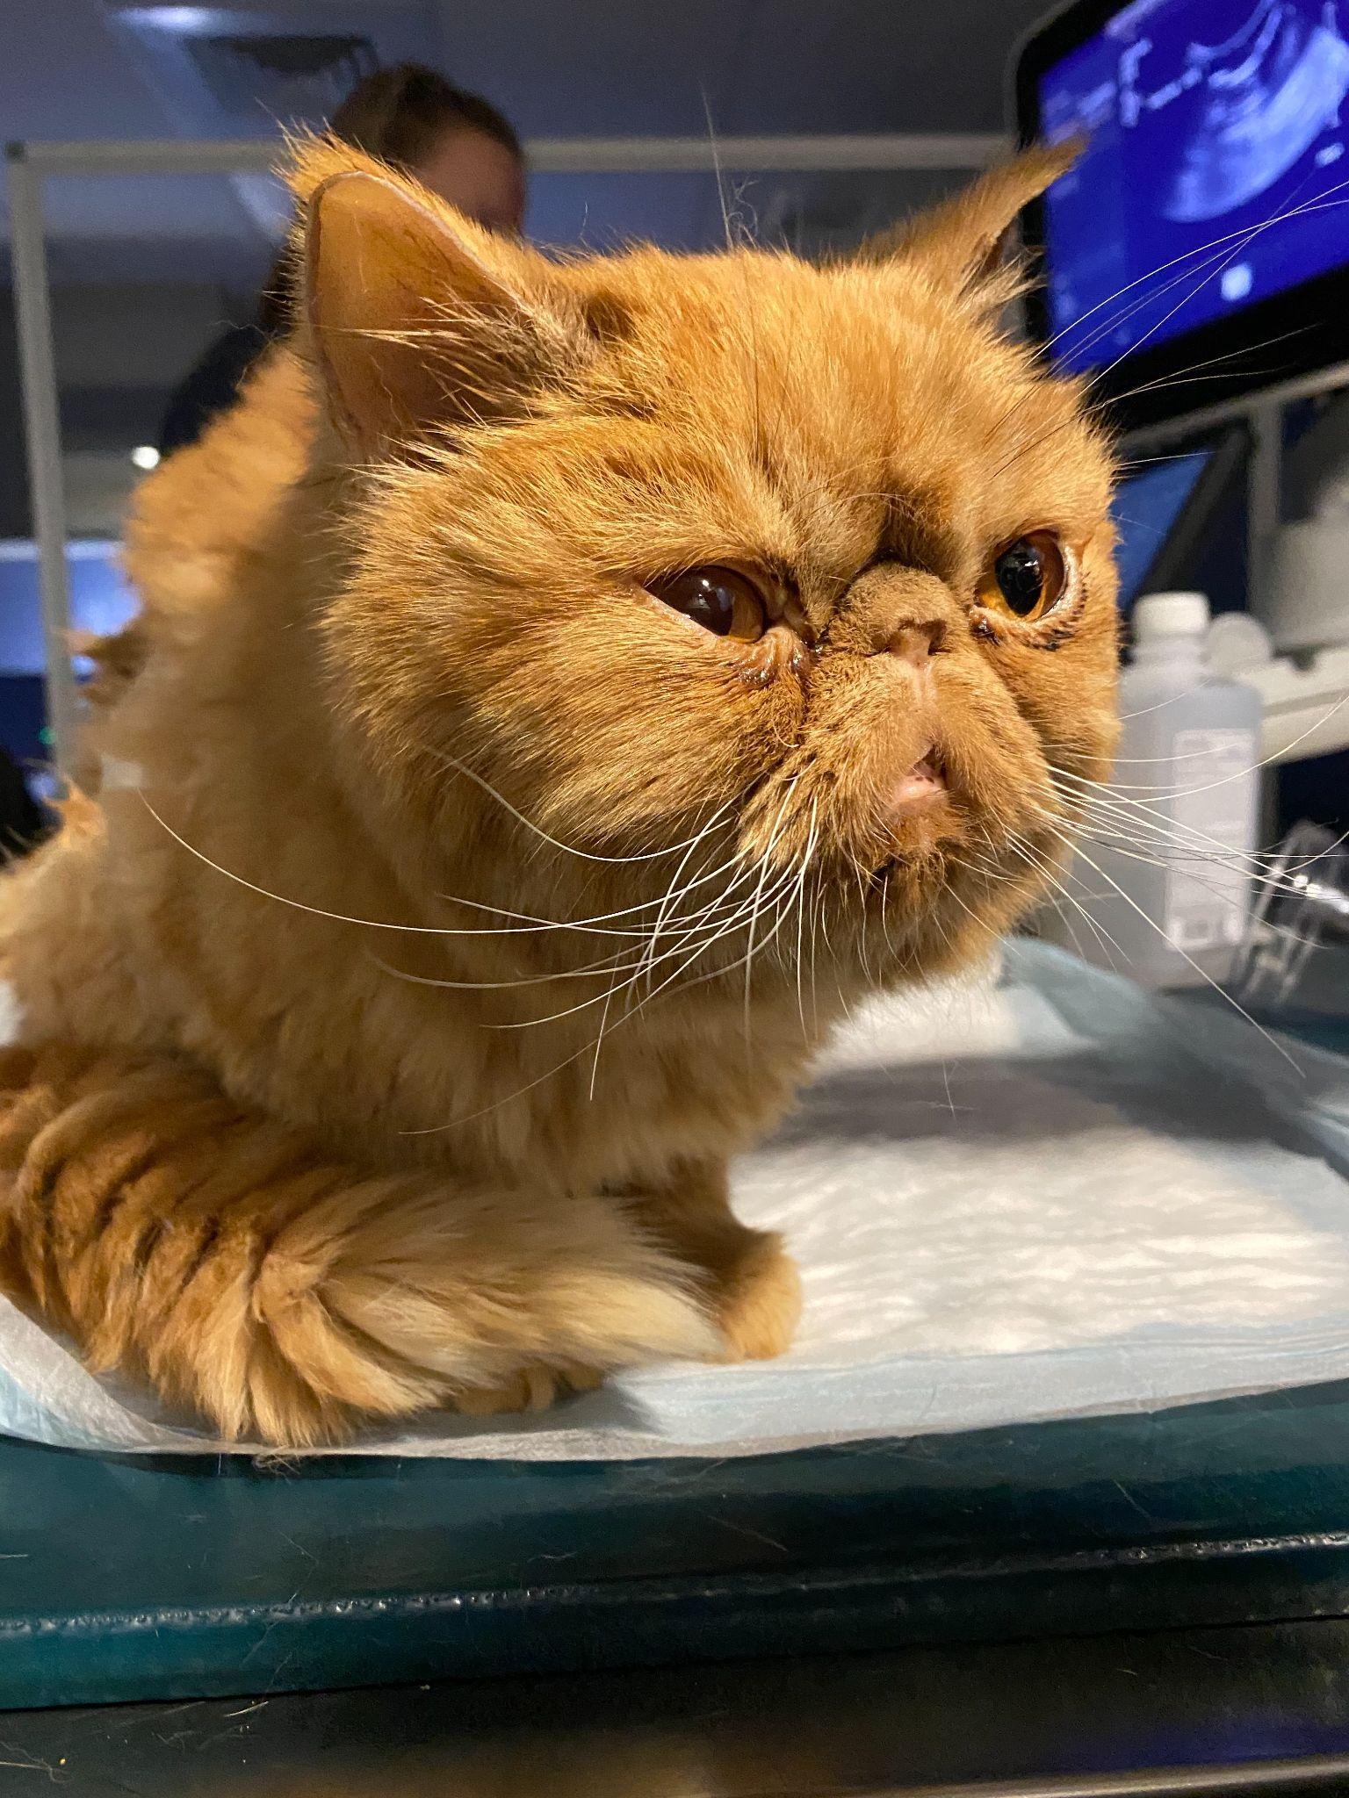
Diagnosis - Chronic URT
DDX - Cuterebra spp, allergies, neoplasia, foreign bodies, nasopharyngeal stenosis, oronasal fistulas, nasopharyngeal polyps, trauma
CT/rhinoscopy
Nasal lavage/brushings (cytology, culture + sensitivity, PCR, fungal culture)
Nasal tissue biopsy (difficult to interpret)
Notes:
Further diagnostic workup is necessary if the clinical signs persist for over 10 days, especially if they fail a therapeutic trial of empiric antibiotics
Given the DDX list, a CT/rhino is the next diagnostic recommendation to facilitate investigation and sample collection.
Culture/sensitivity is for identifying antimicrobial susceptibility of severe secondary bacterial infections that occur secondary to an untreatable underlying cause like idiopathy inflammatory rhinitis
Nasal tissue biopsy can be difficult to interpret given the long standing inflammation.

Slide 7
Treatment - Chronic URT
ABX based on culture and sensitivity
Reserve fluoroquinolones, third generation cephalosporins, azithromycin
Pradofloxacin 5mg/kg PO q24 with tablets, 7.5mg/kg with oral suspension
Pseudomonas spp -> nasal flushing under GA
Fluoroquinoline solo vs. combined with beta-lactam
Duration of treatment is unknown - 1 week past clinical resolution
0.9% NaCl topical administration - mild mucolytic
Notes:
Still recommend doxycycline and amoxicillin unless susceptibility contraindicates usage
Pradofloxacin - treatment of acute respiratory tract infections - Pasteurella multocida, E. coli, Staph intermedius
Azithromycin equivalent to amoxicillin in 1 study of feline URT infections in shelter housing. Also less efficacious as doxycyline for ocular chlamydiosis.
Fluoroquinolones MOA - affects nucleic acid synthesis via inhibition of DNA gyrase (type II topoisomerase) - needed for DNA strand breakage and reunion in bacteria, causes death in the organism
Duration - it’s a bit unclear, but at least for 7 days, continue with clinical improvement - stop after 1 week of clinical resolution or clinical plateau. Possible to stop earlier, but difficult to make those recommendations in a sweeping consensus statement.
Okay to restart a course for at least 7-10 day course if this recurs to assess for treatment response. Potential that clinical resolution may not be achieved in some cats. Some human data recommends switching ABX classes or escalating within a previously used class if recurrence is seen within 3 months based on last culture and sensitivity results for guidance. This consensus statement recommends restarting, but switching/escalating if 48h shows no improvement. Collection of specimens for culture + sensitivity is recommended if none of that helps.
No intranasal antiseptic or antimicrobial recommended. Saline can be used as a mild mucolytic.

Slide 8
Canine Infectious Respiratory Disease Complex

Slide 9
CIRDC
Infectious agents - Canine adenovirus 2*, canine distemper virus*, canine respiratory coronavirus, canine influenza virus*, canine herpesvirus, canine pneumovirus, canine parainfluenza virus*, Bordetella bronchiseptica*, Strep equi zooepidemicus, mycoplasma spp.
Clinical signs - coughing, +/- sneezing, nasal or ocular discharge, fever
Distemper = mucopurulent ocular/nasal discharge + diarrhea
Strep equi zooepidemicus = acute hemorrhagic pneumonia
*= vaccinations available
Notes:
Clinical syndrome has a collection of viruses and bacteria implicated. Some of them have vaccinations available against them; only distemper vaccine prevents colonization and shedding of the organism. The rest of them minimize clinical sign severity.
All of these respiratory pathogens can be found in dogs without clinical signs. Co-infections with multiple pathogens are possible and common.

Slide 10
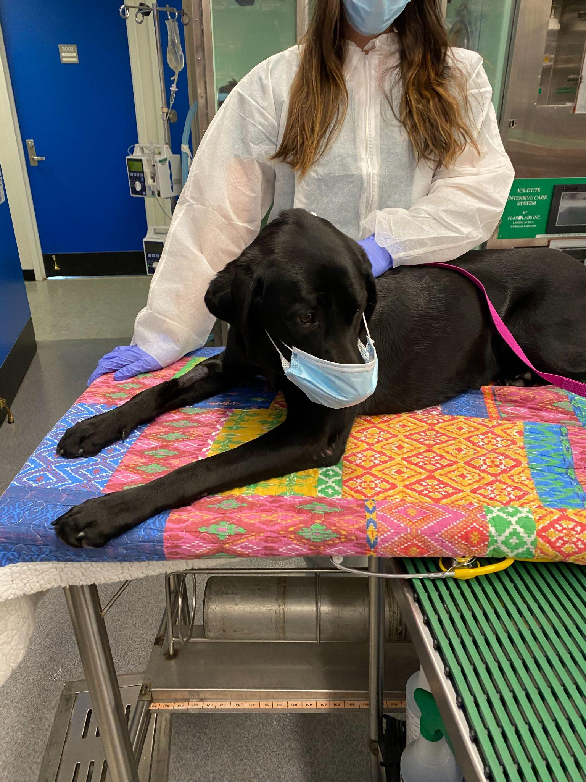
CIRDC - Diagnosis
History
Physical exam
Limited benefit for individual cases
Cytology
Culture and sensitivity
PCR, molecular diagnostics
Notes:
In individual dogs, these respiratory PCR swabs are of limited benefit - all can be isolated in healthy and sick dogs, logistical turnaround is unhelpful, viral shedding peaks early and so depending on when they present it would be nondiagnostic.
More helpful for outbreaks in shelters/kennels.
Three view thoracic radiographs were not mentioned in this section - I usually take 3vCXR to screen for pneumonia before concluding CIRDC

Slide 11
CIRDC - Treatment
Observation
ABX - fever, lethargy, inappetance + mucopurulent nasal discharge
Doxycycline 10mg/kg/day for 7-10 days
Amoxicillin 22mg/kg PO BID for 7-10 days
Amoxicillin-clavulanate 11mg/kg PO BID for 7-10 days
If persistent for 7 days or more, more diagnostics before escalation to fluoroquinolones or azithromycin
Notes:
Majority of cases are viral in etiology - antimicrobials are often not indicated
Most dogs can maintain appetite, energy levels - spontaneous resolution within 10 days without ABX
Bacterial CIRDC suspected in dogs with these clinical signs but WITHOUT pneumonia (crackles/wheezes, CXR) -> empiric doxycycline because of its action against mycoplasma, bordetella
Amoxicillin +/- clavulanic acid can be considered since they have efficacy against secondary bacterial agents such as Pasteurella, Streptococcus, Staphylococcus (clavamox) some anaerobes.
CIRDC not associated with chronic URT disease in dogs, do more of a diagnostic workup if no clinical resolution within 7 days. Do not escalate empirically to fluoroquinolones or azithromycin

Slide 12
Bacterial Bronchitis in Cats and Dogs

Slide 13
Bacterial Bronchitis
Inflammation of the bronchi
Inhaled irritants
Bacterial, viral infections
Heartworm disease
Respiratory parasites
Pharyngeal/esophageal dysfunction
Laryngeal/tracheal dysfunction
Allergies
Secondary to URI/CIRDC
Notes:
Bacterial infecitons - bordetella bronchiseptica, mycoplasma can induce chronic bronchitis or bronchopneumonia
Laryngeal dysfunction - larpar, collapsing airways
Thought to be oral flora colonizing lower airways
Chronic bronchitis in dogs not always associated with large bacterial colonies on BAL wash - not always associated with bacterial infection.

Slide 14
Bacterial Bronchitis - Diagnosis
Physical exam - tracheal/thoracic auscultation
Radiographs - include cervical/intrathoracic trachea
Fluoroscopy, thoracic CT, bronchoscopy
4DX SNAP, serology, fecal flotation, fecal sedimentation, Baermann test
Laryngeal function evaluation
Airway wash + cytology, culture
Notes:
The hallmark clinical sign for bacterial bronchitis in the cat and dog is a cough with or without respiratory distress. In an animal without URI signs but is coughing should have a full diagnostic workup.
Radiographs should include a full view of the trachea, and inspiratory/expiratory rads could be considered to try to evaluate airways in both phases to attempt identification of collapsing airways. Additional diagnostics to consider would be fluoroscopy or thoracic CT.
With radiographic evidence of bronchial disease or suspected with clinical signs, airway washes for cytologic evaluation of airway secretions are indicated to determine type of inflammation present. Mycoplasma culture, aerobic culture + sensitivity can be considered as well
Endotracheal wash is better than bronchoalveolar lavage since BAL washes + brush specimens do not always agree. Neutrophilic inflammation, intracellular bacteria, positive culture with radiographic evidence is gold standard for diagnosis, but trachea is not sterile and so low bacteria cultures and no cytologic evidence of intracellular bacteria should be considered as a negative diagnostic result for bronchitis

Slide 15
Bacterial bronchitis - Treatment
Observation or empiric doxycycline 10mg/kg/day for 7-10 days
Pivot as needed with culture/sensitivity results and clinical picture
Duration - 1 week post resolution
Control primary disease like allergies
Control inflammation to prevent secondary bacterial infections
Notes:
While it would be ideal to wait for culture results, some animals clinical picture requires intervention. The guidelines published the recommend doxycycline as a first line antibiotic.
Duration of treatment is still based on previous experience and not empiric data. Lack of response to therapy may mean primary noninfectious chronic bronchitis.
Most labs do not report antimicrobial susceptibility of Mycoplasma spp cultured, and it’s difficult to culture this bacteria on its own. Doxy, minocycline, fluoroquinolones, azithromycin

Slide 16
Pneumonia

Slide 17
Pneumonia
“Inflammation of the lungs” - combined bacterial insult + pneumonitis clinically
Community acquired pneumonia - 49% Bordetella bronchiseptica
Secondary to viral infections, aspiration, inhalation of foreign bodies, immunodeficiency syndromes, neoplasia, ciliary dyskinesia, bronchiectasis, collapsing airways
Pathogens - E. coli, Pasteurella, Streptococcus, B. bronchiseptica, Enterococcus, Mycoplasma, Staph pseudintermedius, coagulase positive Staph, Pseudomonas
Notes:
In 1 study with 65 puppies under 1 year of age with community acquired pneumonia, 49% had B. bronciseptica. Usually younger and more severely affected dogs in that study.
Aspiration - vomiting, regurgitation, anesthesia recovery, laryngeal paralysis

Slide 18
Pneumonia - Diagnosis
CS - cough, fever, lethargy, inappetance, tachypnea
PE - thoracic and tracheal auscultation, CBC, Thoracic radiographs
Transtracheal, endotracheal, bronchoalveolar lavage
Cytology, aerobic culture + sensitivity, Mycoplasma culture recommended
Consider empiric anaerobic coverage
Consider blood cultures
Investigate primary disease - reason for aspiration, collapsing airways
Notes:
If stable enough for a wash, this should be recommended to the owners before antibiotics are started. ABX should also not be unduly delayed - antimicrobials should be started asap. Blood cultures could be considered if unstable, but there is usually low yield for culture and possible to have false positives.
Anaerobic coverage should be considered - not all labs can culture or provide susceptibility data. Aspiration or grass awn foreign body suspicions raise concerns for anaerobic bacteria.
Be wary of interpretation of culture results for oral or endoscope contaminants (Coagulase negative staph, bacillus, serratia, stenotrophomonas)
Guidelines discuss how aspirated contents can be solely chemical pneumonitis without bacterial components to it and therefore wouldn’t need ABX, but I don’t know how clinically applicable that becomes for our cases.

Slide 19
Pneumonia - Treatment
Empiric parenteral antibiotic - doxycycline, ampicillin +/- sulbactam, cefazolin
Septic patients - parenteral fluoroquinolone + gram positive/anaerobic until culture results available
Some human patients receive glucocorticoids - not recommended currently in vetmed
Duration - historically 4-6 weeks; now re-evaluate 10-14 days after starting ABX
Continue based on clinical, hematological, radiographic findings
Notes:
Doxycycline for Mycoplasma, Bordetella (shelter, boarding environment) and no other clinical signs such as fever, dehydration, lethargy, or respiratory distress are present
Not bactericidal, when would this clinical picture present itself, would doxycycline penetrate extracellular fluid of the lungs?
Strep equi zooepidemicus spp susceptible to penicillin, amoxicillin, ampicillin. Clavamox may be overkill since Strep species are not known to produce beta-lactamases
Aspiration pneumonia - some people in the guidance paperwork said that treatment was not necessary, or start with ampicillin or cefazolin. Dissenters state that the disease can be life threatening and early abx use can be lifesaving.
In septic patients (hypoglycemic, febrile, injected mucous membranes)
SIRS criteria in dogs - T under 100.6, above 102.6*F, HR over 120, RR over 20, WBC under 6k or over 16k, or bands over 3% of total WBC
SIRS criteria in cats - T under 100, above 103.5*F, HR under 140 or over 225, RR over 40, WBC under 5k, above 19.5k, bands above 5% of total WBC
Gram positive/anaerobic coverage - ampicillin, clindamycin
Pneumonitis and inflammatory responses increase pulmonary pathology - some human patients receive steroids to minimize inflammatory damage. Not recommended in vetmed currently for the risk of immunosuppression.

Slide 20
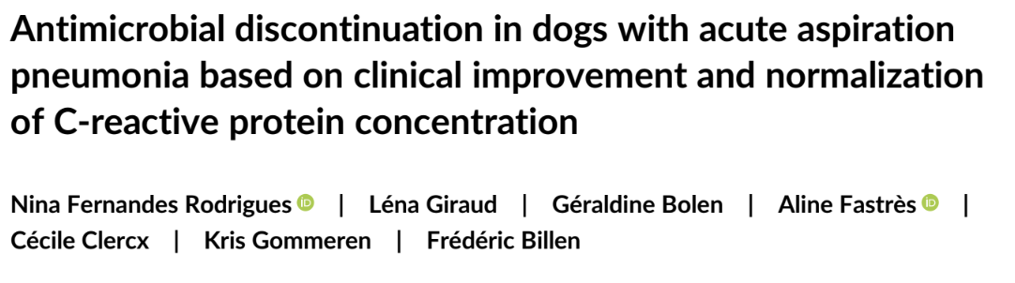
Notes:
As a short aside on this topic, the CUVS journal club recently went over this article about utilizing C-reactive protein in combination with clinical resolution to stop antibiotics. There were 17 dogs that received clavamox; only one dog had enrofloxacin added on. Dogs had abx stopped either at 1, 3, or 5 weeks based on normalization of C reactive protein levels and clinical resolution as reported by owners and physical exam findings. Small study, still needs more information to build off of, but this study found that stopping antibiotics earlier with these goals as checkpoints did not show an increase rate of relapsing aspiration pneumonia.

Slide 21
Pyothorax

Slide 22
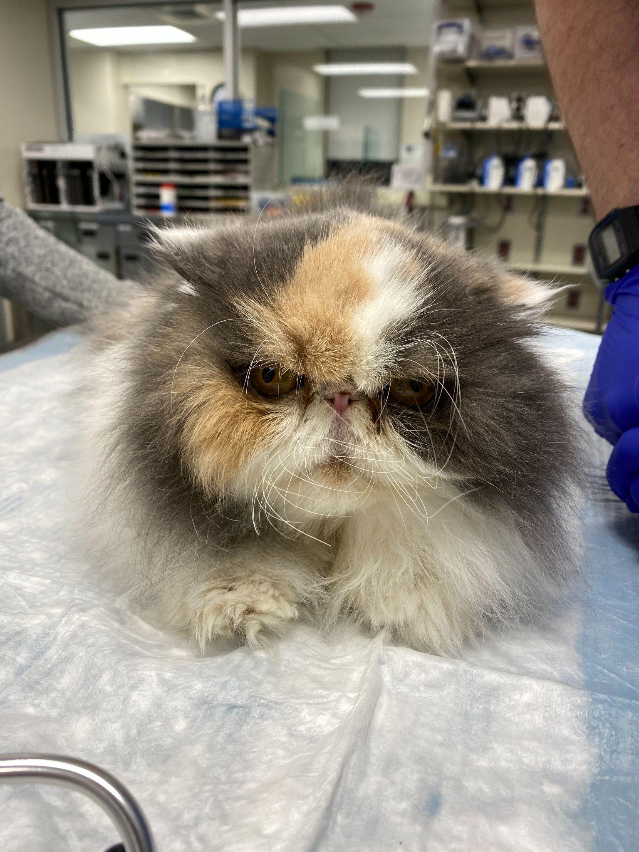
Pyothorax
Cats - oropharyngeal anaerobes (cat bite wounds, URI pathogens)
Dogs - pant foreign material migration, trauma, bite wounds
Notes:
Cats - Fusobacterium, prevotella, Porphyromonas, Bacteriodes, Peptostreptococcus, Clostridium, Actinomycies, Filifactor villosus. Pasteurella, Streptococcus, Staphylococcus
Less commonly Staphylococcus, Mycoplasma, Nocardia, other gram negatives besides Pasteurella, and Rhodococcus equi have been isolated
Dogs - mixed anaerobes(Prevotella, Peptostreptococcus, Propionibacterium acnes, Clostridium spp, Bacteriodes, Fusobacterium) and Enterobacteraceae (E. coli, Klebsiella, Strep canis, Staphylococcus, Enterococcus, Corynebacterium, Bacillus, Trueperella, Pasterella, Acinetobacter, Capnocytophaga, Enterobacter, Stenotrophomonas, Aeromonas, Achromobacter, Serratia, Pseudomonas, Actinomyces, Nocardia, Streptomyces)

Slide 23
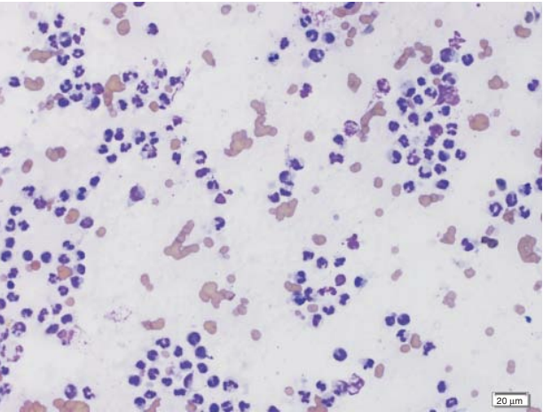
Pyothorax - Diagnosis
Therapeutic/diagnostic thoracocentesis
Septic, suppurative inflammation
Cytology, aerobic/anaerobic mycoplasma culture + susceptibility
Thoracic radiographs
Waddell, L.S. and Puerto, D.A. (2015). Pleural Space Disease: Pyothorax. In Small Animal Surgical Emergencies, L.R. Aronson (Ed.). https://doi.org/10.1002/9781118487181.ch31
Notes:
Radiographs after thoracocentesis should be performed to screen for pulmonary consolidation

Slide 24
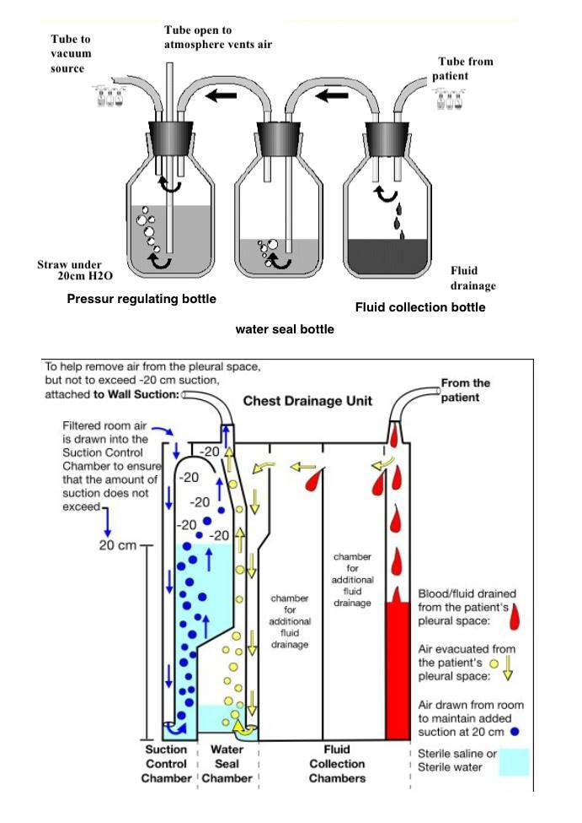
Pyothorax - Treatment
Chest tube placement and lavage
Intermittent or continuous suction
Empiric antibiotics - enrofloxacin + a penicillin/clindamycin
Duration - cats 3 weeks minimum, 4-6
Serial radiographs 10-14 days, and at cessation of ABX
https://www.grepmed.com/images/3385/wallsuction-schematic-pleurevac-waterseal-chesttube
Notes:
You need anaerobic coverage for a pyothorax.
How a Chest Tube Drainage System Works
Bottle 1: Fluid Collection. This is a simple collection bottle that connects directly to your chest tube. Look here to see how much blood you’ve collected from your hemothorax, or fluid from your pleural effusion, or pus from your empyema.
Bottle 2: Water Seal. This is a more complicated setup that allows you to detect air from your pneumothorax (or from a leak due to equipment failure).
Bottle 3: Suction Control. This is the fanciest bottle of all, and includes a manometer that allows you to deliver controlled suction through your chest tube.

Slide 25
References
Lappin MR, Blondeau J, Boothe D, Breitschwerdt EB, Guardabassi L, Lloyd DH, Papich MG, Rankin SC, Sykes JE, Turnidge J, Weese JS. Antimicrobial use Guidelines for Treatment of Respiratory Tract Disease in Dogs and Cats: Antimicrobial Guidelines Working Group of the International Society for Companion Animal Infectious Diseases. J Vet Intern Med. 2017 Mar;31(2):279-294. doi: 10.1111/jvim.14627. Epub 2017 Feb 10. PMID: 28185306; PMCID: PMC5354050.
Fernandes Rodrigues N, Giraud L, Bolen G, Fastrès A, Clercx C, Gommeren K, Billen F. Antimicrobial discontinuation in dogs with acute aspiration pneumonia based on clinical improvement and normalization of C-reactive protein concentration. J Vet Intern Med. 2022 Mar 29. doi: 10.1111/jvim.16405. Epub ahead of print. PMID: 35348224.
Waddell, L.S. and Puerto, D.A. (2015). Pleural Space Disease: Pyothorax. In Small Animal Surgical Emergencies, L.R. Aronson (Ed.). https://doi.org/10.1002/9781118487181.ch31
https://www.grepmed.com/images/3385/wallsuction-schematic-pleurevac-waterseal-chesttube

