Slide 1
Anatomy & Physiology of the GI, Pancreas, & Hepatobiliary Tract
Katie Sotos, DVM, ECC Resident
September 23, 2021

Slide 2
Gastrointestinal Tract
Function and Activities

Slide 3
Digestion and Absorption of Nutrients
Motility
  Ingested food: mouth → rectum
  Mixes and decreases food size to optimize time for digestion and absorption
Secretions
  Salivary glands, pancreas, liver, gall bladder
  Fluid, electrolytes, enzymes, mucous
Digestion
Absorption
  Nutrients, electrolytes, water
  Into bloodstream

Slide 4
Gastrointestinal Tract
Structure
Innervation

Slide 5
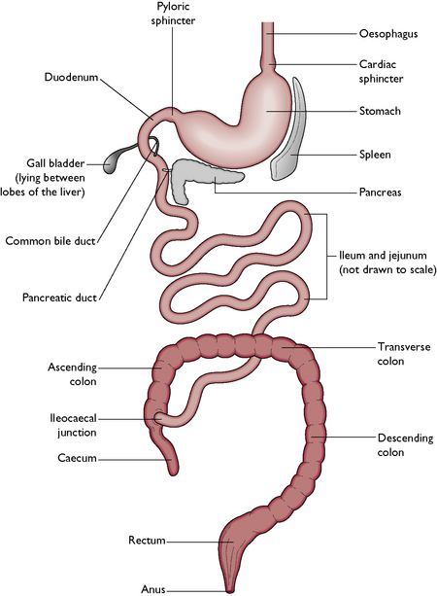
Gross
Anatomy
Mouth
Notes:
Secretory portions: salivary glands, pancreas, liver, gall bladder
Photo Source: https://veteriankey.com/digestive-system/

Slide 6
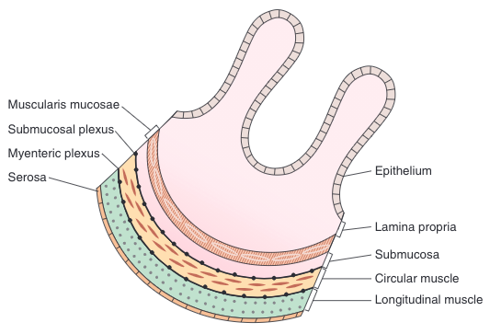
Wall Layering
Notes:
1) Mucosal layer contains:
Epithelial cells: specialized for absorption and secretion
Lamina propria: connective tissue, blood vessels, lymph vessels
Muscularis mucosae: smooth muscle, crontraxtion of which changes the shape of epithelial layer
2) Submucosal layer: collagen, elastin, glands, BVs
3) Submucosal plexus
4) Circular muscle: thick, densely innervated (neurons do not synapse in the GI smooth muscle fibers, but release transmitters from varicosities)
5) Myenteric plexus
6) Longitudinal muscle: thin, few nerve fibers (neurons do not synapse in the GI smooth muscle fibers, but release transmitters from varicosities)

Slide 7
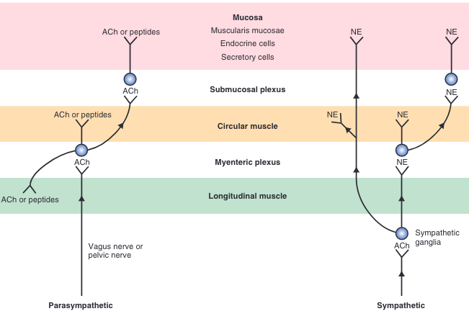
Extrinsic Nervous System
Notes:
Autonomic Nervous System
Extrinsic
SNS
PNS
Intrinsic/enteric
Contained within the submucosal and myenteric plexuses in the wall of the GIT
Communications with SNS and PNS
Parasympathetic Nervous System
Supplied by vagus nerve (CN X) and pelvic nerve
Vagus: innervates upper GIT (i.e. striated muscle of upper 1/3 esophagus, wall of stomach, SI, ascending colon, portion of transverse colon
Vagus: 75% afferent, 25% efferent
Pelvic: innervates lower GIT (i.e. transverse, descending, and sigmoid colon)
Long pre-ganglionic fibers that synapse near or in target organs in ganglia (i.e. in myenteric or submucosal plexus)
Postganglionic neurons are cholinergic (release ACh) and peptidergic (release peptides, i.e. substance P, VIP, others)
Sympathetic Nervous System
Preganglionic fibers are short and synapse outside of the GIT
Sympathetic ganglia: 1) celiac, 2) superior mesenteric, 3) inferior mesenteric, 4) hypogastric
Postganglionic fibers: adrenergic (release NE) and leave sympathetic ganglia to synapse on ganglia in myeneric and submucosal plexuses or directly on smooth muscle, endocrine cells, or secretory cells
50% afferent, 50% efferent

Slide 8
Explain the Vasovagal Reflex,
Provide Examples
Reflex in which both the afferent and efferent limbs are contained within the vagus nerve
Examples: receptive relaxation, potentiation of CCK-stimulated pancreatic acinar cell secretion

Slide 9
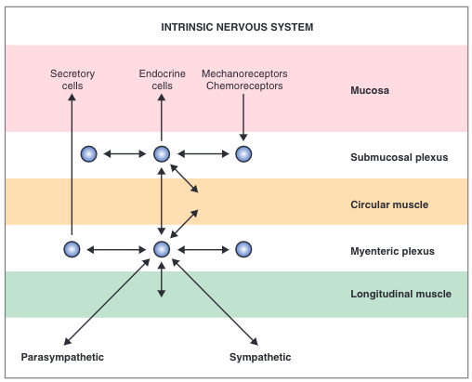
Intrinsic Nervous System
Notes:
Can direct all of the functions of the GIT even without extrinsic innervation
Controls contractile, secretory, and endocrine functions of the GIT
Gets input from SNS and PNS to modulate
Located within myenteric and submucosal plexuses
Sensory: from mechanoreceptors and chemoreceptors in mucosa
Sends info directly to target cell through interneurons

Slide 10
What are neurocrines?
Neurochemicals of the enteric nervous system
Some neurotransmitters, some neuromodulators
Most enteric neurons contain >1 and may cosecrete 2 or >

Slide 11
Gastrointestinal Tract
Regulatory Substances

Slide 12
What is being regulated?
Contraction and relaxation of smooth muscle wall and sphincters
Secretion of digestive enzymes
Secretion of fluid and electrolytes
Trophic effects on GIT tissues
Secretion of other GI regulatory substances
Notes:
Trophic means “growth”

Slide 13
Categories of GI Peptides
Hormones
Paracrines
Neurocrines
Released from GIT endocrine cells
Secreted into portal circulation, thru the liver → systemic circulation → target cells
Secreted by GIT endocrine cells
Act locally, within same tissue that secretes them
  Diffuse through interstitial fluid
  Carried short distances via capillaries
From GIT neurons
Released after action potential
Diffuse across synapse and act on target cell
Notes:
To be a hormone, must:
Be secreted in response to physiologic stimulus and be carried in the bloodstream to a distant site where physiologic action is produced
Function must be independent of any neural activity
Must have been isolated, purified, chemically identified, and synthesized

Slide 14
GI Hormones
Hormone | Structure | Stimulus | Inhibited by | Secreted from | Action
Gastrin
Cholecystokinin (CCK)
Secretin
Glucose-Dependent Insulinotropic Peptide (GIP)
G₁₇ (little gastrin)
G₃₄ (big gastrin)
C-terminal tetrapeptide
Small peptides and aa’s from ptn digestion
Gastric food distention
Vagal stim. through GRP
Low gastric pH
Somat-ostatin
G cells in gastric antrum
H⁺ secretion from parietal cells
Gastric mucosa growth
33-aa
C-terminal heptapeptide
Monoglycerides & fatty acids
Small peptides & aa’s
I cells of duodenal & jejunal mucosa
Contract GB, relax sphincter of Oddi
Secrete pancreatic enzymes & HCO₃⁻
Inhibits gastric emptying
Growth of exocrine panc & GB
27-aa
Tertiary form, αhelix
H+ & fatty acids in SI
SI chyme pH < 4.5
S cells of duodenum
Secrete pancreatic and biliary HCO₃⁻
Inhibits gastrin effect on parietal cells
42-aa
Glucose, aa, fatty acids
K cells of duodenal & jejunal mucosa
An incretin
Inhibits gastric H⁺ secretion
Inhibits gastric emptying
Notes:
Gastrin
G17: secreted in response to a meal
G34: interdigestive period
C-terminal tetrapeptide: minimum required for biologic activity
GRP: gastrin-releasing peptide (bombesin), a neurocrine
CCK
Member of the gastrin-CCK family
Has the same C-terminal tetrapeptide as gastrin, so has some gastrin activity
Secretin
Structurally analogous to glucagon, member of the secretin-glucagon family
All aa required for biologic activity
Pancreatic and biliary HCO3 neutralize H+ in SI lumen, which is required for fat digestion
Pancreatic lipase works best @ pH between 6-8; denatured when pH < 3
Glucose-Dependent Insulinotropic Peptide (GIP)
Member of secretin-glucagon family
9 aa = same as secretin → pharmacologic levels of GIP cause secretion’s actions
16 aa = same as glucagon
Incretin: stimulates insulin secretion (from pancreatic Beta cells)
Oral glucose load is used by cells more rapidly b/c an oral glucose load will lead to GIP secretion and direct Beta cell stimulation vs. IV glucose ONLY leads to direct Beta cell stimulation

Slide 15
GI Candidate/Putative Hormones
What does this mean?
Fail to meet one or more of the criteria necessary to be classified as “official” gastrointestinal hormones
Hormone | Structure | Stimulus | Secreted from | Action
Motilin
Pancreatic Polypeptide
Esteroglucagon
Glucagon-like peptide 1 (GLP-1)
22-aa
Fasting
Upper duodenum
Promotes gastric motility to initiate interdigestive myoelectric complexes q 90 min
36-aa
CHO, lipid, protein ingestion
Pancreas
Inhibits pancreatic secretion of HCO₃⁻ and enzymes
Hypoglycemia
Intestinal cells
Stimulates liver to increase glycogenolysis and gluconeogenesis
selective cleavage of proglucagon
L cells of small intestine
An incretin
Inhibits glucagon secretion
Increases pancreatic cell sensitivity to secretagogues
Delays gastric emptying
Increases satiety/decreases appetite
Notes:
Putative because they fail to meet one or more of the criteria necessary to be classified as “official” gastrointestinal hormones

Slide 16
GI Paracrines
Somatostatin
Histamine
Secreted by: D cells of GI mucosa
Stimulus: Decreased luminal pH
Action:
  Inhibits secretion of GI hormones
  Inhibits gastric H+ secretion
Secreted by: Enterochromaffin-like cells (ECL) of gastric mucosa, especially in H+ secreting portion of stomach
Action: H+ secretion by the parietal cells
Notes:
Secreted by GIT endocrine cells
Act locally, within same tissue that secretes them
Diffuse through interstitial fluid
Carried short distances via capillaries

Slide 17
GI Neurocrines
ACh -- cholinergic
Norepinephrine -- adrenergic
Non-cholinergic parasympathic /peptidergic neurons
  Vasoactive Intestinal Peptide (VIP)
  Gastrin-releasing Peptide (GRP)
  Enkephalins
  Neuropeptide Y
  Substance P

Slide 18
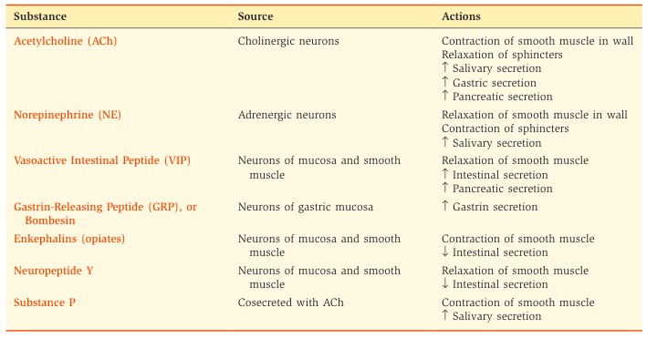
GI Neurocrines

Slide 19
Satiety
Arcuate nucleaus of hypothalamus
Satiety Center
Feeding center
Inhibits appetite in presence of food
In ventromedial nucleus (VPN) of hypothalamus
In lateral hypothalamic area (LHA)
Anorexigenic neurons
Pro-opiomelanocortin (POMC)
Orexigenic neurons
Peptide Y
Leptin
Insulin
GLP-1
Peptide YY (PYY)
Grehlin
Notes:
Leptin
Secreted by fat cells in proportional amount to fat stored in adipose tissue
Stimulates anorexigenic, inhibits orexigenic to decrease appetite and increase energy expenditure
Chronic/long-term effects to decrease appetite because it detects stored body fat
Insulin
Stimulates anorexigeic, inhibits orexigenic thereby decreasing appetite
Fluctuates throughout the day
Short-term effects
GLP-1 (Glucagon-like peptide 1): decreases appetite
Peptide YY (PYY)
From intestinal L cells
Decreases appetite through direct hypothalamic action
Decreases appetite through decreasing grehlin secretion
Grehlin
Secreted by gastric cells before eating a meal
Stimulates orexigenic, inhibits anorexigenic, thereby increasing appetite
Weight loss and starvation stimulate grehlin secretion

Slide 20
Gastrointestinal Tract
Motility
Types of Contractions and Slow Waves

Slide 21
Unitary Smooth Muscle
Cells are electrically coupled via gap junctions
  Low resistance pathways
  Rapid cell-to-cell action potential spread
All smooth muscle of GIT is like this
Notes:
Yields a coordinated contraction

Slide 22
Types of Contractions
Phasic
Tonic
Periodic contraction followed by relaxation
Goal: mixing and propulsion
Location: esophagus, gastric antrum, small intestinae
Constant level of contraction without regular periods of relaxation
Location: upper part of stomach, LES, ileocecal sphincter, internal anal sphincter

Slide 23
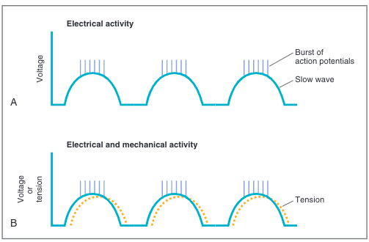
Slow Waves
What are they?
Oscillating depolarization and repolarization of smooth muscle cell membrane potential
Notes:
NOT action potentials
Oscillation
Depolarization: membrane potential becomes less negative and moves closer to threshold
Repolarization: membrane potential becomes more negative and moves away from the threshold
If membrane potential during depolarization occurs all the way to the threshold, an action potential will occur “on top of” the slow wave
Bottom graph shows mechanical action occurring after the electrical response
Frequency varies based on location in GIT
Stomach: 3 slow waves/minute
Duodenum: 12 slow waves/minute
Sets frequency of action potential

Slide 24
Slow Waves
Origin
Mechanism
Interstitial cells of Cajal
  In myenteric plexus
  Pacemaker cells of GIT
Spread by gap junctions
Depolarization: cyclic opening of Ca²⁺ channels => inward Ca²⁺ current
Plateau: Ca²⁺ channels open => inward Ca²⁺ current tp maintain membrane potential
Repolarization: K⁺ channels open=> outward K⁺ current
Notes:
Even subthreshold, waves => weak contractions: basal/tonic contractions
If slow waves depolarize to the threshold, AP occurs on top of slow wave => stronger/phasic contraction
Smooth muscle contractions summates to 1 movement/contraction, not a twitch

Slide 25
Gastrointestinal Tract
Motility
Chewing and Swallowing/Esophagus

Slide 26
Chewing
Function
  Mixes food w/ saliva
    Lubricates
    Facilitates swallowing
  Decreases food particle size
    Facilitates swallowing
Voluntary vs. Involuntary Components
  Voluntary can override
  Involuntary
    Reflex started by food in mouth
    Sensory info from oral mechanoreceptors → brainstem => reflex oscillatory pattern
Notes:
In humans, chewing mixes CHO and salivary amylase for digestion, but veterinary species DO NOT HAVE salivary amylase

Slide 27
Swallowing
Oral Phase
Voluntary
Tongue moves food → pharynx
Pharyngeal Phase
Involuntary
Propels food to esophagus
Esophageal Phase
Involuntary: swallowing reflex and enteric nervous system
Sends food from esophagus to stomach
Somatosensory receptors → vagus & glossopharyngeal → medulla
Soft palate pulls upward, epiglottis covers laryngeal opening, UES relaxes, peristalsis
Swallow reflex closes UES, 2 peristaltic waves
Notes:
Voluntarily initiated, then involuntary reflex controlled by swallowing center in the medulla
Sensed by: somatosensory receptors in pharynx→ medulla via vagus nerve and glossopharyngeal nerve
Medulla coordinates and directs motor to striated muscle of pharynx, upper esophagus
Pharyngeal Phase
Soft palate pulls upward => narrow passage for food to get through the pharynx and NOT the nasopharynx
Epiglottis moves to cover laryngeal opening and larynx moves up against it
UES relaxes => pharynx → esophagus
Peristaltic wave of contraction through pharynx => food goes through open UES
NO BREATHING DURING THIS PROCESS
Esophageal Phase
Swallow reflex closes UES to prevent reflux
1st peristaltic waves: swallow reflex, travels down esophagus
If 1st was not enough, 2nd peristaltic wave is generated by enteric NS

Slide 28
Esophageal Motility
1
UES opens, then closes once food through
2
Primary peristaltic contraction
3
LES opens + stomach goes through receptive relaxation
4
Each segment contracts => high pressure behind bolus
Accelerated by gravity
LES mediated by peptidergic fibers in vagus nerve, releasing VIP
LES contracts and returns to high resting tone once food in stomach
Secondary peristaltic contraction if primary not sufficient
Notes:
Problems posed by the intrathoracic location of esophagus:
Intraesophageal pressure = intrathoracic presssure, which is < atm, so < intra-abdominal pressure
Difficult to keep air out of upper esophagus: UES’ job (P = 50 mmHg)
Difficult to keep gastric acid contents out of lower esophagus: LES’ job (P = 20 mmHg)
If abdominal pressure increases (i.e. pregnancy, obesity), can make pt more prone to gastroesophageal reflux

Slide 29
Gastrointestinal Tract
Motility
Stomach

Slide 30
Gastric Motility
1
2
Contractions
3
Gastric emptying
Receptive relaxation
Decreases pressure and increases volume of oral stomach
Vasovagal reflex: VIP-mediated
Decrease bolus size
Mix bolus w/ gastric secretions to start digestion
Neural and hormonal input
PNS, gastrin, motilin: increase APs and force
SNS, secretin, GIP: decrease APs and force
Controlled by hormones to ensure time for:
H⁺ neutralization – sensed in duodenum by enteric NS
Digestion and absorption in small intestine – fat in duodenum stimulates CCK to slow gastric emptying
Notes:
2) Contractions
Start in the middle of the body of the stomach and move distally, getting more vigorous as pylorus is approached
Periodically propels food towards the pylorus, which is normally closed due to the contraction wave => retropulsion
During fasting, motilin mediates q 90 min migrating myoelectric complexes to clear stomach of remaining residue
3) Gastric Emptying: Liquids empty faster than solids; isotonics empty faster than hyper/hypotonics

Slide 31
Gastrointestinal Tract
Motility
Small Intestine

Slide 32
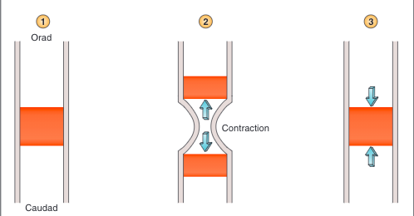
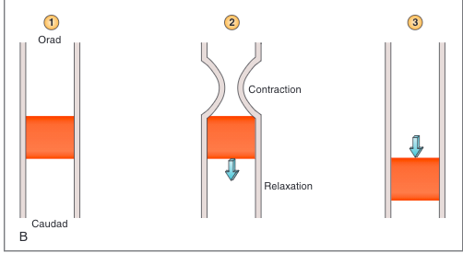
Types of Contractions
Segmental
Mix chyme, exposing it to pancreatic enzymes and secretions
Peristaltic
Propel chyme from small intestine to large intestine
Circular and longitudinal muscles function oppositely, complementing each other; reciprocally innervated to avoid interference
Notes:
Duodenum: 12 slow waves/ min vs. ileum: 9 slow waves/minute
Also has migrating myoelectric complexes q 90min
PNS via vagus nerve: increases contraction through ACh and peptidergic (VIP, enkephalins, molitin)
SNS: decreases smooth muscle activity
Contraction is coordinated by enteric nervous system
Segmental:
Contractions split chyme and send it orad and aborad
When relaxes, chyme comes back together
No propulsive movement
Peristaltic:
Contraction is orad to bolus, relaxation aborad to bolus => bolus moves aborad
Repeats this sequence

Slide 33
Peristalsis
Enterochromaffin cells (SI mucosa) sense food bolus in SI lumen → release 5-HT (5-hydrocytrypatmine/serotonin)
Serotonin binds to receptor on intrinsic primary afferent neurons (IPANs) → peristaltic reflex activated
  Orad to bolus: excitatory nts (ACh, Substance P, Neuropeptide Y) target circular mm and inhibit longitudinal mm → narrowing and lengthening segment
  Aborad to bolus: inhibitory pathways (VIP, nitrous oxide) to circular mm and excitatory to longitudinal mm → widen and shorten segment

Slide 34
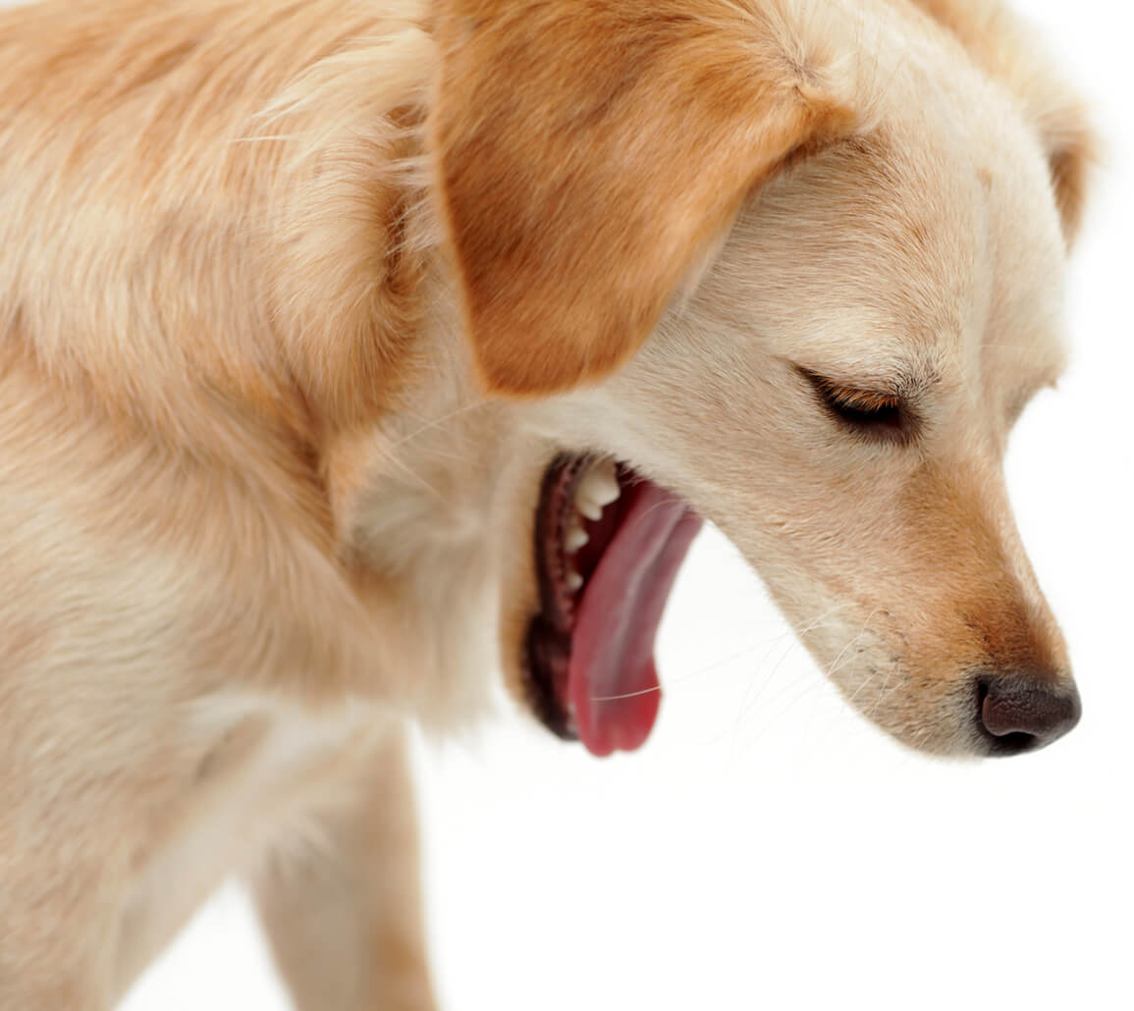
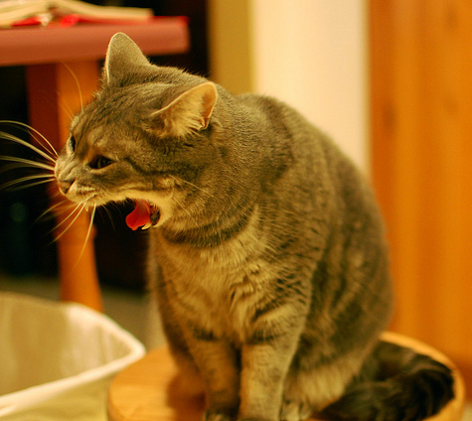
Vomiting
Reflex coordinated by vomiting center in medulla
Afferent: vestibular center, back of throat, GIT, chemoreceptor trigger zone in 4th ventricle
Sequence:
  Reverse SI peristalsis
  Stomach + pylorus relax
  Forced inspiration increases abdominal pressure
  Larynx moves up and forward, LES relax
  Glottis closes
  Forceful expulsion of gastric +/- duodenal contents
Notes:
Retching is the same thing, but the glottis is closed so the stomach contents return to the stomach after the retch
Dog Photo Source: https://dogs.lovetoknow.com/wiki/Dog_Regurgitation_Problems
Cat Photo Source: https://veterinaryhub.com/vomiting-in-cats/

Slide 35
Gastrointestinal Tract
Motility
Large Intestine

Slide 36
Segmental Contractions
Mass Movements
Cecum and proximal colon
Mix contents of large intestine
Assoc. w/ saclike segments, haustra
Moves contents over large distance
1-3 per day
H₂O absorbed in distal colon, so feces here is dry and harder to move
Final mass movement: feces → rectum for storage until actively expelled
Defecation
Smooth muscle of rectal wall contracts
Rectosphincteric reflex: internal anal sphincter relaxes
Valsalva maneuver: expiring against closed glottis to increase abdominal pressure
Gastrocolic Reflex
Distention of stomach by food increases colonic motility and frequency of mass movement
Long arc
Afferent: in stomach, PNS
Efferent: in colon, CCK, gastrin
Notes:
No defecation until EXTERNAL anal sphincter relaxes (under voluntary control, striated muscle); urge occurs once rectum ~ 25% full

Slide 37
Gastrointestinal Tract
Secretion
Saliva

Slide 38
Salivary Secretion
Function
Structure
Dilution and buffering foods which may be harmful
Lubricating ingested food to aid passage through esophagus
HUMANS: begin starch digestion w/ amylase
Begin lipid digestion by enzymes
Parotid
  Serous
  Secrete: aqueous fluid w/ ions, enzymes
Submandibular, sublingual
  Mixed serous and mucous
  Secrete: aqueous and mucin glycoprotein
High blood flow which increases when production stimulated
Innervated by PNS > SNS

Slide 39
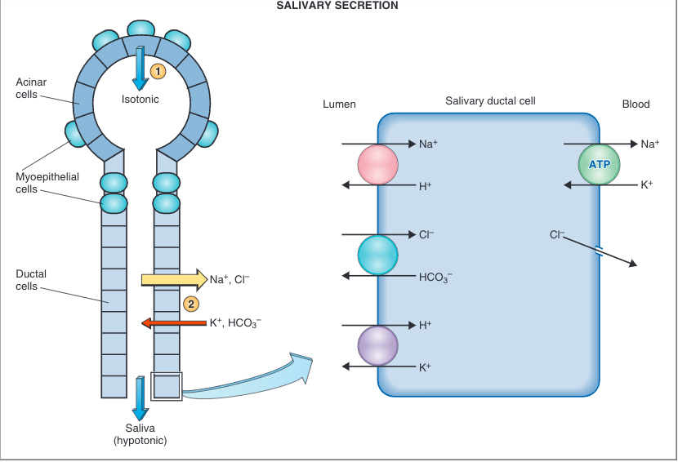
Salivary Structure + Secretion
Identify and describe the function of the different cells
Acinar cells: produce and secrete isotonic saliva, enzymes
Ductal cells: modify saliva by altering electrolytes → hypotonic
Myoepthelial cells: eject saliva into mouth
Notes:
Bunch of grapes, each with single acinus lined by acinar cells which produce initial saliva of H2O, ions, enzymes, including alpha-amylase (only in humans), lingual lipase, kallikrein, and mucous
Alpha amylase: digestion of CHO
Lingual lipase: lipid digestion
Mucin glycoproteins: lubricant
IgA
Kallikrein: cleaves high molecular weight kininogen to bradykinin => local vasodilation and increase in blood flow to salivary glands during production/secretion of saliva
Passes through short segment (intercalated duct) and then striated duct lined with ductal cells which modify saliva to final saliva by altering electrolytes
Specifically, ductal cells absorb Na and Cl and secrete K and HCO3
More NaCl is absorbed than KHCO3 secreted, so there is net absorption of solute
Ductal cells are relatively impermeable to water, so final saliva is hypotonic to plasma
Myoepithelial cells within acini and intercalated duct contract to eject saliva into the mouth
Flow rate
Highest flow rate (4 L/min)→ saliva is more isotonic to plasma because more of the saliva is acinar
Lowest flow rate (< 1 L/min)→ saliva is the most dissimilar to plasma
HCO3 does not follow this rule: at highest flow rates, concentration of HCO3 will be the highest and vice versa at the lowest because HCO3- secretion is under selective secretion by the PNS

Slide 40
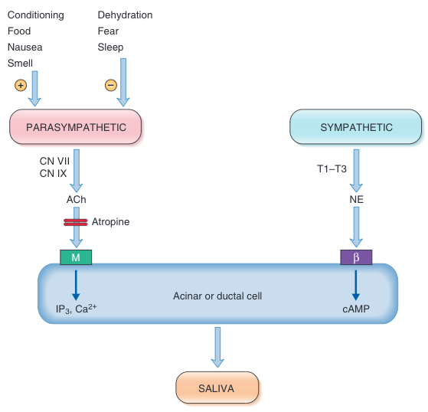
Salivary Secretion Regulation
Notes:
Innervation: autonomic nervous system ONLY
PNS controls volume and enzymatic component (increases)
IP3: inositol 1,4,5-triphosphate
SNS/cAMP increases salivary secretion
T1-T3: superior cervical ganglion

Slide 41
Gastrointestinal Tract
Secretion
Gastric

Slide 42
HCl
Mucus
Gastric Juice
Pepsinogen
(Intrinsic Factor)
Begin protein digestion
Protects mucosa from corrosive HCl and lubricates contents
Required for Vitamin B12 absorption in ileum

Slide 43
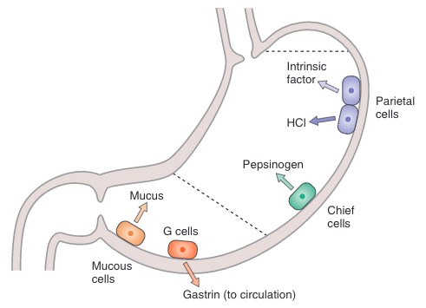
Gastric Mucosa Cell Types, Structure, and Function
Identify and describe the function of the different cells
Oxyntic glands: empty contents into lumen via ducts at gastric pits lined with epithelium
1. Parietal (oxyntic) cells
1
2. Chief (peptic) cells
Pyloric glands: similar to oxyntic, deeper pits
2
3. G cells
3
4. Mucous cells
4
Notes:
Parietal cells secrete HCl and instrinsic factor
SPECIES DIFFERENCE: Canine pancreas is the major source of intrinsic factors vs. Feline exocrine pancreas is the ONLY source of intrinsic factor; humans = stomach
2. Peptic/Chief cells secrete pepsinogen
- When gastric pH is lowered by H+ secretion from parietal cells, pepsinogen converts to pepsin to begin the process of protein digestion
- Cephalic and gastric phases
- Stimulus: vagal stimulation
- H+ => local reflexes => chief cells secrete pepsinogen
3. Third type of oxyntic cell is a mucous neck cell

Slide 44
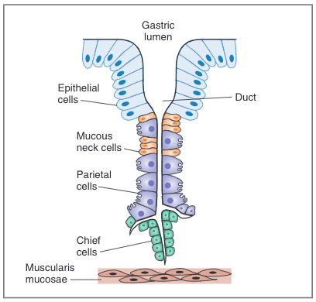
Oxyntic Gland

Slide 45
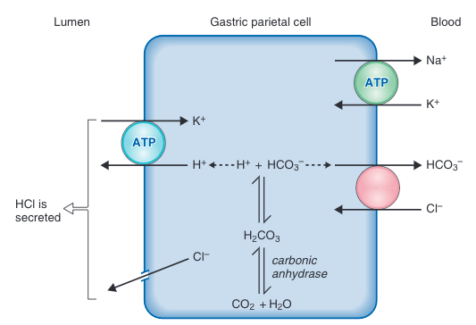
HCl Secretion
Cellular Mechanism
Intracell., CO (anaerobic metabolism) + H₂O
H+ secreted w/ Cl- into lumen via H-K-ATPase
Cl⁻ follows H⁺ into lumen via diffusion through Cl⁻ channels
HCO₃⁻ absorbed into bloodstream with Cl- via Cl-HCO₃ exchanger
Net: Secretion HCl, absorption HCO₃⁻
Notes:
HCl acidifies gastric contents to pH 1-2 to convert inactive pepsinogen to active pepsin
Gastric parietal cells contain carbonic anhydrase
Absorbed HCO3- causes an alkaline tide in gastric venous blood (eventually secreted back into GIT via pancreatic secretions)

Slide 46
Stimulation of HCl Secretion + Rate Control
Substance | Secreted from | MOA | Inhibited/Blocked by
Histamine (paracrine)
ACh (neurocrine)
Gastrin (hormone)
Enterochromaffin-like (ECL) cells in gastric mucosa
Binds to parietal cells at H2 receptor
Coupled to adenylyl cyclase by G ptn => cAMP activation (2nd messenger) => protein kinase A => H+ secretion from parietal cell
Famotidine, Ranitidine, Cimeditine
Vagus nerve
Muscarinic receptor (M₃) on parietal cell => phospholipase C => diaglycerol + IP₃, Ca²⁺ (2nd messengers) =? Activate protein kinases => H+ secretion from parietal cell
Binds to ECL
Atropine
G cells in pyloric antrum
Secreted into circulation --> binds to CCK_{B} receptor on parietal cell => IP3 + Ca2+
Binds to ECL
Notes:
ACh:
IP₃ is from membrane phospholipids; Ca²⁺ is released from intracellular stores
Blocked by anti-cholingergics
Gastrin:
- Released in response to gastric distention, small peptides, amino acids, and vagus nerve stimulation
- CCK_{B} receptor binds gastrin and CCK; CCK_{A} receptor only binds CCK

Slide 47
Stimulation of HCl Secretion + Rate Control
Potentiation
Phases of HCl Secretion
Cephalic phase
  30%
  Stimuli: smelling, tasting, conditioning
  MOA: direct vagus (ACh) and indirect vagus (G cells)
Gastric phase
  60%
  Stimuli: distention, aas, small peptides, alcohol caffeine
  MOA: direct/indirect vagus, gastrin release
Intestinal phase
  10%
  Mediated by products of ptn digestion
Ability of two stimuli to produce a combined response > sum of individual responses
Each substance stimulates H⁺ secretion via different receptor and different 2nd messenger
Gastrin and ACh stimulate histamine release from HCl cells and induce H⁺ secretion by 2nd, indirect route
  H₂ blockers have > effect than atropine (i.e.)
Notes:
Because Atropine does not block the G cell stimulation of the vagus nerve

Slide 48
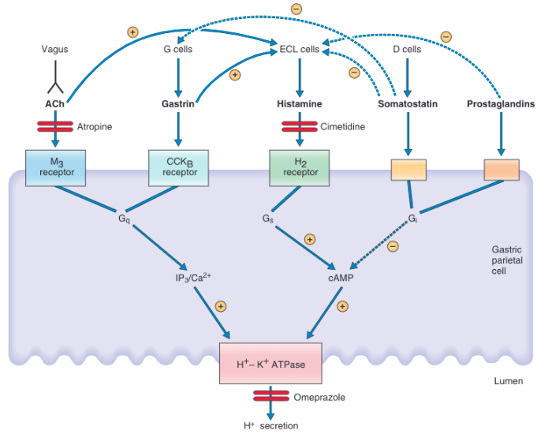

Slide 49
Inhibition of HCl Secretion
Inhibitory Factor | MOA
Low pH of gastric contents
Somatostatin (paracrine)
Prostaglandins
Food is buffer for HCl
Direct: binds to receptor on parietal cell coupled to adenylyl cyclase via G_{i} protein => G_{i} activation => inhibits adenylyl cyclase => reduced cAMP
Indirect:
  Inhibits histamine
  Inhibits gastrin
G_{i} activation
Notes:
Low gastric pH: Food is a buffer for HCl, so when there is no food, gastric contents are more acidic because the buffer is gone and the stomach therefore no longer needs for HCl because there is nothing to digest

Slide 50
Skipped Topics
Peptic Ulcer Disease
  Gastric Ulcers
  Duodenal Ulcers
  Zollinger-Ellison syndrome (gastrinoma)
Pepsinogen Secretion
Intrinsic Factor secretion

Slide 51
Gastrointestinal Tract
Secretion
Pancreatic

Slide 52
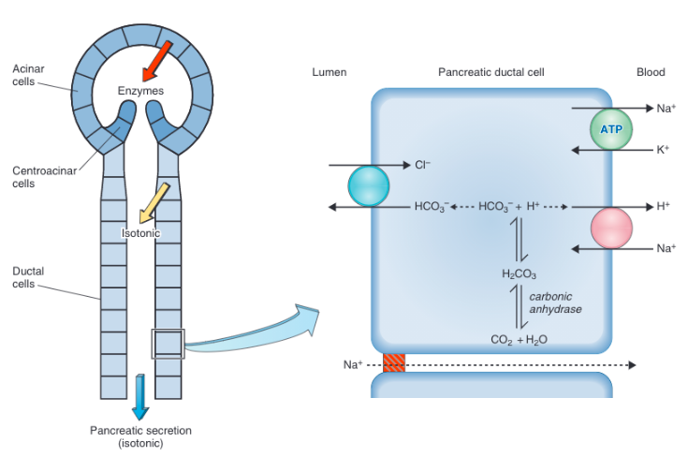
Pancreatic Function, Structure and Secretion
Identify and describe the function of the different cells
Acinar cells: secrete enzymatic portion
Centroacinar cells: secrete aqueous, HCO₃⁻ portion, present in acinus
Ductal cells: secrete aqueous, HCO₃⁻ portion
Overview of Pancreatic Functions:
Secrete enzymes for digestion of CHO, ptn, lipids
Neutralize H+ in duodenal chyme
Notes:
Exocrine pancreas secretes 1L fluid/d into the duodenum
Secretion:
Aqueous component (high in HCO3-) → neutralizes H+ delivered to the duodenum from the stomach
Enzymatic component → digestion of CHO, protein, lipids
Structure of Exocrine Pancreas
90% of pancreas is exocrine, 2% endocrine, then blood vessels and interstitial fluid
Similar to a salivary gland, exocrine pancreas is a bunch of grapes with a single acinus to each grape
Acinus lined with acinar cells which secrete enzymatic portion
Acinus: blind end of the ductal system
Duct lined with ductal cells which extend into a special region of centroacinar cells in acinus: all secrete aqueous, HCO3- component

Slide 53
Formation of Pancreatic Secretion
Enzymatic
Amylase + lipase: secreted active
Proteases: secreted inactive and activated in duodenum
Enzymes: made in rough ER of acinar cells → Golgi apparatus → condensing vacuoles → concentrated in zymogen granules
Notes:
- Stored in zymogen granules until secretion is triggered (i.e. CCK, PNS stimulation)

Slide 54
Formation of Pancreatic Secretion
Aqueous
Isotonic solution to plasma (Na⁺, Cl⁻, K⁺, HCO₃⁻)
  Na⁺, Cl⁻ = plasma
  K⁺, HCO₃⁻ vary with flow rate
Net: HCO₃⁻ secretion → pancreatic ductal juice; H⁺ absorption → pancreatic blood vessel acidification
Notes:
Apical membrane of ductal cells contains a Cl-HCO3 exchanger
Basolateral membrane contains Na-K ATPase and Na-H exchanger
In the presence of carbonic anhydrase, CO2 and H2O combine in the cells to form H2CO3, which then dissociates into H+ and HCO3
HCO3− is secreted into pancreatic juice by the Cl-HCO3 exchanger in the apical membrane
The H+ is transported into the blood by the Na-H exchanger in the basolateral membrane
The net result, or sum, of these transport processes is net secretion of HCO3− into pancreatic ductal juice and net absorption of H+; absorption of H+ causes acidification of pancreatic venous blood
At high flow rates, pancreatic juice HCO3 concentration is the highest and Cl is the lowest

Slide 55
Pancreatic Secretion Regulation
Phases
Cephalic
Intestinal
Stimulus: smell, taste, conditioning
Causes enzymatic secretion
80%
Both enzymatic and aqueous secretion
Gastric
Stimulus: gastric distention
Mediated by: vagus nerve
Causes enzymatic secretion
3
2
1
Notes:
Intestinal phase: accounts for 80% of pancreatic secretion

Slide 56
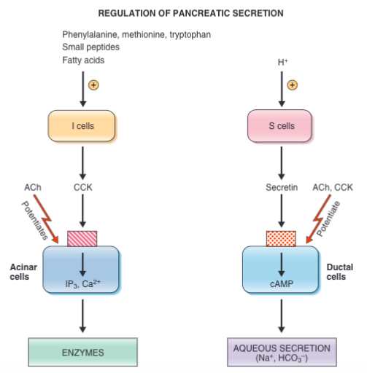
Pancreatic Secretion Regulation
Substances
Notes:
Substances:
Acinar cells
CCK_{A} receptors (**most important**) and muscarinic receptors
I cells are stimulated to secrete CCK by presence of amino acids, small peptides, and fatty acids in the intestinal lumen
Most potent amino acids: phenylalanine, methionine, tryptophan
ACh potentiates CCK through vasovagal action
Ductal cells
Receptors for CCK, ACh, and secretin
Secretin: from duodenal S cells; major HCO3- stimulant, stimulation H+ in intestinal lumen
Pancreatic Lipase: inactive @ low pH, so acidic chyme requires rapid neutralization by HCO3-
Innervation: SNS and PNS
PNS
From vagus nerve
Preganglionic fibers synapse in the enteric nervous system
Postganglionic fibers synapse on exocrine pancreas
Stimulates secretion
SNS
Post-ganglionic neurons from celiac and superior mesenteric plexus
Inhibits secretion

Slide 57
Gastrointestinal Tract
Secretion
Biliary
Notes:
Required for digestion and absorption of small intestinal lipids
Bile is a mix of bile salts, bile pigments, cholesterol
Produced and secreted by the liver, stored in GB, ejected into small intestinal lumen when GB is stimulated to contract
Bile salts emulsify lipids to prepare them for digestion and then solubilize products of lipid digestion in packets (micelles)

Slide 58
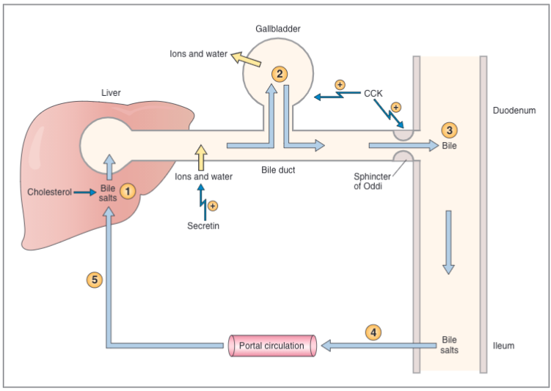
Overview of Biliary System

Slide 59
Overview of Biliary System
Hepatocytes synthesize and secrete constituents of bile
Notes:
Constituents of bile: bile salts, cholesterol, phospholipids, bile pigments, ions, water

Slide 60
Overview of Biliary System
Hepatocytes synthesize and secrete constituents of bile
Bile flows out of liver through bile ducts → GB where bile salts are concentrated through absorption of water and ions

Slide 61
Overview of Biliary System
Hepatocytes synthesize and secrete constituents of bile
Bile flows out of liver through bile ducts → GB where bile salts are concentrated through absorption of water and ions
CCK => GB contraction, sphincter of Oddi relaxation => stored bile → duodenal lumen

Slide 62
Overview of Biliary System
When lipid absorption is completed, bile salts undergo enterohepatic circulation
Bile salts extracted from portal blood by hepatocytes
Notes:
- Enterohepatic circulation: Bile salts absorbed from ileum into portal circulation into the liver
- Reduces demand to synthesize new bile salts; liver replaces the small amount of bile salts that is lost into the feces

Slide 63
Enterohepatic Circulation
Bile salts move from lumen of ileum to portal blood via Na+-bile salt cotransporters
Portal blood → liver
Liver extracts bile salts from portal blood and adds to hepatic bile salt/acid pool
  Bile acid synthesis regulated by negative feedback from bile salts
    Rate-limiting enzyme: cholesterol 7α-hydroxylase
  Recirculation of bile salts → liver: choleretic effect (stimulates biliary secretion)
Notes:
- Enterohepatic circulation: Bile salts absorbed from ileum into portal circulation into the liver
- Reduces demand to synthesize new bile salts; liver replaces the small amount of bile salts that is lost into the feces

Slide 64
Notes:
Bile salts and bile acids: 50%
Phospholipids: 40%
Cholesterol: 4%
Bilirubin: 2%
Ions and water: remaining 4%

Slide 65
Bile Salts and Bile Acids
Cholic acid and chenodeoxycholic acid (primary bile acids) made by hepatocytes from cholesterol
Secreted into small intestinal lumen and dehydroxylated @ C-7 by intestinal bacteria, creating deoxycholic and lithocholic acid (secondary bile acids)
Which is the most abundant bile acid?
Cholic > chenodeoxycholic > deoxycholic > lithocholic
Liver conjugates bile acids with amino acids (glycine, taurine) => 8 total bile salts
What does conjugating the bile acids accomplish?
Changes the pK of the bile acids and makes them more water soluble by making them amphipathic
Notes:
Bile salts are named after their base bile acid and the amino acid with which they are conjugated.
Bile acids pK ~ 3-5, duodenal pH ~ 7. Bile salts pK ~ 1-4, so they are more ionized at duodenal pH
Amphipathic: both hydrophilic and hydrophobic portions

Slide 66
Function of Bile Salts
Emulsification
Forming micelles
Surround lipids with negative charges => lipids repel each other and disperse so there is more surface area for enzymatic reactions
Combines with products of lipid digestion
Surface: bile salts
Core: hydrophobic part of the bile salt and lipids (i.e. monoglycerides, lysolecithin, fatty acids)
Aqueous solution in small intestinal lumen dissolves hydrophilic portion
Notes:
Function depends on amphipathic properties
Primary bile salts have more hydroxyl groups vs. secondary bile salts, so primary is more effective at solubilizing lipids

Slide 67
Phospholipids and Cholesterol
Included in micelles with products of lipid digestion
Amphipathic: hydrophobic parts point into micelle, hydrophilic portions dissolve in aqueous intestinal solution
Bilirubin
Yellow product of hemoglobin degradation (degraded by RES)
Carried in blood bound by albumin
Liver extracts bilirubin from blood and conjugates with glucuronic acid → bilirubin glucuronide → bile’s yellow color
Water and Ions
Secreted into bile by bile duct epithelial cells
Same mechanism as pancreatic dunctal cell
Stimulated by secretin
Notes:
RES: reticuloendothelial system
More on bilirubin glucuronide digestion later

Slide 68
Functions of the Gall Bladder
1
Stores bile
2
Concentrates bile
3
Ejects bile
Fills during interdigestive period b/c sphincter of Oddi is closed
Epithelial cells of GB absorb ions and water isosmotically
Organic compounds not absorbed, so become concentrated as isotonic fluid removed
Within 30 min post-prandial
Stimulus: CCK
Spurts/pulsatile due to rhythmic contractions of duodenum

Slide 69
Gastrointestinal Tract
Digestion and Absorption
Notes:
Intestinal Structure
Surface of SI = arranged in longitudinal folds (folds of Kerckring)
Villi project from the folds
Longest in the duodenum, where most digestion and absorption occurs
Shortest in the ileum
Surface covered with epithelial cells (enterocytes) interspersed with mucus-secreting goblet cells
Apical surface is covered by more tiny folds: microvilli, which form a “brush border”
Folds increase small intestinal surface area by > 600x!
Epithelial cells have the highest turnover rate of any cells in the body, so they are more susceptible to effects of irradiation and chemotherapy

Slide 70
Digestion
Absorption
Chemical breakdown of ingested foods into absorbable molecules
Movement of nutrients, water, electrolytes from intestinal lumen to bloodstream
  Cellular: transporters
  Paracellular: move across tight junctions, between intestinal epithelial cells, through lateral intracellular space

Slide 71
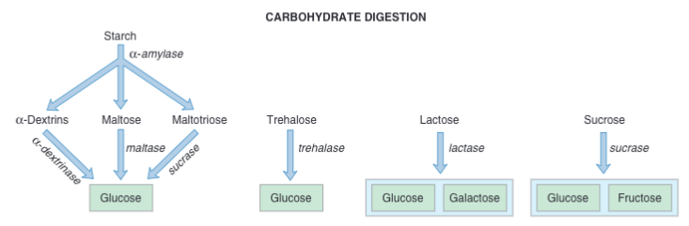
Carbohydrate Digestion
Only monosaccharides can be absorbed, so all poly/disaccharides much be digested to glucose, galactose, or fructose
In humans: salivary α-amylase starts digestion
Dogs and cats do not have α-amylase since they are carnivorous

Slide 72
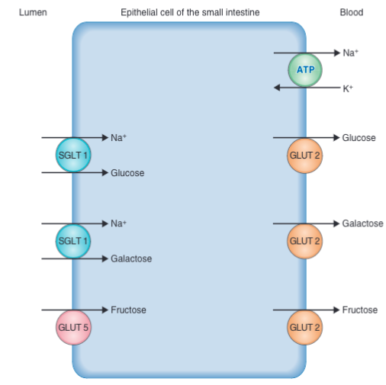
Carbohydrate Absorption
Cotransporters
Facilitated diffusion
Facilitated diffusion
Notes:
Glucose and Galactose
SGLT 1: Na+-glucose cotransporter: moves glucose and galactose from lumen to cell; energy to run this transporter comes from Na-K ATPase on basolateral membrane
GLUT 2: facilitated diffusion for glucose and galactose to get into the bloodstream from the cell
Fructose:
Facilitated diffusion
Apical: GLUT 5
Basolateral: GLUT 2
Lactose intolerance (lactase deficiency) => osmotic diarrhea

Slide 73
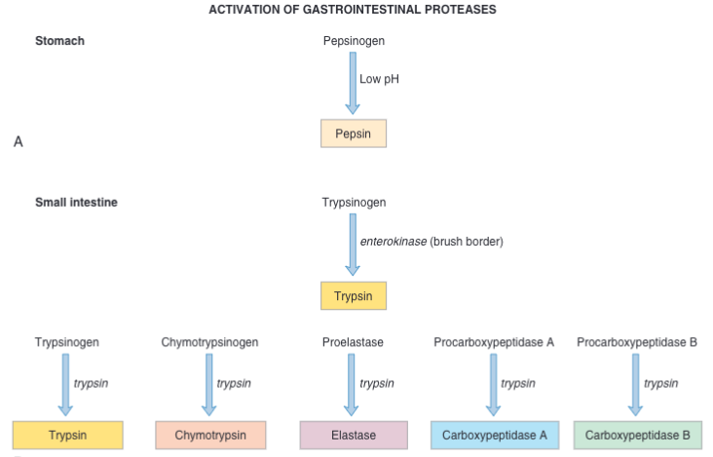
Protein Digestion
Step 1: Enzyme Activation
Notes:
3 isoenzymes of pepsin, active between pH 1-3
Enterokinase is a brush border enzyme which activates trypsinogen → trypsin
Trypsin catalyzes conversion of all other inactive precursors to active enzymes, including more autocatalyzation of more trypsinogen

Slide 74
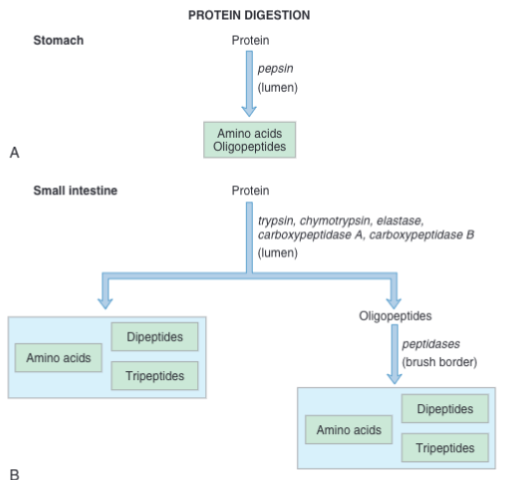
Protein Digestion
Step 2: Forming Absorbable Molecules
What are the two categories of enzymes represented here, what is the difference, and which enzymes belong in which category?
Notes:
Absorbable forms: amino acids, dipeptides, tripeptides
Endopeptidases: hydrolyze interior peptide bonds of proteins; i.e. pepsin (stomach only), trypsin, chymotrypsin, elastase
Exopeptidase: hydrolyze 1 amino acid at a time from C-terminal of proteins and peptides; i.e. carboxypeptidase A & B

Slide 75
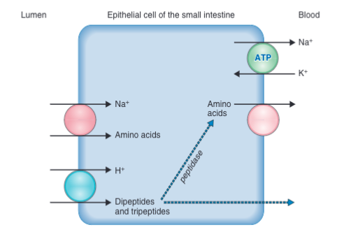
Protein Absorption
Cotransporters
Facilitated diffusion
Notes:
L-amino acids
Transported into cells by Na+- amino acid cotransporters in apical membrane
4 different ones whether neutral, acidic, basic, or imino (NH group) amino acids are being transported
Transported out to bloodstream by different mechanisms of facilitated diffusion

Slide 76
Disorders of Protein Digestion
Chronic pancreatitis → deficiency of pancreatic enzymes, including proteases
Defect/absence of Na⁺-amino acid cotransporters (i.e. cystinuria → excess cystine excretion via GIT or kidney)
Notes:
Cystinuria also leads to excessive excretion of arginine, lysine, and ornithine (similarly structured amino acids)
SOURCE: https://rarediseases.org/rare-diseases/cystinuria/#:~:text=Cystinuria%20is%20an%20inherited%20metabolic,arginine%2C%20lysine%2C%20and%20ornithine

Slide 77
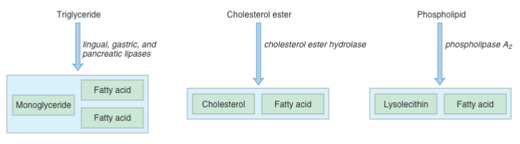
Lipid Digestion
Dietary lipids: triglycerides, cholesterol, phospholipids
Stomach:
  Lingual and gastric lipase
  Lipids emulsified by dietary proteins
Small intestine:
  Pancreatic lipase, cholesterol ester hydrolase, PLA2
  Lipids emulsified by bile salts and lysolecithin
Notes:
There is less cholesterol in veterinary diets vs. human
Stomach:
CCK slows gastric emptying
Pancreatic lipase
Secreted active
Displaced by bile salts, so colipase is secreted to displace bile acids
Cholesterol ester hydrolase
Secreted active
Hydrolyzes ester linked to triglyceride → glycerol
Phospholipase A2
Secreted as proenzyme and activated by trypsin

Slide 78
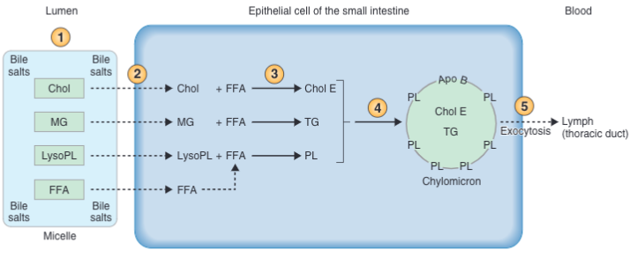
Lipid Absorption
Micelle formation
Micelle diffusion, lipid release, diffusion down concentration gradient
Reesterification of lipids to original form
Chylomicron formation
Exocytosis into lymphatics → thoracic duct → bloodstream
Notes:
Products of digestion are mixed with micelles to become water-soluble and amphipathic
Micelles diffuse through the apical brush border where lipids are released to diffuse down concentration gradients into cells in the mid-jejunum
Inside epithelial cells of small intestine, lipids are reesterified with free fatty acids by smooth ER => original ingested lipids, TGs, CH ester, and phospholipids
Reesterified lipids are packaged with apoproteins (essential for chylomicron absorption, made by intestinal epithelial cells; i.e. ApoB) in lipid-carryig particles, chylomicrons
Chylomicrons packaged in secretory vesicles on Golgi apparatus → basolateral membrane → exocytosis to lymphatic capillaries (lacteals)→ thoracic duct → bloodstream

Slide 79
Disorders of Lipid Digestion
Pancreatic insufficiency
Acidity of duodenal contents (i.e. over-secretion of HCl by gastric parietal cells/gastrinoma; insufficient pancreatic HCO₃⁻)
  Pancreatic enzymes are inactivated w/ acidity
Deficiency of bile salts/ileal resection (decreased enterohepatic circulation)
Bacterial overgrowth causing deconjugation of bile salts
Decreased intestinal cell surface area
Failure to synthesize apoproteins

Slide 80
Vitamin/Mineral Absorption
Vitamins
Calcium
Iron
Some = cofactors/coenzymes
Fat-soluble (A,D,E,K): same as dietary lipids
H₂O-soluble (B₁, B₂, B₆, C, biotin, folic acid, nicotinic acid, pantothenic acid): Na⁺-dependent cotransporter in small intestine
  B₁₂ (cobalamin): requires intrinsic factor
Absorbed in small intestine thru calbindin
Active Vitamin D (1,25-dihydrocycholecalciferol)
  Dietary Vit D (cholecalciferol): inactive
  Liver → Vit D₃: inactive
  Renal proximal tubule → active (ezyme: 1α-hydrocylase)
  Inducing synthesis of Vit D-dependent Ca²⁺ binding proitein (calbindin)
Absorbed in small intestine as free ion (Fe²⁺) or heme iron
Intracell, lysosomal enzymes → free Fe
Free Fe binds to apoferritin → bloodstream
In circulation, Fe binds to transferrin (β-globulin) → liver for storage → bone marrow for heme production
Notes:
Vitamins are acquired from the diet
Intrinsic factor makes B12 resistant to pancreatic protease
Vitamin D deficiency => Rickets and osteomalacia

Slide 81
Gastrointestinal Tract
Intestinal Fluid and Electrolyte Transport

Slide 82
Overview
Small and large intestinal epithelial cells absorb ~ 9L of fluid/d
  Secretions: 7L/d
  Fluid in GIT: 2L/d
  Absorb and secrete Na⁺, Cl⁻, HCO₃⁻, K⁺, and H₂O
  Cellular vs. paracellular route dictated by permeability of tight junctions
    SI: leaky
    LI: tight
If not absorbed, excreted in feces (100-200 mL/d)
Disturbance => diarrhea

Slide 83
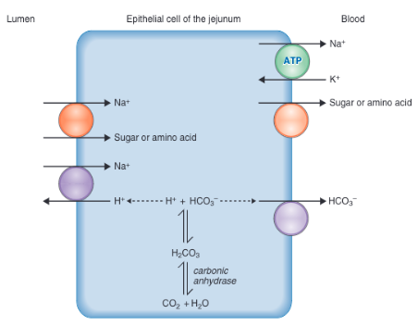
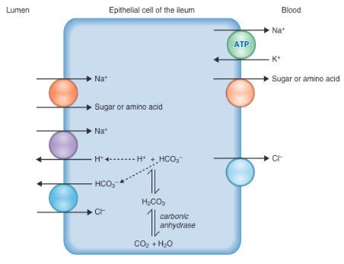
Jejunal Absorption
Net absorption of NaCl
Same as jejunum except: Cl-HCO3⁻ exchange on apical and Cl⁻ transporter (instead of HCO₃⁻) on basolateral
Ileal Absorption
Major site of Na⁺ absorption
  Enters cell via several mechanisms
Net absorption of NaHCO₃
Notes:
Solute absorbed first, then water. The absorbate is always isosmotic
Na enters cells via same mechanisms as early proximal tubule

Slide 84
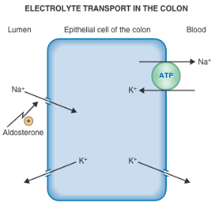
Large Intestinal Absorption
Na⁺ absorption and K⁺ secretion
  Flow rate-dependent K⁺ secretion
Notes:
Similar to distal tubule and collecting ducts of the kidney
High flow rate of intestinal fluid → increased colonic K+, which is how diarrhea contributes to hypokalemia

Slide 85
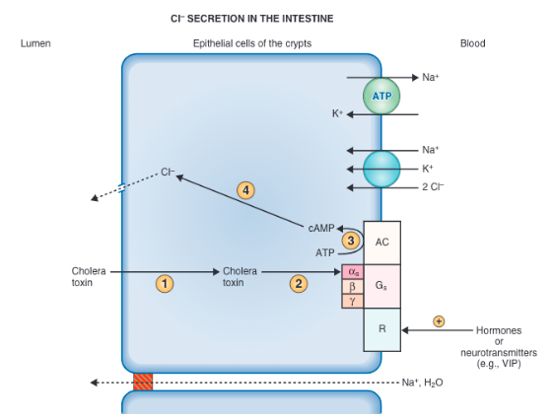
Intestinal Secretion
Notes:
Epithelial cells secrete fluid and electrolytes
Apical membrane has chloride channels
Basolateral membrane has Na-K ATPase and NaK2Cl cotransporter
Cl moves into cell through basolateral mechanisms, then to lumen through channels, followed by Na, then H2O
Apical Cl- channels are usually closed but may open due to hormones and neurotransmitters binding basolaterally (i.e. ACh, VIP) → cAMP → apical Cl- channels open

Slide 86
Diarrhea
Loss of extracellular-type fluid → decreased ECF volume → decreased intravascular volume → decreased arterial BP
Baroreceptor and RAAS attempt to restore BP, but can be futile in the face of massive loss
Electrolyte derangements
  If contains HCO₃⁻, can result in hyperchloremic metabolic acidosis with normal anion gap
  If contains K⁺, can result in hypokalemia

Slide 87
Causes of Diarrhea
Osmotic
Secretory
Non-absorbable solutes in lumen
Overgrowth of enteropathic cell bacteria → crypt cell fluid secretion > absorptive mechanisms
Notes:
Decrease in absorptive surface area (i.e. infection, inflammation, etc. of small intestine)
Osmotic example: lactase deficiency
Secretory example: cholera
(neither common in vet med)

Slide 88
Gastrointestinal Tract
Liver Physiology

Slide 89
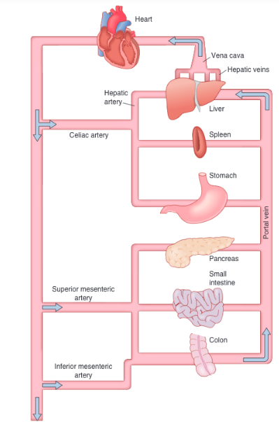
Overview
Notes:
Receives portal blood from the stomach, SI, LI, pancreas and spleen → portal vein delivers most of liver’s blood supply

Slide 90
Functions
1.
2.
3.
4.
5.
Process absorbed substances
Synthesize and secrete bile acids
Produce and excrete bilirubin
Metabolize CHO, protein, lipids
Detoxify and excrete waste products

Slide 91
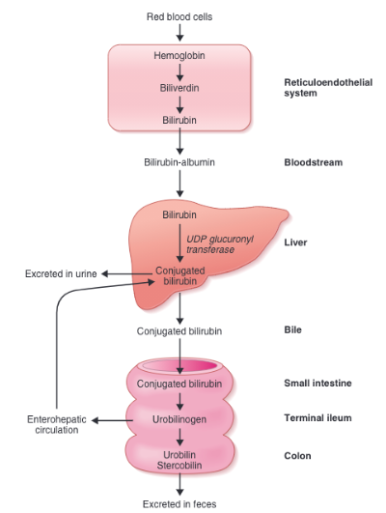
3. Bilirubin Production & Excretion
Explain the pathophysiology of developing icterus.
Free or conjugated bilirubin accumulation.
RBC destruction: unconjugated
Bile duct obstruction/liver disease: conjugated (dark urine, light stool)
Why does GI hemorrhage results in black feces?
Urobilinogen that remains in GIT is oxidized to urobilin & stercobilin, which gives feces its dark color. If there is more bilirubin in the GIT due to the presence of heme, more stercobilin will be formed, so the feces will be darker
Notes:
Conjugated bilirubin is water-soluble, so some is excreted in urine; (conjugated by binding with glucuronic acid)
Conjugated bilirubin is deconjugated by bacterial enzymes in ileum and colon → urobilinogen
Some goes to the liver
Some goes to urine
Some is oxidized to urobilin and stercobilin, which is what gives feces is dark color
Jaundice/icterus is due to free or conjugated bilirubin accumulation

Slide 92
4. Metabolism
Carbohydrates
Protein
Lipids
Gluconeogenesis
Stores glucose as glycogen
Releases stored glucose into bloodstream
Synthesizes non-essential amino acids
Modifies amino acids to enter biosynthetic pathways for CHO
Makes plasma proteins
  i.e. albumin
  i.e. clotting factors
Changes ammonia → urea → excreted in urine
Fatty acid oxidation
Synthesizes lipoproteins, cholesterol, phospolipids

Slide 93
Detoxification
First pass metabolism
Phase I reactions
Phase II
Cytochome P-450 catalyzation
Phagocytoses bacteria through Kupffer cells
Conjugates substances with glucuronide, sulfate, amino acids, glutathione
Notes:
First pass: liver modifies substances absorbed by the GIT

Slide 94
Testing Our Knowledge!

Slide 95
CHALLENGING OURSELVES
Which of the following is/are (an) action(s) of CCK?
  Contraction of the gallbladder
  Acceleration of gastric emptying
  Simulation of HCO₃⁻ secretion
  Stimulation of pancreatic enzyme secretion
A patient with a duodenal ulcer is treated with cimetidine, a drug that inhibits H⁺ secretion in parietal cells. Which of the following is the mechanism of cimetidine’s action?
  Inhibition of H⁺-K⁺ ATPase
  Inhibition of muscarinic receptors
  Stimulation of muscarinic receptors
  Decreased intracellular cyclic AMP levels
  Inhibition of somatostatin
Notes:
A (contraction of gall bladder), C (stimulation of HCO3- secretion), D (stimulation of pancreatic enzyme secretion)
D (decreased intracellular levels of cAMP)

Slide 98
CHALLENGING OURSELVES
During the rising phase (upstroke) of a slow wave, which change in membrane potential is occurring?
  More negative
  Less negative
  More positive
  Less positive
Which phenomenon in salivary ducts explains why the final salivary secretion is hypotonic relative to the primary secretion of the acinar cells?
  Secretion of water
  Absorption of water
  Absorption of more solute than water
  Secretion of more solute than water
Notes:
3. B—less negative (membrane potentials are expressed as intracellular potential with respect to extracellular potential)
4. C—absorption of more solute than water. (Intercalated duct is impermeable to water)

Slide 101
CHALLENGING OURSELVES
Which of the following substances must be digested before being absorbed by the small intestine?
  Ca²⁺
  Alanine
  Fructose
  Sucrose
  Cholesterol
What is the correct sequence of events in lipid absorption: formation of cholesterol ester, action of pancreatic lipase, emulsification of lipids in the intestinal lumen, micelles, chylomicrons?
Emulsification
Pancreatic lipase
Micelles
Cholesterol ester
Chylomicrons
Notes:
5. D—sucrose. The body cannot absorb polysaccharides or dissaccharides

Slide 102
Lipid Absorption
Micelle formation
Micelle diffusion, lipid release, diffusion down concentration gradient
Reesterification of lipids to original form
Chylomicron formation
Exocytosis into lymphatics → thoracic duct → bloodstream
Notes:
This shows steps 3-5
Resterificiation is when cholesterol ester is made

Slide 103
CHALLENGING OURSELVES
As pancreatic flow rate increases, which of the following has/have increased concentration in pancreatic juice?
  Na⁺
  K⁺
  HCO₃⁻
  Cl⁻
  Osmolarity
Which reaction(s) is/are catalyzed by trypsin?
  Pepsinogen to pepsin
  Trypsinogen to trypsin
  Procarboxypeptidase to carboxypeptidase
Notes:
7. C—HCO3-
8. B (trypsinogen to trypsin) and C. Pepsin happens in the stomach

Slide 104
Formation of Pancreatic Secretion
Aqueous
Isotonic solution to plasma (Na⁺, Cl⁻, K⁺, HCO₃⁻)
  Na⁺, Cl⁻ = plasma
  K⁺, HCO₃⁻ vary with flow rate
Net: HCO₃⁻ secretion → pancreatic ductal juice; H⁺ absorption → pancreatic blood vessel acidification
Notes:
Apical membrane of ductal cells contains a Cl-HCO3 exchanger
Basolateral membrane contains Na-K ATPase and Na-H exchanger
In the presence of carbonic anhydrase, CO2 and H2O combine in the cells to form H2CO3, which then dissociates into H+ and HCO3
HCO3− is secreted into pancreatic juice by the Cl-HCO3 exchanger in the apical membrane
The H+ is transported into the blood by the Na-H exchanger in the basolateral membrane
The net result, or sum, of these transport processes is net secretion of HCO3− into pancreatic ductal juice and net absorption of H+; absorption of H+ causes acidification of pancreatic venous blood
At high flow rates, pancreatic juice HCO3 concentration is the highest and Cl is the lowest

Slide 105
Protein Digestion
Step 1: Enzyme Activation

Slide 106
CHALLENGING OURSELVES
Where is the frequency of slow waves the highest?
  Stomach
  Duodenum
  Ileum
Where am I? For each item in the following list, give its correct location in the GI system. (may be anatomic, a graph or portion of a graph, or a concept)
  Gastrin secretion
  Na⁺-bile salt cotransport
  H⁺-K⁺ ATPase
  Intrinsic factor secretion
  Omeprazole action
  Na⁺-glucose cotransporter
  Secondary bile acids (or bile salts)
G cells, gastric antrum
ileum
Gastric parietal cells
Exocrine pancreas (vet spp.)
H⁺-K⁺ ATPase in gastric parietal cells
Apical membrane of intestinal epithelial cells
Intestinal lumen
Notes:
Intrinsic factor secretion is from gastric parietal cells in humans

Slide 107
CHALLENGING OURSELVES
Which of the following is/are mechanism(s) of action of omeprazole?
  Inhibition of ACh action of parietal cells
  Stimulation of somatostatin action on parietal cells
  Inhibition of CCK_{B} receptors
  Inhibition of H⁺-K⁺ ATPase
  Inhibition of Na⁺-K⁺ ATPase
Which of the following suppresses appetite?
  Increased body fat
  Increased insulin levels
  Increased grehlin levels
Notes:
11. D---inhibition of H-K ATPase
12. A (increased body fat), B (increased insulin levels)

Slide 109
Satiety
Arcuate nucleaus of hypothalamus
Satiety Center
Feeding center
Inhibits appetite in presence of food
In ventromedial nucleus (VPN) of hypothalamus
In lateral hypothalamic area (LHA)
Anorexigenic neurons
Pro-opiomelanocortin (POMC)
Orexigenic neurons
Peptide Y
Leptin
Insulin
GLP-1
Peptide YY (PYY)
Grehlin
Notes:
Leptin
Secreted by fat cells in proportional amount to fat stored in adipose tissue
Stimulates anorexigenic, inhibits orexigenic to decrease appetite and increase energy expenditure
Chronic/long-term effects to decrease appetite because it detects stored body fat
Insulin
Stimulates anorexigeic, inhibits orexigenic thereby decreasing appetite
Fluctuates throughout the day
Short-term effects
GLP-1 (Glucagon-like peptide 1): decreases appetite
Peptide YY (PYY)
From intestinal L cells
Decreases appetite through direct hypothalamic action
Decreases appetite through decreasing grehlin secretion
Grehlin
Secreted by gastric cells before eating a meal
Stimulates orexigenic, inhibits anorexigenic, thereby increasing appetite
Weight loss and starvation stimulate grehlin secretion

Slide 110
CHALLENGING OURSELVES
In the peristaltic reflex, which of the following occurs orad to (behind) the food bolus?
  Release of 5-hydrocytryptamine (5-HT) from IPAN neurons
  Contraction of circular muscle
  Contraction of longitudinal muscle
  Action of ACh on circular muscle
  Action of VIP on circular muscle

Slide 111
Peristalsis
Enterochromaffin cells (SI mucosa) sense food bolus in SI lumen → release 5-HT (5-hydrocytrypatmine/serotonin)
Serotonin binds to receptor on intrinsic primary afferent neurons (IPANs) → peristaltic reflex activated
  Orad to bolus: excitatory nts (ACh, Substance P, Neuropeptide Y) target circular mm and inhibit longitudinal mm → narrowing and lengthening segment
  Aborad to bolus: inhibitory pathways (VIP, nitrous oxide) to circular mm and excitatory to longitudinal mm → widen and shorten segment

Slide 112
Source
Costanzo, Linda S. “Gastrointestinal Physiology.” Physiology, 6th ed., Elsevier, Philadelphia, PA, 2018, pp. 339–393.

Slide 113
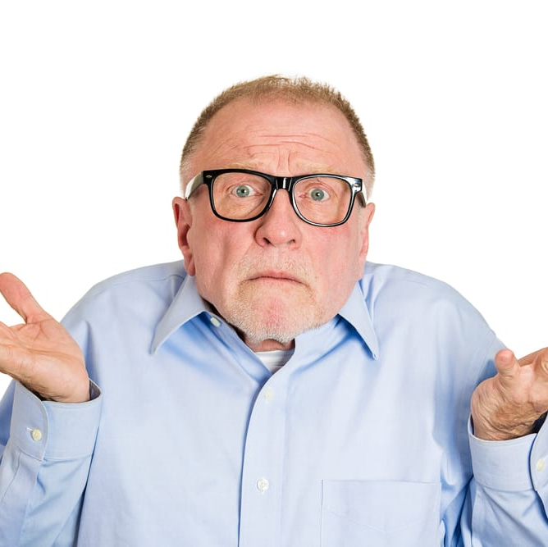
Questions
Notes:
Photo Source: https://health.wyo.gov/healthcarefin/medicaid/confused-older-man/

