Slide 1
Albumin, Magnesium, Phosphorus
Dr. Katie Sotos
May 24, 2022

Slide 2

Case 1: Gladys
Notes:
Case based on Moose Creedon (PLN/Lyme Nephritis, Dr. Cammarano)
Photo Source: https://www.npr.org/2022/03/15/1085173405/bulldogs-health-breed-ban

Slide 3
Case 1: Gladys
6 yo FS English Bulldog
Weight loss + vomiting, PU/PD
  - 6kg in 4 mo
rDVM:
  4DX Lyme +
  USG 1.015, 3+ ptn, pH 5.0, 15-20 WBC/hpf
  PCV 22%, plt 27k
  BUN 72, creat 4.6, phosphorus 8.8
  NIBP: 210-220 mmHg
Notes:
PU/PD is a late finding due to tubular involvement
Isosthenuria is a late sign; Gladys is minimally concentrated

Slide 4
Case 1: Gladys
Rx Amlodipine, Cerenia, Omeprazole→ ate well, no vomiting → rx Enalapril, Doxycycline
Vomiting, lethargic the next day, anorexic + not taking meds
Rx SQF

Slide 5
Case 1: Gladys – PE
T: 102.4 F, HR 120 bpm, RR 28 brpm
MM: pale, moist CRT 1.5s
Generalized muscle atrophy, BCS 3/9
Brittle fur coat
Retinal hemorrhages OU
Sensitive to limb palpation
Grade III/VI L systolic heart murmur
Uncomfortable on caudal abdominal palpation
Popliteal lymphadenopathy

Slide 6
Case 1: Gladys – CUHA Chemistry panel
Serum | Result | Reference Interval | Units
BUN | 130 | 9-26 | mg/dL
Creat | 6.7 | 0.6-1.4 | mg/dL
Phosphate | 10.7 | 2.7-5.4 | mg/dL
K⁺ | 4.4 | 4.1-5.4 | mEq/L
TP | 6.2 | 5.5-7.2 | g/dL
Albumin | 2.0 | 3.2-4.1 | g/dL
Globulin | 4.0 | 1.9-3.7 | g/dL
Calcium | 9.8 | 9.4-11.1 | mg/dL
ALT | 16 | 17-95 | U/L
Cholesterol | 232 | 136-392 | mg/dL
Azotemia
Hyperphosphatemia
Hypoalbuminemia

Slide 7
Case 1: Gladys – CBC
Blood, Whole, EDTA | Result | Reference Interval | Units
HCT | 17 | 41-58 | %
MCV | 74 | 64-76 | fL
MCHC | 33 | 33-36 | g/dL
Absolute Retic. | 50.5 | 11.0-92.0 | thou/uL
nRBC | 0 | 0-1 | /100 WBC
WBC | 11.4 | 5.7-14.2 | thou/uL
Segs | 9.5 | 2.7-9.4 | thou/uL
Bands | 0.9 | 0.0-0.1 | thou/uL
Lymph | 0.2 | 0.9-4.7 | thou/uL
Platelet count | 57, w/ clumps | 186-545 | thou/uL
Non-regenerative, normocytic, normochromic anemia
Neutrophilia with mild left shift, mild toxic change
Thrombocytopenia
Notes:
Comment on path review was that the count may be normal

Slide 8
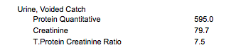
Case 1: Gladys – UA, UPC
Urine, Voided Catch | Result
Color | Light yellow
Turbidity | Slightly cloudy
USG | 1.015
pH | 6.0
Protein | >/= 300 mg/dL
WBC | < 5/hpf
RBC | < 5/hpf
Casts | Granular < 1/lpf
Crystals | Few amorphous
Bacteria | Very few cocci
Protein-Losing Nephropathy
Notes:
We are using this example to discuss hypoalbuminemia, although hyperphosphatemia is obviously a derangement here too. We will discuss that more later.

Slide 9
How does the kidney normally handle protein?
Glomerular Filtration
  Water and solutes leave vascular system through filtration barrier and into Bowman’s capsule, forming ultrafiltrate
    Contains water and small solutes
      If [filtrate] = [plasma], that substance is freely filtered
        i.e. Na⁺, K⁺, HCO₃⁻, glucose, urea, amino acids, peptides (ADH, insulin)
    Does not contain proteins and blood cells

Slide 10
Glomerular Filtration
Formation of Glomerular Filtrate
Filtered fluid passes through glomerular filtration barrier: 1) fenestrated endothelium, 2) basement membrane, 3) slit diaphragms b/w podocytes
Albumin:
  66,000 Da
  Negative
Molecular Size
Electrical Charge
< 7,000 Da filters through
> 70,000 Da is stopped
Positive charges filter through
Negative charges filter less
Due to negatively-charged glycoproteins on filtration barrier
Very little is filtered
Notes:
< 7,000 Da: small ions, glucose, urea, amino acids, many hormones
Albumin ~ 66,000 Da
Not excluded 100%, but only a very small amount gets through
Small substances bound to large proteins are NOT freely filtered (i.e. steroid and thyroid hormones, ~ 40% bound Ca)
Amount filtered decreases as molecular size increases
Compared to neutral charges
Almost all plasma proteins are negatively charged
Some diseases cause glomerular capillaries to leak due to loss of negative membrane charge and → proteinuria

Slide 11
What happens in Lyme Nephritis?
Proposed pathophysiology progression:
Immune-complex glomerulonephritis (ICGN)
Tubular necrosis/regeneration
Interstitial nephritis

Slide 12
Case 1: Gladys – Early or Late State Disease? How do you know?
Late
PU/PD is a late finding due to tubular involvement
Isosthenuria is a late sign (USG 1.015)
Significant azotemia
Granular casts reflect tubular ischemia/necrosis
Significant hypoalbuminemia
  Albumin losses from PLN (and PLE) are initially compensated for through albumin shifts b/w intravascular and interstitial pools
Notes:
Proposed pathophysiology progression of Lyme Nephritis: 1) immune-complex glomerulonephritis (ICGN), then 2) tubular necrosis/regeneration, then 3) interstitial nephritis
With chronic PLN, net albumin deficit occurs and hypoalbuminemia develops

Slide 13
Albumin
Function/Roles
Synthesis and Regulation
Distribution
Catabolism
Hypoalbuminemia
Hyperalbuminemia
Questions

Slide 14
Functions/Roles of Albumin
Major contributor to plasma colloid osmotic pressure (COP)
  60-70%
  30-40% from globulins
Transport molecule for ions and metabolites
  Ca²⁺, Mg²⁺, Cu²⁺
  Fatty acids, thyroxine, bilirubin, bile salts, amino acids
Antioxidant activity
Anticoagulant + antithrombotic activity
Anti-inflammatory effects
Notes:
Transport mlq because of strong negative charge, allowing it to weakly and reversibly bind positively charged ions and molecules
Antioxidant activity through:
Binding reactive transition metal ions like copper
ROS scavenging

Slide 15
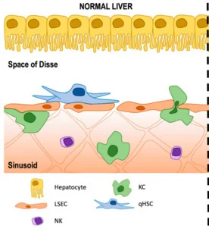
Synthesis of Albumin
Made by 20-30% of all hepatocytes
Space of Disse, exocytosis
Hepatic sinusoids → systemic circulation →
Interstitial space
Back to systemic circulation through lymphatics (thoracic duct)
Notes:
Photo Source: https://www.mdpi.com/2673-4389/1/1/2/htm

Slide 16
What is the main regulator of albumin synthesis?
Colloid osmotic pressure of the hepatic intracellular matrix
  If low COP, more albumin is produced
  If high COP, less albumin is produced

Slide 17
Distribution
100%
75%
Interstitial space of skin
Interstitial space of muscle
50%
30%
25%
40%
30%
Extravascular
Intravascular
Notes:
50-70% is extravascular, mostly in the interstitial spaces in skin and muscle
All albumin present in plasma circulates through interstitium every 24 hours
Factors affecting interstitial COP:
Permeability of capillary walls to protein
Rate of transvascular solvent flow
Protein retention in interstitial matrix
Lymph clearance of protein

Slide 18
Catabolism
Locations: within or near vascular endothelium
Rate: T_{1/2} _{in} plasma = 7-10d (dogs), 6-9d (cats)
Rate regulation:
  Plasma albumin concentration
    Hypoalbuminemia → lower rate of catabolism
    Hyperalbuminemia or higher oncotic pressure → faster rate of catabolism
  Pool size
Main site: undetermined; suspect reticuloendothelial system where the amino acids are then used by the cells

Slide 19
Hypoalbuminemia: Causes
Increased loss
Decreased synthesis
Changes in serum oncotic pressure
Increased catabolism
Notes:
Albumin is small (66,000 Da), so it can be lost through these mechanisms
Decreased production is very tightly and quickly regulated
Fasting or protein-deficient diet
Excess calorie intake in protein-restricted diets
Protein catabolism in severe illness usually targets muscle and spares albumin
_________
Increased loss
Renal (glomerulus: i.e. GN, amyloidosis)
Gut wall (i.e. lymphangiectasia)
Pathologically altered blood vessels (i.e. vasculitis)
Peritoneal cavity (i.e. hepatic sinusoidal hypertension)
Decreased synthesis
Synthetic liver failure
Negative acute phase protein
Changes in serum oncotic pressure
Hyperglobulinemia
Treatment with synthetic colloids
Increased catabolism
Treatment with synthetic colloids or albumin transfusion

Slide 20
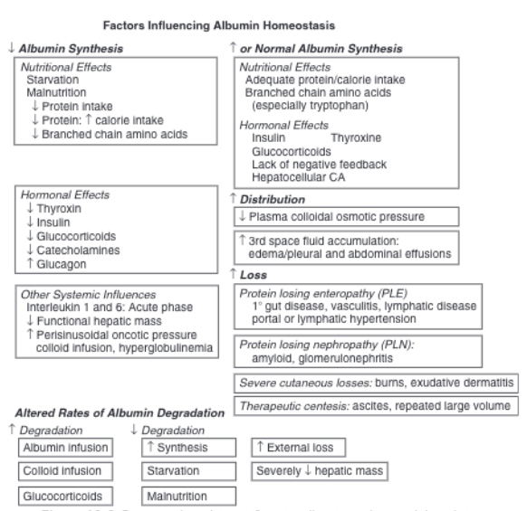
Hypoalbuminemia: Causes
Notes:
Mechanism of hypoalbuminemia in pancreatitis (more common in dogs than cats): intrapancreatic and peripancreatic exudation of albumin
Mechanism of hypoalbuminemia in CHF (more common in R-sided or biventricular):
Lymphatic loss of protein through congested intestine
Decreased hepatic synthesis
Cardiac cachexia
Increased endothelial permeability due to increased capillary pressure and hypoxia
Heart failure fluid has more protein than a transudate because:
Leaky hepatic sinusoids → protein leaks into ascites
Repeated abdominocentesis can → total body protein decrease
Mechanism of hypoalbuminemia in heartworm: glomerular injury and renal protein loss

Slide 21
Hypoalbuminemia: Clinical Signs
Effusions and edema
Notes:
Due to major impact of albumin on COP
Usually, a pure transudate

Slide 22
Hypoalbuminemia Treatment:
Albumin Solutions
Usage: critically ill hypoalbuminemic patients (i.e. alb < 1.5-2.0 g/dL)
  i.e.: vasculitis, SIRS, sepsis
Uniform molecular size based on species
Colloid solutions
PLE/PLN lose all albumin administered, so not useful
Albumin is contained within ascites in synthetic failure, so administering more may exacerbate this
Notes:
If no albumin is available,
pRBC contain 1.5-1.9 g/dL
WB and FFP contain 3.5-4.5 g/dL

Slide 23
Albumin Formulations
Canine-Specific Albumin (CSA)
Human Serum Albumin (HSA)
Lyophilized product
  5g vial, reconstituted to 5%, 10% or 16%
450 mg/kg → serum increase by 0.5 g/dL
  No max daily dose
Non-antigenic
Good evidence in septic peritonitis cases
5% or 25%
Doses extrapolated from humans: 2 mL/kg over 2h, then 0.1-0.3 mL/kg/h
  No > 2 g/kg
Not recommended
  Severe/fatal type III hypersensitivity
  Delayed hypersensitivity (48-72h post infusion)
Notes:
CSA
The 5% CSA is considered iso-oncotic
5 g/dL (about 10x as much as in whole blood or FFP)
CSA is non-antigenic, so no reactions are expected with repeated transfusions
HSA
Type III Hypersensitivity was previously believed to only occur when administered to healthy dogs, but more recent studies have demonstrated adverse effects in ill dogs, showing that critical illness does not preclude the risk of antigenic reactions
- Risk with repeated infusions; antibodies are produced within weeks of 1st administration

Slide 24
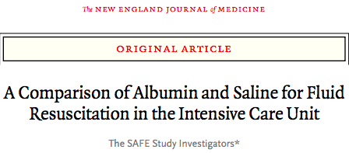
Advantages of Albumin over Non-Protein Colloids? in general
Drug and hormone binding
Antioxidant properties
SAFE Trial (humans)
  4% HSA vs. 0.9% NaCl for resuscitation
  No advantage with either group
  Albumin safe short term
    TBI patients treated w/ HSA: increased death rate at 2yr
Notes:
TBI patients treated w/ HSA: increased death rate at 2 years → suggesting a detrimental effect in some cohorts

Slide 25
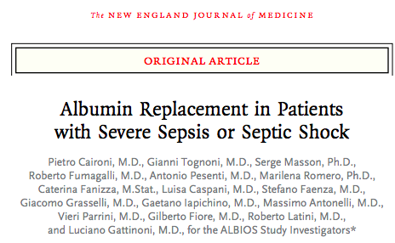
Advantages of Albumin over Non-Protein Colloids? in general
ALBIOS Trial (humans w/ sepsis or septic shock)
  HSA patients had higher MAP and lower net fluid balance
  No difference in mortality or total fluid volume given

Slide 26
Advantages of Albumin over Non-Protein Colloids? in dogs and cats
HSA and CSA significantly increased:
  Serum albumin concentration, total protein concentration
  Colloid osmotic pressure
  Blood pressure

Slide 27
Albumin Questions
Which concentration of CSA is considered iso-osmotic?
  5%
  10%
  16%
  28%

Slide 28
Hyperalbuminemia: Causes
Increased synthesis
1 human, 1 dog: HCC
Decreased catabolism
Very Rare
Notes:
Proposed mechanism: malignant functional hepatocytes or decrease in negative feedback from impaired hepatocellular osmoreceptivity

Slide 29

Case 2: Cotton
8 mo FS Doodle Mix
Acute vomiting
Hx of GI FB sx 1 month ago
Notes:
Photo Source: https://www.dreamstime.com/photos-images/goldendoodle.html

Slide 30
Case 2: Cotton– PE
T: 102.7 F
HR 120 bpm
RR: 32 brpm, eupneic
MM: pink, slightly tacky, CRT 1-2s
Tense, mildly painful abdomen

Slide 31
Case 2: Cotton– ER Diagnostics
PCV/TS: 44%, 6.4
VBG: mild hypochloremic, hypokalemic metabolic alkalosis
GI-focused AUS: difficult to fully elucidate small intestinal findings.
  Suspect partially sonolucent obstructive jejunal FB
  Generalized peritonitis
  Moderate volume of effusion throughout abdomen
Abdominocentesis
  Cytology: several RBC, few broken WBC, no bacteria
Notes:
AXR were concerning for SI mechanical obstruction, so AUS was performed with radiology

Slide 32
Case 2: Cotton– ER Diagnostics
PCV/TS: 44%, 6.4
VBG: mild hypochloremic, hypokalemic metabolic alkalosis
GI-focused AUS: difficult to fully elucidate small intestinal findings.
  Suspect partially sonolucent obstructive jejunal FB
  Generalized peritonitis
  Moderate volume of effusion throughout abdomen
Abdominocentesis
  Cytology: several RBC, few broken WBC, no bacteria
Surgery Recommended

Slide 33
Case 2: Cotton– Chemistry panel
Serum | Result | Reference Interval | Units
BUN | 26 | 9-26 | mg/dL
Creat | 0.9 | 0.6-1.4 | mg/dL
Ca²⁺ | 10.9 | 9.4-11.1 | mg/dL
Phosphate | 11.6 | 2.7-5.4 | mg/dL
Magnesium | 2.2 | 1.5-2.1 | mEq/L
TP | 5.6 | 5.5-7.2 | g/dL
Albumin | 3.4 | 3.2-4.1 | g/dL
AST | 70 | 18-56 | U/L
ALP | 233 | 7-115 | U/L
CK | 1009 | 64-314 | U/L
K⁺ | 4.9 | 4.1-5.4 | mEq/L
Glucose | 67 | 68-104 | mg/dL
Hyperphosphatemia
Mild hypermagnasemia
Hypoglycemia
Mildly elevated AST and CK
Mildly elevated ALP
Notes:
We will discuss hyperphosphatemia later, but ddx include: age vs. crush injury/cell lysis due to necrotic bowel formation

Slide 34
Case 2: Cotton
Acutely decompensated in ER
  Horizontal nystagmus, absent menace OU
  Dusky tacky MM, CRT 4-5s
  Marked tachycardia (sinus ~ 200 bpm), absent femoral pulses, tachypnea
  Marked acidemia (pH 6.837) with mixed respiratory and metabolic acidosis (pCO₂ 97, HCO₃ 16.1, BE -17.9), BG 58, lactate 13.72
    Metabolic acidosis worsened with IV fluid therapy

Slide 35
Case 2: Cotton
Acutely decompensated in ER
  Horizontal nystagmus, absent menace OU
  Dusky tacky MM, CRT 4-5s
  Marked tachycardia (sinus ~ 200 bpm), absent femoral pulses, tachypnea
  Marked acidemia (pH 6.837) with mixed respiratory and metabolic acidosis (pCO₂ 97, HCO₃ 16.1, BE -17.9), BG 58, lactate 13.72
    Metabolic acidosis worsened with IV fluid therapy
Immediate Surgery
Mesenteric Torsion
90-95% Jejunum Resected:
Jejunocolic Anastomosis

Slide 36
Case 2: Cotton– Hospitalization
Serum | Day 0 | Day 1
BUN | 26 | 21
Creat | 0.9 | 0.9
Ca²⁺ | 10.9 | 9.4
Phosphate | 11.6 (H) | 5.9 (H)
Magnesium | 2.2 (H) | 1.4 (L)
TP | 5.6 | 3.3 (L)
Albumin | 3.4 | 1.9 (L)
ALT | 39 | 4244 (H)
AST | 70 (H) | 5097 (H)
ALP | 233 (H) | 299 (H)
CK | 1009 (H) | 13951 (H)
K⁺ | 4.9 | 4.3
Glucose | 67 (L) | 115 (H)
On Day 1 post-op, started feeding ¼ RER through ng tube
Describe the abnormalities on this chemistry panel, including differentials
Hyperphosphatemia
Hypomagnasemia
Hypoproteinemia
LEs consistent with recent surgery +/- concurrent peritonitis
Notes:
The hypoproteinemia was albumin and globulins
Hyperphosphatemia is still present, but it is markedly reduced from previous/pre-op chemistry panel
DDX: refeeding syndrome vs. malabsorption vs. combination (suspect)

Slide 37
Case 2: Cotton– Hospitalization
Serum | Day 0 | Day 1 | Day 2
BUN | 26 | 21 | 5 (L)
Creat | 0.9 | 0.9 | 0.6
Ca²⁺ | 10.9 | 9.4 | 9.0 (L)
Phosphate | 11.6 (H) | 4.5 | 2.5 (L)
Magnesium | 2.2 (H) | 1.4 (L) | 1.3 (L)
TP | 5.6 | 3.3 (L) | 2.8 (L)
Albumin | 3.4 | 1.9 (L) | 1.8 (L)
ALT | 39 | 4244 (H) | 2358 (H)
AST | 70 (H) | 5097 (H) | 729 (H)
ALP | 233 (H) | 299 (H) | 380 (H)
CK | 1009 (H) | 13951 (H) | 4420 (H)
K⁺ | 4.9 | 4.3 | 3.6 (L)
Glucose | 67 (L) | 115 (H) | 149 (H)
On Day 2 post-op, increased feeding to ½ RER
Describe the abnormalities on this chemistry panel, including differentials
Hypomagnasemia
Hypophosphatemia
Hypoproteinemia
Improved LE elevation
Hypokalemia

Slide 38
Magnesium
Function/Roles
Regulation
Distribution
Uptake
Renal Handling
Excretion
Hypomagnasemia
Hypermagnasemia

Slide 39
Function/Roles of Magnesium
Essential cofactor in > 300 enzymatic reactions
  Including ATPase which hydrolyzes ATP, providing energy
  Na⁺-K⁺ exchanger
Endogenous calcium channel blocker
Notes:
Na⁺-K⁺ exchanger is a magnesium-dependent ATPase and creates the electrical gradient across cell membranes
Ca channel blocker: role in regulating peripheral vascular tone and cardiac contractile strength

Slide 40
Regulation of Magnesium
Mechanisms of regulation are complex, poorly understood, incompletely defined
Hormones play a small role in regulation

Slide 41
Distribution
Bone > muscle > soft tissue > RBC > plasma
  67% in plasma: iMg = active
  33% non-ionized
    Bound to plasma proteins (19% of total)
    Chelated w/ PO₄²⁻ or SO₄²⁻ (14% of total)
2nd most abundant intracellular cation after K⁺
Most biologically important form = complexed (i.e. Mg-ATP)
Notes:
Plasma distribution is < 1% in people, so plasma Mg is a very poor representation of total body Mg: Mg levels in plasma can be normal in the face of total body Mg depletion
Serum is preferred to plasma Mg because plasma samples’ anticoagulant can be contaminated to bind Mg
When serum Mg is low, it is not possible to determine whether that is a decrease in ionized or bound fractions (as would be the case in hypoproteinemia)→ this difference may be clinically irrelevant due to how little Mg is in plasma

Slide 42
Uptake
Dietary
  Central cation in chlorophyll
Major site in dogs: colon
Major site in cats: undefined
Biphasic
  Whole body Mg sufficient: uptake is passive and limited
  Whole body Mg depleted: uptake is active

Slide 43
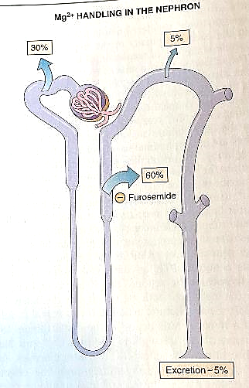
Renal Handling
80% of plasma Mg²⁺ is filterable
  Remaining 20% is bound to plasma proteins
95% is reabsorbed, so only 5% excreted
  30% in proximal tubule
  60% in thick ascending limb
    Driven by lumen-positive potential difference
    Inhibited by diuretics
  5% in distal tubule
Notes:
The Mg bound to plasma proteins does not filter
30% is reabsorbed in the proximal tubule, compared to 67% of Na and Cl reabsorbed here
Inhibited by diuretics because the lumen-positive potential difference is generated by the Na⁺-K⁺-2Cl⁻ cotransporter (see next slide for details)

Slide 44
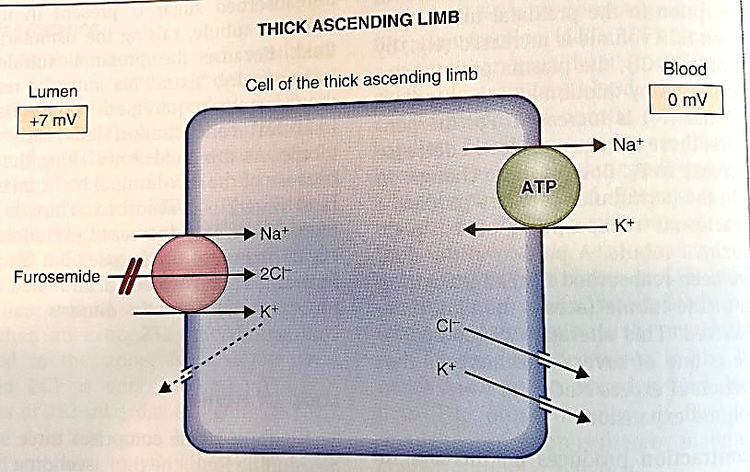
Lumen-Positive Potential Difference
Notes:
Inhibited by diuretics because the lumen-positive potential difference is generated by the Na⁺-K⁺-2Cl⁻ cotransporter
Normally, this cotransporter moves all 3 ions intracellularly from the tubular lumen
Na+ is extruded from the cell into the bloodstream by the Na⁺-K⁺ ATPase
K⁺ and Cl⁻ diffuse through channels in the basolateral membrane into the bloodstream, down their respective electrochemical gradients
A small portion of the K⁺ diffuses back into the lumen, rendering the cotransporter electrogenic, meaning it brings slightly more negative than positive charge into the cell, resulting in a lumen-positive potential difference across the cell membrane
Diuretics bind to the Cl⁻ binding site, so transport stops

Slide 45
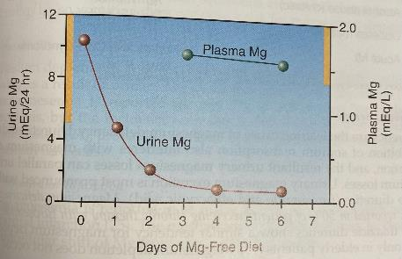
Excretion
Renal
  Load-dependent
Minor contribution from colon
Notes:
Load-dependent: when Mg intake is low, kidneys conserve Mg and renal excretion is practically zero
Photo Source: Marino’s The ICU Textbook

Slide 46
Hypomagnasemia: Parameters
Controversial
  Ionized in acute shifts/losses
  Total in chronic deficiency
    Total may be decreased in these scenarios to keep [iMg] adequate
Notes:
Has been reported in as many as 65% of human ICU patients
Mg depletion may not be accompanied by hypomagnasemia → incidence of depletion is higher
Can do a urinary Magnesium Retention Test to determine whether total body stores are depleted: likely when < 50% of Mg infused is recovered in urine and unlikely when > 80% is excreted in urine
Does not work in patients with impaired renal function

Slide 47
Hypomagnasemia: Causes
Decreased intestinal absorption
Increased renal excretion
Endocrinopathies
Redistribution
Miscellaneous

Slide 48
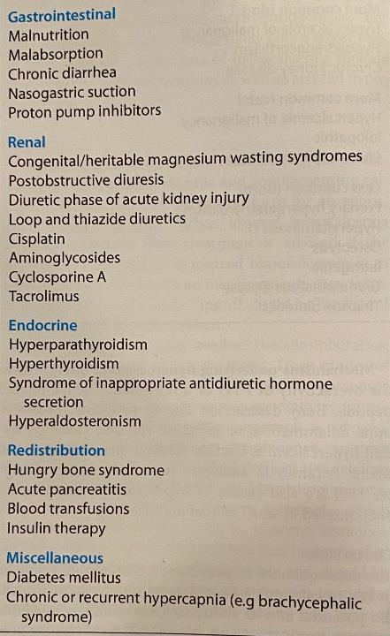
Hypomagnasemia: Causes
Notes:
Human Causes:
- Drugs
Furosemide administration = incidence 50%→ diuretic-induced inhibition of Na⁺ reabsorption interferes with Mg reabsorption. Urinary losses parallel Na’s
Aminoglycosides = 30% → block Mg reabsorption in the ascending Loop of Henle
Amphotericin, pentamidine
Digitalis = 20% → shifts Mg intracellularly
Epinephrine → shifts Mg intracellularly
Cisplatin, cyclosporine → promote renal excretion
Possible prolonged use of PPIs → decreased GI absorption
Secretory diarrhea
Chronic alcohol abuse
Diabetes mellitus → urinary Mg losses accompany glucosuria
Acute myocardial infarction
Hypophosphatemia → enhanced renal Mg excretion

Slide 49
Hypomagnasemia: Clinical Signs
Neuromuscular
Neurological
Nystagmus
Muscle cramps
Fasciculations
Tetany
Muscle weakness
Hemiparesis
Obtundation
Alterations in ECF composition
Hypokalemia
Hypocalcemia
Cardiovascular
Arrhythmias
Arterial hypertension
Notes:
No specific clinical manifestations of Mg deficiency. All of these can suggest it, though.
Hypokalemia can be refractory to K replacement therapy and Mg replacement is often required first
Ca: due to impaired PTH release + impaired end-organ response to parathormone (do we have this in vet med??) → may not correct until Mg is corrected
Tachyarrhythmias d/t loss of endogenous Ca-channel blocker
Torsade's de pointes (specific type of ventricular tachycardia)
Neuro signs correlate w/ decreased CSF concentration of Mg and resolve with Mg infusion

Slide 50
Hypomagnasemia: Clinical Signs
Gastrointestinal
Ileus
Accessory muscle weakness
Increased platelet activation
Respiratory
Reduced upper airway patency
Hemostatic
Notes:
Increases platelet activation secondary to increased cytosolic calcium
Ileus can be non-responsive to traditional therapies other than enteral Mg supplementation
Has been linked to sleep apnea manifestations

Slide 51
Hypomagnasemia: Treatment
Excessive administration of enteral Mg without concurrent total Mg deficiency => laxative effect
Cellular uptake may take up to 24h
  Bolus therapy alone is therefore insufficient
Recommendation: bolus of MgSO₄ + CRI for at least 24h
Daily Dose | Size of Pet
0.5 g | Small dogs, cats
1 g | Dogs 6-20kg
2 g | Larger dogs
Notes:
Not all forms of Mg supplement are equally absorbable or bioavailable
Epsom salt (MgSO4) is poorly absorbed and normally a cathartic/laxative
Magnesium oxide is preferred and has < laxative effect
200 mg/day if < 20 kg
400 mg/day if larger

Slide 52
Hypermagnasemia: Causes
Decreased renal excretion
Iatrogenic
Hemolysis
Notes:
Much less common than hypo; only observed in 5% of hospitalized patients
Not a prominent feature of renal insufficiency unless Mg intake is concurrently increased
Mg concentration within RBC is > plasma by 3x, so hemolysis can increase serum Mg
Others: transient DKA, adrenal insufficiency, hyperparathyroidism, lithium intoxication

Slide 53
Hypermagnasemia: Clinical Signs
Hypotension
Respiratory difficulty
Usu. associated w/ azotemia
Weakness/Hyporeflexia
Arrhythmias: 1st degree AVB, rarely asystole
Notes:
- Asystole occurs due to calcium channel-blocking effects of Mg → conduction delays

Slide 54
Hypermagnasemia: Treatment
Restore GFR with fluids and diuretics
  Hemodialysis
  Furosemide
Insulin and Dextrose: quicken Mg uptake by cells
Parenteral Ca gluconate (10%)
  Temporary antagonism of cardiovascular effects of Mg²⁺

Slide 55
Phosphorus
Functions/Roles
Distribution
Uptake
Renal Handling and Excretion
Hypophosphatemia
Hyperphosphatemia

Slide 56
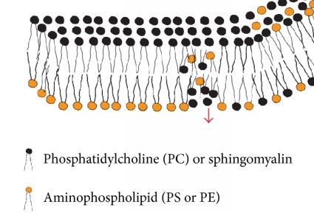
Functions/Roles of Phosphorus
Lipid bilayer of cell membranes
Notes:
PC: phosphatidylcholine (black)
PS: phosphatidylserine (yellow)
PE: phosphatidylethanolamine (yellow)
Sphingomyelin (black)
The phosphorylation of the lipid glycerol head is essential to the creation of a hydrophilic subregion and to the assembly of oriented bilayers
Photo Source: https://www.hindawi.com/journals/bmri/2014/697923/fig7/

Slide 57
Function/Roles of Phosphorus
Lipid bilayer of cell membranes
Glycolysis
Generation of high-energy compounds used to redistribute free energy (i.e. ATP, phosphocreatine)
Activate clotting factors (V and X)
Platelet aggregation
Phosphorylation of proteins → altered protein function
Cofactor for many co-enzymes
Essential for 2-3,DPG formation
Urinary buffer for H⁺

Slide 58
Distribution
Notes:
80%: skeleton, complexed in (hydroxy)apatite biomineral
19-20%: intracellular, most abundant anion
<1%: plasma, may be bound to organic macromolecules or unbound in ionic form
At normal physiology pH (7.4), 80% of unbound phosphate is in divalent form (HPO₄²⁻) and 20% is in the univalent form (H₂PO₄⁻)
Clinical labs only measure the unbound portion→ main screening test is only examining a fraction of whole-body stores

Slide 59
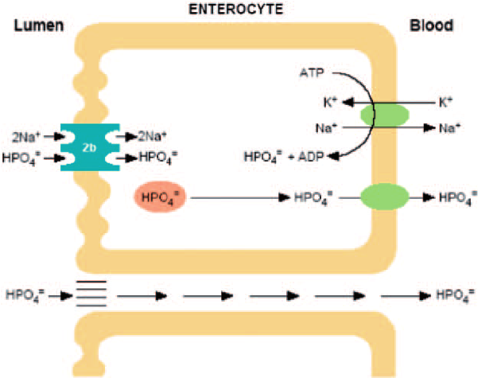
Uptake
Notes:
Taken up by small intestine via passive and active transport
Phosphorus and calcium uptake is enhanced by Vitamin D
Parathyroid hormone (PTH), Vitamin D, and calcitonin regulate the mobilization and storage of phosphorus in the skeleton
Photo Source: https://www.researchgate.net/figure/Reabsorption-of-phosphate-in-the-proximal-tubule-Phosphate-is-transported-across-the_fig2_260447267

Slide 60
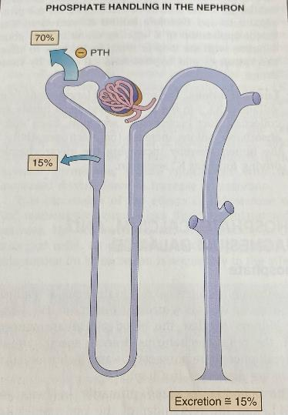
Renal Handling and Excretion
90% filtered
85% reabsorbed
  70% proximal convoluted tubule
  15% proximal straight tubule
  Na⁺-phosphate cotransporter in luminal membrane
    Saturatable
    Reaches a T_{m} after which any phosphate not reabsorbed is excreted
Notes:
Na-PO₄ co-transporter is the predominant site of regulation for phosphate excretion
Tm= transport maximum
The un-reabsorbed portion of phosphorus serves as urinary buffer for H⁺

Slide 61
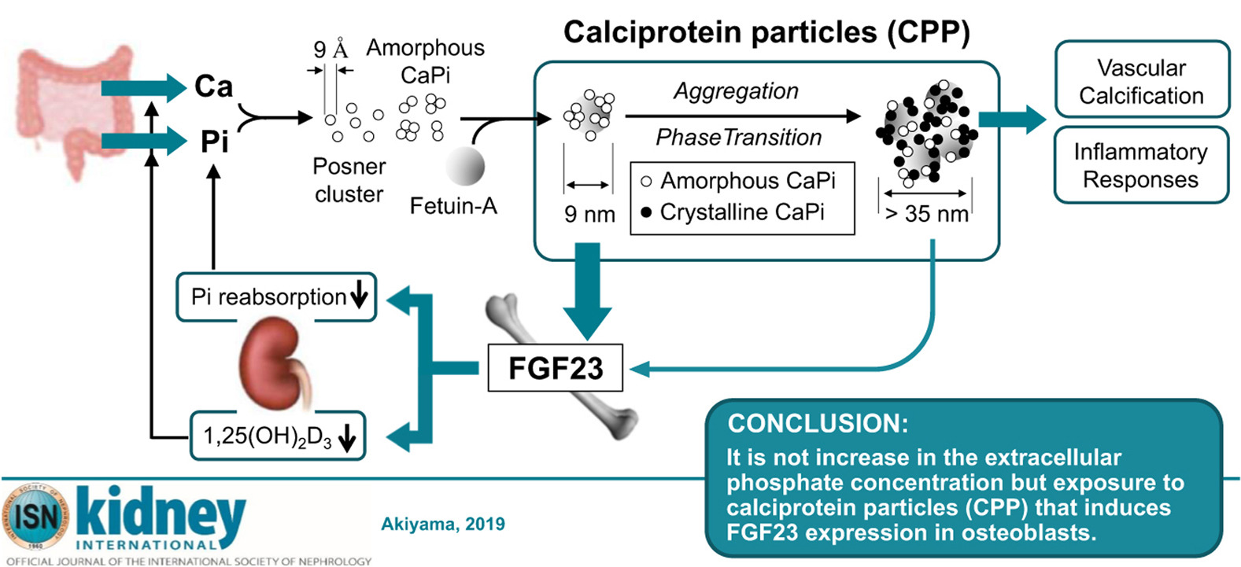
Renal Handling and Excretion
Regulated dietary phosphate, FGF-23, PTH
Notes:
FGF-23 = fibroblast growth factor 23
FGF-23 is secreted by osteoblasts in response to increases in phosphorus uptake
- In a negative feedback loop, FGF-23 then inhibits the production and stimulates the degradation of 1,25-dihydroxyvitamin D (which leads to less PO4 being mobilized from the bones) and concurrently promotes urinary phosphorus excretion
Photo Source: https://kidneyinternational-online.org/article/S0085-2538(19)31111-1/fulltext

Slide 62
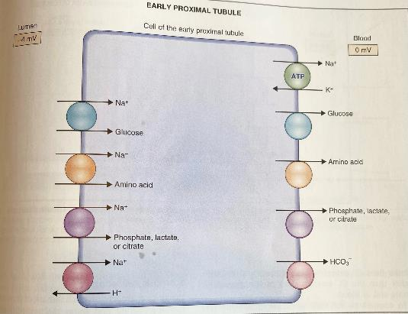
Renal Handling and Excretion
Condition | Transporter?
Metabolic acidosis
Inhibited
⬆serum PO₄³⁻
Inhibited
⬆PTH
Inhibited
⬇serum PO₄³⁻ (acute or chronic)
Upregulated
Vitamin D intox.
Upregulated
Notes:
Inhibiting the transporter means that more PO4 stays in the lumen, to be excreted
Upregulating it means that more PO4 is reabsorbed into systemic circulation
Parathyroid hormone (PTH) inhibits the Na⁺-phosphate cotransporter and decreases T_{m}→ causes phosphaturia, or increased phosphate excretion
PTH binds to a basolateral receptor in the proximal tubule cells which is coupled to adenylyl cyclase via a G_{S} protein → when activated, this adenylyl cyclase catalyzes conversion of ATP to cAMP, the second messenger → then activates a series of protein kinases which phosphorylate components of the luminal membrane
Defect in receptor, G_{S} protein, or adenylyl cyclase complex causes an inherited disorder called pseudohypoparathyroidism in which renal cells are resistant to the action of PTH, so while PTH will be increased in circulation, both urinary phosphate and cAMP are decreased
Respiratory alkalosis: increases intracellular pH, accelerating glycolysis, which is then accompanied by an increase in glucose and phosphorus movement intracellularly; may be important in ventilated patients and to consider/avoid overventilation
Extrapolating from this logic, METABOLIC ACIDOSIS decreases intracellular pH, decelerating glycolysis, which is accompanied by a decrease in glucose and phosphorus movement intracellularly/more phosphorus extracellularly
Elevated serum phosphate or PTH promotes removal of this transporter via endocytosis
Insertion of the transporter into the renal tubular membrane is stimulated by acute reductions in serum phosphate
Chronic hypophosphatemia promotes synthesis of new transporters
Vitamin D may not be by this mechanisms, as it stimulates the reabsorption of BOTH Ca²⁺ and PO₄³⁻ here

Slide 63
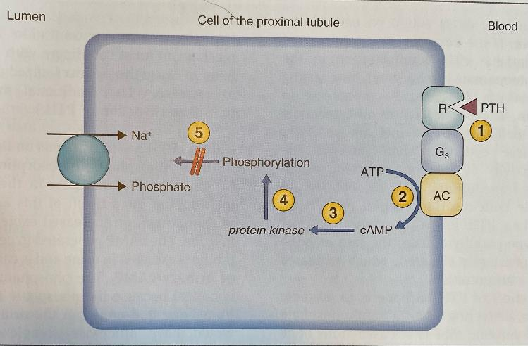
Renal Handling and Excretion
Notes:
Parathyroid hormone (PTH) inhibits the Na⁺-phosphate cotransporter and decreases T_{m}→ causes phosphaturia, or increased phosphate excretion
PTH binds to a basolateral receptor in the proximal tubule cells which is coupled to adenylyl cyclase via a G_{S} protein → when activated, this adenylyl cyclase catalyzes conversion of ATP to cAMP, the second messenger → then activates a series of protein kinases which phosphorylate components of the luminal membrane
Defect in receptor, G_{S} protein, or adenylyl cyclase complex causes an inherited disorder called pseudohypoparathyroidism in which renal cells are resistant to the action of PTH, so while PTH will be increased in circulation, both urinary phosphate and cAMP are decreased

Slide 64
Hypophosphatemia: Parameters
Normal: 3.0-5.0 mg/dL canine, 3.0-6.0 mg/dL feline
  15-20% below = abnormal→2.5 mg/dL cutoff

Slide 65
Hypophosphatemia: Causes
Decreased intestinal absorption
Increased renal excretion
Transcellular shifts

Slide 66
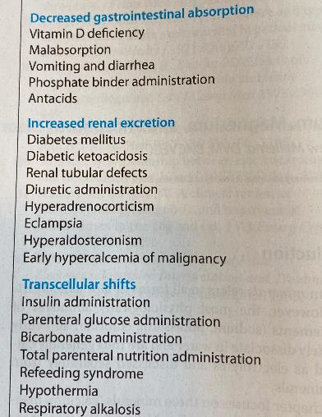
Hypophosphatemia: Causes
Notes:
Refeeding syndrome: release of insulin in the face of pre-existing hypophosphatemia causes PO4 to shift intracellularly (with Mg and K)
“Hungry bone syndrome” can occur after parathyroidectomy or parathyroid ablation for chronic hyperparathyroidism, but is rare
Restoration of effective insulin signaling during DKA treatment decreases PO4 concentrations within first 24h of insulin therapy
Respiratory alkalosis: increases intracellular pH, accelerating glycolysis, which is then accompanied by an increase in glucose and phosphorus movement intracellularly; may be important in ventilated patients and to consider/avoid overventilation
Beta-receptor agonists: moves PO4 intracellularly
Inverse relationship between serum PO4 and circulating levels of inflammatory cytokines→ neutrophils may use PO4, endogenous catecholamines may cause transcellular shifts
PO4-binding substances (i.e. Sucralfate, which contains aluminum)

Slide 67
Hypophosphatemia: Clinical Signs
Usually not evident until [PO₄²⁻] 1.5-2.0 mg/dL
CNS
Cardiovascular
CHF
Acute respiratory failure
Confusion
Paresthesias
Seizure
Coma
Dysrhythmias
Pulmonary
Tissue hypoxia
Notes:
Paresthesias: an abnormal sensation, typically tingling or pricking (“pins and needles”), caused chiefly by pressure on or damage to peripheral nerves
Phosphate depletion can impair myocardial contractility and reduce cardiac output
Tissue hypoxia b/c phosphate depletion is accompanied by depletion of 2,3-DPG, shifting oxyhemoglobin curve to the left and decreasing Hb’s likelihood of releasing O2 to tissues
No major link between low PO4 and respiratory failure→ this was shown in one study in HUMAN patients who could not be weaned from ventilator

Slide 68
Hypophosphatemia: Clinical Signs
Renal
AKI
Metabolic acidosis
Hematological
Hemolysis → pigmenturia
Platelet dysfunction
Leukocyte dysfunction
Gastrointestinal
Persistent ileus
Nausea
Vomiting
Musculoskeletal
Myalgias
Weakness
Rhabdomyolysis
Notes:
Myalgia: muscle aches and pain
Little evidence of phosphate depletion and clinically apparent muscle weakness

Slide 69
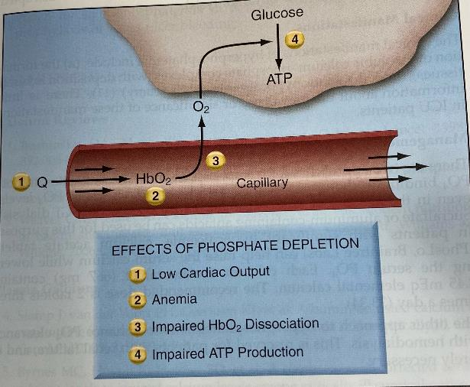
Hypophosphatemia: Effects
Notes:
The effect of phosphate depletion that can impair energy utilization in cells
Photo Source: Marino’s the ICU Textbook

Slide 70
Hypophosphatemia: Treatment
Main goals:
  Correct underlying disease process
  Rapidly decrease risk of hypophosphatemia-induced adverse events
Notes:
Usually, rapid correction of the full deficit is not necessary
Monitoring for visually apparent clinical signs of phosphate depletion is important in guiding the total quantity and rate of initial phosphate replacement

Slide 71
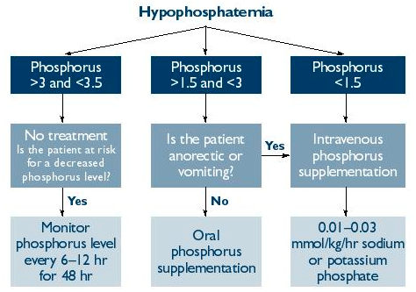
Hypophosphatemia: Treatment
Oral supplementation: not to exceed 108 mg/kg/d
  = renal interstitial mineralization dose
Moderate
Severe
0.03-1.2 mmol/kg/hr
Notes:
If moderately decreased (1.5-2.5 mg/dL), treatment/correction is not necessarily required if no clinical signs are appreciated
Unless the pt is mechanically ventilated, then even mild hypophosphatemia may prevent successful weaning and therefore correction is always recommended
Reassess serum phosphate concentrations q 8-12h while supplementation is ongoing is advised
Photo Source: https://www.vetfolio.com/learn/article/hypophosphatemia

Slide 72
Hyperphosphatemia: Parameters
> 6.0 mg/dL canine, > 7 mg/dL feline

Slide 73
Hyperphosphatemia: Causes
Increased intestinal absorption
Decreased renal excretion
Transcellular shifts
Physiological

Slide 74
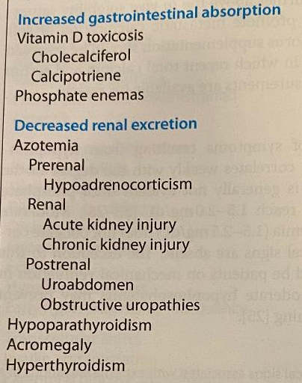
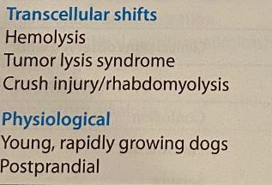
Hyperphosphatemia: Causes
Notes:
Vitamin D toxicosis also decreases renal excretion

Slide 75
Hyperphosphatemia: Clinical Signs
Dependent on severity of elevation and rate of increase
CNS
Cardiovascular
Decreased mentation
Seizures
Dysrhythmias
Q-T interval prolongation
Musculoskeletal
Weakness
Cramping
Hyperreflexia
Tetany
Notes:
- Tetany is due to acute hypocalcemia

Slide 76
Hyperphosphatemia: Clinical Signs
Renal
Renal injury
Exacerbation of pre-existing CKD
Gastrointestinal
Anorexia
Nausea
Vomiting
Reduced visual acuity
Ocular
Conjunctivitis
Dermatologic
Pruritus

Slide 77
Hyperphosphatemia: Treatment
Prompt correction achievable by:
  Extracorporeal therapies (rarely necessary)
    Hemodialysis
    Peritoneal dialysis
  Prompt restoration of renal excretion
    Administer calcium-poor fluids
    Loop diuretics
    Renal excretion is efficient so if renal function is adequate, hyperphosphatemia usually resolves quickly
Notes:
Dialysis is reserved for patients with renal failure and is rarely necessary in people

Slide 78
Hyperphosphatemia: Treatment
Treat underlying condition
  If CKD
    Reduce dietary protein intake
    Decrease GI absorption with phosphate-binding salts (Al, Mg, Ca)
      NOT helpful in ER usually because pt is not eating
Notes:
Sucralfate contains aluminum and can be used for this purpose

Slide 79
Phosphorus Questions
Which of the following is NOT a cause of hypophosphatemia?
  Refeeding syndrome
  Diuretic administration
  Metabolic acidosis
  Vomiting and diarrhea

Slide 80
Phosphorus Questions
True or False: Clinical signs of hypophosphatemia correlate well to the degree of reduction
  False. Clinical signs usually are not apparent until phosphate concentrations reach 1.5-2.0 mg/dL

Slide 81
References
Caironi, P. et al. Albumin replacement in patients with severe sepsis or septic shock. The New England Journal of Medicine, 2014; 370:1412-21.
Costanzo, L.S. Physiology 6th Edition. Chapter 6: Renal Physiology, Chapter 9: Endocrine Physiology. Elsevier 2018.
Drobatz et al. Textbook of Small Animal Emergency Medicine 1st Edition. Chapter 101: Lyme Nephritis, Chapter 110: Calcium, Magnesium, and Phosphorus Disorders, Chapter 168: Colloid Fluid Therapy, Chapter 169: Crystalloids Versus Colloids. Wiley and Sons, Inc. 2019.
Eclin path. Albumin, Effusion, Casts.
Hooft, K. & Drobatz, K.J. & Ward, C.R.. Hypophosphatemia. Compendium on Continuing Education for the Practicing Veterinarian, 2005; 27:900-910.
Marino, Paul. Marino’s The ICU Book 4th Edition. Chapter 37: Magnesium, Chapter 38: Calcium and Phosphorus. Wolters Kluwer Health/Lippincot Williams & Wilkins, 2014.
SAFE Study Investigators. A comparison of albumin and saline for fluid resuscitation in the intensive care unit. The New England Journal of Medicine, 2004; 350:2247-56.
Dibartola, S.P. Fluid, Electrolyte, and Acid-Base Disorders in Small Animal Practice, 4th Edition. Chapter 19: Fluid, Electrolyte, and Acid-Base Disturbances in Liver Disease, Chapter 22: Management of Fluid and Electrolyte Disorders in Renal Failure, Chapter 27: Fluid Therapy with Macromolecular Plasma Volume Expanders. Elsevier Saunders, 2012.

