Slide 1

Acute Liver Injury & Failure
+ Hepatotoxins
Paula Simons
2nd year ECC Resident
Cornell Veterinary Specialists

Slide 2
Liver Injury/Failure – Key Points
Occurs as a result of severe hepatocyte injury or dysfunction
Manifests as an acute or chronic process
Loss of hepatic function leads to a spectrum of metabolic derangements
  Can see clinical onset of hepatic encephalopathy and coagulopathy
  Other complications: GI ulceration, sepsis, cardiopulmonary dysfunction, and ascites
Liver is capable of regenerating 75% of it’s functional capacity

Slide 3
Definitions
Acute liver injury:
Acute hepatocellular damage and necrosis with retained hepatic function
Acute liver failure:
Hepatocellular damage so extensive that it compromises hepatic, synthetic, excretory, and regulatory functions
Absence of preexisting liver disease, presence of hepatic encephalopathy occurring within 8 weeks of hyperbilirubinemia, and coagulopathy

Slide 4
Pathophysiology

Slide 5
Common Causes

Slide 6
Clinical Features
Variable histologic changes seen with acute vs chronic liver disease
Acute = hepatocellular necrosis, fat accumulation, or hepatocellular drop out
Chronic = hepatocellular necrosis + fibrosis, inflammation, and ductular hyperplasia
Common clinical features:
Hypotension
Lactic acidosis → poor perfusion + decreased hepatic lactate metabolism
Electrolyte alterations
Hepatic encephalopathy
Coagulopathy
+/- MODS
Hepatorenal syndrome (in humans)

Slide 7
Hepatic Encephalopathy
Hallmark feature of hepatic failure
Neuropsychiatric syndrome with many neurologic abnormalities
Occurs when > 70% of hepatic function is lost
CNS enters encephalopathic state
  > 20 different compounds have been found in excess in circulation:
    Ammonia, aromatic amino acids, endogenous benzodiazepines, GABA, glutamine, short chain fatty acids, tryptophan, and more
  Substances impede neuronal and astrocyte function, cause cell swelling, inhibition of membrane pumps/ion channels, elevations in intracellular Ca concentrations, depression of electrical activity, and interfere with oxidative metabolism

Slide 8
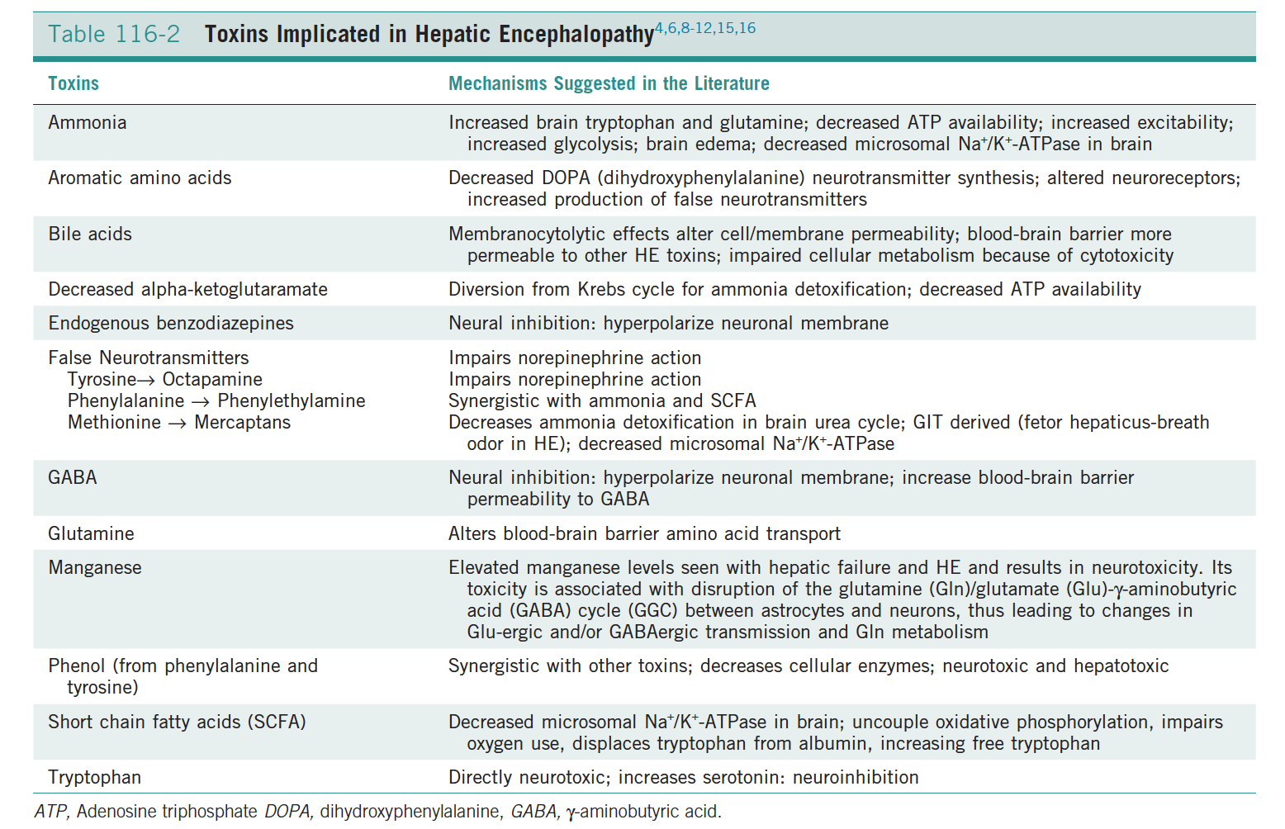

Slide 9
Classification and grading of HE
3 types:
  Type A- Acute liver failure
  Type B- Portal systemic bypass
  Type C- Cirrhosis and portal hypertension

Slide 10
Precipitating factors of HE

Slide 11
Ammonia
Considered the most important neurotoxic substance
Produced by GI flora and converted in the normal liver to urea and glutamine via the urea cycle
    Typically considered colonic bacteria + H. pylori in the stomach
    Intestinal mucosa has high glutaminase activity → enteric source of ammonia
Excitotoxic and associated with increased glutamate (excitatory neurotransmitter)
  Overactivation of glutamate receptors (mainly NMDA) is implicated as one cause of HE-induced seizures
  With chronicity, inhibitory factors (GABA and endogenous benzodiazepine) surpass the excitatory stimulus → signs of coma and CNS depression
  Long standing metabolic dysfunction (i.e. chronic liver failure) = alterations in neuronal responsiveness and energy requirement

Slide 12
Ammonia
Liver = ammonia detoxification
  Two pathways:
    Ammonia → urea by periportal hepatocytes = urea cycle
      Urea = less toxic than ammonia and water-soluble → excreted by the kidneys
    Glutamine is synthesized by perivenous hepatocytes = high glutamine synthetase activity
In liver failure, ability to metabolize ammonia or glutamine is reduced = hyperammonemia
  Kidneys contain glutaminase → metabolize and synthesize glutamine
    Can excrete ammonia → organ of net ammonia excretion
  Skeletal muscle = ammonia sink → source of glutamine synthease

Slide 13
manganese
Dogs not Cats
  Neurotoxin believed to synergize with ammonia
  Increased in cirrhosis secondary to decreased biliary excretion
  Accumulates preferentially in basal ganglia in humans w/ HE
  Mechanisms of neurotoxicity have not been fully characterized
  Promotes free radical production, inner mitochondrial membrane depolarization, and loss of cellular integrity

Slide 14
HE - Cerebral Changes
Cerebrum has glutaminase and glutamine synthetase
  Astrocytes have high glutamine synthetase activity → forms glutamine and releases into circulation
  Ammonia freely passes through BBB
  Organ of net ammonia removal
  Glutamine suspected to cause astrocyte swelling by acting as an osmolyte → influx of water
Can see cerebral edema, increased intracranial pressure, and possible brain herniation
  Edema seen in ~80% of human patients and 33% can develop herniation with hepatic failure
Variable clinical signs → most suggestive of neuroinhibition
Excitatory activity such as seizures, aggression, and hyperexcitability also occur
  Excitotoxic → increased release of glutamate = major excitatory NT
    Overactivation of glutamate receptors (NMDA) = cause of seizures
  With chronicity inhibitory GABA and endogenous benzodiazepines surpass excitatory stimulus → signs of coma or CNS depression
  Long standing metabolic dysfunction = alterations in neuronal responsiveness and energy requirements

Slide 15
Treatments
Aimed at decreasing ammonia concentrations
  In humans → NH3 levels not associated with the degree of encephalopathy
    Meaning?
      Other neurotoxins may be important in the pathophysiology of HE
  Veterinary patients → NH3 concentrations also do not correlate with signs of HE
    Dogs with normal NH3 can also have HE signs OR high NH3 levels can be neurologically normal

Slide 16
Coagulation Disorders
Multifactorial causes of coagulation abnormalities
Spontaneous hemorrhage is uncommon
Hemorrhagic complications = GI ulceration, invasive procedures, or other concurrent medical problems
Suggested causes:
Decreased factor synthesis
Increased factor utilization
Decreased factor turnover
Increased fibrinolysis and tissue thromboplastin release
Synthesis of abnormal coagulants
Decreased platelet function/numbers
Vitamin K deficiency
Increased production of anticoagulants

Slide 17
Other Complications
Increased susceptibility to infection
Bacterial infection occurring in 80% of human patients
Inhibition of the metabolic activity of granulocytic cells, cell adhesion, and chemotaxis
Decreased hepatic synthesis of plasma compliment
Reduced phagocytic ability of Kupffer cells → translocation of bacteria from portal circulation
Systemic hypotension
Suspected secondary to vasodilation → centrally mediated due to systemic infection, inflammation, cytokine release, cerebral edema, or circulating toxins
Pulmonary abnormalities
33% of humans will develop pulmonary edema → altered permeability of pulmonary capillaries leading to vascular leak
Decreased albumin/colloid osmotic pressure and vasodilation
Endotoxemia

Slide 18
Other Complications
Acid-base disturbances
Lactic acidosis secondary to poor perfusion
Renal dysfunction
Well described in humans
Mediated by pathologies that damage liver and kidney
Portal hypertension
Secondary to cirrhosis
Chronic liver failure
Sinusoidal collapse → blockage of intrahepatic flow
Portal pressure elevation
Can see portal vein thrombosis
Rare in dogs
i.e. lepto & NSAIDS
Decreased RBF and GFR from hypotension & hypovolemia

Slide 19
Clinical Signs
Nonspecific:
Anorexia, vomiting, diarrhea, weight loss, and dehydration
Icterus with intrahepatic cholestasis
Rule out pre/post hepatic causes
Polyuria + Polydipsia
failure to produce urea leads to defective renal medullary concentrating ability and delayed release/response to ADH

Slide 20
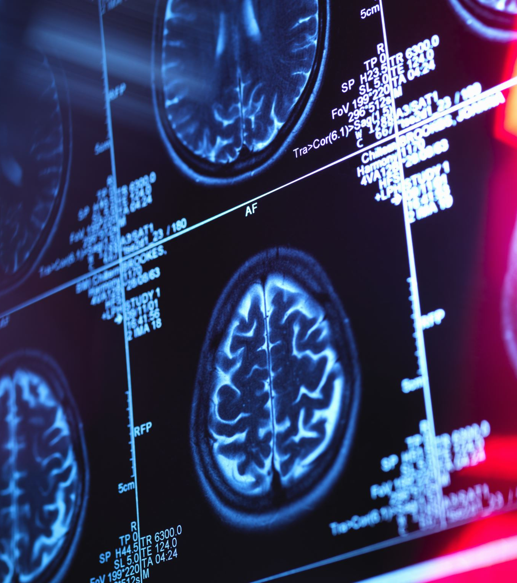
Clinical signs of Hepatic encephalopathy
Huge range of clinical signs
  Behavioral changes – panting, pacing,
  Ataxia
  Blindness
  Circling
  Head-pressing
  Seizures
  Ptyalism → more common in cats
  Coma
  Bleeding diathesis, melena, and ascites

Slide 21
Diagnosis
Fulminant failure with signs of HE + chemistry changes, evidence of coagulopathy, and associated history/PE findings
Blood Smear:
  Target cells, acanthocytes, and anisocytosis
CBC:
  Non-regenerative anemia → chronic disease, chronic blood loss, or hepatic shunts
  Regenerative anemia → GI ulceration
  Leukocytosis or Leukopenia with infectious causes or translocation
  Thrombocytopenia → DIC or ITP w/ infectious/immune mediated causes of liver failure

Slide 22
Biochemistry
Elevated Hepatic enzymes
  ALT & AST = increased with leakage from damaged hepatocytes
  ALP = increased with cholestatic diseases
    Short half-life in cats = active liver disease with elevations
  GGT = increased with cholestatic disease and is more specific and less sensitive than ALP
  Normal or mild increases does not rule out hepatic disease → consider end-stage disease or vascular anomalies
Hyperbilirubinemia
  Bilirubin escapes into circulation with significant cholestasis, bile duct obstruction, or canalicular membrane disruption
  Icterus when values at least 2.3-3.3 mg/dl

Slide 23
Biochemistry
Hepatic failure:
  Hypoalbuminemia, hypocholesterolemia, hypoglycemia, and decreased BUN
  Albumin produced only in the liver → 66-80% loss of liver function
    Hallmark of chronic liver dysfunction but consider concurrent disease - i.e. PLE/PLN and third spacing
  Cholesterol – 50% synthesized in the liver
    Can also see hypercholesterolemia with EHBTO or pancreatitis due to abnormal elimination
  Hypoglycemia with < 30% of liver function present due to liver’s maintenance of glucose homeostasis

Slide 24
Urine Sediment
Ammonium biurate crystals with vascular anomalies
Dogs can conjugate and produce bilirubin in their renal tubules → small amount is normal in health
Cats do not have this ability & have a higher threshold to resorb bilirubin
    Bilirubinuria is always inappropriate and indicative of abnormal bilirubin metabolism

Slide 25
Further Assessment of Hepatic Function
Prolongation of PT/PTT, ACT, and BMBT may be observed with coagulopathies
Increased pre/postprandial serum bile acids indicative of hepatic dysfunction
Ammonia testing
  Testing is problematic because ammonia is unstable
  Arterial samples preferable over venous
  Normal levels do not rule out HE
  Serial measurements may not correlate with clinical signs of HE
  Spurious results may occur
  Ammonia tolerance testing not recommended if concern for HE exists

Slide 26
Electrolyte Abnormalities
Hypokalemia
  Decreased intake, vomiting, K-wasting diuretics used to treat ascites
  Hyperventilation and respiratory alkalosis may encourage renal potassium excretion
Hypophosphatemia
  Hypocapnia → shift of intracellular CO2 extracellularly → raises intracellular pH and accelerates use of phosphate to phosphorylate glucose
  Hepatocellular regeneration may cause intracellular shift
    May be a positive prognostic indicator
  Monitor for hemolysis of RBC’s

Slide 27
Diagnostic Imaging
Abdominal radiographs
  Useful for size and contour, identifying mass lesions, and evaluating abdominal detail
Abdominal ultrasound
  Evaluation of hepatic parenchymal architecture, the biliary tract, and vascular structures
  Useful to guide sampling
Computed tomography with angiography helpful to diagnose portosystemic shunts but requires GA
  Carries considerable risk for patients with clinical HE

Slide 28
Cytologic or Histologic Evaluation
Detection of disease not caused by PSS
FNA → useful for infiltrative neoplasia (lymphoma) but gives little evidence of hepatic parenchymal change
  Very insensitive
Liver biopsies under US guidance, laparoscopy, or surgery
  Humans use a transjugular approach under fluoroscopy to avoid penetrating the hepatic capsule → avoids third space bleeding
    Not currently recommended in veterinary patients
  Coagulation testing prior to sampling
  Multiple samples stored for aerobic/anaerobic culture, copper testing (dogs), and PCR testing

Slide 29
Treatment
Treatment of underlying liver disease, decreasing complications of HE, and supportive care
Hepatocytes have immense ability to regenerate with support and time
Anticonvulsant therapy
  Propofol – 0.5-1mg/kg IV then 0.05-0.1mg/kg/min CRI for immediate control of seizures
  Levetiracetam shown to prevent post-anesthetic seizures with repair of PSS
    Loading prior to procedure
  Mannitol therapy (0.5-1G/kg over 20-30 minutes) if cerebral edema is a concern
    Herniation commonly seen in people
  Use of benzodiazepines is controversial with HE induced seizures
    GABA and it’s receptors are implicated in pathogenesis of HE
  Flumazenil is beneficial in humans with HE-induced comas but has not been proven to improve outcomes

Slide 30
Treatment
Symptomatic therapies:
  Withholding food
  Cleansing enemas with warm water and lactulose
  Oral lactulose = Nonabsorbable disaccharides
    Digestion by colonic bacteria produces volatile fatty acids trapping of ammonium ions within the colon due to decreasing colonic pH
    Inhibit ammonia production by colonic bacteria
    Reduced intestinal transit time
  Antimicrobial therapy
    Metronidazole and ampicillin decrease GI bacterial numbers → reduction in ammonia production
      Metronidazole and Ampicillin decrease risk of bacterial translocation and systemic bacterial infections
      Dose reduction in metronidazole to prevent neurotoxicity

Slide 31
Treatment
Bleeding patients
  Gastric ulceration = treatment with acid receptor blockade and sucralfate
  Coagulopathic patients with active bleeding → FFP or Whole blood + subcutaneous Vitamin K
  Significant anemia = pRBC or Whole blood
    With HE: fresh whole blood is preferred due to increased levels of ammonia in stored blood
Ascites
  If due to low oncotic pressure → consider synthetic colloid therapy
  If due to portal hypertension → use diuretic and low Na diet
    Spironolactone is diuretic of choice → aldosterone antagonism and potassium sparing effects
Hepatic Fibrosis:
  Drugs to decrease connective tissue formation → prednisone, C-penicillamine, and colchicines

Slide 32
Treatment
Fluid Therapy
  Maintain hydration and provide cardiovascular support
  LRS is debated due to decreased hepatic conversion of lactate
  K + Glucose supplementation often needed
Nutritional Management
  Readily digestible, contain protein source of high biologic value, supplies essential fatty acids, and meets minimum vitamin/mineral requirements
  Avoid low protein diets unless concern of HE → Milk and vegetable proteins are lower in AAA’s and higher in BCAA’s → less likely to potentiate HE
  TPE or PPE if enteral intake not tolerated

Slide 33
Nutraceuticals
  SAMe → hepatoprotective, antioxidant, and anti-inflammatory
    Precursor to the production of glutathione → critical role in the detoxification of the hepatocyte
  Vitamin E → antioxidant that prevents and minimizes lipid peroxidation
  Silymarin = active extract in milk thistle → antioxidant and free radical scavenging properties
    Inhibits lipid peroxidation, increases hepatic glutathione, and depresses hepatic collagen formation

Slide 34
Nutraceuticals
  Ursodeoxycholic/Ursodiol → hepatoprotective recommended for most type of inflammatory, oxidative, and cholestatic liver disease
    Anti-inflammatory, immunomodulatory, and antifibrotic → promotes choleresis
    Decreases toxic effects of bile acids on hepatocytes
    Contraindicated in patients with outflow obstruction
  Zinc → essential trace mineral involved in many metabolic and enzymatic functions of the body
    Enhances ureagenesis, glutathione metabolism, antifibrotic, copper chelation, and immune function
    Zinc deficiencies seen in humans with liver disease and may correlate with hepatic encephalopathy

Slide 35
Prognosis
Hepatic failure = poor ~ 14% survival
  Poor prognostic factors = PT >100 seconds, very young/old animals, viral/idiosyncratic drug reactions, and marked increases in bilirubin
  With hepatotoxins → antidote can improve survival markedly though many do not have an antidote
Failure with congenital PSS → good with appropriate medical management and occlusion

Slide 36
Future Therapies
Liver transplant
Stem Cell Therapy → improves the regenerative environment of the organ
  Currently under investigation → improvement seen in mice with acute liver injury

Slide 37
Common Hepatic Toxicities

Slide 38
Acetaminophen
AKA Tylenol, paracetamol, and APAP
COX-3 inhibitor
Rapid absorption through the stomach and SI → peak absorption within 30-60 minutes
Poor plasma binding → wide systemic distribution
Metabolism in the liver via 3 pathways → glucuronidation, sulfation, and cytochrome p-450 mediated oxidation
Part of drug is metabolized into non-toxic conjugates → some is excreted unchanged in urine or metabolized into toxic metabolite → N-acetyl-para-benzoquinoneimine (NAPQI) via p-450 pathway
NAPQI is detoxified by conjugation with glutathione (GSH) in the liver

Slide 39
Acetaminophen
Toxicity
  75-100 mg/kg in dogs → MetHb w/ doses > 200 mg/kg
  10 mg/kg in cats
  Glucuronidation and sulfation elimination pathways become saturated as dose increases and more of drug is converted to NAPQI. GSH becomes depleted leading to oxidative injury
  Cats more sensitive due to deficiency in glucuronyl transferase → enzyme required to metabolize acetaminophen via glucuronidation pathway → sulfation pathway quickly saturated → more drug metabolized to NAPQI
Systems affected
  Heme/CV → Heinz body and MetHb formation +/- hemolytic anemia due to binding of NAPQI and oxidative damage to RBC and Hb molecules
    Collapse, shock, death
  Hepatic → NAPQI binding to hepatocyte membranes → hepatocellular death and necrosis
  GI → vomiting, diarrhea
  Nervous → HE secondary to hepatotoxicity
  Renal → tubular necrosis
  Resp → dyspnea and tissue hypoxia secondary to MetHb impairing RBC oxygen carrying capacity
  Skin → facial/paw edema and icterus

Slide 40
Acetaminophen
Clinical Features:
Cats = MetHb → shock, brown MM, resp distress, cyanosis, dull/depressed mentation or coma, and edema of the face and paws
Dogs = hepatoxicity, GI signs, and CNS signs → V+, abdominal pain, icterus, coma, HE
Diagnostics:
CBC: MetHb, Heinz body anemia
Chem: Elevated ALT, AST, and T Bili
Hypoglycemia and prolonged PT/PTT with severe hepatic failure

Slide 41
Acetaminophen
Detoxification:
Induce vomiting within 2 hours of ingestion
Activated charcoal (1-3g/kg) with cathartic once with ingestion <1 hour prior → no significant enterohepatic recirculation so additional doses will not work → will interfere with NAC administration
Treatments:
Supplemental O2 if needed
IVF +/- pRBC’s for hemodynamic stability
Antidote → provision of glutathione substrates → NAC 140mg/kg once then 70 mg/kg IV q4-6 hours for 7-17 doses → may be more effective PO
Antioxidants → SAMe 18mg/kg/dat + Vitamin C (Ascorbic Acid) 30mg/kg IV q6 to reduce Methb to Hb
Alternative Therapy → Cimetidine 5-10mg/kg IV to reduce metabolism of APAP by p450 pathway
FFP + Vitamin K for coagulopathy
Methylene Blue 1.5mg/kg IV for 1-2 doses (not used in cats due to risk of MetHb production)

Slide 42
Aspirin
Aka acetylsalicylic acid (ASA) → OTC NSAID and antipyretic
MOA:
  Non-selective prostaglandin inhibitor → irreversible inhibition of COX
  Inhibition of thromboxane and prostacyclin disrupts platelet aggregation and hemostasis
  Inhibition of PGE2 production disruptions normal GI and renal blood flow
  Salicylates alter Kreb’s cycle → MODs from uncoupling of oxidative phosphorylation
Pharmacokinetics
  Rapidly absorbed into stomach and proximal small intestines → metabolized by the liver, intestines, and RBC’s into salicylic acid
  Highly protein bound and conjugated with glucuronate and glycine
  Half life @ 25mg/kg = 7-8 hrs in dogs and 38-45 hrs in cats (prolonged half life due to decreased glucuronate)

Slide 43
Aspirin
Toxicity:
Dose dependent
Mild <50mg/kg = GI side effects
Significant toxicity with 100-500mg/kg in dogs and multiple doses of 80mg/kg in cats
>100mg/kg = potential for death
Chronic administration (23mg/kg q8 >6 days) caused gastric lesions in dogs
Systems Affected
GI : V+, hematemesis, D+, melena, GI ulcers
Heme: Anemia, bone marrow suppression, Heinz body formation (cats)
Renal: azotemia, ARF
Hepatic: Hepatopathy reported with high doses in cats
CNS: depression, seizures, coma, death
Resp: Resp depression and pulmonary edema

Slide 44
Aspirin
Clinical features:
Not apparent for hours to days after ingestion
GI losses, cramping, anemia, altered mentation, resp changes
Diagnostics:
CBC: Heinz bodies (cats), anemia
Chem: Increased ALP, AST, ALT, and GGT

Slide 45
Aspirin
Detoxification:
Emesis if ingestion was a few hours ago
Gastric lavage with ingestion <1-2 hours prior
Activated charcoal with cathartic → repeated w/o cathartic q6-8 for 24 hours
Treatment:
IVF
Dialysis for patients in ARF that qualify
Urine alkalinization? Target urine pH of 7.5-8 with Na Bicarb
No antidote available
Misoprostol, Sucralfate, PPI or H2 blockers for gastroprotection
pRBC’s for severe anemia
With hepatopathy → SAMe and Vitamin K

Slide 46
NSAIDS
Overdoses of human and veterinary NSAIDs have the potential to cause liver failure and hepatocellular necrosis
  Human NSAIDs can result in longer half life and differing metabolism → more significant disease.
Treatment and support similar to aspirin toxicity

Slide 47
Sago Palm – Order Cycadaceae
Toxicity with any part of the plant ingested → illness dependent on amount of plant and part ingested
  Common ornamental plant
Toxin is ingested orally and absorbed through the GIT
Cycasin contains a glucose molecule → hydrolyzed in the gut → GI and hepatic toxicity
  Azoglycoside toxins cycasin and mathylazomethanol
Systems Affected:
  Hepatic: acute severe hepatic necrosis at 2-3 days
  GI: V+/D+ in 15 min to several hours
  Neurological: Weakness + ataxia and worse with hepatic disease

Slide 48
Sago Palm
Clinical Features:
  Signs begin within 15 minutes to 3 days and duration is 1-9 days
  GI signs first then hepatic enzyme changes
  Will see V+/D+ then icterus and abdominal pain → may progress to weakness, ataxia, and seizures
Detoxification:
  Induce emesis within several hour of ingestion
  Activated charcoal + cathartic then AC every 4-6 hours for 2 doses
Treatments:
  No antidote available
  Aggressive fluid therapy , seizure control, anti-emetics, GI protectants, Vitamin K1, hepatic protectants, and NAC
Prognosis for recovery is good if liver enzymes are not elevated by 48 –72 hours.
  The reported recovery rate after treatment is approximately 42%.
  Long term survival may be poor.
  Methylazomethanol, one of the toxins associated with sago palm toxicosis, damages neuronal DNA and death may occur in recovered animals 8 –12 weeks after initial toxic exposure.

Slide 49
Heavy Metals - Iron
Lethal when ingested in large quantities
Found in multivitamins, fertilizers, and hand warmers
Circulating iron in excess of binding capacity is very reactive and causes oxidative damage → must be in readily ionizable form to be absorbed and toxic → metallic iron and iron oxide are not toxic
MOA:
  Loss of mucosal limitations of iron absorption due to corrosive effects
  Oxidative damage to cells due to reactive hydroxyl ions and hydroxyl radicals
  GI, hepatic, and CV damage
  Vasodilation and vascular damage → hemorrhage and shock
  Animals have inability to excrete excess iron

Slide 50
Heavy Metals - Iron
Toxicity:
  Oral toxic dose (dogs)
  < 20 mg/kg of ionizable iron is nontoxic.
  20 – 60 mg/kg of ionizable iron can result in clinical signs.
  > 60 mg/kg of ionizable iron can result in serious clinical disease.
  Injectable iron is more toxic due to much greater bioavailability.

Slide 51
Heavy Metals - Iron
Systems affected:
  CV – damage to vascular endothelial cells + hemorrhage
  Metabolic – hypovolemia/hypotension → lactic acidosis
  GI – erosions, ulcerations, hemorrhage, corrosive effects, and potential stricture formation of esophagus and GIT
  Hepatic – free iron has great exposure to hepatocytes via portal blood flow → damages hepatocellular membranes
  Nervous – CNS edema from vascular damage or HE

Slide 52
Heavy Metals - Iron
Clinical features:
4 Phases of toxicity
0-6 hours: GI signs +/- hemorrhage
6-24 hours: Apparent recovery
12-96 hours: GI signs, hemorrhage, shock, tremors
2-6 weeks: potential stricture formation
Diagnostics:
Serum iron levels should be checked 2 –3 hours post-ingestion.
Normal level in dogs: 94 – 122 μ g/dL
Level at which chelation is necessary: > 350 – 500 μ g/dL
Monitor at 2 –3 hours and at 5 –6 hours postingestion in asymptomatic patients (absorption rates vary with tablet dissolution and serum iron concentrations may change rapidly).
Monitor every 6 to 8 hours in patients on chelation therapy

Slide 53
Heavy Metals - Iron
Detoxification
AC does not bind
Induce emesis in asymptomatic patient
Gastric lavage – contraindicated with GI hemorrhage
Emergency gastrotomy if unable to decontaminate and toxic dose ingested
Treatment:
IVF and CV support
Gastroprotectants
Chelation

Slide 54
Heavy Metals - Iron
Chelation/Antidote:
Deferoxamine mesylate 15 mg/kg/h, slow IV infusion or 40 mg/kg IM q 4 – 6 hours or 40 mg/kg, slow IV q 4 –6 hours
For chelation when indicated by serum iron exceeding TIBC, or when serum iron levels are > 350 – 500 μ g/dL
Oral milk of magnesia or aluminum hydroxide will precipitate iron in the GIT as insoluble iron hydroxide.
Prognosis:
Good if no clinical signs by 8 hours
Fair to guarded with decontamination prior to clinical signs
Guarded in patients with clinical signs

Slide 55
Mushrooms - Amanita
MOA: inhibit nuclear RNA polymerase II → decreased protein synthesis and cell death
  Hepatocytes susceptible due to high metabolic rate
After exposure, toxic effects to GI cells → rapid GI absorption and distribution (not plasma bound)
Extremely toxic → ingestion of two mushrooms is enough to kill an adult dog
Systems affected:
  GI signs 8-12 hours after exposure
  Hepatic failure 36-48 hours after exposure
  Renal → if surviving liver failure → MODS can develop
  Neuro → secondary to HE

Slide 56
Amanitin Poisoning
Clinical Features = Four Phases:
Phase 1: aclinical latency period for 8-12 hours
Phase 2: 6-24 hours after ingestion → GI signs
Phase 3: False recovery → hours to days → monitoring liver and kidney function
Phase 4: 36-84 hours after ingestion → fulminant liver failure
Diagnosis:
A-amanitin in serum, urine, gastric contents → urine considered superior → excreted up to 72 hours post-exposure
Therapy: No antidote →high mortality rate even with treatment
Treatment for hepatic liver failure

Slide 57
Aflatoxins
Produced by Aspergillus species → Found in garbage, crops, and improperly stored foods
Epoxide metabolite damages hepatocytes → cell necrosis, fibrosis, and biliary hyperplasia
Toxicity:
  60 ppb of aflatoxin in dog food has been associated with canine aflatoxicosis.
  6.7 – 15 ppm aflatoxin in moldy bread has been reported toxic to dogs.
  No natural toxicity reported in cats
Diagnosis: Assays of the suspected source can be performed by many state veterinary labs
  Residues can be found in urine, liver, and kidney

Slide 58
Aflatoxins
Clinical Features:
May be delayed up to 3 weeks post-exposure
Anorexia, V+/D+, depression, seizures, icterus, epistaxis, GI hemorrhage, etc
Early detoxification with single dose of AC
Antidote: None
Supportive care with IVF, gastroprotectants, and hepatic support
Prognosis: Guarded to poor once clinical signs are apparent

Slide 59
Blue-Green Algae
Proliferates in fresh and brackish water causing algal blooms – unknown which contain toxins (microcystins)
Hepatotoxic and neurotoxic forms
MOA:
  Microcystins are hepatotoxic but inhibiting protein phosphatases 1 and 2A. Disrupts cytoskeletal components and causes rearrangements of actin within the hepatocytes → severe liver damage
  Free radical formation and and mitochondrial alterations → acute centrilobular necrosis
Clinical Signs:
  D+, weakness, pale MM, icterus, and shock → usually occur within 30 minutes of exposure → rapid death within hours

Slide 60
Blue Green Algae
Detoxification:
  Emesis if asymptomatic
  AC is questioned
  Bathe animal thoroughly → wear protective clothing
Treatment:
  No antidote available
  Supportive care for hemorrhagic shock and hepatic failure
Prognosis: Poor – animals often die before treatment occurs

Slide 61
Xylitol
Five-carbon sugar alcohol commonly used as a sugar substitute in chewing gums, candies, nicotine gums, toothpastes, and baked goods
MOA:
  Xylitol is a potent stimulator for insulin secretion from the pancreas in dogs.
  The mechanism of hepatic necrosis is unknown. There are two proposed mechanisms:
    depletion of hepatic cellular ADP, ATP, and inorganic phosphorus molecules or production of reactive oxygen species during the metabolism of xylitol
    Severe hepatic necrosis results in secondary impaired clotting factor production and DIC
    Profound hypokalemia can be seen secondary to endogenous insulin secretion
    Rapidly absorbed after ingestion → peak plasma levels in 30 min to 1 hour

Slide 62
Xylitol
Toxicity
Hypoglycemia — a dose > 0.1 g/kg
Hepatic failure —a dose > 0.5 g/kg
However, it is unclear if it is truly dose dependent or an idiosyncratic reaction
Clinical Signs:
Vomiting, hypoglycemic shock, and signs of acute liver failure
Diagnostics:
BG every 1-2 hours for first 6-8
Monitor hepatic enzymes → can see hepatic failure in absence of hypoglycemia → monitor for 72 hours

Slide 63
Xylitol
Decontamination
Emesis within 1-6 hours → not if patient showing signs of hypoglycemia
AC not recommended
Treatment:
No known antidote
IVF supplemented with dextrose even if normoglycemic
Dextrose boluses if hypoglycemic
Hepatic support and GI protectants if vomiting
Prognosis:
Fair to guarded with prompt treatment → worse with liver failure
Good with only transient hypoglycemia

Slide 64
Hepatoprotectants
Name | MOA
SAM-e | synthesized by ATP in all cells; Plays role in transmethylation (maintain cell membrane integrity), transsulfuration (generates GSH), aminopropylation (anti-inflamm)
N-acetylcysteine | thiol donor; stimulates gsh, detoxifies hepatotoxins acts as free radical scavenging, improves microcirculatory blood flow
Silymarin | derivative of milk thistle; scavenges ROS, prevents lipid peroxidation, and induces the antioxidant system
Vitamin C – Ascorbic Acid | major water-soluble antioxidant is believed to decrease lipid peroxidation either directly or indirectly by regenerating vitamin E.
Vitamin E - alpha tocopherol | Free radical scavenger; should not be used in coagulopathic patients as it may compete by vit K

