Slide 1
ALI and ARDS
Samantha Davis, DVM

Slide 2
Definition
Acute respiratory distress syndrome: a syndrome associated with peracute respiratory distress characterized by severe hypoxemia and bilateral diffuse alveolar infiltrates not caused by hydrostatic pulmonary edema
Secondary to a underlying disease process- pulmonary vs non
Acute lung injury: a condition defined by the same variables as ARDS but with less severe hypoxemia
Notes:
First described in the 1960s, development of acute hypoxic respiratory failure in adults associated with a variety of etiologies, leading to pulmonary inflammation and the development of nonhydrostatic pulmonary edema in patients.

Slide 3
Definition
1994 AECC criteria
1. Acute onset respiratory distress
2. Bilateral infiltrates on chest radiographs
3. Hypoxemia, P/F ≤ 200 mmHg
4. Pulmonary artery wedge pressure ≤ 18 mmHg or the absence of clinical left atrial hypertension
Notes:
American European Consensus Conference

Slide 4
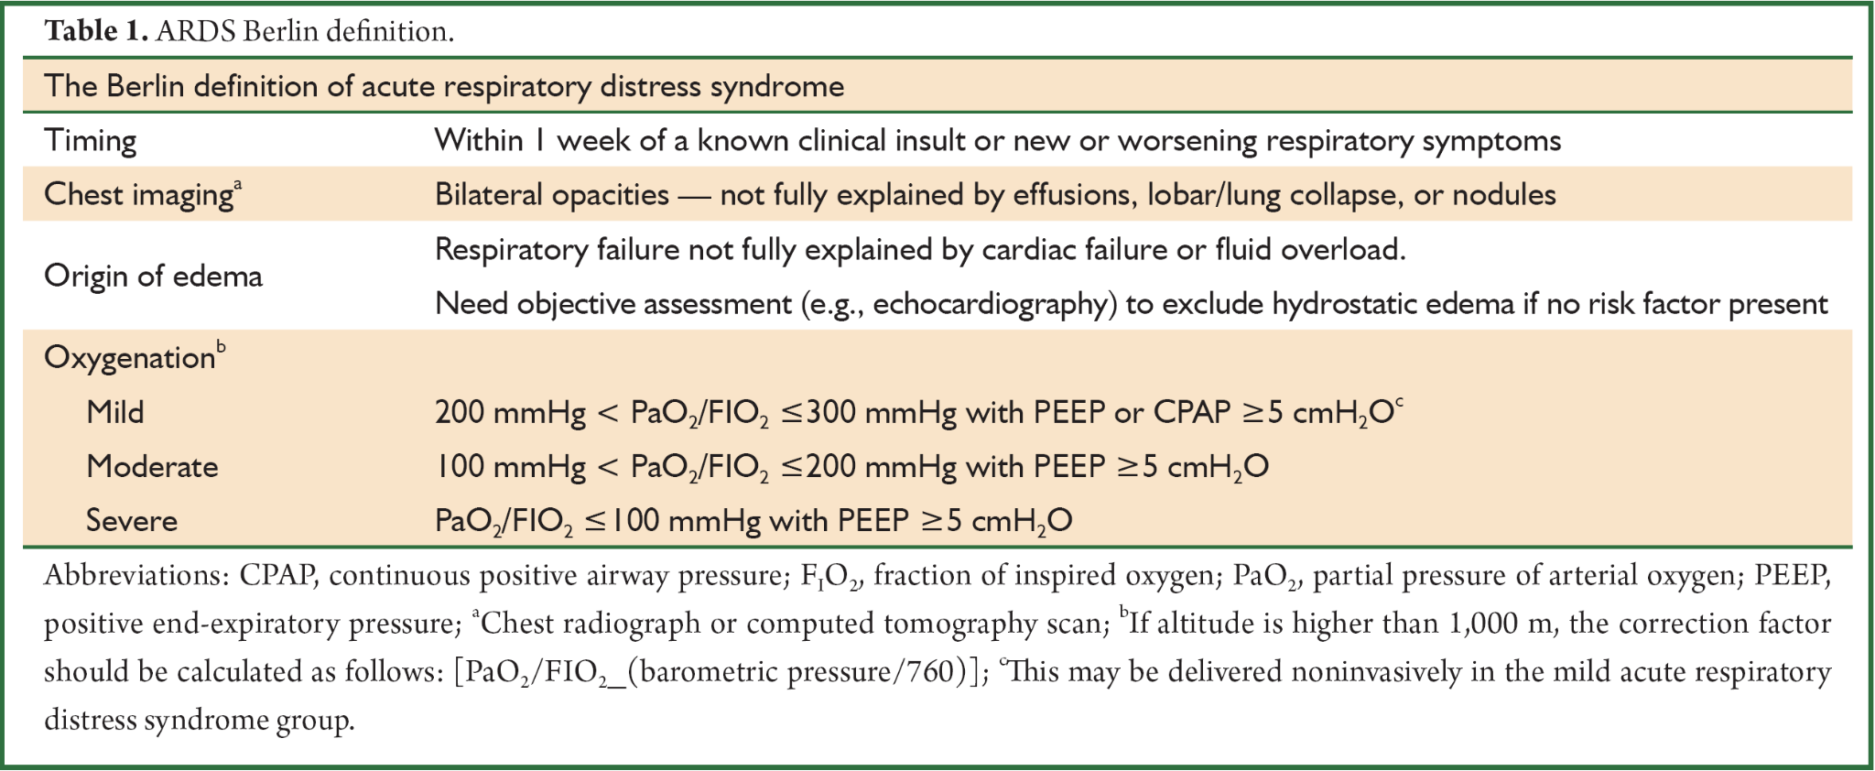
Definition
Notes:
Replaced in 2012, more clear definition of oxygenation and vent settings, as well as timing

Slide 5
Criteria
VetARDS:
Acute onset of respiratory distress <72 hours, labored breathing at rest
Presence of known risk factors
Evidence of pulmonary capillary leak without increased pulmonary capillary pressure
Evidence of inefficient gas exchange
(optional) Diffuse pulmonary inflammation
Notes:
In 2007, the Dorothy Russell Havemeyer working group created a consensus
Any diagnostic tool that can rule out causes of PE d/t increased hydrostatic pressure - usually rads
ALI is P/F < 300 mmHg
Get into specifics in the diagnostics section 3,4,5

Slide 6
Risk Factors
Risk factors: inflammation (pancreatitis), infection (pneumonia), sepsis, SIRS, severe trauma, blood transfusions, smoke inhalation, near drowning, aspiration of stomach contents, drugs and toxins
Sepsis is the most commonly reported risk factor for ARDS in humans, with pneumonia being the most common cause of sepsis
Notes:
Based on human risk factors as well as veterinary
Incidence of VetALI 3.7% in dogs within 24-48 hours of blood transfusion vs 25% in people, TRALI or ALI?

Slide 7
Pathophysiology
Inciting cause creates a proinflammatory state that damages:
Epithelium of type I pneumocytes involved in gas exchange
Pulmonary capillary endothelium, increasing permeability
Formation of pulmonary edema, neutrophil recruitment, cytokine production —> leads to V/Q mismatch and poor lung compliance
May lead to SIRS, MODS
Notes:
Cover internal surface of alveoli
IL-1 and TNF alpha
V/Q mismatch- Poorly ventilated alveoli d/t fluid accumulation, physiologic shunt occurs when de-ox blood flow past flooded alveoli

Slide 8
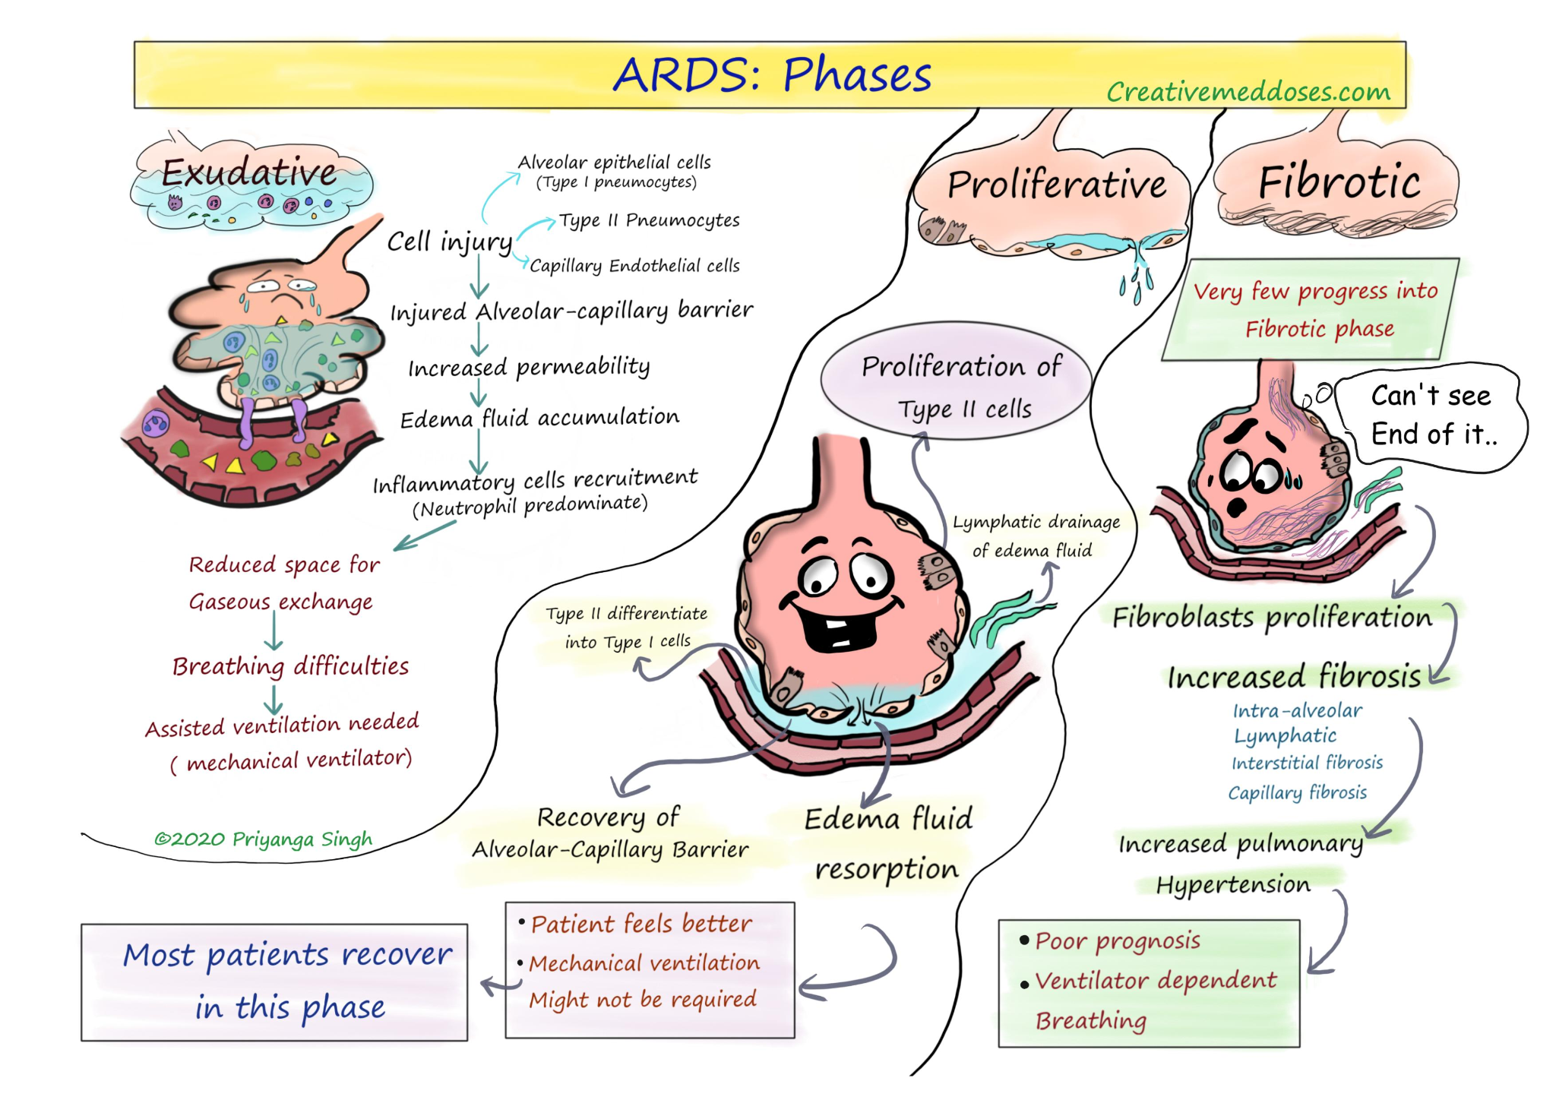

Slide 9
Phases of disease
Week 1: Acute or exudative phase
24-48 hours CXR may be normal, next 2-3 days increasing bilateral patchy alveolar infiltrates progress to diffuse consolidation, air bronchogram, small volume effusion
Non homogeneous distributions, gravity dependent
Week 2 : Intermediate or proliferative phase
Proliferation of Type II cells, Reticular opacities on imaging
Week 2 and later: Late or fibrotic phase
Evidence of pulmonary fibrosis, more than 70% patients have changes 6 months follow up
Notes:
Described in human literature

Slide 10
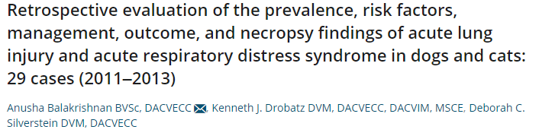
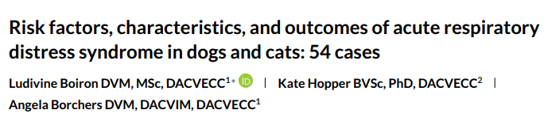
ARDS in veterinary practice

Slide 11
Clinical presentation
Median age 8-9 yrs, no sex or breed predisposition, but more common in dogs than cats
Respiratory distress was the most common complaint
Other common complaints: vomiting/regurgitation, lethargy, cough, anorexia or trauma
Prevalence 3.2% dogs, 1.3% cats
Notes:
2- 14/29 in Bala paper, at diagnosis all had labored breathing at rest (median RR- 46) and in Boiron paper (46%) presented in resp distress, remainder developed it in hospital
4- Worldwide estimates of the incidence of ARDS range from 7.2 to 34 cases per 100 000 person-years.

Slide 12
Diagnostics- Imaging
Imaging: chest radiographs, thoracic CT, echocardiogram
Bilateral/diffuse infiltrates on CXR
Bilateral dependent density gradient on CT
Proteinaceous fluid within the conducting airways
Increased extravascular lung water
Notes:
1- vet ARDS- #3 evidence of pulmonary capillary leak
2- multilobar patchy alveolar infiltrates in all patients, mild pleural effusion in 1- Bala, 98% CXR consistent with ARDS- Boiron

Slide 13
Diagnostics - Imaging
CT more accurate in detecting causes and complications with ARDS patients
Can assess recruitment and hyperinflation to determine optimal PEEP and TV
Lung ultrasound: superior to auscultation and CXR for pulmonary edema and alveolar consolidation, based on distribution of B lines
CXR still useful as bedside modality, can help with modification of PEEP in patients in MV
Notes:
CXR may under represent the occurrence of ARDS- CT gold standard in people
CT- lungs appear small (baby lung), acute exudative lesions are gravity dependent - prone MV to improve ventilation to the dorsal areas of the lungs

Slide 14
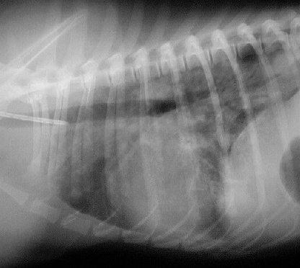
Thoracic radiograph

Slide 15
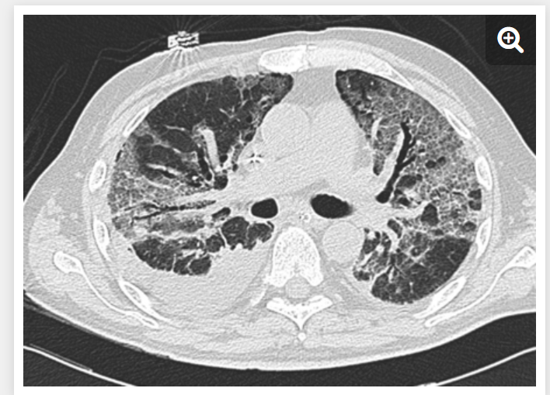
Thoracic CT- human
Notes:
Typical computed tomography features of acute respiratory distress syndrome showing: non-homogeneous distribution, a ventro-dorsal gradient of density, more dense consolidation in the dependent regions, widespread ground-glass opacities associated with thickening of interlobular septa (crazy paving), and pleural effusion.

Slide 16
Diagnostics
BAL/TTW:
Transtracheal wash/BAL sample neutrophilia
TTW/BAL biomarkers of inflammation
Molecular imaging (PET)
Notes:
Also vet ARDS criteria- #3
Severe neutrophilic pulmonary inflammation and septic suppurative inflammation

Slide 17
VetARDS criteria #4
Evidence of inefficient gas exchange:
Hypoxemia without PEEP or CPAP and known FiO2
P/F ratio: ≤ 300 mmHg for VetALI, ≤ 200 mmHg for VetARDS
Increased Aa gradient
Venous admixture (non cardiac shunt)
b. Increased dead space ventilation

Slide 18
Diagnostics
SPO2- >95% correlated to paO2 >80 mmHg
ABG- PaO2, SaO2, paCO2, pH
Use these values for Aa gradient, P/F ratio, S/F ratio
Notes:
Obvious issues with accurate SPO2

Slide 19
A- a gradient
Alveolar -arterial gradient measures the difference between the oxygen concentration in the alveolus and arterial system
Normal is < 10-15 mmHg on room air
Notes:
Allow us to determine cause of hypoxemia, if normal indicates hypoventilation vs elevated in pneumonia

Slide 20
Aa gradient
What is the Aa gradient if the pCO2 is 40 mmHg ?
PAO2= FiO2 (760 mmHg -46 mmHg X FiO2) - (paCO2/0.8) = ?
PaO2= 70 mmHg
A-a gradient= 30 mmHg
100 mmHg
Notes:
PAO2= FiO2 (760 mmHg -46 mmHg X FiO2) - (paCO2/0.8) = ?
118 mmHg

Slide 21
Diagnostics- P/F ratio
Ratio of arterial oxygen partial pressure to fractional inspired oxygen
At sea level normal ratio should be 400-500 mmHg
PaO2/FiO2 ratio is used to assess oxygenation when patient is not on room air
Notes:
Arterial sampling is required can be hard to patients, esp cats in resp distress, trends are important which require a sampling line
Median P/F ratio was 160 - Boiron, < 200 in 74% and > 200 but < 300 in remaining 26%

Slide 22
Sample P/F problem
PaO2= 90 mmHg
FiO2 = 40%
What is the P/F ratio?
Notes:
225
500X fiO2= PaO2

Slide 23
SpO2/FiO2 ratio
SpO2/FiO2 can be considered as a surrogate for P/F since ABG cannot always be obtained in animals in respiratory distress
Rice, et al S/F < 315 corresponded with a P/F ratio of < 300, S/F < 235 with P/F <200
Calabro et al showed a moderate correlation between S/F and P/F ratio (P < 0.01)
S/F not validated in veterinary ARDS patients

Slide 24
Treatment
What are the main treatments for ARDS?

Slide 25
Treatment
Mechanical ventilation: Boiron et al, MV recommended in 86%, 49% received it, Balakrishnan, et al 50% dogs and 80% cats received it
3/6 dogs survived and did not require MV
Treatment of underlying disease process, early recognition
Avoid overzealous IV fluid administration
Notes:
2- unclear if truly had ARDS
Surfactant therapy, cytokine blocking agents, IV beta agonists , inhaled NO

Slide 26
Mechanical ventilation
Recommended in cases with severe, persistent hypoxemia that is not responsive to oxygen supplementation
Relieves work of breathing
Pressure vs volume assist control- no difference in mortality (humans)
Notes:
2015 meta analysis showed no difference in in hospital mortality between volume and pressure control modes

Slide 27
Mechanical ventilation
Higher PEEP used to recruit collapsed alveoli to increase oxygenation
Higher airway pressure needed for a given tidal volume due to poor pulmonary compliance
Low tidal volume to protect the lungs from volutrauma

Slide 28
Mechanical ventilation
What is a downside of low tidal volume ventilation?
Hypercapnea and acidosis
What are the effects of excessive PEEP?
Increased intrathoracic pressure and right ventricular afterload, lung overinflation

Slide 29
Mechanical ventilation
What is a downside of low tidal volume ventilation?
Hypercapnea and acidosis
What are the effects of excessive PEEP?
Increased intrathoracic pressure and right ventricular afterload, lung overinflation

Slide 30
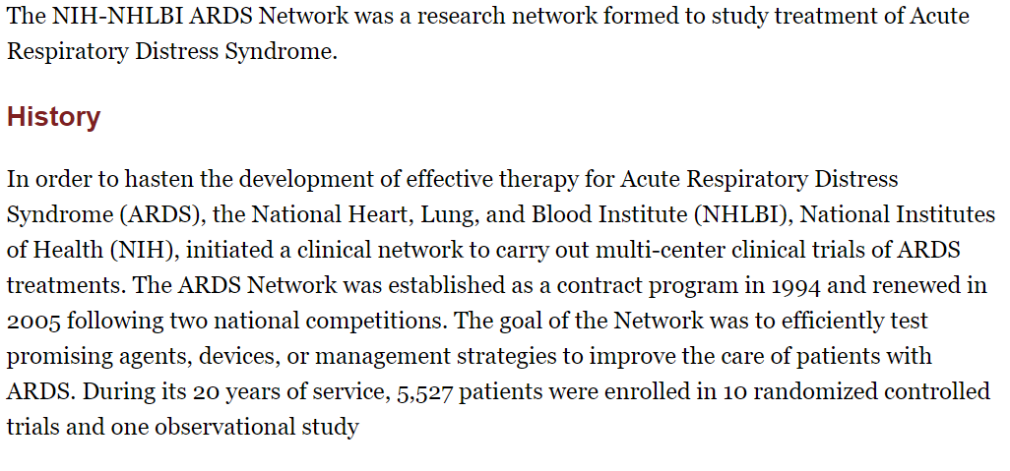
ARDSnet

Slide 31
ARDSNET inclusion criteria
PF ratio ≤300 (corrected for altitude)
Bilateral (patchy, diffuse, or homogenous) infiltrates consistent with pulmonary edema
No clinical evidence of left atrial hypertension

Slide 32
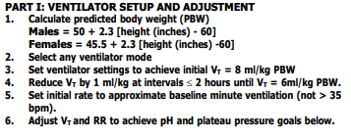
ARDSnet

Slide 33
ARDSnet
What is the oxygenation goal for PaO2 or SPO2?

Slide 34
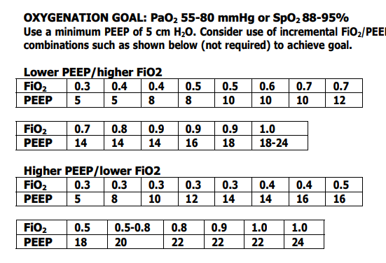
ARDSnet
Notes:
Tolerate lower b/c want to avoid volutrauma - lower TV = lung protective ventilation- permissive hypoxemia and hypercapnea, higher PEEP table- less than 20, start with first one

Slide 35
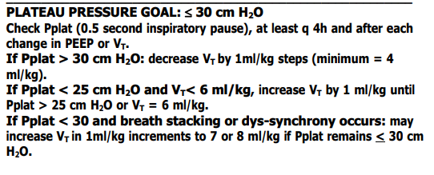
ARDSnet

Slide 36
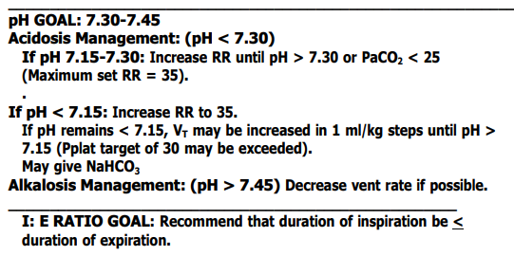
ARDSnet
Notes:
Ok for pH 7.2

Slide 37
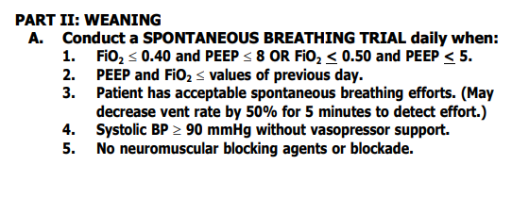
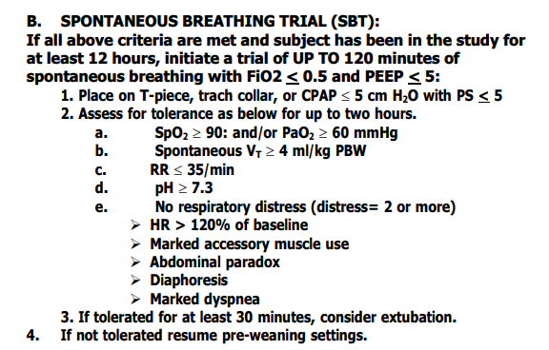
ARDSnet

Slide 38
Necropsy
Common histopathologic findings:
Neutrophilic interstitial pneumonia
Alveolar edema
Type II pneumocyte hyperplasia
Alveolar hemorrhage
Correlation between clinical findings and necropsy are poor, Boiron et al, 45% were diagnosed with ARDS with no evidence on necropsy
Notes:
Correlation between

Slide 39
Outcome/ Prognosis
Boiron et al- 42% died or were euthanized within 24 diagnosis
Overall case fatality rate 90% -100% cats, 84% dogs
Balakrishnan et al- Overall mortality rate 90%- 80% cats, 92% dogs
Median duration of hospitalization 3.5 days for dogs, 2 days for cats
Prognosis and cost were major factors in euthanasia decisions
Notes:
Historically, the ARDS case fatality rate was reported to be around 60%.^{5–7} Over the past 2 decades, there has been a progressive improvement in survival from ARDS, with current mortality rates ranging between 26% and 35%

Slide 40
Bonus question
Name the 5 criteria for VetARDS.

Slide 41
References
Zompatori M, Ciccarese F, Fasano L. Overview of current lung imaging in acute respiratory distress syndrome. Eur Respir Rev. 2014 Dec;23(134):519-30. doi: 10.1183/09059180.00001314. PMID: 25445951.
Lee JA, Drobatz KJ, Koch MW, King LG. Indications for and outcome of positive-pressure ventilation in cats: 53 cases (1993-2002). J Am Vet Med Assoc. 2005 Mar 15;226(6):924-31. doi: 10.2460/javma.2005.226.924. PMID: 15786995.
Kaku S, Nguyen CD, Htet NN, Tutera D, Barr J, Paintal HS, Kuschner WG. Acute Respiratory Distress Syndrome: Etiology, Pathogenesis, and Summary on Management. J Intensive Care Med. 2020 Aug;35(8):723-737. doi: 10.1177/0885066619855021. Epub 2019 Jun 17. PMID: 31208266.
Boiron L, Hopper K, Borchers A. Risk factors, characteristics, and outcomes of acute respiratory distress syndrome in dogs and cats: 54 cases. J Vet Emerg Crit Care (San Antonio). 2019 Mar;29(2):173-179. doi: 10.1111/vec.12819. Epub 2019 Mar 12. PMID: 30861281.
Mauri T, Lazzeri M, Bellani G, Zanella A, Grasselli G. Respiratory mechanics to understand ARDS and guide mechanical ventilation. Physiol Meas. 2017 Nov 30;38(12):R280-H303. doi: 10.1088/1361-6579/aa9052. PMID: 28967868.

Slide 42
References
Balakrishnan A, Drobatz KJ, Silverstein DC. Retrospective evaluation of the prevalence, risk factors, management, outcome, and necropsy findings of acute lung injury and acute respiratory distress syndrome in dogs and cats: 29 cases (2011-2013). J Vet Emerg Crit Care (San Antonio). 2017 Nov;27(6):662-673. doi: 10.1111/vec.12648. Epub 2017 Sep 5. PMID: 28873275.
Cagle LA, Hopper K, Epstein SE. Indications and outcome associated with positive-pressure ventilation in dogs and cats: 127 cases. J Vet Emerg Crit Care (San Antonio). 2022 Jan 19. doi: 10.1111/vec.13176. Epub ahead of print. PMID: 35043547.
Wilkins PA, Otto CM, Baumgardner JE, et al. Acute lung injury and acute respiratory distress syndromes in veterinary medicine: consensus definitions: the Dorothy Russell Havemeyer Working Group on ALI and ARDS in veterinary medicine. J Vet Emerg Crit Care 2007; 17(4): 333– 339.
Calabro JM, Prittie JE, Palma DA. Preliminary evaluation of the utility of comparing SpO2/FiO2 and PaO2/FiO2 ratios in dogs. J Vet Emerg Crit Care 2013; 23(3): 280– 285.

