Slide 1
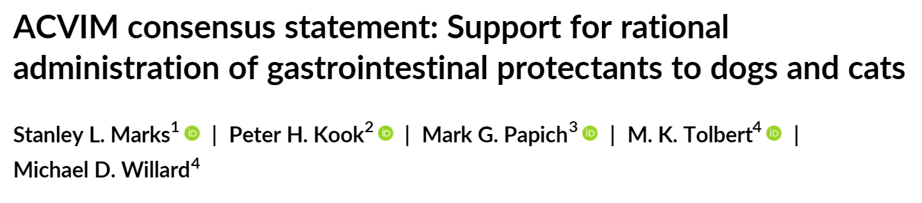

Bathilda Lake, DVM
Notes:
Hi everyone! Today I am going to be covering the ACVIM consensus statement on what support there is in veterinary medicine on the use of gastrointestinal protectants in dogs and cats. This consensus statement was published in 2018.

Slide 2
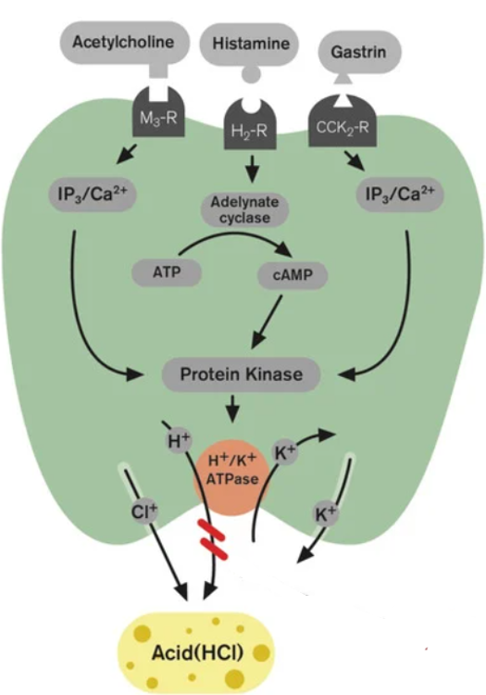
review
Notes:
As a brief review, I know that we recently went over the anatomy and physiology of gastric acid secretion, but I figured it would be a good idea to have it fresh in our minds before delving into the consensus statement. As we know, the key player in acid secretion is a H+/K+ ATPase which is also called the proton pump. The proton pump is in the parietal cell which is responsible for the transport of hydrogen ions into the gastric lumen exchanging one hydrogen ion for one potassium ion. The parietal cells bear receptors for three stimulators of acid secretion. First there is acetylcholine which is the neurocrine control, histamine which is the paracrine control, and gastrin which is the endocrine control. Stimulation of these receptors ultimately leads increased release of hydrogen ions decreasing gastric pH.

Slide 3
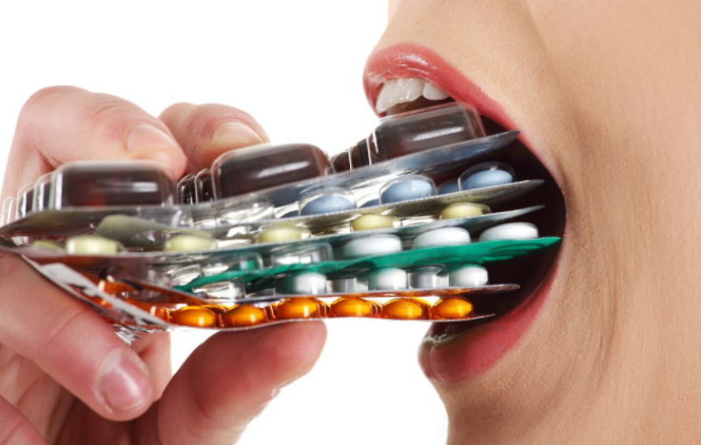
Why is there a consensus statement?
PPIs and H2 blockers are overprescribed
Long term effects
Vox.com
Notes:
Why is there a need for a consensus statement on gastroprotectants in veterinary medicine? In both veterinary and human medicine, gastroprotectants are commonly prescribed and in fact, are over prescribed. There are existing guidelines on their use in human medicine, but these are often not followed. Gastroprotectants are not as benign as they may seem and do have long term side effects in both veterinary and human patients. The secretion of acid in the stomach has many important roles including breaking down of proteins, helps absorption of certain elements, release of other hormones, and modulates intestinal microbiome and regulating bacterial overgrowth.

Slide 4
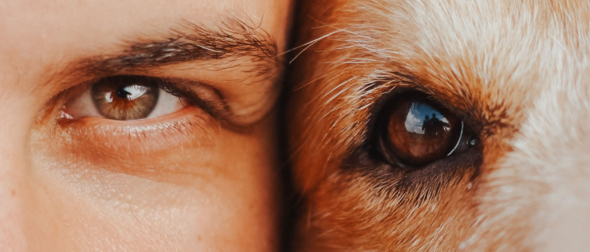
Differences between dogs/cats & humans
Do dogs have a lower fasting pH compared to humans?
What is the gastric pH of a dog?
  pH remains <2 greater than 85% of the team with the pH >4 only 4.7% of the time
What about the gastric pH of cats? Humans?
Are there any differences between the species?
Lifebeyondnumbers.com
Notes:
According to older studies, dogs had a higher fasted gastric pH when compared to humans, however, more recent studies show that the pH is comparable to humans. This is most likely due to the methodology of the older studies and how they measured gastric pH. The intragastric pH of healthy control dogs measured with a catheter-less pH capsule remained <2.0 >85% of the time and a pH > 4.0 of only 4.7% of the time. Using the same methodology, the gastric pH was measured in cats and surprisingly enough, cats were very similar to dogs…for once cats are the same as dogs and don’t do their own thing! Humans also have a very similar pH as dogs and cats with a pH >4 only occurring 4.4% of the time. The biggest difference between humans and dogs/cats is the buffering capacity of food. Humans have more of a buffering capacity after ingesting a meal whereas dogs and cats do not seem to experience the same effect.

Slide 5
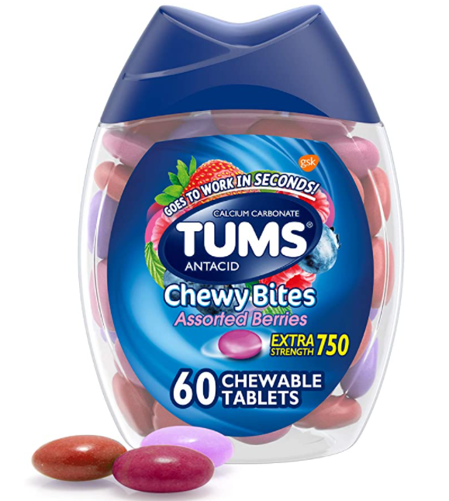
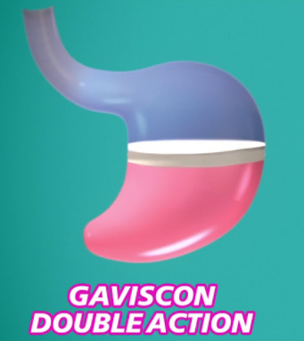
Antacid or anti-acid?
Mechanism of action
Adverse effects
Decrease pepsin activity
Binds to bile acids
Stimulates local prostaglandin synthesis
Constipation
Can cause aluminum toxicity in renal failure
Drug interactions
Gen Z (18-25 years old)
Notes:
Antacids are the oldest of the gastroprotectants. These comprise a group of inorganic, relatively insoluble salts of aluminum hydroxide, calcium carbonate, magnesium hydroxide that lack systemic effects. These group of medications work by decreasing pepsin activity, binding to bile acids in the stomach, and stimulating local prostaglandin synthesis. Unfortunately, these agents do no work very effectively and only have a small capacity to buffer gastric pH which means their effect is very short lived. Because of these reasons, antacids are only used in conjunction with H2 blockers or PPIs for GERD in humans. There is a product in the UK that has the addition of alginate which binds to the excess acid and then floats like a raft on top of the gastric contents which then creates a physical barrier so that the acid cannot interact with the cardia region of the stomach so that it cannot cause gastric reflux. The adverse reactions of this group of antacids are constipation, aluminum toxicity in the presence of renal failure and drug interactions. These drugs can chelate since they contain elements like aluminum and magnesium and chelate medications such as fluroquinolones and tetracyclines decreasing their absorption. They can also decrease the absorption of fungal medications specifically the “azole” group. Dosing in veterinary medicine is based on anecdotal experience and can be 5-10 mL up to 6x per day.

Slide 6
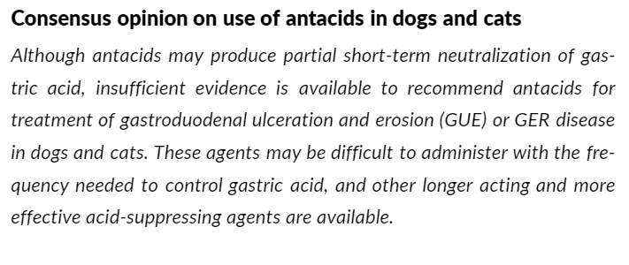
consensus
Notes:
The consensus provided by the authors about this drug class states: Although antacids may produce partial short-term neutralization of gastric acid, insufficient evidence is available to recommend antacids for the treatment of gastroduodenal ulceration and erosion or GERD in dogs and cats. These agents may be difficult to administer with the frequency needed to control gastric acid, and other longer acting and more effective acid-suppressing agents are available.

Slide 7
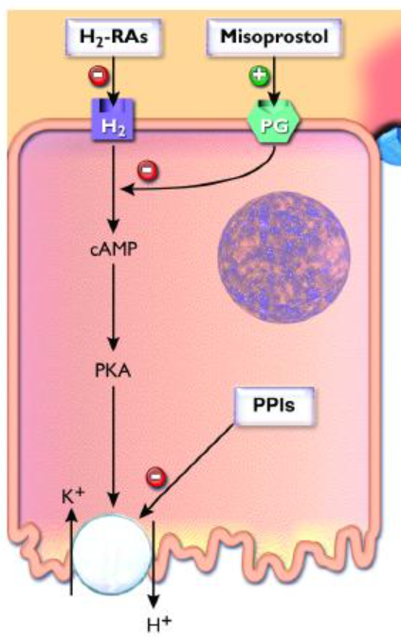
Histamine type 2 antagonist
Vetfoilio.com
Mechanism of action
- Inhibit acid secretion by competitively blocking H-2 receptors on the parietal cell
Tachyphylaxis
- 3-13 days
- Faster if IV?
Effective?
60% decrease in mean percentage time pH >3
PPI> Famotidine > ranitidine
Notes:
The next class of drugs are histamine type 2 antagonist. The mechanism of action is by competitively blocking H-2 receptors on the parietal cells. H2 blockers are metabolized by the liver and excreted via the kidneys. Tachyphylaxis can occur and has been reported to develop at 13 days, but has been reported as fast as 3 days. This occurs in both dogs and cats and in humans the tachyphylaxis develops faster if given IV. It is thought that the tachyphylaxis develops due to gastrin-induced up regulation of enterochromaffin-like cell synthesis of histamine, which competes with the antagonist at the parietal cell. Because of this phenomenon acute discontinuation of H2 blockers can cause a rebound acid hypersecretion. There is a 60% decrease in mean percentage time that pH is >3. The clinical efficacy of H2 blockers has not been fully evaluated in veterinary medicine as there is no great studies looking at this. We do know that the H2 blockers are inferior to PPIs for increasing intragastric pH as well as prevention of exercise-induced gastritis in dogs. There was a study performed in healthy beagles that showed that famotidine at 0.5 mg/kg q12hr was more effective than ranitidine 2 mg/kg q12hr based off of intragastric pH measurements via gastrostomy tube. Even at higher doses, PPIs are still more effective than H2 blockers. This holds true for both dogs and cats. Famotidine compared to placebo showed that famotidine had some efficacy in dogs, but in cats there was no difference.

Slide 8
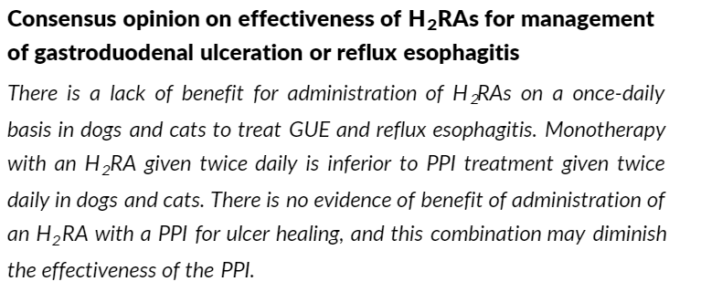
consensus
Notes:
The consensus provided by the authors about H2 blockers is that there is a lack of benefit for administration of H2 blockers on a once-daily basis in dogs and cats to treat GERD and esophagitis. Monotherapy with an H2 blocker given twice daily is inferior to PPI treatment given twice daily in dog and cats. There is no evidence of benefit of administration of a H2 blocker with a PPI for ulcer healing and this combination may diminish the effectiveness of the PPI.

Slide 9
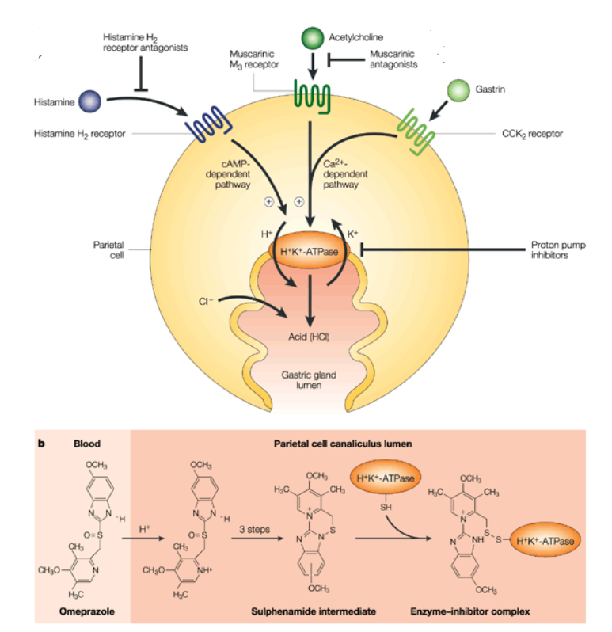
Proton pump inhibitors
Mechanism of action
Binds to the H-K-ATPase and causes enzyme inactivation leading to decrease acid production
formulation
Degrades in acidemia
Coated capsules
Metabolism
Degrades in acidemia
Coated capsules
Notes:
PPIs target the final common pathway of acid production. PPIs are weak bases that are unprotonated at the physiologic pH of blood and once it is in an acidic environment of the active parietal cell, the drug becomes protonated and trapped where it forms a disulfide bond with cysteine residues on the alpha subunit of the H-K-ATPase pump causing enzyme inactivation and decreased acid secretion. Acid secretion resumes only after new proton pumps are synthesized, resulting in a prolonged effect after administration. Dormant parietal cells are activated after initial PPI administration. Therefore, inhibition of acid secretion is approximately 30% of maximal on day 1 of administration because of incomplete binding to all H-K-ATPase. Typically, maximal inhibitory occurs after 2-4 days of treatment. Delay in maximal PPI activity is related to their stability. If PPIs are administered in an acidic environment, this may cause degradation of the medication before it reaches the intestine where it is absorbed systemically. As the PPIs work, the acidity decreases which helps increase efficacy. Breaking or crushing the tablets or using compounded formulation may dimmish the effect of PPIs. Humans have longer gastric emptying times compared to dogs and cats so unsure if the extended release capsules truly make a difference for a veterinary patients. Increased concentrations with repeated doses may occur due to inhibition of cytochrome P450 which inhibits metabolism of PPIs, specifically omeprazole. Since eating stimulates acid secretion, it is best to administer PPIs 30-40 minutes prior to eating or with a meal. PPIs are metabolized by cytochrome P450 enzymes in the liver. As I said, omeprazole can actually inhibits its own metabolism by the same enzyme so it can alter metabolism of other drugs that are metabolized by cytochrome P450.

Slide 10
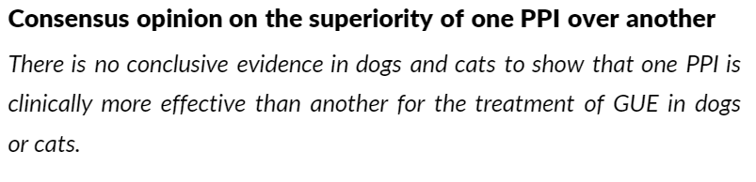
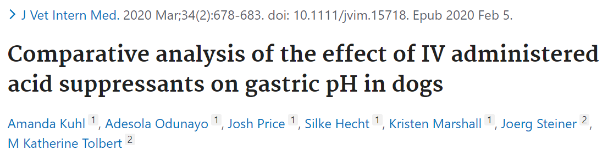
Which is the best ppi?
Notes:
According to this consensus statement, the authors concluded that there was no evidence in dogs and cats to show that one PPI is clinically more effective than another for the treatment of GUE in dogs and cats. However, there was a more recent study that was published out of JVIM that compared famotidine, esomeprazole, and pantoprazole that concluded that a famotidine CRI and esomeprazole were superior at acid suppression compared to pantoprazole. Dogs received pantoprazole or esomeprazole at 1 mg/kg IV q12h and famotidine with a loading dose of 1 mg/kg followed by 8 mg/kg IV CRI daily for 3 consecutive days. The intragastric pH was recorded at baseline and for 72 hours of treatment. The mean pH and the mean percentage time (MPT) the intragastric pH was ≥3 or ≥4 were compared among and within treatment groups. They found that there was significant increases in mean pH was noted over time with all 3 treatments. Only esomeprazole and famotidine CRI achieved the goals established for the treatment of gastroduodenal ulceration in people. The clinical significance of these results is not known at this time.

Slide 11
Clinical efficacy of PPIs
Limited studies ☹
Why do we give it q12h vs q24h?
Do you taper PPIs?
Notes:
There are only limited studies performed in veterinary patients on the efficacy of PPIs and most are preclinical development trails for humans. In addition, a lot of these studies involve pharmacologic stimulation of gastric acid secretion, so it is hard to know what to do with this information clinically. There is a study that shows that PPIs are superior to H2 blockers in preventing exercise-induced gastritis in dogs. Why do humans typically use PPIs once daily and in veterinary medicine we give it twice daily? This is because there was a study that compared once daily PO administration of omeprazole compared to cimetidine or placebo in ulcer healing scores in dogs with aspirin induced ulcers and showed no difference. It is recommended to taper PPIs after administration for >4 weeks to avoid rebound gastric acid hypersecretion. It is reasonable to decrease by 50% on a weekly basis.

Slide 12
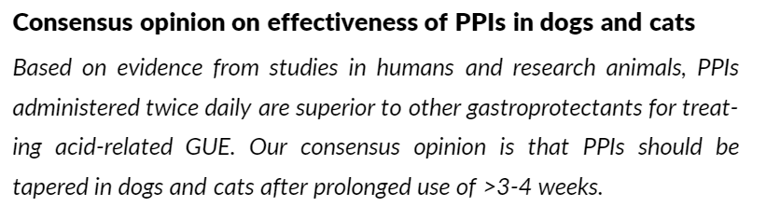
consensus
Notes:
Based on evidence from studies in humans and research animals, PPIs administered twice daily are superior to other gastroprotectants for treating acid-related GUE. Our consensus opinion is that PPIs should be tapered in dogs and cats after prolonged use of >3-4 weeks

Slide 13
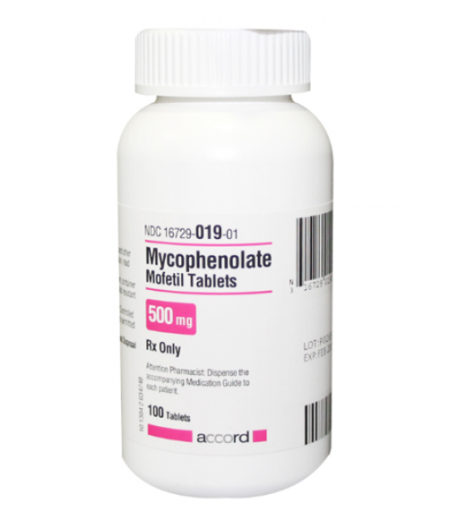
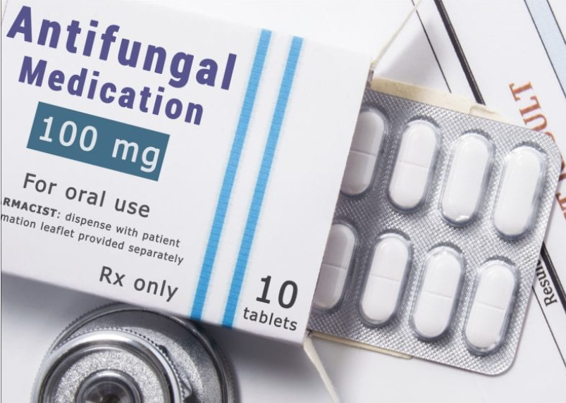
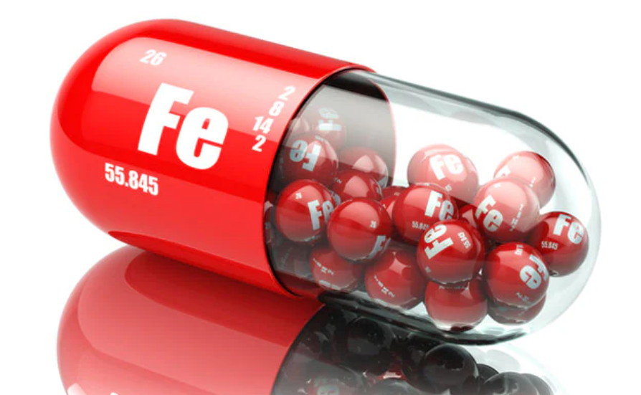
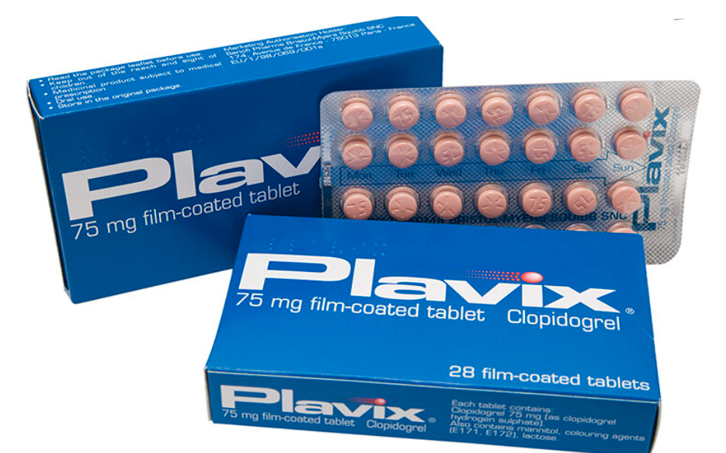
Drug interactions with ppis
Antifungal drugs
Iron
Mycophenolate
Clopidogrel
Notes:
Remember that normal gastric pH is typically around 1-2 and with administration of PPIs this can increase to >4 for the greater part of the day. This can cause drug interactions that can alter the absorption of some drugs and nutrients. Antifungal drugs of the azole class like ketoconazole, itraconazole, etc. are poorly soluble. In order for azole drugs to be absorbed they must undergo dissolution at a low pH. This is why they are recommended to be given with food as food stimulates acid production. Itraconazole in solution of oral administration is usually formulated in cyclodextrin which helps maintain solubility and fluconazole is also more water soluble so these specific azoles are less effected by administration of PPIs. Iron needs hydrochloric acid to promote absorption because it reduces the ferric acid form to the more soluble ferrous form. Decrease absorption of iron with concurrent administration of PPIs in humans has been documented. It is unknown if this occurs in small animals. Mycophenolate is a prodrug that is converted to the active drug in acidic environments. Mycophenolate is commonly associated with GI side effects so PPIs are commonly prescribed with mycophenolate which can decrease the conversion to the acid form therefore decreasing the efficacy. This has been documented in human patients, but not explored in dogs and cats. Clopidogrel is also a prodrug that has to be converted to the active form. This is done by CYP enzymes which omeprazole can inhibit decreasing the concentration of the active form of clopidogrel. We know that this is how it is metabolized in humans, but it is not known if this is the same in dogs and cats. It is also importance of this interaction is controversial, but the FDA does discourage the administration of both medications at the same time. There was a study in experimental dogs looking to see if there was a decrease in the antiplatelet effects of clopidogrel when administered with omeprazole, but the active metabolite was not measured.

Slide 14
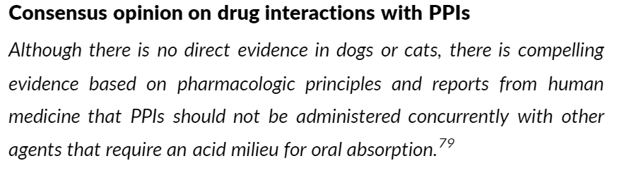
Consensus
Notes:
The authors of the consensus statement conclude that although there is no direct evidence in dogs or cats, there is compelling evidence based on pharmacologic principles and reports from human medicine that PPIs should not be administered concurrently with other agents that require an acid milieu for oral absorption.

Slide 15
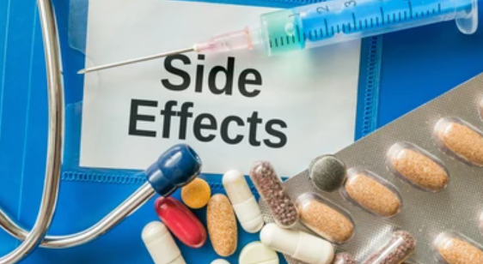
Adverse effects of ppis
Renal effects?
Increased gastrin levels
Bacterial overgrowth
Risk with NSAIDs
Diarrhea
Notes:
In humans, there was been a correlation with administration of PPIs and acute interstitial nephritis, AKI, and CKD. Other reported adverse reactions in humans include dementia, cobalamin deficiency, osteoporosis, and pathologic fractures, community-acquired pneumonia, hypomagnesemia, cardiovascular events, Clostridium difficile-associated diarrhea, drug interactions, and spontaneous bacterial peritonitis in patients with hepatic cirrhosis. A lot of these effects are correlations not cause and effect and the quality of the associations are low. In veterinary patients there are two potential adverse effects from chronic administration. These include loss of negative feed back mechanism causing blood gastrin concentrations are increased as a result of PPI administration. Increased gastrin concentrations causes trophic effects on the gastric mucosa and has been correlated to development of gastric tumors in rats. Studies in humans have not made this correlation and it is unknown in veterinary patients. Secondly, bacterial overgrowth is another consequence of chronic PPI administration in people. The low gastric pH does inhibit bacterial growth so with chronic PPI administration this can lead to increase survival of ingested bacteria. This also can lead to higher risk of aspiration pneumonia as more bacteria could also be aspirated. When PPIs and NSAIDs are prescribed together this can increase the risk of injury to the intestinal epithelium. The NSAIDs can cause injury to the epithelial cells and in combination with bacterial overgrowth furthering intestinal injury. Perhaps treating with probiotics in this case would be beneficial but no studies have been done evaluating this. Diarrhea is the most common adverse effect caused by PPIs in dogs. This has not been reported in cats.

Slide 16
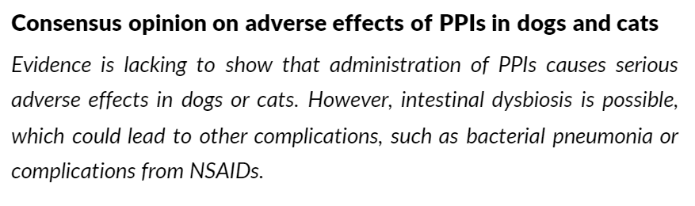
consensus
Notes:
The author’s consensus is that evidence is lacking to show that administration of PPIs cause serious adverse effects in dogs and cats. However, intestinal dysbiosis is possible, which could lead to other complications, such as bacterial pneumonia or complications from NSAIDs.

Slide 17
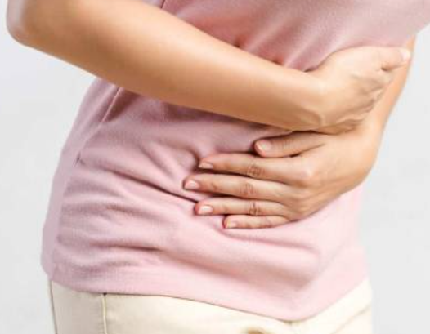
misoprostol
Mechanism of action
efficacy
Adverse reaction
Dose q8h to q12h
Effective at protecting against aspirin induced gastrointestinal lesions
No effective for steroid induced lesions
Effective in cats!
Abdominal pain
Diarrhea
Abortion
Notes:
The next drug is misoprostol. Misoprostol is a synthetic prostaglandin E1 analogue that is relatively specific for parietal cell receptors and decreases histamine, pentagastrin, and meal-stimulated gastric acid secretion. It binds to prostaglandin receptors and inhibits histamine-stimulated cAMP formation. Misprostol also has cytoprotective effects caused by increased bicarbonate secretion, decreased pepsin content of gastric secretion, preservation of tight junctions among epithelial cells, increased mucous layter, increased mucosal blood flow, and improvement of mucosal regenerative capacity. Studies in dogs support dosing every 8 to 12 hours as once daily is inadequate. A study looked at administration of aspirin and misoprostol to evaluate the gastroprotective effects of misoprostol. Misoprostol significantly decreased GUE or hemorrhage associated with aspirin, but did not completely eliminate gastric lesions. It is reasonable to use misoprostol is PPIs are not working, however, the protective effects with other NSAIDs except aspirin as not been evaluated. There is no evidence that misoprostol helps against glucocorticoid induced GUE. Misoprostol is also effective in cats at decreasing GUE in combination with aspirin and with cats in septic shock. Adverse reactions of misoprostol includes abdominal pain and diarrhea. These are the main reasons why misoprostol is used infrequently in people to prevent GUE. In people, abortion is also a big side effect.

Slide 18
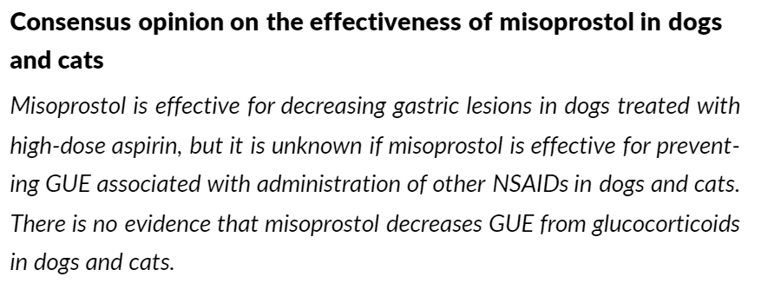
Consensus
Notes:
The authors of the consensus statement conclude that misoprostol is effective for decreasing gastric lesions in dogs treated with high-dose aspirin, but it is unknown if misoprostol if effective for preventing GUE associated with administrating of other NSAIDs in dogs and cats. There is no evidence that misoprostol decreases GUE from glucocorticoids in dogs and cats.

Slide 19
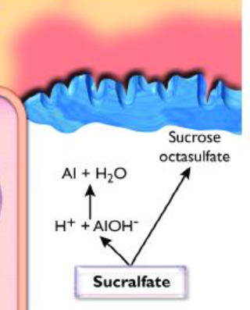
sucralfate
Mechanism of action
efficacy?
Adverse effects
Helps ulcers heal
Stimulates prostaglandin
Comparable to H2 blockers
Limited time of action
Analgesia?
Constipation
Aluminium toxicity
Xerostomia
Nausea
Vomiting
Headache
Urticaria
Rashes
Notes:
Last, but no least is sucralfate or carafate. Sucralfate is a complex salt of sucrose octasulfate and aluminum hydroxide. Sucralfate forms stable complexes with protein in damaged mucosa where there is a high concentration of protein, either from fibrinogen, albumin, or globulins from the exudate of an ulcer or from damaged cells. In acidic environments sucralfate becomes viscous and partially dissociates which helps it bind to damaged mucosa that have positively charged proteins on the damaged mucosa. In an ex vivo study done in dogs, sucralfate was effective in promoting repair of the gastric mucosal tissues that had acid induced injury. Sucralfate can also stimulate prostaglandin stimulation which furthers its protective effects. Sucralfate was compared to H2 blockers in treating reflux esophagitis and was found to be comparable and both drugs were better at treating low grade versus high grade esophagitis. Sucralfate has a limited esophageal retention time which may decrease the effectiveness. Unsure if sucralfate has an analgesic effect as no studies have been done, but anecdotally in humans there may be some pain control with esophagitis. There are no studies involving combination of sucralfate and H2 blockers compared to either drug alone in treating GUE or reflux esophagitis. Sucralfate is relatively safe and has minimal advere effects. Since there is aluminum in sucralfate caution should be used with long term use in patients with renal insufficiency to avoid aluminum intoxication. Other reported adverse effects include constipation, xerostomia (dry mouth), nausea, vomiting, headache, urticaria, and rashes.

Slide 20
Sucralfate drug interactions
Ciprofloxacin
Theophylline
Tetracycline
Doxycycline
Minocycline
Digoxin
Notes:
Administration of ciprofloxacin, theophylline, tetracycline, doxycycline, minocycline, and digoxin with sucralfate can decrease bioavailability of these drugs. However, if sucralfate was administered 2 hours prior, there was no effect on the bioavailability of these drugs. Actually, if sucralfate was administered 2 hours prior to the administration of ciprofloxacin the bioavailability was significant increased. Interestingly, this was not found with enrofloxacin.

Slide 21
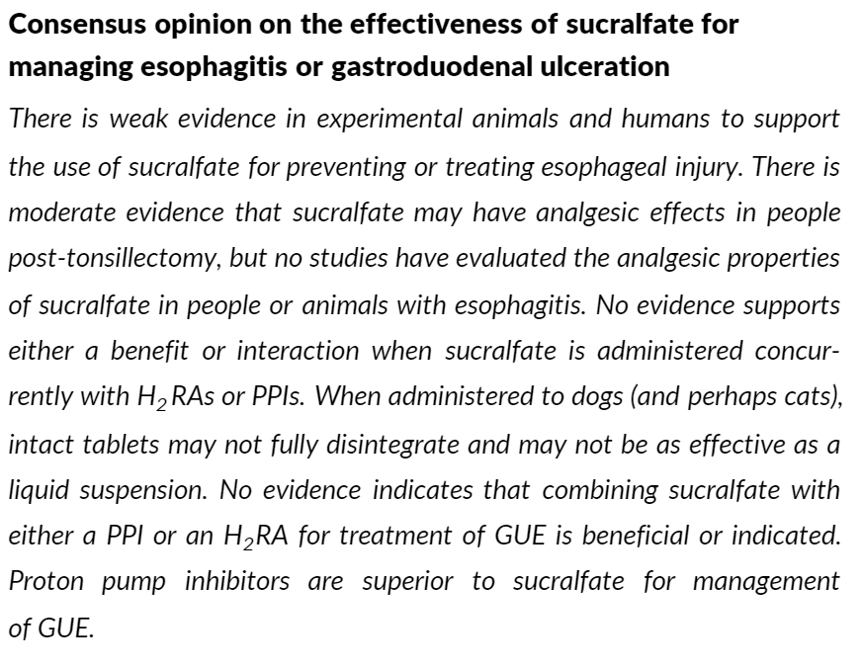
consensus
Notes:
Consensus on sucralfate is that there is weak evidence in experimental animals and humans to support the use of sucralfate for preventing or treating esophageal injury. There is moderate evidence that sucralfate may have analgesic effects in people post-tonsillectomy, but no studies have evaluated the analgesic properties of sucralfate in people or animals with esophagitis. No evidence supports either a benefit or interaction when sucralfate is administered concurrently with H2 blockers or PPIs. When administered to dogs (and perhaps cats), intact tablets may not fully disintegrate and may not be as effective as liquid suspension. No evidence indicates that combining sucralfate with either a PPI or H2 blocker for treatment of GUE is beneficial or indicated. PPI are superior to sucralfate for management of GUE.

Slide 22
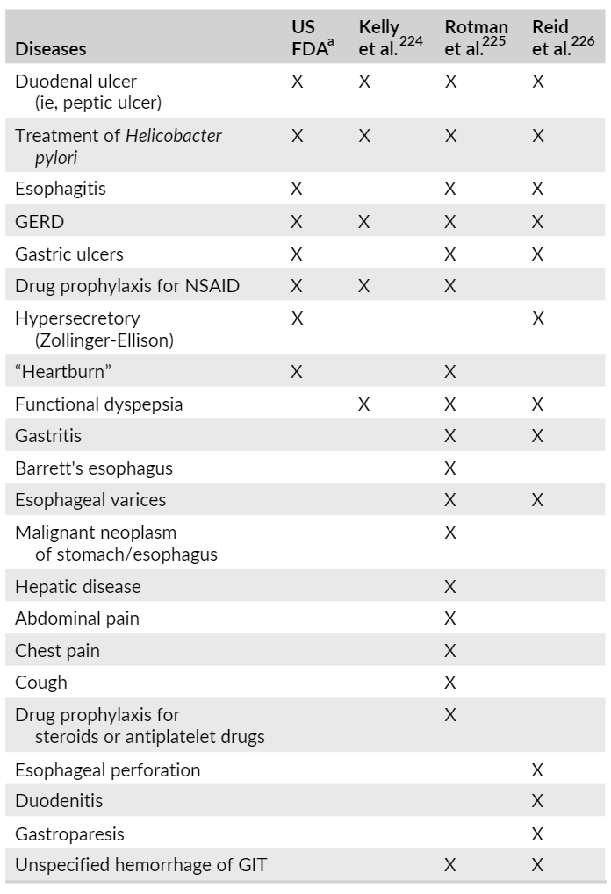
Indications and guidelines for gastroproectants in humans
Notes:
A metanalysis in humans with >14,000 humans with GUE or erosive esophagitis showed that healing GUE was strongly correlated maintaining a gastric pH >4 for at least 16 hours of the day and healing of esophagitis if gastric pH was >3 for 18-20 hours a day. In humans, PPIs are indicated to treat Helicobacter pylori peptic ulcers, GERD, esophagitis, benign gastric ulcers, prophylaxis for NSAID-associated ulcers, and certain hypersecretory diseases.

Slide 23
Indications and guidelines for gastroproectants in dogs and cats
Notes:
This consensus statement goes over 10 different diseases where gastroprotectants might be indicated in dogs and cats.

Slide 24
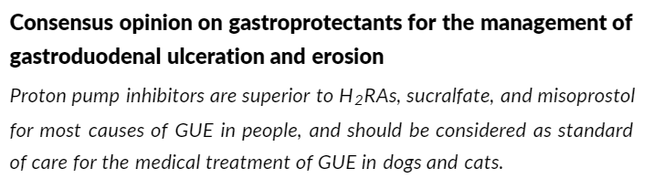
1. Gastroduodenal ulceration and erosion (GUE)
Notes:
There are many disease that can predispose to gastroducodenal ulceration and erosion in dogs in cats. These include, gastrointestinal and pancreatic neoplasia, NASID administration, hepatic disease, and inflammatory bowel disease. NSAID induced GUE in cats is not as common as in dogs and is more common with neoplasia such as gastrinomas. Regardless of the cause of GUE in dogs and cats, suppression of acid secretion should improve healing. Make sure you are using a twice daily administration versus once daily to achieve the proper acid suppression. At this point, I think its all been hammered in that PPIs are more effect than H2 blockers.

Slide 25
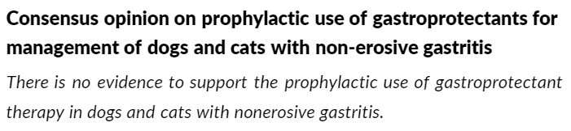
2. Gastritis (acute vs chronic)
Notes:
When a diagnosis of gastritis is made, gastroprotectants are often prescribed. This thought has been extrapolated from humans in treating H. pylori gastritis which we know that dogs and cats do not suffer from. Vomiting is a common clinical sign seen with gastritis, but acid-suppressant drugs should not be used as an anti-emetic. There is no evidence to support the prophylactic use of gastroprotectant therapy in dogs and cats with non-erosive gastritis.

Slide 26
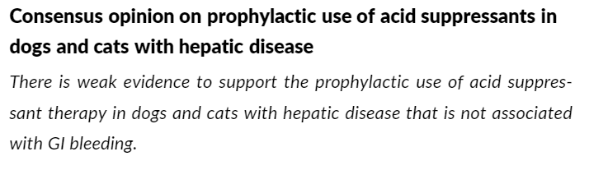
3. Hepatic disease
Notes:
Hepatic disease has been associated with GUE, but direct cause of hepatic disease and GUE is not strong. There are not studies directly looking at the prevalence of upper GI bleeding in dogs and cats with hepatic disease. The pathogenesis between hepatic disease and GUE is unknown, but in humans the most common cause of GI bleeding with hepatic disease is altered mucosal blood flow because of portal hypertension. In dogs, there may be decreased hepatic degradation of gastrin and subsequent stimulation of acid hypersecretion, however a study compared gastrin levels in dogs with experimentally induced hepatic disease to a control group and no difference was found, but this studies had several limitations. One study did find a correlation in dogs with intrahepatic shunts and a decrease in death attributed to GI hemorrhage or ulceration after implantation of perio and post surgical life long administration of PPIs, but the underlying mechanism of how shunts lead to GI hemorrahge and ulceration may not be related to hepatic dysfunction or portal hypertension. There is weak evidence to support the prophylactic use of acid suppressant therapy in dogs and cats with hepatic disease that is not associated with GI bleeding.

Slide 27
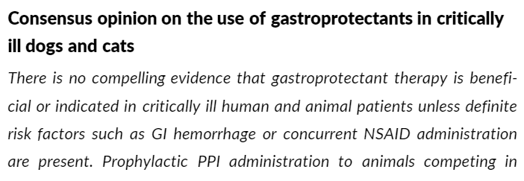
4. stress-related mucosal damage
Notes:
In humans in an ICU setting the benefits of stress ulcer prevention is controversial. Giving H2 blockers and enteral nutrition was associated with an increased risk of hospital acquired pneumonia and mortality. When looking at PPIs in an ICU setting in humans, PPIs were more effective than H2 blockers in preventing clinically important upper GI bleeding, but their use did not decrease mortality in the hospital or duration of ICU stay. In veterinary patients, the prevalence, severity, and efficacy of prophylactic gastroprotectants in an ICU setting is unknown. There is a study done in the UK looking at critically ill dogs and found an association between hemorrhagic gastric disease and mortality but gastroprotectant drugs did not improve survival in this population of dogs. There is no great evidence that supports use of PPIs or H2 blockers in preventing stress related mucosal damage, but there might be some benefit in performance dogs, specifically racing Alaskan sled dogs. Gastric erosions, ulcers, and hemorrhage were observed in 48% of 70 dogs after completing the Iditarod sled dog race. Of course, using PPIs is more effective in these dogs than H2 blockers. There is also some evidence that PPI administration can also help in Labrador retrievers undergoing explosive detection training as well. There is no compelling evidence that gastroprotectant therapy is beneficial or indicated in critically ill human and animal patients unless definite risk factors such as GI hemorrhage or concurrent NASID administration is present. Prophylactic PPI administration to animals competing in strenuous, competitive events might decrease stress related mucosal damage and improve overall performance.

Slide 28
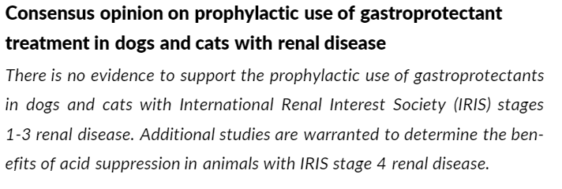
5. Renal disease
Notes:
Gastritis and GUE is more commonly associated with end-stage renal disease. Acid suppression in people is often recommended for renal disease patients with ulcer bleeding. There is no recommendation for the use of prophylactic acid suppressant treatment in human patients with renal disease, but are recommended if other risk factors are present such as NSAID or corticosteroid treatment or if ulcer development is present. In advance renal disease in dogs and cats, there is no strong association with GUE. A study done in cats showed no significant differences in serum gastrin concentrations or gastric pH between cats with CKD and healthy cats. Prophylactic and long term use in humans with renal disease can lead to derangements in serum calcium and PTH concentrations, osteoporosis, and pathologic fractures. 36-80% of cats with CKD also have renal secondary hyperparathyroidism that can lead to decreased bone mineral density and increased bone resorption cavities. Chronic acid suppressant administration on calcium metabolism and bone remodeling in dogs and cats with CKD could lead to serious sequelae. So the consensus is, there is no evidence to support the prophylactic use of gastroprotectants in dogs and cats with IRIS stages 1-3 renal disease. Additional studies are warranted to determine the benefits of acid suppression in animals with IRIS stage 4 disease.

Slide 29
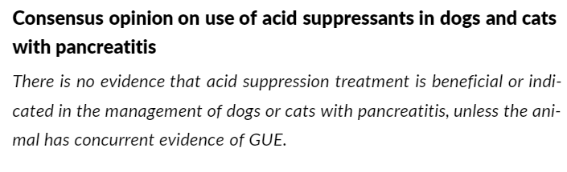
6. Pancreatitis
Notes:
Acid suppressant therapy is often used in treating pancreatitis. The rationale is that pancreatitis increases the risk of upper GI bleedings due to hypovolemia and local peritonitis, but the incidence in dogs and cats is unknown. In humans, it is thought that GI hypoperfusion, severe illness, hypoxemia, and use of NSIADs for pain relief can lead to mucosal barrier failure and contribute to acute mucosal lesions in severe pancreatitis. There is no evidence that acid suppression treatment is beneficial or indicated in the management of dogs or cats with pancreatitis, unless the animal has concurrent evidence of GUE.

Slide 30
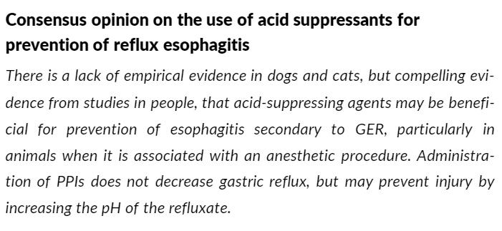
7. Reflux esophagitis
Notes:
In dogs, the most common cause of high-grade esophagitis and stricture formation is gastroesophageal reflux during anesthesia associated in 46-65% of cases. This occurs due to an incompetent lower esophageal stricture that can be due to anesthetic drug administration. A study was done in dogs undergoing elective orthopedic surgeries and the dogs were administered esomeprazole 12-18 hours and 1-1.5 hours prior to anesthesia and it significantly lowered gastric pH but did not have an impact on the number of reflux events. A similar study showed the same associated in cats receiving omeprazole prior to anesthesia. PPIs are again, more effective than H2 blocker. I don’t think I can say this enough. Also PPIs are more effective at relieving clinical signs in erosive reflux versus non-erosive reflux. So, the consensus is that there is a lack of empirical evidence in dogs and cats, but compelling evidence from studies in people that acid suppressing agents may be beneficial for prevention of esophagitis secondary to GER, particularly in animals when it is associated with anesthetic procedures. Administration of PPIs does not decrease gastric reflux, but may prevent injury by increasing the pH of refluxate. But then you have to think, what about aspiration pneumonia and the increased bacterial load? Basically, as always, more research and studies need to be done.

Slide 31
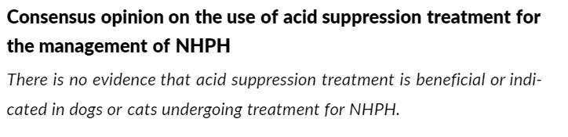
8. Helicobacter
Notes:
When treating H. pylori, PPIs are almost always included in the treatment. Dogs and cats don’t really get H. pylori infections, but can have other Helicobacter infections. There are no great studies looking at acid suppressant therapy in non-H. pylori Helicobacter infections in dogs and cats. Therefore, the consensus is that there is no evidence that acid suppression treatment is beneficial or indicated in dogs or cats undergoing treatment of non-H.pylori Helicobacter infections.

Slide 32
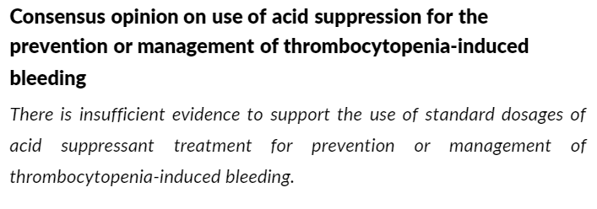
9. thrombocytopenia-induced bleeding
Notes:
Platelet aggregation can be inhibited by acidic environments, especially for bleeding GI ulcers. However, in humans, PPIs are not routinely given with ITP. Gastrointestinal hemorrhage is rarely observed in human patients with ITP. We all know that dogs with ITP commonly have GI bleeding which is why they usually require so many blood transfusions. Therefore, PPI administration is very commonly started with a diagnosis of ITP in veterinary patients. However, one study looked at the probability of survival to discharge in a group of dogs with ITP that did or did not receive PPIs and showed no difference. So although many of our ITP patients have GI bleeding it is uncertain if PPIs help treat the bleeding. In conclusion, there is insufficient evidence to support the use of standard dosages of acid suppressant treatment for prevention or management of thrombocytopenia-induced bleeding.

Slide 33
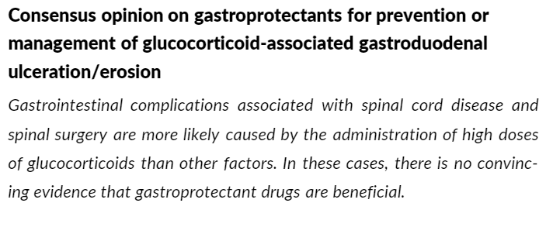
10. Spinal cord injury and intervertebral disc surgery
Notes:
Spinal cord injury and surgery in dogs have been associated with GI complications. This has been correlated with administration of high-dose steroids and GI complications included diarrhea, melena, bleeding, and GI perforation. High-dose steroids in general can lead to GI complications and can produce gastric hemorrhage. Injury of the GI tract secondary to steroid administration is most likely not due to hypersecretion of acid, but more likely associated with decreased defense mechanisms and altered gastric mucosal blood flow. There are no studies done that show the support of acid suppressing agents in these dogs, but the studies that have been done have not evaluation PPIs so this is unknown. In conclusion, GI complications associated with spinal cord disease and spinal surgery are more likely caused by administration of high doses of glucocorticoids than other factors. In these cases, there is no convincing evidence that gastroprotectant drugs are beneficial.

Slide 34
Future considerations
Probably overuse gastroprotectants in veterinary medicine
Hopefully with improved technology, we can perform better studies evaluating the use of these drugs in our veterinary patients
We need more information on clear defined endpoint and goals
Delayed or long acting PPIs?
Notes:
Like in human medicine, the use of gastroprotectants is most likely overused. I am sure in human medicine a big factor is self-medicating as a lot of gastroprotectants are sold over the count. I personally, take PPIs and think I suffer from GERD, but have never been diagnosed so I am definitely contributing to this phenomenon. We now have better technologies such as GI telemetric monitoring devices and capsule endoscopy that can help further good quality research and studies. Clearly, there is a need for more information to help defind clear endpoints and goals when using these drugs in both human and veterinary patients. Recently, there has been the development of delayed or long acting PPIs and there indications for use and efficacy in veterinary patients are still unknown. Controlled studies evaluating the efficacy of gastroprotectant drugs in clinical patients, as well as the judicious application of these drugs, should further optimize the management of reflux esophagitis and GUE in dogs and cats.

Slide 35
THANK YOU
Notes:
Thank you all for listening to my presentation and I hope if you take anything from this lecture it is that PPIs are better than H2 blockers.

