Slide 1
Searching FOLIO’s Inventory
CUL Training, April 2021
Laura E. Daniels
*remember to record this session

Slide 2



Caveat searcher…
Current functionality is a work in progress
Various proposed developments… in flux
(such as Elastic search proof of concept)
What does this mean for us?
  We will often need to try searching multiple ways
  We will document & share successful search strategies
  We will inevitably be frustrated at times
  We will provide feedback on how searching needs to work differently and it will get better over time

Slide 3
Inventory Basics
Search & filter: left pane
Results: middle (or default) pane
Detail view: right pane
Instances, Holdings, Items
  Instance segment is the default
  Instances always returned in results display

Slide 4
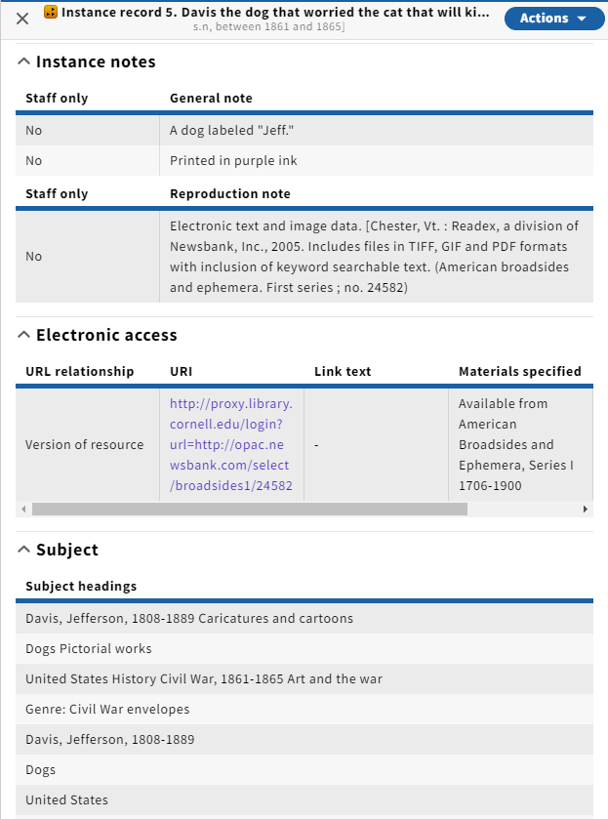
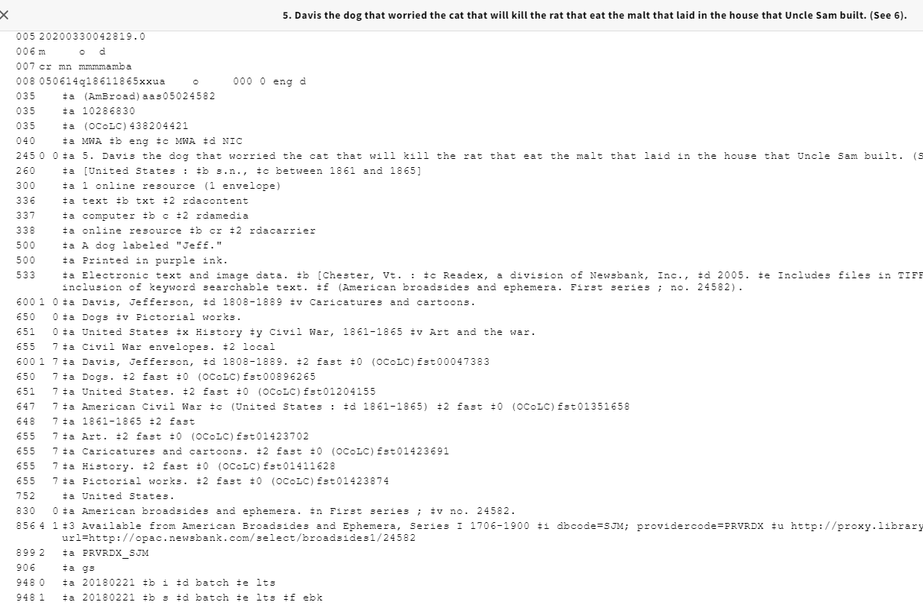
Keep in mind
Instance data is abstracted from MARC bibliographic data but ≠ MARC bibliographic data

Slide 5
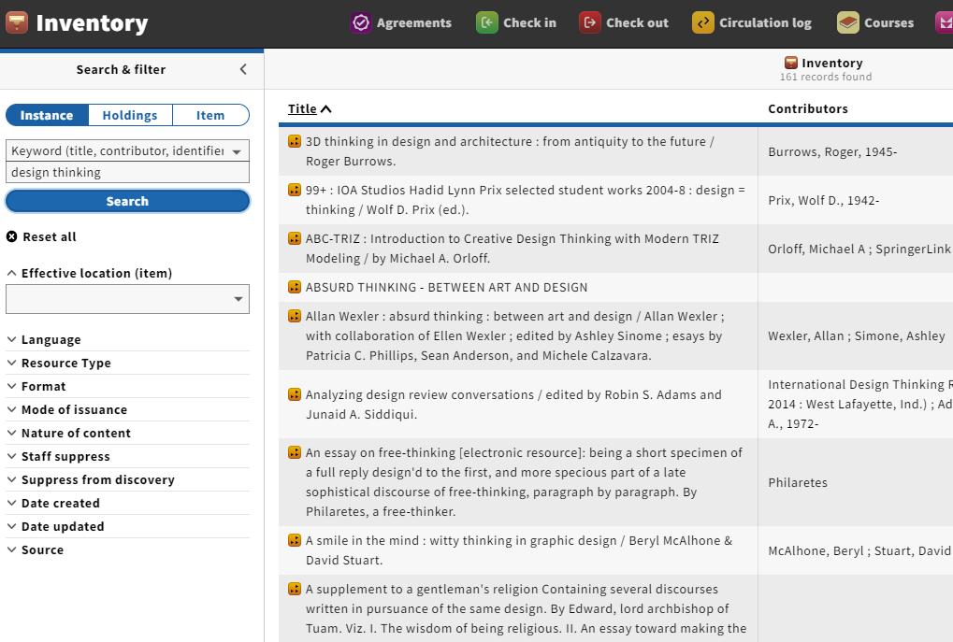
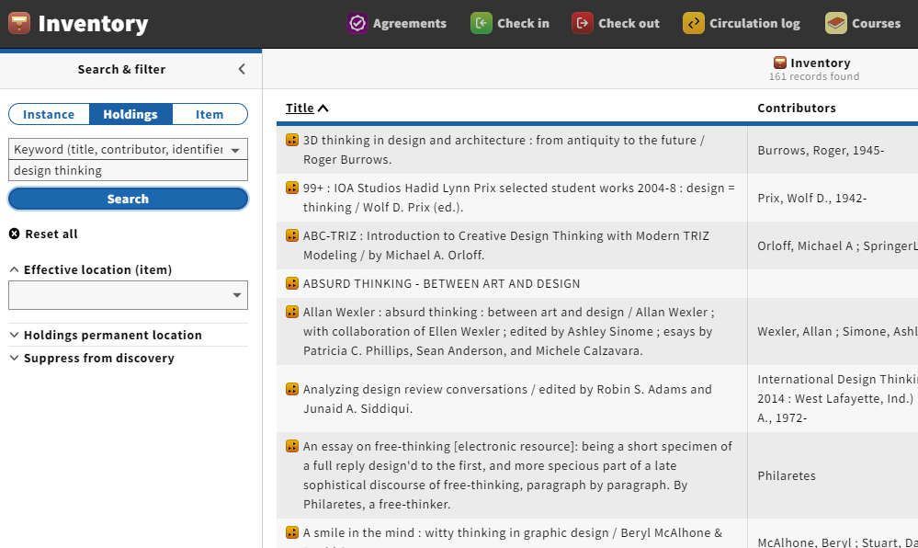
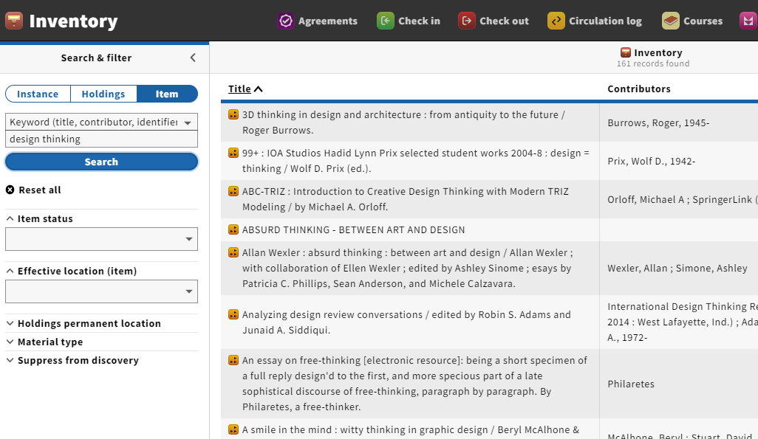
Same initial results for a keyword search across all three segments…
But different filters

Slide 6
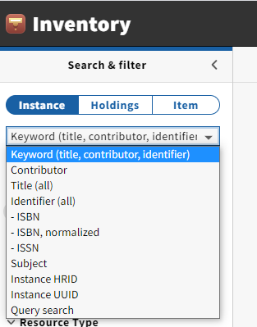
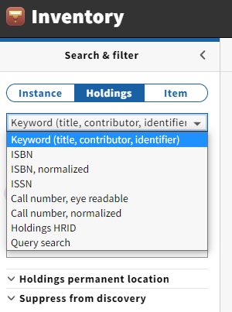
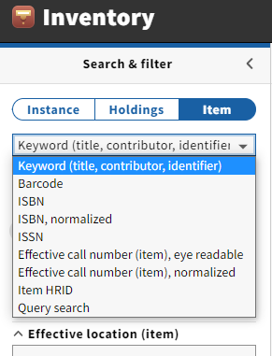
And some different search options

Slide 7
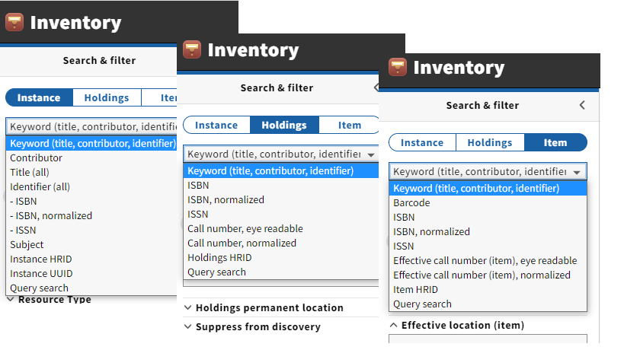
Pop quiz (open book)
1) Name one element that is present in all search segments (instance, holdings, item)
2) Name one element that is only in the Instance segment
3) Name one element that is only in the Holdings segment
4) Name one element that is only in the Item segment

Slide 8
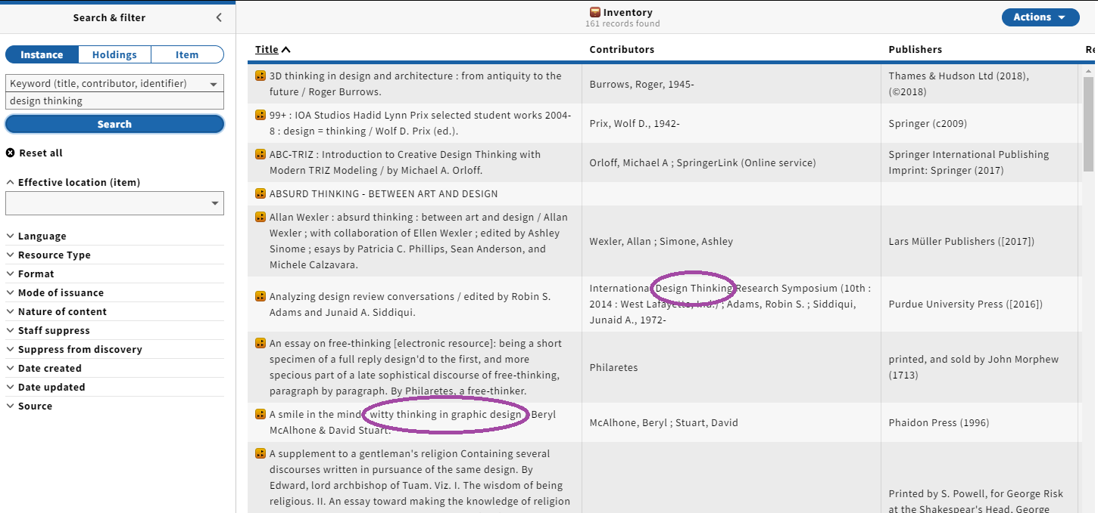
Keyword search includes multiple (but not all) elements*
*title for instance is only title proper

Slide 9
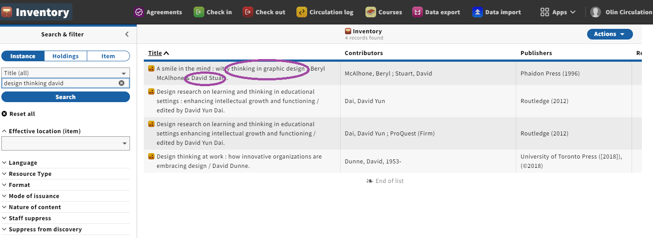
Title may include unexpected values (such as statement of responsibility); notice, also, in this and the previous example word order does not matter

Slide 10
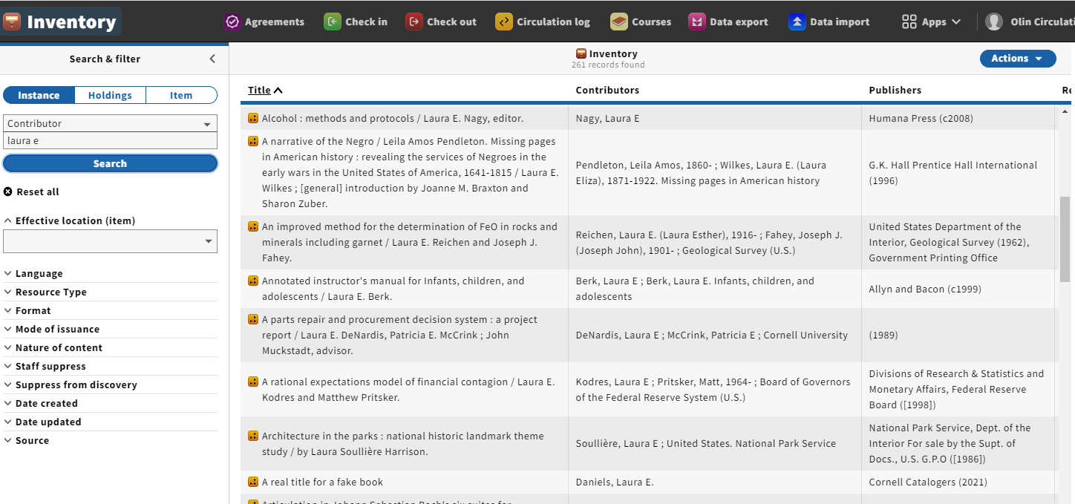
In the Contributor element, word order does matter (but you don’t have to start at the beginning of the element)

Slide 11
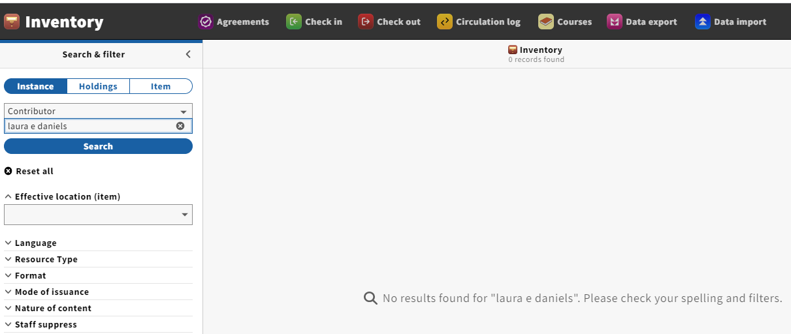
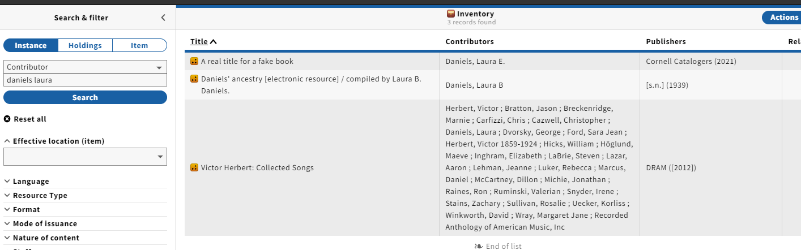
Order matters– but punctuation is optional

Slide 12
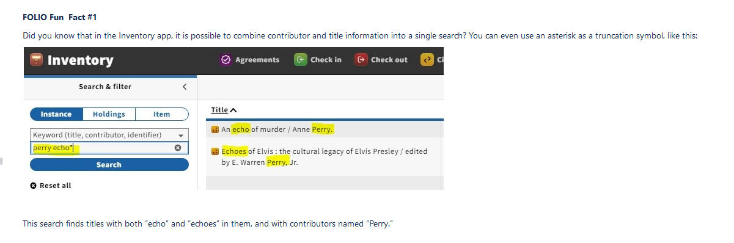
Reminder: you can combine author/title info in the Keyword search

Slide 13
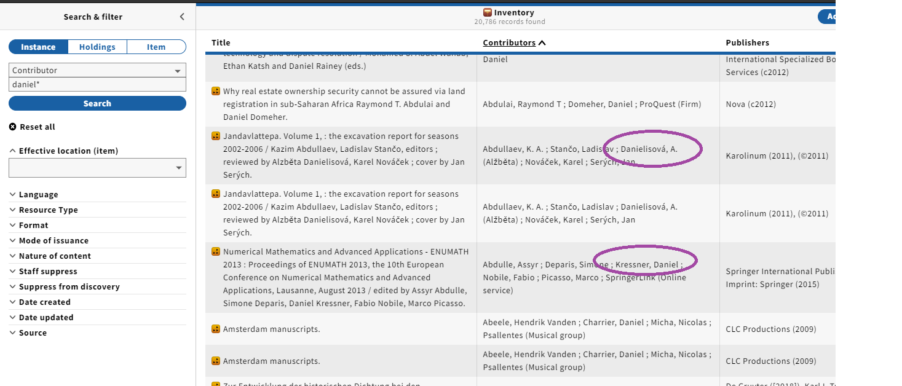
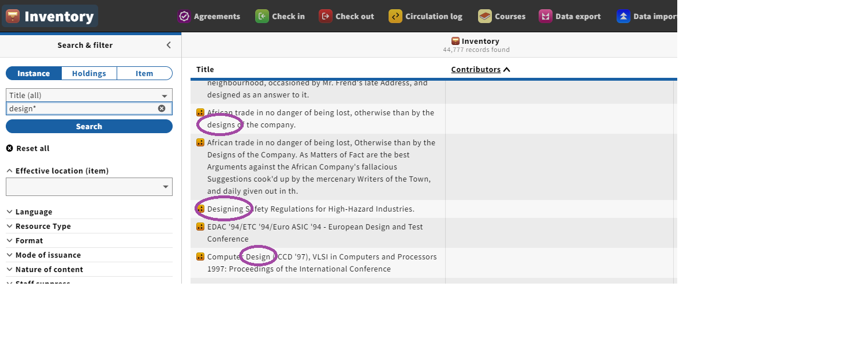
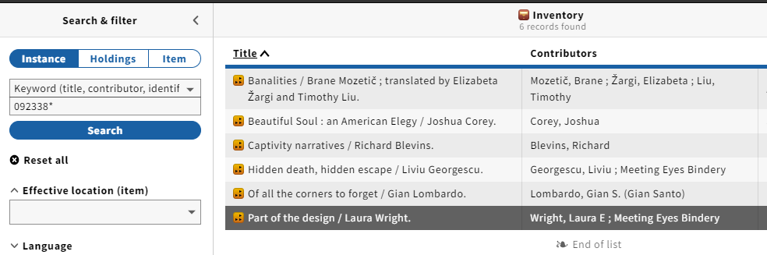
Use the asterisk *
for truncation

Slide 14
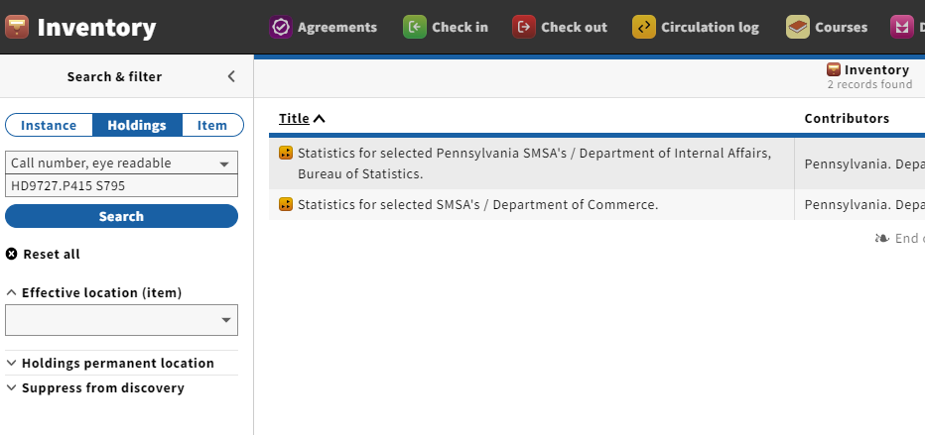
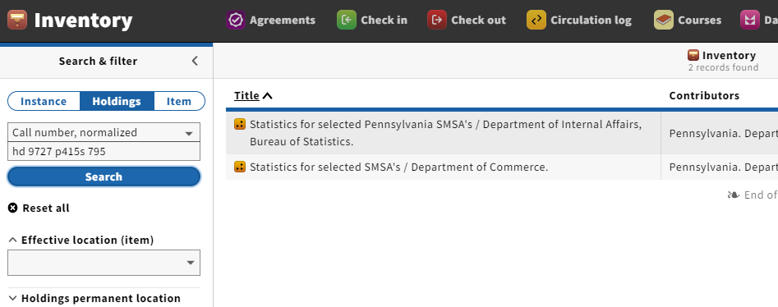
Call number searches
Eye readable: formatting, spaces must be exact (good if you’ve copied from the online catalog)
Normalized: spaces, punctuation are ignored
Both are case insensitive

Slide 15
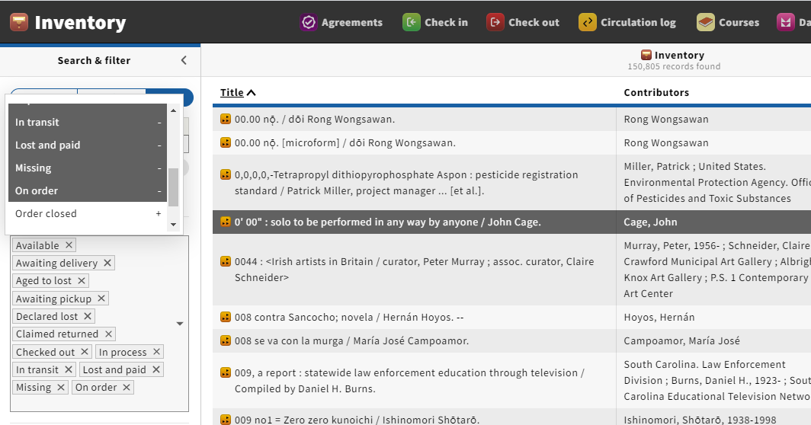
Filter display changes if large number of options selected

Slide 16
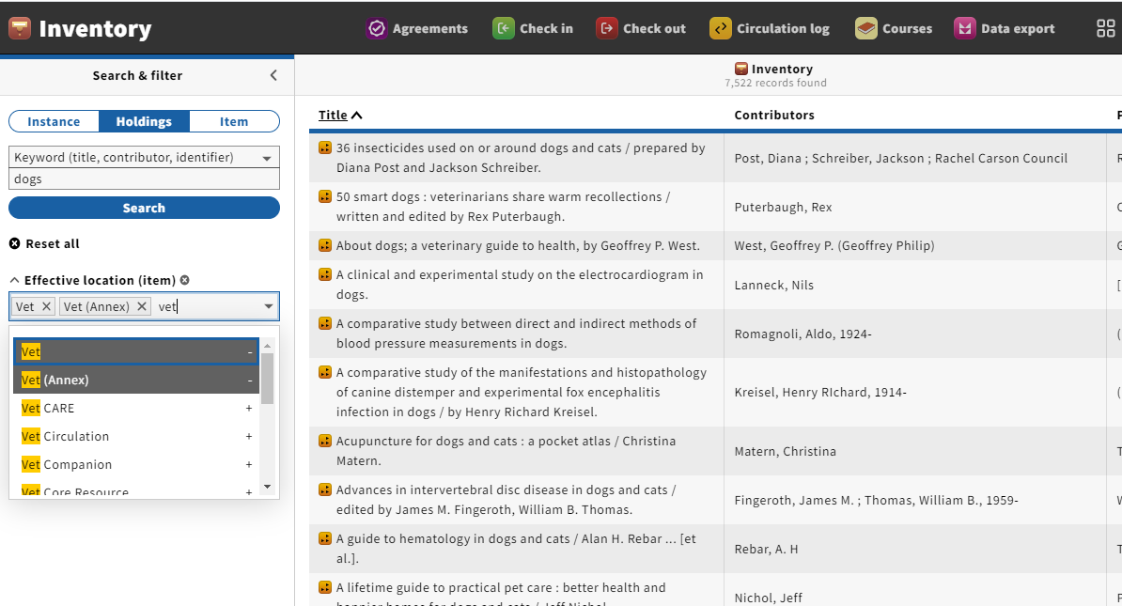
Effective location
  –in theory an item can be assigned a different location than its holdings
  – temporary location can be different from permanent location

Slide 17
Query search (advanced)

Slide 18
Query searching
Uses CQL syntax (common query language)
Local documentation (Confluence)
FOLIO community documentation (FOLIO wiki)

Slide 19
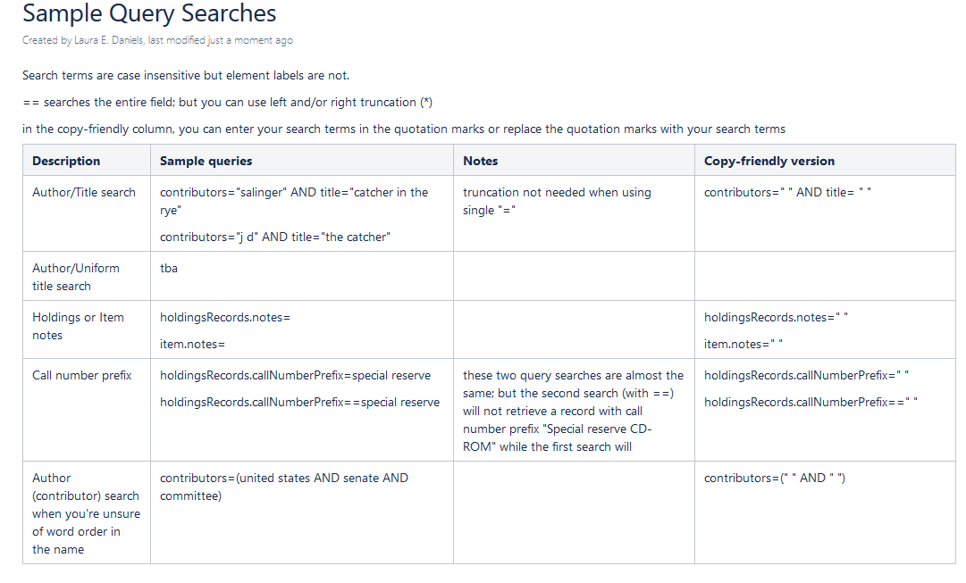
Samples (a work in progress)

Slide 20
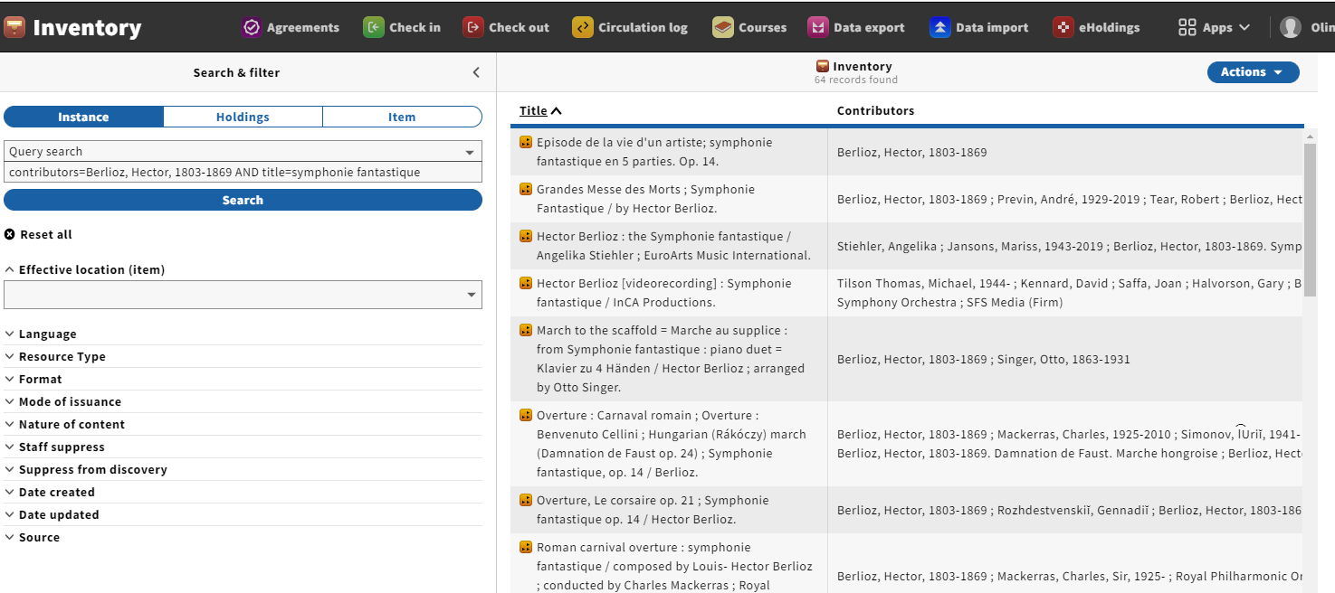
Example Query search (author/title)

Slide 21
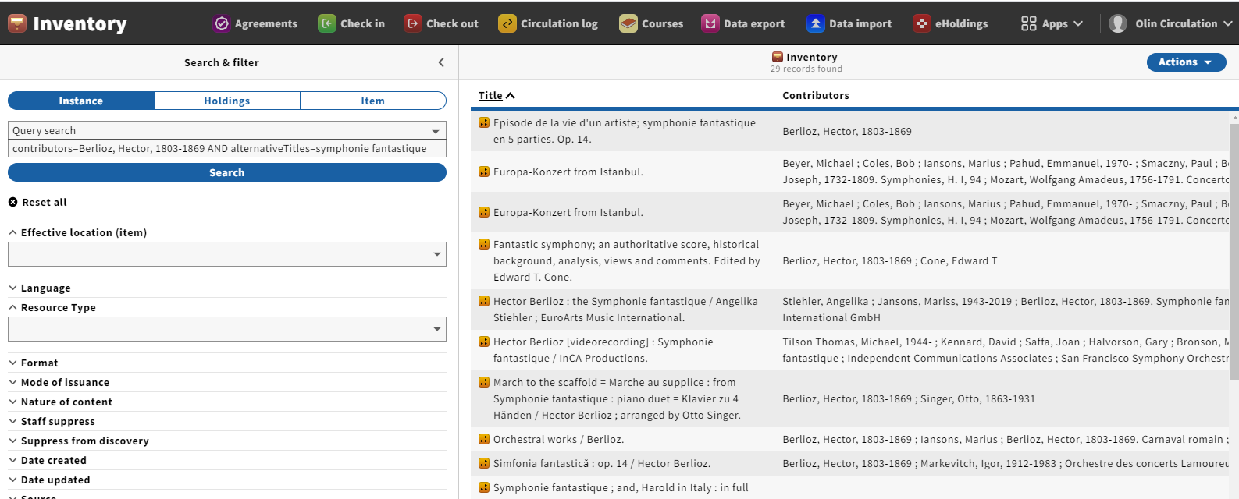
Example Query search (author/uniform or other alternative title)

Slide 22
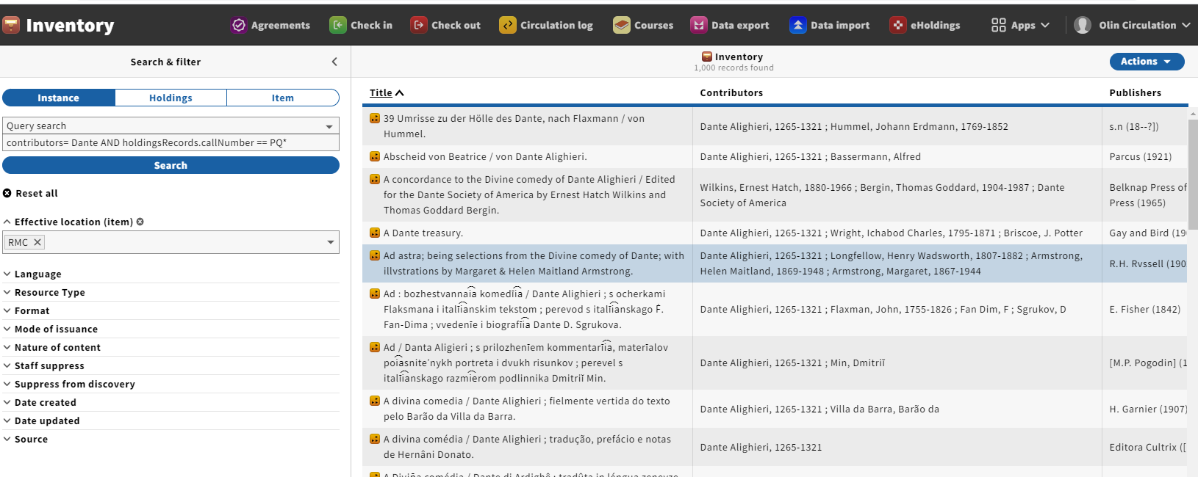
Example Query search with filter

Slide 23
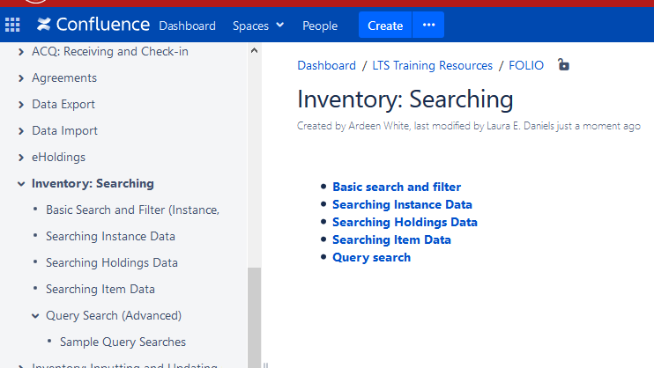
Confluence Documentation for Searching Inventory
*don’t forget to stop recording

