Slide 1
The FOLIO Organizations App
Presented by:
Jean M. Pajerek
Emma Raub
June 2021

Slide 2

Parts of this presentation have been adapted from documentation available at:
https://docs.folio.org/docs/acquisitions/organizations/
Caveat: While this documentation was written for the Honeysuckle version of FOLIO, much of it is applicable to the Iris version as well.

Slide 3
What does the Organizations app do?
“The Organizations app allows you to manage organizations with which your library interacts. Organization records are a place where you can store information about an organization, including contact information, websites, interfaces, and accounts.”

Slide 4






The Organizations app interacts with several other FOLIO apps.

Slide 5
An “Organization” in FOLIO may or may not be a vendor.
Vendors are not the only organizations with which the Library interacts.
All vendors are Organizations, but not all Organizations are vendors.
Notes:
In Voyager, we have vendor records, whether the organization in question is actually a vendor or not. In FOLIO, vendors are a type of “organization.”

Slide 6
What’s the difference between organizations that are vendors and organizations that are not vendors?
Vendors are a type of organization used in Orders and Invoices to purchase and pay for library material.
Non-vendors are used with Agreements and Licenses, but don’t require the details needed for payment.

Slide 7

Over to Emma!

Slide 8
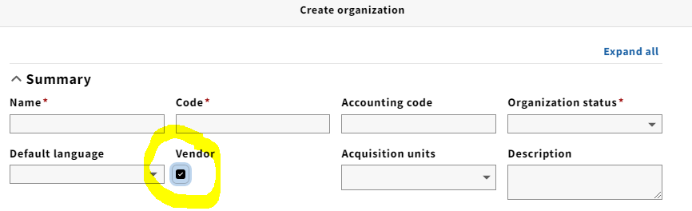
When creating a new vendor record in the Organizations app, it is necessary to explicitly indicate that the organization is a vendor.
Notes:
In Voyager, the equivalent of the “Accounting code” is the “Institution ID.” This is the code used by the library in its payment system to reference the organization. Even though the Accounting code is not a required field, we need to supply one because without this code, an invoice cannot be approved and paid.

Slide 9
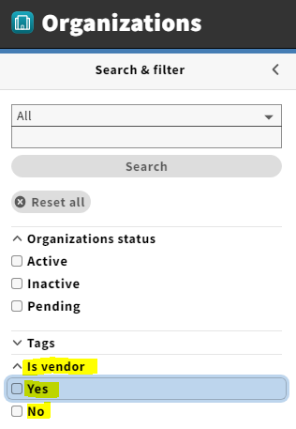
When searching in the Organizations app, it is possible to filter a search according to whether the organization you are looking for is a vendor or not.

Slide 10
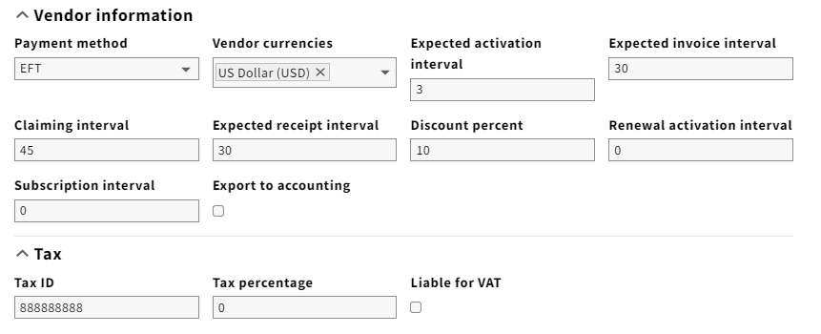
An organization that has been designated as a vendor has a number of fields that non-vendor organizations do not have.
Notes:
As you would expect, these vendor-specific fields have to do with monetary transactions, receipt intervals, Electronic Data Interchange (EDI), and other vendor-related functions.

Slide 11
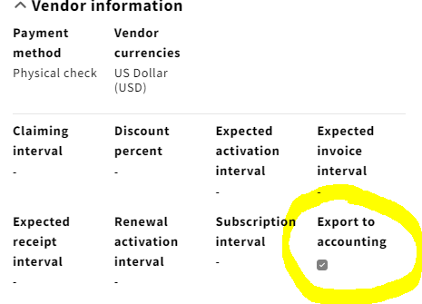
The information that you enter in the Vendor information accordion determines some of the defaults that appear when you apply the vendor to an order or invoice.

Slide 12
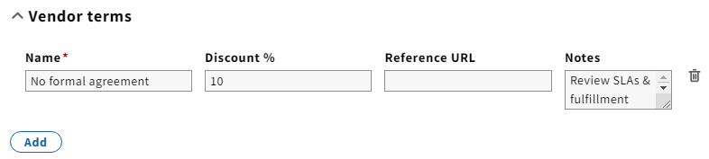
Vendor terms summarize an agreement with a vendor.

Slide 13
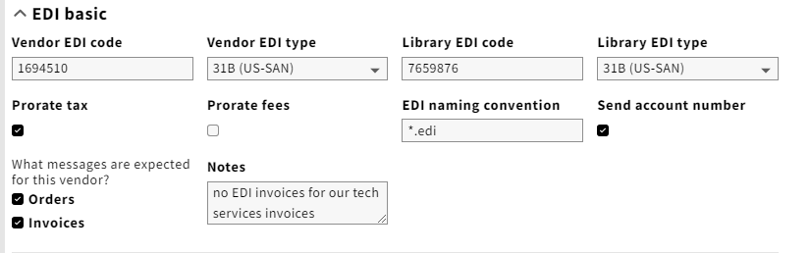
Fields associated with EDI (Electronic Data Interchange) processing of orders or invoices.

Slide 14
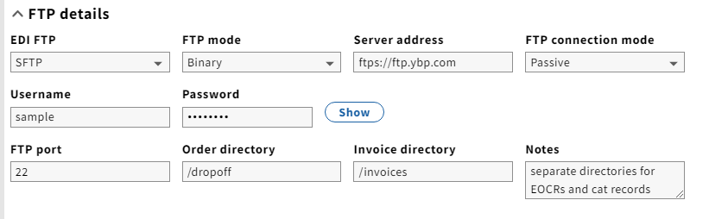
FTP details for EDI

Slide 15
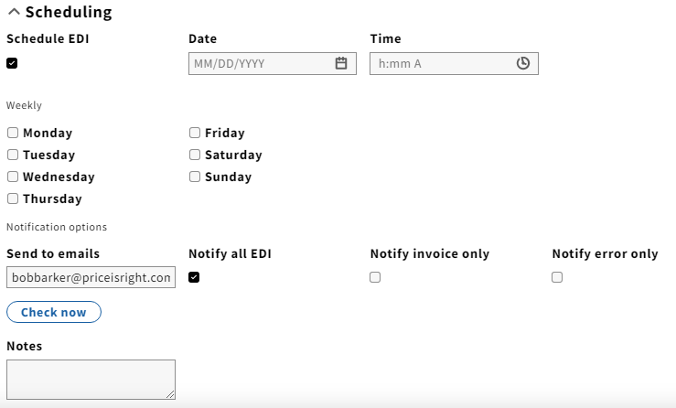
Scheduling EDI

Slide 16
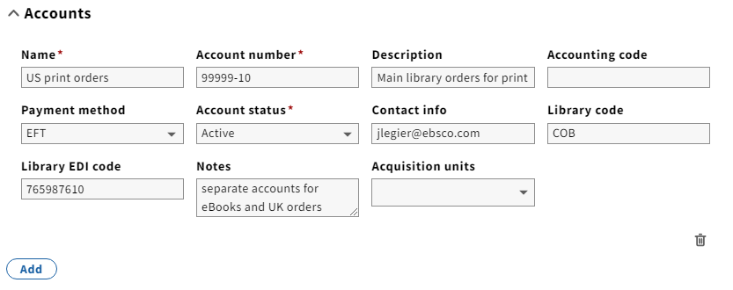
Fields associated with vendor accounts

Slide 17
I mentioned earlier that the Organizations app interacts with several other FOLIO apps.

Slide 18
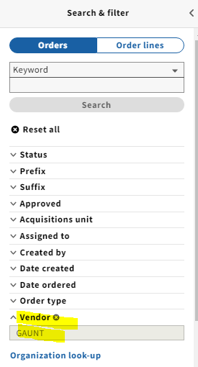
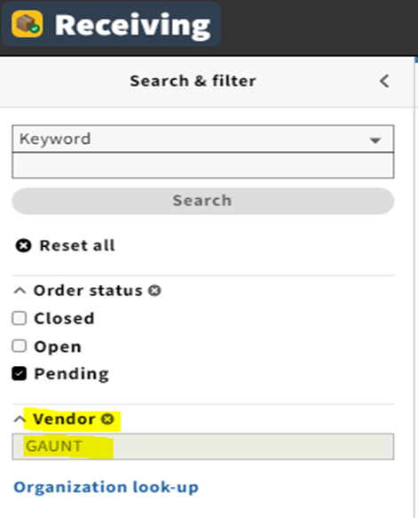
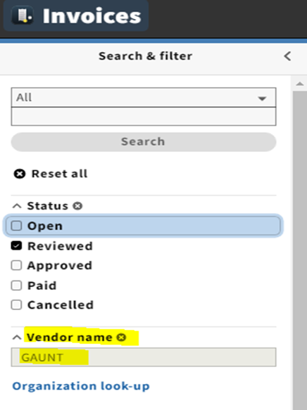
In the Orders, Receiving, and Invoices apps, searches can be filtered by vendor.

Slide 19
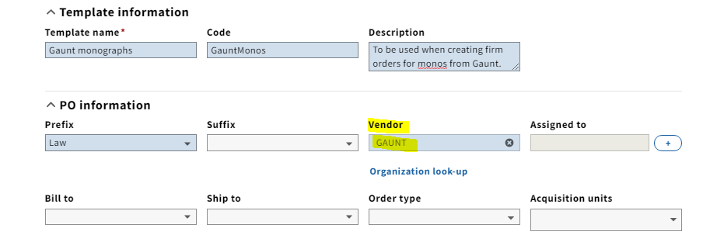
Order templates can incorporate vendor information.

Slide 20
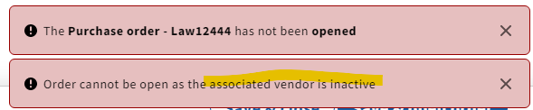
FOLIO will allow you to CREATE a purchase order using a vendor that is not active, but it will not allow you to OPEN that purchase order.

Slide 21

Insufficient information in a vendor record can prevent an invoice from being approved and paid.

