Slide 1

Ordering in FOLIO presented by
Jean M. Pajerek
May 2021

Slide 2
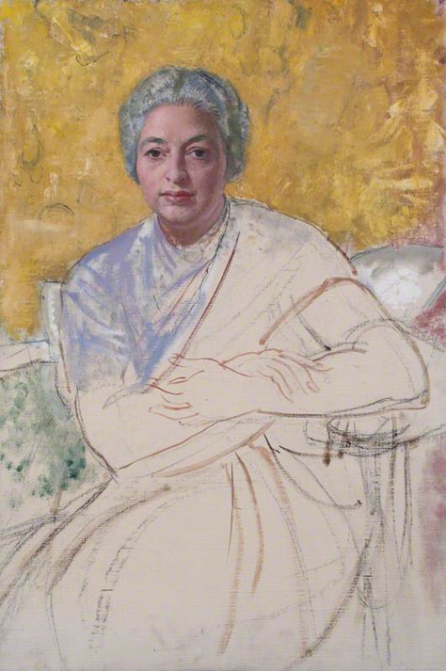
Disclaimer!
Keep in mind that FOLIO is a work in progress.
  There are parts of it that just … aren’t there yet.
  Many parts of FOLIO that do exist are not fully
  documented.
  The version of FOLIO that we are bringing up in July (Iris) is a little different from the version we’ve had access to in our training database (Honeysuckle).

Slide 3
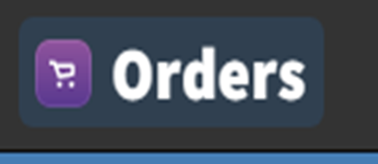
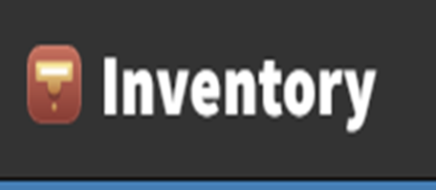


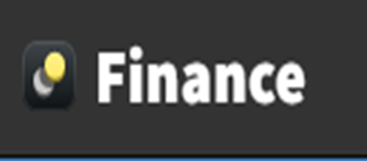
In FOLIO, ordering is accomplished through the complex interactions of four separate apps:

Slide 4
Questions to be asked and answered when creating an order
Is there a record in OCLC for the material(s) being ordered?
Is the order a one-time order, like a monograph, or an ongoing order, like a serial or a multi-volume monograph?
Is the material being ordered in a physical format, like a printed book; an electronic format, like an e-book; or a combination of the two? Or none of the above?

Slide 5
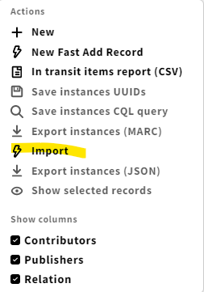
Is there a record in OCLC for the material(s) being ordered?
  If yes, use the Import function under the blue “Action” button in the Inventory app to import the record into FOLIO. Once imported, the instance record info can be
  brought into a purchase order line using
  the “Title look-up” feature in the Orders
  app.
Note: this functionality is not available in
our training instance of FOLIO, but will be
available in the Iris version of FOLIO we are
implementing in July.

Slide 6
What if there is no record in OCLC for the material(s) being ordered?
Keep in mind that it is NOT necessary for there to be a pre-existing instance record in Inventory for a purchase order to be created.
If there is no record in OCLC for the material(s) being ordered, create the purchase order directly in the Orders app, paying particular attention to the required fields, which are indicated by a red asterisk.
Depending on what you are ordering, instance, holdings and item records may be created in Inventory as part of the ordering process, but do not have to be.

Slide 7
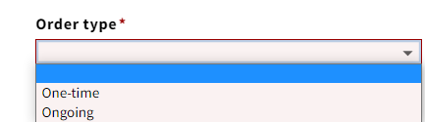
Is the order a one-time order, like a monograph, or an ongoing order, like a serial or a multi-volume monograph?
When creating a new purchase order, one of the required fields is “Order type.” There are only two Order types: “One-time” and “Ongoing.” Select the appropriate Order type from the drop-down list.

Slide 8
Tips on “Order type”
The “Order type” is applied at the purchase order level and applies to each purchase order line on the purchase order.
For this reason, it is inadvisable to order continuations and monographs on the same purchase order.
For ongoing orders, we recommend that the purchase order contain only one purchase order line. This is current practice in Voyager.
For ongoing orders for which you expect to record receipt of physical pieces, it is very important to check the “Manually add pieces for receiving” checkbox in the PO line details accordion of the POL.

Slide 9
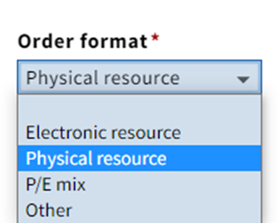
Is the material being ordered in a physical format, like a printed book; an electronic format, like an e-book; or a combination of the two? Or none of the above?
When creating a new purchase order line (POL), one of the required fields is “Order format.” Select the appropriate Order format from the drop-down list.

Slide 10
The choices you make at the beginning of the ordering process will determine which PO and POL fields become available to be filled out.
For example, if you select the order format for an electronic resource, FOLIO expects you to fill out fields that have to do with e-resources, such as date of activation and whether it is a trial or not. Since e-resources do not have item records, the default setting in the “Create inventory” field of the POL for an e-resource will display as “Instance, holding” instead of “Instance, holding, item.”
If you select “Ongoing” for your order type, FOLIO may expect you to supply subscription-related information such Renewal interval and Renewal date.

Slide 11
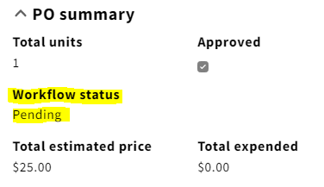
Purchase order workflow status
Every purchase order in FOLIO has one of three workflow statuses:
Pending – this is the default status of a newly created purchase order.
Open – this status is similar to Approved/Sent in Voyager.
Closed – when no further action is to be taken on the purchase order, a status of “Closed” applies.

Slide 12
What happens when the status of a purchase order changes from “Pending” to “Open?”
Once you have created your purchase order and are satisfied that the information in it is complete and correct, you are ready to “Open” the order. Opening an order initiates the following processes:
Instances, holdings, and items will be created within Inventory, as indicated by you on the POL.
Funds specified in the fund distribution(s) on the POL(s) will be encumbered.
Some fields will no longer be editable within the Orders app.*
In the Receiving app, pieces may become available to be received.
Notes:
* Opened orders can be “unopened” by staff with the required permission.

Slide 13
What are the fields that can be edited in an open purchase order?
When a purchase order has the status of “Open,” the fields that are controlled by the instance, holdings, or item records in Inventory cannot be edited from within the Orders app. Fields that can be edited on an open purchase order include the following, but this is not an exhaustive list:
Vendor Quantity
Bill to/Ship to information Receipt status
Tags Payment status
Notes, including Receiving note Fund distribution
Subscription start date Receipt due (date)
Price Expected receipt date

Slide 14
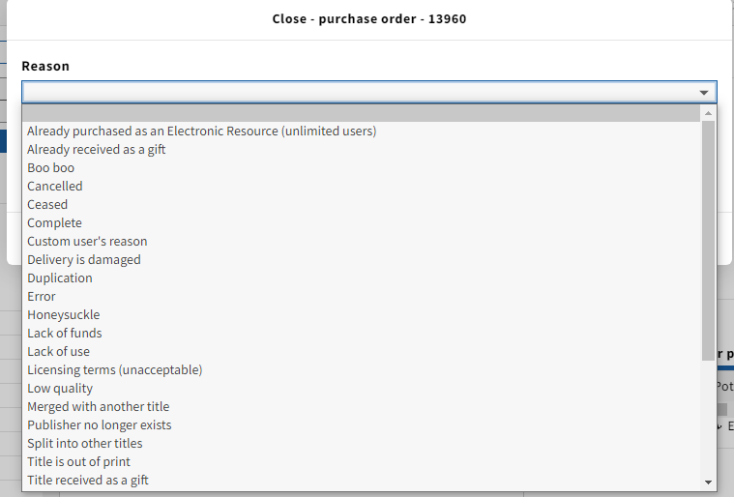
What does it mean for a purchase order to have the status of “Closed?”
There are a number of reasons why a purchase order may be closed.
When a purchase order is closed manually by a staff member, a reason for the closure must be specified by selecting it from a drop-down list:
The drop-down list is
invoked by clicking on the
blue “Actions” button in the
PO and selecting “Close
order.”

Slide 15
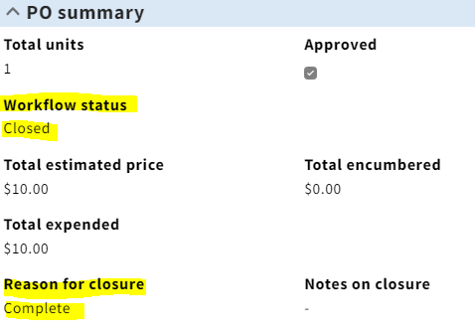

FOLIO itself will automatically close a purchase if certain conditions are met:
If all POLs on the purchase order are fully received (or receipt is not required)
AND the invoice for every POL on the PO is fully paid
This message displays on the POL display of a closed and complete POL.

Slide 16

Let’s dive in and get our feet wet!

