Slide 1
FOLIO Technical Services Overview: The Inventory App
Laura Daniels

Slide 2
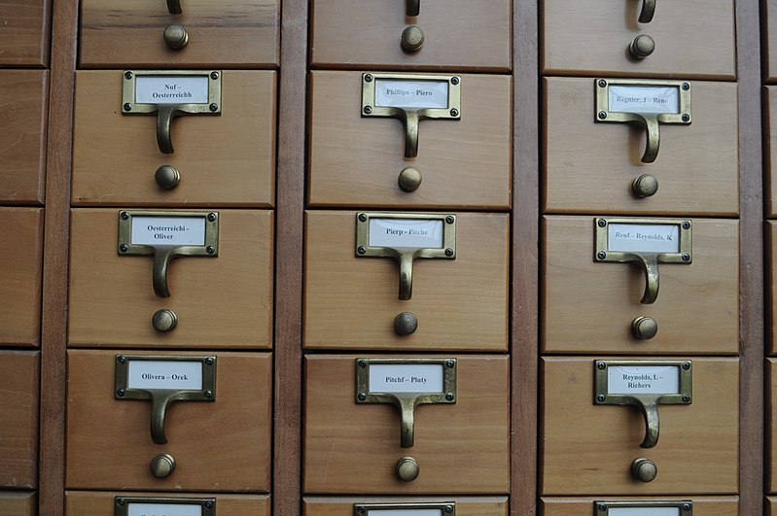
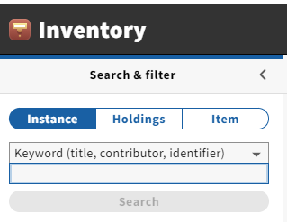
Basic Structure of Inventory
Instance (similar to Voyager bib)
Holdings
Item
photo by Joe Mabel

Slide 3
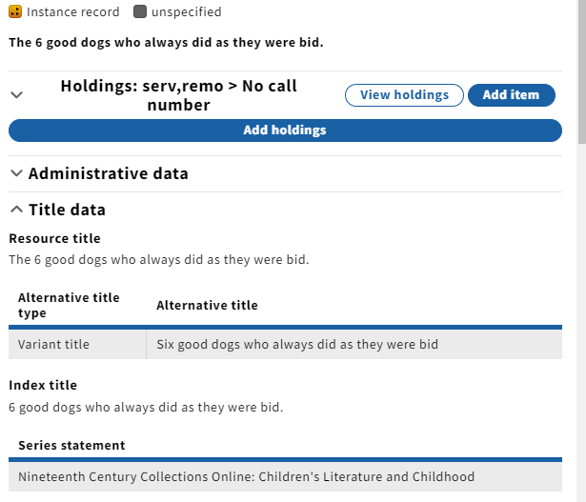
Instances
Abstract of bibliographic description
Most will have underlying source data (MARC)
But you don’t need to be able to read MARC
For migrated records,
instance hrid = voyager bibid
Elements (instead of fields/subfields)

Slide 4
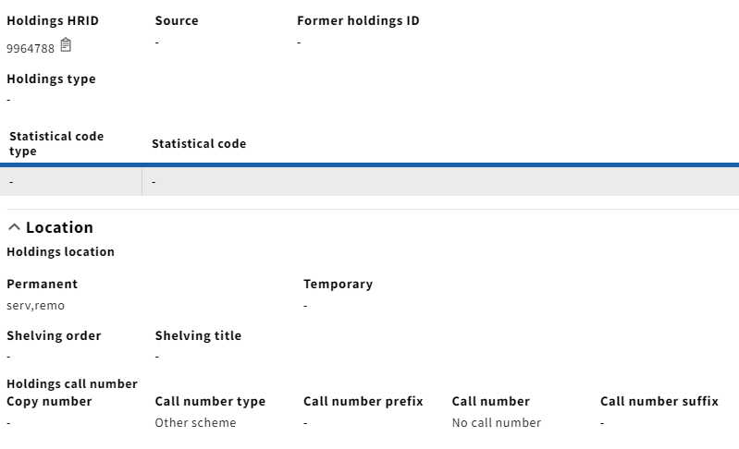
Holdings
Also not MARC and CUL does not plan to keep underlying MARC
Like in Voyager, you must have an Instance record in order to create a holdings record
Key elements:
  Permanent location (think 852 $b)
  Call number, with prefix & suffix
  (think 852 $k $h $i $m)

Slide 5
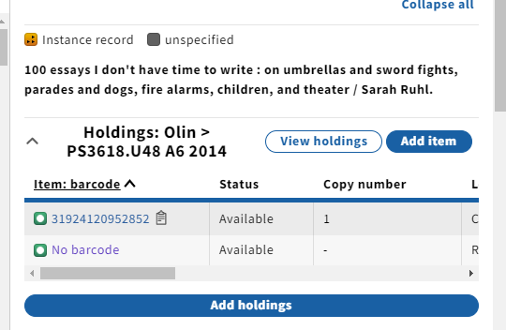
Items
Like in Voyager, item records must be associated with holdings
Can have more than one item record per holdings
Click on the barcode (or “No barcode” to view an item

Slide 6
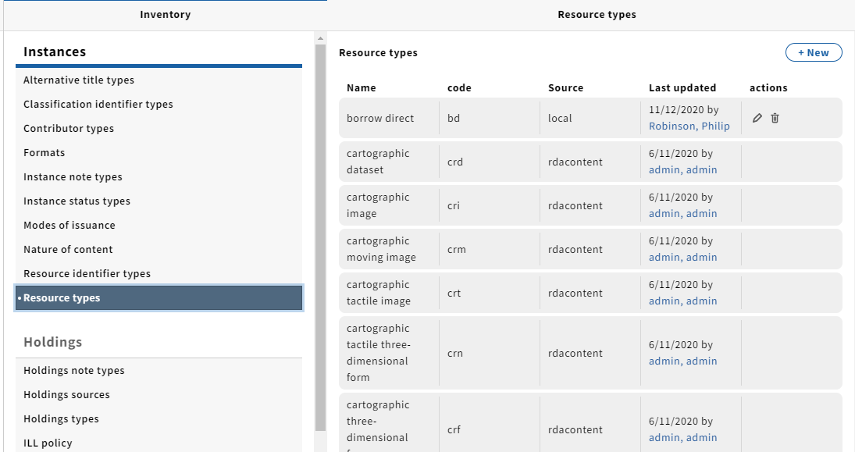
Some Terminology
Effective location
Intellectual record
Reference data
SRS (source record storage)

Slide 7
Searching Inventory
Search indexes based on Inventory data, not underlying source data
A significant change coming in Iris to title index: will include alternative titles & series titles
Results sortable, but still limited by what displays

Slide 8
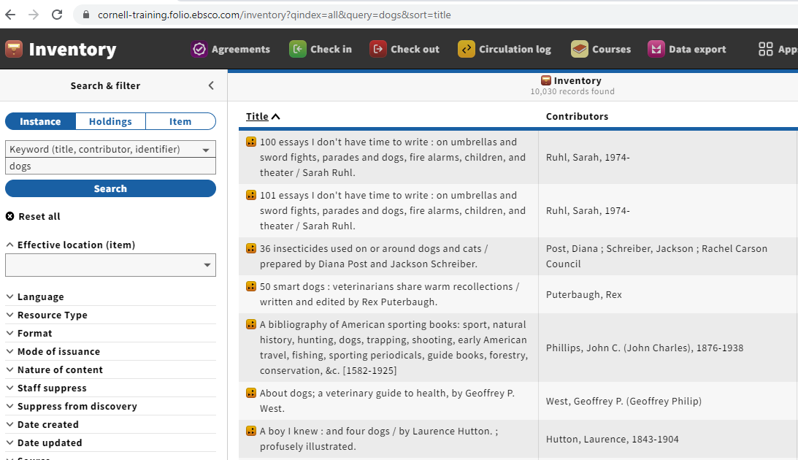
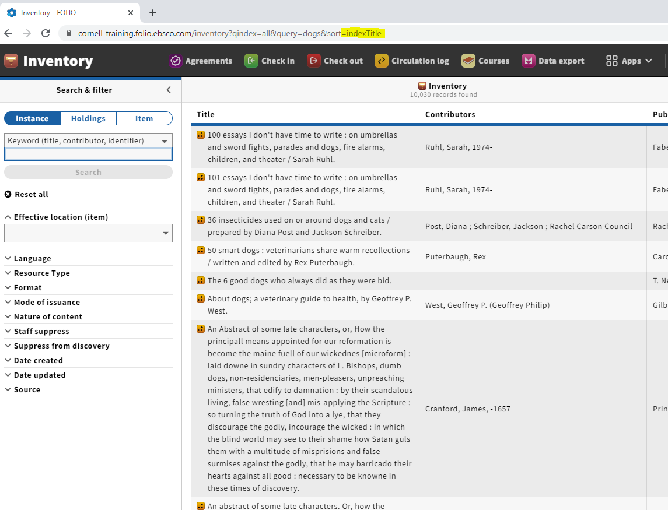
Bonus feature: sorting hack
indexTitle is case sensitive

Slide 9
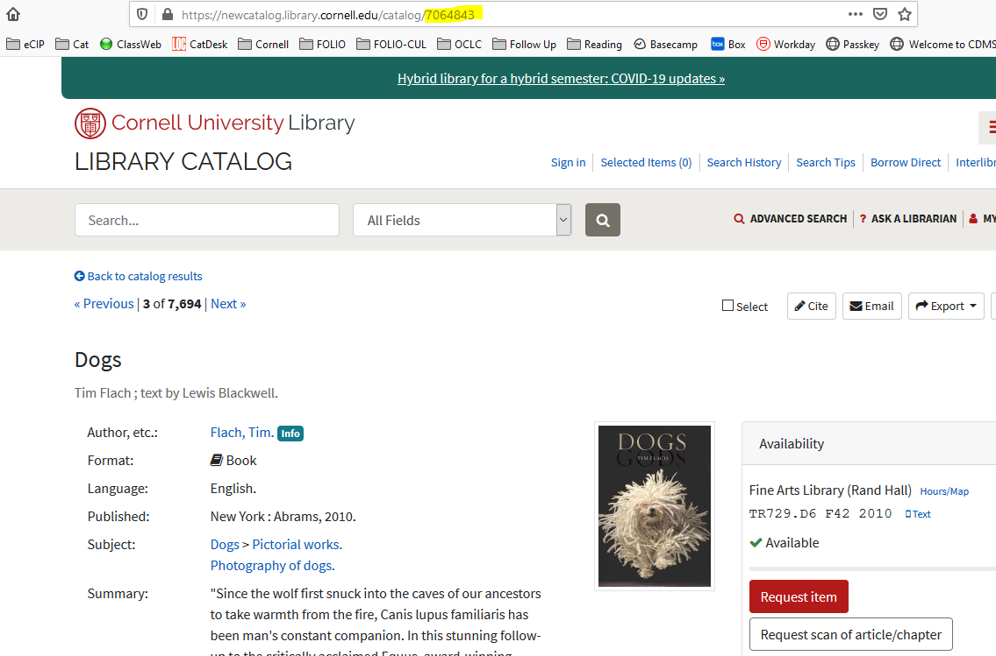
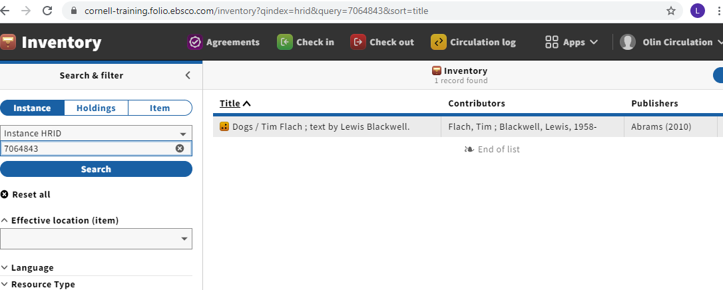
Copy record id from public catalog url to open that Instance record in Inventory (search as Instance HRID)

Slide 10
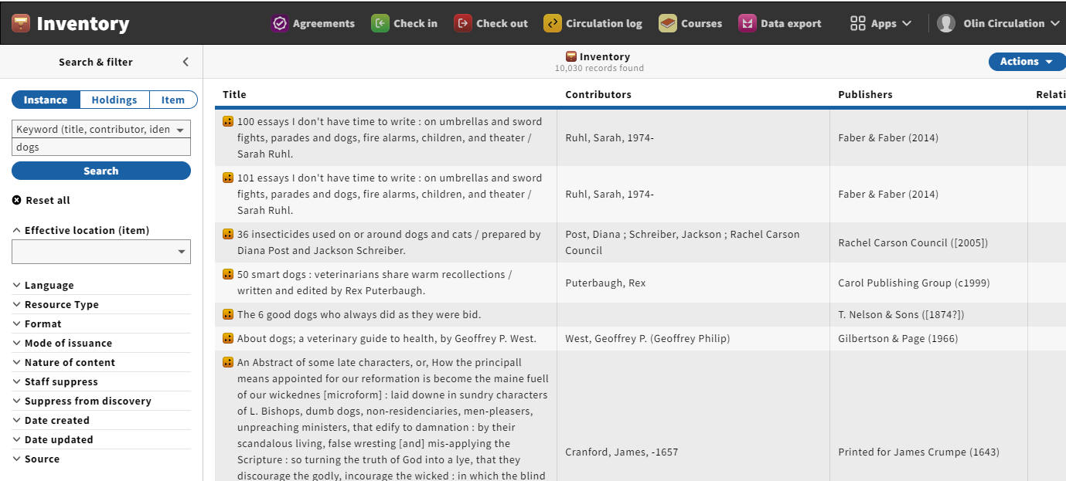
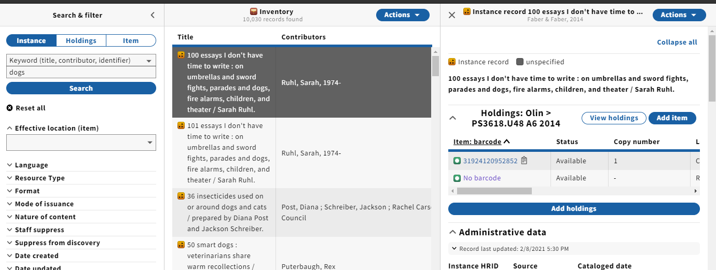
Creating, Editing, Deleting
Middle pane Actions menu: create new
Right pane (detail view) Actions menu: duplicate
View→Edit
Accordions are “collapsed” if none of the elements have data in them

Slide 11
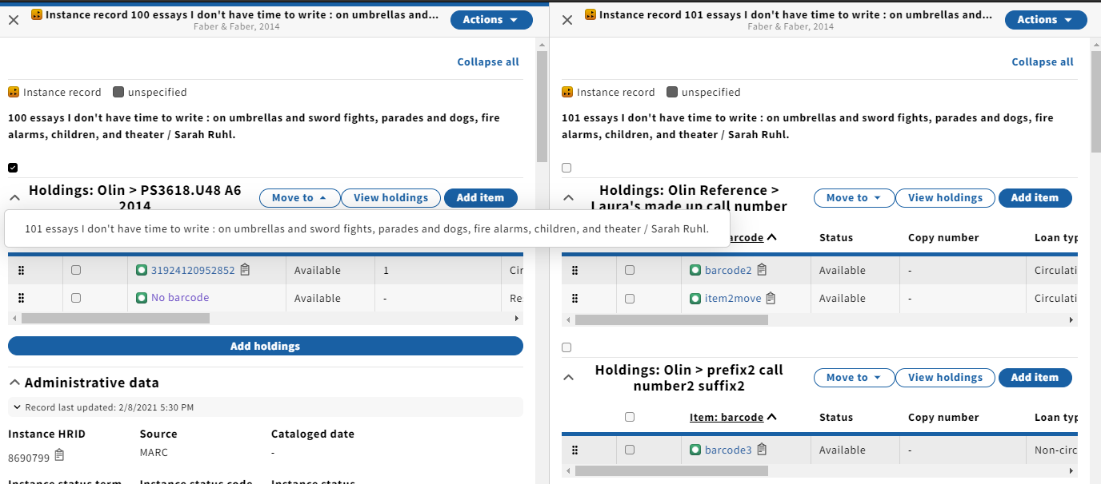
Moving holdings and items
Moving holdings
Moving items
Demo

Slide 12
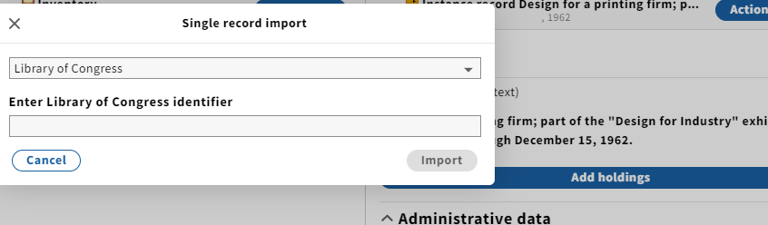
Cataloging (sneak preview)
Import/Overlay from OCLC coming in Iris

