Slide 1
Creating Invoices in FOLIO
Presented by Lisa Maybury
June 2021

Slide 2
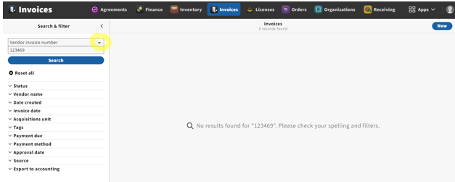
To begin the process of manually creating a new invoice, launch the Invoice app and search the vendor invoice number in the search box near the top of the left-hand pane.

Slide 3
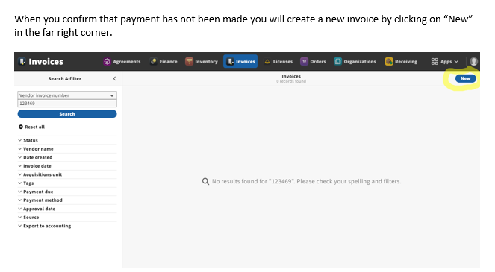

Slide 4
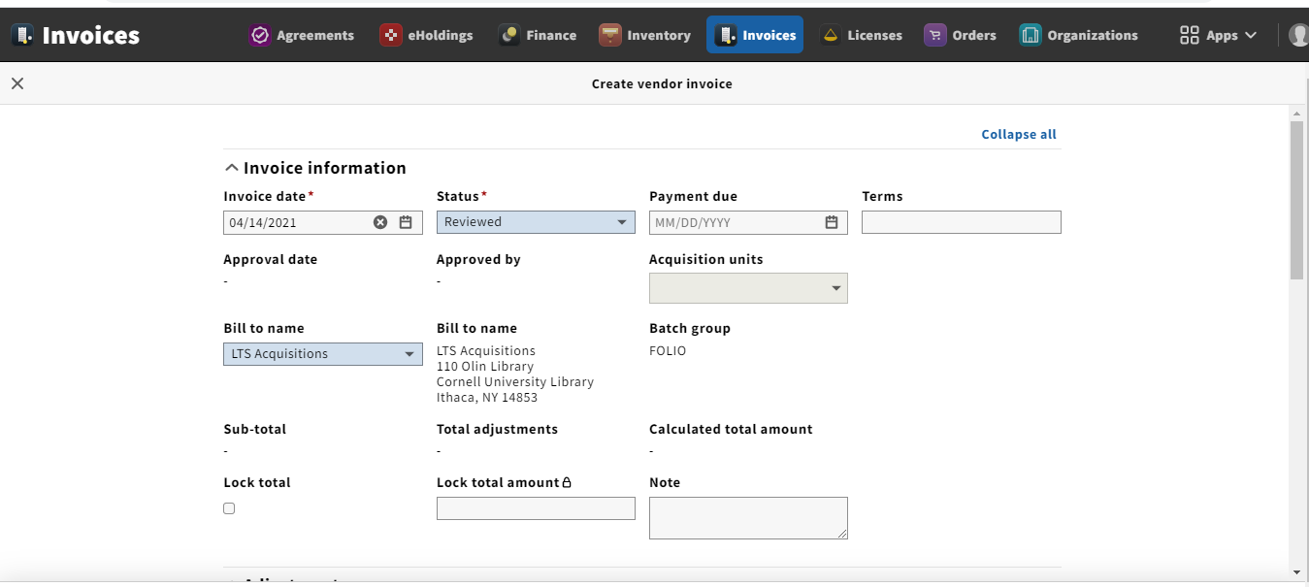
By clicking on “New” you will get the following screen: Let’s look at the fields you will need to populate:
NOTE: The Status needs to be changed from “Open” to “Reviewed” when you are ready for Accounting to make payment.

Slide 5
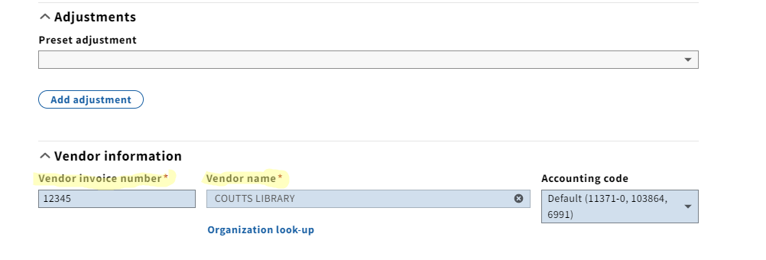

Slide 6
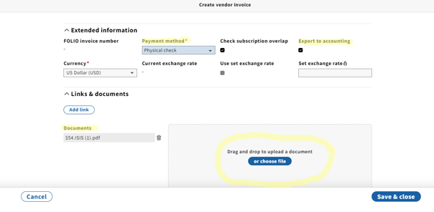
We will be updating the “Payment method” to “Physical check” unless we are paying with a procurement card, in these cases update the payment method to “Credit card”. You will always check the box for “Export to accounting” for physical check. You DO NOT check this box for Payment method “Credit card”. After you upload your invoice, click Save & close.

Slide 7
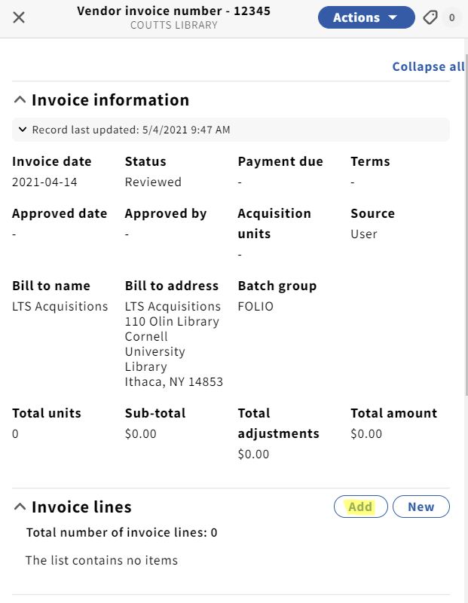
After you Save & close, you will add your line items by clicking on the “Add” button below.

Slide 8
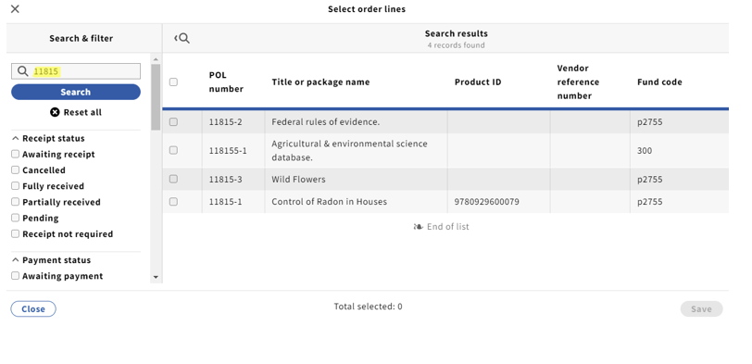
You can search by the Purchase Order number, title and you can also set parameters as you see fit: I’m looking for purchase order number 11815 but as you can see the search will truncate:

Slide 9
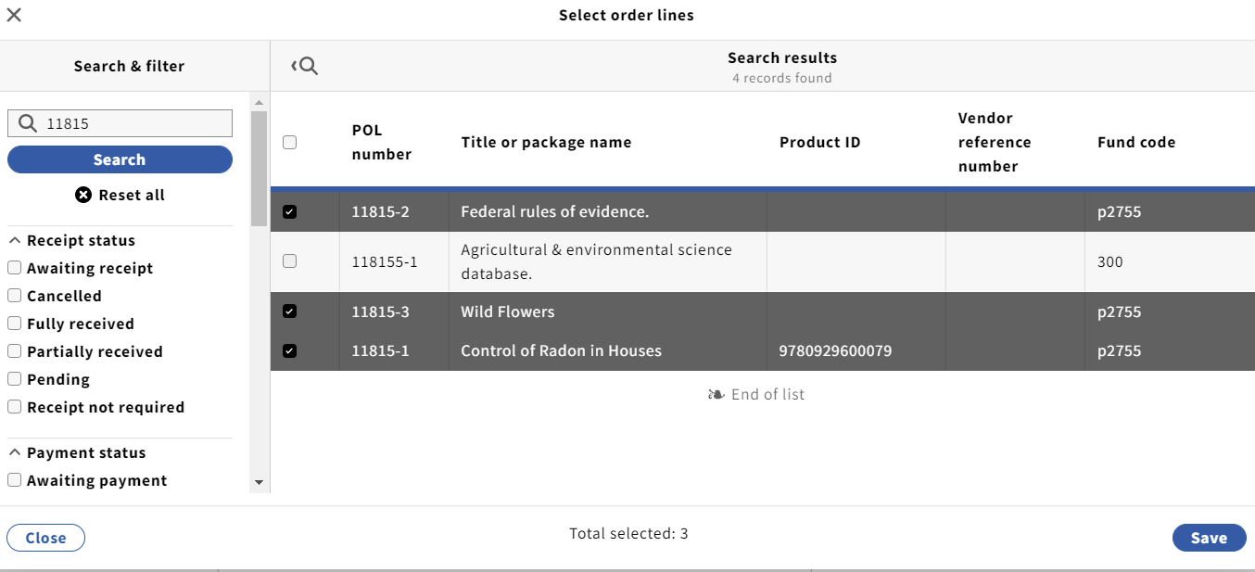
You will now select the POL numbers you are paying for by checking the box (Note: if you wanted to pay for all POL’s, you would just check the one box to the left of the POL number column); then click Save:

Slide 10
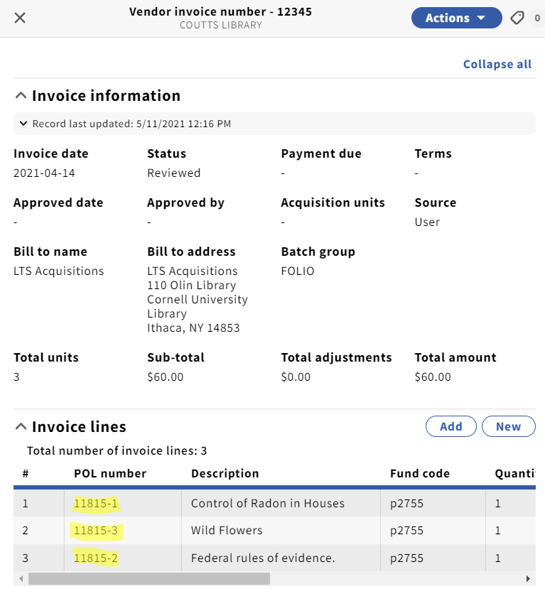
After clicking save you will see the POL’s that you selected are now attached to the invoice:

Slide 11
Some things to keep in mind:
Your totals are calculated by FOLIO
The “Lock total” box on your “header” is a feature that we will use when loading EDI invoices. This will “lock” the total of the invoice line items that appear on the invoice. This will override what the price is on the POL. With this box checked, if the totals don’t match the invoice will not be able to be approved for payment. As we know, many EDI invoices are loaded without the adjustment (i.e. Shipping/service charge/discounts etc.) which would throw the totals off. Your invoice total in FOLIO should match your paper invoice total you are working from.
When manually creating an invoice, your sub-total is based on the prices within the POL’s. If the price changes from the point of order to when you are receiving it, you will need to go to the invoice line and click the blue “Actions” button in the upper right hand corner and select “Edit”. Below shows you where you will change the price as it is stated on the invoice.

Slide 12
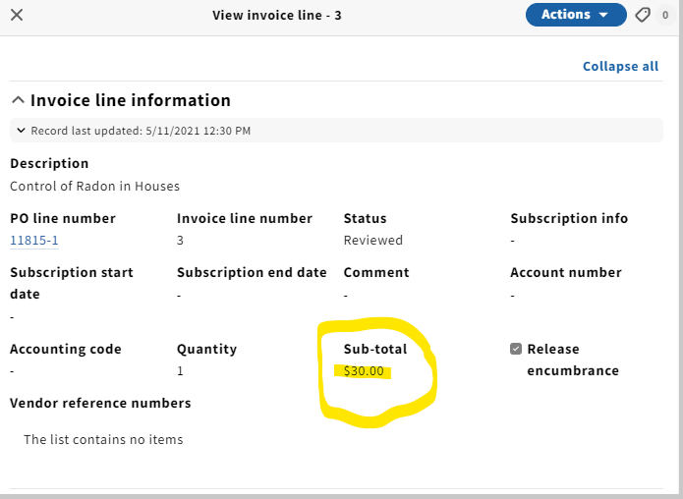

Slide 13
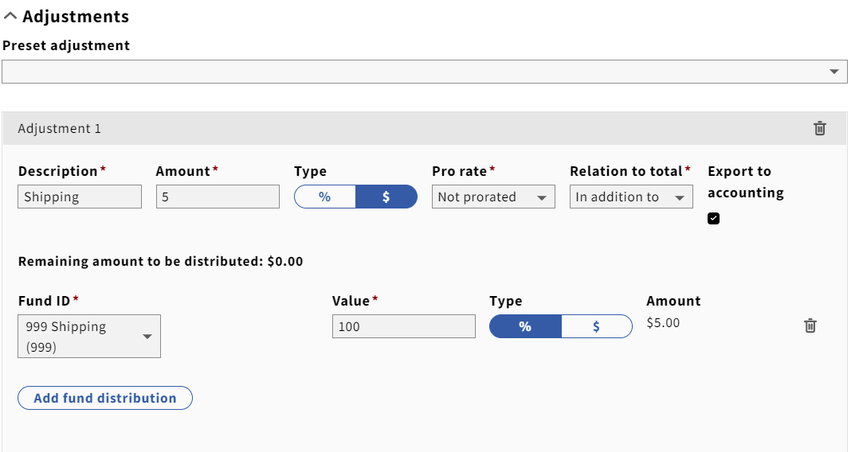
Adjustments:
This is where you will add postage and handling, service charge, discount etc. You have the ability to add adjustments at the invoice level or the invoice line level. In most cases, we will use this price adjustment at the invoice level rather than the invoice line level.

Slide 14
Questions?
Are we ready to do this together?

