Slide 1

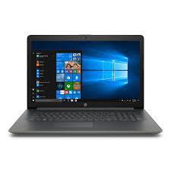

FOLIO Technical Services Overview:
Acquisitions* presented by
Jean M. Pajerek
Cornell Law Library
*These slides incorporate text provided by Duke University.

Slide 2





In FOLIO, there are five separate apps directly involved in acquisitions functions.

Slide 3

Orders represent purchases that the library plans to make.
Orders contain high-level information including
Order number
Vendor
Order type – either one-time or ongoing
Workflow status – pending, open, closed
Each order consists of one or more order lines (POLs), which specify the material being ordered and the expected cost.

Slide 4
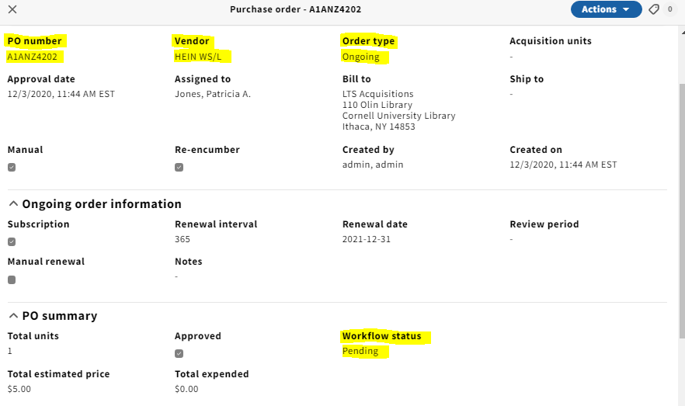

Slide 5
A purchase order must contain one or more purchase order lines (POLs)
Purchase order line details include information about the resource being ordered:
Purchase order line (POL) number
Acquisition method
Order format
Receipt status
Payment status
Vendor, price and quantity information
Receiving notes
Fund distribution
Intended location

Slide 6
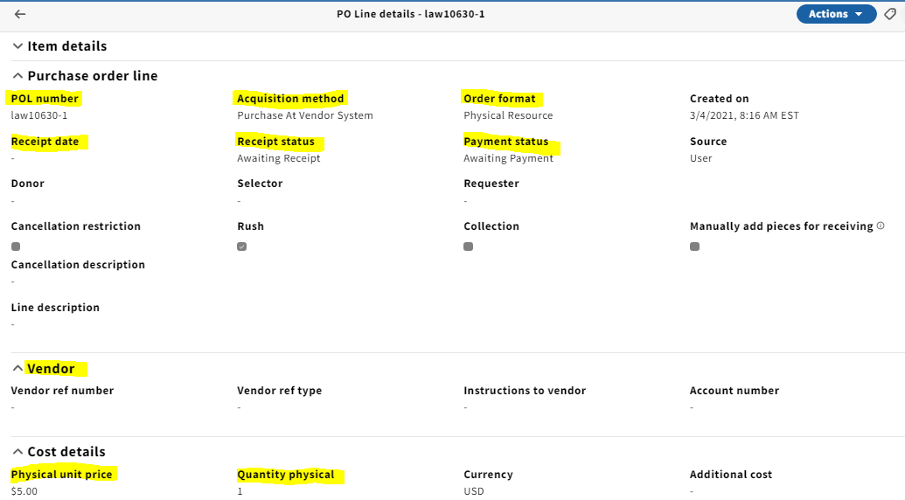
Expand the “Item details” accordion to see more info about this line item.

Slide 7

Once the workflow status “Open” is applied to a purchase order, some of the information on the purchase order line is no longer editable. The items indicated on the POLs can be received.
During receiving, you can:
Mark the item received
Enter a barcode
Enter comments
Change the item’s location
Take action based on information provided in a receiving note, e.g., “Rush for course reserve.”

Slide 8
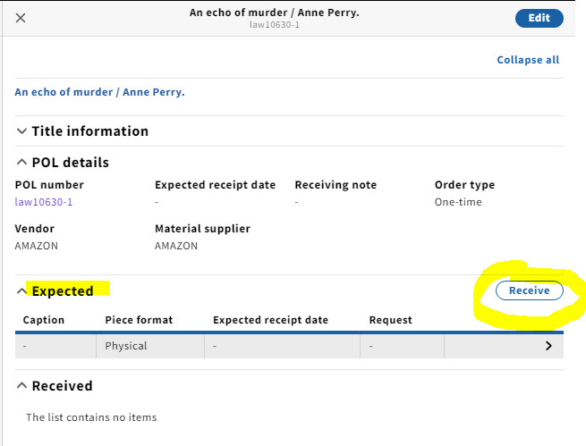
Click here to see the instance record in Inventory
Click here to see the purchase order line in Orders.

Slide 9
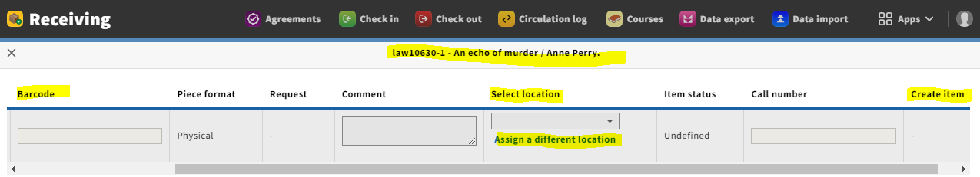
Clicking on the “Receive” button takes us to this screen

Slide 10

Invoices are used to process payments.
Paying an invoice will:
Release encumbrances against funds
Show funds as expended
Create a voucher that can be sent to an external financial system
Close an order if it has also been fully received

Slide 11
Similar to Orders, Invoices consist of Invoices and Invoice lines.
The Invoice record is high-level with only a few required fields:
Invoice date
Status
Invoice number
Vendor
Currency
Payment method
Invoices can also include attachments or links to documents.

Slide 12
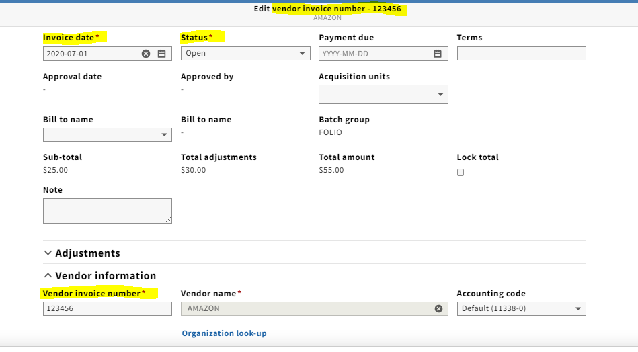

Slide 13
Invoice Lines
In most cases, Invoice lines link the invoice to a purchase order line, but do not have to. An invoice can have more than one line.
When you create an invoice line, it will automatically pull in relevant details from the order (if there is one), including the cost and fund distribution.
If additional funds are needed, they can be added through another fund distribution or an adjustment.
Adjustments are used to cover expenses like shipping, taxes, etc.

Slide 14
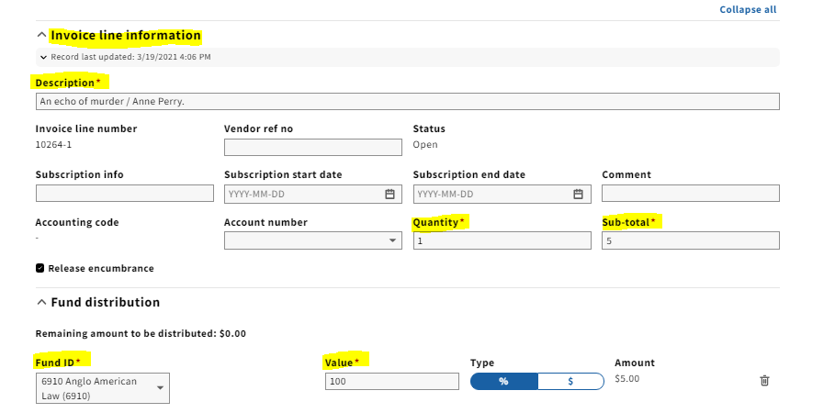
The required fields in the invoice line are populated from the purchase order line, if there is one.

Slide 15

Organizations represent entities that a library interacts with.
Vendors are a type of organization used with Orders and Invoices.
Non-vendors are used with Agreements and Licenses, but don’t require the details needed for payment.
Key metadata:
Name, code, status
Contact information and people
Interfaces (Online platforms with log in details)

Slide 16
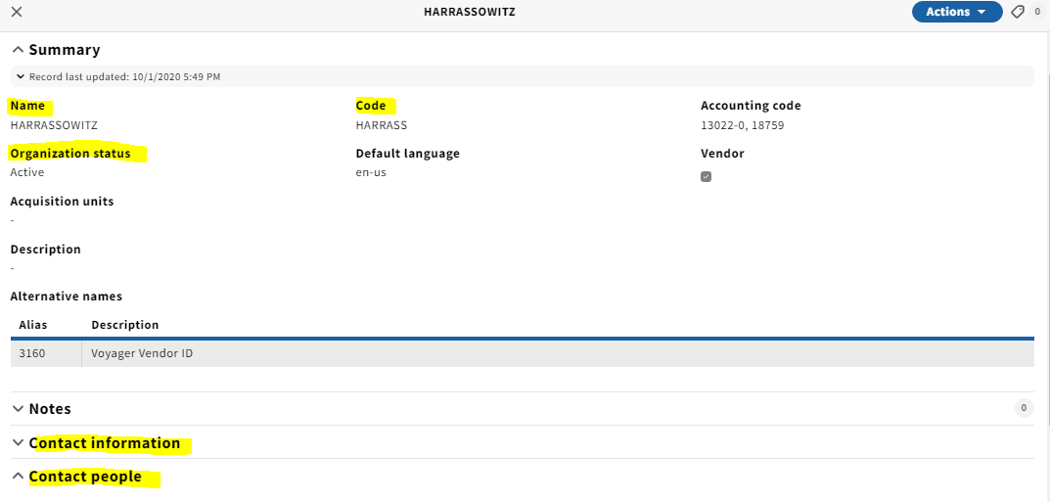
This indicates that the organization is a Vendor.

Slide 17
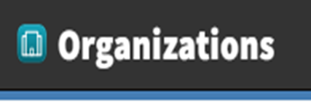
When an organization is marked as a vendor, it get an additional set of fields to facilitate payments.
Vendor information (payment type, currency, default intervals)
Tax information (ID and percentage)
Terms (Link to terms, discount percentage)
EDI (Electronic Date Interchange) Information (Details needed to load EDI orders and invoices)
Accounts (Account numbers and codes)

Slide 18
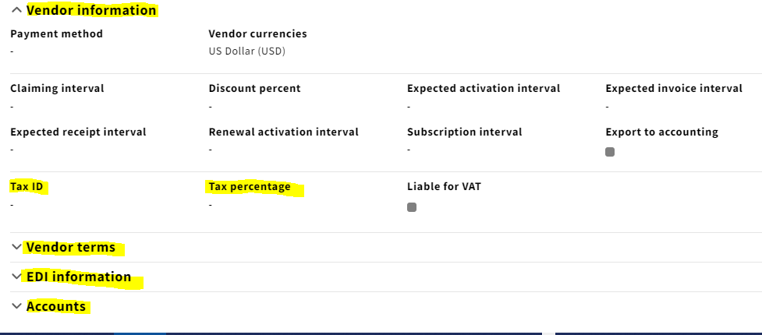
Organizations designated as vendors include this additional information

Slide 19

Finance records allow libraries to create fund structures, allocate funds, manage fund balances and report on funds.
FOLIO financials are used purely for internal management purposes. The process of issuing payments must be handled by an external system -- though some integration with FOLIO will be possible.

Slide 20
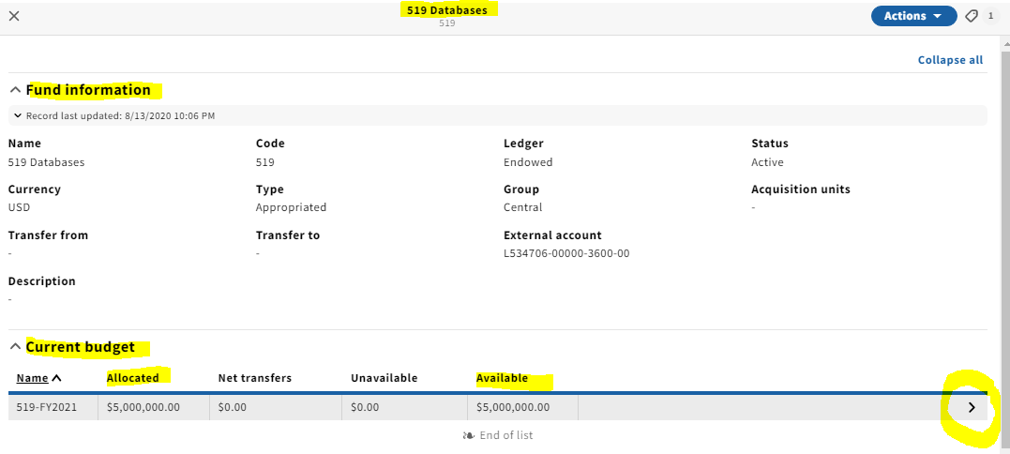
This is the fund record for fund 519
Click here to see the Budget summary screen

Slide 21
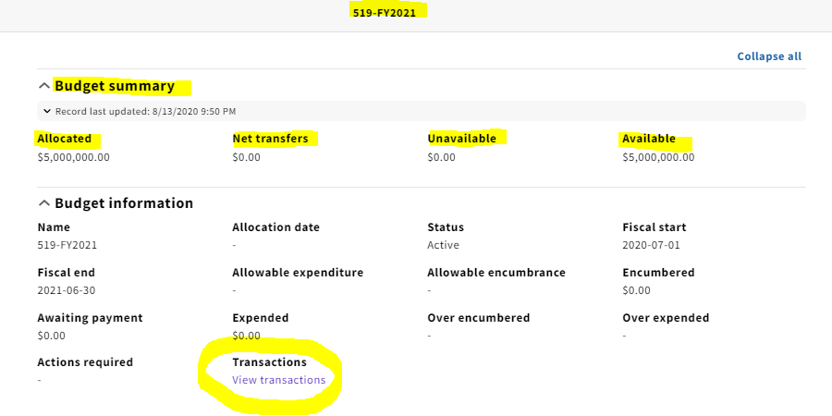
This is the Budget summary screen
Click here to see the transactions associated with this fund.

Slide 22
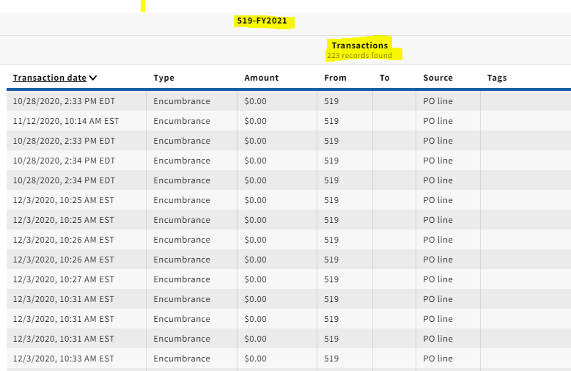
These are the transactions associated with fund 519

