Slide 1

Organizations!
the basics
See here: https://confluence.cornell.edu/display/ltstr/Organizations

Slide 2

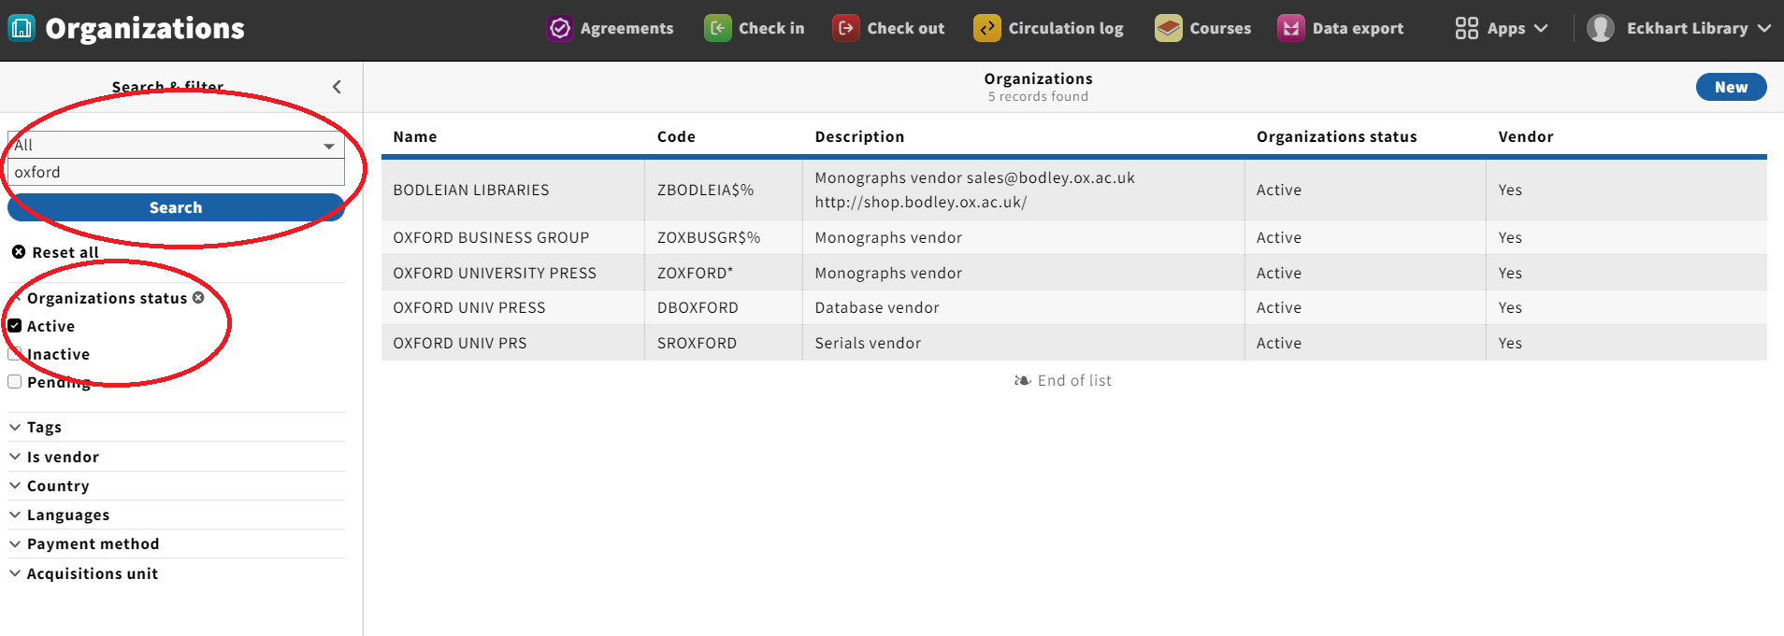
Searching for an organization:
This is the Orgs app (training): https://cornell-training.folio.ebsco.com/organizations
See here: https://confluence.cornell.edu/display/ltstr/Searching+for+an+organization+record+and+filtering+by+status

Slide 3
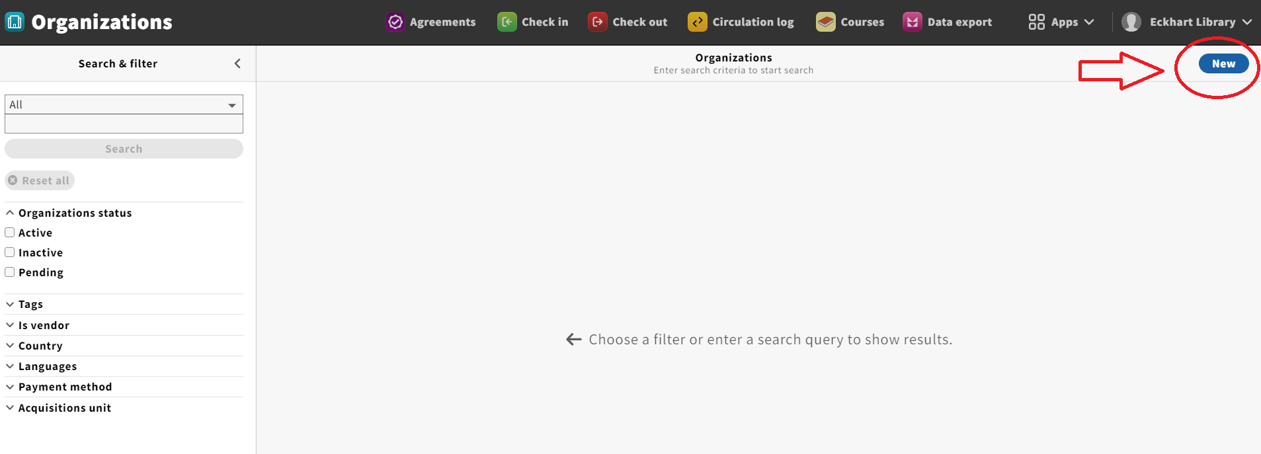
Creating an organization:
This is the Orgs app (training): https://cornell-training.folio.ebsco.com/organizations
See here: https://confluence.cornell.edu/pages/viewpage.action?pageId=393686072

Slide 4
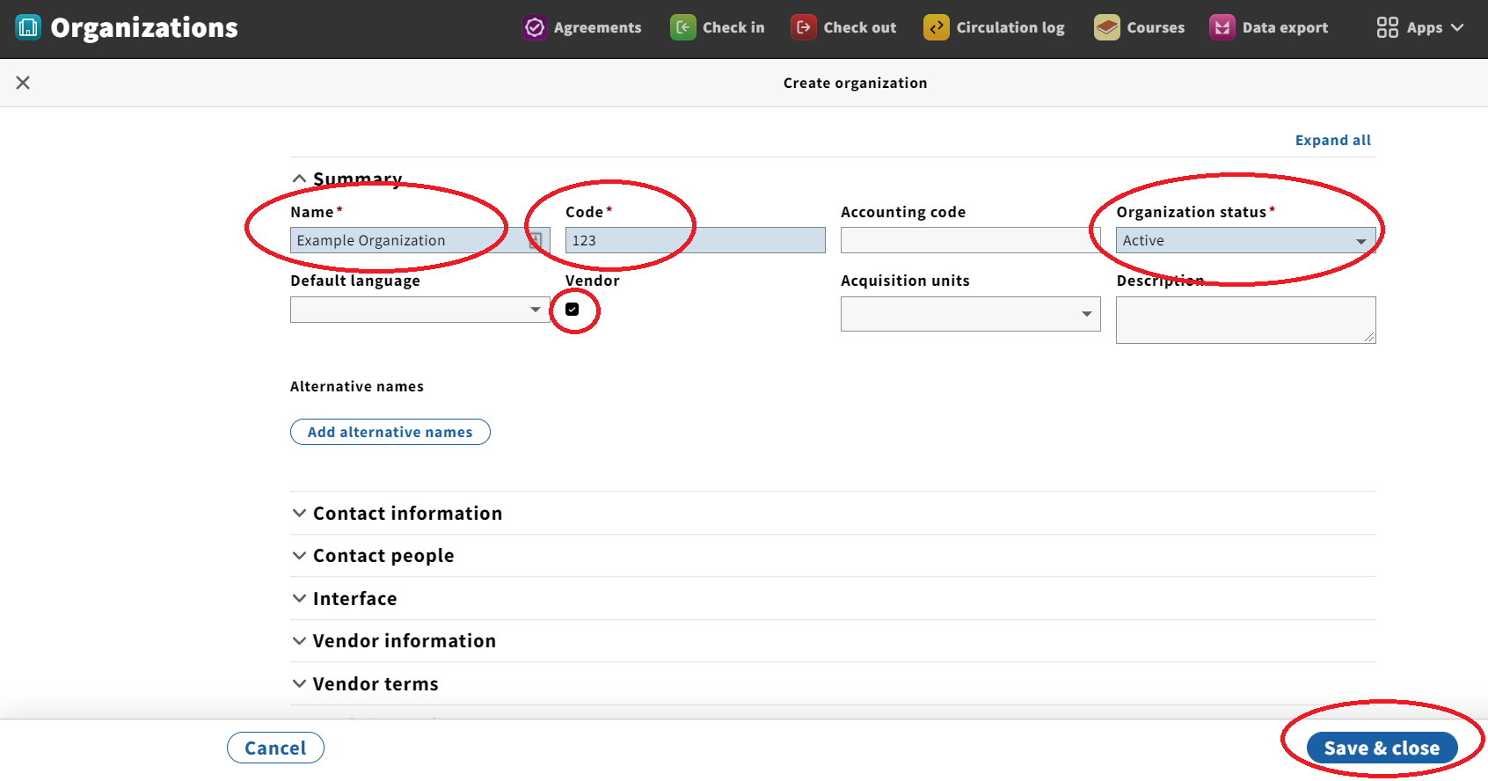
Creating an organization:
This is the Orgs app (training): https://cornell-training.folio.ebsco.com/organizations
See here: https://confluence.cornell.edu/pages/viewpage.action?pageId=393686072

Slide 5
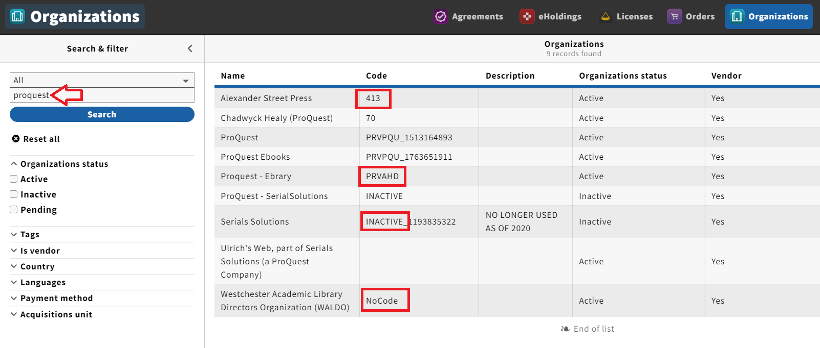

But what is a code?
the real FOLIO
EBSCO provider code (numbers)
Old: ProQuest provider code (letters)

Slide 6
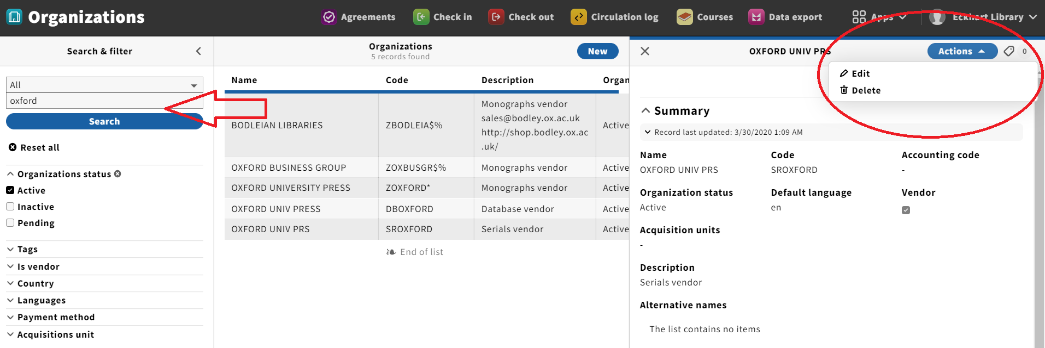
Editing an organization:
This is the Orgs app (training): https://cornell-training.folio.ebsco.com/organizations
See here: https://confluence.cornell.edu/display/ltstr/Editing+and+deleting+an+organization+record

Slide 7
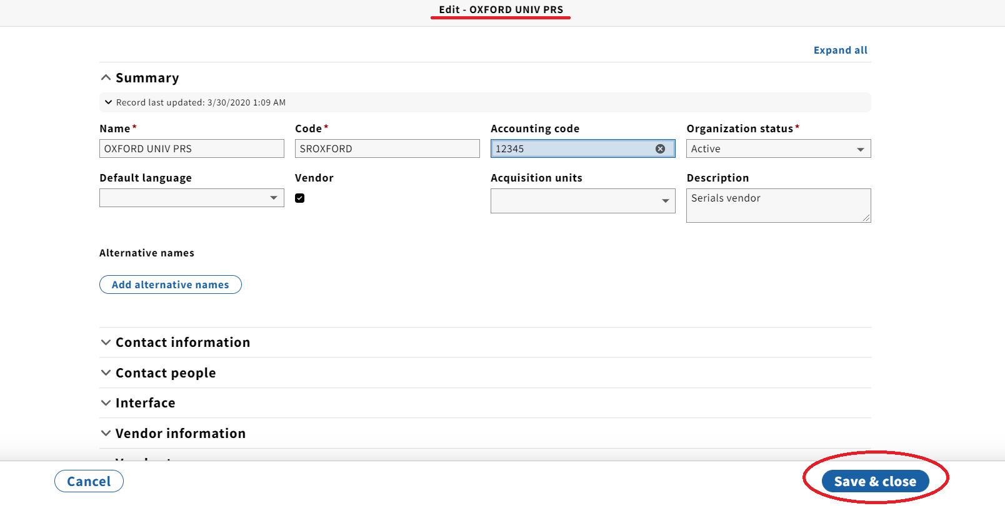
Editing an organization:
This is the Orgs app (training): https://cornell-training.folio.ebsco.com/organizations
See here: https://confluence.cornell.edu/display/ltstr/Editing+and+deleting+an+organization+record

Slide 8
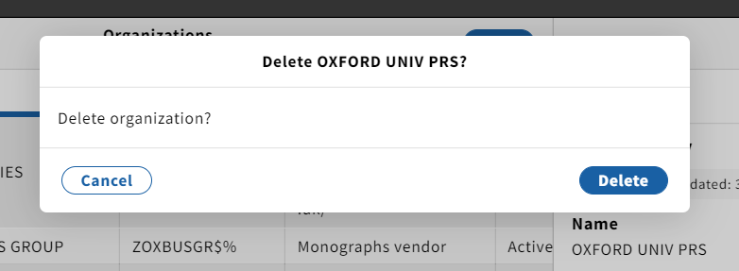
Deleting an organization:
This is the Orgs app (training): https://cornell-training.folio.ebsco.com/organizations
Same initial steps as editing, but select Delete under the Actions drop-down menu.
See here: https://confluence.cornell.edu/display/ltstr/Editing+and+deleting+an+organization+record

Slide 9
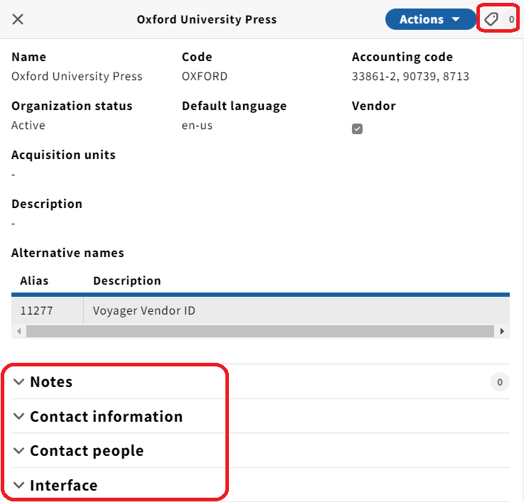

And now...the fun stuff!
Notes
Contact information
Contact people
Interface
Tags

Slide 10
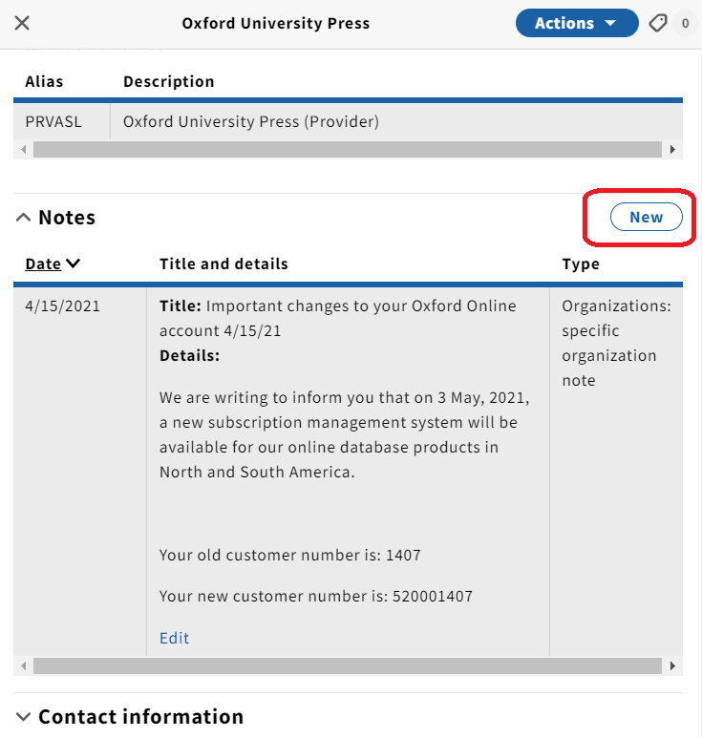
Notes & organizations:
This is the Orgs app (training): https://cornell-training.folio.ebsco.com/organizations
This is the Settings app for real (Notes).
This is the Orgs app for real (Oxford).
See here: https://confluence.cornell.edu/pages/viewpage.action?pageId=395446062

Slide 11
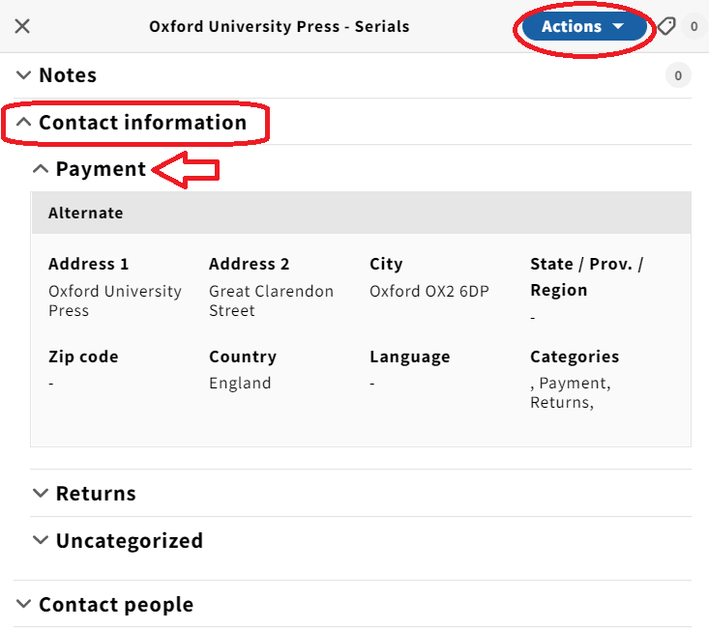
Contact information:
This is the Orgs app (training): https://cornell-training.folio.ebsco.com/organizations
OUP Serials.

Slide 12
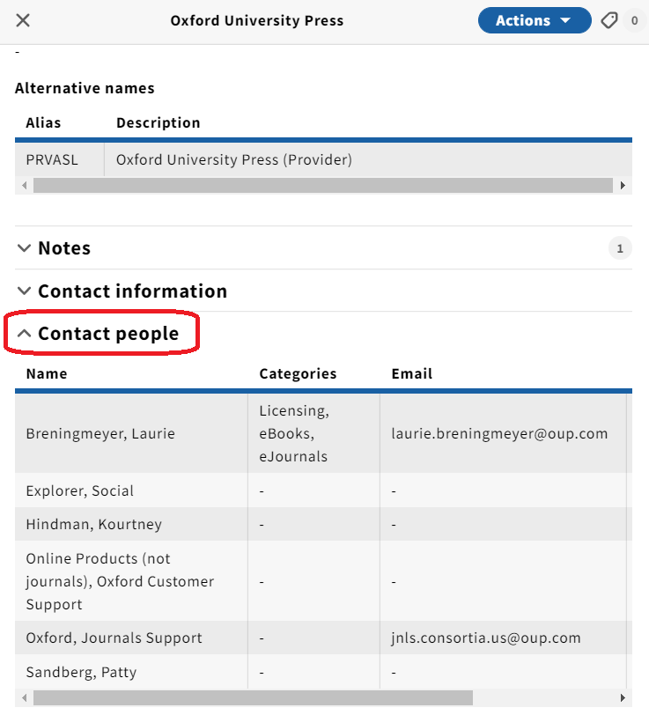
Contacts & organizations:
This is the Orgs app (training): https://cornell-training.folio.ebsco.com/organizations
OUP (live).
OUP (training).
See here: https://confluence.cornell.edu/display/ltstr/Contacts%3A+how+to+add%2C+assign%2C+edit%2C+unassign+and+delete+contacts

Slide 13
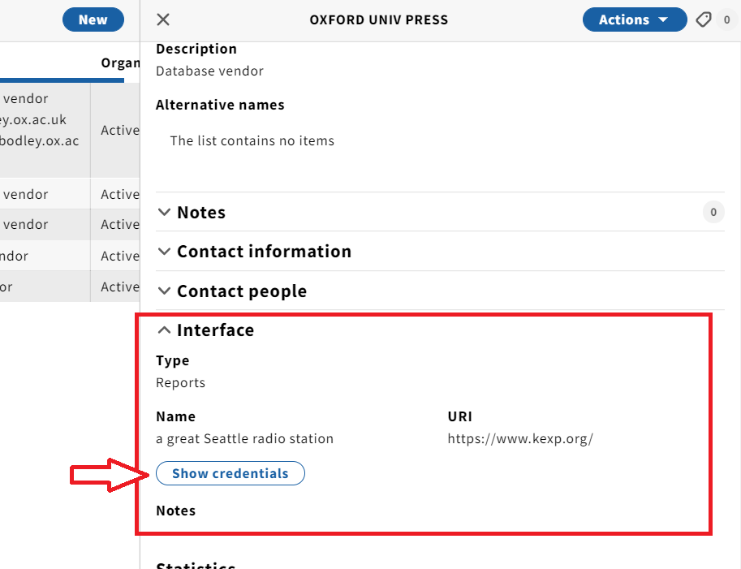
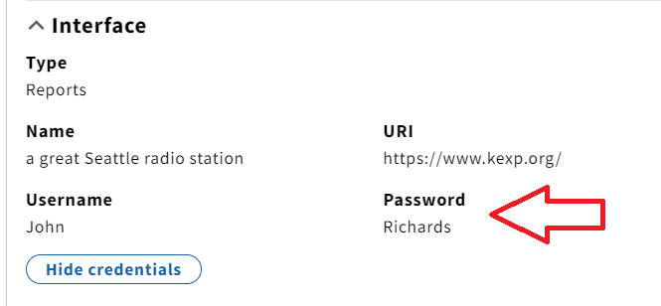
Interfaces & organizations (viewing):
This is the Orgs app (training): https://cornell-training.folio.ebsco.com/organizations
See here: https://confluence.cornell.edu/display/ltstr/Interfaces%3A+how+to+view+an+interface+and+login+credentials

Slide 14
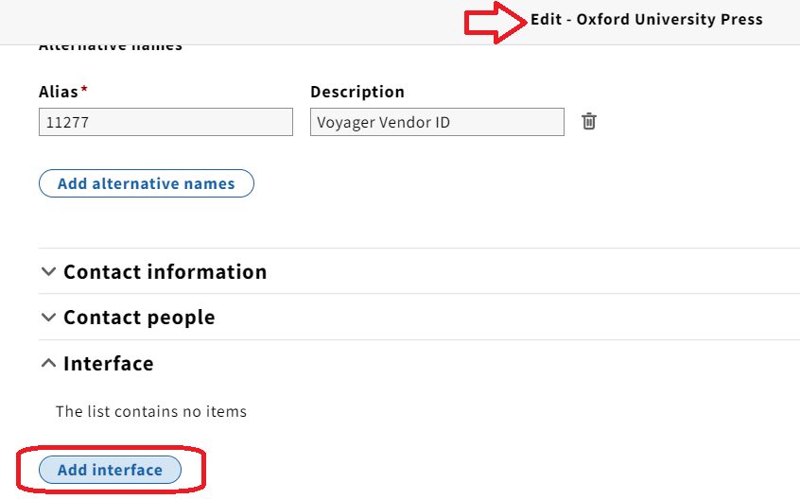
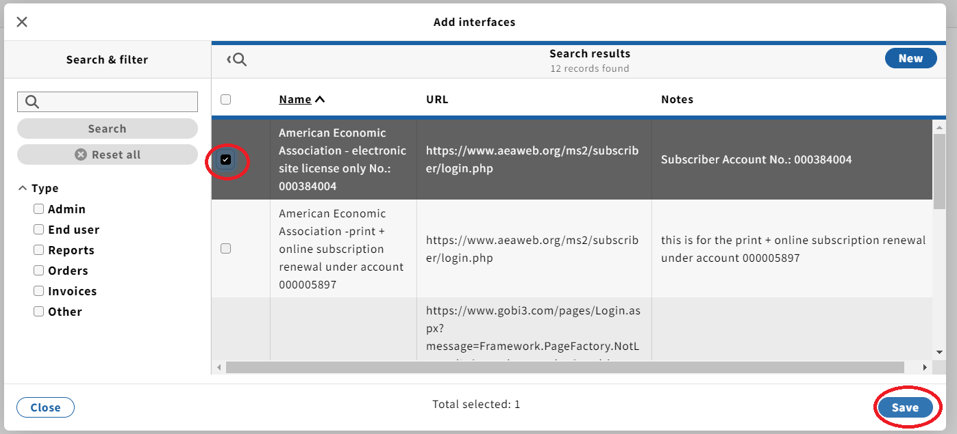
Interfaces & organizations -
adding an existing interface:
See here: https://confluence.cornell.edu/display/ltstr/Interfaces%3A+how+to+create%2C+edit%2C+and+delete+an+interface

Slide 15
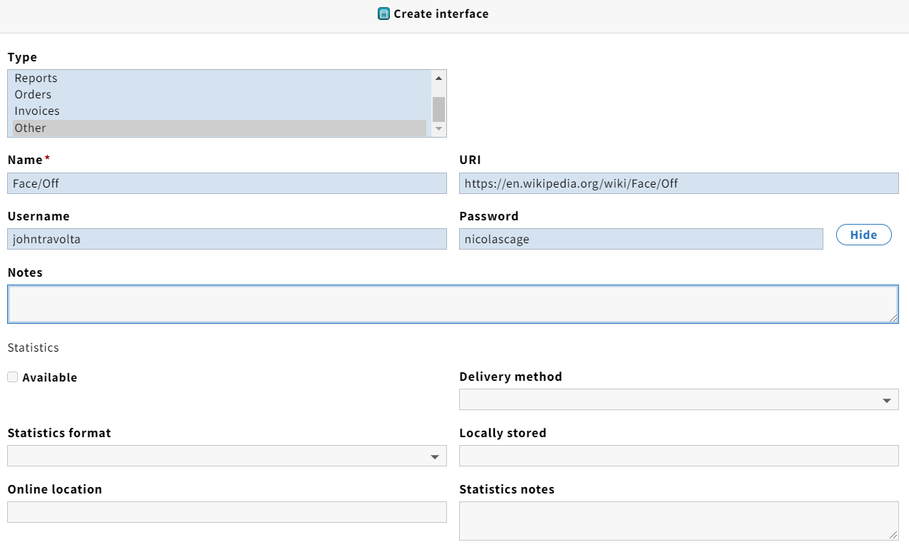
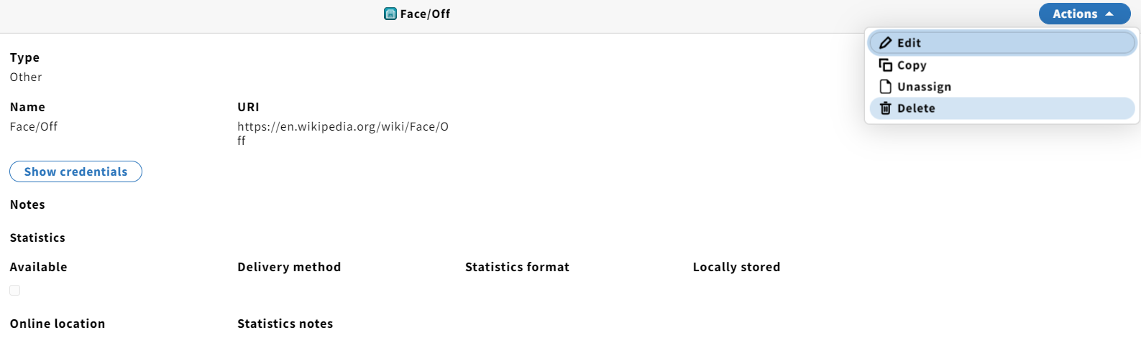
Interfaces & organizations -
creating (new), editing, and deleting:
Quick demo.
See here: https://confluence.cornell.edu/display/ltstr/Interfaces%3A+how+to+create%2C+edit%2C+and+delete+an+interface

Slide 16
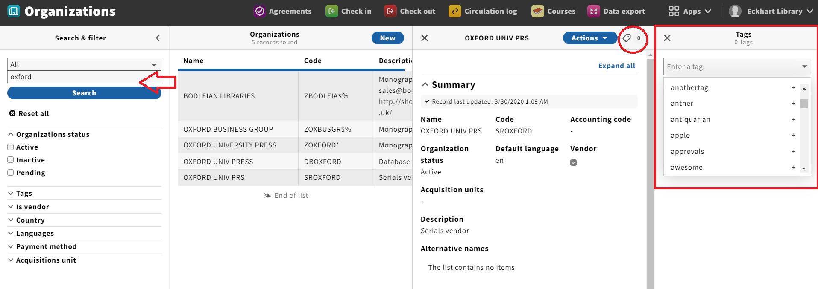
Tags & organizations:
Tiny demo.
See here: https://confluence.cornell.edu/display/ltstr/Tags%3A+adding+tags+to+an+organization+and+filtering+by+tags

Slide 17
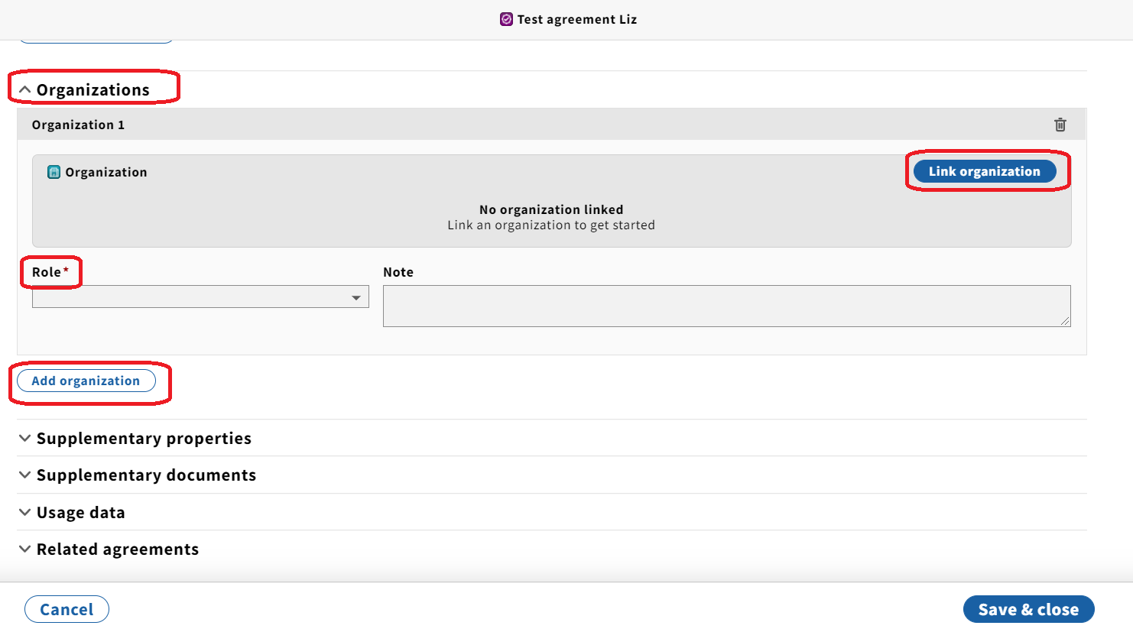
Organizations & Agreements
In Agreements, a linked organization is usually a Content Provider and/or a Vendor.
Demo.
See linking and removing organizations from agreements.

Slide 18
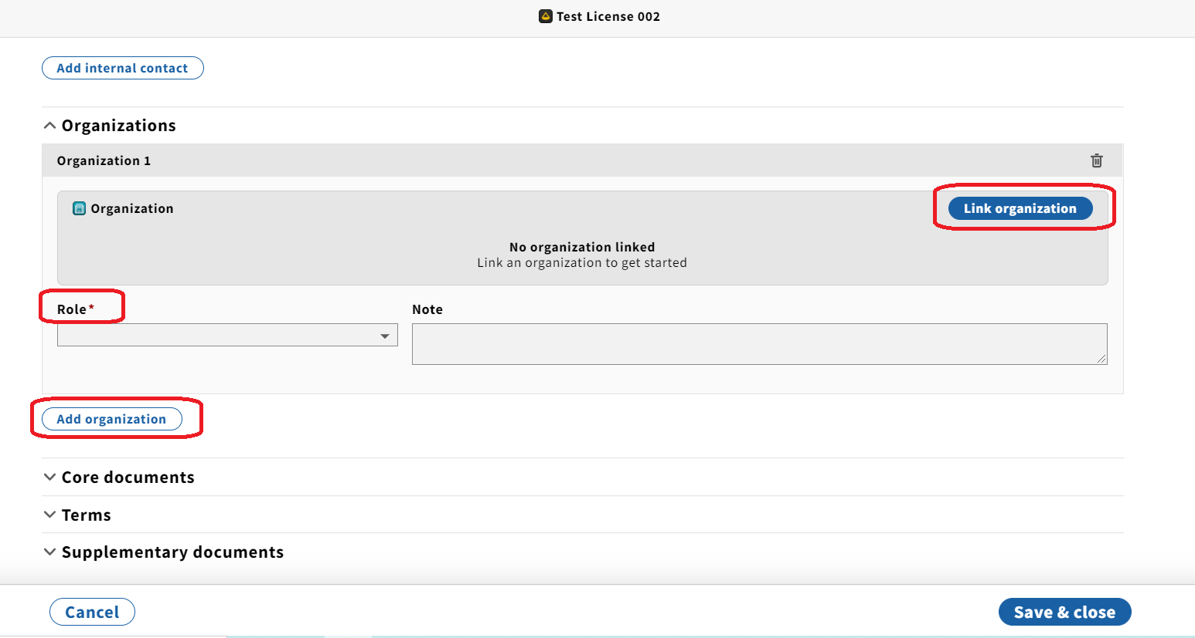
Organizations & Licenses
In Licenses, a linked organization is usually a Licensor.
Demo.
See attaching and removing organizations from licenses.

Slide 19
And now…
Vendors with Jean!

