Slide 1
The FOLIO Finance App
Presented by
Jean M. Pajerek, with assistance from Ann Crowley
June 2021

Slide 2
This presentation is based in part on documentation located at:
https://docs.folio.org/docs/acquisitions/finance/
Caveat: This documentation is based on the Honeysuckle version of FOLIO, but much of the information applies to the Iris version as well.

Slide 3
The Finance app is designed to:
Accommodate hierarchical and flat fund structures of varying complexity
Track fund activity in detail and easily customize summary information
Provide current and historical summaries in real time at all levels of the fund structure
Thanks to Dennis Bridges for this information

Slide 4
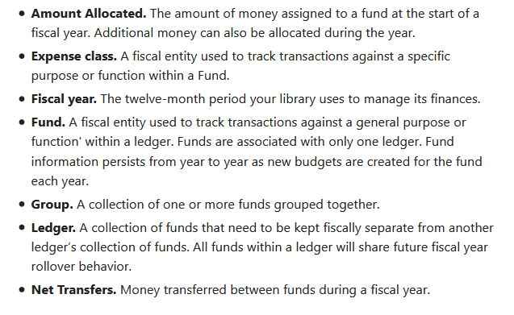
Terminology
This is something new for us.

Slide 5
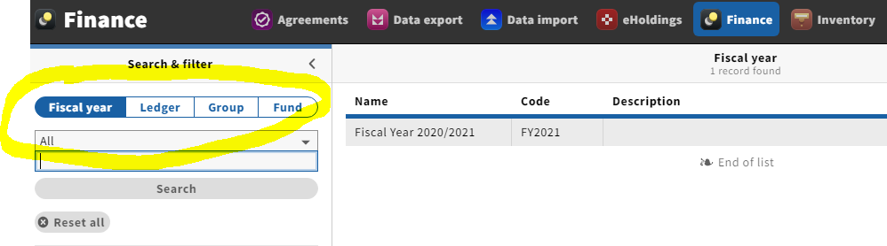
In the Finance app, the Search & filter area has 4 “segments”: Fiscal year, Ledger, Group, and Fund
Notes:
In the test instance of FOLIO, we see only the current fiscal year.

Slide 6
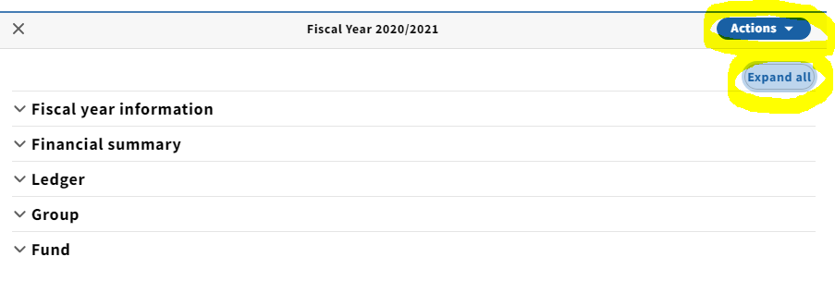
When you click on the name of a ledger, this information appears in the right-hand pane.
“Expand all” refers to the “accordions” of
categorized information to the left.

Slide 7
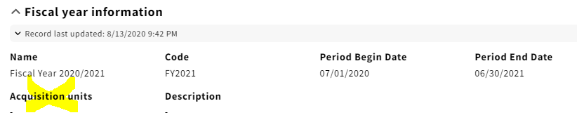
The “Fiscal year information” is very basic.
CUL is not using the “Acquisitions Unit” feature.

Slide 8
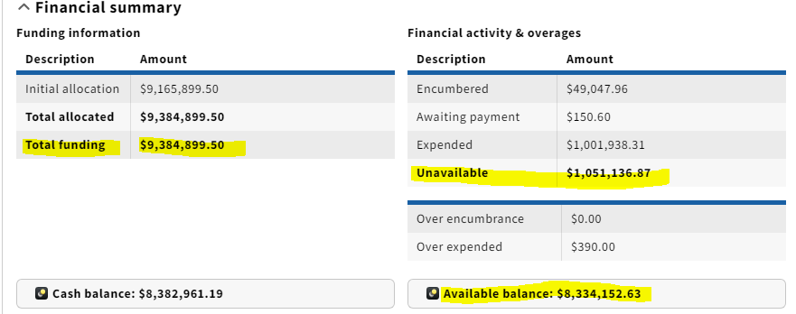
This is the “Financial summary” accordion

Slide 9
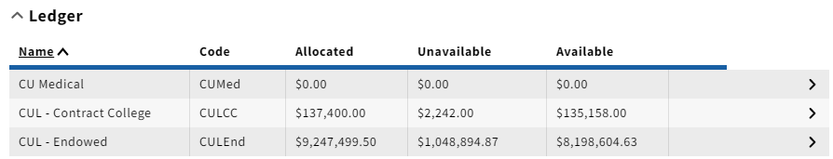
Opening the “Ledger” accordion, we see this:
Notes:
In our production instance of FOLIO, we’ll also have a ledger for the Lab or Ornithology.

Slide 10
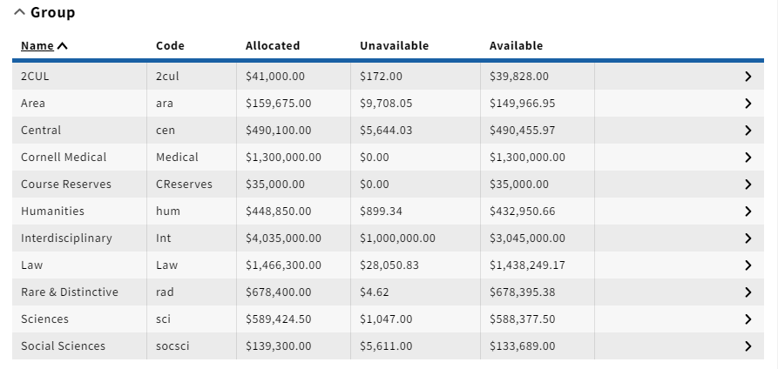
The “Group” accordion displays the groups into which we have categorized our funds.
Notes:
The columns can be sorted by clicking on the column headers. Clicking on the arrow to the right side will bring you to more specific information about that group.

Slide 11
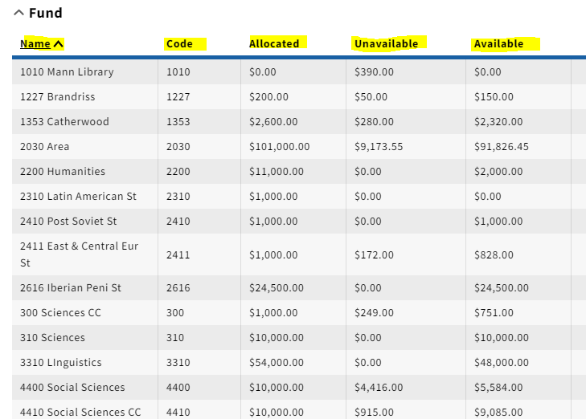
In the “Fund” accordion, we can see very basic information about individual funds.

Slide 12
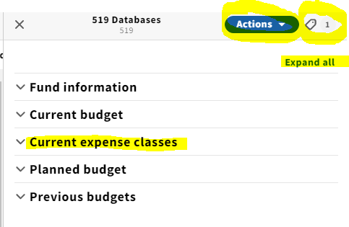
Let’s look at a record for an individual fund.

Slide 13

Unless you work in Accounting, the only permission available to you under the “Actions” menu when you view a fund may be this one:

Slide 14
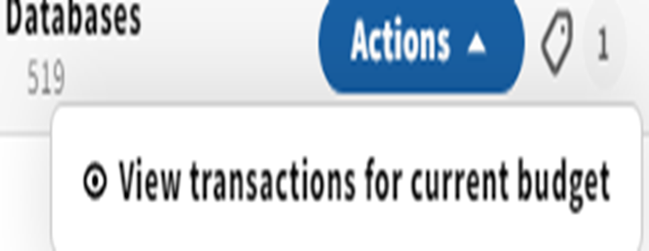
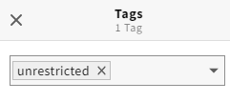
Notice the tag icon in the upper right corner of the display. Tags can be used to filter a search.
This icon indicates that there is one “tag” associated with this fund.
Clicking on the tag opens it, so we can see that the
fund is tagged as “unrestricted.”

Slide 15
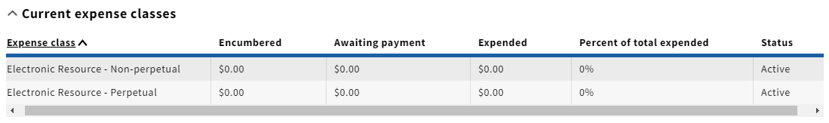
These are expense classes associated with fund 519 (Databases).

Slide 16

Let’s check out the app!

