Slide 1



FOLIO: Serials Check-in and Claiming
Presented by:
Joanna Cerro
Library Technical Services
Cornell University Library

Slide 2
Table of contents
Searching for and selecting a serial to check
Adding issues to the Expected field in Receiving
Receiving an issue
Adding an issue to the holdings receipt history in the Inventory app
Consolidation of Receipt history
Adding a completed volume to holdings
How to process serials to be barcoded
Creating an item record
Claiming

Slide 3

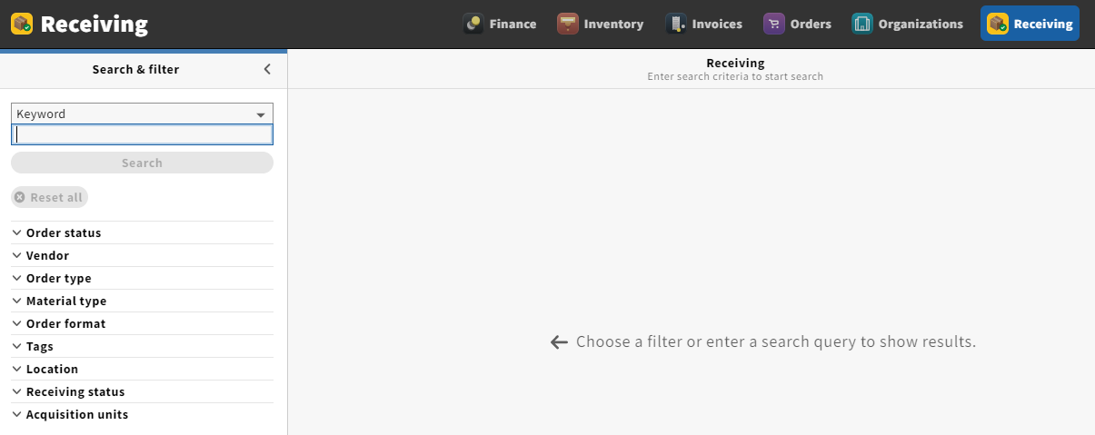
Begin in the Receiving app:

Slide 4
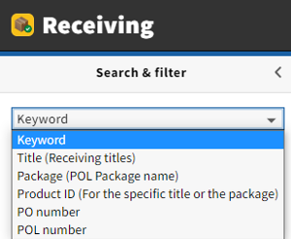
There are many ways to find a title in the Search & filter panel.
Keyword: Generally the easiest search method, as it includes all
options following it in the drop-down menu
  Title, Package, Product ID (including ISSN and HRID), PO number and
  POL number are all searchable using the Keyword search
  ISSN searchable using the keyword option
Title: Search by title name
Package (POL Package name): Search by package name
Product ID: Search by ISSN and HRID (formerly BIB ID)
PO number: Search by PO number
POL number: Search by POL number
Note: ability to search by ISSN and HRID is not available in our training instance. This should be available by the time we go live.

Slide 5
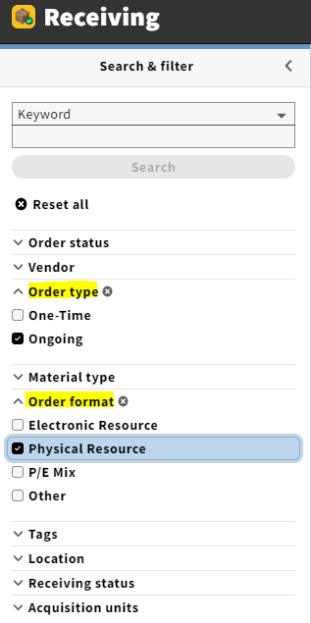
There are several filters available to help narrow down a search
Filtering your search by Order type: Ongoing and Order format: Physical Resource will result in displaying print serials only

Slide 6
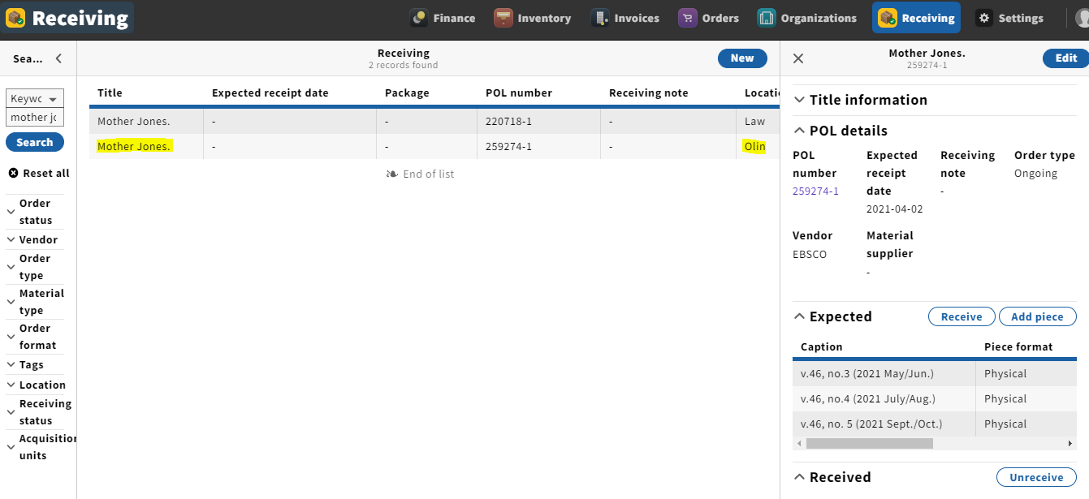
After searching and locating the title you are checking in, click on the title from the larger panel
If several locations appear, choose the line with the appropriate location
A third panel to the right-hand side of the screen will appear

Slide 7
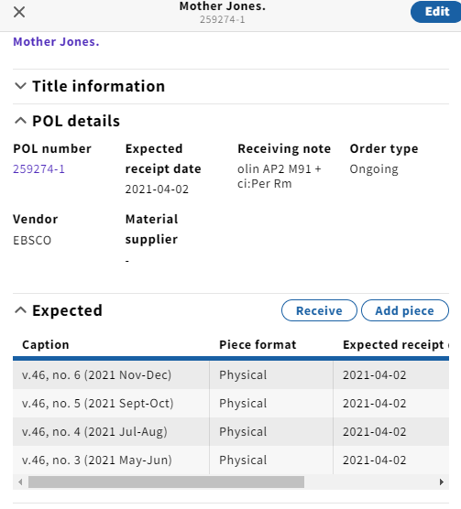
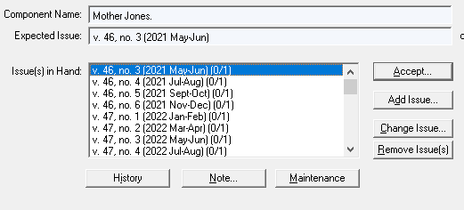
While our predictive patterns won’t be migrating, a limited number of issues from our predictive patterns in
Voyager are expected to migrate to FOLIO

Slide 8
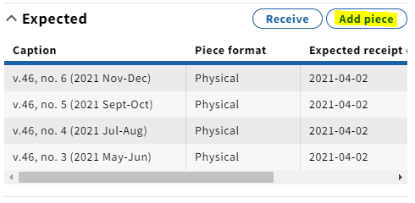
Manually adding issues to the Expected field
As the issues in the Expected field deplete, we will need to add more manually
It’s good practice to have at least three issues built up in this field
To do so, click Add piece

Slide 9
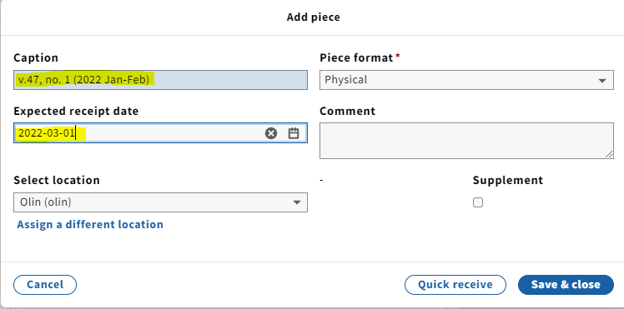
A pop-up will appear where you will fill in the enumeration and chronology modeled after the format used in Expected and Received issues
You will also want to add an approximate date of when we can expect to receive this issue. This will come in handy for claiming later on
Click Save & close

Slide 10
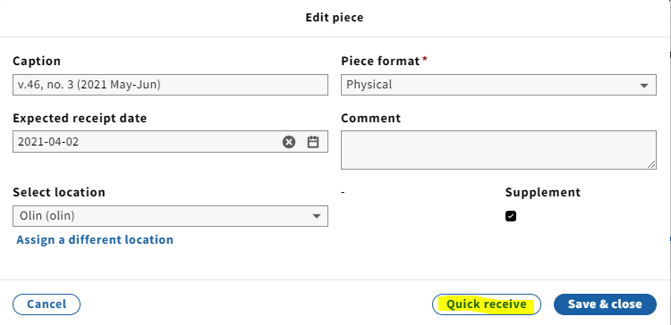
Receiving an issue
In the Expected field, click on the issue you are checking in
The Edit piece box will pop up
Click Quick receive

Slide 11
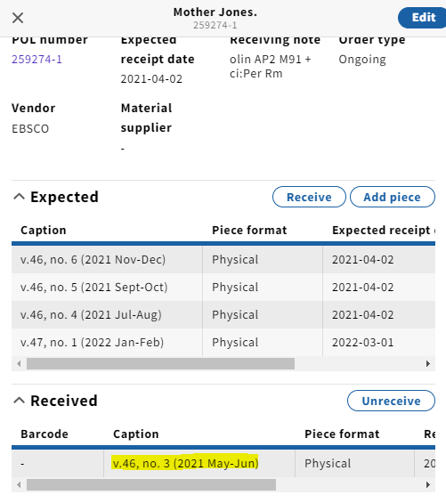
The issue will then appear in the
Received field

Slide 12
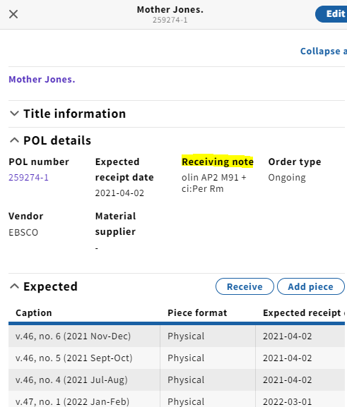
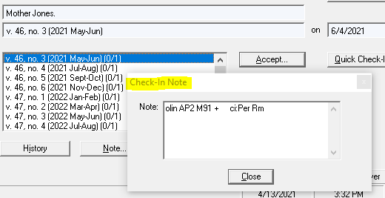
Note that the check-in pop up note in Voyager will be
migrating to the Receiving note field in FOLIO

Slide 13


Adding an issue to the holdings receipt history in the Inventory app
There is currently no connection between the Receiving and Inventory apps
In order for issues to be publically displayed in Blacklight and discoverable by patrons, they must also be added to the Receiving history in the holdings record through the Inventory app

Slide 14
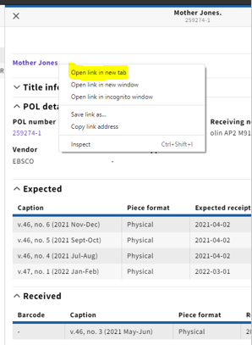
Navigate to the Instance record in Inventory by right-clicking
the title at the top of the record in the Receiving app and
opening the link in a new tab
This will make copying the enumeration and chronology
easier later on

Slide 15
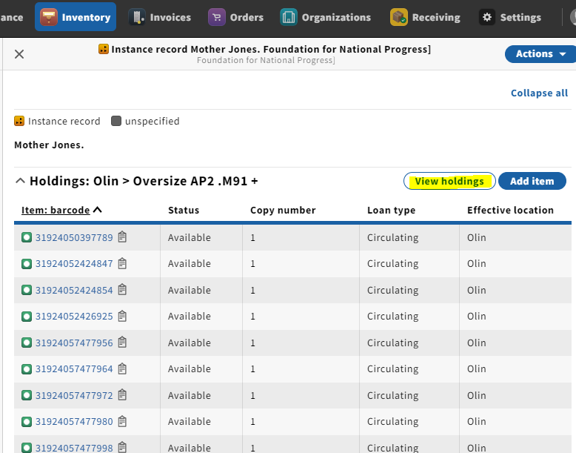
Opening the link will bring you to the Instance record in the Inventory app
Find the holdings related to the appropriate location
Click on View holdings

Slide 16
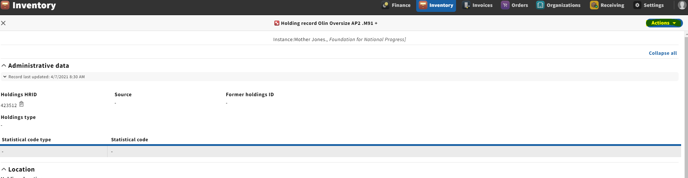
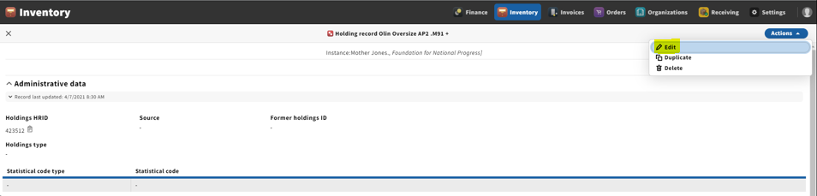
Click Actions near the upper right-hand corner of the screen
Click Edit from the drop-down menu

Slide 17
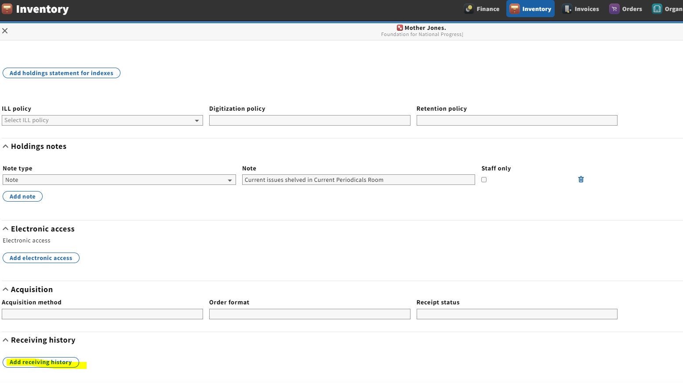
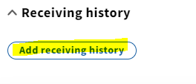
Scroll to the bottom of the page
Click Add receiving history

Slide 18
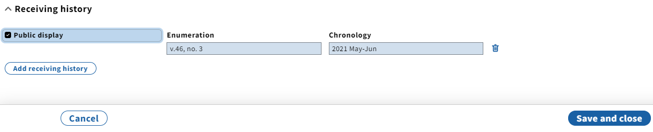
Copy/paste or type caption from the Receiving app into the enumeration/chronology fields in the holding’s Receiving history
The Public display toggle should be checked, since we are only adding current issues of a serial to the Receiving history (this is a similar function to the Display in OPAC column in Voyager Acquisitions)

Slide 19
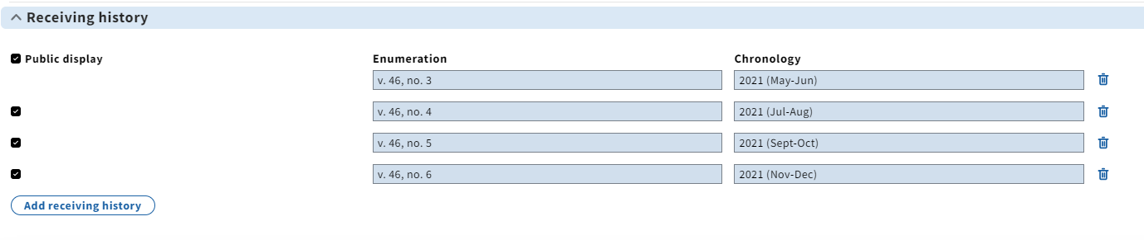
A note about public display in holdings
The current functionality requires us to list publicly displayed issues in ascending order by chronology and NOT the order in which issues are received
The most recent issues should be listed at the bottom

Slide 20
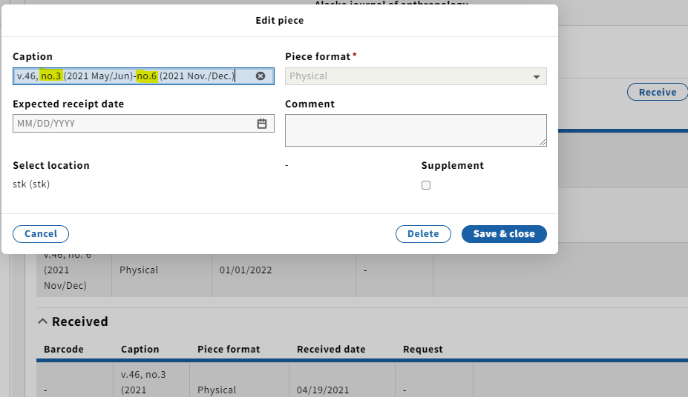
Consolidation of Receipt history
As we begin to build up a check-in history in the Receiving app, note that multiple consecutive issues can be consolidated onto one line

Slide 21
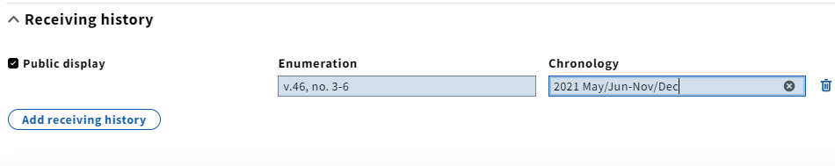
Multiple issues can also be consolidated onto one line in the Receiving history in the Inventory app

Slide 22
Adding a completed volume to holdings
When all issues in a volume have been received, the holdings statement should be updated to include the completed volume (similar to how we add a volume to the holdings record in Voyager once it’s complete)
To do so, make sure you’re in edit mode by clicking Actions at the top right corner of the screen and select Edit

Slide 23
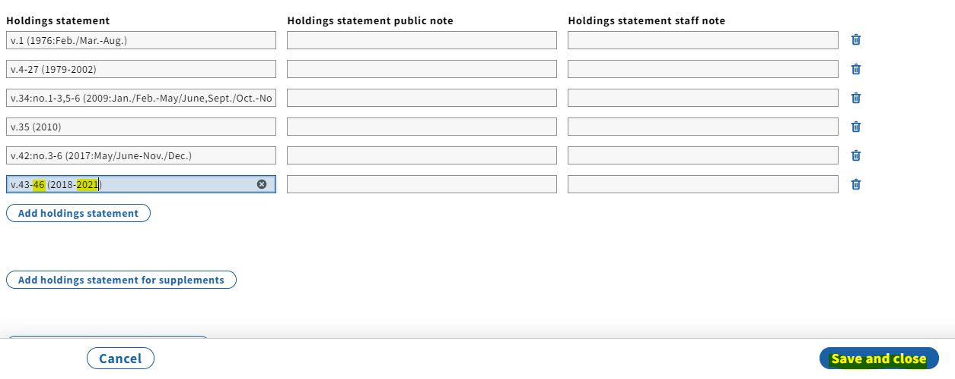
Scroll to the Holdings statement and add the completed volume
Click Save & close

Slide 24
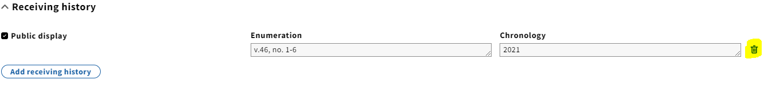
Once you’ve added the volume to the holdings statement, delete the publicly displayed issues by clicking the trashcan(s) to the right of the enum./chron. field(s)
There’s no need to uncheck the Public display box, since you’re deleting the lines
Note that publicly displayed issues will only be populating this field

Slide 25
How to process serials to be barcoded
For individual serial issues that are barcoded (annual volumes, titles sent to the Annex, etc.), a similar process of checking in a serial applies with a few exceptions
Vols. that will be getting an item record should be checked-in in the Receiving app and added to the holdings statement in Inventory. You can skip adding the volume to the Receiving history in Inventory/holdings, since you’ll be adding it directly to the holdings statement

Slide 26

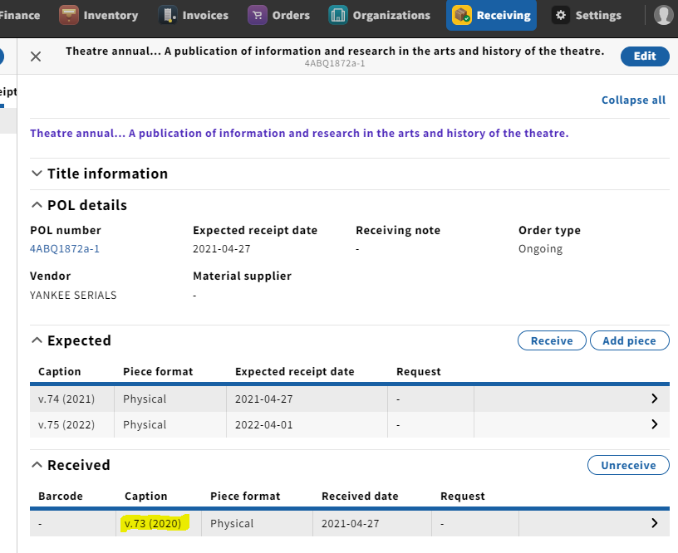

Slide 27
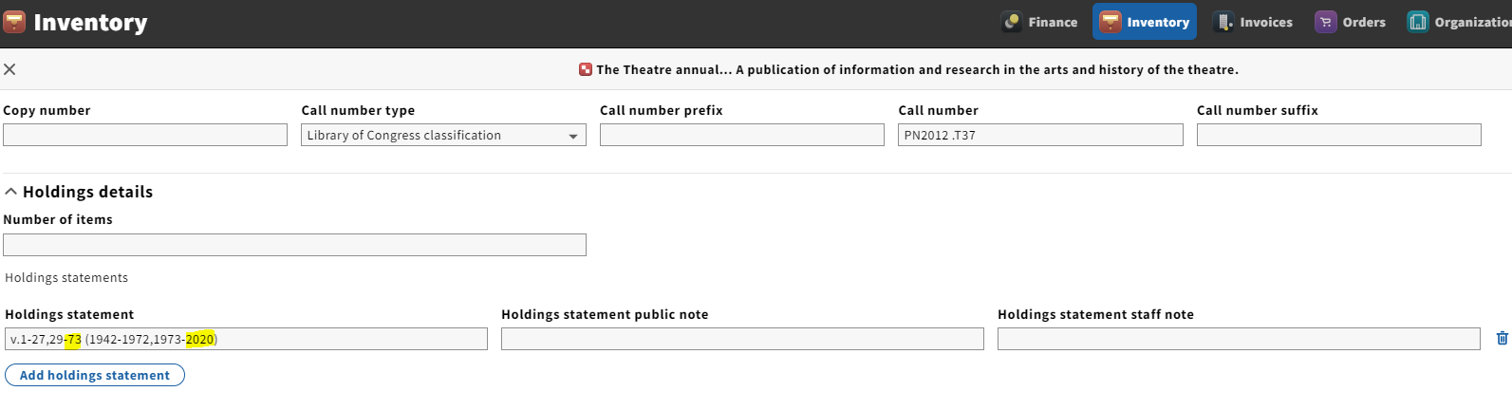
Add the volume and year to the holdings statement in Inventory

Slide 28
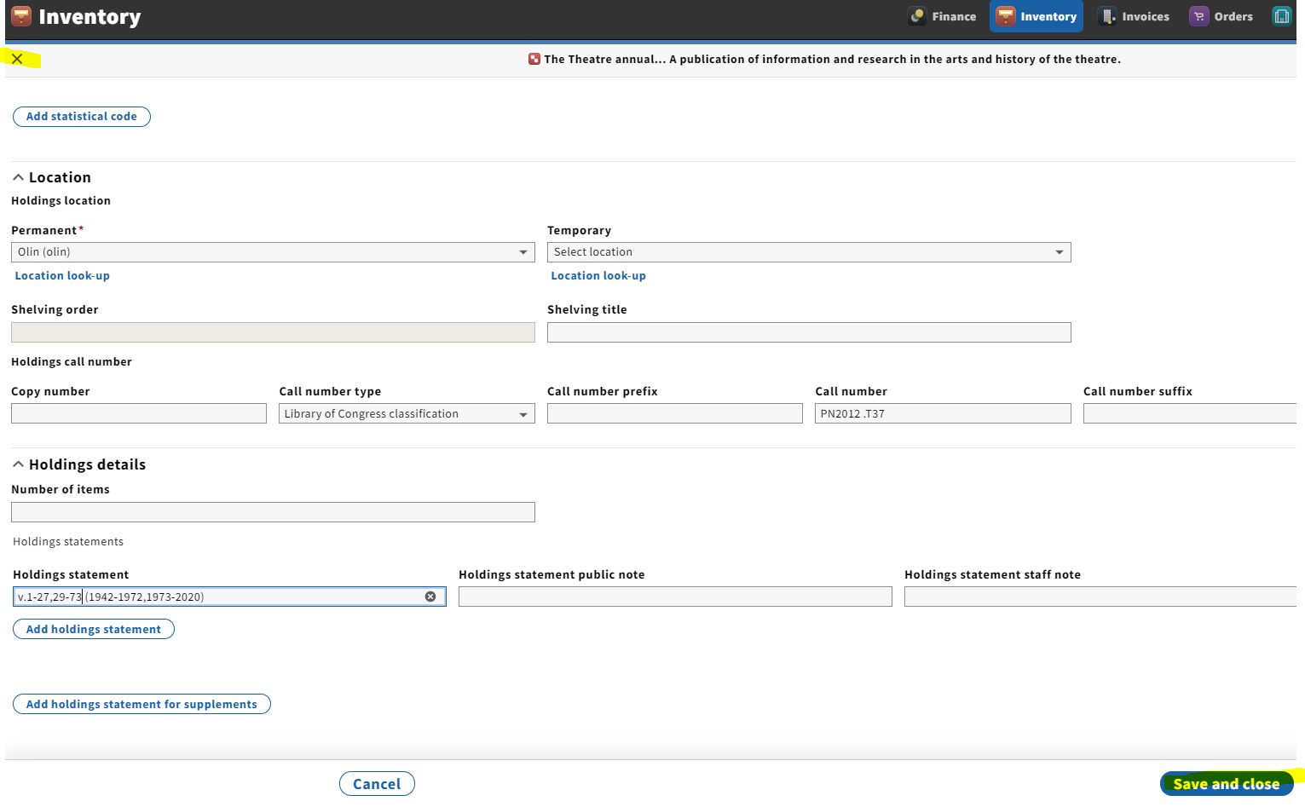
Click Save and close when done
Click the X in the upper left-hand corner to exit the holdings record, which will bring you back to the Instance

Slide 29
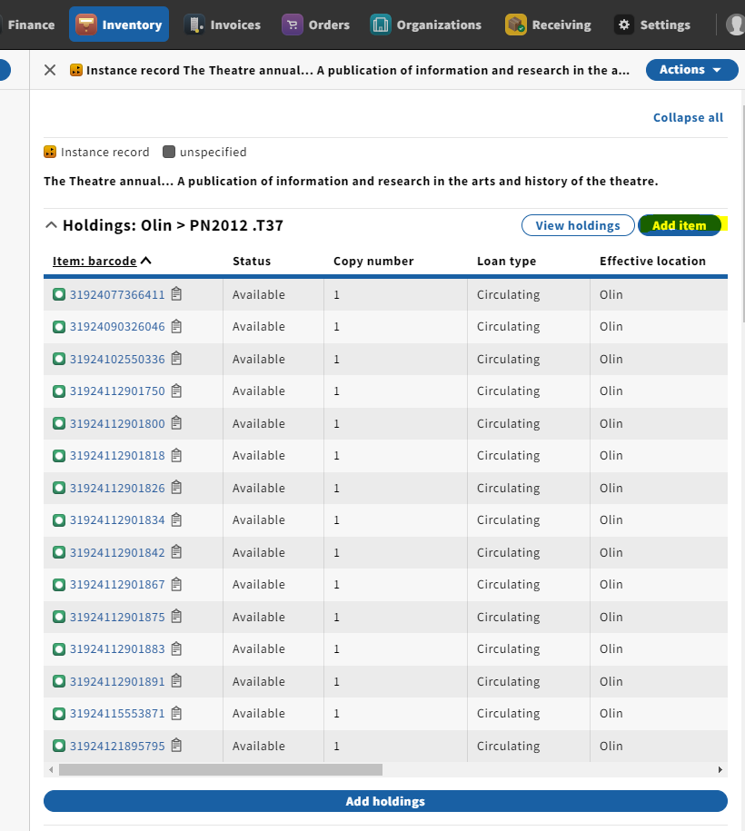
Creating an item record
From the Instance record, click on Add item

Slide 30
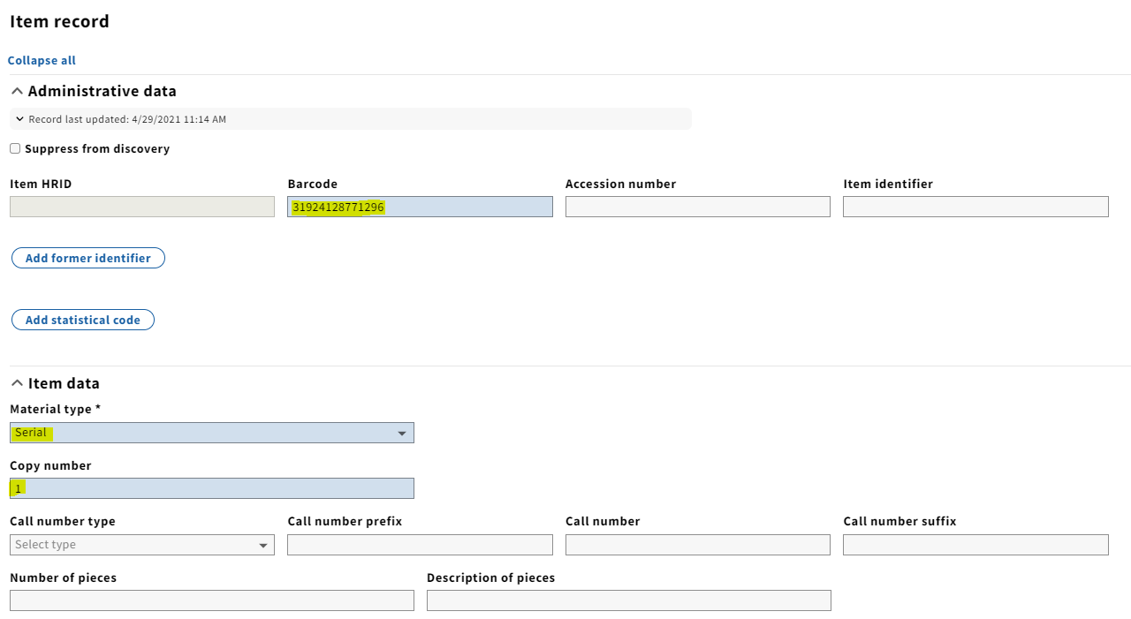
Fill in relevant information including Barcode, Material type (required) and Copy number (this will generally be 1 for serials)

Slide 31
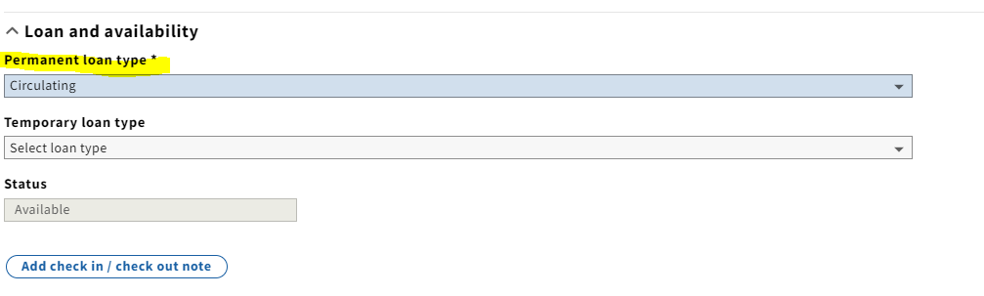
Scrolling down will bring you to Permanent loan type which is also a required field

Slide 32
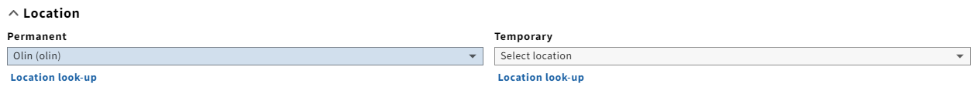
You will need to select the location for the item under Location
Can also select a temporary location if there is one
When done filling in the appropriate fields, click Save and close

Slide 33
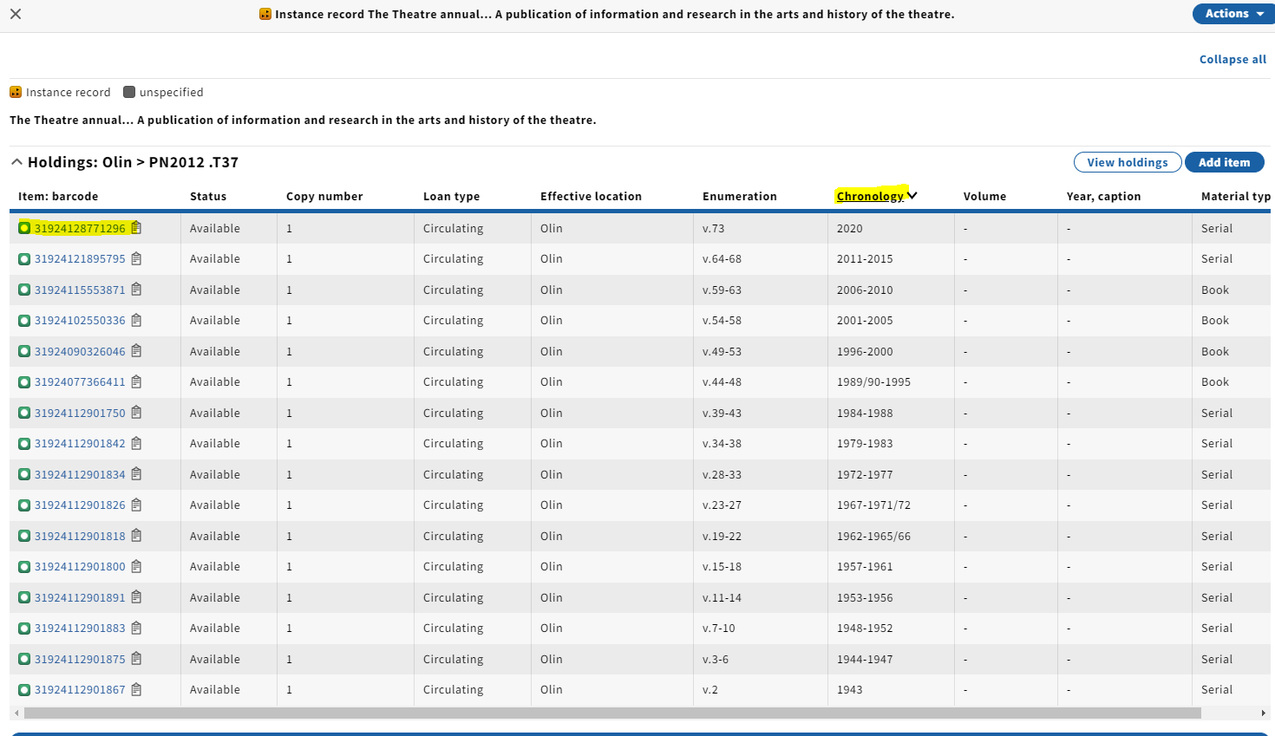
From the Instance record, clicking Chronology in the Item records display will allow you to sort chronologically
This will allow you to see the item record you just created

Slide 34
Questions so far?

Slide 35
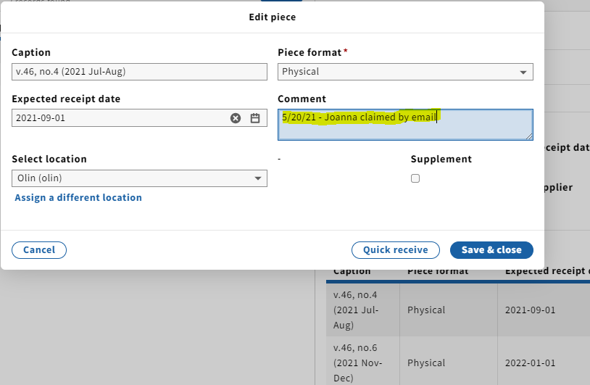
Claiming a print serial
FOLIO does not automatically flag skipped issues in Receiving. Special attention needs to be made in determining what needs claiming.
If an issue has been skipped, the following actions should be taken:
  At the point of claiming the issue, click on the skipped issue from Expected field
  In the Comment field, type when and how the claim was submitted to the vendor
  Click Save & close

Slide 36
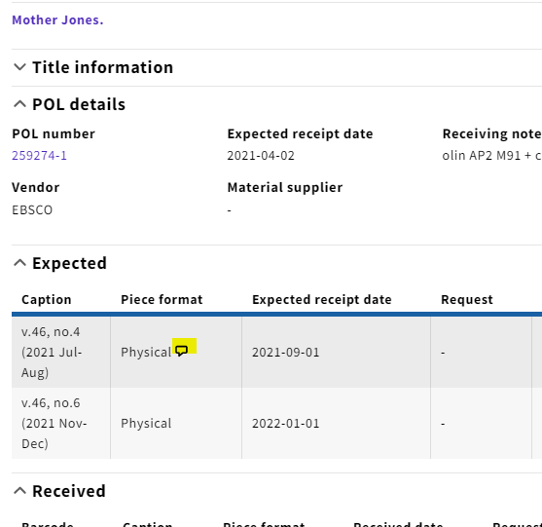
A speech bubble will appear in the Piece format column if a comment has been made in the Edit piece box, which in turn flags if something has been claimed

Slide 37
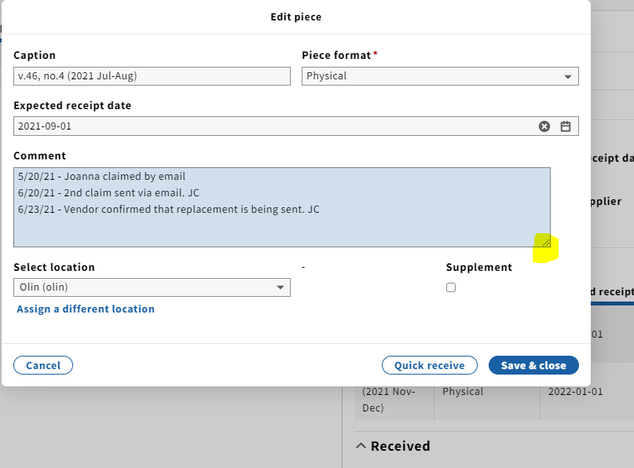
If an issue requires multiple claims, you can add onto the text in the Comment field with claim follow-ups/responses from vendors
Clicking and dragging the bottom right corner extends the text field for better view

Slide 38
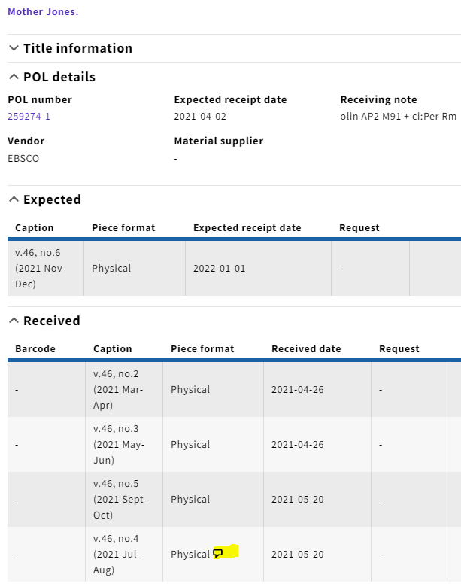
After checking in the claimed issue, you’ll want to clear the Comment field in order to remove the speech bubble graphic

Slide 39
In Iris, it is not possible to do a filtered search by Expected receipt date in the Receiving app
This is currently in development and will be a possibility in a future version of FOLIO
This would potentially allow for systematic claiming down the road

Slide 40
Thanks for your time!

