Slide 1

Creating Records in FOLIO AND the technical services workflow
Presented by:
Laura Daniels
Jean M. Pajerek
April 2021

Slide 2

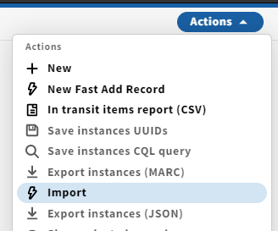

Many new Inventory records will be imported into FOLIO
Inventory records = Instances (i.e. bibs), Holdings, Items
Batch processes (files of records, e.g., from vendors)
Individual records (from OCLC)

Slide 3
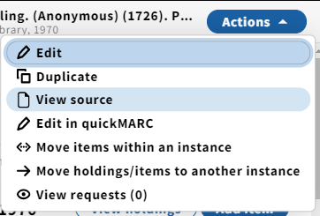
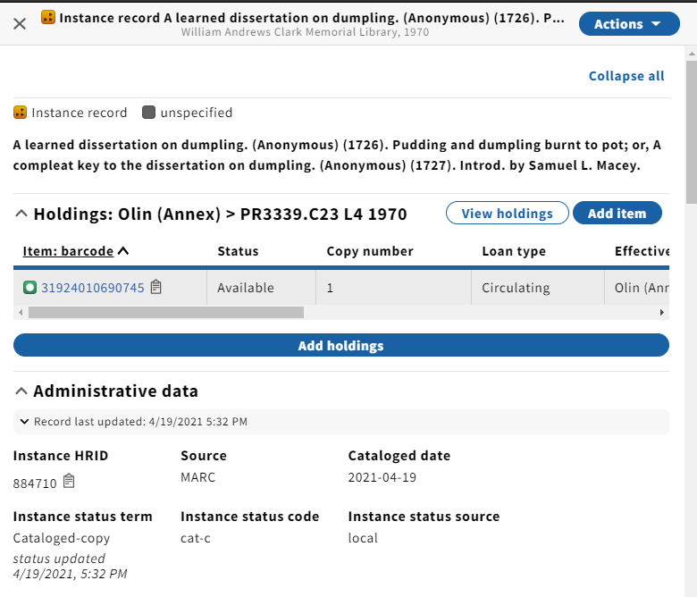
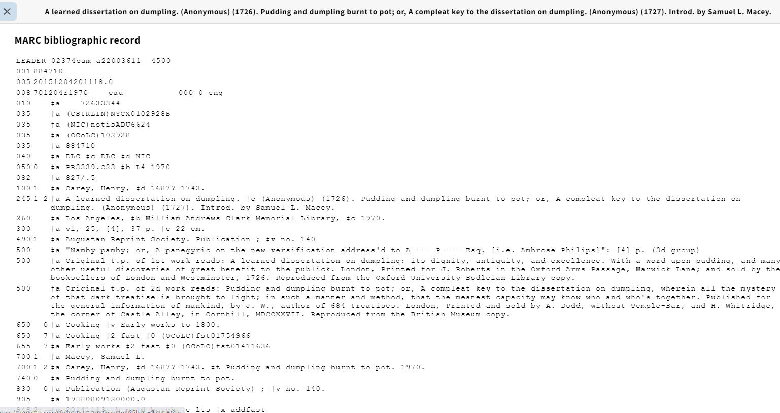
Most instances will have underlying MARC source data

Slide 4
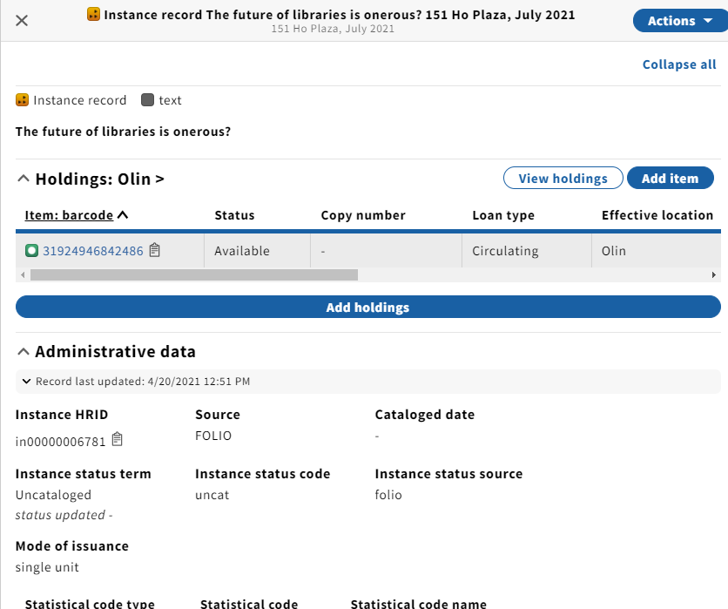
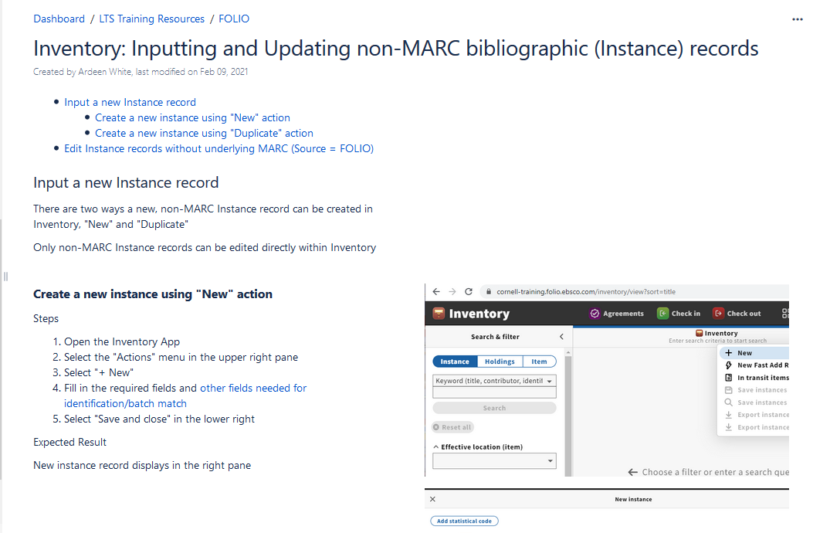
But it’s possible to have an Instance with no underlying source, aka “native FOLIO”
Inputting and Updating non-MARC records

Slide 5

Under what circumstances would we create an instance record in Inventory that is not a MARC record?
Jean will talk about an acquisitions-related scenario.
Another scenario for creating a non-MARC instance record in Inventory is when there is no record found for an item that needs to circulate (i.e., on the fly):
Fast Add
http://www.mepixels.com/photo/cheetah-fast-hunting-for-afternoon-food-3261
Notes:
This is exactly the situation fast-add is intended for

Slide 6
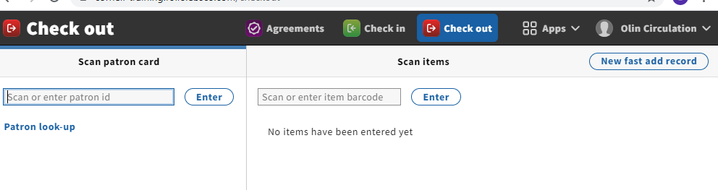
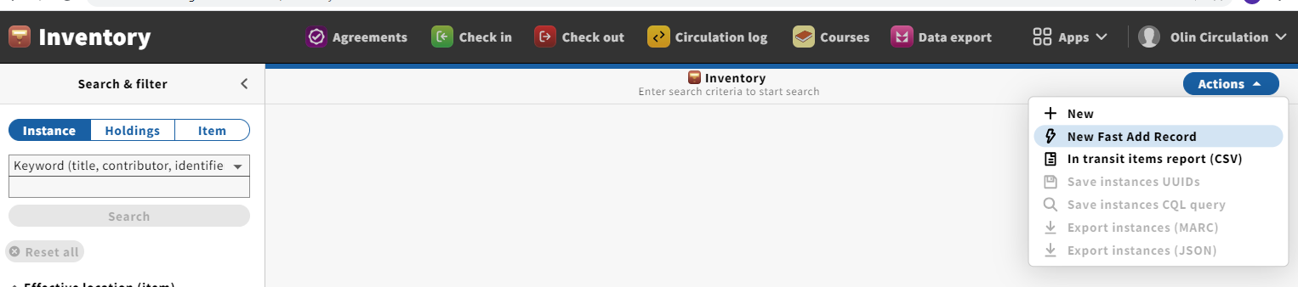
Either Check out or Inventory

Slide 7
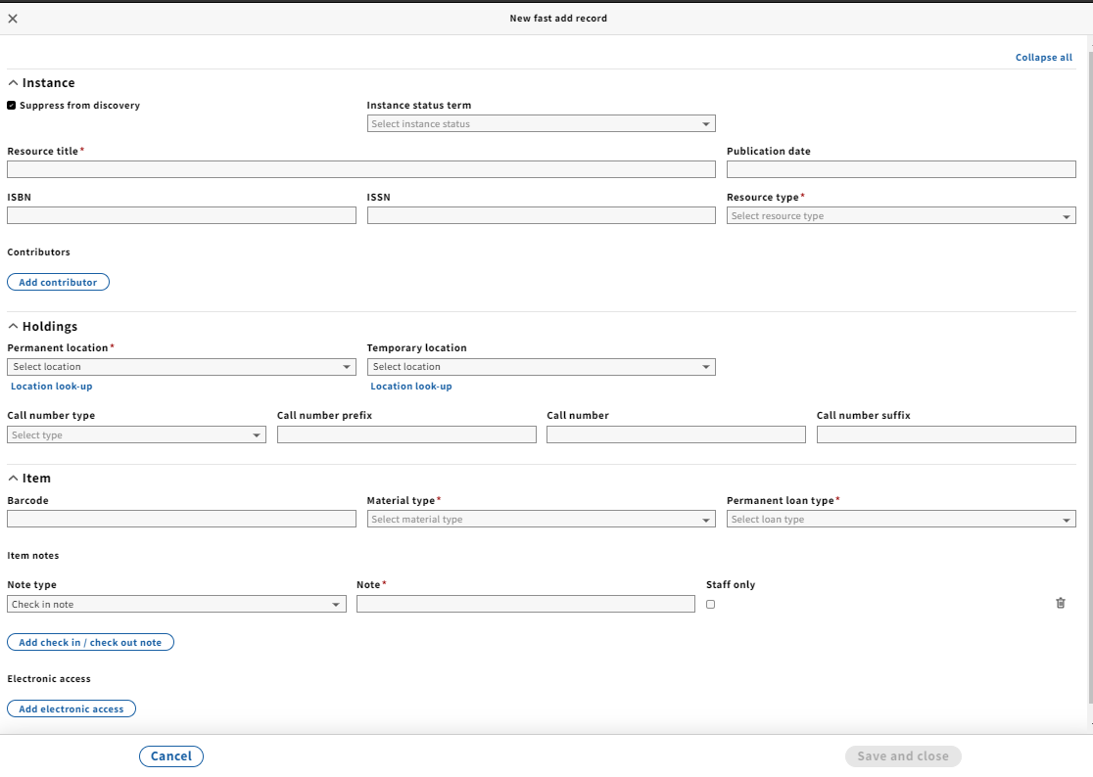
Advantages?
Disadvantages?

Slide 8
Advantages?
Fast
Some defaults supplied
All three types of records (instance, holdings, item) at once and on the same screen
Prompts for check-in note
Disadvantages?
Limited data (no instance or holdings notes, no variant titles)

Slide 9
Demo
https://cornell-training.folio.ebsco.com/checkout

Slide 10
Pop quiz!
True or False?
Instance records in the FOLIO Inventory app must be based on MARC records.
  True
  False

Slide 11
Instance records in the FOLIO Inventory app must be based on MARC records.
  True
  False
  The correct answer is FALSE. In the Inventory app, Instance records may be either MARC records or non-MARC records.

Slide 12
True or False?
In FOLIO, purchase order lines must be based on an instance record that already exists in Inventory, whether a MARC record or a non-MARC record.
  True
  False

Slide 13
In FOLIO, purchase order lines must be based on an instance record that already exists in Inventory, whether a MARC record or a non-MARC record.
  True
  False
  Purchase order lines in FOLIO do NOT have to be connected to a pre-existing Inventory instance record of any kind. You do not HAVE to create an instance record in Inventory at any point during the ordering process.

Slide 14
True or False?
In FOLIO, invoice lines must be derived from an existing purchase order line.
(Hint: there is a pattern here!)
  True
  False

Slide 15
In FOLIO, invoice lines must be derived from an existing purchase order line.
(Hint: there is a pattern here!)
  True
  False
  Invoice lines in FOLIO do NOT have to be derived from a purchase order line, although they can be.

Slide 16
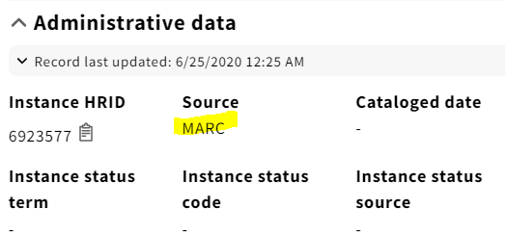
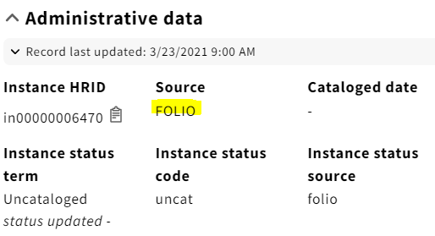
We know that instance records in Inventory can be based on either MARC data or non-MARC data:

Slide 17
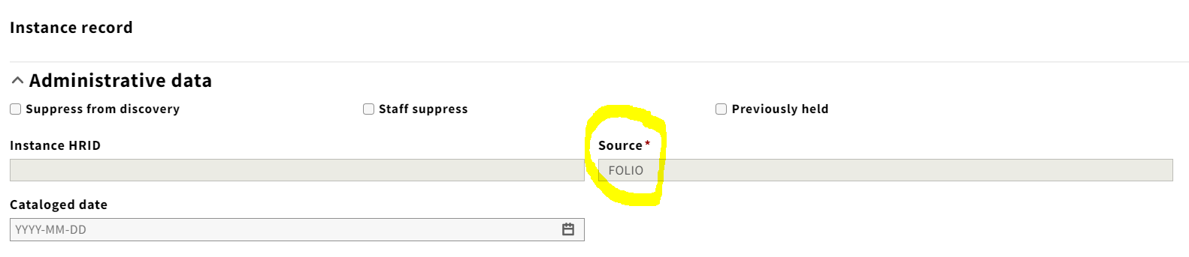
Under what circumstances would we create an instance record that is not a MARC record?
A common scenario for creating a non-MARC instance record in Inventory is when there is no MARC record available to use when creating a order for something. This could be library material that has no record in OCLC yet, or some kind of equipment, like a laptop. When you create a non-MARC instance record within Inventory, the “Source” field is filled in automatically with the system-supplied value of “FOLIO,” and cannot be edited.
Notes:
You might want to create a non-MARC record for something like a laptop or an umbrella, that needs to circulate but is more easily described in a non-MARC record.

Slide 18
Ordering library material that does not have a MARC record in OCLC
If you are creating a purchase order for library material that does not have a MARC record in OCLC yet, there are a couple of possible workflows in FOLIO:
Create an instance record in Inventory
Switch to the Orders app and create your purchase order, importing the bibliographic information into the purchase order line from the instance record you just created in Inventory.
OR, in this 2nd scenario:
Create the purchase order in the Orders app and enter the bibliographic information into the purchase order line, allowing FOLIO to create the instance, holdings and item records in Inventory automatically.
Notes:
Does anyone have a guess as to which workflow is more efficient?

Slide 19
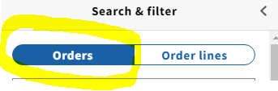

Let’s see how this works in practice
Scenario 2
You need to create an order for physical library material (not electronic) that has no record in OCLC. Once you have ascertained that there is no record in OCLC that you can use as the basis for your purchase order, proceed as follows:
Launch the Orders app, and select the “Orders” segment in the left-hand pane.
In the upper-right corner of the screen, click on the blue “New” button. You will be taken to a screen that says “Create purchase order.”
Notes:
If you connect your POL to an instance record, the connection is broken if you change some of the info, and a new instance is created.

Slide 20

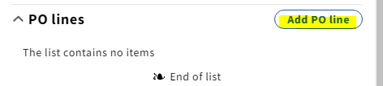
Scenario 2, continued
Fill out as many of the fields as you can; only vendor and order type are required. If you are using an order template, a lot of the information is supplied automatically from the template.
When finished, click the button in the bottom right corner that says “Save & close.”
You should see a green confirmation message, called a “toast,” letting you know that your order was successfully created. Your order displays in the right-hand pane.
Scroll down your purchase order until you come to the section, or “accordion,” called “PO lines.” Click on the button that says “Add PO line.”

Slide 21


Scenario 2, continued
You should find yourself on a screen that says “Add PO line” at the top:
If you used an order template to create your order, some of the fields will already be filled in with information supplied automatically by the template.
Using the information you have about the material being ordered, fill out the required fields in the purchase order line form. Required fields are indicated by a red asterisk. Price information is required, but the system does not require you to specify a fund in Honeysuckle. However, if you do not, no encumbrance will be recorded.
For this exercise, pay particular attention to the field in the “Physical resource details” accordion of the purchase order line that says “Create inventory.” Select the option for “Instance, holding, item.”

Slide 22

Scenario 2, continued
At the bottom of the POL screen, there are two buttons in the lower right corner. One says “Save & close” and the other says “Save & open order.”
If you are finished adding POLs to this purchase order, and you are satisfied that you have entered all the required information correctly, you can click on “Save & open order.”
“Opening” the order is similar to changing the status of an order from “Pending” to “Approved/Sent” in Voyager.

Slide 23
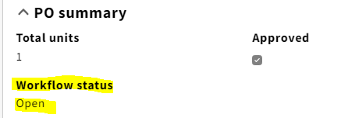
Scenario 2, continued
“Opening” the order is necessary to set in motion the process of creating the instance, holdings, and item records in Inventory. When you successfully open an order, you will see a green confirmation “toast” message. You can see the workflow status of the PO in the “PO summary” accordion of the purchase order; it has changed from “Pending” to “Open”:

Slide 24
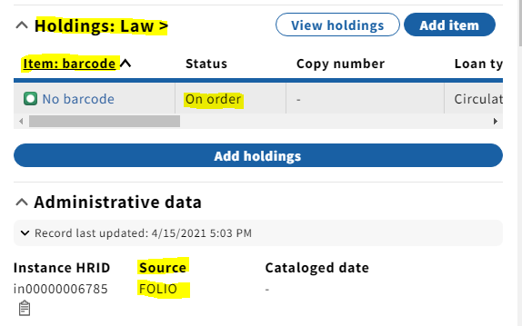
Scenario 2, continued
Once the order is open, you should be able to search in Inventory for the title(s) you ordered. FOLIO has created the instance, holdings, and item records for you. Notice that the item record status is “On order” and the record source is “FOLIO,” not MARC.

Slide 25
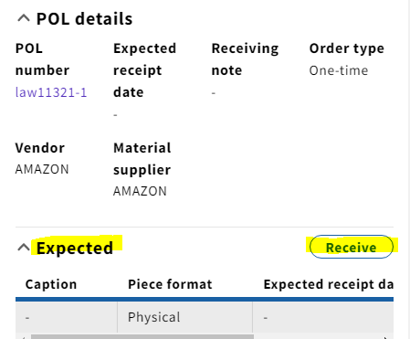
Scenario 2, continued
Meanwhile, in the Receiving app, a record is created in anticipation of the receipt of the material you just ordered. Notice that there is a link to the corresponding POL:
Link to purchase order line

Slide 26

Things to keep in mind
The records you’ve created in this process have particular relationships, or “dependencies,” that may subject them to automatic processes, or prevent you from doing certain things to them.
For example, receiving the material you’ve ordered will automatically change the item status from “On order” to “In process.”
If we create an invoice for the title we ordered and received, once the invoice is paid, the Workflow status of the purchase order automatically changes to “Closed” (if there are no other POLs on the PO):

