Slide 1
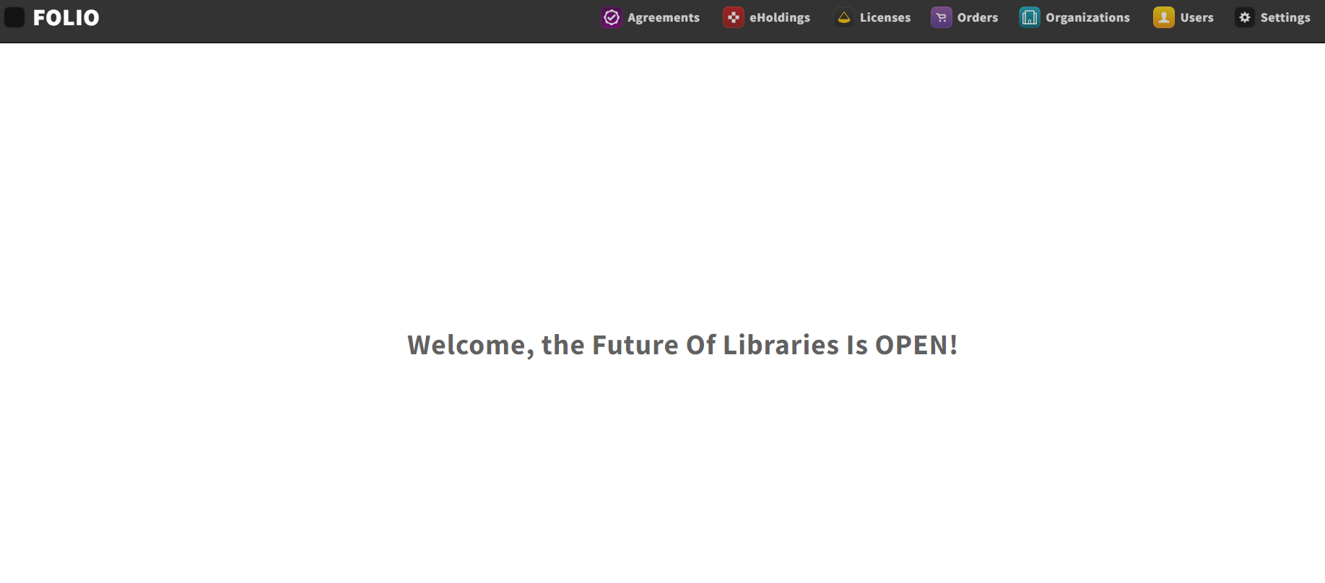

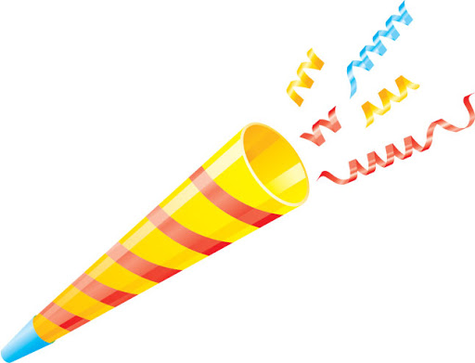


Cornell’s FOLIO ERM,
est. March 2020

Slide 2



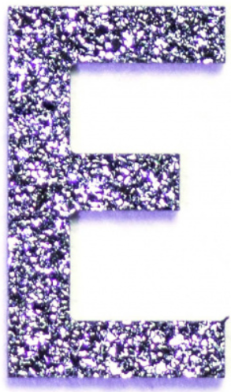




Notes:
https://cornell.folio.ebsco.com/licenses?filters=status.active&sort=name

Slide 3
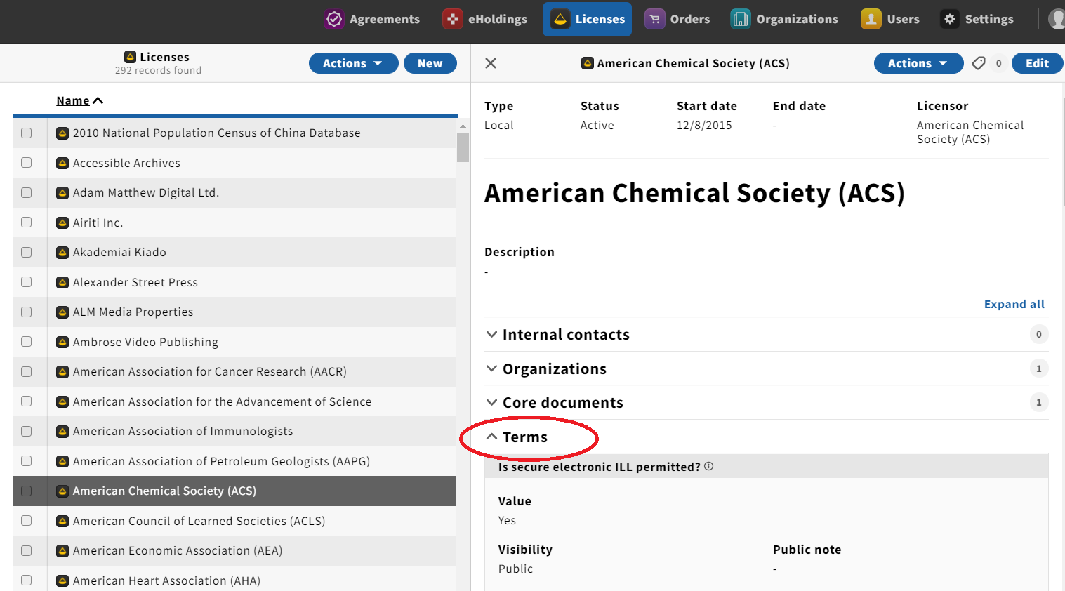
the catalog
Notes:
https://newcatalog.library.cornell.edu/catalog/11802714

