Slide 1
Acquisitions Odds and Ends
Presented by
Joanna Cerro and Jean Pajerek
June 2021

Slide 2
This session covers:
Creating and using order templates
Processing cancellations in FOLIO
Expense classes in FOLIO
Entering diacritics in FOLIO
Processing monograph claims in FOLIO
Creating a spreadsheet from a search result in the Orders app

Slide 3
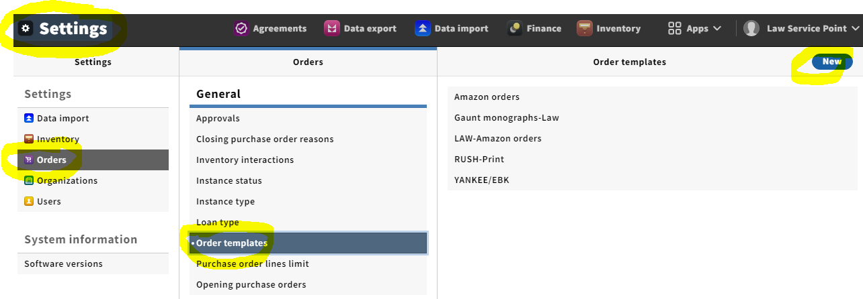
To create a new order template, start in the Settings app. Select “Orders,” then “Order templates,” then “New.”
Notes:
You need to have the proper permissions to create order templates. People with the Acq3 permissions are able to create order templates.

Slide 4
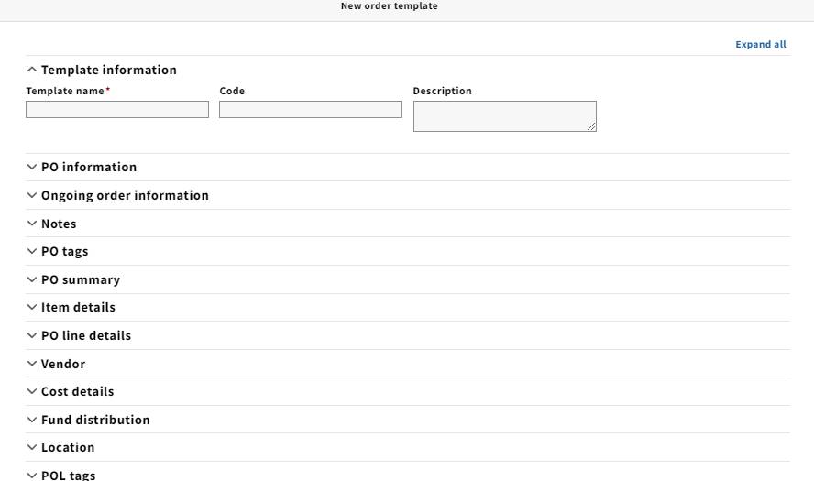
There are quite a few accordions you can fill out in an order template, but nearly all are optional.

Slide 5
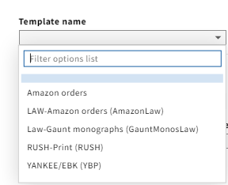
Order templates that have been created are listed in a drop-down list under “Template name” when you create a new purchase order in the Orders app.

Slide 6
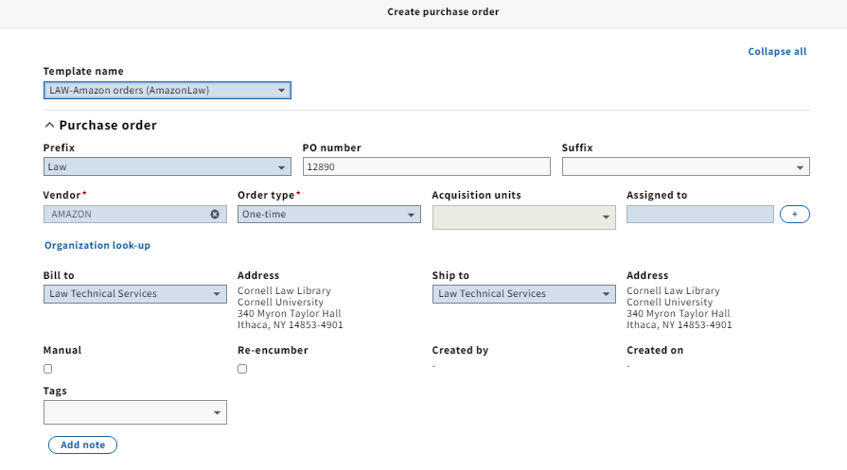
After selecting a template from the drop-down list, fields in the purchase order are populated with the values supplied in the selected template.
Notes:
Keep in mind that the values supplied by the template can be overridden by the person creating the purchase order.

Slide 7
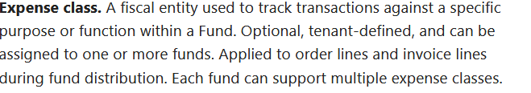
New with FOLIO Iris – Expense classes

Slide 8
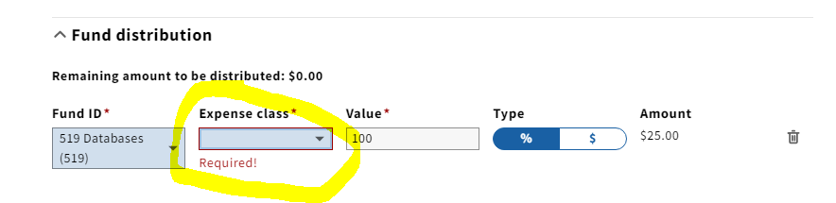
When there are expense classes associated with a fund, it becomes a required field in a POL.

Slide 9
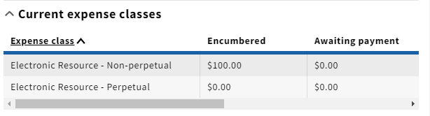
Expense classes are useful for tracking certain kinds of expenditures within a fund.
Notes:
Expense classes are determined by the implementing library.

Slide 10
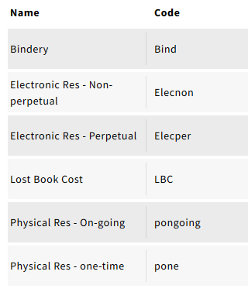
These are the expense classes Ann Crowley has set up so far:

Slide 11
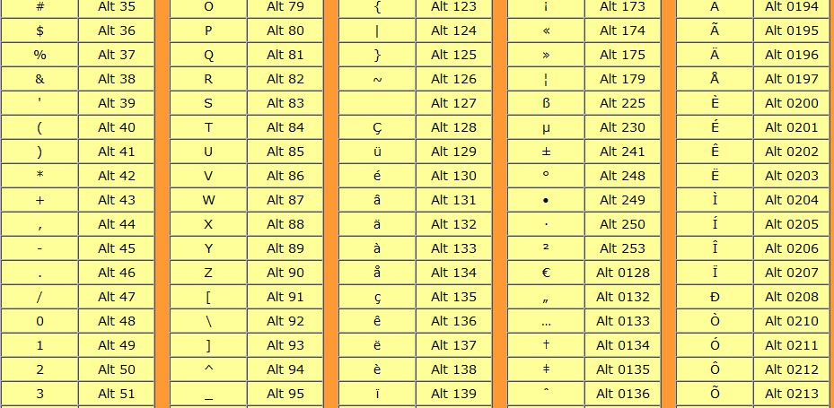
Diacritics and special characters can be entered into FOLIO records in more than one way.

Slide 12
https://tools.oratory.com/altcodes.html#:~:text=Press%20the%20Alt%20key%2C%20and,and%20the%20character%20will%20appear
The document linked to above describes how to enter diacritics and special characters using particular sequences of keys.
For example, this e-umlaut combination can be produced by holding down the “alt” key and entering 137 using the numeric keypad on your keyboard.

Slide 13
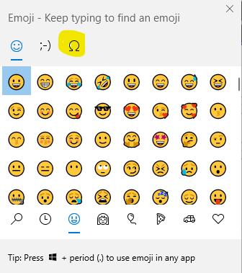
If you use Microsoft Windows, you can use the emoji keyboard to enter diacritics.

Slide 14
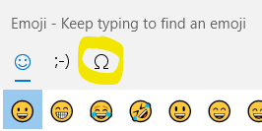
Using the emoji keyboard to enter special characters
Position your cursor within the text where you need the diacritic or special character.
While holding down the “Windows” key, press the period key. The emoji keyboard should appear on your screen.
Click on the “symbols” character to bring up the symbols keyboard.

Slide 15
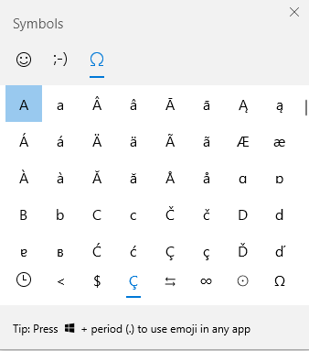
Click on the desired character to enter it into FOLIO.

Slide 16

Monographs in need of claiming in FOLIO can be identified using the “Expected receipt date” in the POL as a search filter, if that information is present in the record.
Notes:
The Expected receipt date is one of the search filters used to identify monographs that are overdue and require claiming.

Slide 17
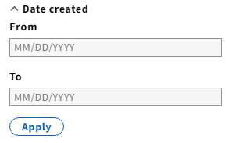
The “Date created” associated with a POL can also serve as a reference point for identifying material to claim and is a more reliable data point because it is system-supplied.

Slide 18
In the Orders app, with the “Order lines” segment selected in the search pane, search for unreceived monographs by applying additional search parameters (besides a date range).
Receipt status=“Awaiting receipt”
Location, Fund code, Vendor, Rush status, and Order format are among the possibilities for narrowing your search.

Slide 19
https://cornell-training.folio.ebsco.com/orders/lines?createdDate=2021-01-01%3A2021-05-31&poNumberPrefix=Law&receiptStatus=Awaiting%20Receipt
This search combines Receipt status= “Awaiting receipt” with purchase order number prefix=“Law” and a date range for “Date created.”

Slide 20
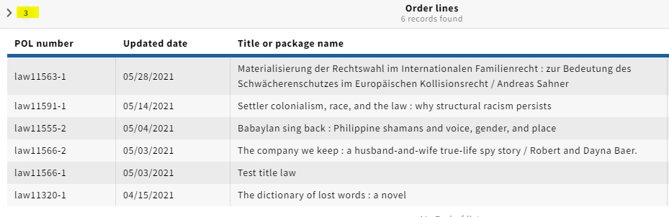
With the search pane closed, the numeral “3” displays in the upper left corner to remind you that 3 filters have been applied to this search.

Slide 21
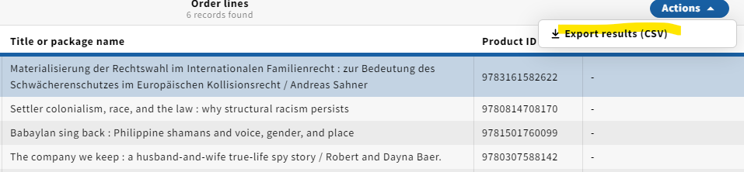
To create a spreadsheet of the search results, click on the blue “Actions” button and select “Export results (CSV).”

Slide 22
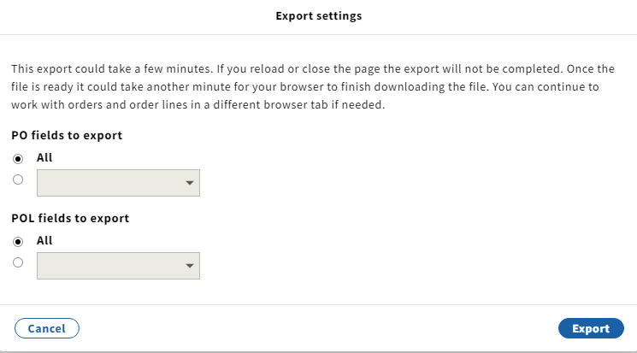
The export tool will ask you which fields you want to include in your report.

Slide 23

Select your desired fields and click the blue “Export” button to generate your report.
If you are using Chrome as your browser,
an alert icon like this should appear in the
bottom left corner of your screen once the
spreadsheet has been generated.

Slide 24
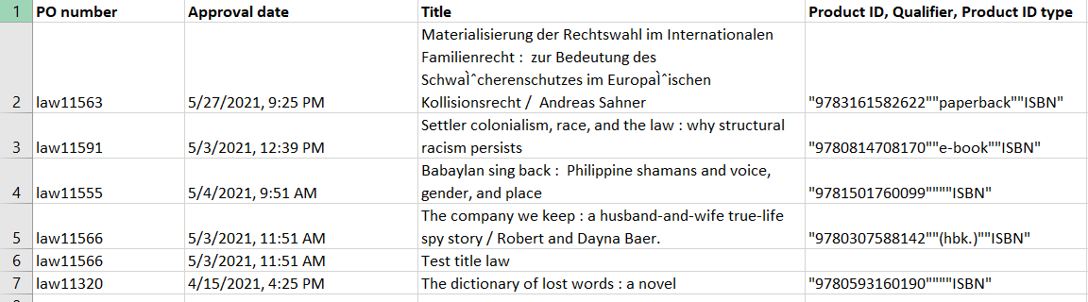
A spreadsheet with the fields you selected should be downloaded to your computer.

