Slide 1
Batch Processing
in FOLIO
Jenn Colt, Library Technical Services

Slide 2



FOLIO Apps directly related to batch processing

Slide 3
Supporting players...
“The Lehigh App” (batch loading for MARC order records)
LTS Workflows automation application (formerly known as LSTools)
LDP (reporting)
MARC query API (API for searching MARC records)
Support for Spine-o-Matic (spine labeling software)
...in other words, “batch processing” is complicated - and more than just batch loading records.

Slide 4
Data Import
Currently, the data import app imports only MARC bibliographic records
You can import holdings and item data by embedding it in a MARC record and then mapping it holdings and items.
The import portion of using data import is pretty easy!
Setting up data import jobs is pretty complicated (but most of LTS won’t need to worry about it).

Slide 5
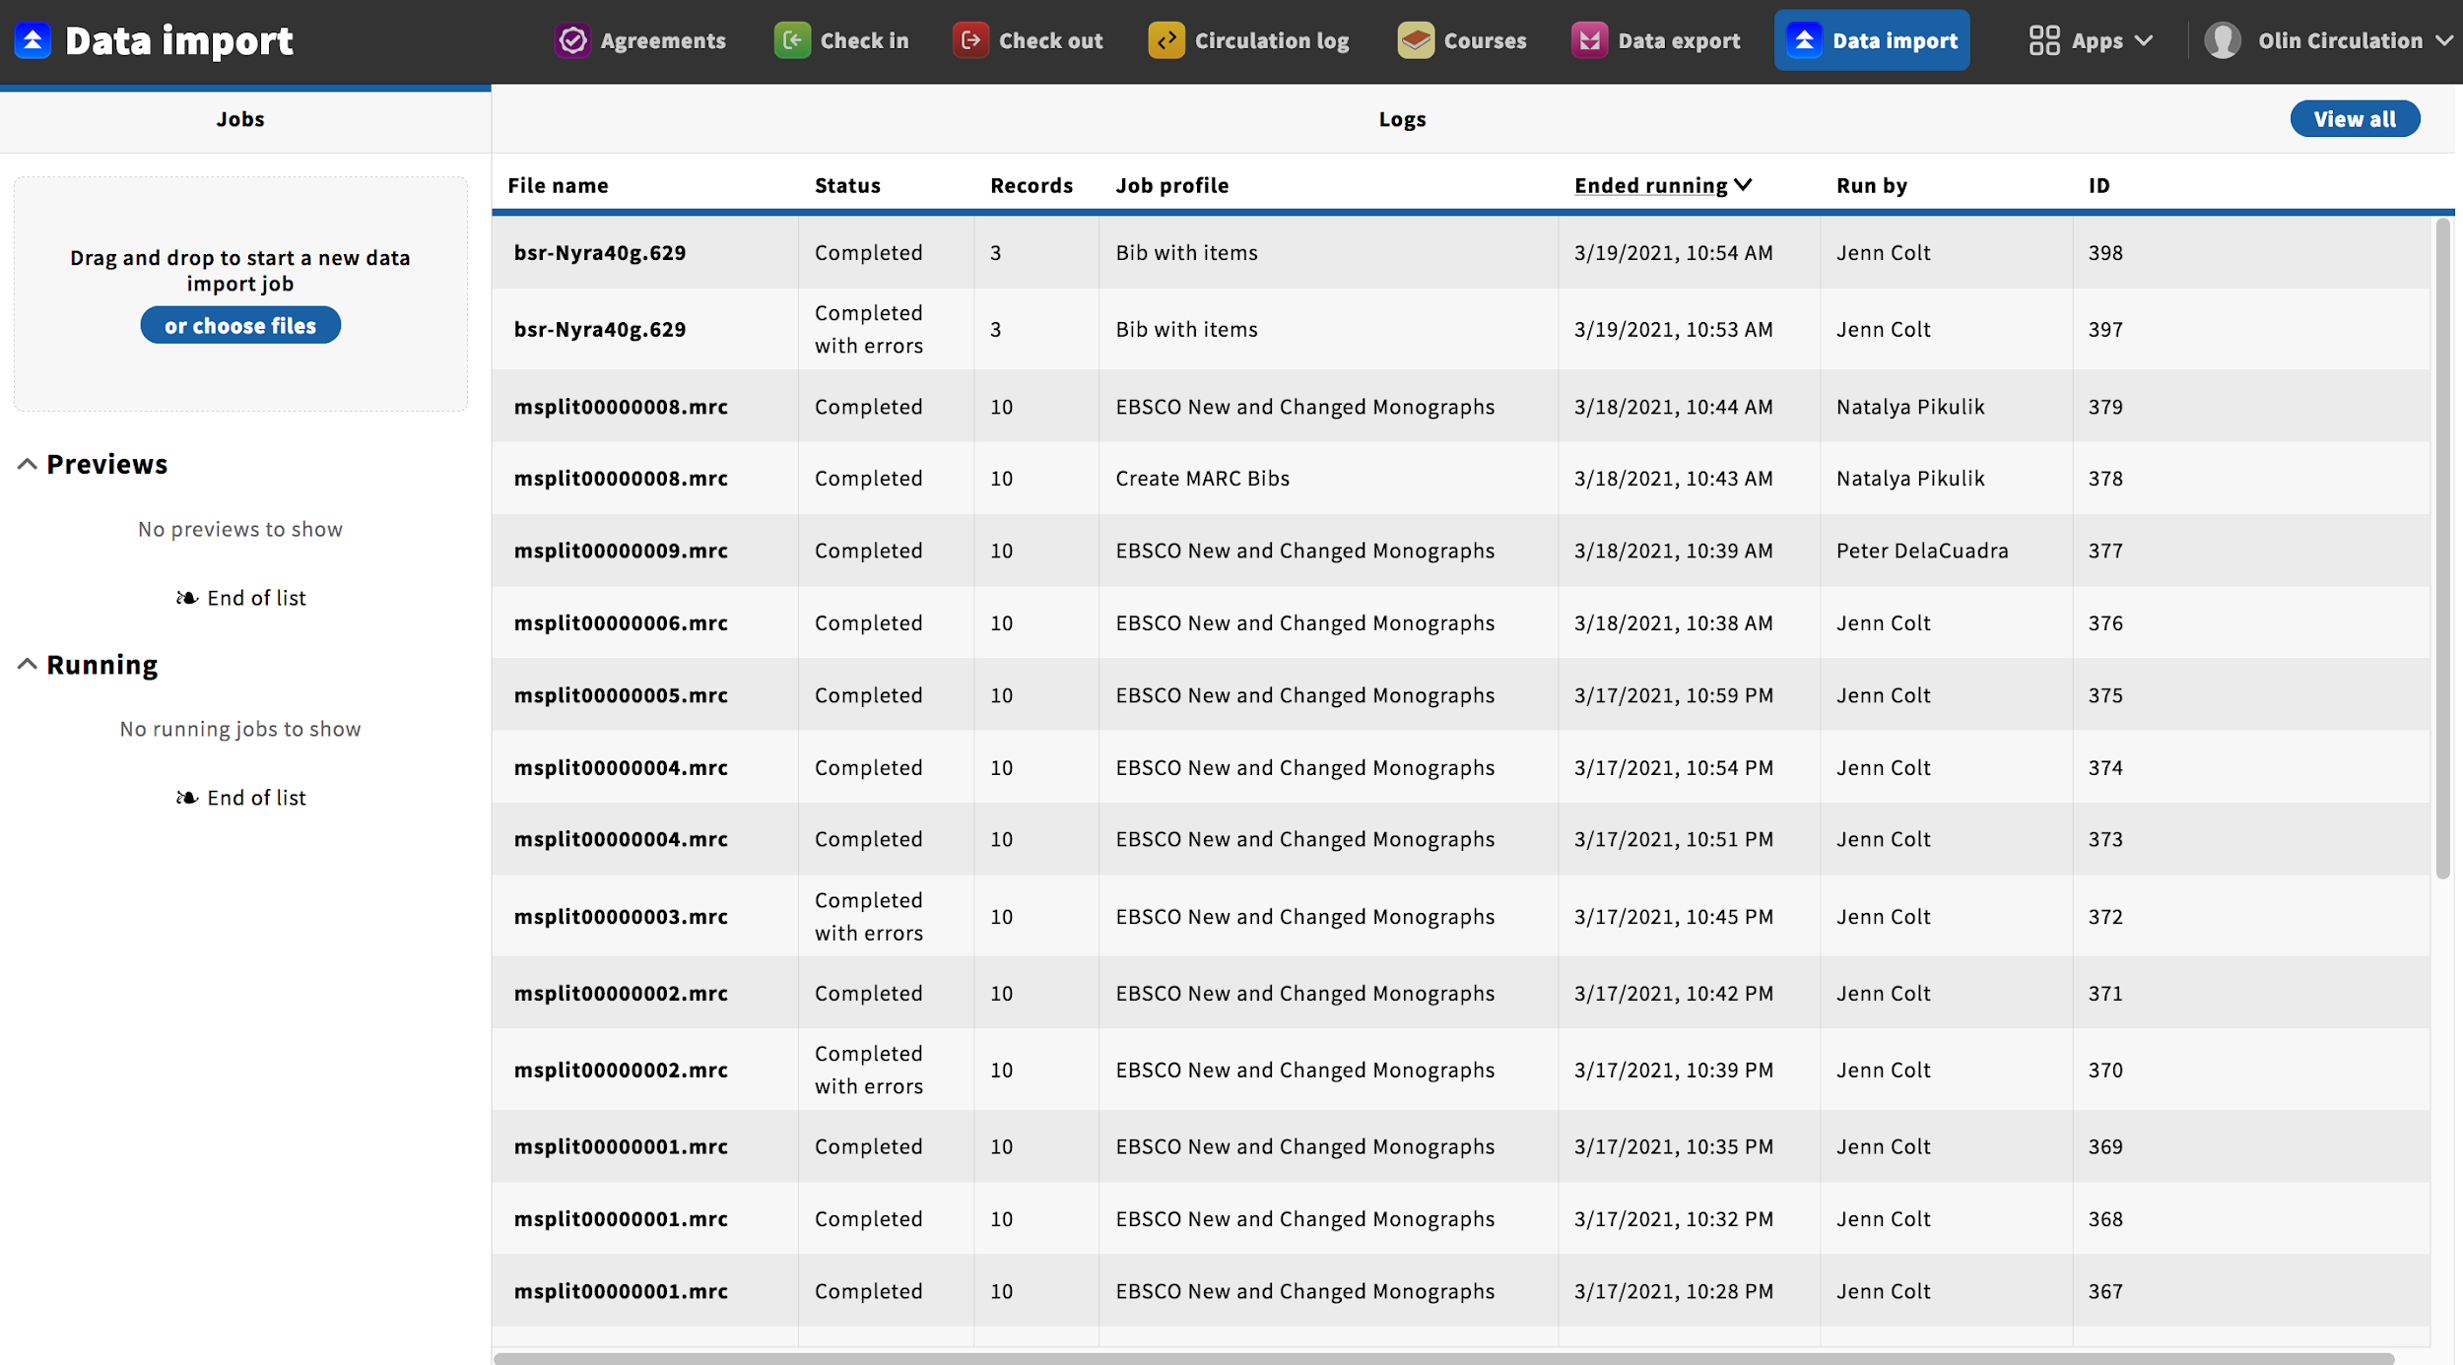

Slide 6
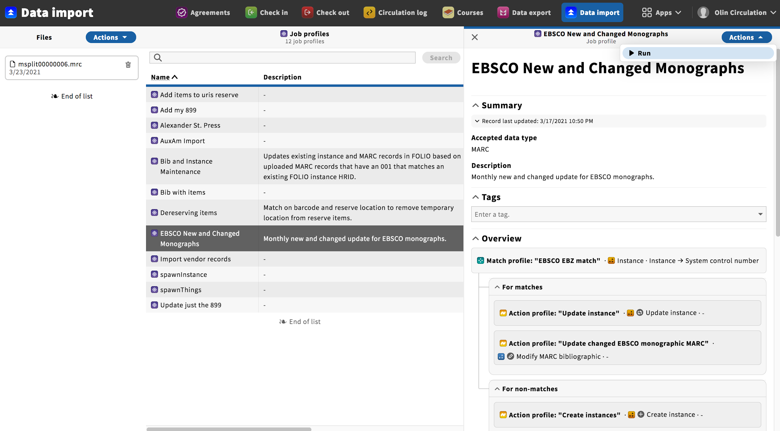

Slide 7
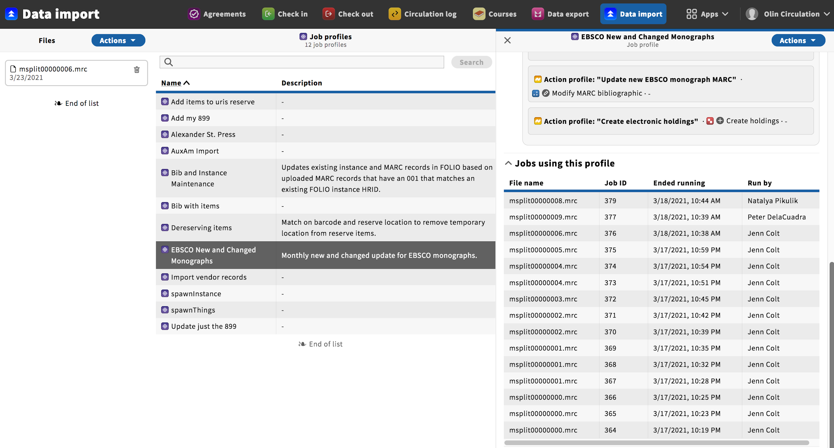

Slide 8
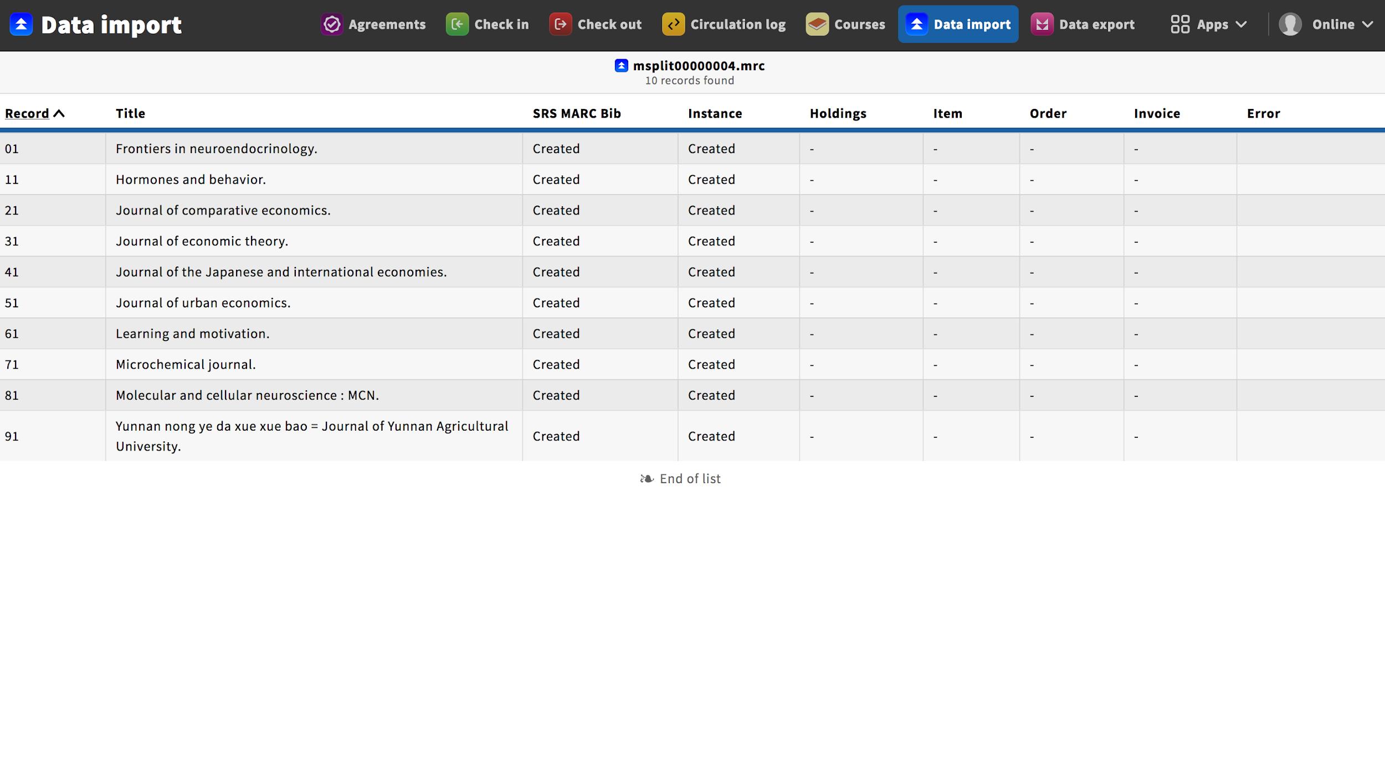

Slide 9
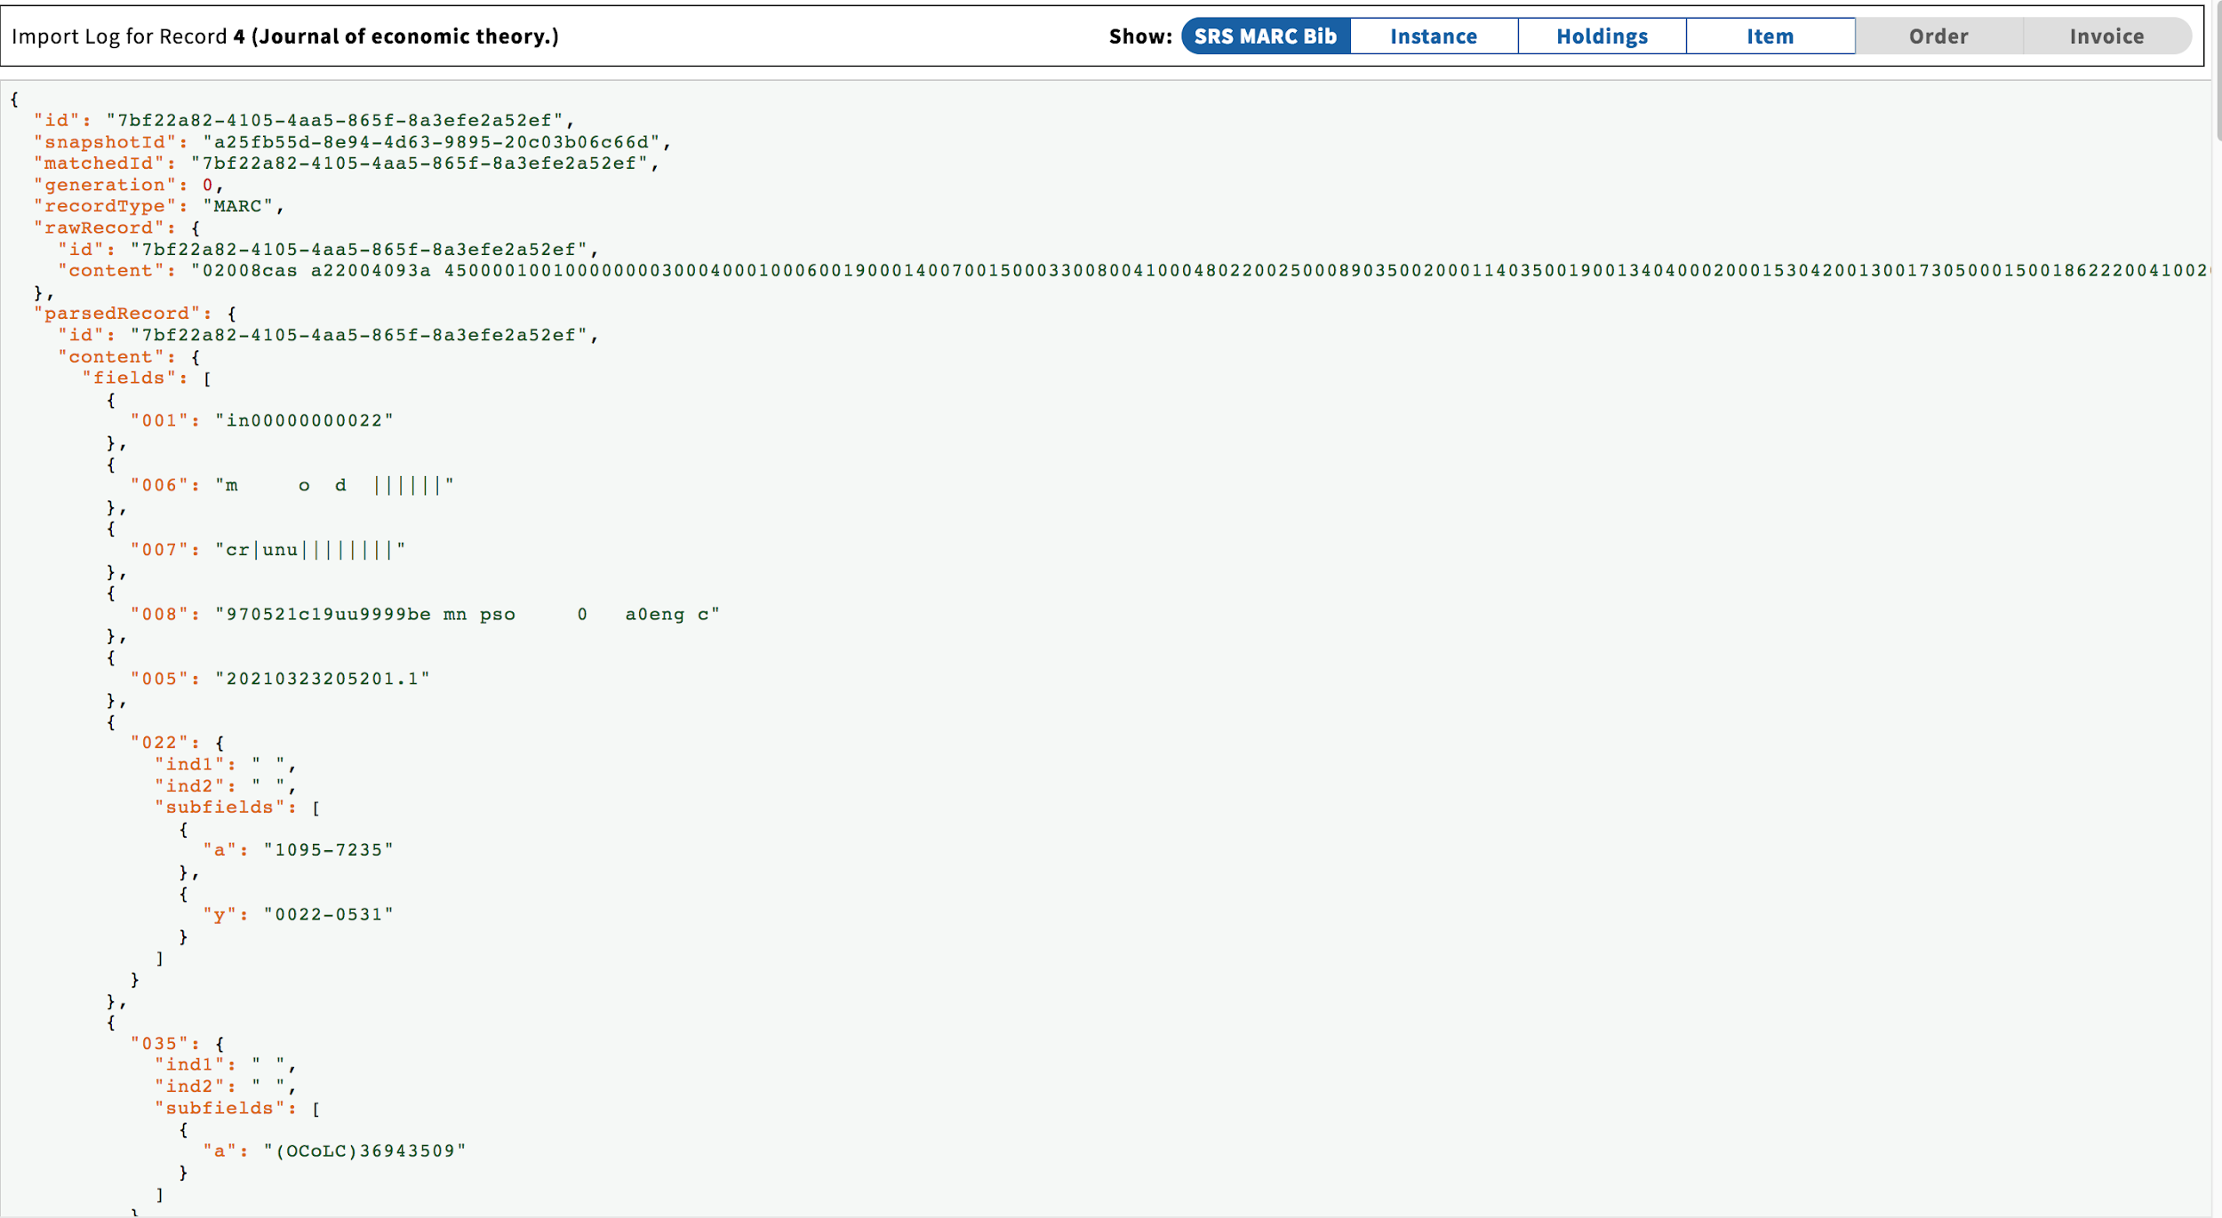

Slide 10
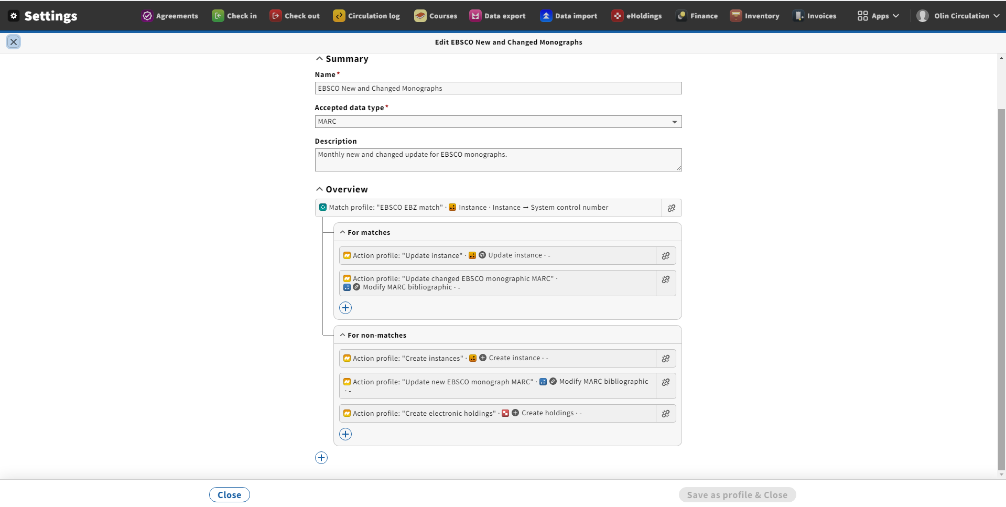

Slide 11
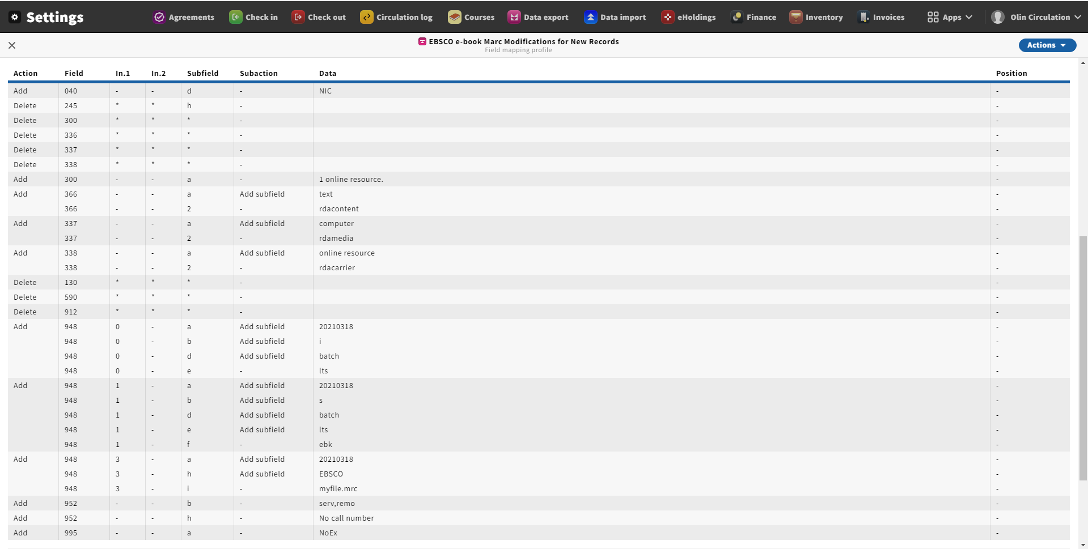

Slide 12
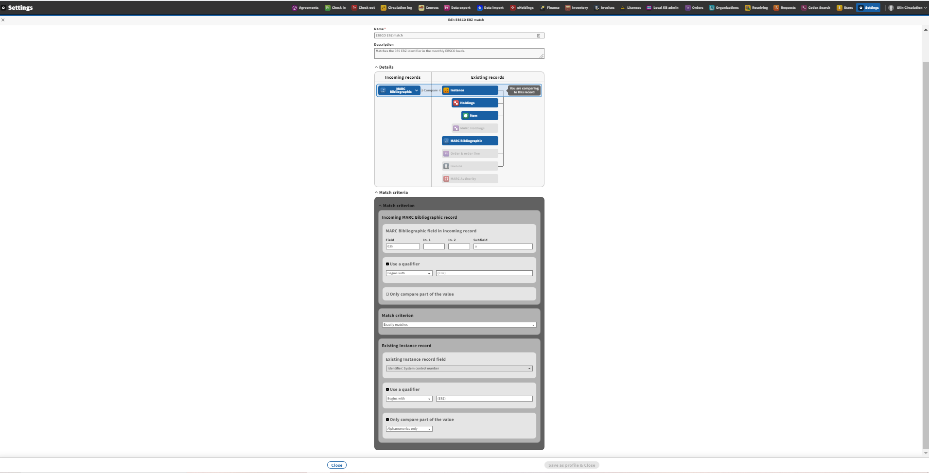

Slide 13
Data Export
FOLIO exports data through in-app reports in a number of places
FOLIO also exports data to the LDP reporting database
For our purposes right now, we’re talking about the app currently called “Data Export”
This app only exports MARC, but you can include data from holdings and items in the MARC you export (remember we aren’t using MFHDs in FOLIO, data export creates them on the fly when needed)
Data export gets some important updates in Iris, so not everything here is on our training instance

Slide 14
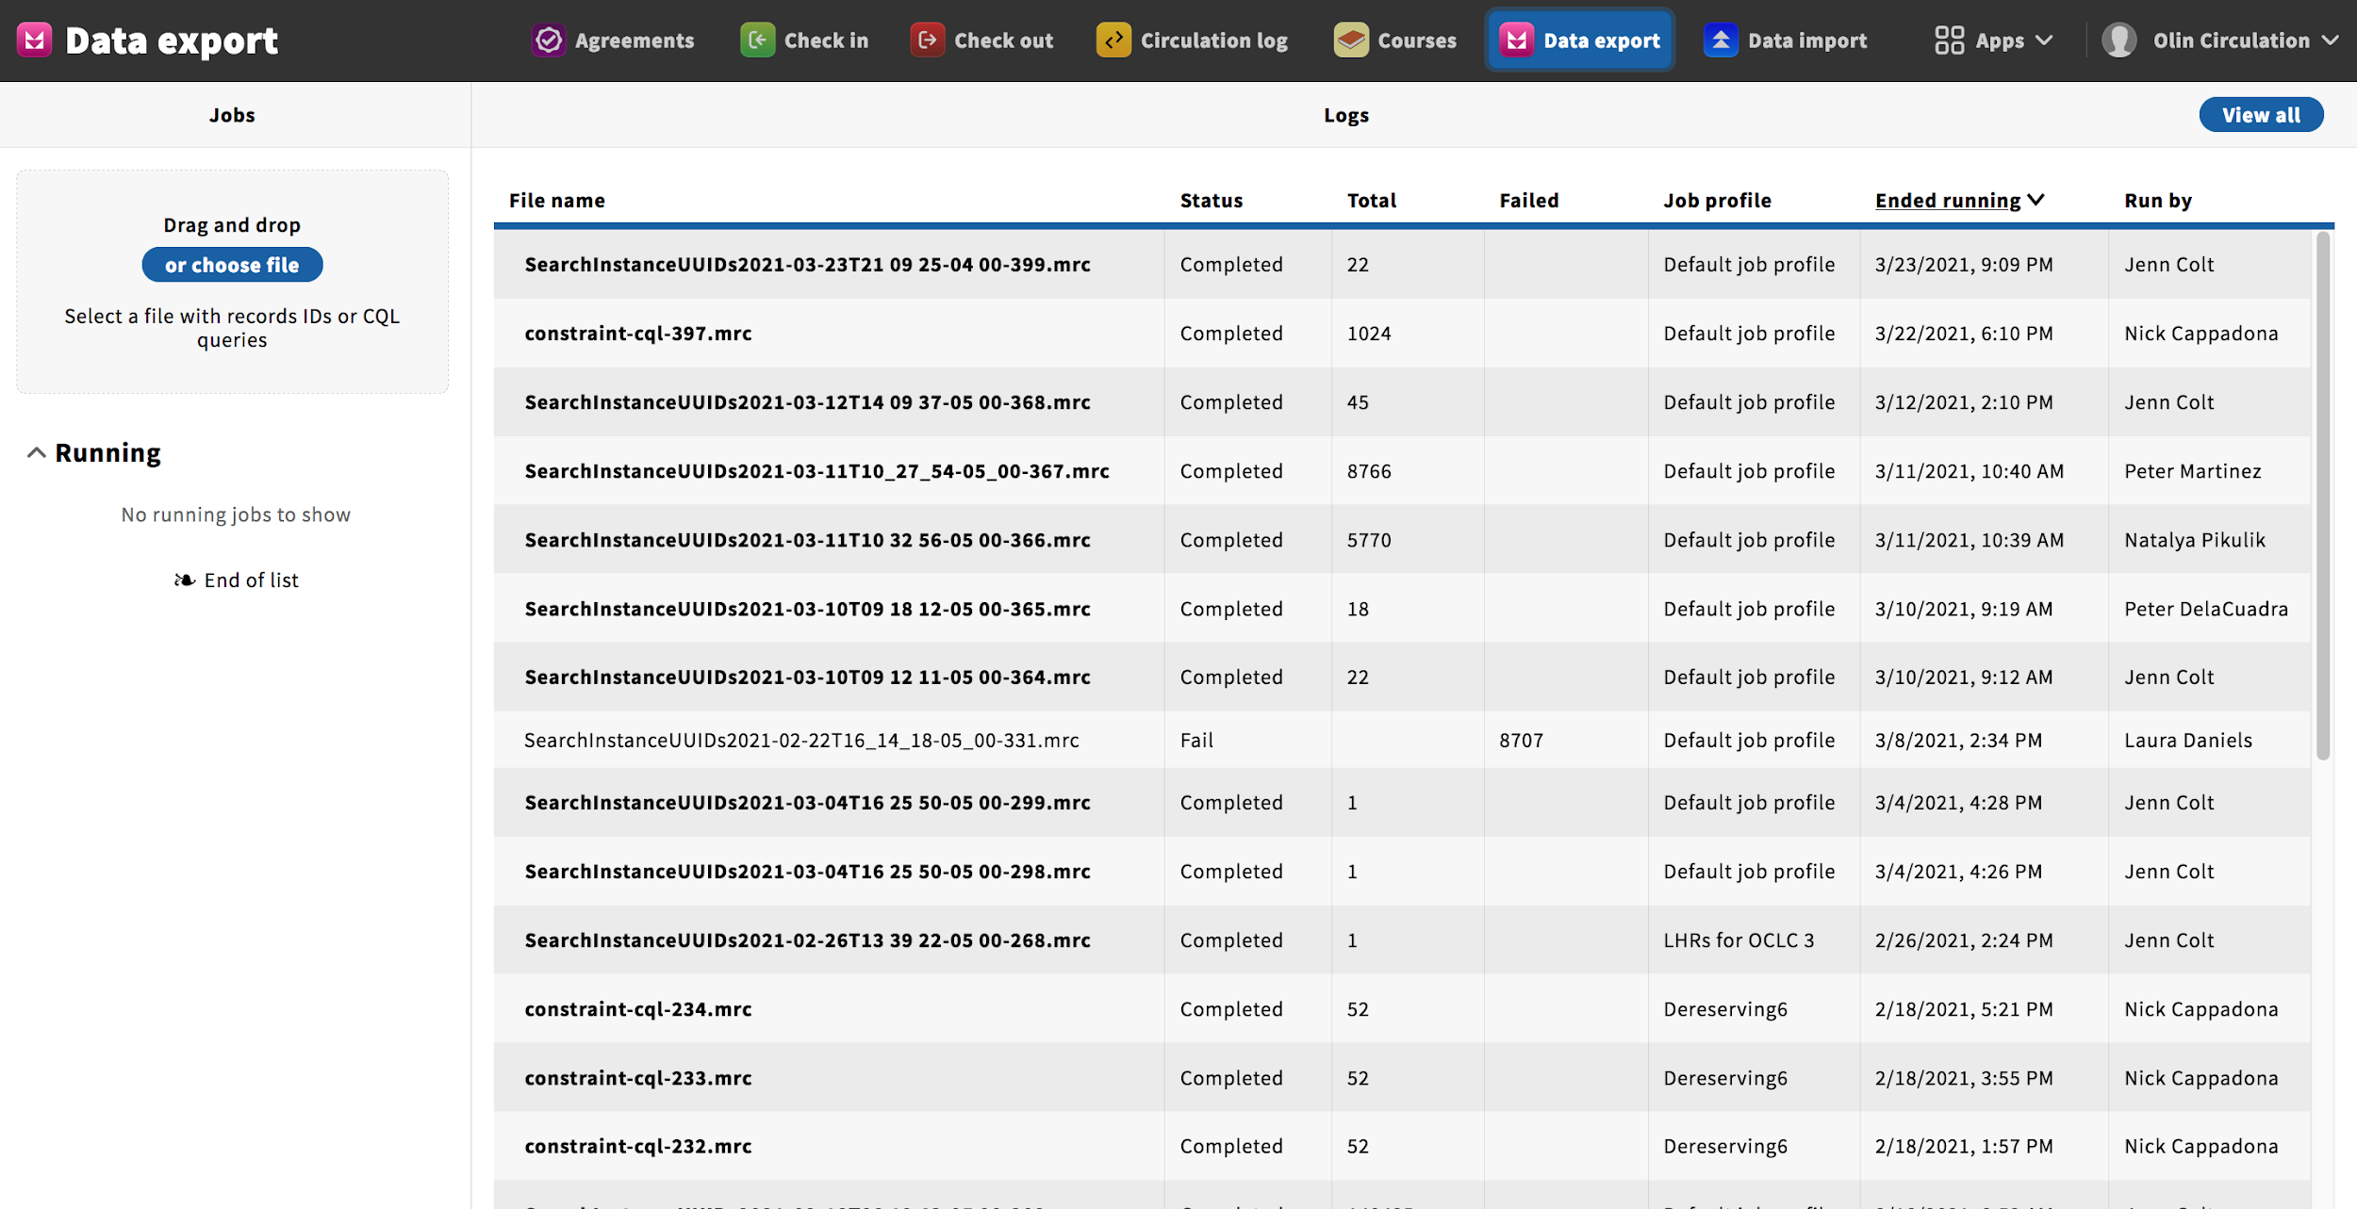

Slide 15
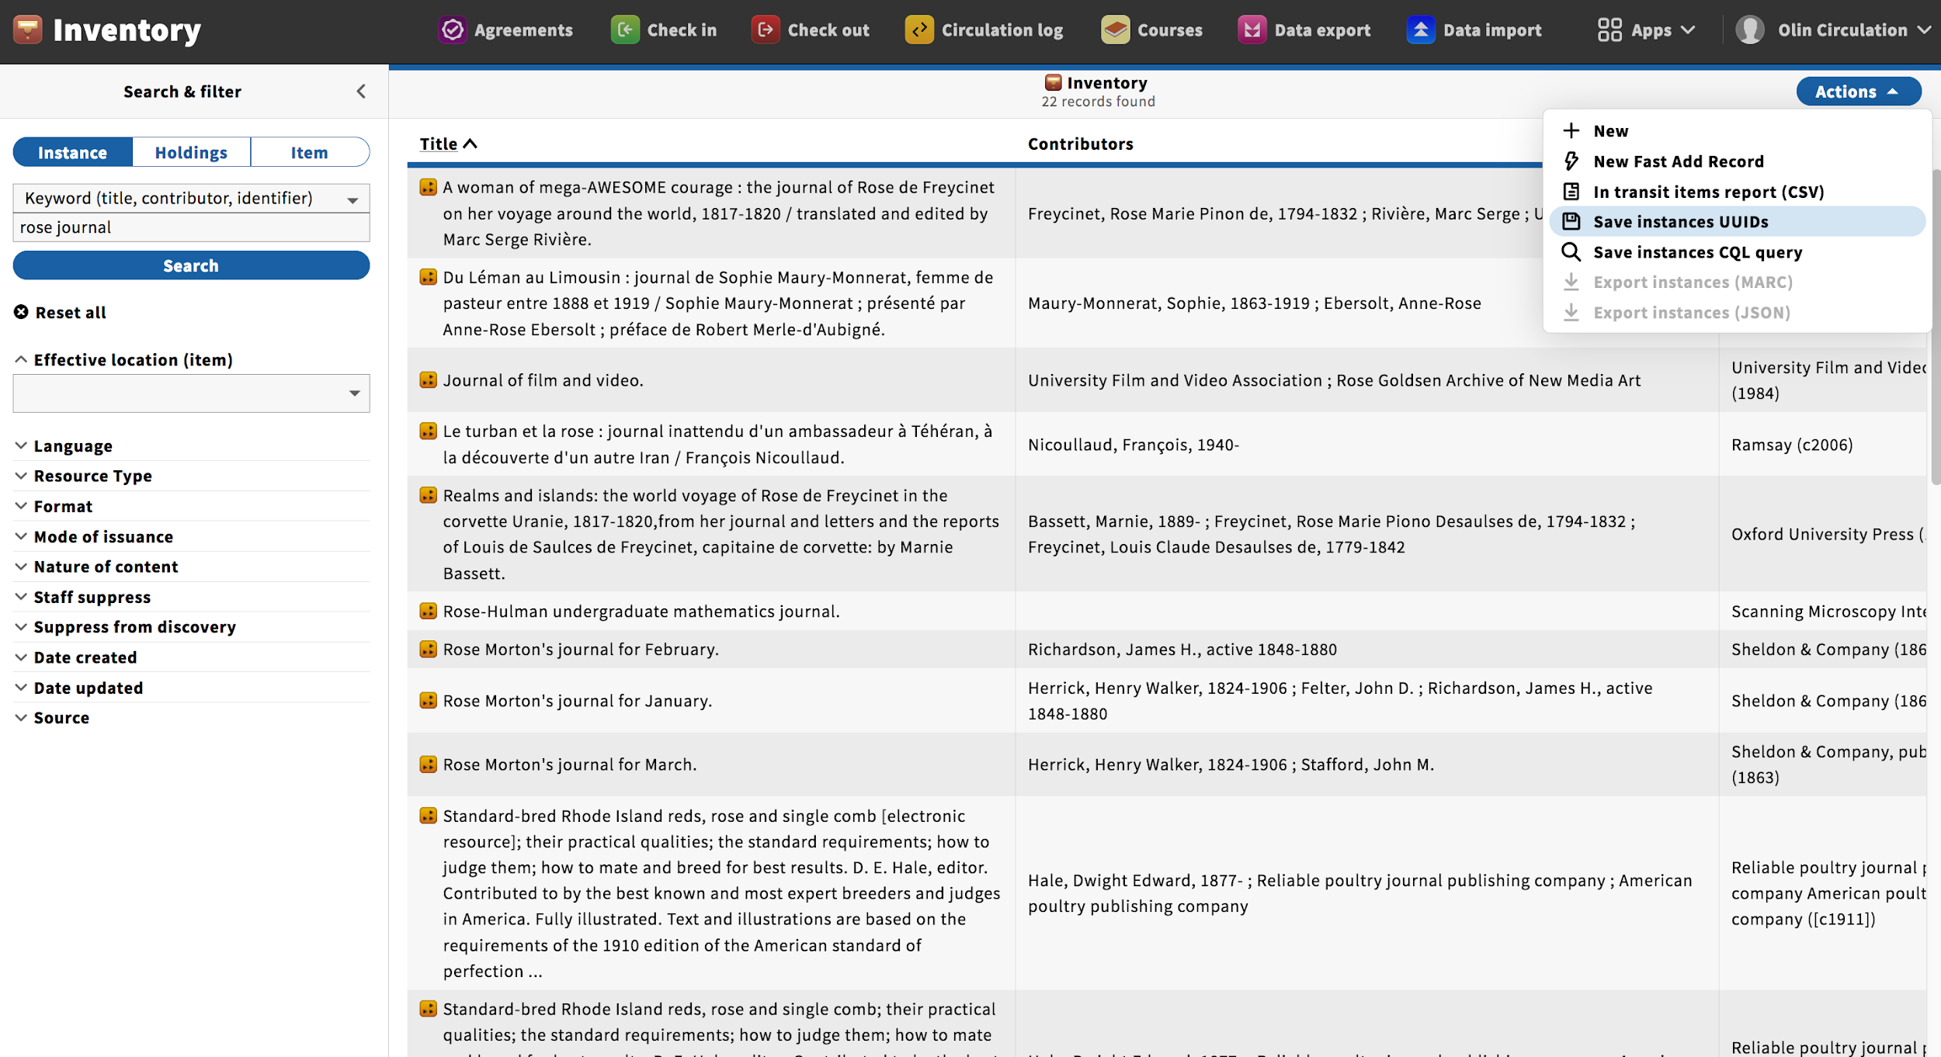

Slide 16
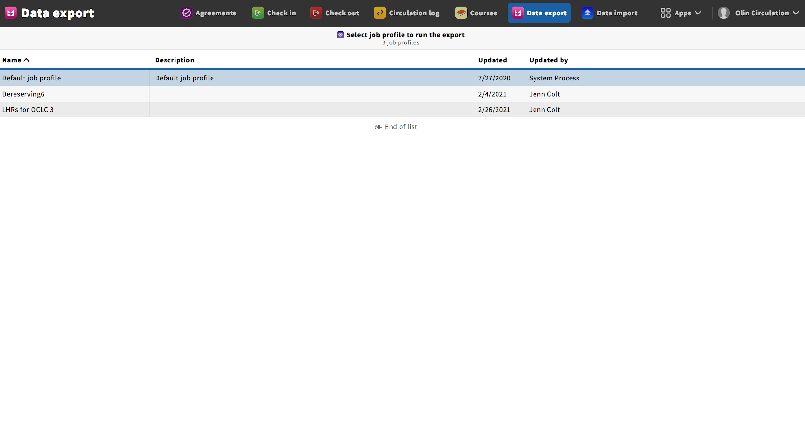

Slide 17
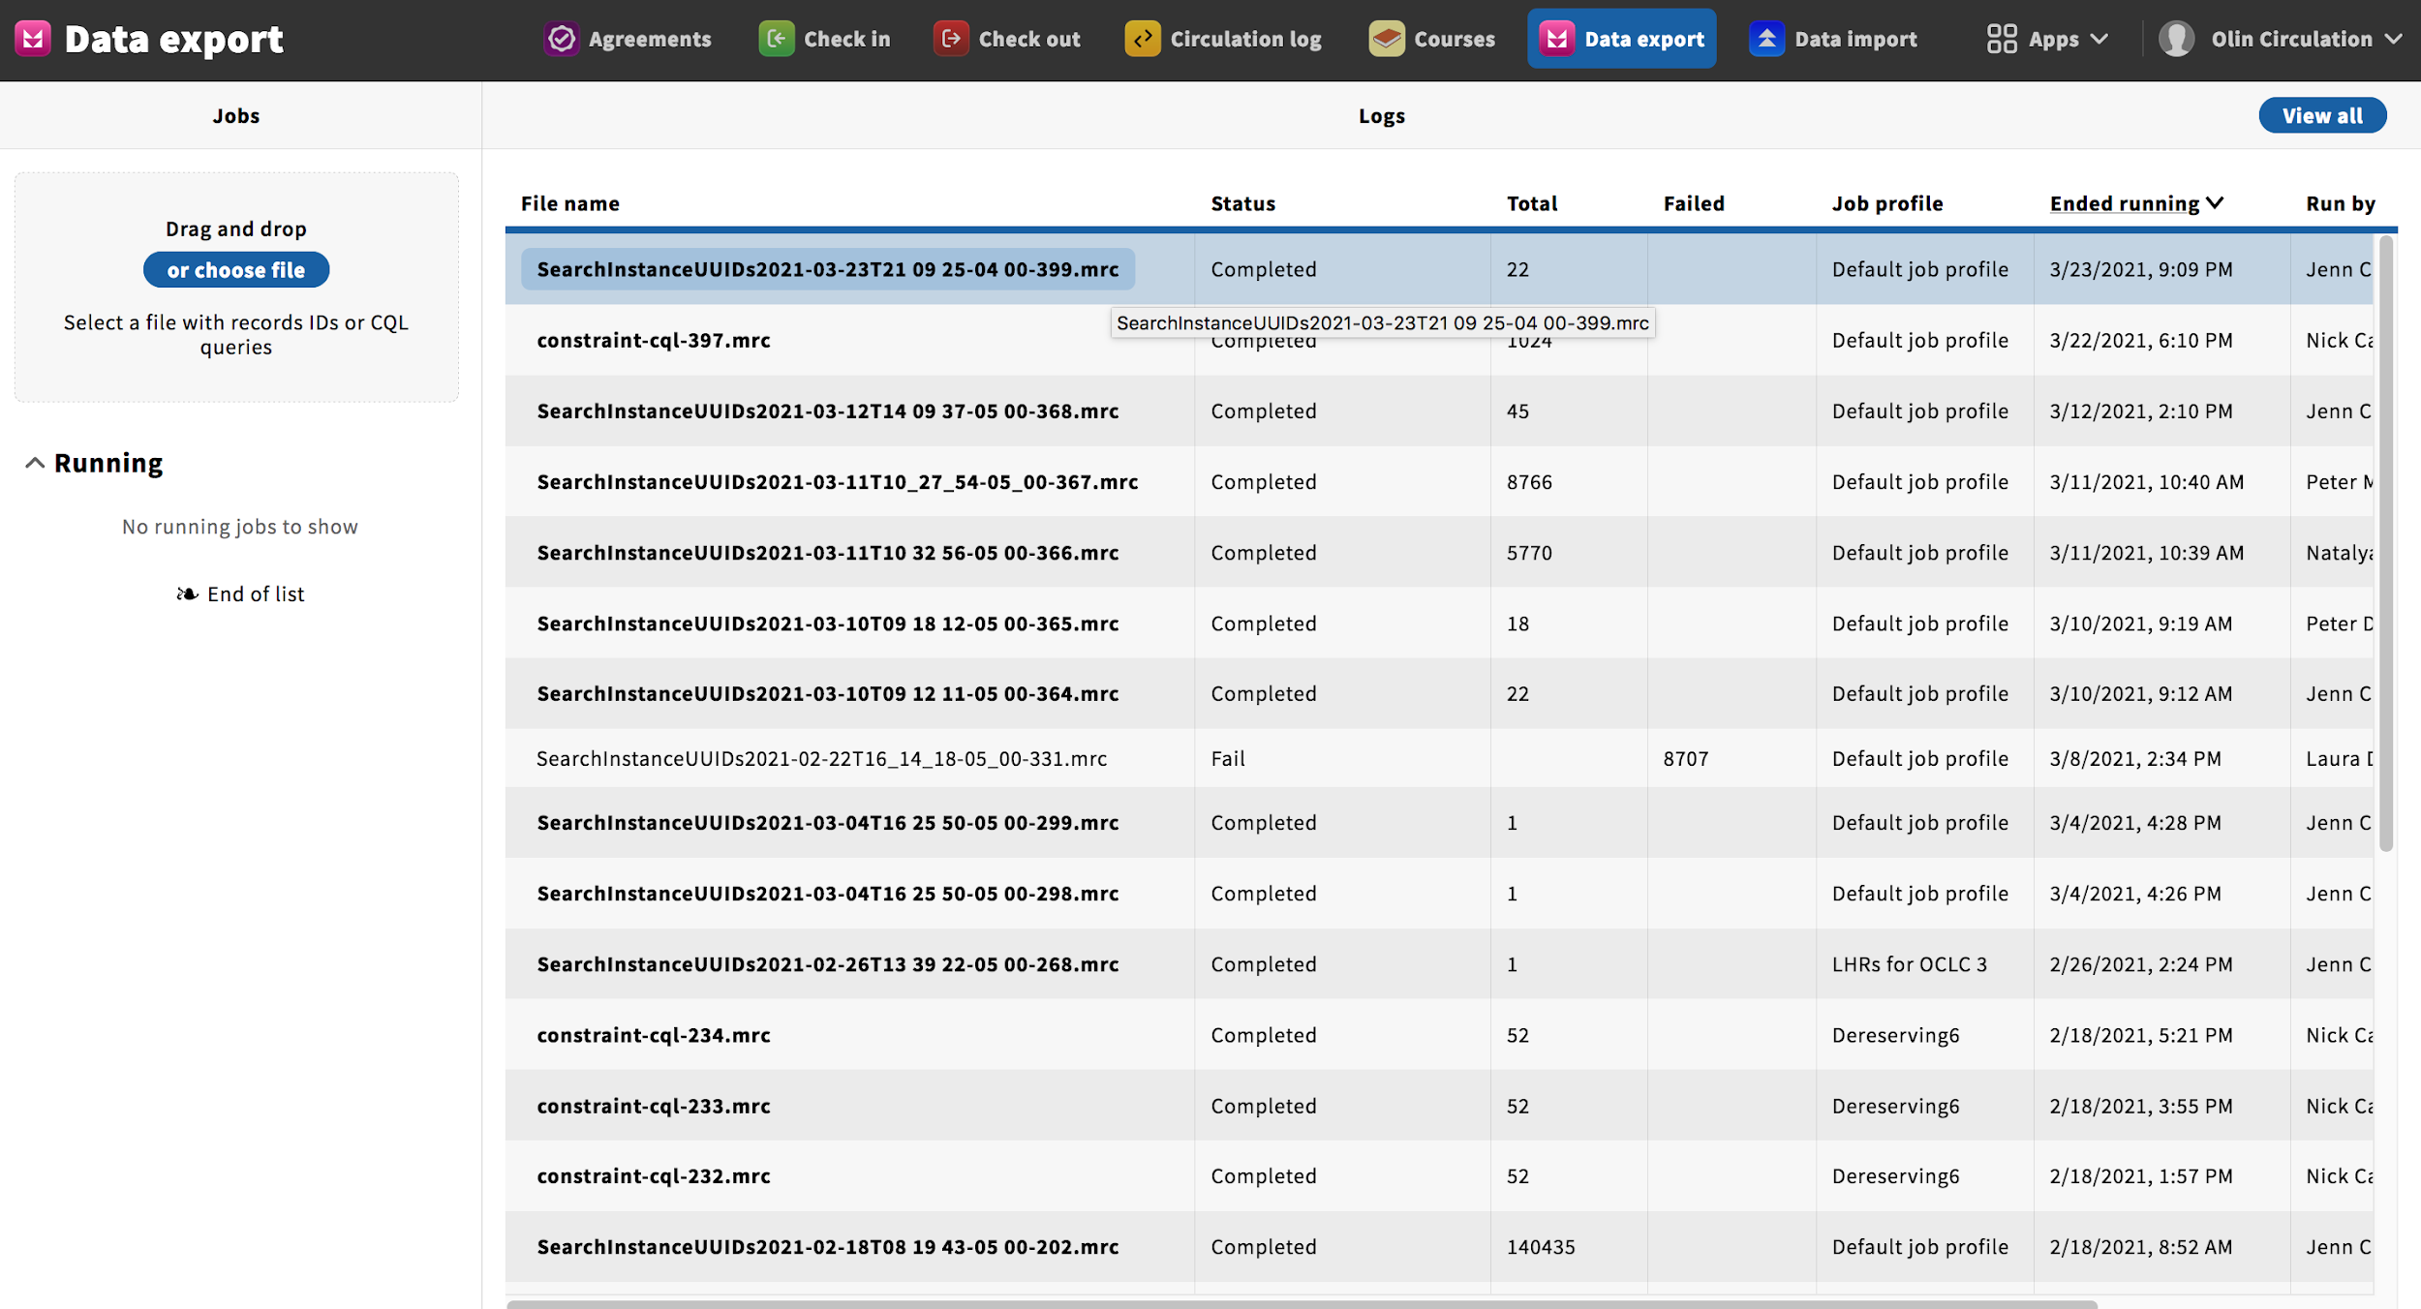

Slide 18
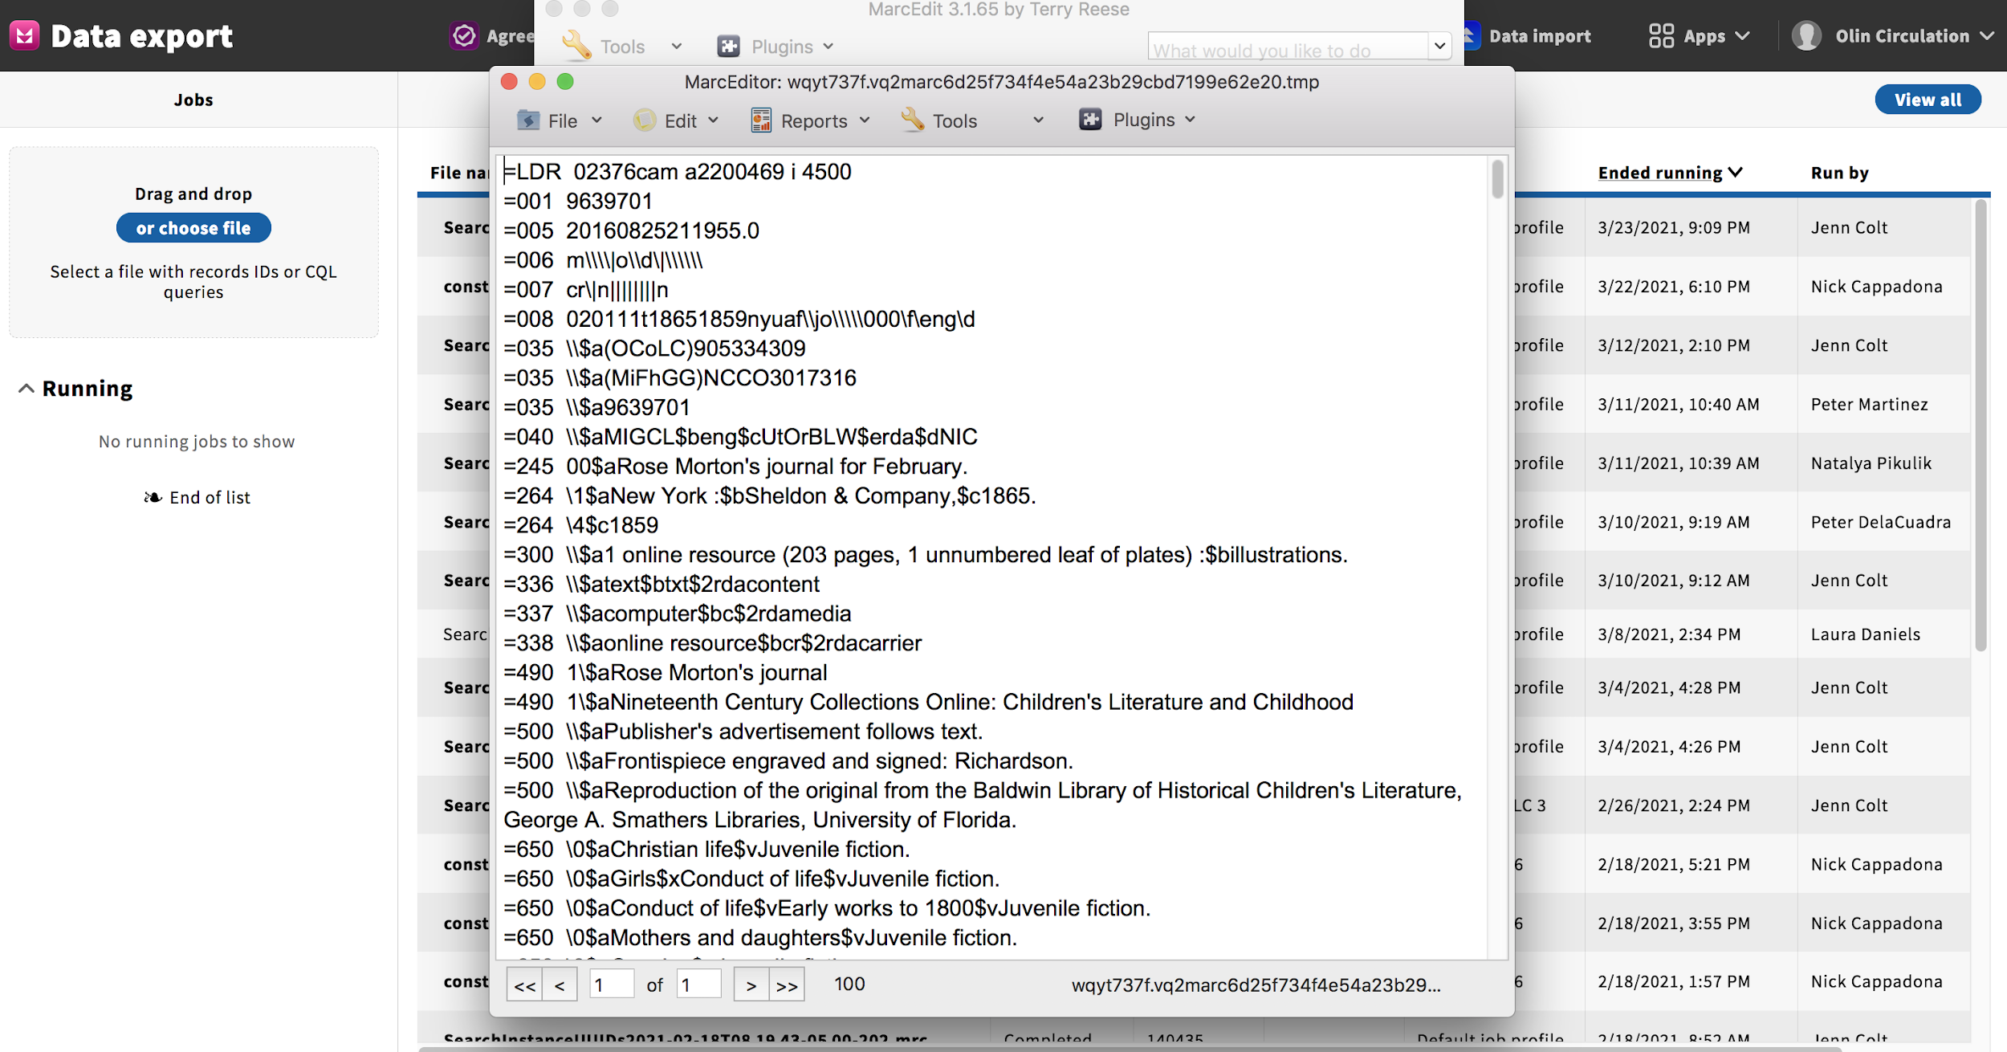

Slide 19
