Slide 1

Instruction program
Albert R. Mann Library
overview

Slide 2
1. What kind of outreach does your unit do?
-Start-of-semester newsletters/announcements to each major and academic unit from Head of Operations & Outreach
-Presentations to departmental faculty meetings
-(pre-Covid) Announcement bulletin (w/ occasional games and prizes)
-Rotating announcement banner on Mann website

Slide 3
Spring 2021 | Fall 2020*
37 course-related Sessions for 33 courses | 64 course-related sessions for 48 courses *Fall 2019 (pre-COVID) – 93 course-related sessions for 67 courses
7 non-course related sessions (orientations, campus organizations) | 10 non-course related sessions (orientations, campus organizations)
2. Total class sessions taught by Mann each fall and spring

Slide 4
3. Total workshops (beside the CUL orientation workshops) offered by Mann
Spring 2021 | Fall 2020
31 public workshops Workshops have grown in the past couple years with many from Maskerspace. We also offer Citation Management, GIS, data visualization and evidence synthesis | 30 public workshops

Slide 5
Requests for instruction:
  a) 1/3 come to me and Mel from CUL or Mann instruction form or
  b) 2/3 go to librarians directly
If the latter, librarian can decide to teach the session or pass over to instruction team. Instruction team = 5 core members
If request originally comes to Mel/me or is passed to instruction team, we operate on a ’claim then ask’ model:
  a) Google spreadsheet lists each request and rel. details
  b) Previous prep materials linked to in box (if available)
  c) If specialized skills requested, reach out to functional experts in unit
4. Division of instruction requests among people in unit

Slide 6
-Individual librarians work with requestor to create lesson plan
-We have a ‘menu of instruction options’ sheet with time requirements for teaching.
-Past lesson plans shared in Box folders with all of Mann instructors
5. Process for creating & sharing lesson plans

Slide 7
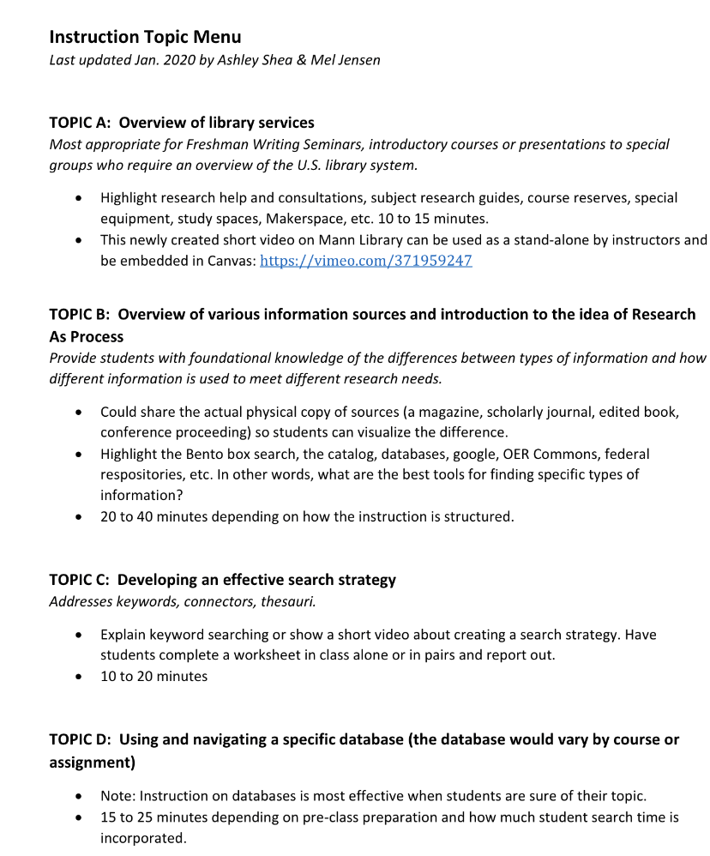
5. Process for creating & sharing lesson plans, cont.

Slide 8
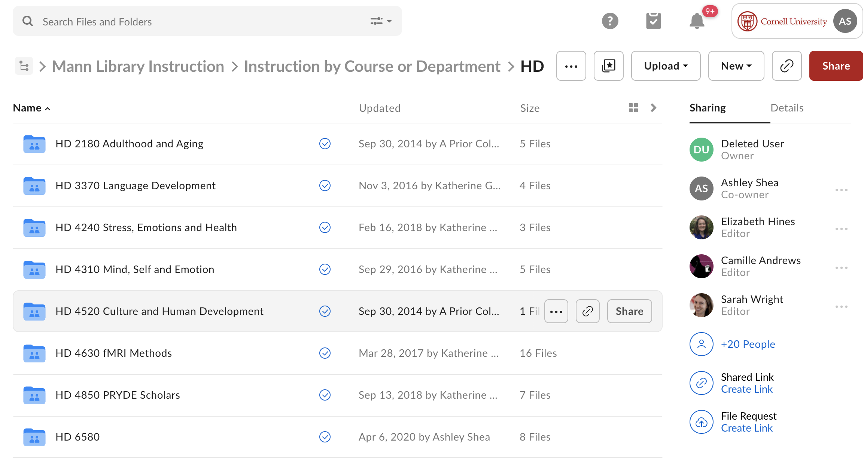
5. Process for creating & sharing lesson plans, cont.

Slide 9
6. Online learning objects created & actively used by Mann
Growing collection of instruction videos on our Mann Instruction Vimeo channel (Nuts & bolts systematic review, basic 3D modeling, MergentOnline, etc.)
3 libwizard tutorials on evaluating sources, articles and evidence (being used by faculty in BioG 1250, BioG 1500 and Comm 3800):
https://cornell.libwizard.com/f/EvaluatingEvidence
https://cornell.libwizard.com/f/EvaluatingSources
https://cornell.libwizard.com/f/EvaluatingArticles
LARGE collection of course-based and subject-based libguides
…Probably more than captured here!

Slide 10
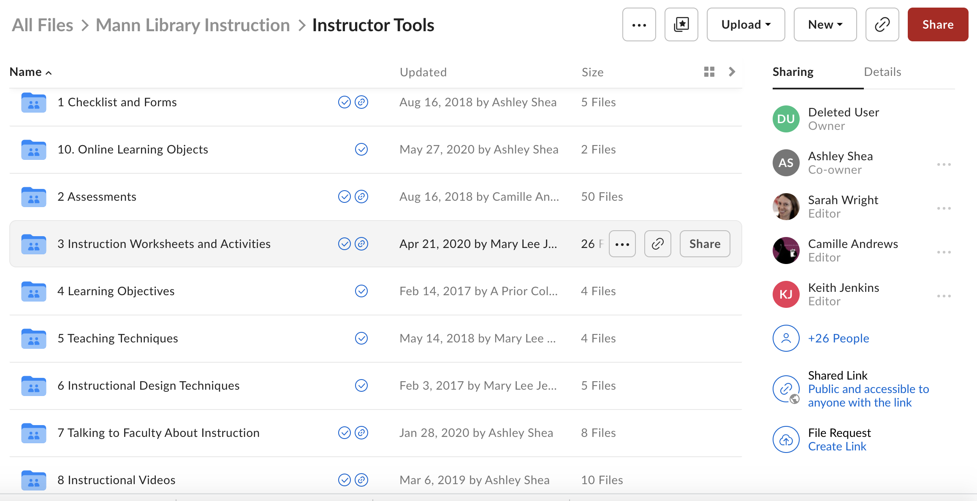
7. How/where is the collection organized and maintained?
-Mann instruction Vimeo channel: https://vimeo.com/371959247
-Box folders
-Mann instruction toolkit: https://guides.library.cornell.edu/manntoolkit

Slide 11
  -Membership and voting rights on CALS and CHE Curriculum Committees and membership on relevant subcommittees
(most recently: the CALS Learning Outcomes Subcommittee)
-Partnering with departments (AEM) to assess course-based learning outcomes
8. Alignment of instruction with needs of department, colleges, university

Slide 12
Newly revised L.O.s with relevant overlap to librarian skills
CLO1: Find, access, critically evaluate and interpret information, theories and assumptions in one or more major knowledge domains to understand issues, inform decision-making, and reach defensible conclusions.
CLO3: Apply data literacy skills to the preparation, interpretation and development of conclusions with quantitative and qualitative data.
CLO4: Use technologies that assist with data collection, organization, analysis, design, communication and presentation.
CLO5: Communicate effectively through written, oral and visual expression for a variety of purposes and audiences.
CLO8: Demonstrate knowledge of ethical principles that guide self, interpersonal, social, societal and global interactions, and ethics in research, practice, and communication of knowledge in the student’s major discipline.
8. Alignment of instruction with needs of department, colleges, cont.

Slide 13
9. Credit-bearing courses at Mann
ALS 1200: Information Chaos: Navigating Today’s Information Landscape
Aligned with CLO 1, CLO 5, CLO 8
ALS 1210: Data Literacy: Skills to Engage with Data
Aligned with CLO 3, CLO 4
Next: Business and economics data course? (Tom)

Slide 14
10. Assessment of program’s impact?
-Haven’t really done this at the program level! Would love to, and might be starting to think about this in coming months…
-Some instructors doing in the class or course that they work with

Slide 15
11. Percentage of instruction is conducted online vs. in-person (pre-COVID)?
Pre-covid: all instruction was in-person
Post-covid: About 15% of our instruction was asynchronous; remainder was synchronous
Spring 2021: 4 sessions were asynchronous, 28 sessions were synchronous (Zoom)

Slide 16
12. Any other instructional activities beyond teaching not captured? (i.e., assignment design, curriculum mapping, creation of artifacts delivered by disciplinary faculty, etc.)?

Slide 17
13. Greatest instructional challenges for unit
-Would love to do more skills-based assessment. This requires more long-term buy-in than we typically have for a one-shot.
- Not a challenge per se, but currently grappling with future of ALS 1200 and 1210 courses. How big should they become? As enrollment grows, asking questions about impact, reach and staff resources

