Slide 1
Vanders chapter 8-10
Samantha Davis, DVM
June 15, 2021

Slide 2
Topics
Chapter 8: Renal regulation of potassium balance
Chapter 9: Regulation of hydrogen ion balance
Chapter 10: Regulation of calcium and phosphate balance

Slide 3
Chapter 8: Regulation of Potassium
Potassium is distributed between ICF and ECF
98% intracellular, 2% extracellular, tightly regulated ~ 4 mEQ/L
EC concentration depends on 1) total amount of body K 2)distribution between ECF and ICF
Dietary K must be taken into cells quickly to avoid large swings in ECF
Skeletal muscle has the largest IC volume so acts as a buffer
Kidneys are primarily responsible for regulating K
Insulin and epinephrine increase uptake into cells via Na-K-ATPase
Acidosis- H+ moves into cells so K+ must move out
Notes:
3- The balance between intake and excretion determines total body K, primarily lost in sweat, feces or V/D
4- K will alter excitability of nerve and muscle tissue, depolarize
7- High amount of plasma K– insulin will be released with glucose often to power the pump
During exercise and secondary to trauma K moves out, epi pushes pack in

Slide 4

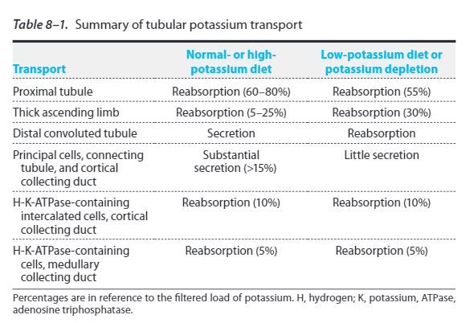
Renal transport
Freely filtered through Bowmans space
90% reabsorbed

Slide 5
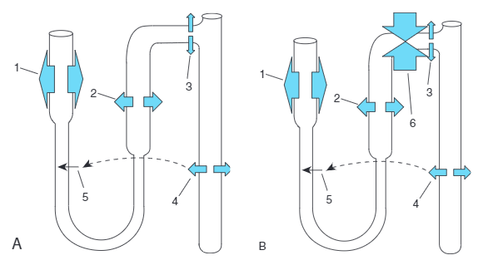
Reabsorption
A
1) Filtered K reabsorbed
2)Thick ascLOH reabsorbed
3) Cortical CD reabs via IC cells
4) Medullary CD reabs via IC cells
5)Some K+ reabsorbed into medullary interstitium recycles to thin LOH
B
1) Major secretion into collecting tubule
Notes:
A- low B- high

Slide 6
Movement of K
Active transport is always coupled with another solute
Proximal tubule: Na-K-ATPase on basolateral side allows K into cell and pushes Na out
H-K antiporter on the luminal side allows K into cell while pushes H out
Through passive channels K must be pushed back into the interstitium so it is available for this process
Thick ascLOH: pumped into cells from tubule via NaK2Cl antiporters and Na-K-ATPase from interstitium
Through passive channels K must be pushed back into the lumen so it is available for this process

Slide 7
Secretion
Distal nephron
Principal cells- uptake K+ via Na-K-ATPase and secretion into tubular lumen
Intercalated cells A and B- A reabsorbs via luminal H-K-ATPase and enters interstitium via K channels
Excrete K when dietary intake increases and reduce when intake decreases
Principal cells have two major K channels to secrete K
ROMK- at normal K levels, released from vesicles to luminal side
BK- at high levels, open at luminal side
Notes:
ROMK- renal outer medulla, big

Slide 8
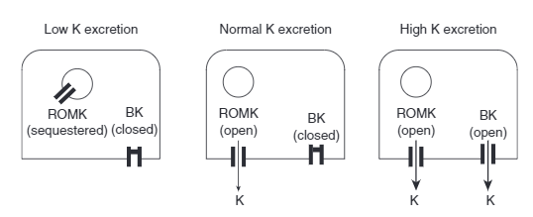
Secretion

Slide 9
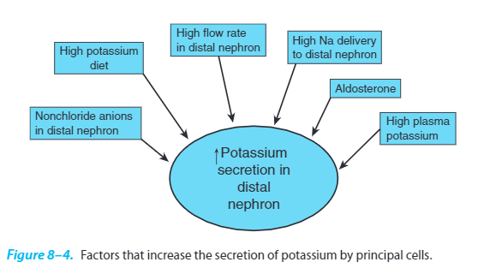
Secretion

Slide 10
Secretion
High plasma K- Filtered load proportional to plasma concentration, interstitium of principal cells same K concentration as plasma, Na-K-ATPase is sensitive to this concentration and varies rate based on it
Aldosterone secreted when plasma K level is high, increases Na-K-ATPase expression to pump into cell and ROMK to pump out
High delivery of Na- if changes in filtered load and reabsorption rates upstream, if more Na delivered to principal cells, more will be pumped out via the Na-K-ATPase, more K pumped in, which can be recycled but usually causes more secretion into the lumen
Notes:
Increase K secretion in principal cells

Slide 11
Secretion
4) Distal nephron flow rate- detected by bending of cilium in principal cells- (increased flow/increased Na- (a)activation of BK, (b)sweeps away K in lumen to keep low gradient that favors secretion
5) Concentration non-chloride anions- under conditions where reabsorption of Na is restricted due to Cl replacement, depolarization of luminal membrane to favor K secretion
6) Dietary K- GIT senses this and increases ROMK expression
Notes:
5- cannot accompany Na b/c permeability is less than Cl, more negative

Slide 12
Balance
In order to balance dietary intake of Na and K, there must be open K channels
Diuretics:
Increase urine volume and reduce ECF volume
Excrete Na and water but also K
Proximal tubule and LOH – block Na reabsorption and therefore K, however most Is not lost due to this!
Due to increased excretion by distal nephron due to increased flow rates
Aldosterone may be increased in certain diseases (hyperaldosteronism, CHF) and when coupled with diuretic increases flow rate to nephron so can lose a large amount of K
Notes:
1-Aldosterone control
2-Na and K reabs are linked

Slide 13
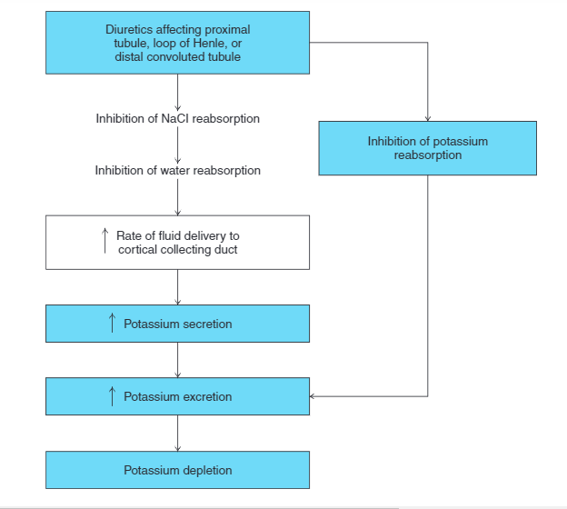
Diuretics

Slide 14
Acid base on K excretion
Alkalosis causes efflux of H into ECF, so K goes into cell and increases urinary excretion (hypokalemic)
Acidosis causes influx of H into cell and efflux of K (hyperkalemic)
Intracellular pH effects Na-K-ATPase and channels – low pH cause inhibition so K can escape, high pH causes the inhibition to be lifted to stimulate the pumps, so more K into cell

Slide 15
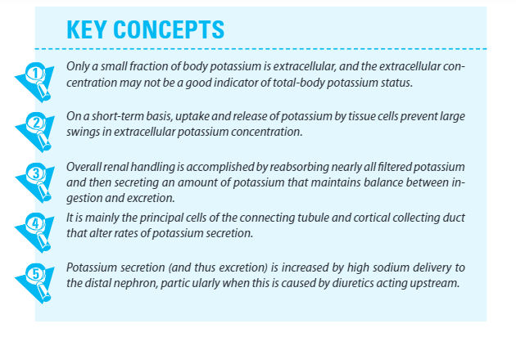
Take home points

Slide 16
Chapter 9: Regulation H+ balance
Acid base balance:
Matching excretion of acid base equivalents to input via kidneys
Regulating the ratio of weak acids to conjugate bases in buffer systems
Gain acids or bases by:
Diet
GI tract secretions
Metabolism of stored fat and glycogen
Acid base disturbance is usually transient and relies on other systems for regulation

Slide 17

Buffers
Buffers prevent large changes in pH due to transient accumulations
Buffer system: weak acid, conjugate base and free proton
At equilibrium, the concentration of free H ions is determined by the ratio of the concentrations of conjugate base to weak acid – pH= pK + log[base/acid]
ECF buffers= phosphate, albumin and hemoglobin
CO2 and HCO3 system: CO2 acts as a weak acid, combines with H2O to form carbonic acid which dissociates to HCO3 and H+
Enzyme carbonic anhydrase
Notes:
1- input doesn’t immediately match output
2- acid dissociates to conj base and H
3- Acid + buffer → H combines with conj base so less free protons to make major changes in pH
4- concentrations are regulated in body

Slide 18
Acid base
Addition or loss of H does not impact PaCO2, since PaCO2 is regulated by ventilation, so it is kept constant , however major change on HCO3
H+ +HCO3→ carbonic anhydrase→ CO2 and H2O→ exhale CO2, restore CO2 and H2CO3, but lose HCO3
Kidneys are responsible for generating HCO3
Large amount of metabolic CO2 generated: arterial blood→ tissue capillaries, CO2 + water in RBCs form H and HCO3→ H buffered by hemoglobin (1+ HCO3)
Venous return to lungs there is reversal HCO3 and H→ water and CO2 which is diffused into lungs (1-HCO3)
CO2 and HCO3 excreted separately, input of H from a fixed acid must be balanced by the kidneys
Notes:
4- why does PCO2 not acidify the body?

Slide 19
GI
Cells lining the gut can secrete HCO3 and H, pancreas and liver also secrete HCO3
Cells in the GI tract separate H and HCO3, so different regions of GIT acidify or alkalinize (lumen vs interstitium)
Nearly acid base neutral, small net secretion of HCO3 into intestinal lumen and H into blood
Change in disease states- ie vomiting
Oxidative metabolism of fats and carbs are acid base neutral, however in disease states this can change ie lactic acidosis or ketosis

Slide 20
Renal HCO3 reabsorption
Freely filtered at renal corpuscle, 4320 mmol/day!
HCO3 reabsorption linked to H+ secretion
Large amount of H+ secretion into lumen of proximal tubule, in distal nephron via Type A IC cells
In the cells HCO3 and H+ are created, H actively secreted in tubular lumen
HCO3 stays in the cell transported across basolateral membrane to interstitium- blood
H in tubular lumen combines with filtered HCO3→ H2O and CO2 →into cell→ HCO3 and H → H to secreted to lumen, HCO3 basolateral to enter plasma
The filtered HCO3 is gone but replaced
H helps with HCO3 conservation, H not excreted in urine but used to form H2O
Notes:
3- in proximal tubule H into lumen via NHE-3 antiporter, Type A IC cells have a H-K-ATPase which moves H to lumen and K into cell
HCO3 to move basolateral via Cl-HCO3 antiporter or Na-HCO3 symporter
6- Proximal tubule reabsorbs 80-90%, thick asc LOH 10%, remaining in distal nephron, carbonic anhydrase throughout to facilitate the reaction

Slide 21
HCO3 excretion
Excrete enough HCO3 in urine to match input
Allow some filtered HCO3 to pass in urine
Secrete HCO3 via Type B IC cells -CCD
Produced via CA reaction in the cell→HCO3 moves into the tubular lumen via Cl-HCO3 antiporter and H via H-ATPase pump on basolateral side
Excretion of acids- when H+ added to body reduces HCO3, so need to replace
H ion and HCO3* created from CO2 and water in the cell→ H ion secreted and combined with conjugate base of buffer that is NOT HCO3 in lumen → acid form of the buffer generated and excreted in the urine
Secretion of H+ helped generate new HCO3 to replace the HCO3 used when acid load entered body initially

Slide 22
Source of buffers via filtration
H+ ion secretion can facilitate HCO3 reabsorption as well as generated new HCO3- same process but the result depends on 1 step – luminal H+ combines with HCO3 or none HCO3 buffer
Filtered- phosphate
2 forms: H2PO4- is a weak acid (20%), HPO4-2 is the conjugate base (80%)
Most of the base form combines with secreted H ions in collecting duct – when minimum tubular pH 4.4 is met almost all is converted to acid which is excreted, HCO3 goes to blood
About 40 mmol/day of un-resorbed divalent phosphate (base) available to buffer – cannot be upregulated
In DM ketones can act as buffers in the urine, but are poor due to low pK, so pH must be very low in order to combine with free H+
Notes:
2-when combined with phosphate to make new HCO3 H will be lost in the urine
3- monovalent dihydrogen phosphate , divalent monohydrogen phos

Slide 23
Source of buffers via synthesis
Synthesis – Ammonium
Due to processing of the core of amino acids: carboxyl to HCO3 and amino to ammonium, ammonium goes to liver to be processed to glutamine, consume 1 HCO3 for 1 ammonium- acid base neutral
Glutamine (HCO3 and ammonium) taken up by proximal tubule cells via interstitium and lumen→ convert to HCO3 and ammonium→ ammonium to tubule exchanged for Na via NHE-3 antiporter and new HCO3 to blood
From proximal tubule → Thick asc LOH 80% reabsorbed by NaK2Cl multiporter into cell from lumen (acts as K)→ ammonium is trapped in the medullary interstitium
High concentration leads to secretion of some NH3 into the thin descLOH
Lastly, in medullary collecting ducts- secretion as H+ and ammonia → ammonium from the medullary interstitium to be excreted
Notes:
Ammonium is the protonated form of ammonia – acid
Ammonium can masquerade as a K+ or H+ to enter cells
Allows the body to get rid of extra nitrogen and H from protein catabolism

Slide 24
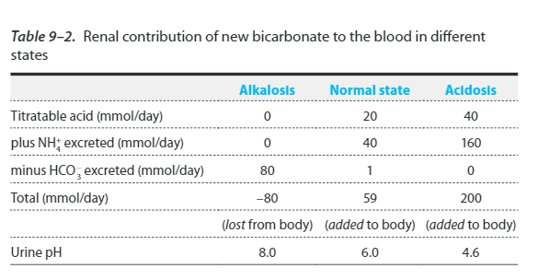
Quantitative

Slide 25
Metabolic acidosis/alkalosis
Causes of acid base disturbances
Increased acid via diet, infusion or production
Decreased renal production of HCO3 so acid is not excreted
Direct loss of HCO3
Decrease in arterial pH stimulates ventilation, vice versa
Renal compensation is usually complete and respiratory is partial

Slide 26
Metabolic acidosis/alkalosis
Elevation of HCO3 in response to elevated CO2 in respiratory acidosis = compensation
Compensation occurs via increased ammonium production and excretion, drop in extracellular pH stimulates renal tubule hydrogen secretion so HCO3 absorption is complete, urine is acidic
In respiratory alkalosis the increase in intracellular pH reduces tubular hydrogen ion secretion so HCO3 reabsorption is not complete, HCO3 secretion is stimulated, urine is alkalotic
Effectiveness varies and pH does not return to normal

Slide 27
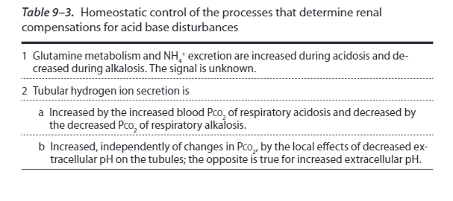
Acid base disturbances

Slide 28
Metabolic alkalosis
Factors causing the kidneys to maintain or generate a metabolic alkalosis
EC volume contraction → metabolic alkalosis, so should decrease H ion secretion to decrease HCO3 reabsorbtion, but stimulates Na reabsorption→ increases H secretion via Na-H antiporter in proximal tubule
Also aldosterone increases H secretion→ problem: all HCO3 reabsorbed so pH doesn’t change
Loss of Cl (diuretics or vomiting) leads to ECF volume contraction→ stimulates H ion secretion, so HCO3 excretion is zero
Aldosterone excess and K depletion (diuretics) stimulate marked H ion secretion→ reabsorb all filtered HCO3 and make more
Notes:
Low K weakly stimulates H secretion

Slide 29
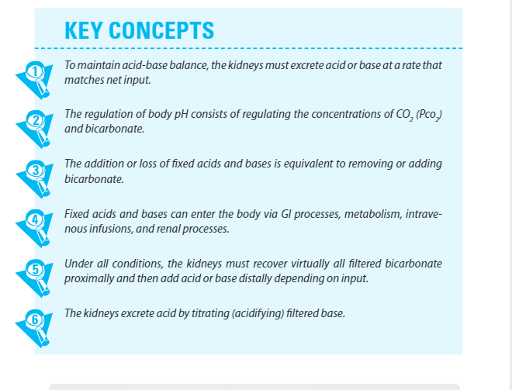
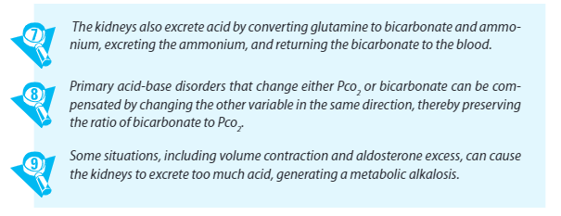
Take home points

Slide 30
Chapter 10: Regulation of Ca and phosphate balance
Calcium is the 5th most abundant element in the body, majority found in bone, ECF (vital for structure and function)and within cells (vital for signaling)
Regulation of Ca via GI tract and kidneys
Ca plasma alterations: Rapid transfer via bone to ECF
Most dietary Ca is not absorbed but passes directly through the feces, but can be absorbed or secreted as needed
3 forms of Ca: 1) free, ionized (50%) 2) bound to albumin (40%) 3) complexed with anions (15%)
pH effects the ability of Ca to bind with nerve membranes, low pH increases binding, lower free Ca
Notes:
5- Easily complex with plasma proteins and small anions which effects free amount

Slide 31
Ca roles in body functions
Calcium is bound to many transporters, enzymes and channels, affecting their shape and charge, so calcium can bind reversibly to components of signaling pathways to turn cellular processes on and off
Cells regulate intra-cytosolic Ca to be low, using active transport systems, so it does not complex with phosphate
This ability to complex is helpful in bone, hydroxyapatite is made from hard complexes of Ca, phosphate and hydroxyl groups
Tight balance of Ca/Phos so complexes do not form- cause of kidney stones in high urinary Ca content
ECF Ca- triggers smooth and cardiac muscle, hormones and neurotransmitters, regulate nerve and muscle cell excitation
Notes:
Tetany- voltage gated Na channels, low levels cause more spontaneous firing

Slide 32
Ca balance: GI
Ca can be absorbed from the intestinal lumen passively though channels → binds to mobile cytosolic Ca binding proteins(calbindins)→transported via Ca-ATPase and Na-Ca antiporter to basolateral side

Slide 33
Ca balance: renal
Kidneys: 60% filterable, majority absorption in proximal tubule, 97-99% reabsorbed
Proximal tubule: passive and paracellular
Distal segments: active and transcellular – same as GI
Ca excretion= Ca filtered –Ca reabsorbed
Ex: increased intake, increased Ca filtered, decrease reabsorption and increased excretion
Sodium and acidosis increase Ca excretion

Slide 34
Ca balance: bone
Bone: primary buffering system and repository of Ca
Ca moves between blood and bone fluid
Bone fluid separated from ECF via bone membrane- layer of flattened osteoblasts
Movement of Ca into bone fluid to be buffered
Remodeling via osteoclasts/blast frees Ca from bone to move to ECF, much slower
Notes:
Bone fluid- passage ways that contain fluid

Slide 35
Vitamin D
Cholecalciferol D3 is synthesized by UV light and 7 dehydrocholesterol on the skin
Vitamin D2 from diet (ergocalciferol)
Circulating Vitamin D is hydroxylated at the 25 position in the liver→ 1,25 hydroxyvitamin D
Also hydroxylated at position 1 in the proximal tubules →calcitriol
1,25 hydroxyvitamin D (active form, hormone) exerts actions on target cells, stimulates active absorption of calcium and phosphate in the gut and kidney

Slide 36
PTH
Parathyroid hormone exerts control over GI tract, kidneys and bone
All the activity is within the first 34 peptides, half life in plasma is short <10 mins
Secretion is controlled via concentration of Ca in the ECF bathing the PT glands
High phosphate stimulates PTH synthesis
PTH regulates Ca homeostasis:
Stimulates bone to move Ca to ECF via release of Ca across bone membrane, stimulates resorption via osteoclasts
Stimulates activation of Vitamin D and Ca transport from bone in response to hypocalcemia
Increases renal tubular Ca reabsorption in distal convoluted and collecting tubule
Notes:
Low Ca stimulates secretion and high inhibits it, inhibition via G protein linked receptor

Slide 37
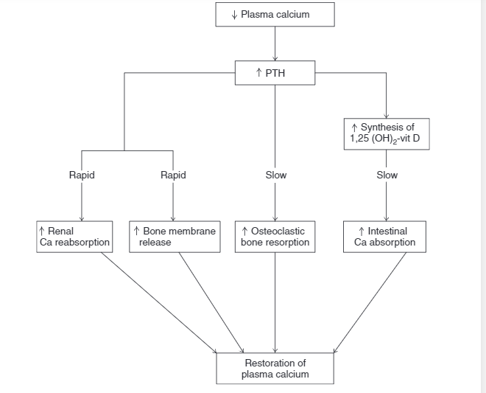
Hypocalcemia

Slide 38
Ca and phosphate
When Ca is released from bone so is phosphate, so when GI absorption of Ca increases so does phosphate
However, do not want to increase phosphate because it will decrease dissolved Ca
So, (4) PTH reduces proximal tubule reabsorption of phosphate to decrease ECF concentration

Slide 39
Primary hyperparathyroidism
Primary hyperparathyroidism- defect in the glands or tumor causes continuous excess PTH secretion
Enhances bone resorption which leads to high plasma Ca and low phosphate
Urinary Ca excretion is increased, despite tubular Ca reabsorption increase
This occurs because the filtered load > than reabsorptive rate, so large amount not reabsorbed and therefore excreted

Slide 40
Renal phosphate handling
5-10% plasma phosphate is protein bound, 90-95% filtered at renal corpuscle
About 75% reabsorbed in proximal tubule
Increases from dietary intake or from bone, increases filtered load meaning more excretion
Phosphate is reabsorbed via tubular maximum limited system, majority reabsorbed
Acidosis increases Ca and phosphate release from bone, more plasma phosphate means more filtered load which means more buffer for H
Ex: CKD low GFR decreases ability to excrete phosphate, which leads to high PTH and osteoporosis
Tx: decreased absorption in gut by giving Ca to complex with phosphate, which decreased absorbed amount
High PTH should signal kidneys to form Vit D, but in CKD they have less ability to do so, so can give Vit D but will increase phosphate absorption in the gut!

Slide 41
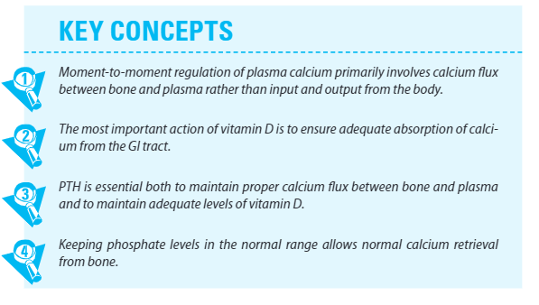
Take home points

Slide 42
Reference
Eaton, D. C., & Pooler, J. (2018). Vander's renal physiology. McGraw-Hill Medical.

