Slide 1
Shock/Trauma sessions
A tale of two cats
Tomas Williams
Second year ECC resident
Cornell University

Slide 2
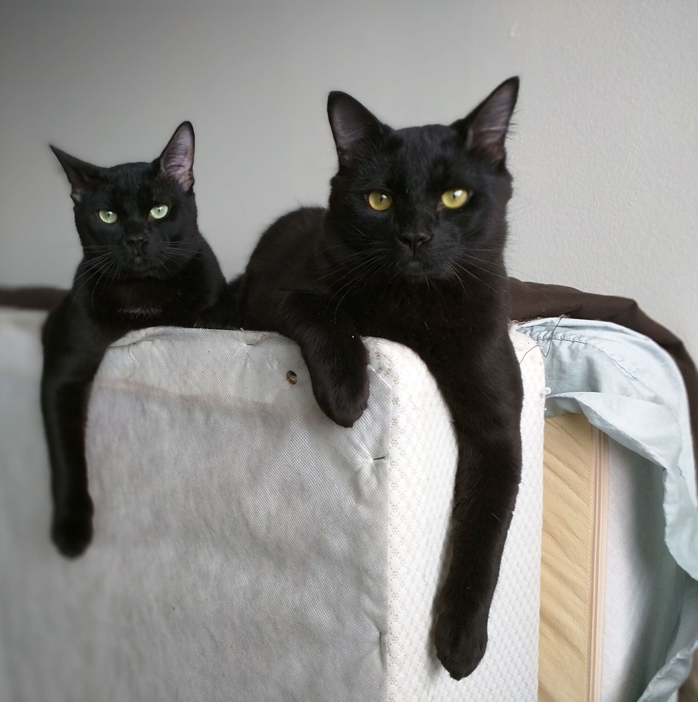

Slide 3
Case #1
Signalment: 2 yo DSH, Bit by a dog 30 minutes prior to arrival at CUHA
After initial stabilization:
Problem list:
1) Bite wounds
2) Maxillofacial trauma

Slide 4
Bite Wounds

Slide 5
Bite Wounds
10-15% of all veterinary trauma cases
High pressure and shearing forces (450 psi)
The smaller the dog, the greater the damage
Small dogs (< 10 kg) overrepresented
Kidney damage can occur, bones, joints and spinal trauma
Circulatory compromise and massive tissue necrosis
Thorax most common site
Bites to the thorax higher mortality rates than bites elsewhere
Notes:
canine teeth are designed for tissue penetration, the incisors for grasping, and the molars/premolars for shearing tissue. The curved canine
teeth of large dogs are capable of deep penetration, whereas the smaller, straighter canine teeth of domestic cats can penetrate directly into tissues, leaving a relatively small cutaneous hole.
The jaws of larger dogs in particular can generate tremendous crushing (up to 450 psi) and shearing forces, and the canine teeth can
tear and lacerate the skin, hypodermis, and underlying musculature.
In one study, male dogs weighing less than 10 kg presented with more severe multiple bite wounds. (Miniature pinchers, Pekinese, and small terrier breeds
were overrepresented.) Many of these victims are lifted and violently shaken by the attacker. Direct and indirect trauma to internal organs frequently occurs.
The kidneys in small animals are particularly susceptible to bite wounds over the back. In addition, bone fractures, joint injuries, and spinal trauma also may occur.
Circulatory compromise from the division of vessels and compromise to collateral vascular channels can result in massive tissue necrosis.

Slide 6
Management of Bite wounds
Temporary care: (if P is unstable)
Minimize further contamination of the wound (cover it)
Clip hair and clean skin around wound
Pressure lavage the wound (18 G needle)
Open the wound
Antimicrobial ointment and systemic antibiotics if indicated
Notes:
Goal of temporary care: reduce the amount of contamination present and reduce the possibility of further contamination from organisms in the hospital environment (nosocomial infection).

Slide 7
Management of Bite wounds
2) Definitive management
Under GA
Deeper cleaning/debridement and uncapping
Drain placement if needed

Slide 8
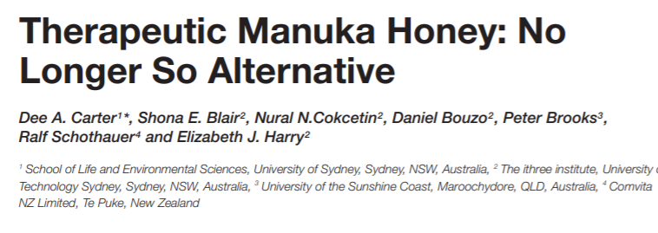
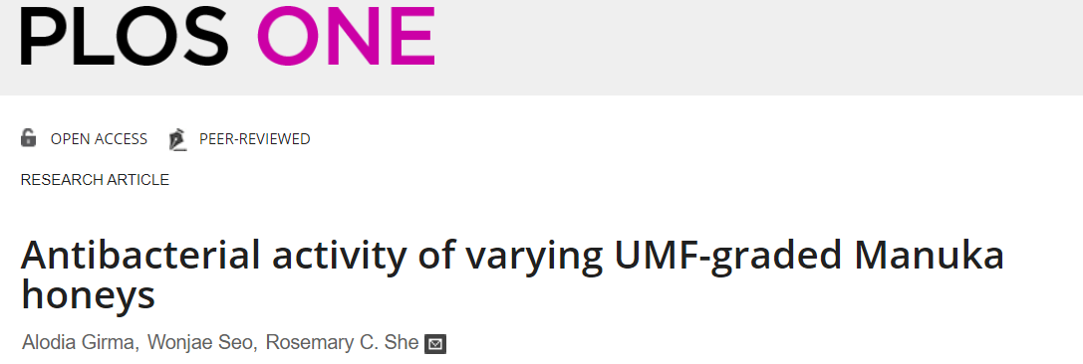
Antimicrobial activity against a spectrum of organisms including those with multi-drug resistance, with more potent activity overall against gram-positive than gram-negative bacteria
effective against methicillin-resistant S. aureus (MRSA), β-haemolytic streptococci and vancomycin-resistant Enterococci (VRE)

Slide 9
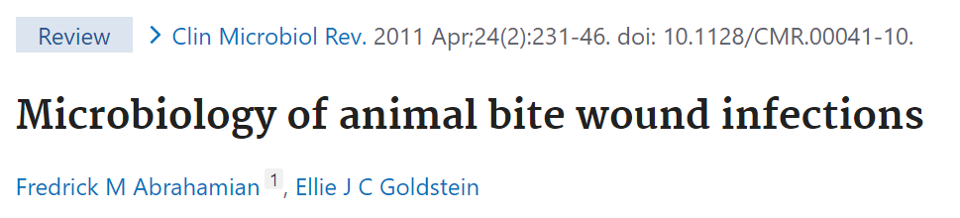
Infection and bite wounds
Polymicrobial flora of the oral cavity (aerobic and anaerobic)
Aerobic infections more common than anaerobic alone
Pasteurella spp → most common agent isolated from wounds in people
In general, 3 hours is considered the maximum acceptable delay in administration of antibiotics in bite wound management
Notes:
The polymicrobial flora of the oral cavity can inoculate wounds with aerobic and anaerobic bacteria. Bite wounds
resulting in perforation of the gastrointestinal tract can result in the spillage of additional bacterial contaminants
. In human studies, aerobic infections are more common than anaerobic infections alone. (Bite wounds have a 5–10% risk of infection in humans; by contrast, nonbite lacerations have an infection rate of 5%.) However, with the presence of anaerobic bacteria, the severity of the infection is often increased. Pasteurella spp. are Gram‐negative nonmotile pleomorphic coccobacilli that are commonly
Antibiotics are normally administered after bite injuries, and several hours may pass before administration and
effective blood levels are achieved. In general, 3 hours is considered the maximum acceptable delay in administration
of antibiotics in bite wound management. To avoid the several‐hour delay to achieve an adequate serum
level associated with oral antibiotics, intravenous administration
Cephalosporins are generally effective against Pasteurella spp. and a variety of other microorganisms. Amoxicillin or clavulanate potassium
can be useful against Pasteurella multocida resistant to penicillins and β‐lactamase Staphylococcus spp. Fluoroquinolones are useful for resistant Gram‐positive
and Gram‐negative infection. In the presence of Gramnegative organisms, an aminoglycoside such as gentamicin
should be considered.
Antibiotics are not a substitute for the appropriate surgical management of bite wounds.

Slide 10
Small details
Culture the wound?
  Only if the wound is infected/Useless in uninfected bite wounds
Rabies booster if vaccinated
Euth/isolation if unvaccinated
Notes:
Culturing the acute uninfected bite wound is useless in determining the potential infection organisms. Culture
samples should be submitted from deep within the wound by aspiration or incision, drainage, and exploration
of the area.
Aspiration of lymph nodes or areas of cellulitis also can be employed to obtain accurate culture samples. More superficial wound cultures are more likely to include contaminants that will lead to misleading results.
The most accurate source for culturing infected wounds is from tissue samples from the abscess wall.
Although uncommonly performed in practice, Gram

Slide 11
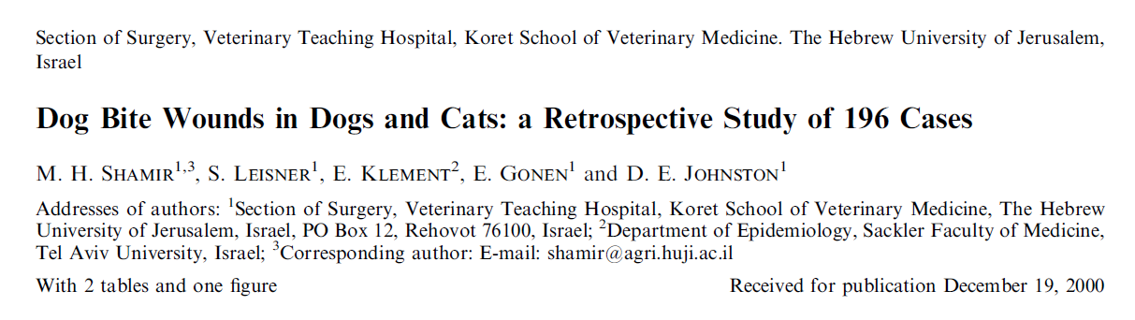
Male dogs over-represented
Median age of dogs 4 years. Cats 1 year
Thorax, extremities and head being most frequent sites
Mortality 11%
The median weight of the dogs that died was 6 kg
The general mortality rate for cats was 27%

Slide 12
Twenty-seven (79%) out of 34 animals that had their abdominal wounds explored had penetrating injury
Injury to internal organ was found in 22 animals (65%)
Surgical debridement was performed on 153 dogs (83%). Penrose drains were used in 82 dogs (44%)
Wounds were sutured in 117 of the dogs (63%)
Twenty-one (48%) out of 44 animals that had abdominal injury had exploratory laparotomy due to penetrating abdominal wounds
Twenty-one (31%) out of 68 animals that had thoracic injury went through exploratory thoracotomy
  Twenty-one (31%) had rib fractures, and eight (12%) had injury involving the lung parenchyma or airways

Slide 13
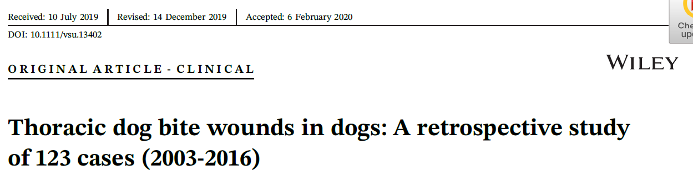
Twenty-five dogs underwent exploratory thoracotomy, including lung lobectomy in 12 of these dogs
Presence of pneumothorax , pseudo-flail chest , or rib fracture was associated with increased odds of undergoing exploratory thoracotomy
Presence of pleural effusion and obtaining a positive bacterial culture were associated with increased odds of mortality
The level of wound management correlated with the length of hospitalization but was not associated with mortality

Slide 14
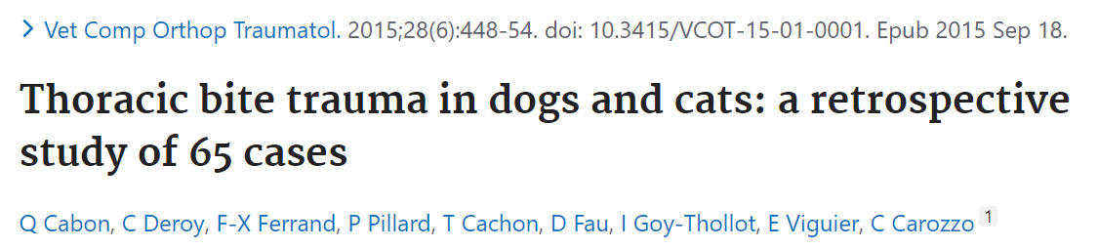
22%of patients with normal respiratory patterns showed thoracic radiographic lesions
Respiratory distress was not correlated with mortality
Radiographic lesions were observed in 77% of dogs and 100% of cats
Mortality rate 15.4%
No studied factor correlated with mortality, and the long-term outcomes were excellent
A penetrating injury, more than three radiographic lesions, or both together seemed to be indicative of the need for a thoracotomy

Slide 15
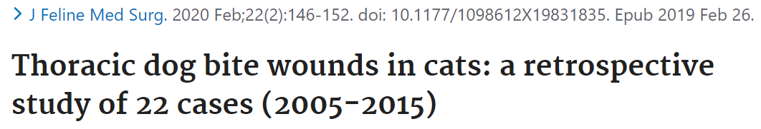
Neither an abdominal wound nor abdominal surgery were associated with mortality
Pneumothorax was the most common radiographic finding
Individual radiographic lesions were not significantly associated with respiratory pattern, presence of pseudo-flail, need for thoracotomy or lung lobectomy, or survival
The presence of ⩾3 radiographic lesions was associated with the presence of a penetrating wound and with having thoracic exploration
Local exploration was performed in 7/20 cats, while 8/20 underwent thoracic exploration
Wound management type was not significantly associated with mortality
Overall mortality rate was 27%

Slide 16
Craniomaxillo-facial trauma

Slide 17
Cranio-maxillo-facial trauma
Common reason for presentation to ER
CT as standard of care
Most common causes:
  Animal altercations
  Vehicular accidents
  Falls from height
  Unknown
  Mandible and nasopharynx most common fractured sites
  No evidence-based method to classify fractures
    Le Fort method in humans

Slide 18
Cranio-maxillo-facial trauma
More than one site commonly affected
Physical exam not very sensitive for some skull fractures
Multidisciplinary approach
Not all fractures require surgical stabilization
Small animals more commonly affected

Slide 19
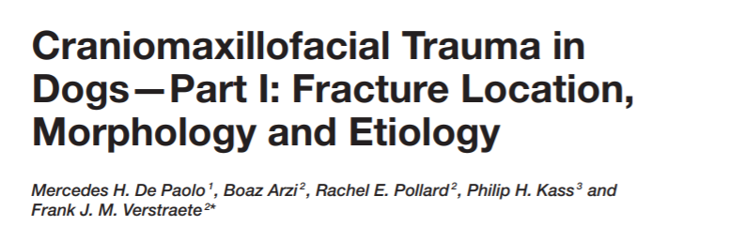
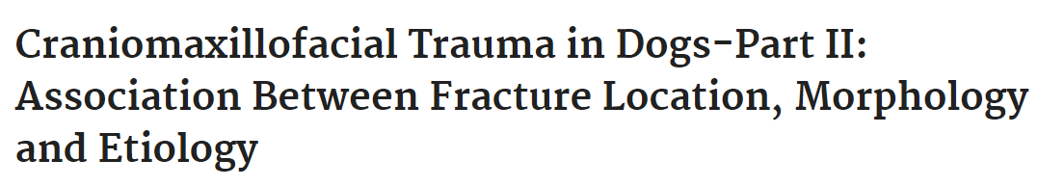
156 dogs
Animal bites most common cause (50%), unknown trauma (15%), HBC (13%), blunt trauma (13%)
Small dogs (<10 kg) and juveniles, intact males
Most common fx site: maxillary bone, followed by premolar and molar region of mandible
Least affected region: occipital and parietal bones
All regions can be affected

Slide 20
TMJ fractured in 30% of all cases
Maxillary bone fx tend to be more severe and more displaced/fragmented
HBC: mandible most commonly affected (50%)
TMJ fx in 40% of HBC
Bite wound fx: maxillary most commonly affected (45%)
Younger and smaller animals, more likely to have displaced fx
Molar part of mandible likely fx with mid-ramus
TMJ and zygomatic process of temporal bone fx likely to be combined

Slide 21
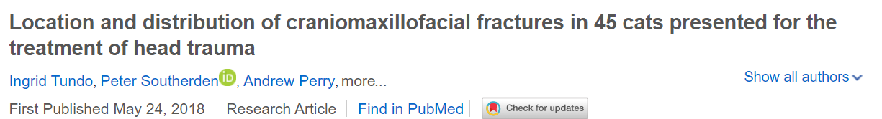
45 cats
23 NM, 4 MI, 17 FS and 1 FI
Mean age: 53 months
Causes: HBC (75%), bite wound (2%), fall from height (2%), others
Mandible most common site of fx (87%), skull (80%)
Skull fx: 86% had bilateral fx
Mandible fx: 18% were bilateral
TMJ fx present in 9%
Median number of fx regions: 8!!! (1-13)

Slide 22
Case #2
3 yo MC cat
Presented to CUHA ER after HBC
CPA on admission
CRP → ROSC
Developed subcutaneous emphysema after extubation

Slide 23
Tracheal trauma

Slide 24
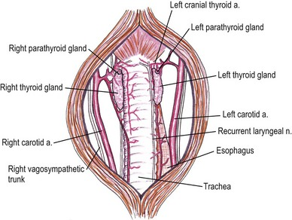
Tracheal Trauma
Air leakage into subcutaneous and mediastinum
Can lead to respiratory compromise
Crushing injuries can lead to stenosis

Slide 25
Causes
Projectile injuries
  Tracheal penetration and damage of cartilages
  Amount of damage depends on size of projectile and velocity
Bite wounds
  Compressive and shearing forces
Endotracheal tube damage
  Low volume, high pressure tubes – linked to tracheal trauma
Blunt trauma
  Tracheal collapse

Slide 26
Pathophysiology
Transection or avulsion can lead to respiratory compromise and death
Subcutaneous emphysema
Pneumomediastinum → pneumothorax
Intrathoracic tracheal rupture in cats → blunt trauma
Intubation
  Most common cause of tracheal damage in cats
    Over inflation of the cuff
    Improper placement of ET tube
    Use of stylet
    Failure to deflate the cuff before extubation or repositioning the animal
Notes:
Perforation of the trachea can lead to SQ emphysema. Severe emphysema can result in respiratory impairment
Air from caudal trachea can leak into cranial mediastinum and even retroperitoneal space
Pneumomediastinum rarely causes physiologic compromise unless the mediastinum ruptures resulting in pneumothorax
Intrathoracic tracheal rupture in cats has been assoc w blunt trauma (HBC). Hypothesis hyperextension of the neck occurs and because the carina is fixedm the trachea ruptures cranial to this point as it is violently stretched

Slide 27
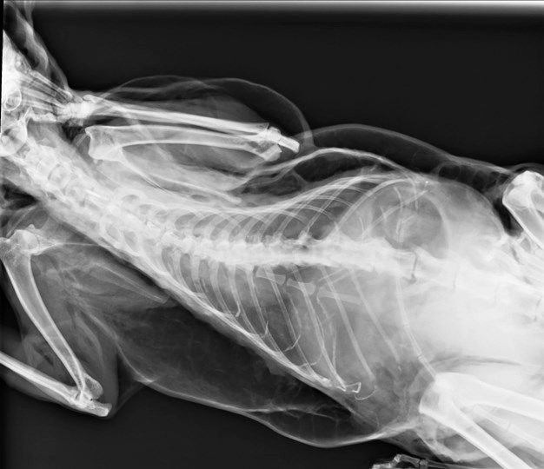
Clinical signs
Subcutaneous emphysema
Skin and subcutaneous perforation
Stenosis: delayed clinical signs
  To produced clinical signs: 50-75% of luminal stenosis is required
Notes:
Animals with tracheal collapse or stenosis secondary to trauma can develop dyspniea over days or weeks; stridor on inspiration is often heard, excersice intolerance
In cats with intrathoracic tracheal tear can be mild to severe and present immediately or even weeks after trauma
IN cats w tracheal trauma due to intubation, SC emphysema is moderate to marked and usually apparent DURING or immediately AFTER the anesthesia.

Slide 28
Differential diagnosis
Barotrauma
Laryngeal perforation
Esophageal perforation
Cervical bite wounds
Migrating foreign bodies
Notes:
Barotrauma can also lead to SQ emphysema: overinflation of the lungs can cause marginal alveoli to rupture, air escapes into the perivascular or peribronchial connective tissue sheaths and migrates into the mediastinum and cervical tissue planes.

Slide 29
Diagnosis
Physical examination
Radiographs
CT
Tracheoscopy/bronchoscopy

Slide 30
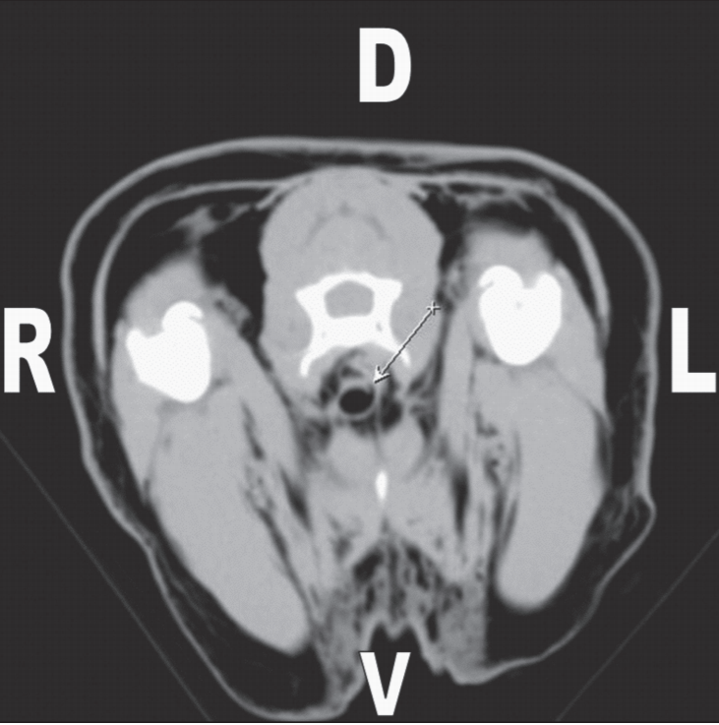

Slide 31
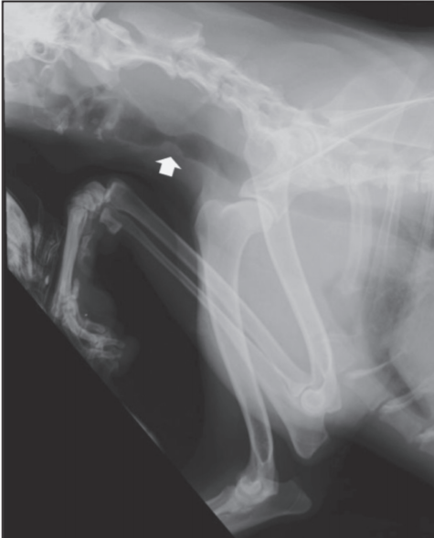

Slide 32
Treatment
General anesthesia
Endotracheal intubation: smaller diameter tube
Positive pressure ventilation should be avoided if possible
Surgical repair
  Cervical trachea: ventral approach
  Intrathoracic trachea: right lateral thoracotomy
  20% of the trachea can be resected in a young dog
  Up to 50% in an adult
    Split cartilage technique used for anastomosis
Notes:
In cats w complete intrathoracic tracheal disruption, positive pressure ventilation can blow out the membrane of mediastinum leading to a tension pneumothorax
Apply low pressure to the bag, instead of MV
High frequency Jet Ventilation has been used

Slide 33
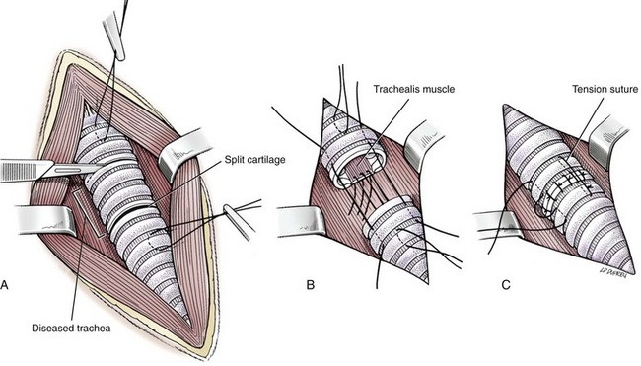

Slide 34
Post-op care
Chest tube in place for 24 hours after procedure
Analgesia
Cage rest
Complications:
  Leakage
  Stricture formation:
    bougienage can be attempted

Slide 35
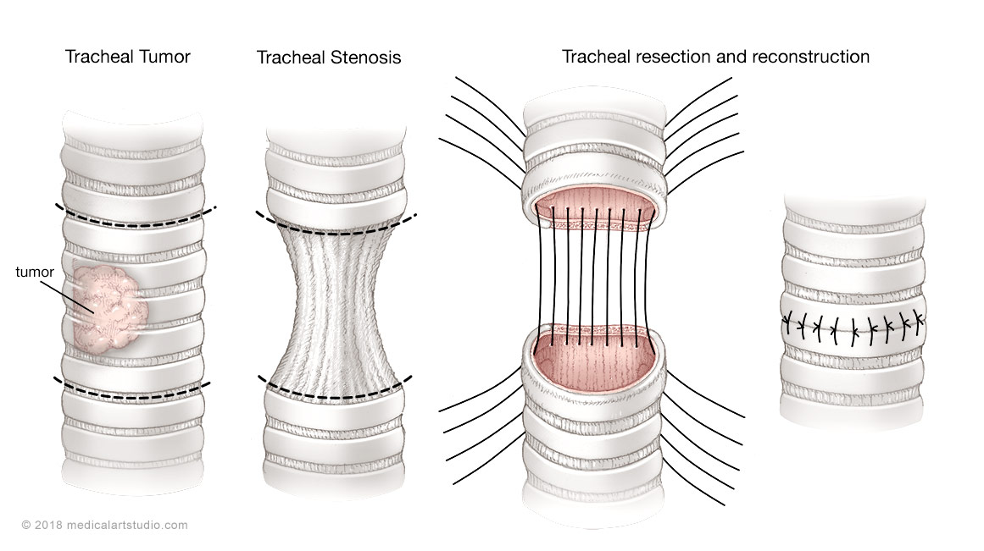
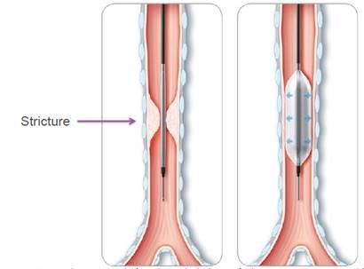
Treatment
Strictures:
  Resection
  Balloon dilation

Slide 36
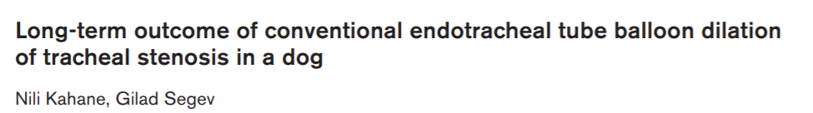
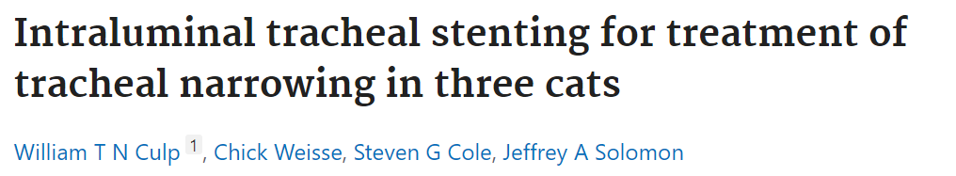
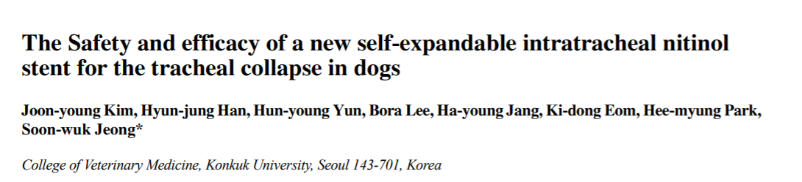

Slide 37
Outcome and prognosis
Stenosis after resection and anastomosis is an infrequent complication
Use of appropriate size (high-volume, low pressure cuffs) ET tube and minimum air in the cuff to create the seal
  Cuff should be incrementally inflated until a pressure of 20 cm H20 is held
  Average 1.5 mls

Slide 38
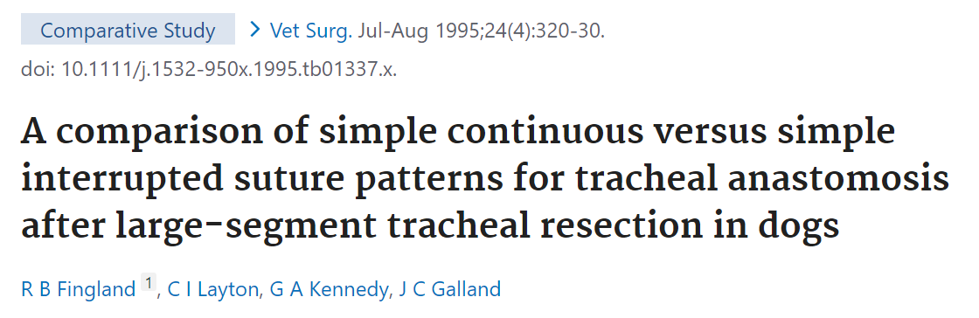
Two suture techniques for tracheal anastomosis
8 cartilages were resected from the trachea of each of 12 dogs
6 dogs simple interrupted vs 6 simple continuous
The dogs were evaluated for 150 days after surgery
Anastomotic stenosis was mild in all dogs
Mean percent luminal stenosis determined planimetrically was significantly greater for dogs that had the simple continuous suture technique

Slide 39
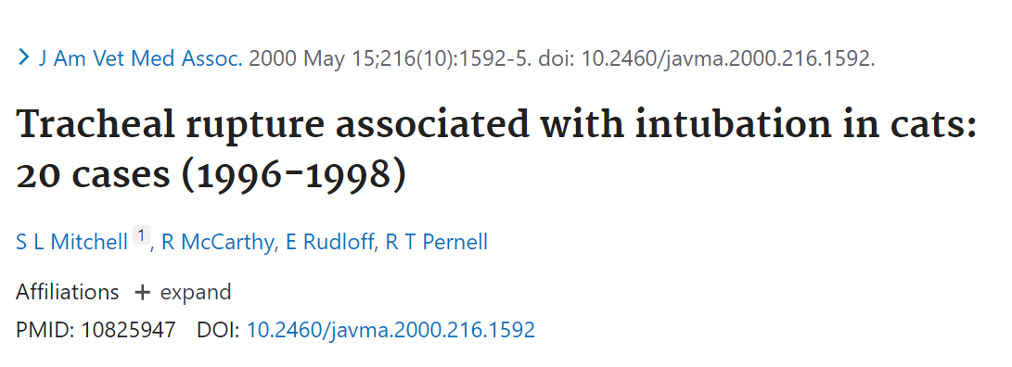
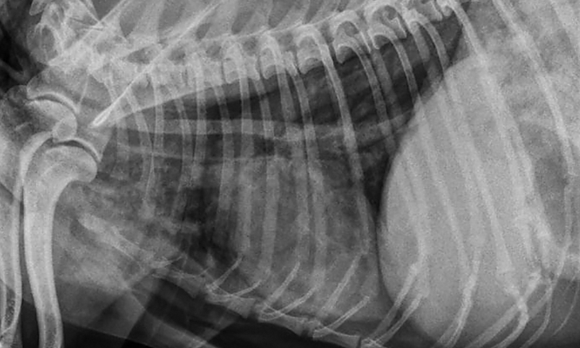
Most common clinical signs
  subcutaneous emphysema (100%)
  Dyspnea (30%)
  Stridor (15%)
  Thoracic rads:
    Pneumomediastinum and SQ emphysema in 90%

Slide 40
Treatment:
  Medical management (75%)
    O2 supplementation
    Monitoring
    Cage rest
    Sedation
    Duration of treatment: 12 – 72 hours
    Surgical treatment (for severe cases or when medical management failed)
      Ventral approach (one cat)
      Ventral approach combined with thoracotomy (3 cats)

Slide 41
Outcome: 94% survived
MST: 15 months (3 to 30 months)
Subcutaneous emphysema took 1 to 6 weeks to resolve
Stylet had been used in 15/20 cats
Low-pressure, high volume ET tubes had been used in 11/20 cats

Slide 42
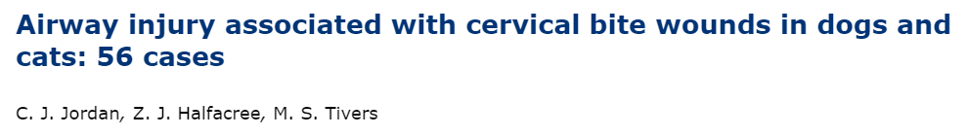
55 animals
25% had injuries to vital structures (airway injury 17%)
  associated with either subcutaneous or mediastinal emphysema
Other structures: jugular vein, pharynx, esophagus and spine
Median duration of hospitalization was one day (0-19) with 96% surviving to discharge
Long-term follow-up (16-114 months) revealed that 87% were alive with 13% that died due to unrelated reasons

Slide 43
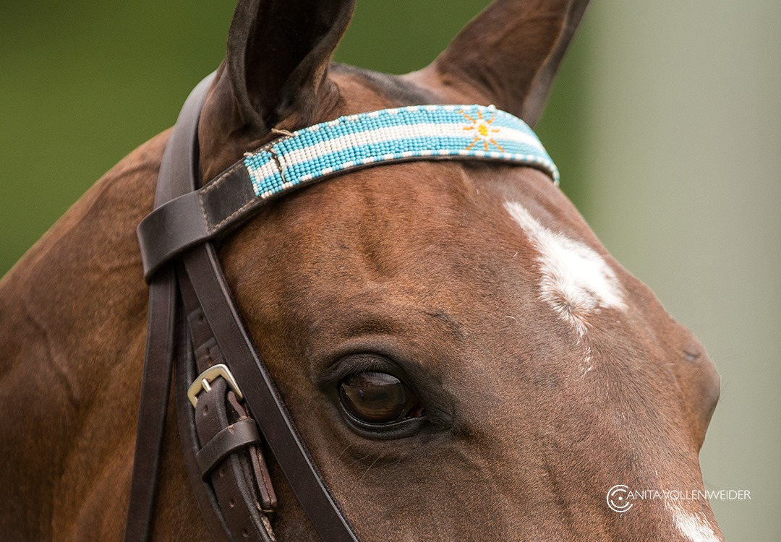
Thank you!

