Slide 1

Vasoactive agents
Tomas Boullhesen-Williams, DVM
ECC resident
1/5/20

Slide 2
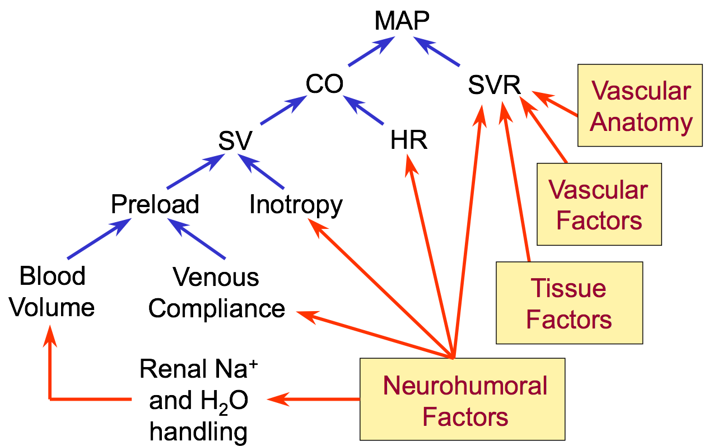
Arterial Blood Pressure
Provides the hydraulic force that drives blood flow and allows adequate tissue perfusion
Determined by:
  Cardiac output
  Systemic Vascular Resistance
CO is a function of SV x HR

Slide 3
CO, Stroke Volume and HR
SV is determined by:
  preload (stretching of the ventricles before each contraction - largely a function of venous return)
  Contractility (force of ventricular contraction)
  Afterload (force needed to overcome aortic pressure and achieve left ventricular outflow - SVR
HR is determined by the balance between Sympathetic and Parasympathetic NS

Slide 4
Systemic Vascular Resistance
Vascular tone (SVR) is affected by systemic and local factors
  Catecholamines - responsible for basal systemic vascular tone and minute-to-minute regulation of BP
  Angiotensin II and vasopressin - long term regulation of BP
  Vasodilatory substances: NO, Histamine, prostacyclin and CO2
  Local vasoconstrictive substances: endothelin, TXA and Thrombin

Slide 5
Hypotension
1) Reduction in preload
  Hypovolemia: hemorrhage, severe GI/urinary losses
  Relative hypovolemia - venodilation and pooling - decreased preload
  Obstruction of venous return
2) Reduction of cardiac function
  Primary cardiac disease: DCM, HCM
  Secondary cardiac disease: severe acidosis or alkalosis, toxins, drugs, SIRS/sepsis, ischemia
3) Reduction in SRV
  SIRS/sepsis: inappropriate vasodilation - maldistribution

Slide 6
Treatment of hypotension
Fluid resuscitation – cornerstone
Positive inotropes
Vasopressor agents

Slide 7
When to start pressors?
After a ‘reasonable’ amount of IVF have been given
  ‘Reasonable’?
  Guided by CVP and bedside echocardiography
Four D’s of fluid therapy: drug, duration, dosing and de-escalation
Standardized Protocols to treat sepsis and hypotension?

Slide 8
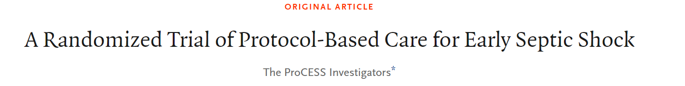
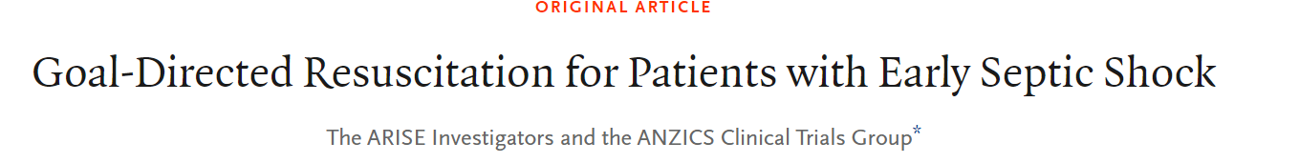
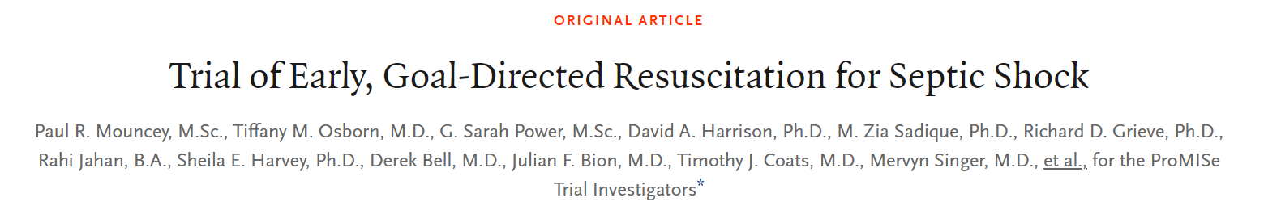
No improvement in outcomes with End Goal Directed Therapy, questioning the need and pointing towards the potential dangers of protocolized care for patients with severe and septic shock

Slide 9
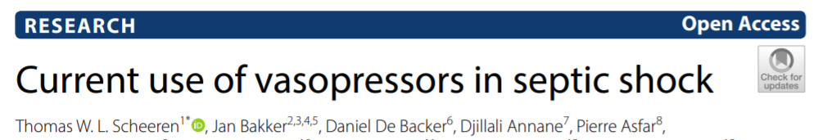
839 physicians from 82 countries responded (65% main specialty/activity intensive care)
Main trigger for vasopressor use was an insufficient mean arterial pressure (MAP) response to initial fluid resuscitation (83%)

Slide 10
When to start pressors?
Universally agreed that achieving an adequate MAP is important. Number remains controversial
MAP does not equate with perfusion:
  Increasing the MAP with a pure vasoconstrictor (phenylephrine) may not improve organ perfusion.
  If MAP is increased without causing excessive vasoconstriction (with fluid resuscitation and/or norepinephrine), then perfusion will improve
Septic shock vs hypovolemic shock:
  hypoperfusion in septic shock due to multiple factors (venodilation, arterial dilation, intravascular volume depletion, and sometimes septic cardiomyopathy)
  Initiating therapy with fluid alone will only address one of these factors, and therefore often fails

Slide 11
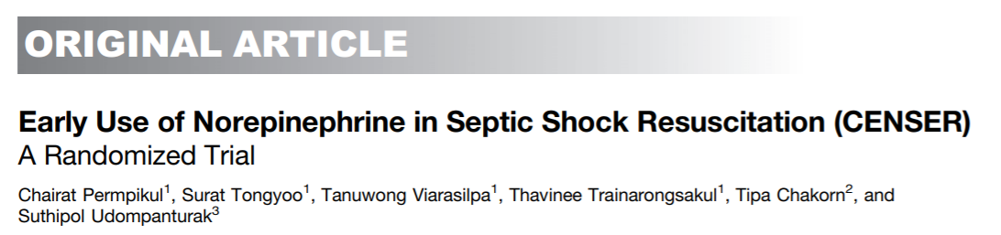
Early May Be Better: Early Low-Dose Norepinephrine in Septic Shock
  The early norepinephrine group was associated with lower incidences of cardiogenic pulmonary edema and new-onset arrhythmia
  Early norepinephrine was significantly associated with increased shock control by 6 hours
  Further studies are needed before this approach is introduced in clinical resuscitation practice

Slide 12
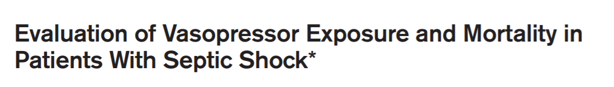
Early May Be Better: Early Low-Dose Norepinephrine in Septic Shock
  Early use of vasopressors may help spare crystalloid-use-associated complications

Slide 13
Which pressor to use?
Why is the patient hypotensive?
Have I optimized volume status and ruled out other diagnoses?
How can I pharmacologically redirect blood flow to improve the problem?
  Problem with VASCULAR TONE?
  Problem with PUMP FUNCTION?
  MULTIFACTORIAL problem?
When choosing between similar agents, does evidence support use of a specific agent over another?

Slide 14
Which pressor to use?
Vascular tone issue? (neurogenic shock)
  Phenylephrine and vasopressin: pure pressor agents, no direct impact of pump function
Pump issue?
  agents that increase inotropy and contractility (Dobutamine and isoproterenol). Generally, pure inotropes and have no vasoconstrictive properties
Multifactorial problem? (anaphylaxis and septic shock)
  Medications that operate at multiple receptors. (epinephrine, norepinephrine and dopamine)

Slide 15
Which pressor to use?
General cardiovascular support:
  Dopamine and Dobutamine. They increase HR and contractility with modest effect on vasomotor tone
  Dobutamine tends to moderately decrease SVR (improving forward flow)
  Dopamine tends to increase SVR and BP
  If hypotension is a problem, then dopamine is the drug of choice - has positive effect on BP
  If high levels of dopamine fail to increase BP, stronger vasoconstrictors are indicated

Slide 16
How/When to start them?
Treat the underlying cause if possible:
  Treat bradycardia, AV block if present
  Reverse any drugs given that can induce hypotension
  Treat tachyarrhythmias if present
  Treat hypovolemia
  Treat poor contractility if present

Slide 17
Which pressor to use?
Focusing therapy on BP without reference to tissue perfusion can be problematic
  Excessive vasoconstriction impairs tissue perfusion
The net effect of the vasopressors is determined largely by the pretreatment status of the CV system and drug dosages

Slide 18
Surviving sepsis campaign guidelines
Recommend NE as first choice vasopressor
Dopamine as an alternative to NE only in selected patients (low risk of arrhythmia)
Recommend against low-dose Dopamine for renal protection
Recommend Dobutamine in patients who show persistent hypoperfusion despite adequate fluid loading and the use of vasopressor agents

Slide 19
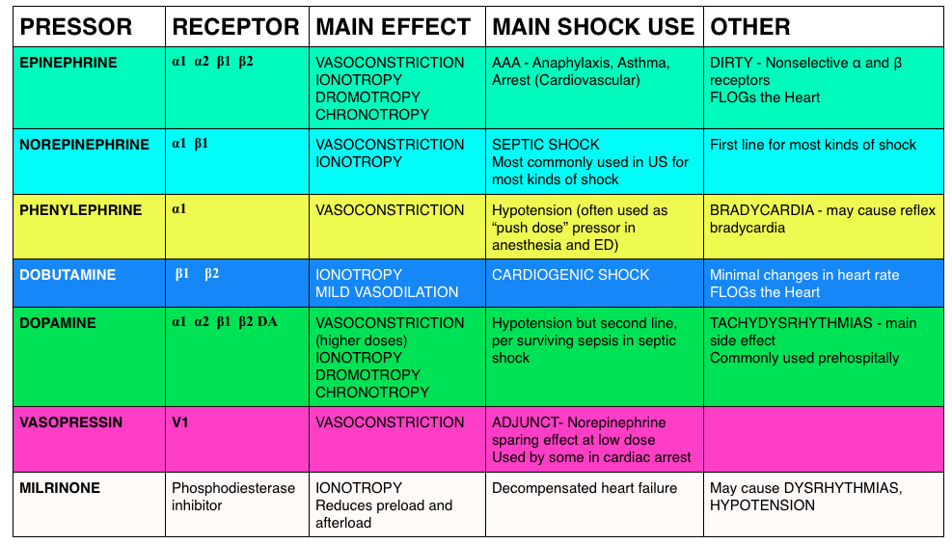
Vasopressors and inodilators

Slide 20
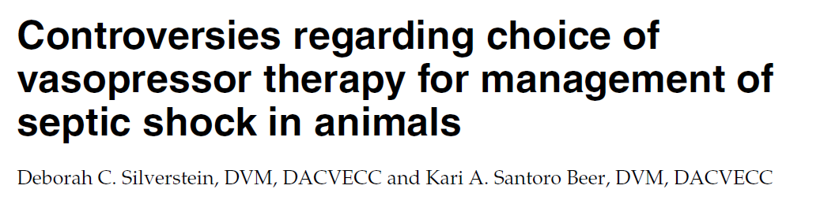
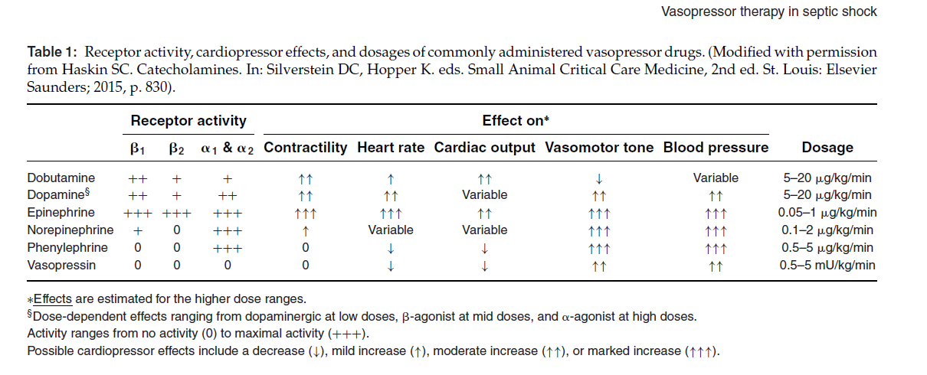

Slide 21
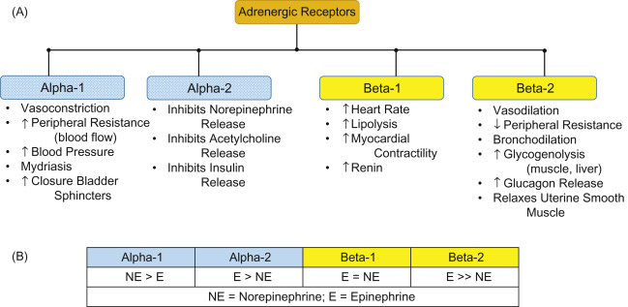
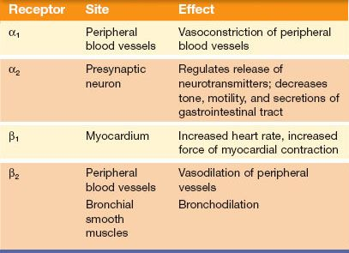

Slide 22
Inodilators: Dobutamine
Synthetic analog of dopamine
Mechanism of action:
Strong Beta one agonist activity
No dopaminergic effects
Physiologic effects:
Causes modest vasodilation, marked increase in CO and little change in BP in animals with no systolic failure (critically ill patients and GA)
How to titrate
Ideally, the inodilators should be titrated against cardiac output or a surrogate of cardiac output (urine output)
They shouldn't be titrated against blood pressure, because they have no predictable effect on blood pressure
To know:
Prolonged infusion of dobutamine may cause desensitization of beta-receptors and reduced efficacy

Slide 23
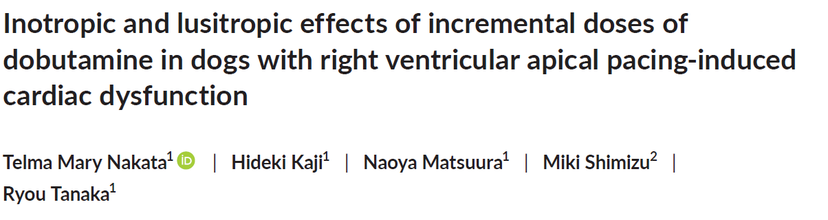
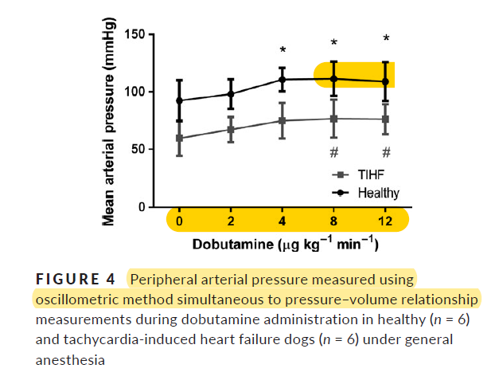
Dobut papers
maximal positive lusitropic effects of dobutamine at a dose of 8 μg kg/min in ventricular pacing-induced cardiac dysfunction without further impairment of ventricular filling

Slide 24
Vasopressors: Epinephrine
Mechanism of action
At lower doses the beta-agonist effects may predominate; with ongoing up-titration there are increasing alpha-agonist effects as well
Physiologic effects:
Potent inotrope, chronotrope, arteriolar and venular vasoconstrictor
Increases BP and can cause ventricular ectopic pacemaker activity
Increases HR, SVR, CO and arterial BP in anesthetized cats and people with sepsis or heart failure
Stabilizes mast cells
Beta-2 agonist stimulation causes bronchodilation

Slide 25
Vasopressors: Epinephrine
Clinical uses
Bradycardia and bradycardic shock (given inotropic effects)
Anaphylaxis and CPR in which the sum of its effects are desired
Can be used as CV support in critically ill patients but has higher incidence of sinus tach and ventricular arrhythmia
Not a first choice pressor but can be used with dopamine and other pressors have failed
How to titrate:
Depends on clinical application
To know:
Epinephrine is a powerful drug with established efficacy in sepsis, also useful in bradycardia and cardiogenic shock
Main concern is that at high doses for long periods of time promotes stress cardiomyopathy
It causes lactate production which isn't dangerous (may be physiologically beneficial)

Slide 26
Vasopressors: Norepinephrine
Mechanism of action
Alpha receptor agonist
Arteriolar and venous constriction
Minimal Beta one activity (may increase HR)
Physiologic effect
Causes vasoconstriction and increases BP with variable effects on HR, CO may increase, decrease or remain unchanged
Animals with an effective circulating blood volume but with vasodilation would be expected to experience an increase in CO due to venoconstriction of capacitance vessels
Hypovolemic animals are already vasoconstricted, and further venoconstriction of resistance vessels associated with NE would lead to further decrease in venous return and CO
Animals with poor myocardial contractility might have an increase in contractility and CO since NE has some Beta one activity

Slide 27
Vasopressors: Norepinephrine
Clinical use
Widely popular first-line agent for a variety of shock states (septic shock, cardiogenic shock with severe hypotension)
Good “broad spectrum” vasoactive agent when it's unclear precisely what is going on
How to titrate:
Typically, against blood pressure
There is no “maximal dose” of norepinephrine
To know:
Strong track record in septic

Slide 28
Vasopressors: Dopamine
Mechanism of action:
Hits a variety of receptors at different dose ranges (“dirty” drug)
Beta and alpha agonist
Also stimulates the release from sympathetic nerve endings
Dopamine receptor agonist - induces arterial vasodilation in many vascular beds
Dopamine receptors:
  D1: (post synaptic) responsible for vasodilation
  D2: (pre synaptic): inhibit NE release from nerve endings - promotes less vasoconstriction
Exogenously administered dopamine:
Does not cross BBB
Dose related effects:
  Low dose (1-3 mcg/kg/min): vasodilation and increases renal blood flow and may increase urine output
  Medium dose (5-10 mcg/kg/min): Beta effects
  High dose (>15 mcg/kg/min): alpha effects

Slide 29
Vasopressors: Dopamine
To know:
Increased mortality compared to norepinephrine in the subgroup of patients with cardiogenic shock (De Backer 2010)
It also increased mortality compared to epinephrine among septic children (Ventura 2015)
It's often impossible to figure out what dopamine is doing (given the variety of different effects at different doses in different patients)
May directly stimulate diuresis via action on dopamine-receptors, thereby falsely suggesting that renal perfusion is adequate
There is a relatively high risk of tissue necrosis if it extravasates
Better agents exist: there is nothing dopamine does that can't be achieved with the use of norepinephrine and/or epinephrine
Dopamine may cause greater malperfusion of the gut compared to norepinephrine

Slide 30
Vasopressors: Ephedrine
Sympathomimetic amine - not a catecholamine
Mechanism of action
Acts by increasing the release of NE from nerve endings
Some Beta agonist effects
Physiologic effects:
Cardiovascular stimulant and bronchodilator
Not very reliable as CV support
To know:
Effects on a singular dose may last 5-15 minutes
CRI can be used (0.02-0.2 mg/kg/min)
Prolonged use can deplete NE stores, which can cause tachyphylaxis
Crosses BBB

Slide 31
Vasopressors: Phenylephrine
Mechanism of action
Pure alpha agonist
No Beta activity
Physiologic effects:
Causes vasoconstriction and increases SVR and BP
Venoconstriction increases the preload
Decreases HR
CO may decrease or increase
For a patient who is preload-responsive with a stronger ejection fraction, phenylephrine could cause a net increase in cardiac output

Slide 32
Vasopressors: Phenylephrine
Clinical use
Vasodilatory shock
How to titrate:
typically, against blood pressure
To know:
Drop in CO seems to occur with phenylephrine boluses, but not with infusions (evidence shows that infusion functions similarly compared to a NE CRI)
It is safe to give peripherally
Ten times less potent than norepinephrine and generally supplied as a fairly dilute solution (large volume needed)

Slide 33
Vasopressors: Isoproterenol
Mechanism of action:
Potent B receptor agonist with no alpha receptor activity
Physiologic effects
Potent vasodilator and hypotensive agent
In animals under GA, it increases HR, CO and decreases BP

Slide 34
Vasopressors: Vasopressin
Mechanism of action:
Stimulates V1 and V2 receptors, causing vasoconstriction and renal water retention
No effect on the heart
Physiologic effects:
Increases SVR with a baroreceptor reflex decrease in HR, no change on contractility and CO
BP is usually increased
Venoconstriction, which may increase preload
Its dominant effect on cardiac output is often to cause a reduction (but this may depend on the heart's ability to tolerate increased afterload)
Does not control vascular tone in normal animals but it is essential during hypotension

Slide 35
Vasopressors: Vasopressin
Clinical use:
Vasodilatory shock (particularly sepsis). Typically given in low doses (0-0.06 U/min), either as primary or secondary agent
How to titrate:
Typically, against blood pressure
To know:
May preferentially cause vasoconstriction of post-glomerular arterioles in the kidney, causing improvement in renal function
It may cause some pulmonary vasodilation, which can be helpful in the context of pulmonary hypertension
Vasopressin shouldn't generally be given peripherally (if it extravasates, there is no antidote)
Vasopressin can cause digital ischemia, especially when combined with NE

Slide 36
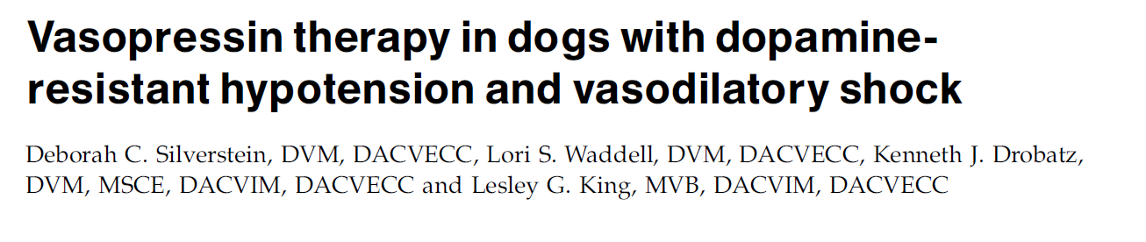
Mean arterial blood pressure increased following vasopressin therapy in all the dogs
Vasopressin may prove useful in the treatment of vasodilatory shock,
All 5 patients euthanized in this report

Slide 37
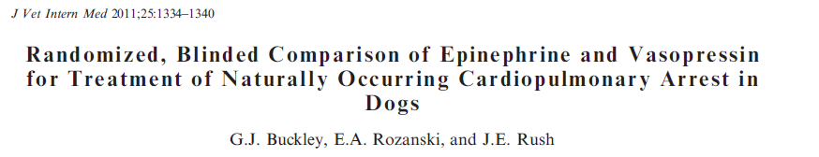
ROSC was similar in dogs receiving epinephrine or vasopressin
Survival advantage at 1 hour was seen in those animals receiving epinephrine
No advantage of routine use of vasopressin over epinephrine was detected

Slide 38
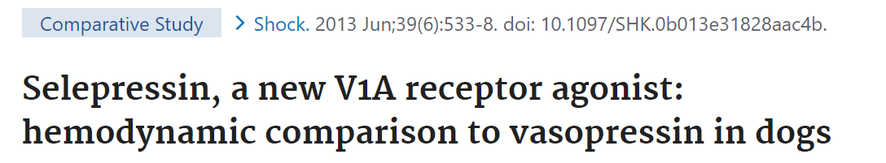
Similar hemodynamic characteristics: peripheral vasoconstriction and decreased aortic blood flow being more pronounced than the increase in coronary resistance and decrease in coronary blood flow
Selepressin bore no relevant coronary ischemic liability, suggesting that V1a receptor agonists are a potential pharmacological target for treatment of vasodilatory hypotension in shock

Slide 39
Catecholamines and cortisol
Cortisol plays key role in CV system and it is essential for normal catecholamine activity
Absence of cortisol leads to profound hypotension, poor myocardial contractility and poor cardiac output
Vasodilation and vasoparesis are common
Consider CIRCI as a cause of persistent hypotension after IVF and pressors failed

Slide 40
Other effects of catecholamines
Hyperglycemia (epinephrine): decreases insulin secretion and glycogenolysis (alpha agonism), and increases glucagon levels and ACTH secretion (beta agonism)
Hyperlactatemia (epinephrine)
Beta 2 agonism increases cellular K uptake → hypokalemia

Slide 41
References
Small animal Critical care medicine. Silverstein, chapters 157 and 158
https://emcrit.org/ibcc/pressors/#overview
https://litfl.com/inotropes-vasopressors-and-other-vasoactive-agents/
Controversies regarding choice of vasopressor therapy for management of septic shock in animals. Silverstein. JVECC 2015
Randomized, Blinded Comparison of Epinephrine and Vasopressin for Treatment of Naturally Occurring Cardiopulmonary Arrest in Dogs. Buckley et al. JVIM 2011

Slide 42


Thank you

