Slide 1
Thoracic Trauma
Katie Sotos, DVM

Slide 2
General Info
Often diagnosed sooner than abdominal trauma due to respiratory compromise
Extent of trauma usu. not known at 1st evaluation
Extensive diagnostics often required for full assessment
Sometimes conservative management is adequate; surgery is often required

Slide 3
Overview
Blunt Trauma
  Vehicular
  High-rise falls
  Intentional abuse
  Others (bite wounds, thoracic compression during CPR, rubber bullets)
Penetrating Trauma
  Bite wounds
  Gunshot
  Others (impalement/stab wounds, evisceration)
Specific Conditions
  Rib Fractures
  Flail Chest
  Pulmonary Contusions
  Pneumothorax, Tension Pneumothorax
  Effusions
  Body Wall Rupture
  Diaphragmatic Rupture/Hernia
Other Considerations

Slide 4
Blunt Trauma

Slide 5
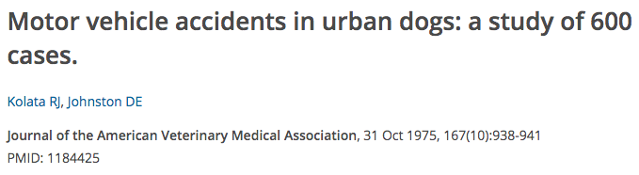
Blunt Trauma:
Motor Vehicle Accidents
Cause of the majority of blunt trauma cases
  12% of dogs HBC had thoracic trauma
  63% of HBC skeletal injuries are cranial to T13
  Injuries include: pulmonary contusions, pneumothorax, hemothorax, rib fractures
Notes:
Kolata RJ, Johnston DE: Motor vehicle accidents in urban dogs: a study of 600 cases, J AM Vet Med Assoc 167:938, 1975

Slide 6
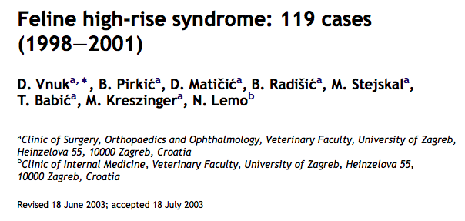
Blunt Trauma:
High-Rise falls/syndrome
More common in cats
  34% had thoracic trauma
  Falls from >/= 7th floor are more likely to result in thoracic trauma
  Injuries include: pneumothorax (20%), pulmonary contusions (13%), hemothorax
  Good prognosis: 97% survival
Notes:
Vnuk D, Pirkic B , Matcic D, et al: Feline high-rise syndrome: 119 cases (1998-2001), J Feline Med Surg 14:131, 2012.

Slide 7
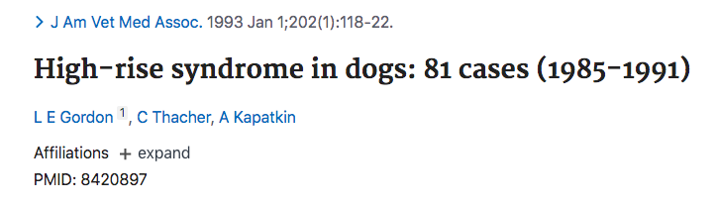
Blunt Trauma:
High-Rise falls/syndrome (CONT’d)
Dogs: injuries similar to cats but with differences in degree and distribution

Slide 8
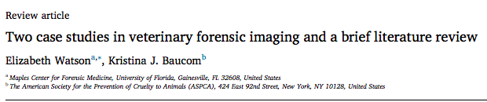
Blunt Trauma:
Intentional/Abuse
Predominant features: trauma to the skull, teeth, vertebrae, bilateral rib fractures
Notes:
https://doi.org/10.1016/j.fri.2020.200382
Received 28 March 2020; Received in revised form 20 April 2020; Accepted 12 May 2020
Forensic Imaging 21 (2020) 200382
Available online 15 May 2020
2666-2256/ © 2020 Elsevier Ltd

Slide 9
Penetrating Trauma

Slide 10
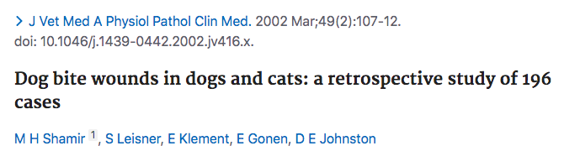
Penetrating Trauma:
Bite Wounds
Thorax a common site of bite wounds
May not be obvious whether a bite has penetrated the cavity
  Surgery is often required for exploration
Mortality only occurred with bite wounds if cavitary penetration was present
  Exploratory thoracotomy did not alter prognosis
Notes:
Shamir MH, Leisner S, Klement E, et al: Dog bite wounds in dogs and cats: a retrospective study of 196 cases, J Vet Med A Physiol Pathol Clin Med 49:107, 2002.

Slide 11
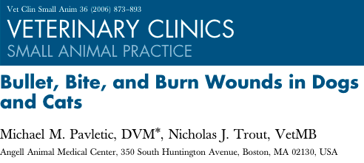
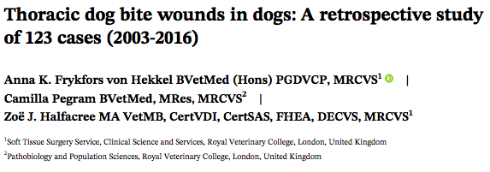
Penetrating Trauma:
Bite Wounds (Cont’d)
Pneumothorax, pulmonary contusions/lacerations, hemothorax, thoracic tracheal trauma
Negative CXR findings cannot rule out injury
Pseudo-flail chest, rib fracture, or pneumothorax injuries were more likely to undergo thoracotomy
Nonsurvival higher in dogs with pleural effusion or + bacterial culture

Slide 12
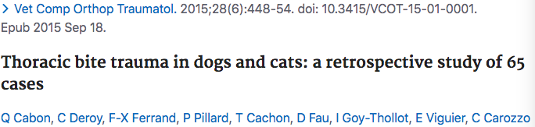
Penetrating Trauma:
Bite Wounds (Cont’d)
22% of patients w/ normal respiratory pattern had radiographic lesions
Respiratory distress not correlated with mortality
Thoracotomy assoc. w/ increased duration of hospitalization, but not mortality
  Recommended if penetrating injury, > 3 radiographic lesions, or both
Long-term outcomes excellent

Slide 13
Penetrating Trauma:
Gunshots
Severity of injury depends on physics of the gunshot
Shock waves can draw contaminants into the wound
Assess pt stability and treat life-threatening injuries
Radiographs
Pneumothorax and hemothorax are common
  Thoracocentesis for diagnosis and therapy
  Thoracostomy tube if significant/persistent air or blood accumulation
  If unstable, may require exploratory thoracotomy
Pericardiocentesis vs. pericardial window for tamponade
Esophageal endoscopy
  Minimal insufflation if perforated due to risk of tension pneumothorax/ pneumomediastinum

Slide 14
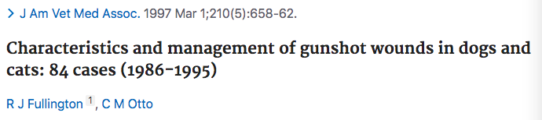
Penetrating Trauma:
Gunshots (cont’d)
Usu. managed with conservative treatment or thoracocentesis
  Only 1 underwent thoracotomy (n=32)
Infection concern: rec. broad spectrum anti-microbials
Vertebral column and abdominal involvement carry worse prognosis than dogs with thoracic or limb injuries
Overall outcome good (most survived) with adequate treatment

Slide 15
Specific Conditions

Slide 16
Rib Fractures
Common
Often associated with:
  Pulmonary contusions
  SQ emphysema
  Pneumothorax
  Pleural effusion
Rarely require surgical fixation
Multiple may cause FLAIL CHEST

Slide 17
Flail Chest
Multiple fractures of both dorsal and ventral aspects of 3 or > adjacent ribs → creates a segment that moves independently from the thoracic wall and paradoxically with breathing
Pseudo-flail chest: significant disruption of the intercostal musculature that creates similar paradoxical chest wall movement
  Frykfors von Hekkel study showed statistically significant positive correlation between presence of pseudo-flail chest and wound depth
Highly assoc. w/ pleural space disease and pulmonary contusions→ must be addressed first:
  Immobilization of the flail segment
    Place it dependently
    Bandage the chest

Slide 18
Pulmonary contusions
Common due to direct injury to pulmonary parenchyma
Tissue disruption and hemorrhage impair gas exchange and decrease pulmonary compliance
Can worsen over 24-48 hr post injury prior to improvement
Can cause ARDS
Management
  Monitoring oxygenation
  Supplemental O2→ may require mechanical ventilation
    Prevent hypoxemia
    Reduce respiratory effort
#1 cause of death in adult humans with blunt thoracic trauma

Slide 19
Pneumothorax
Open vs. closed
  Open: penetrating thoracic injury → air enters chest
  Closed: air originating from the respiratory system accumulates within the pleural space
  Both can occur (i.e. severe bite wound w/lung punctures)
Traumatic vs. spontaneous vs. iatrogenic
  Spontaneous: bullous emphysema, i.e. migrating FBs
  Iatrogenic: complication of thoracic procedures
Clin signs: Tachypnea, tachycardia, respiratory distress, anxiety
Diagnosis: CXR/CT + thoracocentesis
Notes:
Pneumothorax, Karl C Maritato, Jose A Colon, David H Kergosien
Compend Contin Educ Vet. 2009 May; 31(5):232-42

Slide 20
Pneumothorax (CONt’d)
Goal of ER stabilization: re-establish subatmospheric pleural pressure
  Stable patient: place a chest tube, seal open wound, then surgery (i.e. lung lobectomy, chest wall reconstruction)
  Near-CPA patient: immediate anesthesia, intubation, mechanical ventilation
    Leave open chest wounds open to allow air to escape during PPV
    Surgical exploration, debridement, chest wall reconstruction may be indicated ASAP
Prognosis of traumatic pneumothorax is good if no other life-threatening injuries are present

Slide 21
Tension Pneumothorax
Continuous source of air entering the pleural cavity
  i.e. alveolar rupture, bullae rupture, open pneumothorax/sucking chest wound
  Can be induced by PPV (barotrauma)
    Low tidal volumes are recommended if mechanical ventilation occurs to minimize lung injury
Patients often experience more severe respiratory distress and dyspnea or sudden death
May require continuous suction
  May require lung lobectomy

Slide 22
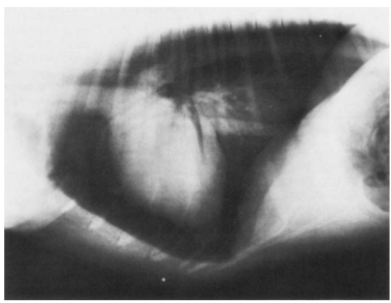
Tension Pneumothorax (CONt’d)

Slide 23
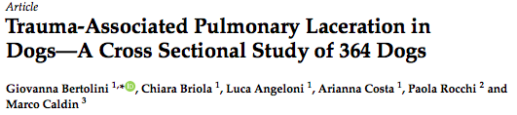
Pulmonary Laceration
Pulmonary parenchymal tear due to high-energy blunt trauma
  A.K.A. traumatic bullae, traumatic pneumatocele, hematocele, traumatic lung cyst, pseudocyst
Oval space lesion on imaging
Seen on CXR in ~60% (n=22); remainder ID’d on CT
  Almost always associated w/ contusions and alveolar hemorrhage
Dogs w/ pulmonary lacerations were significantly younger (p = 0.02) and heavier than those without (p < 0.0001)
  Median age 42 months with vs. 62 months without
  Median weight 20.8 kg with vs. 8.7 kg without

Slide 24
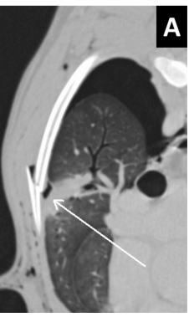

Slide 25
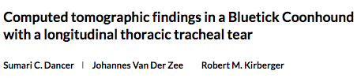
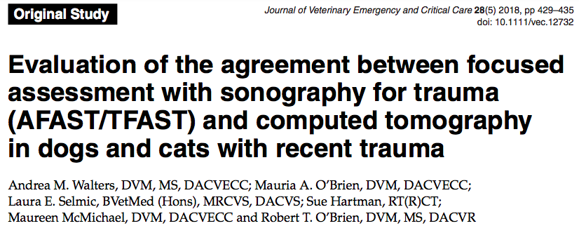
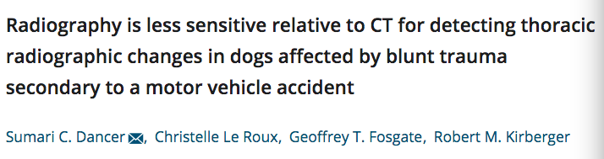
Evidence Supporting CT Usage

Slide 26
Pneumomediastinum
Tracheal/bronchial rupture
Tracheal avulsion
  Can have delayed presentation from days to weeks
  Surrounding soft tissue structures form a “pseudo-trachea” and maintain the airway short term
Esophageal rupture
  Consider endoscopy

Slide 27
Effusions
Hemothorax
  Rupture of intercostal vessels, pulmonary vessels, vena cavae, aorta, or heart
  Often associated with obvious signs of blood loss, cardiovascular compromise, hypotension, shock, and respiratory compromise
  Treatment:
    Conservative: external pressure, internal counterpressure, autotransfusion
    Surgery: if pt not responding to fluid resuscitation efforts, has rising intra-cavitary PCV, or has continued/progressive effusion based off of ultrasound or PE

Slide 28
Effusions (CONT’d)
Chylothorax
  Triglycerides and mononuclear cells
  Treatment:
    Thoracoscopy, interventional radiology—still developing methods
    Surgery: thoracic duct ligation, pericardiectomy, omentalization of thoracic cavity, cisterna chyli ablation, combination
Pyothorax
  Inflammatory exudate, often septic
  Pyrexia present in ~ 50% of cases
  Also associated with hypotension
  Treatment
    Medical: bilateral thoracostomy tubes, IV Abx, +/- intrapleural lavage
    Surgical: CT often required for planning

Slide 29
Body Wall/Thoracic Wall Rupture
Less common than abdominal due to:
  Ribs provide protection
  Anchored thoracic organs
Surgical emergencies
  Prevent organ entrapment
  Prevent gross contamination

Slide 30
Diaphragmatic hernia/rupture
Suspect if respiratory distress following traumatic event
Obvious clinical lesions not present in ~ 50% of cases
Consider AXR or AUS if suspected
Surgery is indicated following stabilization
  Emergency surgery if any GI organs are displaced or if respiratory stability is unachievable
Outcome is good: 90% perioperative survival rate if acute or chronic

Slide 31
Other Considerations

Slide 32
Patient Stability and Comfort
Cardiac
  Arrhythmias and traumatic myocarditis→ VPCs, CPA
  Pneumopericardium
  Traumatic LV-RA communication
  Traumatic ASD
  Traumatic RA tear
Systemic:
  Oxygen support
  Treating shock, fluid resuscitation
  Anemia from hemorrhage
  Thrombocytopenia from consumption
  Traumatic coagulopathy
  Pain: full mu opioid agonists recommended, consider local/regional blocks
External wound care, antimicrobial therapy

Slide 33
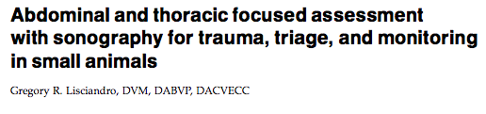
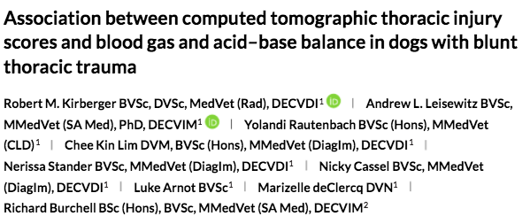
Other Pertinent Literature
JVECC 2011;21(2):104-122
JVECC 2019;29:373-384

Slide 34
Sources
Ackerman and Millman: Unilateral Tension Pneumothorax in Dog. Presented at 1978 annual meeting of the American College of Veterinary Radiology.
Bertolini et al: Trauma-Associated pulmonary laceration in dogs - a cross sectional study of 364 dogs. Vet Sci March 2020, 7, 41 doi:10.3390/vetsci7020041
Cabon et al: Thoracic bite trauma in dogs and cats: a retrospective study of 65 cases. Vet Comp Orthop Traumatol. 2015;28(6):448-54.
Dancer SC, Le Roux C, Fosgate GT, Kirberger RM: Radiography is less sensitive relative to CT for detecting thoracic radiographic changes in dogs affected by blunt trauma secondary to motor vehicle accidnet. Vet Radiol Ultrasound. 2019;60:648-658.
Dancer SC, van der Zee J, Kirberger RM: Computed tomographic findings in a Bluetick Coonhound with a longitudinal thoracic tracheal tear. Vet Radiol Ultrasound, 2020;61:E12-E16.
Drobatz KJ, Hopper K, Rozanski EA, Silverstein DC. Textbook of Small Animal Emergency Medicine, Blunt and Penetrating Thoracic Trauma chapters.
Frykfors von Hekkel AK, Pegram C, Halfacree ZJ: Thoracic bite wounds in dogs: a retrospective study of 123 cases (2003-2016). Veterinary Surgery. 2020; 49:694-703.
Fullington RJ, Otto CM: Characteristics and management of gunshot wounds in dogs and cats 84 cases (1986-1995). J Am Vet Med Assoc. 1997 Mar 1;210(5):658-62.
Gopakumar and Stevenson: Congenital lobar emphysema and tension pneumothorax in a dog. J Vet Diagn Invest. 2007 May;19(3):322-5.
Gordon LE, Tacher C, Kapatkin A: High-rise syndrome in dogs: 81 cases (1985-1991). J Am Vet Med Assoc. 1993 Jan 1;202(1):118-22.
Han H-J, Kim J-H: Concurrent pulmonary hypoplasia and congenital lobar emphysema in a young dog with tension pneumothorax: a rare congenital pulmonary anomaly. Acata Vet Scand. 2019 Jul26;61(1):37.
Kolata RJ, Johnston DE: Motor vehicle accidents in urban dogs: a study of 600 cases, J AM Vet Med Assoc 167:938, 1975.
Marino, Paul: The ICU Book 4th ed.
Maritato KC, Colon JA, Kergosien DH: Pneumothorax. Compend Contin Educ Vet. 2009 May; 31(5):232-42
Pavletic MM, Trout NJ: Bullet, Bite, and Burn Wounds in Dogs and Cats. Vet Clin Small Anim 36 (2006) 873-893.
Shamir MH, Leisner S, Klement E, et al: Dog bite wounds in dogs and cats: a retrospective study of 196 cases, J Vet Med A Physiol Pathol Clin Med 49:107, 2002.
Silverstein DC and Hopper K. Small Animal Critical Care Mediicine, 3rd ed.
Tréhiou CB et al: CT is helpful for the detection and presurgical planning of lung perforation in dogs with spontaneous pneumothorax induced by grass awn migration: 22 cases. Vet Radiol Ultrasound 2020 Mar;61(2):157-166.
Vnuk D, Pirkic B , Matcic D, et al: Feline high-rise syndrome: 119 cases (1998-2001), J Feline Med Surg 14:131, 2012.
Walters AM, et al: Evaluation of the agreement between focused assessment with sonography for trauma (AFAST/TFAST) and computed tomograpy in dogs and cats with recent trauma. Journal of Veterinary Emergency and Critical Care 28(5) 2018:429-435.
Watson E, Baucon KJ: Two case studies in veterinary forensic imaging and a brief literature review. Forensic Imaging 21 (2020). https://doi.org/10.1016/j.fri.2020.200382

