Slide 1
Pathophysiology of Shock and Trauma
Jeff Beverly, DVM
Cornell University
August 2020

Slide 2
Outline
Resources
Definitions & Equations that guide understanding
Determinants of Oxygen Delivery
Categorization of Shock
Compensatory responses
Next week: Lactate
Following:

Slide 3
Resources
Critical Care Medicine, Parillo and Dellinger, 4th ed.
Chapter 21: Circulatory Shock
Available via confluence: June 16 2014-15
Silverstein and Hopper, 2nd ed.
Chapter 5: Shock
Functional Hemodynamic Monitoring. 2005.
DO2/VO2 Relationships.
By: JL Vincent
Pages 251-258
Available via Cornell Library
Critical Care Medicine. 2013
Venous Return in Critical Illness.
By: Funk, Jacobsohn, Kumar
Open source: emcrit.org

Slide 4
Definition of Shock
Oxygen consumption (VO2) > Oxygen delivery (DO2)
Widespread reduction in effective tissue perfusion leads to cellular injury

Slide 5
Definition of Shock
VO2 > DO2
VO2 = f (obligatory + facultative)
Obligatory are cell health
Repair
Maintenance
Growth
Membrane transport
Facultative are cellular ‘jobs’
Biosynthesis
Contractility
Electrolyte transport
Protein transport

Slide 6
Definition of Shock
VO2 > DO2
VO2 = f (obligatory + facultative)
DO2 = f (central + peripheral)
Central factors
Cardiac Output
[Hb]
PaO2
Peripheral factors
Distribution of cardiac output
Autonomic control of vascular tone
Local vessel responses
Affinity of Hb for O2

Slide 7
Definition of Shock
VO2 > DO2
VO2 = f (obligatory + facultative)
DO2 = f (central + peripheral)
Central factors
Cardiac Output far more important in regulation as this CAN change acutely, whereas [Hb] cannot and SaO2 cannot increase beyond 100%
[Hb]
PaO2
Peripheral factors
Distribution of cardiac output
Autonomic control of vascular tone
Local vessel responses
Affinity of Hb for O2

Slide 8
Definition of Shock
VO2 > DO2
VO2 = f (obligatory + facultative)
DO2 = f (central + peripheral)
Central factors
Cardiac Output
[Hb]
PaO2
Peripheral factors
Distribution of cardiac output
Autonomic control of vascular tone
Local vessel responses
Affinity of Hb for O2
Influenced by inflammatory conditions via
microthrombi, altered tone, edema

Slide 9
Deeper into equations
Difference between molecular oxygen measures
PaO2: Partial pressure arterial oxygen
Free oxygen dissolved in plasma
Units: mmHg
Does not quantify the bound O2
SaO2 and SpO2: Arterial oxygenation concentration
Bound oxygen relative to heme groups
Units: percentage (%)
Relative value, not quantitative
SpO2: Measured via pulse oximetry
SaO2: Measured via blood gas
CaO2: Arterial oxygen content
Quantified value of both bound and dissolved
Units: mL O2 / dL
CaO2 = Hb x 1.34 x SaO2 + PaO2 x 0.003

Slide 10
Deeper into equations
DO2 = CO x CaO2
= CO x ( Hb x 1.34 x SaO2 + PaO2 x 0.003 )
neglecting dissolved O2
= CO x Hb x 1.34 x SaO2
VO2 = CO x [ CaO2 - CvO2 ]
= CO x [ (Hb x 1.34 x SaO2 + PaO2 x 0.003)
- (Hb x 1.34 x SvO2 + PvO2 x 0.003)]
neglecting dissolved O2
= CO x Hb x 1.34 x (SaO2 - SvO2)
O2ER = Oxygen extraction ratio
= VO2 / DO2
= ( SaO2 - SvO2 ) / SaO2
Normal O2ER is roughly 25-35%,
meaning SvO2 is 65%- 75%

Slide 11
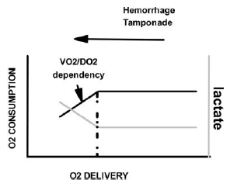
Deeper into equations
Oxygen Extraction Ratio
O2ER = VO2 / DO2 = ( SaO2 - SvO2 ) / SaO2

Slide 12
Deeper into equations
Oxygen Extraction Ratio
Region where body maintains VO2 independent of DO2 (CO x CaO2) by effectively reducing SvO2
  Less ‘leftover’ O2 returning to the heart
O2ER increases as DO2 decreases

Slide 13
Deeper into equations
Oxygen Extraction Ratio
DO2crit: DO2 threshold after which VO2 starts to fall as well, triggering anaerobic metabolism and shock

Slide 14
Deeper into equations
Oxygen Extraction Ratio
O2ER = VO2 / DO2 = ( SaO2 - SvO2 ) / SaO2
DO2 = CO x Hb x 1.34 x SaO2
VO2 = CO x Hb x 1.34 x (SaO2 - SvO2)
In states of shock, DO2 decreases, which causes
O2ER to increase, and the body responds by:
Decreasing SvO2
Increasing CO
Anaerobic metabolism

Slide 15
Determinants of O2 Delivery
MAP
DO2
SVR
CO
CaO2
Systemic
Vasopressin
Angiotensin II
Nervous system
Hb
SaO2
PaO2
HR
Nervous system
SV
Contractility
Preload
Afterload
Local
Co2
NO
PG
Hist

Slide 16
Determinants of O2 Delivery & Tissue Perfusion
DO2
CO
CaO2
SV
Contractility
Preload
Afterload
HR
Nervous system
[Hb]
SaO2
PaO2

Slide 17
Determinants of O2 Delivery & Tissue Perfusion
DO2
MAP
CO
CaO2
SV
Contractility
Preload
Afterload
HR
Nervous system
Hb
SaO2
PaO2
Tissue Perfusion = f ( DO2, MAP)
DO2 = CO x CaO2
MAP= CO x SVR
TP = f (SV x HR(CaO2, SVR))
SVR
Systemic
Vasopressin
Angiotensin II
Nervous system
Local
Co2
NO
PG
Hist

Slide 18
Determinants of O2 Delivery
DO2
MAP
CO
CaO2
SV
Contractility
Preload
Afterload
HR
Nervous system
Hb
SaO2
PaO2
Systemic
Vasopressin
Angiotensin II
Nervous system
Local
Co2
NO
PG
Hist

Slide 19
Types of Shock
Hypovolemic
Obstructive
Distributive
Cardiogenic
Hypoxemic

Slide 20
Hypovolemic Shock
Decreased preload
Decreased stroke volume
Decreased CO
Decreased MAP
Decreased DO2
Example: hemorrhage (internal, external), GI loss
DO2
MAP
CO
CaO2
SV
Contractility
Preload
Afterload
HR
Nervous system
Hb
SaO2
PaO2
SVR
Systemic
Vasopressin
Angiotensin II
Nervous system
Local
Co2
NO
PG
Hist

Slide 21
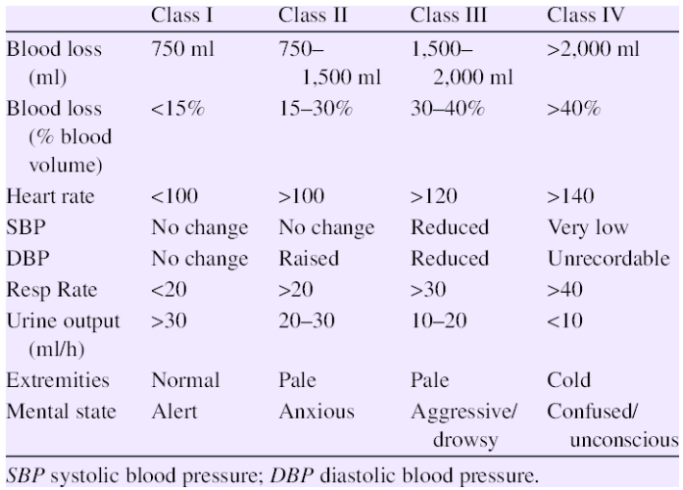
Hypovolemic Shock
Hemorrhage in humans

Slide 22
Hypovolemic Shock
Human Patients
Canine: BV = 90ml/kg
<13 ml/kg 13-27ml/kg 27-36 ml/kg >36ml/kg
Feline: BV= 60ml/kg
<9ml/kg 9-18 ml/kg 18-24ml/kg >24ml/kg

Slide 23
Obstructive Shock
Decreased venous return
Decreased preload
Decreased stroke volume
Decreased CO
Decreased MAP
Decreased DO2
Example: GDV, Cardiac tamponade, Severe PTE
DO2
MAP
CO
CaO2
SV
Contractility
Preload
Afterload
HR
Nervous system
Hb
SaO2
PaO2
SVR
Systemic
Vasopressin
Angiotensin II
Nervous system
Local
Co2
NO
PG
Hist

Slide 24
Distributive Shock
Decreased SVR
Decreased MAP
Decreased preload due to venous pooling
Decreased stroke volume
Decreased CO
Decreased MAP
Decreased DO2
Example: Sepsis (NO), Anaphylaxis (Hist), Neurogenic
DO2
MAP
CO
CaO2
SV
Contractility
Preload
Afterload
HR
Nervous system
Hb
SaO2
PaO2
SVR
Systemic
Vasopressin
Angiotensin II
Nervous system
Local
Co2
NO
PG
Hist

Slide 25
Cardiogenic Shock
Decreased contractility
Decreased stroke volume
Decreased CO
Decreased MAP
Decreased DO2
Example: DCM, Mitral Regurg
DO2
MAP
CO
CaO2
SV
Contractility
Preload
Afterload
HR
Nervous system
Hb
SaO2
PaO2
SVR
Systemic
Vasopressin
Angiotensin II
Nervous system
Local
Co2
NO
PG
Hist

Slide 26
Hypoxemic Shock
Decreased Hb or SaO2
Decreased CaO2
Decreased DO2
Example: Hemolysis, hemorrhage (sort of), CO toxicity, V/Q mismatch
DO2
MAP
CO
CaO2
SV
Contractility
Preload
Afterload
HR
Nervous system
Hb
SaO2
PaO2
SVR
Systemic
Vasopressin
Angiotensin II
Nervous system
Local
Co2
NO
PG
Hist

Slide 27
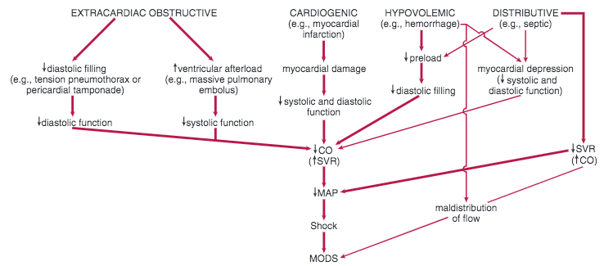
Types of Shock

Slide 28
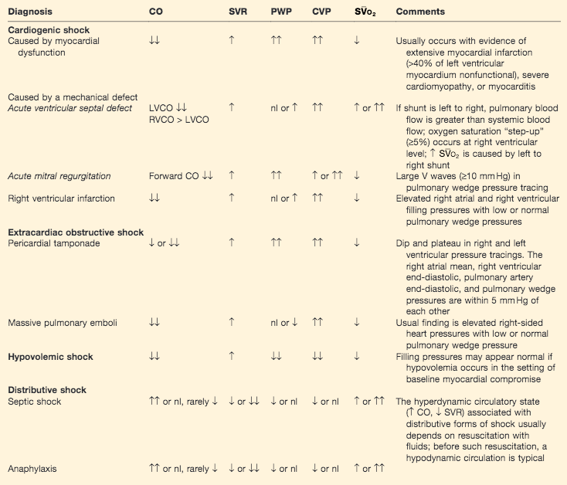
Types of Shock
PWP: pulmonary wedge pressure -
analogous to left preload
CVP: central venous pressure -
analogous to right preload
SVO2: venous O2 saturation

Slide 29
Stages of Shock
Compensated
  Redistribution of fluid from interstitial to vascular
  Vasoactive agents to maintain BP
    Catecholamines
    Vasopressin
    Renin
Decompensated
  Hypotension
  Hyperlactatemia
  Anaerobic metabolism
Terminal
  Cell Death
  Diminished catecholamine response
  Depleted vasopressin
  Increased NO production -> vasodilation -> pooling

Slide 30
Compensatory Shock

Slide 31
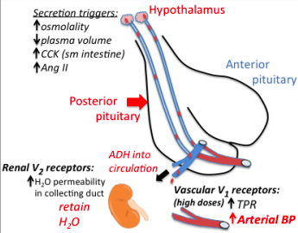
Vasopressin

Slide 32
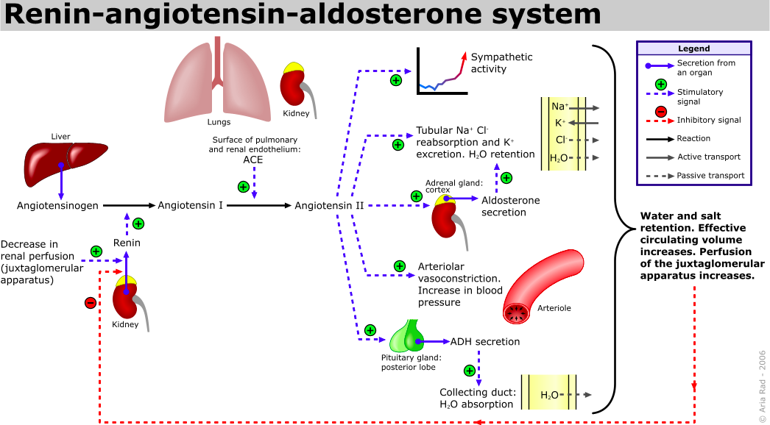
Angiotensin II

Slide 33
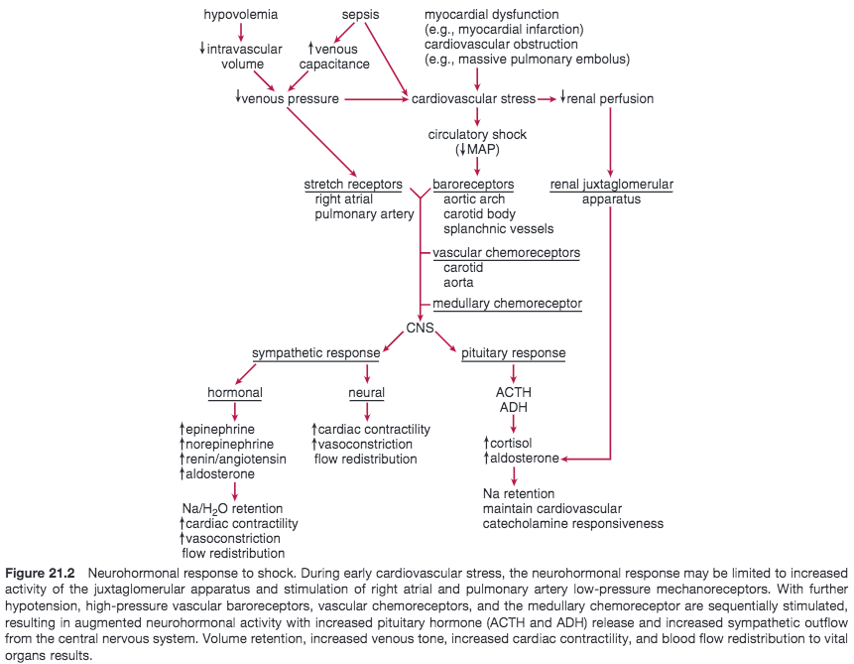
Neurohormonal Response

Slide 34
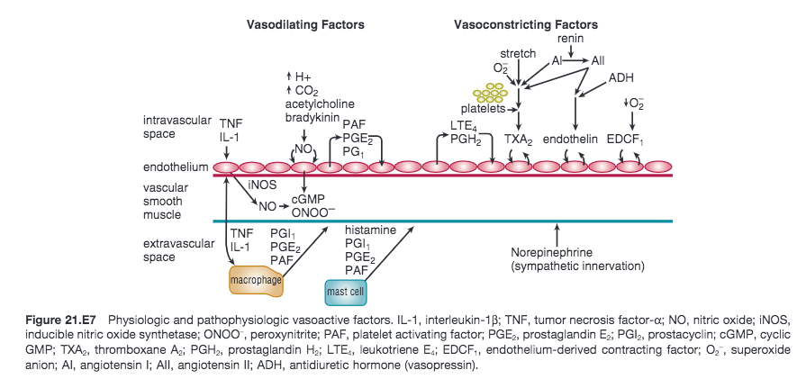
Vasoactive Response

Slide 35
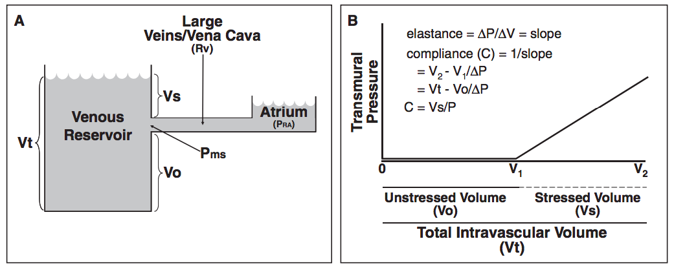
Venous Response

Slide 36
Resources
Critical Care Medicine, Parillo and Dellinger, 4th ed.
Chapter 21: Circulatory Shock
Available via confluence: June 16 2014-15
Silverstein and Hopper, 2nd ed.
Chapter 5: Shock
Functional Hemodynamic Monitoring. 2005.
DO2/VO2 Relationships.
By: JL Vincent
Pages 251-258
Available via Cornell Library
Critical Care Medicine. 2013
Venous Return in Critical Illness.
By: Funk, Jacobsohn, Kumar
Open source: emcrit.org

Slide 37

Thank you

