Slide 1
Nutrition in critical illness
Noelle Herrera
1/7/20

Slide 2
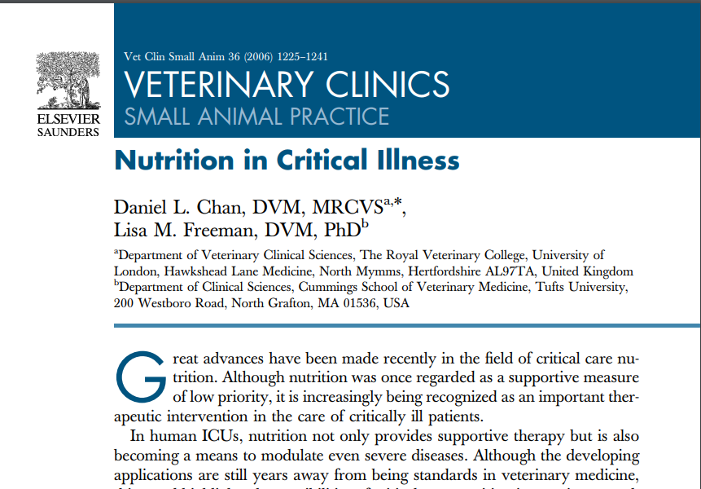

Slide 3
Why do we care?
If a healthy patient is acutely fasted → glycogenolysis
If a healthy patient has prolonged anorexia → metabolic shift towards fat deposits, sparing the muscle.
If a sick patient is fasted or anorexic →glycogen stores are depleted quickly, especially in a cat, so there is a shift towards breakdown of amino acids from muscle stores (lean body mass). In prolonged anorexia, inflammation from the underlying illness alters hormones and cytokines such that amino acid breakdown continues. Fat deposits are left alone and there is both a negative nitrogen and energy balance.
When there is prolonged loss of lean body mass → immunosuppression, worsening hypoalbuminemia, decreased respiratory strength, poor skeletal strength, poor wound healing, and thus overall increases in morbidity and mortality.
Our GOAL in providing nutrition in the critically ill is to mitigate the loss of lean body mass, and if we’re lucky, resolve the underlying illness that resulted in malnutrition in the first place.

Slide 4
When to provide nutrition to our patients
Fix shock, dehydration, electrolyte, and acid-base disturbances
Signs of malnutrition:
Unintentional weight loss (>10% body weight)
Body Condition Score: more reliable indicator of lean body mass (stays constant despite restoration of volume status and hydration, iatrogenic fluid shifts)
Muscle Condition Score
Poor wound healing
Hypoalbuminemia
Notes:
Shock → decrease perfusion of the gastrointestinal tract and therefore so motility, digestion, and absorption are decreased.

Slide 5
When to provide nutrition to our patients
Risk factors for malnutrition:
Anorexia >5 days
Trauma
Sepsis
Peritonitis
Pancreatitis
Any compromise to the GI tract (foreign body, intussusception, protein losing enteropathy, GI neoplasm, resection and anastomosis, gastrotomy, enterotomy)
Aim to:
Begin providing nutrition within 3 days of admission
Meet target level of nutrient delivery in 48 to 72 hours
Provide enough calories to support the immune system, wound repair, and cellular division and growth
Notes:
3 day rule: support should be given sooner for those <6 months old, geriatric, severely debilitated, severely cachectic, or if anticipated period of anorexia will be prolonged due to underlying disease process (ie severe maxillofacial trauma).
Nutritional support should also be considered sooner in obese cats at risk of hepatic lipidosis.
Increased metabolic demand, increased protein catabolism, gut derived inflammation, and potential bacterial translocation resulting in the development of SIRS or sepsis. Gut nutrition leads to less catabolism, prevention of protein energy malnutrition, improved integrity of epithelial tight junctions, and overall decreased intestinal inflammation. Avoidance of enteral nutrition in diseased states has been correlated to increased gut permeability, bacterial or endotoxin translocation, and immunosuppression. The gut itself may start or contribute to the systemic inflammatory response in acute pancreatitis.

Slide 6
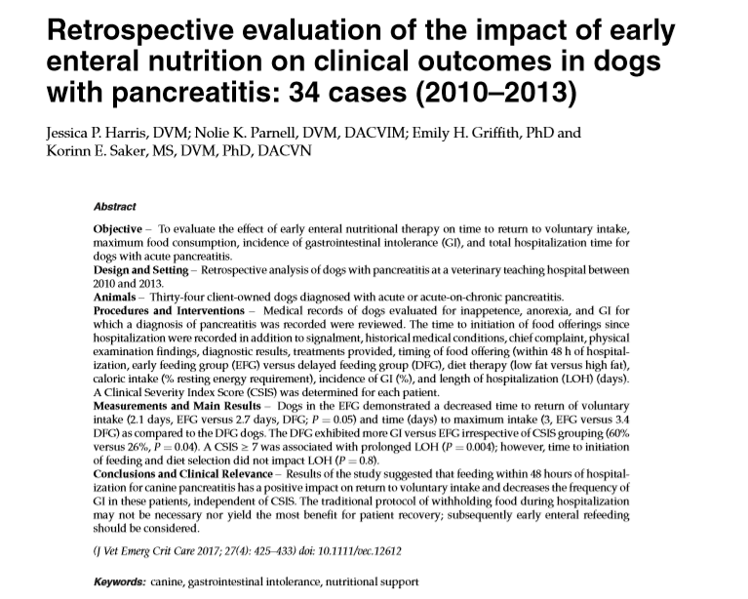
Support for early return to nutrition

Slide 7
Early return to nutrition in pancreatitis
Objective: Evaluated effect of early return to enteral nutrition on the time to voluntary food intake, maximum food consumed, GI signs, and total time to discharge in dogs with acute pancreatitis.
Design: Retrospective analysis of 34 dogs with pancreatitis over 4 years. A clinical severity index score (CSIS) was determined for each patient.
Methods: Pancreatitis was diagnosed by 2 out of the 3: quantitative canine specific lipase (cPLI), lipase/amylase increased >3 times the upper limit, and/or ultrasonographic evidence. Early enteral nutrition group was offered food within 48 hours of hospitalization, the delayed enteral nutrition group was not. Low fat diet had <3g fat/100 kcal. Return to spontaneous intake was if the patient ate a minimum of 5% RER. GI adverse effects were vomiting or regurgitation that occurred within 3 hours of the meal. Assisted-fed (NG tube) versus non-assisted fed group.

Slide 8
Early return to nutrition in pancreatitis
Results: Early feeding group returned to voluntary intake in 2.1 days as opposed to 2.7 days (P= 0.05) and took 3 days to reach maximum intake as opposed to 3.4 days. They had less GI signs (26%) as compared to 60% irrespective of their clinical severity index score (P=0.04). A CSIS >/= 7 was associated with prolonged hospitalization but the time to initiation of feeding and diet selection had no impact. 29.5% of the feedings of high fat content had associated nausea or regurgitation, whereas only 11.8% of the low fat group had it (p= 0.153).
Conclusion: Results suggest feeding within 48 hours of hospitalization has a positive impact on return to voluntary food intake and decreases the frequency of GI in these patients, independent of their CSIS. Total hospitalization was not significantly impacted by early or delayed feedings, rather by illness severity. (scores 7-12 had a mean length of hospitalization of 8 days, whereas those with scores</=6 had a mean of 4.9 (p=0.004)).

Slide 9
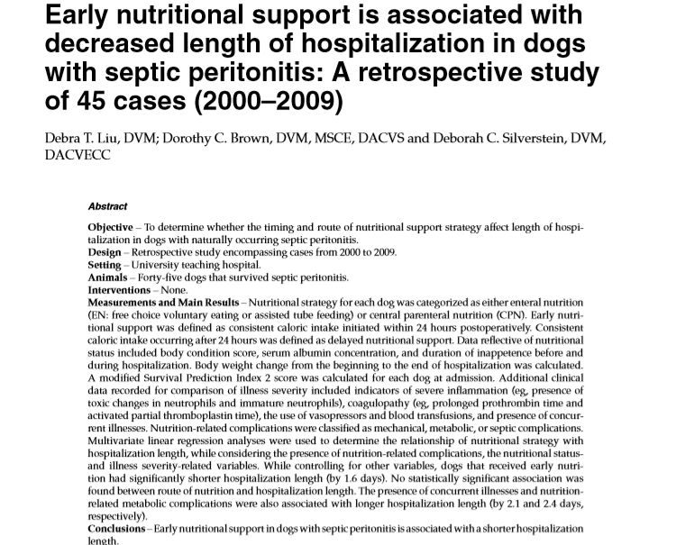
Support for early return to nutrition

Slide 10
EARLY return to nutrition in septic peritonitis
Objective: To determine whether the timing and route of nutritional support affects length of hospitalization in dogs with naturally occurring septic peritonitis.
Design: Retrospective study of 45 cases over 10 years.
Methods: Early nutritional support was that provided within 24 hours of surgery. A modified survival prediction index 2 score was provided for each dog.
Results: when controlling for other variables, dogs that had early nutrition had a significantly shorter length of hospitalization (by 1.6 days). No association was found between route of nutrition and length of hospitalization (LOH). (P= 0.037). Concurrent illnesses contributed to a longer LOH (by 2.1 days).
Conclusion: Early nutritional support in dogs with septic peritonitis is associated with a shorter hospitalization length.

Slide 11
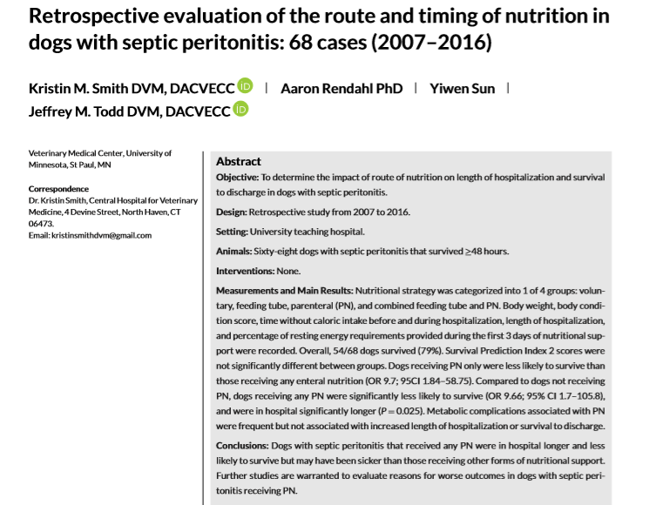
Support for early return to nutrition

Slide 12
EARLY return to nutrition in septic peritonitis
Objective: To determine the impact of route of nutrition on length of hospitalization and survival to discharge in dogs with septic peritonitis.
Design: Retrospective study on 68 patients over 10 years.
Methods: 4 nutritional groups: voluntary, feeding tube, parenteral, and mix of feeding tube and parenteral. Survival prediction index 2 scores were not significantly different between the groups.
Results: Dogs receiving only parenteral were less likely to survive than enteral nutrition (p=0.009). Dogs receiving any PN were less likely to survive (p=0.025), and were in the hospital significantly longer (p=0.025). Dogs receiving any form of PN were significantly more likely to receive vasopressors and blood products. There was a significant difference in albumin (p=0.049) between feeding groups with dogs that ate voluntarily having a significantly higher albumin than those with PN or tube feedings.

Slide 13
EARLY return to nutrition in septic peritonitis
Results continued: Dogs that voluntarily ate were significantly more likely to survive than dogs receiving assisted nutrition (p=0.020). Dogs that had combined PN and EN tube feedings had a significantly longer hospital stay than those that voluntarily ate (p=0.018).
Conclusion: Dogs with septic peritonitis that received any PN were in the hospital longer and were less likely to survive but may have been sicker to begin with.

Slide 14

How many calories?
Resting energy requirements alone
Reduces adverse effects (mostly GI complications), hepatic dysfunction (mostly cholestasis), and increased carbon dioxide production.
Allometric formula: $RER= 70 x {kgs}^{0.75}$
Formula on ICU flow sheet acceptable for patients weighing between 3 and 25kgs.
Under and over-weight patients should still be fed at their current weight.
Patients that are significantly overweight (>25% ideal body weight) should have an adjusted “current weight” to be used to calculate RER.
    25% of excess weight is lean while 75% is fat.
    If ideal body weight for a 30kg dog is 20kgs, he has 10kg of excess weight, 2.5kgs of which is lean tissue. Therefore the adjusted weight is 22.5kgs.

Slide 15
Enteral support
Enteral support is prioritized whenever possible to preserve the intestinal barrier, promote intestinal healing, and prevent intestinal atrophy and bacterial translocation.
Enteral feeding modalities:
Nasoesophageal/gastric feeding tube:
  Pros: minimally invasive, no need for GA, continuous versus bolus feedings
  Cons: misplacement, liquid only diets, uncomfortable, can become dislodged with sneezing, coughing, and vomiting
Esophagostomy tube:
  Pros: can feed a slurry, intermittent bolus feedings, animals tolerate quite well, owner-friendly
  Cons: requires GA, tube obstruction, dislodgement, etc., cellulitis at stoma site.
Notes:
A meta-analysis comparing enteral to parenteral nutrition in people following GI surgery showed reduced risk of anastomotic leak in patients receiving enteral nutrition.
Enteral nutrition is though to maintain tight junctions between intra-epithelial cells, stimulate blood flow, release endogenous trophic agents (gastrin, bile salts, cholecystokinin), reduces villous atrophy, and supports IgA-producing lymphocytes in GI-associated lymphoid tissue.

Slide 16
Enteral support
Gastrotomy tube:
  Pros: bolus feeding, provides months of nutritional support.
  Cons: percutaneous, endoscopic, or surgically-placed. Local cellulitis, peritonitis if dislodged.
Jejunostomy tube:
  Pros: bypass stomach or pancreas
  Cons: liquid diet only due to limited volume capacity of jejunum, continuous infusion, diarrhea, tube occlusion, and tube dislodgement leading to peritonitis.
Notes:
Premature (<14 days) gastrotomy tube dislodgement- immediately evaluate for peritonitis
Jejunostomy: significant stomach wall resection, severe pancreatitis, pancreatectomy
Anorexic animal: 5 to 10 ml/kg of slurry is recommended per feeding initially.
One study showed that full gastric capacities of 45 to 90 ml/kg have been measured (Saker and Remillard 2010), however this volume of feeding is not recommended in critically ill animals.
Bolus feedings should be administered slowly over 20 to 30 minutes while the animal is monitored for any signs of nausea.

Slide 17
parenteral support
Types:
Total parenteral nutrition (TPN):
  Provides all the daily nutrients the patient requires (preferred over PPN)
    Take into account patient’s total fluid rate.
  Requires a central venous catheter due to high osmolality (jugular vein >> saphenous vein)
  Costs 10-20% more than PPN
  Contains: dextrose, crystalline amino acids, and lipid
    Amino acid solutions lack taurine but if not fed for more than 10 days, it is not a problem. 8.5% is the most commonly used (3.5-15%).
    Balanced electrolyte solutions
    Lipid component: 10-30% solutions. Reduce or eliminate this portion if hypertriglyceridemic
Partial parenteral nutrition (PPN):
  Adjunctive nutritional support
  Contains all of the above
Notes:
Appendix in the VCNASAP article has worksheets for formulating TPN and PPN.
Materials warehouse
**For central administration, the osmolality should not exceed 1400 mOsm/l
Peripheral administration, the osmolality should not exceed 600 to 750 mOsm/l to minimize risk of prevent thrombophlebitis**

Slide 18
parenteral support
Rules of administration:
Catheter that has always maintained aseptic technique
No other use for the catheter prior to or with the PN
Each infusion set and bag are never disconnected and as such go wherever the patient goes. (outside, to ultrasound, etc.)
Each infusion set and bag are replaced every 24 hours using aseptic technique.
Contraindicated in thrombocytopenia
TPN is administered at 50% the ideal rate for first 24 hours to ensure no complications.
TPN is weaned over 6 to 12 hours to avoid hypoglycemia. PPN may be abruptly discontinued.
Complications: introduction of infection, local irritation, hyperglycemia, lipemia, azotemia, hyperammonemia, cholestasis, and electrolyte disturbances.
Monitoring: body temperature, respiratory rate and effort, fluid overload, glucose, triglycerides, electrolytes, PCV/TS, check serum for lipemia, BUN/creatinine.

Slide 19
Sources
Chan DL, Freeman LM. Nutrition in critical illness. Vet Clin Small Animal 2006;26:1225-1241.
Harris JP, Parnell NK, Griffith EH, et al. Retrospective evaluation of the impact of early enteral nutrition on clinical outcomes in dogs with pancreatitis: 34 cases (2010-2013). J Vet Emerg Crit Care 2017;27:425-433.
Kathrani A. Nutritional support in the intensive care unit. In practice 2016:18-24.
Liu DT, Brown DC, Silverstein DC. Early nutritional support is associated with decreased length of hospitalization in dogs with septic peritonitis: a retrospective study of 45 cases (200-2009). J Emerg Crit Care 2012:22:453-459
Smith KM, Rendahl A, Sun Y, et al. Retrospective evaluation of the role and timing of nutrition in dogs with septic peritonitis: 68 cases (2007-2016). J Vet Emerg Crit Care 2019;29:288-295..

