Slide 1
Hypoxemia:
Oxygen Therapy
Jessica Sands, DVM
Small Animal Emergency and Critical Care (ECC) Resident

Slide 2
Today’s Agenda:
Review of important respiration concepts
Review of oxygen measurements
Methods of supplementation
  Invasive vs non-invasive
    Qualifications
    Monitoring
    Advantages/disadvantages/complications

Slide 3
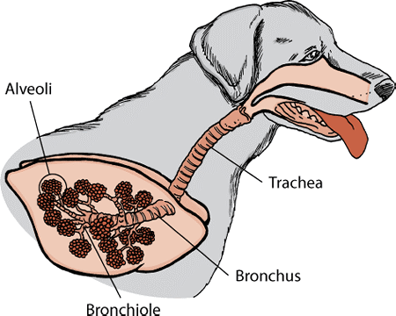
Atmospheric oxygen (PO₂)
= Barometric pressure (P_{b}) x Fractional concentration oxygen (FiO₂)
= 760mmHg x 0.21
=159mmHg
Arterial oxygen (PaO₂)
= Alveolar oxygen (PAO₂)
= 100mmHg
Alveolar oxygen (PAO₂)=
= PiO₂ - (PACO₂ / Respiratory quotient (R))
= 150 – (40/0.8)
= 100mmHg
Pressure of inspired oxygen (PiO₂) = FiO₂ (P_{b} – P_{H2O})
= 0.21 (760mmHg- 47mmHg)
= 150mmHg
Notes:
CO2 and O2 are PERFUSION limited under normal circumstances, so PaO2=PAO2

Slide 4
Mechanisms of Hypoxemia
Diffusion impairment
Hypoventilation
Low PiO₂
Shunt
VQ mismatch
Low venous oxygen content
Not responsive to supplemental O₂
Notes:
Mechanisms of hypoxemia review! Name them!
Which one is not responsive to oxygen supplementation

Slide 5
Atmospheric oxygen (PO₂)
= Barometric pressure (P_{b}) x Fractional concentration oxygen (FiO₂)
= 760mmHg x 0.21
=159mmHg
Low venous oxygen
Arterial oxygen (PaO₂)
= Alveolar oxygen (PAO₂)
= 100mmHg
Decreased PO₂ (P_{b} or FiO₂)
Diffusion impairment
V/Q Mismatch
Shunt
Alveolar oxygen (PAO₂)=
= PiO₂ - (PACO₂ / Respiratory quotient (R))
= 150 – (40/0.8)
= 100mmHg
Pressure of inspired oxygen (PiO₂) = FiO₂ (P_{b} – P_{H2O})
= 0.21 (760mmHg- 47mmHg)
= 150mmHg
Hypoventilation

Slide 6
Clinical Measurement of Oxygen and Gas Exchange

Slide 7
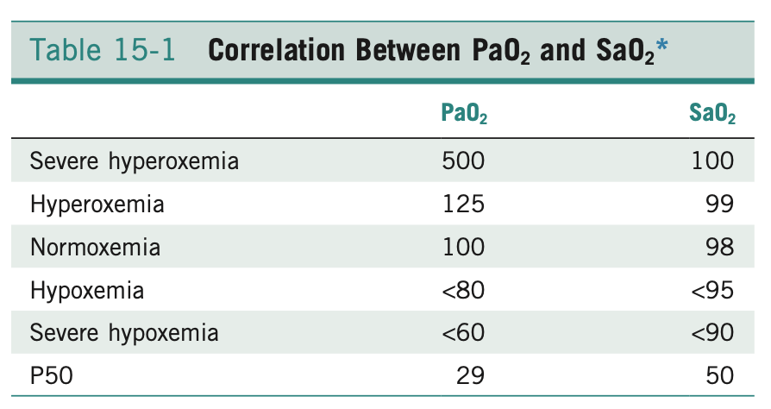
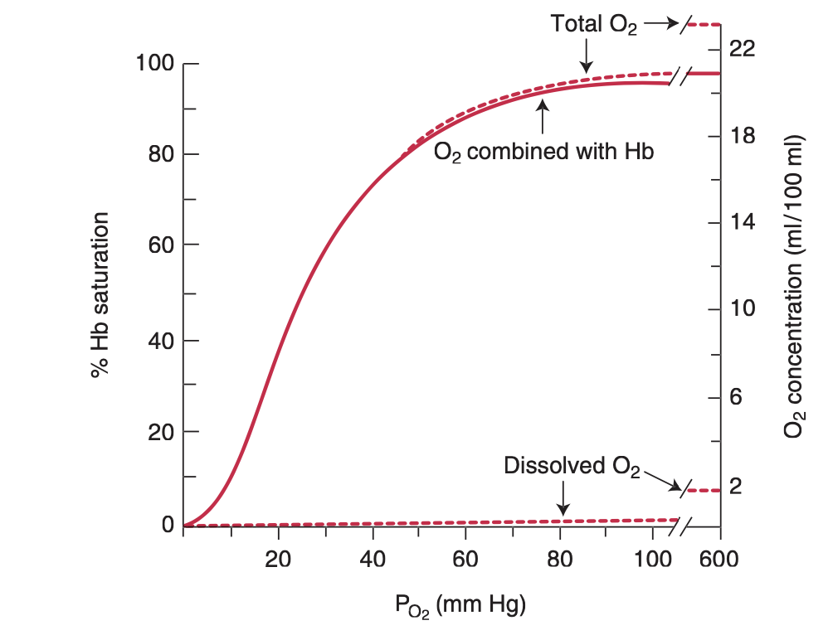
Hemoglobin Oxygen Saturation (SaO₂)
Blood oxygen content
  CaO₂= (1.34×Hb×SaO₂)+(0.003×PO₂)

Slide 8
A-a PO₂ Gradient
Difference between calculated P_{A}O₂ and measured P_{a}O₂
  Normal value: <10
  Clinically relevant oxygenation deficiency: >/= 20
Most useful for patients breathing ROOM AIR (FiO2=21%)
  Normal to have increased gradient breathing supplemental oxygen

Slide 9
The 120 Rule
Additive values of PaCO₂ and PaO₂ will be ~120 if hypoxemia is due to hypoventilation
  Additive values of PaCO₂ and PaO₂ <120 indicates venous admixture
Only used when breathing ROOM AIR (FiO2=21%)

Slide 10
PaO₂/F_{i}O₂ Ratio
Calculation of gas exchange efficiency
  Normal: >400
  Severe gas exchange impairment (ALI): 200-300
  ARDS: <200
Better estimate of pulmonary function when patient receiving supplemental O₂
  Can be used to guide escalation of care

Slide 11
Need For Supplemental Oxygen
Hypoxemia Definition:
  SpO2 <95%
  PaO₂ <80mmHg
Clinical Indications for oxygen supplementation:
  SpO₂ <93%
  PaO₂ <70mmHg

Slide 12
Methods of Oxygen Supplementation
Traditional oxygen therapy
Non-invasive ventilation
Mechanical Ventilation
Notes:
Method dependent on patient stability, size, degree of hypoxemia etc.
Also dependent on on characteristics of oxygen failure: hypoxemia vs hypercapneic (ventilatory) failure

Slide 13
Traditional Oxygen Therapy
Flow-by/ Facemask
Nasal/Nasopharyngeal Prongs
Oxygen Hood
Oxygen Cage
Transtracheal Oxygen

Slide 14
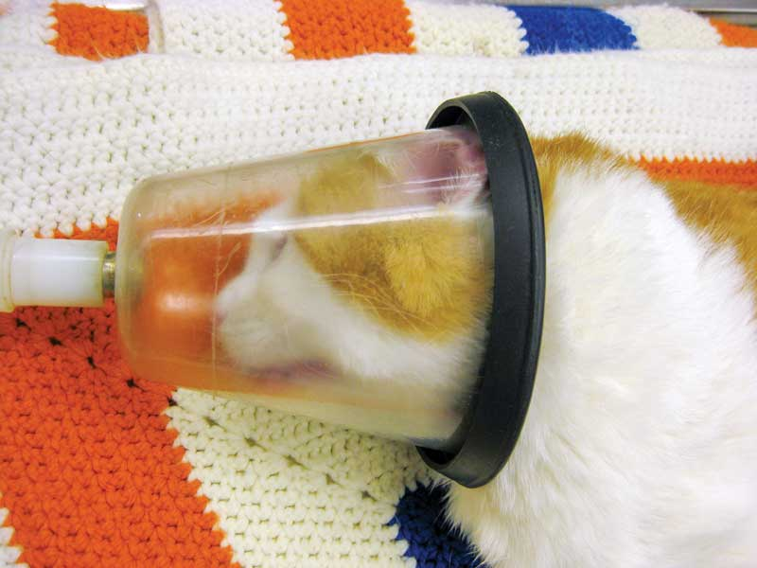
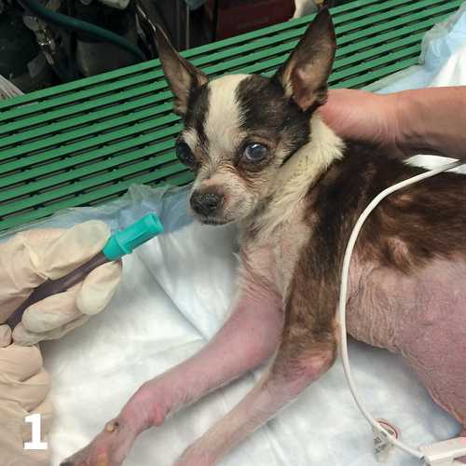
Flow-by and Face Masks
  Setup
    Administered to patient with O₂ hose +/- mask
  FiO₂ 25-40%
    O₂ Flow of ~2-3L/minute
Notes:
1997 Study evaluated amount of oxygen administered via facemasks/flow by

Slide 15
Flow-by and Face Masks
Pros
Cons
Easily/quickly administered
  Good for triage exam
Patient easily accessed during administration
Large amount of supplemental O₂ wasted to the environment
Limited increase in FiO2
Facemasks trap heat in larger patients
Less useful in mobile patients

Slide 16
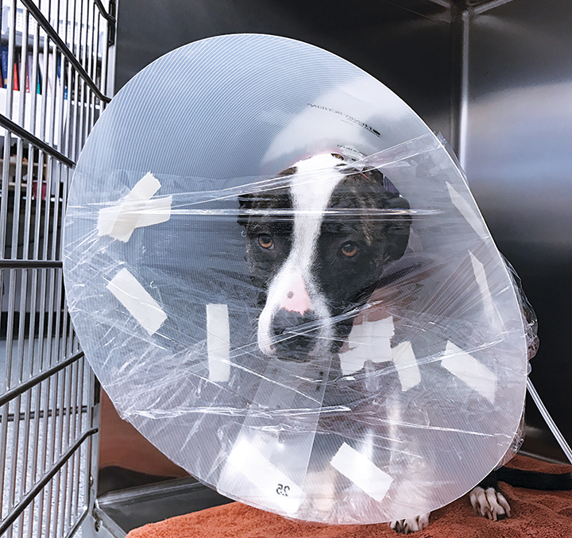
Oxygen Hood
  Setup
    Typically a large e-collar covered with saran wrap
    O₂ provided via oxygen hose
    Portion left open for CO₂ and heat escape
  FiO₂ 30-40%
    O₂ Flow of ~1L/minute
Notes:
Study performed in 1996 established protocol

Slide 17
Oxygen Hood
Pros
Cons
Economical
Supplies usually available at any practice
CO₂ Accumulations in larger patients
Heat accumulation in larger patients
  Panting can worsen respiratory status
Limited increases in FiO₂

Slide 18
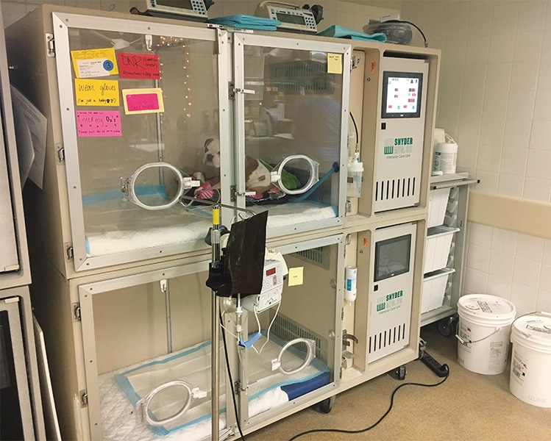
Oxygen Cage
  Setup
    Commercially available O₂ cages
  FiO₂ up to 60%

Slide 19
Oxygen Cage
Pros
Cons
Requires no patient restraint/restriction
Heat accumulation in larger patients
Concerns for accessibility of patient?
  O₂ levels decrease when door opened
Limited increase in FiO₂

Slide 20
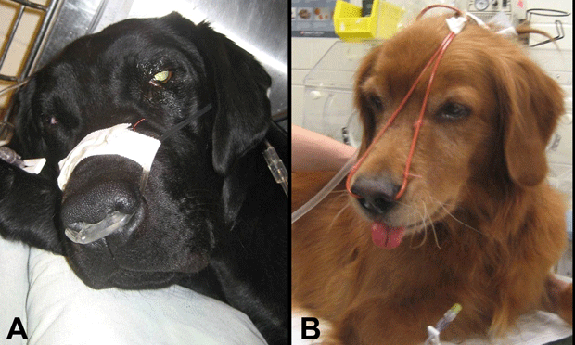
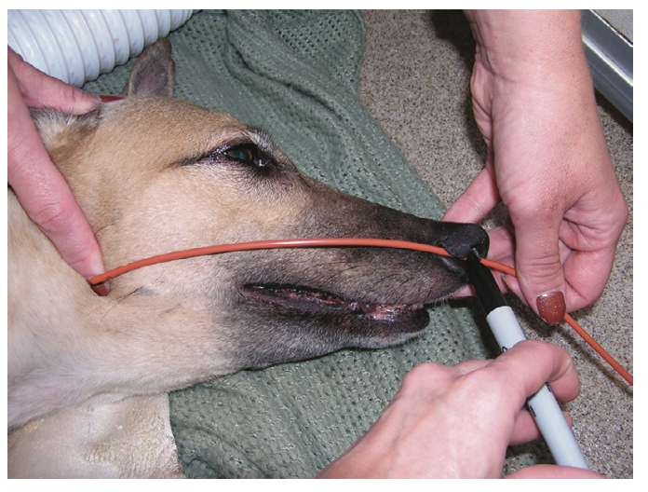
Nasal/nasopharyngeal O₂
  Nasal Setup
    Human nasal prongs adapted for canine face with tape bridge +/- suture
    Red rubber catheters with tip placed to level of medial canthus
      May provide increased FiO₂ compared to prongs
  Nasopharyngeal setup
    Similar red rubber setup as nasal prongs, but measured to the level of the ramus of the mandible
  FiO₂ = 30-70%
Notes:
Chart out of SACCM

Slide 21
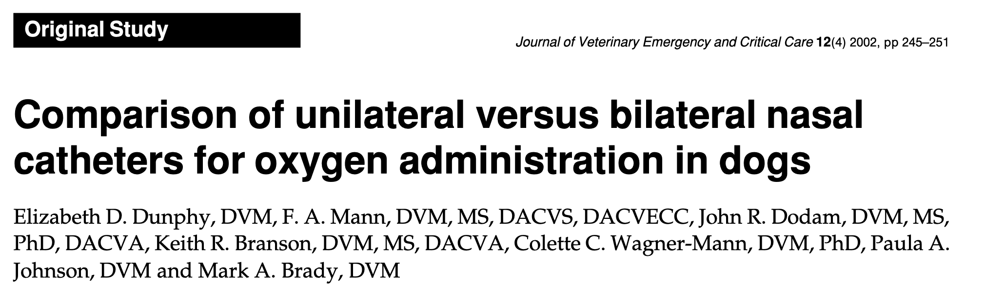
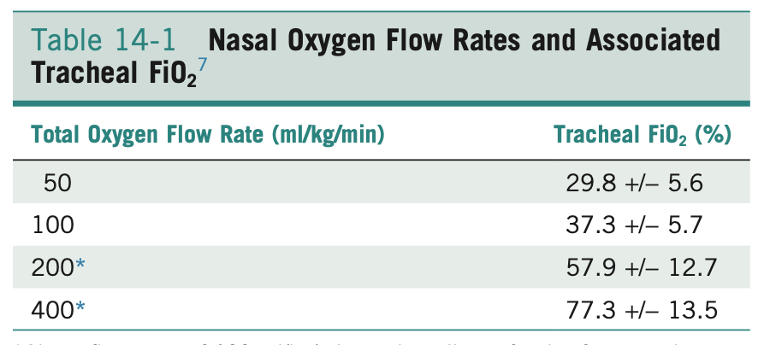
Nasal/nasopharyngeal O₂
  Increase in FiO₂ dependent on TOTAL flow rate through catheter(s)
    No difference in FiO₂ between 1 catheter vs divided between 2
    Patients generally do not tolerate total flow rates >/=200mL/kg/min
Notes:
Chart out of SACCM summarizing 2002 JVECC study examining tracheal FiO₂ and patient comfort level

Slide 22
Nasal/nasopharyngeal O₂
Pros
Cons
Alternative for O₂ cage in larger dogs
Improved patient mobility
Easily instrumented
Cold/dry Air causes airway irritation
  Cannot be used for long periods of time or at high flows
Limited increase in FiO₂

Slide 23
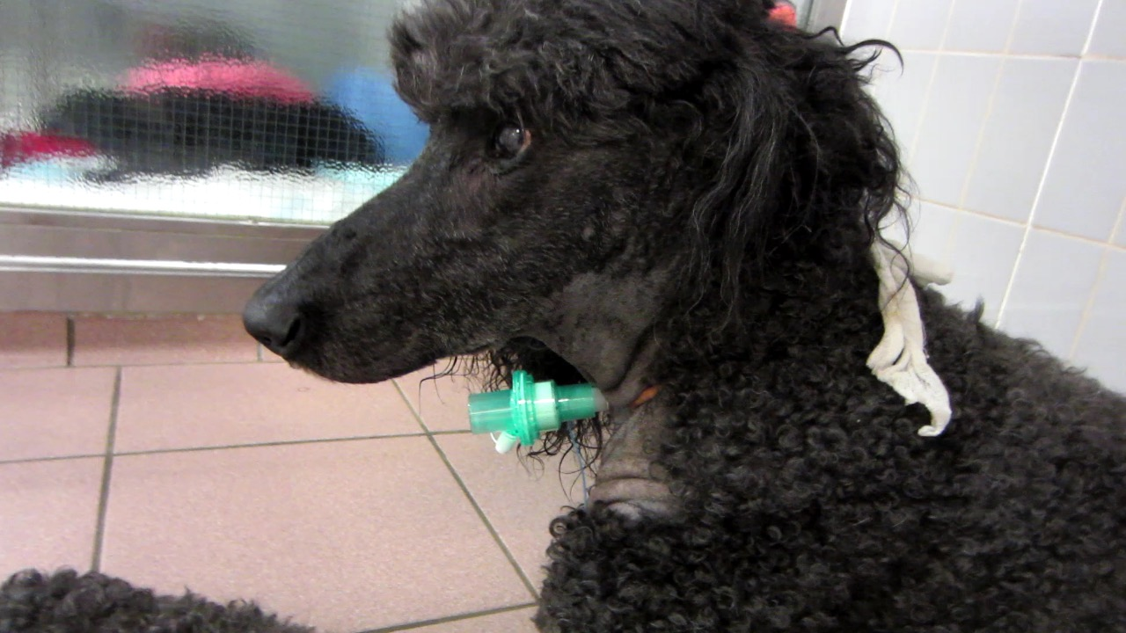
Transtracheal Oxygen
  Setup
    Through the needle large-bore catheter can be inserted through cervical trachea to the level of carina
    Tracheostomy tube
      Caution not to transect more than 50% diameter of tracheal lumen
  FiO₂= 30-60%
    flow rates of 50mL/kg/min

Slide 24
Transtracheal Oxygen
Pros
Cons
Appropriate in animals with upper airway obstruction
Small amount of PEEP possible
Cold/dry Air causes airway irritation
  Cannot be used for long periods of time or at high flows
Invasive

Slide 25
Cold, poorly-humidified air
Causes dehydration of airways
  Significant patient morbidity/discomfort- tolerance may limit duration of treatment
  Decreases effectiveness of conciliary clearance
    Increase risk of infections
    Inspissated secretions can obstruct airway
Cold air induces bronchoconstriction
  Increases airway resistance

Slide 26
Non-Invasive Ventilation
Continuous Positive Airway Pressure (CPAP)
High flow nasal oxygen (HFNO)
Notes:
Non-invasive Ventilation provides increased ventilatory/oxygen support and is generally used to bridge the gap between cases failing traditional oxygen therapy (TOT) and those that would formerly have have required mechanical ventilation
Provides pressure support via the upper airways

Slide 27
Continuous Positive Airway Pressure (CPAP)
Setup
  Tight fitting facemask/ helmet provides increased PEEP and supplemental oxygen
Indications
  Hypoxemic respiratory failure failing traditional oxygen therapy (TOT)

Slide 28
Continuous Positive Airway Pressure (CPAP)
Tolerance
  Healthy dogs instrumented using routine sedation (ace and morphine) tolerated mask placement and maintained adequate ventilation (Briganti et al 2010)
  Majority of dogs (13/15) in Ceccherini et al 2020 study tolerated helmet
  Cats required heavy sedation that impaired ventilation (needed to be intubated)
Significant increase in PaO₂ (Ceccherini et al 2020, Briganti et al 2010)
Significant level of PEEP
  Significant reduction in RR, WOB Aa gradient and increase in P:F (Ceccherini et al 2020)
Notes:
Total of 3 studies investigating CPAP in veterinary medicine (1 in dogs, 2 in cats; 1 case report and 1 )

Slide 29
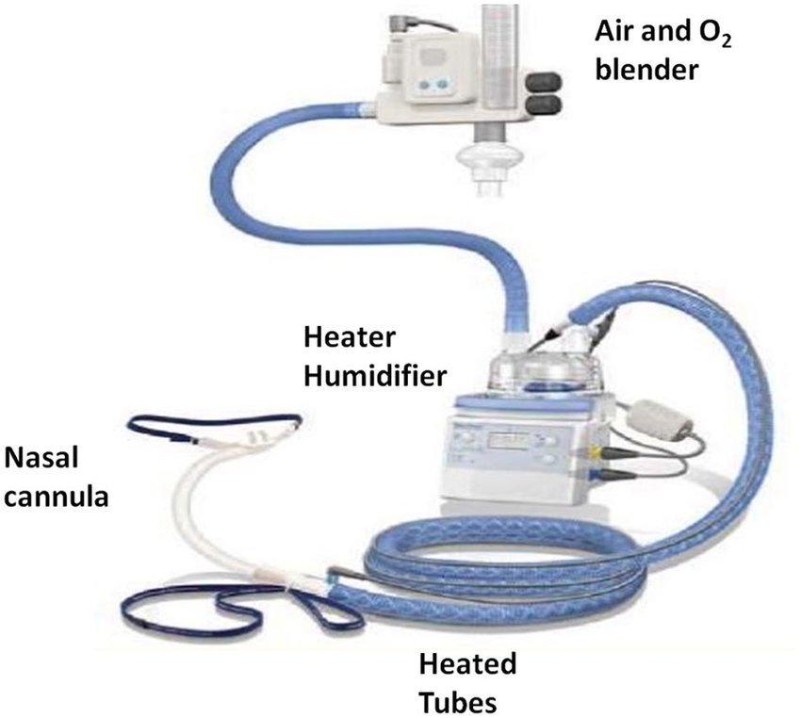
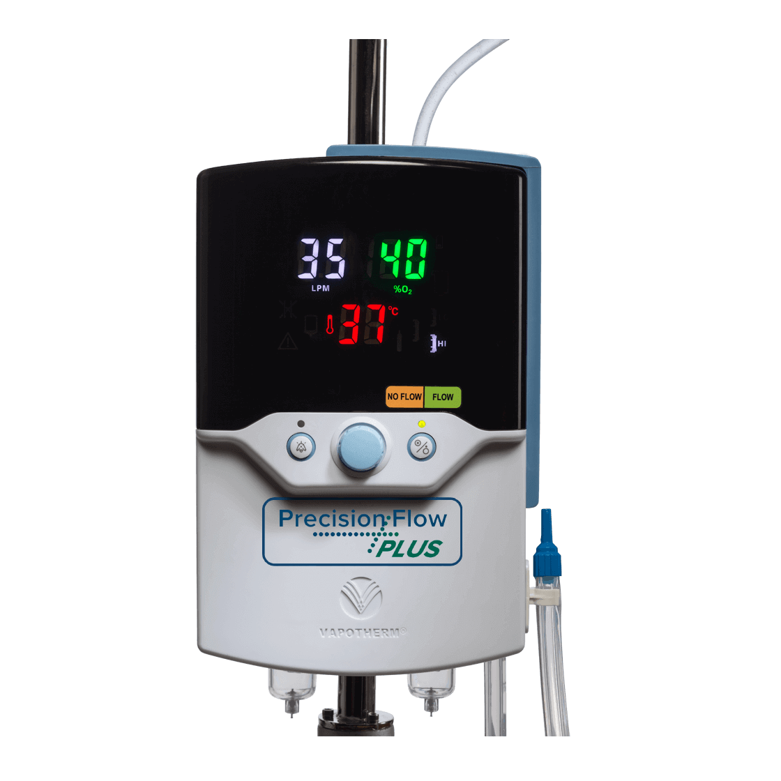
High-Flow Nasal Oxygen (HFNO)
Indications
  Hypoxemic respiratory failure failing traditional oxygen therapy (TOT)
  Increased work of breathing (WOB) despite TOT
  Can be used to has intermediate between TOT and MV
Contraindications
  Ventilatory failure
Notes:
Two most common machines used include the vapotherm and optiflow

Slide 30
High-Flow Nasal Oxygen (HFNO)
Heat and Humidification
  Improved tolerance of higher flow rates
  Improves airway secretion mobilization
PEEP
  Positive airway pressures when Flow > minute ventilation
  PEEPs of 4-6 cmH₂O achieved depending on flow rate and mouth position
Increased PaO₂
  Correlated with increased flow rates due to airway dead space washout and airway recruitment

Slide 31
High-Flow Nasal Oxygen (HFNO)
Nasal cannula
  50% occlusion of the nares to provide appropriate amount of PEEP and necessary air escape
    Total nare surface area (use only ONE nasal prong if necessary)
  Use tape and/or modeling clay to modify to dog face

Slide 32
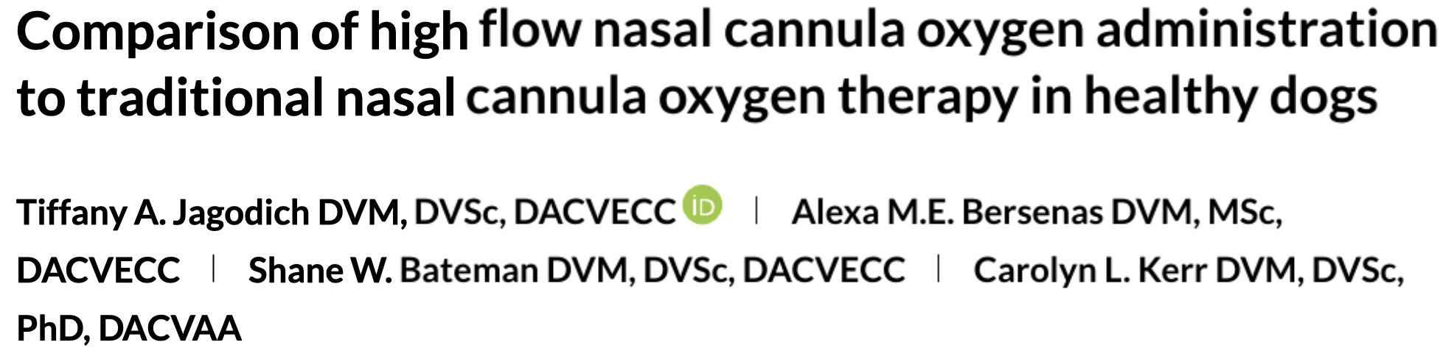
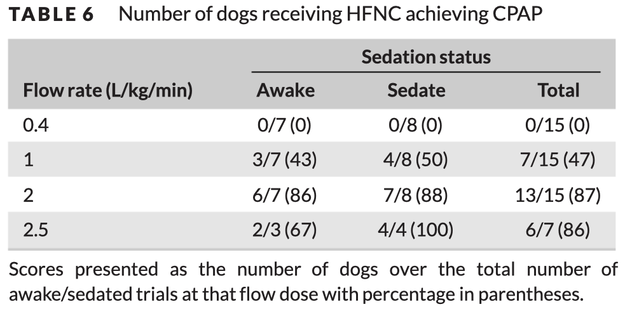
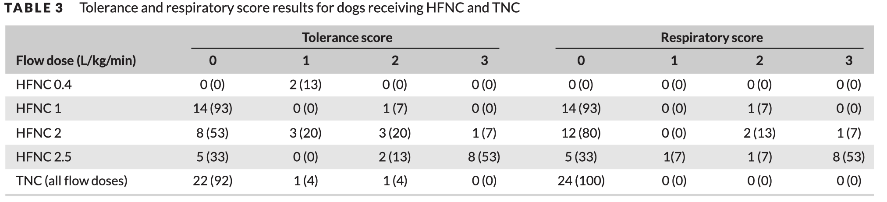
High-Flow Nasal Oxygen (HFNO)
Flow rate
  CPAP achieved with flows between 1-2L/k/min (Jagodich et al 2019)
    No significant difference in CPAP between 2 and 2.5LPM
      This increase in flow rate above 2L/kg/min was associated with worse patient tolerance (Jagodich et al 2019, Pouzot-Nevoret et al 2019)
Notes:
2019 randomized experimental crossover study of 8 healthy beagle dogs published in 2019 in JVECC by Jagodich et al
Suggested that flow rates between 1-2L/kg/min provided level of CPAP without significant increase inpatient discomfort
Flow rate of 1L/kg/min provided 4.2cmH20 CPAP and 2L/kg/min provided 6.56cmH20 CPAP
In both tolerance and respiratory scores, lower numbers were more favorable.

Slide 33
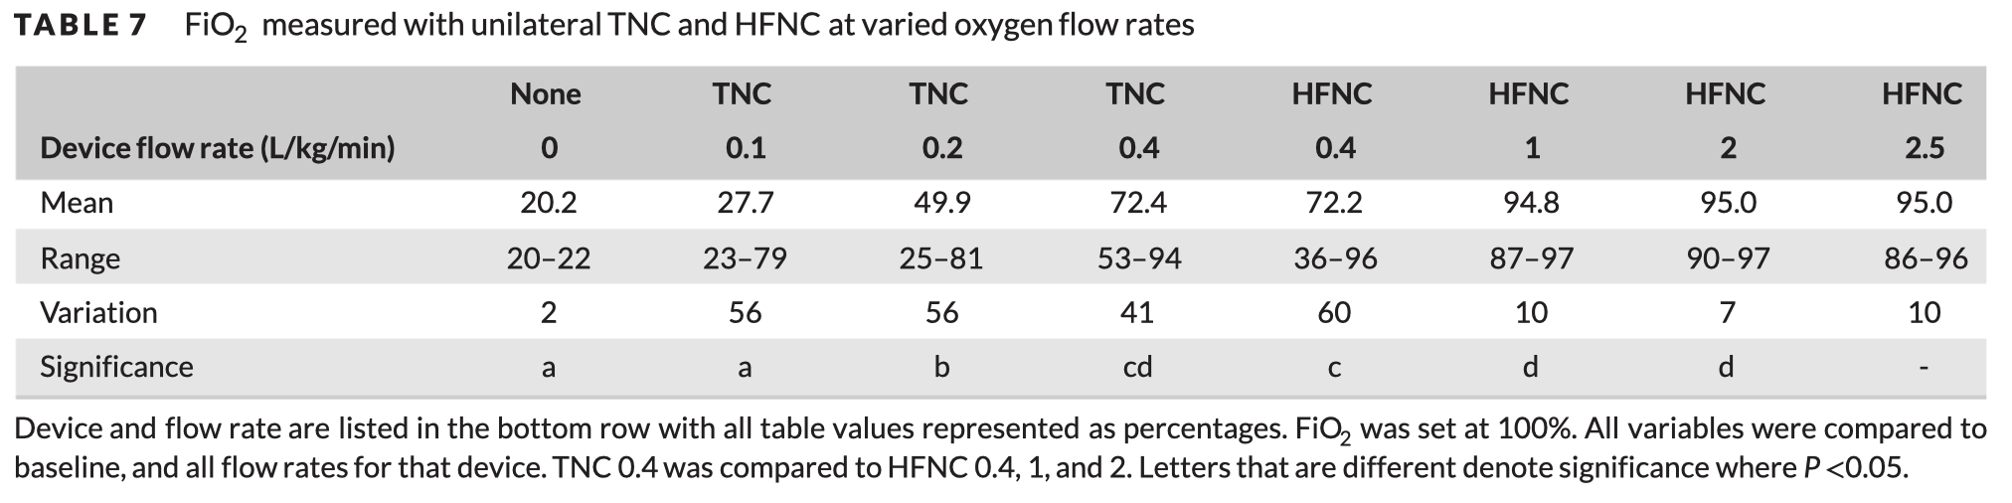
High-Flow Nasal Oxygen (HFNO)
Increased flow rates associated with higher FiO₂ due to wash out of airway deadspace (Jagodich et al 2019)
  No benefit to flow rates above 2L/kg/min

Slide 34
High-Flow Nasal Oxygen (HFNO)
Complications
  Development of hypercapnia (Keir et al 2016, Daly et al 2017, Jagodich et al 2018, Jagodich et al 2019)
    Not clinically significant
    Suggested mechanisms include: sedation-related hypoventilation, CO2 trapping causes by CPAP effect
    Not reported in humans
  Air leak
    Persistence of a traumatic pneumothorax noted in 1 case (Keir et al 2016)

Slide 35
High-Flow Nasal Oxygen (HFNO)
Prognosis
  In human medicine, clinical outcomes similar between HFNO and other NIV methods (CPAP)
  Multicenter RCT published in NEJM in 2015 showed increased ventilator-free days in patients treated with HFNO compared to NIV group
    Paucity of evidence in veterinary literature
Criteria for escalation of therapy
  Insufficient improvement within 1 hour of therapy
    Biochemical parameters (PaO₂, PaCO₂), or clinical parameters (WOB)
    Single veterinary study evaluating response to treatment noted improvements in 60% of dogs within 30 minutes (Jagodich et al 2020)

Slide 36
High-flow nasal oxygen
Pros
Cons
Humidified air
  Better tolerance
Level of PEEP
May help some cases avoid need for MV
  Increased cost and morbidity associated with therapy escalation
May delay time to MV in patients who would benefit from more aggressive therapy
Select few patients may not tolerate interface

Slide 37
Mechanical Ventilation

Slide 38
Mechanical Ventilation (MV)
Indications
  Inadequate PaO₂ despite less invasive oxygen supplementation methods
    TOT or NIMC/HFNO
  Inadequate ventilation (PaCO₂ >/= 60mmHg)
    Primary lung disease vs neuromuscular disease
  Excessive work of breathing (WOB) and concern for respiratory fatigue
  Severe refractory hemodynamic compromise
    Anesthesia/heavy sedation cause decreased oxygen consumption

Slide 39
Mechanical Ventilation (MV)
Prognosis depends on species and underlying disease processes
  Cats have a poorer prognosis for survival/successful weaning than dogs in all categories
  Disease Processes
    Neuromuscular/ventilatory failure (57-71% survival) (33% in cats)
      Cervical disease (62-71%)
      Intracranial disease (13%)
      Toxicosis (0-86%)
      Post-ROSC (11%) (11% in cats)
    Pulmonary parenchymal disease (20-33% survival) (14% in cats)
      Pneumonia (60%)
      Heart failure (62-77%%)
      Pulmonary contusions (33-57%)
      ARDS (8%)

Slide 40
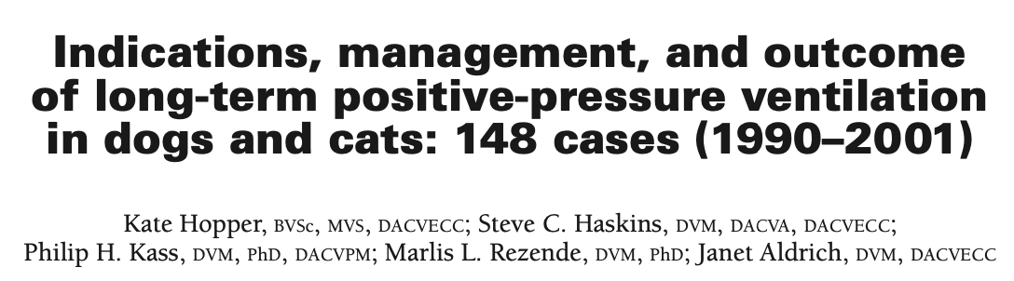
Mechanical Ventilation (MV)
According to Hopper et al 2007, Lower Pi:F ratios, feline patients, higher PEEP were associated with worse outcomes
Notes:
Hopper et al 2007 investigated the prognosis associated with long-term MV defined as MV of >/=24h

Slide 41
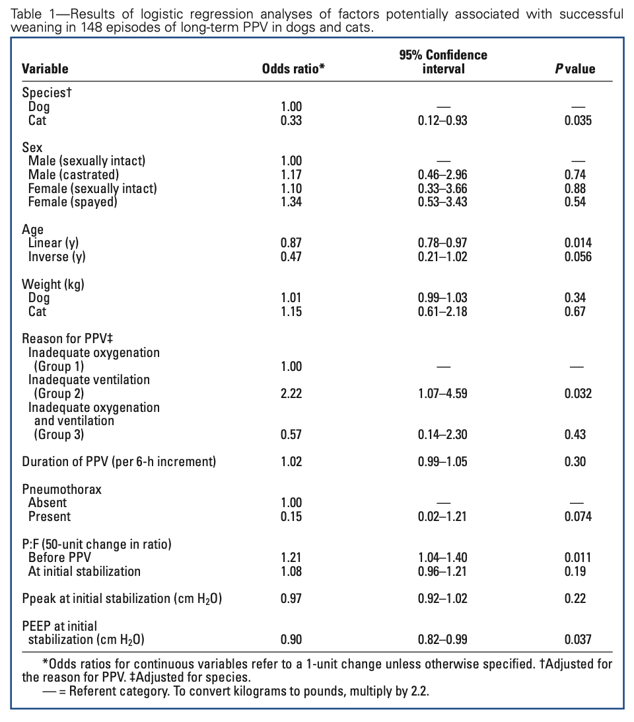
Mechanical Ventilation (MV)
According to Hopper et al 2007, Lower Pi:F ratios, feline patients, higher PEEP were associated with worse outcomes in patients receiving MV for >/= 24h
  Compared to pulmonary parenchymal disease, animals with neuromuscular disease had better prognosis
Notes:
Hopper et al 2007 investigated the prognosis associated with long-term MV defined as MV of >/=24h

Slide 42
Mechanical Ventilation (MV)
Sedation
  Generally injectable: protocol varies by patient
Endotracheal tube maintenance
  ET tube cuff pressures between 20-25mmH₂O
    Higher pressures can lead to tracheal necrosis
    Lower pressures predispose to VAP
  Move ET tube location every 4 hours
  Replace every 24-48 hours if excessive secretions
Airway care
  ET tube suctioning at least every 4 hours
Oral
  Clean at least every 4 hours with dilute chlorhex solution
Recumbent/anesthetized care
  PROM
  Urinary catheterization
  Nutrition (NG tube, E tube, other)
  Eye lubrication
Notes:
The American Thoracic Society recommends maintaining ET tube cuff pressure above 20mmH2O to prevent VAP

Slide 43
Mechanical Ventilation (MV)
Complications
  Pneumothorax (7-28%)
    Cats (28%)
  Ventilator-Associated Pneumonia (VAP)
    Dogs (23%)
    Cats (15%)
  Oral ulcerations (8-90%)

Slide 44
Oxygen Toxicity

Slide 45
Oxygen Toxicity
Associated with FiO₂ >/= 50% for 24-72 hours
  Cats may be more sensitive than dogs
Occurs in phases
  Initiation: ROS species produced within 12-72 hours of exposure to FiO₂₌100
  Inflammation: Increased cytokines induce pulmonary edema and inhibit gas exchange
  Proliferation: Increased type II pneumocytes (not helpful for gas exchange)
  Fibrosis: Permanent
Clinical application: Decrease oxygen supplementation to the minimum acceptable level ASAP

Slide 46
Therapy | Max FiO₂ | PEEP | Type of Resp Failure | Heavy sedation?
Flow by/ face mask | 40 | No | Hypoxemic | No
Oxygen Cage | 60 | No | Hypoxemic | No
Nasal(pharyngeal) Prongs | 70 | No | Hypoxemic | No
CPAP | 40 | Yes | Hypoxemic | Sometimes
High Flow | 95 | Yes | Hypoxemic | No
Mechanical Ventilation | 100 | Yes | Hypoxemic, Ventilatory | Yes

Slide 47

Questions?

Slide 48
References
1. Basics of Mechanical Ventilation for Dogs and Cats | Elsevier Enhanced Reader. doi:10.1016/j.cvsm.2013.03.009
2. Beal MW, Paglia DT, Griffin GM, Hughes D, King LG. Ventilatory failure, ventilator management, and outcome in dogs with cervical spinal disorders: 14 cases (1991-1999). Journal of the American Veterinary Medical Association. 2001;218(10):1598-1602. doi:10.2460/javma.2001.218.1598
3. Briganti A, Melanie P, Portela D, Breghi G, Mama K. Continuous positive airway pressure administered via face mask in tranquilized dogs. Journal of Veterinary Emergency and Critical Care. 2010;20(5):503-508. doi:https://doi.org/10.1111/j.1476-4431.2010.00579.x
Brown JE, Bersenas AME, Mathews KA, Kerr CL. Noninvasive ventilation in cats. Journal of Veterinary Emergency and Critical Care. 2009;19(5):416-425. doi:https://doi.org/10.1111/j.1476-4431.2009.00458.x
5. Campbell VL, King LG. Pulmonary function, ventilator management, and outcome of dogs with thoracic trauma and pulmonary contusions: 10 cases (1994–1998). Journal of the American Veterinary Medical Association. 2000;217(10):1505-1509. doi:10.2460/javma.2000.217.1505
6. Ceccherini G, Lippi I, Citi S, et al. Continuous positive airway pressure (CPAP) provision with a pediatric helmet for treatment of hypoxemic acute respiratory failure in dogs. Journal of Veterinary Emergency and Critical Care. 2020;30(1):41-49. doi:https://doi.org/10.1111/vec.12920
7. Daly JL, Guenther CL, Haggerty JM, Keir I. Evaluation of oxygen administration with a high-flow nasal cannula to clinically normal dogs. American Journal of Veterinary Research. 2017;78(5):624-630. doi:10.2460/ajvr.78.5.624
8. Donaldson RE, Barfield D. Quality of life following mechanical ventilation in dogs and cats. Journal of Veterinary Emergency and Critical Care. 2020;30(6):718-721. doi:https://doi.org/10.1111/vec.13002
9. Dunphy ED, Mann FA, Dodam JR, et al. Comparison of unilateral versus bilateral nasal catheters for oxygen administration in dogs. Journal of Veterinary Emergency and Critical Care. 2002;12(4):245-251. doi:https://doi.org/10.1046/j.1435-6935.2002.t01-1-00049.x
10. Edwards TH, Coleman AE, Brainard BM, et al. Outcome of positive-pressure ventilation in dogs and cats with congestive heart failure: 16 cases (1992–2012). Journal of Veterinary Emergency and Critical Care. 2014;24(5):586-593. doi:https://doi.org/10.1111/vec.12230

Slide 49
References
11. Hoareau GL, Mellema MS, Silverstein DC. Indication, management, and outcome of brachycephalic dogs requiring mechanical ventilation. Journal of Veterinary Emergency and Critical Care. 2011;21(3):226-235. doi:https://doi.org/10.1111/j.1476-4431.2011.00635.x
12. Hopper K, Kass PH, Rezende ML, Aldrich J. Indications, management, and outcome of long-term positive-pressure ventilation in dogs and cats: 148 cases (1990–2001). Scientific Reports. 2007;230(1):12.
13. Jackson RM. Pulmonary Oxygen Toxicity. CHEST. 1985;88(6):900-905. doi:10.1378/chest.88.6.900
14. Jagodich TA, Bersenas AME, Bateman SW, Kerr CL. Comparison of high flow nasal cannula oxygen administration to traditional nasal cannula oxygen therapy in healthy dogs. Journal of Veterinary Emergency and Critical Care. 2019;29(3):246-255. doi:https://doi.org/10.1111/vec.12817
15. Jagodich TA, Bersenas AME, Bateman SW, Kerr CL. High-flow nasal cannula oxygen therapy in acute hypoxemic respiratory failure in 22 dogs requiring oxygen support escalation. Journal of Veterinary Emergency and Critical Care. 2020;30(4):364-375. doi:https://doi.org/10.1111/vec.12970
16. Jagodich TA, Bersenas AME, Bateman SW, Kerr CL. Preliminary evaluation of the use of high-flow nasal cannula oxygen therapy during recovery from general anesthesia in dogs with obstructive upper airway breathing. Journal of Veterinary Emergency and Critical Care. 2020;30(4):487-492. doi:https://doi.org/10.1111/vec.12971
17. Kalil AC, Metersky ML, Klompas M, et al. Management of Adults With Hospital-acquired and Ventilator-associated Pneumonia: 2016 Clinical Practice Guidelines by the Infectious Diseases Society of America and the American Thoracic Society. Clin Infect Dis. 2016;63(5):e61-e111. doi:10.1093/cid/ciw353
18. Keir I, Daly J, Haggerty J, Guenther C. Retrospective evaluation of the effect of high flow oxygen therapy delivered by nasal cannula on PaO2 in dogs with moderate-to-severe hypoxemia. Journal of Veterinary Emergency and Critical Care. 2016;26(4):598-602. doi:https://doi.org/10.1111/vec.12495
19. King LG, Hendricks JC. Use of positive-pressure ventilation in dogs and cats: 41 cases (1990-1992). J Am Vet Med Assoc. 1994;204(7):1045-1052.

Slide 50
References
20. Lee JA, Drobatz KJ, Koch MW, King LG. Indications for and outcome of positive-pressure ventilation in cats: 53 cases (1993-2002). Journal of the American Veterinary Medical Association. 2005;226(6):924-931. doi:10.2460/javma.2005.226.924
21. Mach WJ, Thimmesch AR, Pierce JT, Pierce JD. Consequences of Hyperoxia and the Toxicity of Oxygen in the Lung. Nursing Research and Practice. 2011;2011:1-7. doi:10.1155/2011/260482
22. NEJM199404143301507.pdf. Accessed February 25, 2021. https://www.nejm.org/doi/pdf/10.1056/NEJM199404143301507?articleTools=true
23. Pouzot‐Nevoret C, Hocine L, Nègre J, et al. Prospective pilot study for evaluation of high-flow oxygen therapy in dyspnoeic dogs: the HOT-DOG study. Journal of Small Animal Practice. 2019;60(11):656-662. doi:https://doi.org/10.1111/jsap.13058
24. Powell LL. Mechanical Ventilation in the Emergency Room. In: Textbook of Small Animal Emergency Medicine. John Wiley & Sons, Ltd; 2018:1216-1218. doi:10.1002/9781119028994.ch188
25. Rutter CR, Rozanski EA, Sharp CR, Powell LL, Kent M. Outcome and medical management in dogs with lower motor neuron disease undergoing mechanical ventilation: 14 cases (2003–2009). Journal of Veterinary Emergency and Critical Care. 2011;21(5):531-541. doi:https://doi.org/10.1111/j.1476-4431.2011.00669.x
26. Silverstein DC, Hopper K. SACCM. Elsevier Saunders, St Louis Missouri, 2nd ed. 2015
27. Ticehurst K, Zaki S, Hunt GB, Macpherson C, Nicholson H. Use of continuous positive airway pressure in the acute management of laryngeal paralysis in a cat. Australian Veterinary Journal. 2008;86(10):395-397. doi:https://doi.org/10.1111/j.1751-0813.2008.00350.x

