Slide 1
Lactate
Victoria Chu, DVM

Slide 2
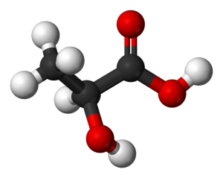
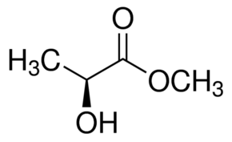
Lactate forms:
Lactate = C₃CH(OH)COO⁻ = anion
Lactic acid C₃CH(OH)COOH
  pKa = 3.8 at physiologic pH, so typically fully dissociated into lactate anions and protons (H+)
L-lactate
  >99% total body lactate
  Isomer of major physiological significance
D-lactate
  Formed by glyoxalase pathway or produced by commensal bacteria in mammalian GIT
  Efficiently metabolized and reabsorbed by the kidney
Normal half-life: 20-60 mins
What two stereoisomers of lactate are there?

Slide 3
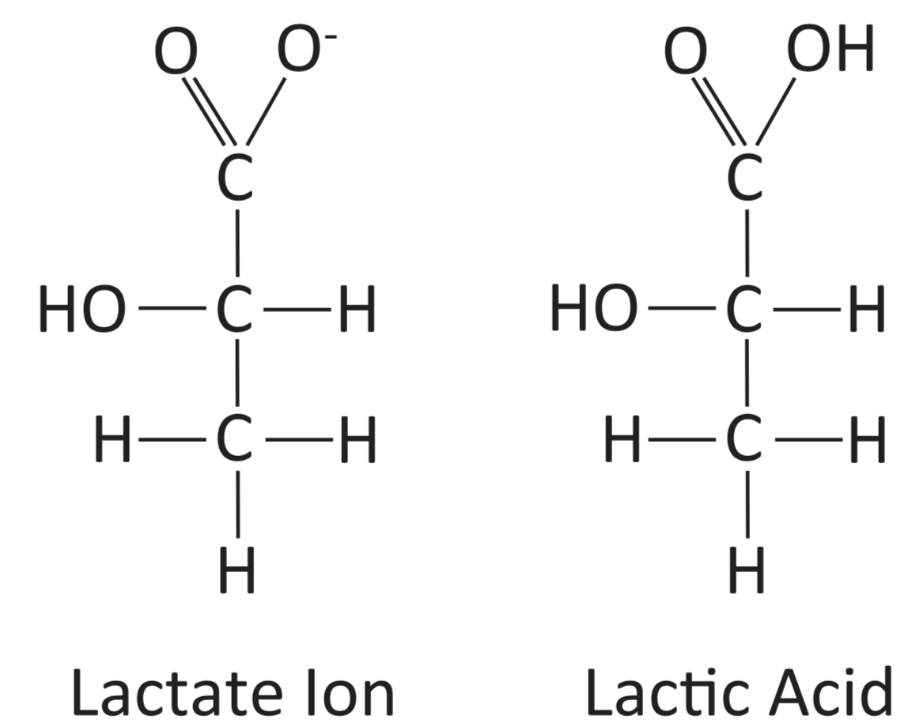
C₃CH(OH)COO⁻ = anion
C₃CH(OH)COOH

Slide 4
Definitions
Hyperlactatemia: serum, plasma, or blood lactate concentration is above relevant reference interval (pH normal with buffering system)
Lactic acidosis: moderate to severe hyperlactatemia with concurrent metabolic acidosis
  Common cause of metabolic acidosis in dogs and cats
  Result of ATP hydrolysis w/o concurrent proton consumption by ETC and subsequent proton accumulation
  Strong anion (similar acidifying effect as chloride per Stewart’s physiocochemical approach)
    [SID⁺] = [Na⁺] + [K⁺] + [Ca²⁺] + [Mg²⁺]– [Cl⁻] - [lactate]
    ↑lactate = ↓Strong ion difference (SID) = proportionate ↑H+ and acidosis
  Quantitative approach: Every 1mmol/L increase in lactate = decreased BE 1 unit

Slide 5
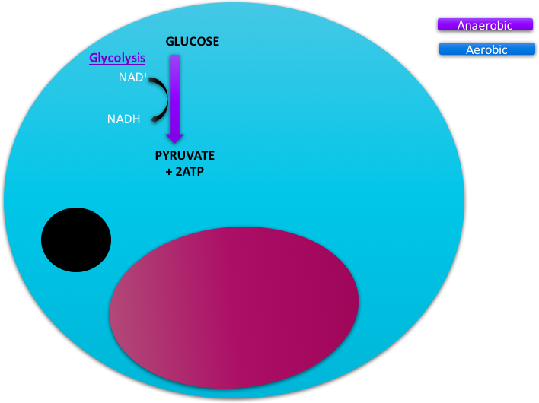
Glucose
Metabolism
Glycolysis
  6-carbon glucose → two 3-carbon pyruvate, 2 ATP, 2 reduced nicotinamide adenine dinucleotide (NADH)
  Requires glucose and oxidized (NAD⁺) to produce ATP
  Does NOT require oxygen
  Pyruvate transported into mitochondrion→decarboxylatation → acetyl-CoA
    Reaction irreversible, requires NAD⁺, catalyzed by pyruvate dehydrogenase complex
Notes:
Aerobic conditionsglucose -> pyruvate (and 2ATP) by glycolysis

Slide 6
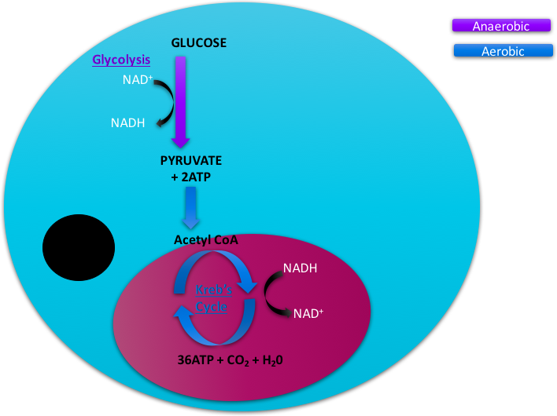
Glucose
Metabolism
Tricarbocylic acid (TCA) cycle
  Acetyl-CoA goes through TCA cycle
    AKA Kreb’s cycle or citric acid cycle (CAC)
    Produces CO2, 3x NAD+, and 1 reduced flavin adenine dinucleotide (FADH)
      Protons from NADH and FADH2 create proton gradient for production of ATP through electron transport chain (ETC)
*Oxidation of 1 glucose molecule produces 36 molecules of ATP*
Notes:
then pyruvate is convered in mitochondria via crebs cycle to make 36atp

Slide 7
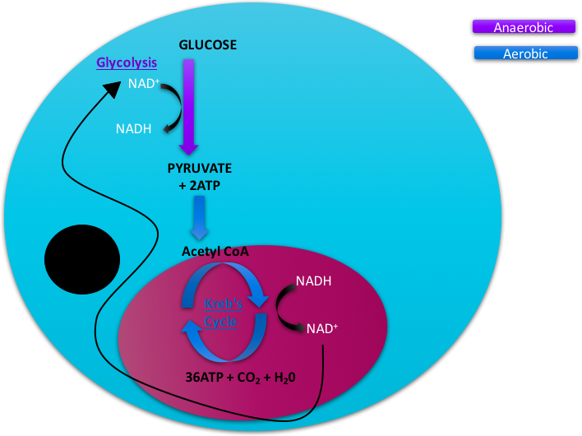
Glucose
Metabolism

Slide 8
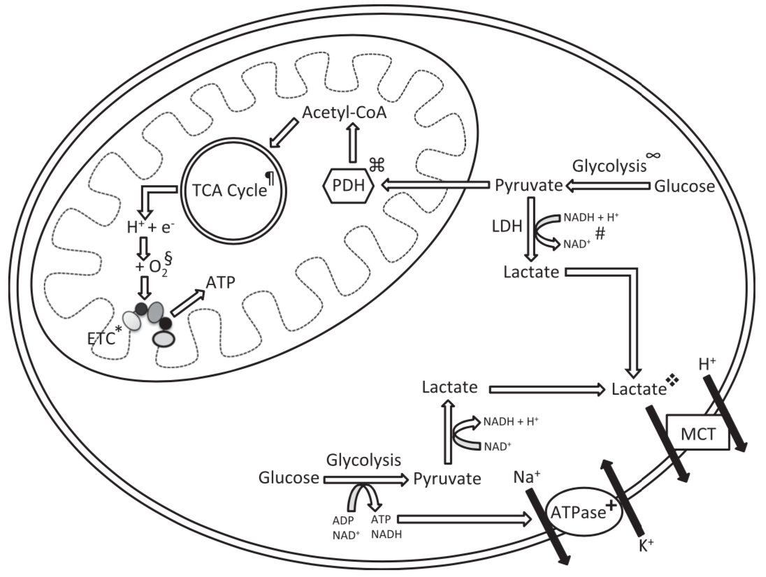
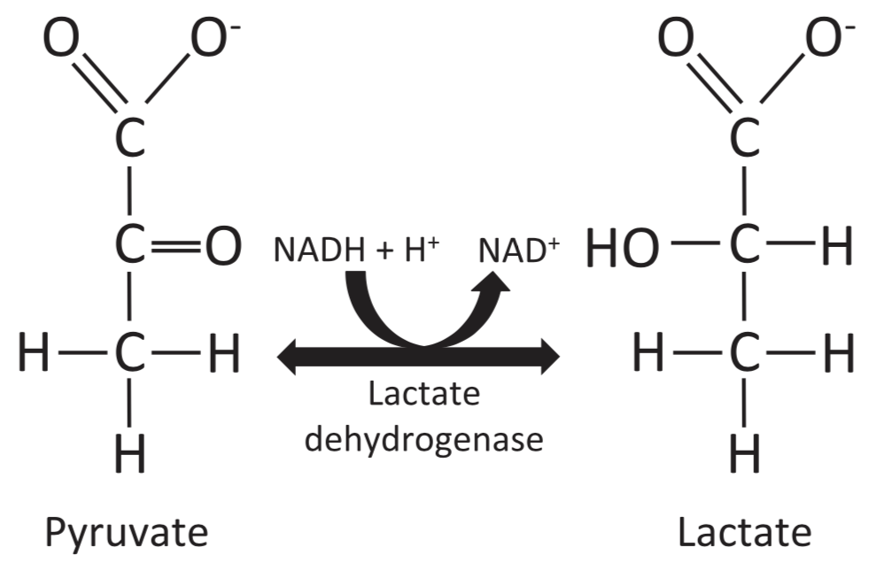
Lactate Biochemistry
Pyruvate → Lactate (by lactate dehydrogenase (LDH))
  Reversible cytosolic reaction
  NADH oxidized to NAD +
When oxygen demand exceeds supply (anaerobic condition):
  NAD+ store deplete, pyruvate and NADH accumulate in cytosol, ↑LDH activity
  Lactate formation ↓pyruvate and H+ in cytosol, replenish NAD+ for glycolysis
When oxygen supply restored:
  LDH transforms lactate → pyruvate → TCA cycle or gluconeogenesis

Slide 9
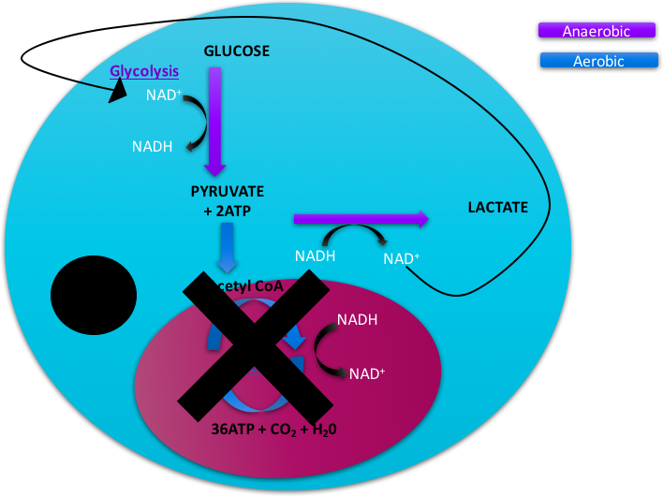
Glucose
Metabolism
In cells without mitochondria (RBC):
pyruvate instead converted to lactate via LDH so NAD can be recycled
in normal health 10% pyruvate -> lactate
LDH

Slide 10
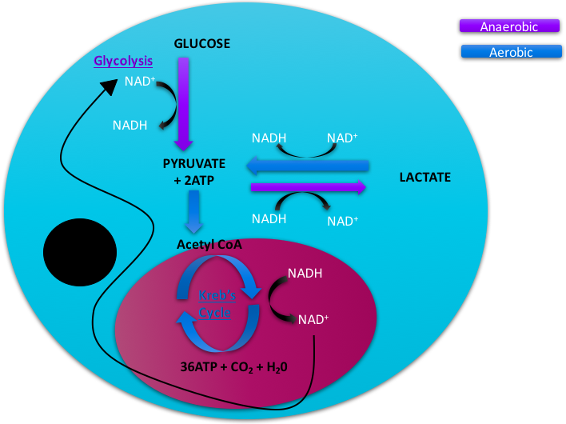
Glucose
Metabolism
LDH
Pyruvate to lactate is reversible process

Slide 11
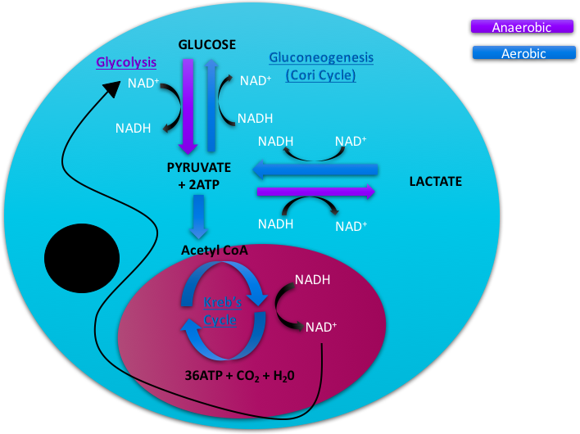
Glucose
Metabolism
CORI CYCLE = production of lactate in 1 tissue and conversion to glucose in another
LDH

Slide 12
Glucose
Metabolism
LDH
Notes:
Draw the basic outline of glucose metabolism in an aerobic and anaerobic metabolizing cell

Slide 13
Lactate transport
3 main forms of lactate transports:
Lactate crosses cell membrane and moves into blood via bi-directional:
  Proton-linked monocarboxylate transports (MCT)
    Sodium-coupled MCT (14 different ones)
    Facilitated passive transport
    MCT 1 and MCT 4 most important
    Role in “lactate shuttle”: energy currency exchange b/w different cells and tissue types
      In brain, striated muscle, liver, kidneys and myocardium
  Free diffusion
  Anion exchanger

Slide 14
Lactate Production
What three tissues are highest lactate producers?
High producer of lactate
  Skeletal muscle (40-50%)
  Brain (13%)
  Adipose tissue (variable)
  Other: renal medulla, GIT, skin, RBC, WBC, platelets
    In blood: RBC 80%, WBC 13% (neut), platelet 7%
      In vitro red cell glycolysis can artificially increase lactate
      WB lactate is higher than plasma lactate

Slide 15
Lactate clearance/consumption
What three tissues are most important for lactate clearance?
Liver (20-30%)
  Large reserve capacity for lactate metabolism (conversion back to pyruvate)
  Clearance is maintained in cirrhotic livers
  Clearance may fail in acute hepatopathies
  Clearance is decreased in acidosis
    During marked hypoperfusion shifts to production
Renal cortex (20%)
  Freely filtered through glomerulus
  Reabsorbed via proximal convoluted tubule (almost completely)
  Lactate metabolism (gluconeogenesis) and some lactate excretion at higher load
  Clearance is increased in acidosis
Myocardium (5-15%) – important lactate consuming tissue
Brain and skeletal muscles can switch to net lactate consumption
  Sometimes preferred over glucose

Slide 16
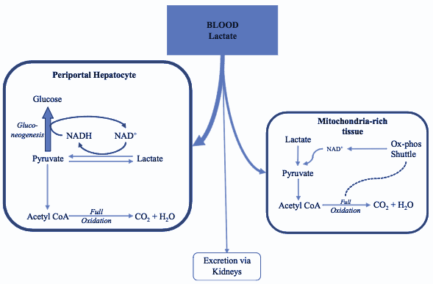
Lactate clearance/consumption
Lactate constantly produced, level depends on balance between production and clearance
Lactate shuttle - from producing cells to consuming cells

Slide 17
Lactate → Acidosis
Lactic acid
Lactate
H⁺
**Lactate produced in physiologic processes is NOT lactic acid**
So why does hyperlactatemia cause a metabolic acidosis?
Notes:
Equilibrium, favors H+ at physiologic pH

Slide 18
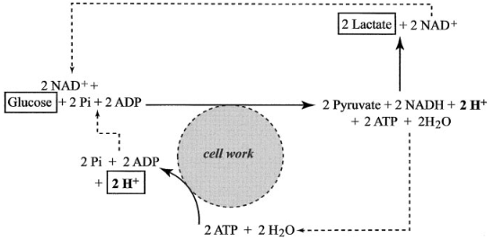
Lactate → Acidosis
Glycolysis produces ATP that is hydrolyzed and generates H+
Net gain in H+ is avoided in health because:
  Lactate consumption removes equivalent number of H+
  ATP produced H+ usually consumed to ETC
  H+ produced in anaerobic respiration is also buffered in blood
  Acidosis only happens when buffers overwhelmed and decreased aerobic metabolism
Increased glycolysis → increased lactate
Increased ATP and H+

Slide 19
Classifications
Type A: Insufficient oxygen supply
  Relative: from increased oxygen demand
  Absolute: from decreased oxygen delivery
Type B: Adequate oxygen supply
  B1: underlying disease
  B2: drug or toxin induced
  B3: congenital errors in metabolism

Slide 20
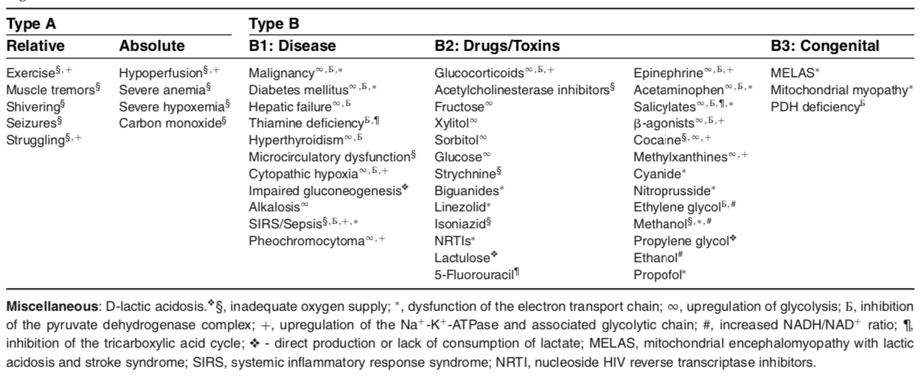

Slide 21
Type A Hyperlactatemia
DO2 = CO x (1.39 x [Hb] x SaO2 + (0.003 x PaO2))
DO2 should be greater than VO2 (oxygen extraction)
  In health 25-30% extracted
  Below critical DO2 anaerobic metabolism increases and lactate is produced
1.39 is the hemoglobin oxygen binding capacity
0.003 is the amount of oxygen dissolved in blood per each mmHg of O2
As delivery decreases extraction can increase

Slide 22
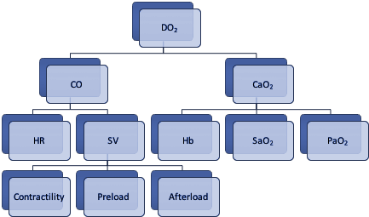
Oxygen Delivery
Anything that influences DO2 can increase lactate production
Increased lactate may be present without any other markers for hemodynamic instability

Slide 23
Relative Type A Hyperlactatemia
Increased oxygen demand:
  Causes: exercise, seizure activity, shivering, trembling, struggling
  In healthy animals, lactate levels fall rapidly following cessation of activity
    ½ life = 20-60min
  Seizure-induced hyperlactatemia usually due to muscle activity
  Ex: Greyhound racing lactate >30mmol/L; 5 min bath cats ~7mmol/L

Slide 24
Absolute Type A Hyperlactatemia:
Decreased oxygen delivery
Shock:
  Most common cause of pathologic hyperlactatemia
  Shock = inadequate O2 delivery to tissues → impaired mitochondrial respiration and increased anaerobic metabolism
  Occurs quickest in maldistributive shock > hypovolemic, cardiogenic, obstructive
    Due to impaired oxygen extraction from mitochondrial and microcirculatory dysfunction
  Shock clinical findings: tachycardia, hypotension, depressed mentation, inadequate urine output
  “Occult shock”: tissue hypoperfusion despite “normal” standard hemodynamic variables
    “Decreased central venous oxygen saturation despite normalization of heart rate and blood pressure post shock resuscitation in sick dogs.” J Vet Emerg Crit Care 2014
    Clinical trial showed persistent hyperlactatemia and/or persistently low ScvO2 (<70%) suggesting ongoing tissue hypoperfusion despite normalization of routine hemodynamic parameters
  Type B hyperlactatemia contributes to shock-associated hyperlactatemia as well
  Mild hypoperfusion = lactate 3-5 mmol/L; moderate 5-7; severe >7

Slide 25
Absolute Type A Hyperlactatemia:
Decreased oxygen delivery
Regional Ischemia
  Lactate is a nonspecific marker of mesenteric or splanchnic ischemia
  GDV study: 74% in one study lactate >6mmol/L had gastric necrosis, 33% in another study
Anemia and Hypoxemia
  Correlation b/w anemia & lactate depends on chronicity: acute severe anemia (hemorrhage, hemolysis) more likely to develop hyperlactatemia
  Hypoxemia: PaO2 needs to be <40 mmHg before lactate increase
Carbon Monoxide Poisoning
  CO binds to Hb with 250x affinity than O2 → COHb →inhibits effective O2 transport
  CO shifts oxyhemoglobin curve to the left
    ↓O2 delivery → cellular damage and oxidative stress
  Hyperlactatemia occurs from tissue hypoxia +/- mitochondrial dysfunction & catecholamine effects

Slide 26
Type B1 Hyperlactatemia: Underlying Dz
Malignancy
  Variety of potential mechanisms:
    Increased production of glycolytic enzymes by hypoxia-inducible factors 1 and 2
    Increased production of glycolysis intermediate (pentose phosphate pathway)
    Mitochondrial dysfunction
    Reduced hepatic clearance
    Malnutrition → thiamine deficiency
  Warburg effect: Malignant cells preferentially use glycolytic pathways despite oxygen available, leading to lactic acid fermentation in cytosol
  Lactate may also alter tumor microenvironment that inhibits destruction of neoplastic cells
  Modern chemo: inhibition of enzymes involved in lactate transport and metabolism inhibit tumor growth in various neoplastic cell lines
  Human: hematologic neoplasia, lung/prostate/breast cancers
  Uncommon cause in dogs; diagnosis of exclusion, confounded by other pathologies such as sepsis or hepatic dysfunction

Slide 27
Type B1 Hyperlactatemia (Cont’d)
Diabetes mellitus
  Altered carbohydrate metabolism
    Hyperlactatemia due to upregulated glycolysis, impaired glycogenesis, reduced pyruvate dehydrogenase (PDH) activity, reduced oxidative metabolism
  Commonly seen in DKA : hypovolemia (type A) + altered CHO metabolism (type B1)
  DM dogs have higher lactate levels than non-diabetic
  DM/DKA cats have higher D-lactate conc, but not L-lactate
Hepatic disease
  Rarely a cause, either acutely challenged by lactate load or experiencing concurrent hypoperfusion (severe hepatic dysfunction or failure)
  Hepatic lactate production increased via glycolytic upregulation, reduced PDH activity, and impaired hepatic gluconeogenesis
  Could be combo of increased hepatic lactate production and decreased hepatic lactate clearance
Renal disease
  Hyperlactatemia from AKI or CRF rare unless with hypovolemia

Slide 28
Type B1 Hyperlactatemia (Cont’d)
Thiamine (B1) deficiency
  Uncommon but well documented cause of hyperlactatemia
  Deficiency leads to compromised bioenergetics and accumulation of pyruvate and lactate
    Caused by sepsis, critical illness, chronic malnutrition, TPN w/o thiamine supplementation, hyperthyroidism
  Thiamine important in metabolic pathway after converted to thiamine pyrophosphate (TPP)
    TPP is a cofactor for: PDH, alpha-ketoglutarate dehydrogenase in TCA cycle, transketolase in pentose phosphate pathway, and ketoacid dehydrogenase
  Signs in dogs/cats: cervical ventroflexion, ataxia, mydriasis, depressed mentation, sz activity
Hyperthyroidism
  Increase basal metabolic rate → ↑ CHO metabolism + hyperlactatemia via upregulation of glycolysis and hexose monophosphate pathway
  Hyperthyroidism/thyroid storm are risk factors for thiamine deficiency

Slide 29
Type B1 Hyperlactatemia (Cont’d)
Microcirculatory dysfunction
  MOST important cause of impaired O2 extraction in maldistributive shock
  Sepsis enhances NO production, alters neurohormonal control of endothelial and vascular smooth muscle, reduces RBC flexibility, activates WBC → microcirculatory heterogeneity
  Microcirculatory flow impaired due to erythrocyte aggregation, leukocyte adhesion, local edema, microvascular thrombosis
  Microcirculatory shunt contributes to hyperlactatemia and increases SvO2 seen in sepsis
  It can occur independently of macrocirculatory hemodynamic variables
    Normalization of vital parameters ≠ normalization of tissue perfusion
Altered cellular respiration= cytopathic hypoxia
  Causes: mitochondrial dysfunction, upregulation of glycolysis, impaired gluconeogenesis
    direct cytochrome inhibition (E.g. cyanide)
    Impaired mitochondrial regeneration
    Loss of normal electrochemical gradient b/w mitochondrial matrix & intermembrane space resulting in impaired ATP production
    PDH dysfunction

Slide 30
Type B1 Hyperlactatemia (Cont’d)
Catecholamines
  Adrenergic stimulation by catecholamines leads to hyperlactatemia
  Epinephrine = most important
    Dose-related increase in lactate → increased cAMP production via B2-adrenergic stimulation
    Results in glycogenolysis, glycolysis, lipolysis and stimulation of Na/K/ATPase pumps
  Septic + hemorrhagic shock: upregulation of skeletal muscle Na/K/ATPase associated glycolysis = significant source of lactate
  Cause of hyperlactatemia in pheochromocytoma, acute asthmatic crisis (both endogenous release and b2 agonist therapy)
  Fun fact: Seen in healthy university students following exam

Slide 31
Type B1 Hyperlactatemia (Cont’d)
Sepsis and SIRS:
  Complex and multifactorial
    Skeletal muscle Na+/K+-ATPase upregulation
    Mitrochondrial dysfunction including direct cytochrome inhibition
    Increased hepatic lactate production
    Impaired tissue oxygen extraction
    Capillary shunting
    Increased NO production, altered neurohormonal control of endothelial smooth muscle, reduce erythrocyte flexibility, increased leukocyte activity, PDH inhibition

Slide 32
What are some drug/toxins that cause B2 hyperlactatemia?

Slide 33
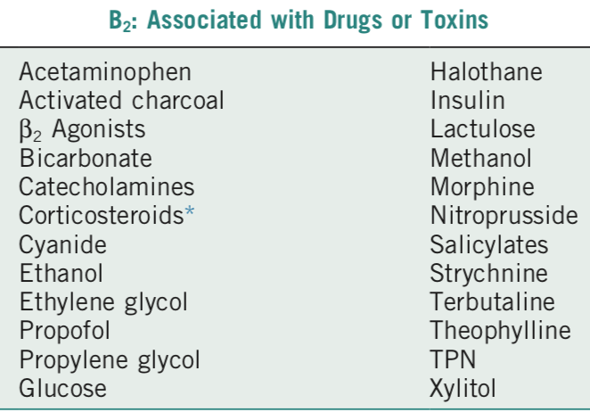
Type B2 Hyperlactatemia:
Drug/toxin induced

Slide 34
Type B2 Hyperlactatemia:
Drug/toxin induced
Acetaminophen
  Hepatic dysfunction → impaired lactate clearance; impaired mitochondrial respiration; methemoglobinemia
Salicylate
  Decreases CoA availability; inhibits succinate dehydrogenase and alpha-ketoglutarate dehydrogenase
  Increase permeability of inner mitochondrial membrane → uncoupling oxidative phosphorylation and stimulates phosphofructokinase → lacate production
Adrenergic agonists and sympathomimetics
  B2 agonists (terbutaline, albuterol): adrenergic stimulation
  Methylxanthines (theophylline, theobromine): ↑ plasma catecholamine, inhibit cAMP breakdown to enhance b-receptor effect, and direct stimulation of Na/K/ATPase
  Cocaine: some sympathomimetic, but mostly ↑ muscle activity or seizures -> ↑ lactate

Slide 35
Type B2 Hyperlactatemia:
Drug/toxin induced
Propofol (not seen in dogs/cats)
  Propofol Infusion Syndrome (PRIS) → impaired fatty acid oxidation and mitochondrial dysfunction
Cyanide/Na nitroprusside
  Cyanide toxicity can occur from smoke inhalation, ingestion of toxins (stone fruit pits, cassava roots, bitter almonds, and bamboo shoots) or infusion of Na nitroprusside
  Cyanide: noncompetitive inhibition of ferric iron in cytochrome C oxidase (IV) → ATP depletion, acidosis, hyperlactatemia, and venous hyperoxia from decrease O2 extraction
  Na nitroprusside: metabolized into 1x NO + 5x cyanide → iatrogenic cyanide toxicity can occasionally occur
    Can also cause hypotension → type A hyperlactatemia
Glucocorticoids
  At both anti-inflammatory and immunosuppressant dose:
    Promotes amino acid conversion to pyruvate
    Inhibits PDH
    Potentiate hyperlactatemic effect of catecholamines
    Alter CHO metabolism

Slide 36
Type B2 Hyperlactatemia:
Drug/toxin induced
Alcohols (ethanol, methanol, propylene glycol, ethylene glycol)
  Ethanol metabolism shifts NAD/NADH ratio in favor of lactate production
    Clinical relevance is controversial
  Methanol: alcohol dehydrogenase converts methanol →formaldehyde→formate, which causes metabolic acidosis, inhibits electron transport chain and worsens hyperlactatemia
    Paint remover, windshield washing fluid, antifreeze, some illicit alcohols
  Propylene glycol:
    Solvent for many drugs (etomidate, phenobarbital, esmolol, digoxin, diazepam etc.)
    Dogs can develop high AG met acidosis and hyperlactatemia
    Cats can develop Heinz body anemia and elevated D-lactic acidosis
  Ethylene glycol:
    EG metabolism to toxic metabolites glycolic acid, oxalate, and glyocylic acid
    Metabolism increases NADH/NAD+ ratio and inhibits pyruvate metabolism → promotes lactate formation

Slide 37
Type B3 Hyperlactatemia: Congenital
Congenital defects in metabolism:
  Mitochondrial encephalomyopathy with lactic acidosis and stroke syndrome
  Defects in pyruvate dehydrogenase (PDH) or in TCA cycle
  Defects in gluconeogenesis affecting pyruvate carboxylase, phosphoenolpyruvate carboxyinase, fructose 1,6-bisphosphatase, or glucose 6-phosphatase
Mitochondrial myopathies reported in GSD, JRT, old English sheepdog, Clumber spaniels, Sussex spaniels

Slide 38
D-Lactate
In mammals, D-lactate efficiently metabolized and reabsorbed by kidney
Increased bacterial fermentation in GI or altered carbohydrate metabolism can increase d-lactate production → D-lactic acidosis
Documented in cats with DKA, EPI, propylene glycol toxicity, GI disease (short bowel syndrome)
D-lactate considered contributing factor in high anion gap metabolic acidosis
LRS: racemic mixture of D-lactate and L-lactate
  L-lactate metabolized, consumes H+ → alkalinizing effect

Slide 39
LRS solution
Caution with:
  Rapid IV bolus
  Disease states
  Sampling line contamination
Large volume bolus in healthy dogs causes significant increase in lactate, but should return to normal within 60mins.
  Should not have clinical effect but caution with interpreting repeat lactate.
  Increased to >2.5 after 50mins at 180mL/kg/hr, average increase 1.7

Slide 40
Measurement of Lactate
Can be measured in whole blood, plasma, or serum
  Plasma lactate = lactate in plasma fraction
  WB lactate= concentration of intraerythrocytic and plasma lactate fractions following RBC lysis
Collection technique:
  struggling that increases muscle activity may effect lactate concentration (variable results in two different cat studies)
  prolonged occlusion of vessel also may increase lactate
Sample collection:
  RBC, WBC and platelets consume glucose & produce lactate → delay in separation of serum and plasma from cells can cause decrease in glucose and increase in lactate
  Collect sample into heparinized syringe, capillary tube or blood tube, and process it ASAP (within 15 mins)
  Sodium citrate interferes w/ lactate measurements ; lithium heparin tube inhibits glycolysis
Sampling site:
  Small difference between peripheral venous, central venous, arterial vessels
  Same site consistency should be used for serial evaluation

Slide 41
Lactate analyzers
Range of handheld, benchtop, and lab analyzers available
  Benchtop more accurate and precise than handhelds
Commercial lactate analyzers only measure L-lactate using whole blood
  Enzymatic amperometry
    Used by most benchtop blood gas analyzers (e.g. i-STAT, ANOVA) on WB, take ~ 2 minutes
    Use modified amperometric cell that contains lactate oxidase, which produces H2O2 from lactate
    The H2O2 is oxidized at a platinum anode producing a current proportional to lactate concentration
    This reads 13% higher than spectrophotometric analyzers so need to correct for HCT to reduce the difference
  Enzymatic colorimetry
    Takes 1 hour. Used by blood chemistry analyzer
    Uses spectrometric absorption to measure NADH produced by L-lactate oxidation
    NADH detected by light absorption at 340 nm
Gas chromatography & mass spectrometry can measure both L- and D- (send out to lab)

Slide 42
Lactate as Prognostic Indicator: People
PEOPLE: hyperlactatemia associated with poor outcome with moderate predictive power
  Association between admission hyperlactatemia and poor outcome
    15,179 trauma patients: mortality 22.7% if presenting lac >6mmol/L compared to 2.26% if <6mmol/L
  As predictor of death, higher cut-offs for admission lactate are inherently associated w/ lower sensitivity but higher specificity
  Serial lactate measurements provide more robust prognostic info
    TRAUMA: 100% survival if lactate normalized w/in 24 hours, 78% if it remains increased for 48 hours, 14% if increased > 48 hrs
    SEPSIS: 60% mortality in patients whose lactate had <10%decrease w/in 6 hours, compared to 19% mortality in those w/ > 10% decr in lac

Slide 43
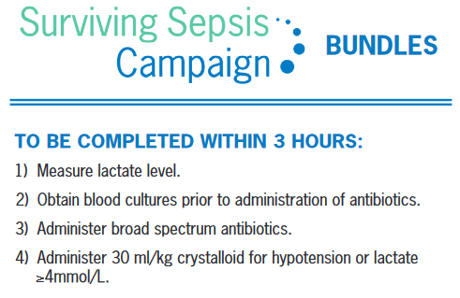
Surviving Sepsis
Septic Shock = Vasopressor requirement and serum lactate level greater than 2 mmol/L in the absence of hypovolemia. This combination is associated with hospital mortality rates greater than 40%.
“We suggest guiding resuscitation to normalize lactate in patients with elevated lactate levels as a marker of tissue hypoperfusion (weak recommendation, low quality of evidence)”

Slide 44
Lactate as Prognostic Indicator:
Dog
DOGS
  Despite study limitations, association between admission/initial lactate and mortality well documented in dogs
  High lactate in nonsurvivors in dogs: blunt or penetrating trauma, sepsis or SIRS, spontaneous hemoabdomen, IMHA, babesiosis, HWD, generalized illness, GDV, and post-op cholecystectomy
  Lactate significant predictor of mortality in APPLE scoring system (acute patient physiologic and laboratory evaluation)

Slide 45
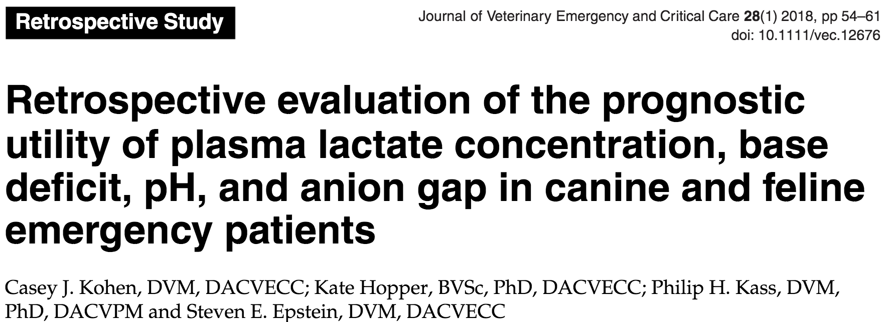
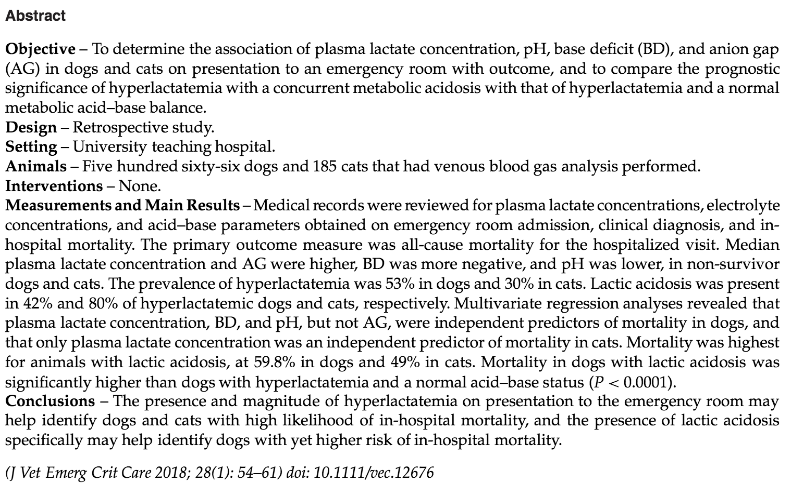
Lactate was the only independent predictor of mortality in cats, but in dogs lactate, BD, and pH all predict
Mortality in dogs with lactic acidosis was significantly higher than dogs with hyperlactatemia and a normal acid-base status (P < 0.0001).

Slide 46
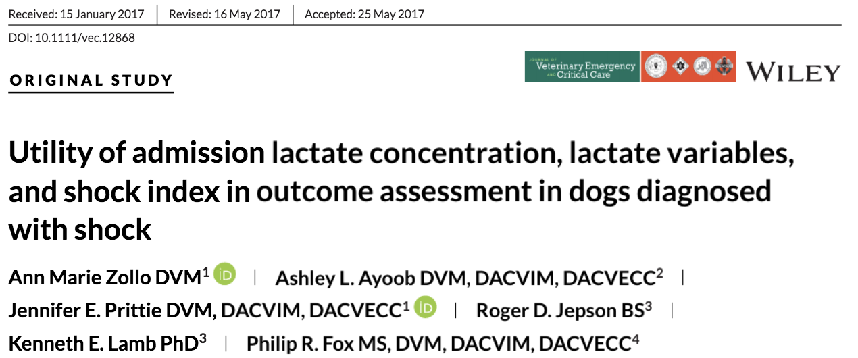
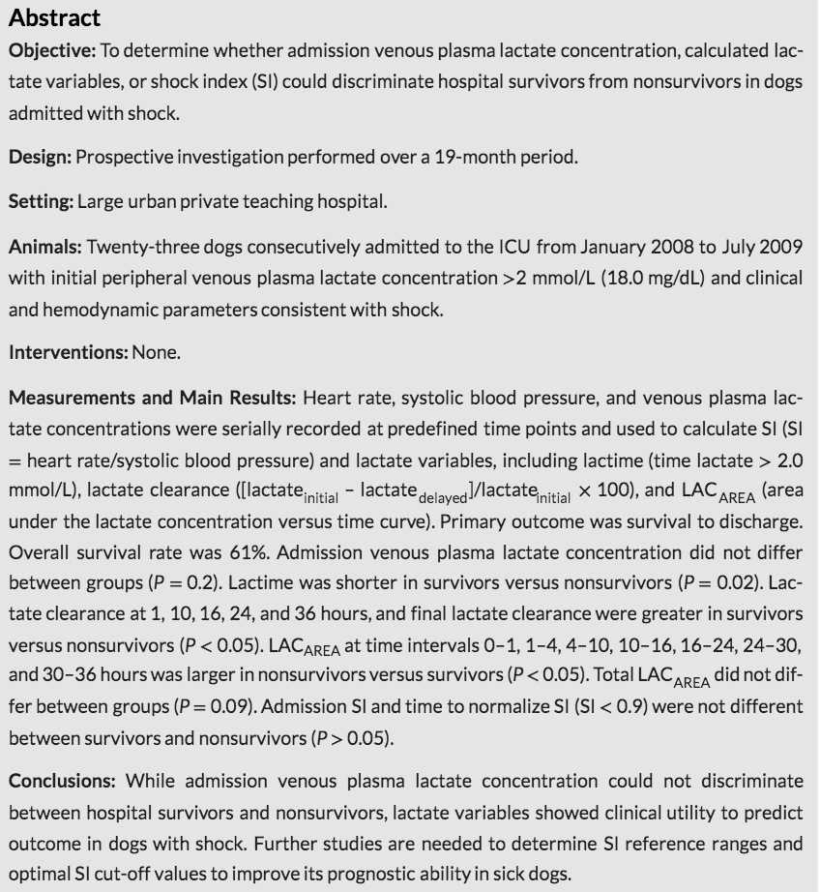
Lactate measured at 0,1,4,10,16,24,30,36,48 hours
Lactime (time lactate >2.0mmol/L) shorter in survivors vs nonsurvivors
Lactate clearance (1, 10, 16, 24, 36hrs) greater in survivors vs nonsurvivors
This study did not see difference in admission lac between survivors vs nonsurvivors

Slide 47
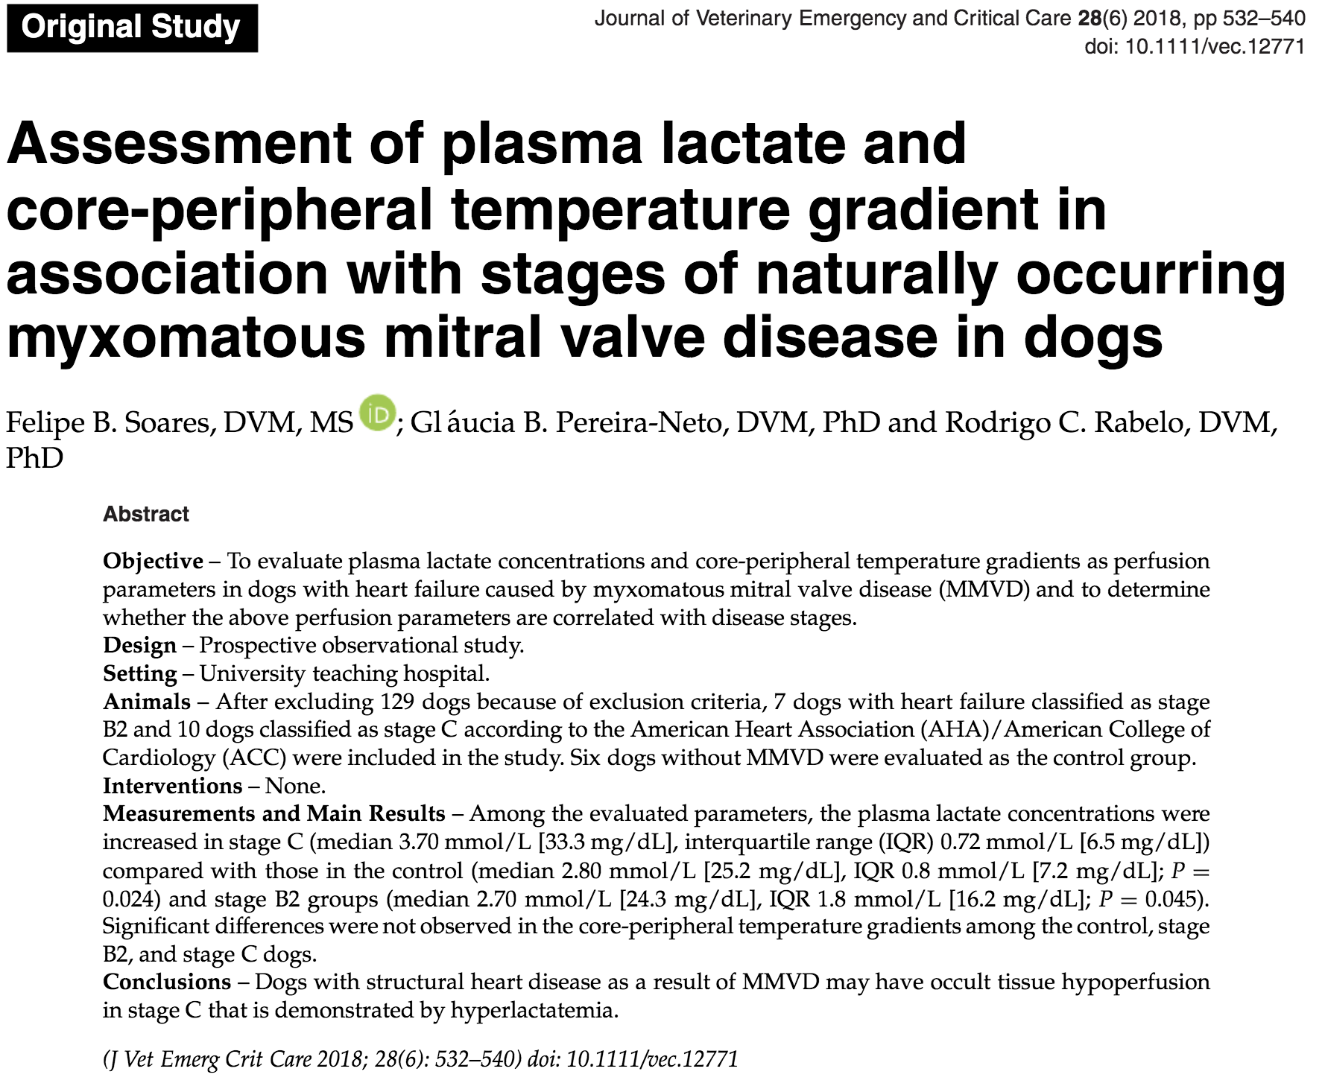

Slide 48
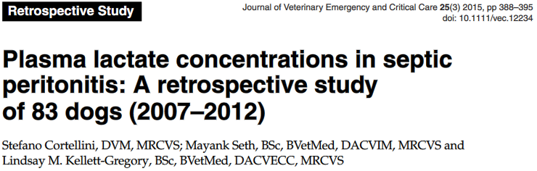
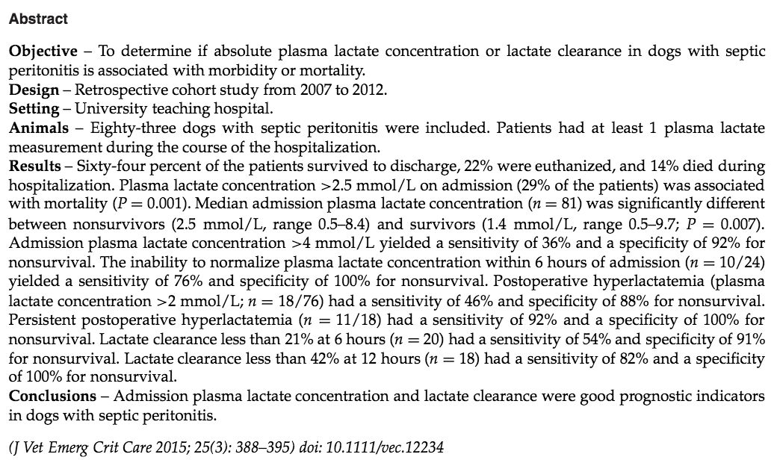
Higher intake lactate was associated with non-survival
Inability to normalize within 6hrs sens 76% and spec of 100%
Persistent post-op hyperlactatemia sens 92% and spec 100%
Clearance less than 42% at 12hrs sens 82% and spec 100%

Slide 49
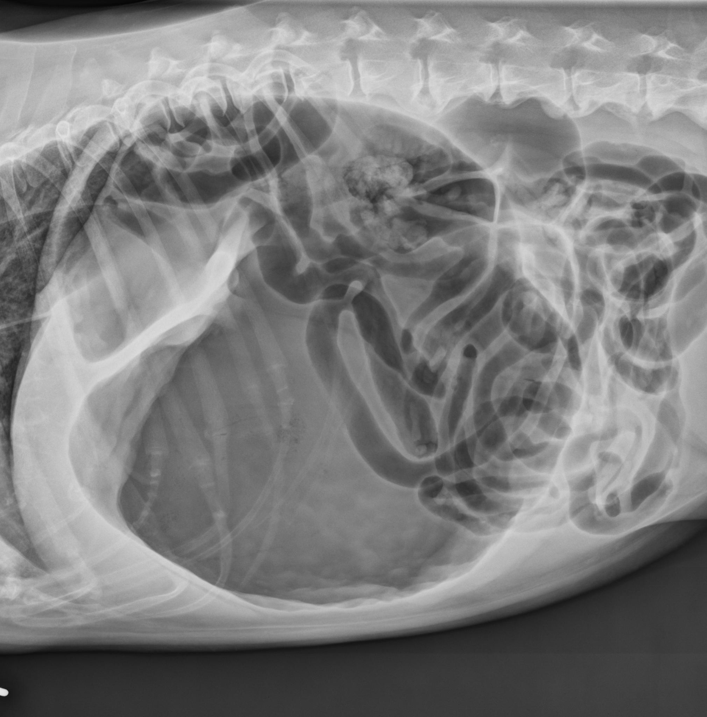
GDV and Lactate
Analysis between 5 papers:
Survival more likely if lactate <4
If lactate >6 increased likelihood of gastric necrosis
Decrease by >40-50% after fluids associated with survival (100% vs 50%)
Continued 24-48hrs less likely to survive
Summary: low initial lactate and good clearance are predictors for survival, less specific for mortality so continue with treatment

Slide 50
Lactate as Prognostic Indicator:
Cats
CATS
  Less lactate studies in cat, results variable
  Admission lac >4mmol/L associated w/ lower survival and increased duration of hospitalization
  Lactate clearance: Lac >4 and decrease >30% w/in 8 hours admission higher survival than lac decreased <30%
  however these results are less consistent than in dogs

Slide 51
Lactate as Therapeutic Guide
PEOPLE: Lactate-guided therapy can be used to guide resuscitation in septic patients when more expensive or invasive monitoring techniques are not available or inappropriate
VETERINARY:
  Conti-Patara 2012 paper: evaluated using lactate as a component of a protocolized therapy strategy in dogs with SIRS/sepsis
  If volume status is adequate and there is persistent hyperlactatemia, interventions should be directed to optimize DO2 and to consider type B causes

Slide 52
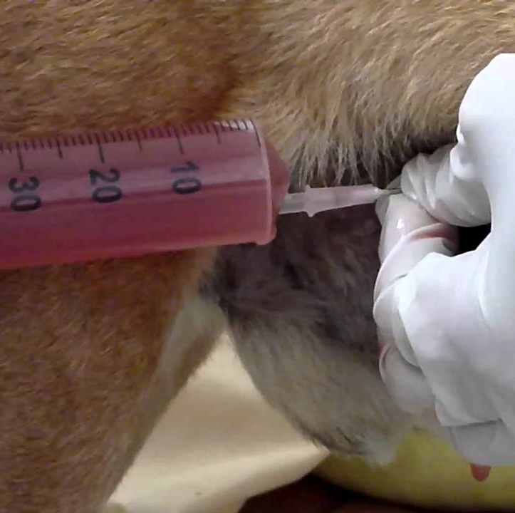
Lactate in Peritoneal Effusion
Peritoneal effusion
  Levin 2004 paper: abd fluid lactate > 2.5mmol/L 100% Sn 91% Sp in dogs, and 67% Sn and 67% Sp in cats
  Bonczynski 2003: paper > 2mmol/L difference b/w abd fluid and blood is 63-100% Sn and 100% Sp in dogs
Lactate is greater in septic abdominal effusion than blood
  Normal effusion lactate does not reliably exclude septic cause
Post-op blood to peritoneal ratios are not reliable, especially with drains
Neoplastic effusions may have similar lactate/glucose levels to septic effusions

Slide 53
Lactate in other body fluids
Synovial fluid
  Proot 2015 paper: Lactate not correlated with NCC, and Lac > 6.5 mmol/L able to distinguish b/w canine patients with septic arthritis with 100% Sn and 100% Sp
CSF: NOT USEFUL
  Increased in both bacterial meningitis and cellular hypoxia (stroke, seizure, etc)
  2013 Caines: dogs with intracranial dz had higher CSF lactate level then in normal dogs, but does not correlate to peripheral lactate levels
  2019 Mariani: no sig. difference in lactate b/w inflammatory CNS disorders in dogs
  In people, after other confounding conditions have been excluded, CSF lact >4 can differentiate septic from aseptic meningitis
Pericardial effusion
  Pericardial lactate higher (9 mmol/L) in dogs w/ neoplasia vs without
  Not evaluated in cats
Dystocia: lactate from fetal scalp or umbilical cord blood can be used to identify fetal distress

Slide 54
Management of Hyperlactatemia
Aimed at CAUSE of hyperlactatemia
If cause is physiologic, treatment is not indicated
  Expect decrease by 50% every 1-2hrs if cause has resolved
If increasing despite therapy, or decreasing more slowly than expected consider:
  Hypovolemia?
  Other causes of decreased oxygen delivery?
  If not responsive, consider Type B hyperlactatemia

Slide 55
Management of Hyperlactatemia
High lactate + no muscle activity + low venous O2 content/saturation or high venous CO2 → inadequate tissue DO2
  Causes: macrocirculatory or microcirculatory compromise, anemia, hypoxia
High lactate + high peripheral O2 conc → reduced O2 extraction
  Causes: mitochondrial dysfunction w impaired O2 utilization e.g. SIRS, sepsis; microcirculatory shunting

Slide 56
Management of Hyperlactatemia
Macrocirculatory derangements: IVF, blood products, supplemental O2, vasopressors, inotropic support
Tx of mitochondrial dysfunction:
  Cofactor supplementation: thiamine
  Mitochondrial antioxidants
  ROS scavengers
  Mitochondrial membrane stabilizers
  Discontinue contributors e.g. epinephrine, corticosteroids if clinically appropriate

Slide 57

Management of Hyperlactatemia
Many pharmacologic agents have been investigated to accelerate lactate metabolism or inhibit production
  NO benefit, possible harm
Sodium bicarbonate
  NaHCO3 increased risk of hypernatremia, hyperosmolality, ionized hypocalcemia, overshoot alkalosis, hypercarbia and intracellular and CSF acidosis
  Upregulates phosphofructokinase so increases glycolysis and lactate production
  May increase mortality when used to treat lactic acidosis
  “We suggest against the use of sodium bicarbonate therapy to improve hemodynamics or to reduce vasopressor requirements in patients with hypoperfusion-induced lactic acidemia with pH ≥ 7.15 (weak recommendation, moderate quality of evidence)”

Slide 58
Key Points:
Lactate is constantly being produced in all cells
Lactate levels increase in disease secondary to:
  Increased production
    Increased metabolic rate
    Decreased oxygen delivery
  Decreased clearance
Elevated lactate levels or decreased clearance are associated with worse outcomes
Treatment of hyperlactatemia should be aimed at identifying and addressing the underlying cause

