Slide 1

Generalized LMN diseases
DISEASES THAT AFFECT THE PERIPHERAL NERVES, JUNCTIONS, AND MUSCLES ETC

Slide 2
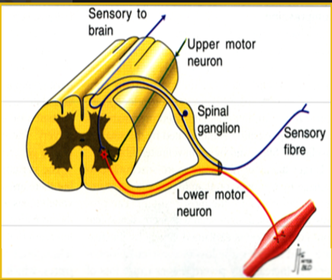
Lower Motor Neuron
Paresis/plegia
Decreased /absent tone (flaccid)
Decreased/absent reflexes (hypo-/areflexia)
Severe/early muscle atrophy (neurogenic)
Generalized motor neuron diseases can be caused by a lesion anywhere along the lower motor neuron pathway
  Peripheral nerve or nerve root
  Neuromuscular junction
  Muscle
EMG changes: Spontaneous potentials

Slide 3
Peripheral neuropathies
Can be primary, or secondary to other diseases
- Cancer
- Metabolic disease
Common causes
- Metabolic
  - Hypothyroidism, diabetes
- Degenerative (Inherited or Toxic)
- Infectious/Inflammatory:
  Coonhound paralysis
  Toxoplasma/Neospora

Slide 4
Acute Generalized Lower Motor Neuron Disease
There are three main causes of acute generalized lower motor neuron diseases:
- Coonhound paralysis (polyradiculoneuritis)
- Botulism
- Tick paralysis
Remember: Rabies can cause ascending flaccid paralysis due to destruction of the spinal cord grey matter

Slide 5
Coonhound Paralysis (Polyradiculoneuritis)
Etiology/Pathogenesis
- Frequently occurs in hunting dogs that have been exposed to raccoons
- Raccoon saliva is believed to alter the peripheral nerve antigenicity, resulting in inflammation and segmental demyelination
- Can be seen in dogs with no exposure to raccoons, because other factors (viruses, drugs) can incite a similar immune reaction
- Antibodies are produced against the myelin sheath and the axon
- Ventral (motor) roots and motor axons are preferentially involved
- Analagous to a peripheral neuropathy of humans referred to as Guillain Barre syndrome

Slide 6
Clinical signs
- Ascending LMN paralysis that progresses to tetraparesis/plegia over 2-10 days
  Hypo/areflexia
  Flaccidity
  Severe muscle atrophy within 10 days
May be hyperesthetic
If initiated by a racoon bite, signs come on 7-14 days after the bite

Slide 7
Diagnosis
- History and clinical signs, R/O tick paralysis
  Evidence of denervation seen after 5-7 days
- EMG changes: Spontaneous activity
- Slowed nerve conduction velocity
- Nerve biopsy: Inflammation

Slide 8
Treatment/Prognosis
- Centers on good nursing/physical therapy
  Well padded area to prevent pressure sores
  Frequent bathing to prevent urine scalding (animals will retain the ability to urinate)
  Physical therapy
- In people: Use immunoglobulin therapy and/or plasma exchange (plasmapheresis)
- Steroids increase chance of recurrence in people and do not seem effective in dogs
- Clinical signs usually resolve in 3-6 weeks but relapses are possible

Slide 9
Toxoplasma/Neospora Infections
Etiology and Pathogenesis
- Usually results from transplacental infection of young dogs with the protozoal organism
- Infection of Tox or Neospora can result in similar signs
- Signs result from infection of the nerves, muscles, and sometimes the CNS

Slide 10
Clinical signs:
Classic presentation
- Puppy: <6 months of age (usually between 2-4 months old)
- Classically present with progressive paraplegia with the pelvic limbs held in rigid extension
- Signs suggestive of myositis, such as weakness that worsens with exercise
- Can also have multifocal CNS signs

Slide 11
Diagnosis
- Signalment and clinical signs
- Elevated CK and eosinophilia
- Positive serologic titers: Definitive with neospora, need to demonstrate a rising titer with toxo
- Presence of the organism on muscle biopsy
CSF: Eosinophilia

Slide 12
Treatment/Prognosis
- Clinda 12.5mg/kg PO BID is treatment of choice
- Pyrimethamine (0.5mg/kg PO q24) and sulfadiazine (60mg/kg PO q24) have been utilized with folic acid supplementation
Antibiotic therapy with TMS/Pyremethamine/Azithromyocin
- Prognosis is guarded (poor for the recovery of function once the limbs become rigidly extended)- Early diagnosis improves prognosis

Slide 13
Metabolic Neuropathies
Whenever working up a peripheral neuropathy consider:
- Diabetes (Cats)
- Hypoglyemia- Insulinomas (Dogs)
- Hypothyroidism (Dogs)
- Chronic OP toxicity
- Lead and other heavy metals
- Neoplastic/Paraneoplastic disorders

Slide 14
Metabolic Neuropathies
Clinical Findings
- Vary from mild ataxia to severe tetraparesis
- Pelvic limbs are often more severely affected than thoracic limbs

Slide 15
Metabolic Neuropathies
Diagnosis
- Finding of concurrent metabolic disease in association with signs of LMN dysfunction
- Electrodiagnostic testing may reveal evidence of denervation and slowing of nerve conduction velocities
- Nerve biopsies may be useful in confirming a diagnosis

Slide 16
Metabolic Neuropathies
Treatment
- Treatment of the primary disease
- Prognosis is variable and recovery may be slow

Slide 17
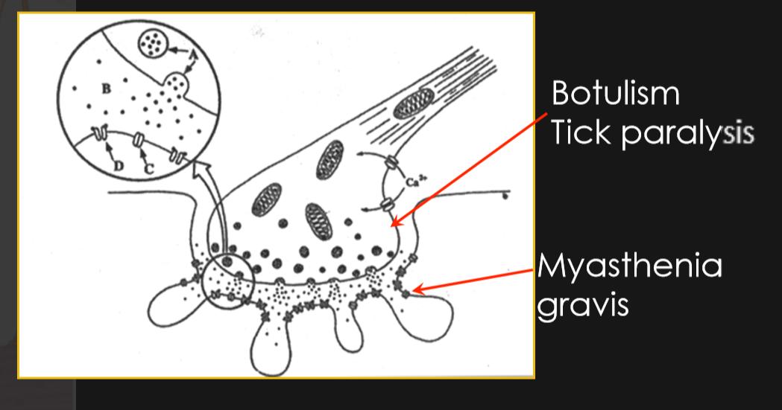
Junctionopathies
-Disease of the neuromuscular junction

Slide 18
Junctionopathies
Due to disease affecting any part of the neuromuscular junction
- Causes include:
  Toxins- botulism, tick paralysis
  Immune disease- myasthenia gravis
  Anomalous disease- congenital myasthenia gravis

Slide 19
Botulism etiology & pathogenesis
- Occurs when dogs ingest spoiled carcasses/food containing the botulinum toxin (from Clostridium botulinum)
- Occurs in dogs but has not been reported in cats
- Several different botulism toxins exist
  Types A, D, E are most common in affected humans
  Types C and D are most common in carnivores
- Exotoxin acts by blocking the presynaptic release of acetylcholine, thus inhibiting transmission at both somatic and autonomic neuromuscular junctions

Slide 20
Botulism: Clinical Findings
- History of acute GI upset prior to the onset of weakness
- Tetraparesis (LMN) develops over 24-72 hours
- Pelvic limbs often affected first
- Spinal reflexes are depressed and hypotonia is present
- May see cranial nerve involvement (VII, IX, & X)
- May see megaesophagus and dysphagia
- May see mydriasis, arrythmias, KCS (ANS)

Slide 21
Botulism: Diagnosis
- History and clinical presentation, R/O tick paralysis
  Suspected in animals with dietary indiscretion and LMN signs
- Early on may find toxin in feces or serum
- Electrophysiological characteristics

Slide 22
Botulism: Treatment
- Use of polyvalent antitoxin is usually ineffectual once clinical signs become evident
- Need to provide supportive care
  Well padded area to prevent pressure sores
  Frequent bathing to prevent urine scald
  Physical therapy
  Assess respiratory function: May need ventilatory support
- If the animal survives the acute period, gradual improvement is seen over 2-3 weeks.

Slide 23
Tick paralysis: Etiology
- Toxins produced by Amblyomma, Ixodes, and Dermacenter ticks
- Toxin acts on the terminal portion of the motor nerve fiber, inhibiting presynaptic release of acetylcholine

Slide 24
Tick paralysis: Clinical signs
- Generalized LMN signs
- Variable degree of involvement, ranging from mild paresis to tetraplegia
- Spinal reflexes are typically depressed
- Cranial nerve deficirs are less pronounced

Slide 25
Tick paralysis: Diagnosis
- Typical clinical signs during when ticks are active
- Presence of tick!
- Response to treatment (resolution of clinical signs after removal of a tick or administering tick dip/treatment)

Slide 26
Treatment
- Remove any ticks (search carefully)
- Spray for ticks (e.g. With frontline) even if you cannot find one
- Provide supportive care
- Should see rapid improvement (normally within 48 hours) of tick removal

Slide 27
When faced with a dog with generalized LMN signs
Top 3 differentials are:
- Tick paralysis, Coonhound paralysis, Botulism
SOOO- Rule out and treat for tick paralysis
Provide supportive care and consider electrophysiology/biopsy for further workup

Slide 28
Myasthenia Gravis: Etiology
- Acquired form: Most common
  Production of antibodies vs the post synaptic nicotinic ACH receptor causes rapid fatigue of impulse conduction
  Both cellular and humoral immunity is involved
Congenital form is rare
  Results from lack of acetylcholine receptors
  Reported most commonly in JRT
  Also reported in smooth haired fox terriers, springer spaniels, and Siamese cats

Slide 29
Myasthenia Gravis: Clinical findings
1. Focal form: Regurgitation and aspiration pneumonia as a result of megaesophagus and pharyngeal dysfunction
2. Generalized form: Exercise intolerance and regurgitation
  Exercise intolerance of paresis following exercise, which is frequently more pronounced in the pelvic limbs
  Clinical recovery usually occurs within a few minutes of rest, but is again exacerbated by further exercise (episodic weakness)
  Megaesophagus and associated regurgitation are frequently seen
  Animals may also have a voice change
  LMN signs are usually not nearly as dramatic as those seen with coonhound paralysis, botulism, and tick paralysis (reflexes are normal)
3. Fulminant form: rare. Presents as severe generalized LMN tetraplegia and is rapidly fatal

Slide 30
Myasthenia Gravis: Diagnosis
- Clinical findings
  Episodic weakness should suggest a diagnosis of myasthenia when cardiac and respiratory causes have been excluded
- Response to Tensilon Test
  Reversal of clinical signs by the administration of the anticholinesterase agent Tensilon (edrophonium 0.1-0.2mg/kg IV) supports a diagnosis
  Signs should resolve within 1 minute, and effect may last up to 15 minutes
  Atropinize animals first to block the muscarinic receptors (can cause a cholinergic crisis)
Decremental decline in evoked motor unit potential on repetitive nerve stimulation, which may be reversed by Tensilon
Acquired disease is diagnosed by the presence of antibodies against acetylcholine receptor in the serum
- Serum titers for ACH receptor antibody
Congenital disease is diagnosed by documenting decreased numbers of acetylcholine receptors on muscle biopsy
Chest rads: Look for thymoma, aspiration, megaesophagus

Slide 31
Myasthenia Gravis: Treatment/Prognosis
- Anticholinesterase agents: Pyridostigmine (Mestinon) by mouth or neostigmine IM if there is severe regurgitation
  Pyridostigmine (0.5-3mg/kg PO BID-TID) begin at the low end of the dose and gradually increase as needed
  Neostigmine (0.04mg/kg IM QID) useful if severe megaesophagus precludes the use of orals
- immunosuppressive doses of corticosteroids introduced over 2 weeks (may be of use in the acquired form) if no aspiration pneumonia
- The amount of medications needed to control clinical signs may be reduced and often eventually eliminated
- May need to feed via PEG tube if significant amounts of regurgitation
- Prognosis is worse with severe regurgitation
- 50% of dogs pass away within 1 month of diagnosis while the other 50% do great (the poor prognosis is due to regurgitation and aspiration

Slide 32
Myopathies
- Disorders that primarily or secondarily affects the muscle
- Inflammatory: Infectious or Immune – mediated
- Degenerative: Inherited or Acquired
  Structural proteins
  Ion channel dysfunction
  Metabolic

Slide 33
Myopathies: Clinical signs
- Weakness
- Exercise intolerance
- Muscle atrophy
- Spinal reflexes may be normal or depressed
- Muscle hypertrophy associated with stiffness
- +/- pain (myalgia)
- +/- megaesophagus and cardiomyopathy

Slide 34
Myopathies: Diagnosis
- Clinical presentation
- +/- Elevated CK
- Electrodiagnostic testing
  Electromyography may reveal abnormal spontaneous activity
- Muscle biopsy (evidence of inflammation without associated infection)
- Endocrine testing
- Protozoal titers

Slide 35
Myopathies
Treatment
- Corticosteroid therapy usually results in improvement
  Starts with initial oral prednisolone dose of 2.2mg/kg divided BID
  Gradually taper dose once improvement is noted
  Steroids can be discontinued in some dogs after several weeks, while other dog require more lengthy every other day therapy
  Chemotherapeutic or immunomodulatory drug may be beneficial in dogs that do not respond to glucocorticoids

Slide 36
Polymyositis
- Immune mediated disease affecting the appendicular muscles
- Rarely caused by protozoal infection
- Generalized weakness and exercise intolerance
- Elevated CK

Slide 37
Immune-mediated polymyositis: treatment
- Check for aspiration pneumonia first
- Immunosuppress with corticosteroids
- Prednisone: 2-4mg/kg divided BID for at least 2 weeks
- Taper gradually once improvement is noted

Slide 38
Masticatory myositis
- Similar to polymyositis but antibodies are directed specifically against muscles of mastication
- These muscles have unique type IIM fibers

Slide 39
Masticatory Myositis: Clinical signs
- Marked atrophy of the temporalis and masseter muscles
- May start with swollen, painful temporal mms, pain on opening the mouth
- May develop trismus as muscles fibrose

Slide 40
Masticatory myositis: Diagnosis
- Clinical presentation
- May have mild elevation of CK
- Electromyography may reveal abnormal spontaneous activity
- Positive titer for antibodies against type IIM fibers
- Changes on muscle biopsy – principally mononuclear cell infiltrate with marked muscle fiber necrosis and associated myophagocytosis

Slide 41
Masticatory Myositis Treatment
- Corticosteroid therapy usually results in improvement
- Start with initial oral prednisone dose of 2mg/kg divided BID
- Gradually taper dose once improvement is noted
Steroids can be discontinued in some dogs after several weeks, while other dogs require more lengthy every other day therapy

Slide 42
Feline hypokalemic polymyopathy
- Hypokalemia causes muscle necrosis
- Hypokalemia usually results from a K+ losing nephropathy and dietary insufficiency
Other differentials for ventroflexion of the neck:
- Thiamine deficiency, hyperthyroidism, Chronic OP toxicity, any other myopathy

Slide 43
Feline hypokalemic polymyopathy
Clinical signs
- Ventroflexion of the neck (due to weakness of the cervical extensor muscles)
- Tetraparesis with weakness worsening after exercise in some cats
- Myalgia
- Less common clinical signs include stilted gait, reluctance to walk, pyrexia, and muscle atrophy

Slide 44
Diagnosis
- Typical clinical signs associated with hypokalemia
- Elevated CK
+/- Fractional excretion of potassium in urine
+/- Electromyography (spontaneous activity) and Biopsy (necrosis present)
Rule out: Chronic OP toxicity, hyperthyroidism, thiamine deficiency

Slide 45
Treatment
- Increase dietary K: Change diet or supplement
- If K <2.5mEq/L, supplement via IV first with 0.5-1meq/kg/hr KCl
- Cats improve upon K supplementation

Slide 46
Things to remember
- Myopathies and myasthenia gravis do not cause CP deficits and may have normal reflexes
- The esophagus is skeletal muscle in the dog
- Always check the breathing pattern/efficacy in recumbent dog
- Nerve conduction is slower when cold
- The heart is also made from muscle

Slide 47
Algorithm for LMN Tetraparesis
Exercise intolerant
- Normal reflexes
Decreased reflexes
Neuropathy
Junctionopathy (pre-synaptic)
Myopathy
Mild/early neuropathy
Junctionopathy (post syn)
Check CK
Ach R Antibody
EMGs
Muscle Biopsy
Chest Rads
Look for ticks
EMGs/NCVs
Muscle/Nerve Biopsy
Chest rads

