Slide 1
Infectious & Inflammatory Neurologic Diseases
Noelle Herrera
8/4/2020

Slide 2
Outline
Inflammatory
NME
NLE
GME
SRMA
Infectious
Bacterial: Meningitis, Diskospondylitis
Protozoal: Toxoplasma, & Neospora
Parasitic: Cuterebra, etc.
Viral: Distemper, Rabies, FIP, FeLV & FIV
Fungal: Crypto, etc.

Slide 3
Inflammatory Diseases
All inflammatory brain diseases share a common feature in that all have an influx of leukocytes into the brain (cerebritis or encephalitis) or meninges (meningitis).
Because of the close anatomical association of these structures, more than one area of the nervous system can be involved in the inflammatory process.
Inflammation of the meninges = meningitis
Inflammation of the brain = encephalitis
Inflammation of the meninges & brain = meningoencephalitis

Slide 4
Inflammatory Diseases
Aberrant immune response against central nervous system tissue, underlying stimulus unknown
Cytokines & chemokines
Autoantibodies against astrocytes are detected predominantly in NME
Recent vaccination, herpesvirus type I (NME) & distemper virus (NME), cancer, etc. have been implicated but never proven
Clinical Signs:
Acute or subacute
Progressive, fatal if left untreated
Multifocal or diffuse process
Often have cranial nerves deficits (blindness), seizures, paresis, ataxia and tremors
Frequently associated with systemic alterations such as cervical pain, fever, apathy, anorexia, and hyperesthesia
State of consciousness can be affected (depression, stupor, coma)

Slide 5
Inflammatory Diseases
Differential diagnoses for multifocal and progressive disease process:
metabolic, nutritional, toxin, multiple vascular processes, cognitive deficit syndrome, or neoplasia (although usually focal)
Physical exam:
Ophthalmoscopic exam: chorioretinitis or edema of the optic disc can be observed.
Joint or muscular pain (SRMA)
Definitive diagnosis = brain biopsy
Presumptive diagnosis:
Combination of history, neurologic exam, blood work, urinalysis, and MRI, CSF tap (may be normal)
Minimum database, CXR, +/- AUS (often normal but rules out other differentials)
MRI can mimic neoplastic and vascular lesions
  More likely to be inflammatory if there is meningeal enhancement, irregular lesion shape, and/or multifocal location
  Less likely to be inﬂammatory if supratentorial location alone and/or singular lesion
Notes:
Why testing for infectious diseases is so important
Lactate in CSF has been studied

Slide 6
Meningitis
Causes:
The most common cause of meningitis as whole in dogs is SRMA
  non-septic suppurative meningitis of unknown etiology that responds to immunosuppressive doses of corticosteroids
Clinical Signs:
Fever, spinal pain, cervical rigidity, and stiff gait
If due to infection and it spreads to neural parenchyma → encephalitis, myelitis, or an abscess.
If inflammatory exudate obstructs the flow of CSF → hydrocephalus
If host inflammatory mediators disrupt the blood-brain barrier → cerebral edema & increased ICP
Diagnosis:
Analysis of CSF (pleocytosis, certain WBC differentials, increased protein)
MRI > CT:
  May be normal early on in disease → diffuse or patchy brain edema
  Post-contrast CT and/or MRI may show abnormal enhancement of the leptomeninges.
Notes:
CSF protein concentration is often increased, because of either breakdown of the blood-brain barrier, intrathecal immunoglobulin production, or both.
A total nucleated cell count less than 3 cells/µl and a protein concentration less than 25 mg/dl are usually considered normal

Slide 7
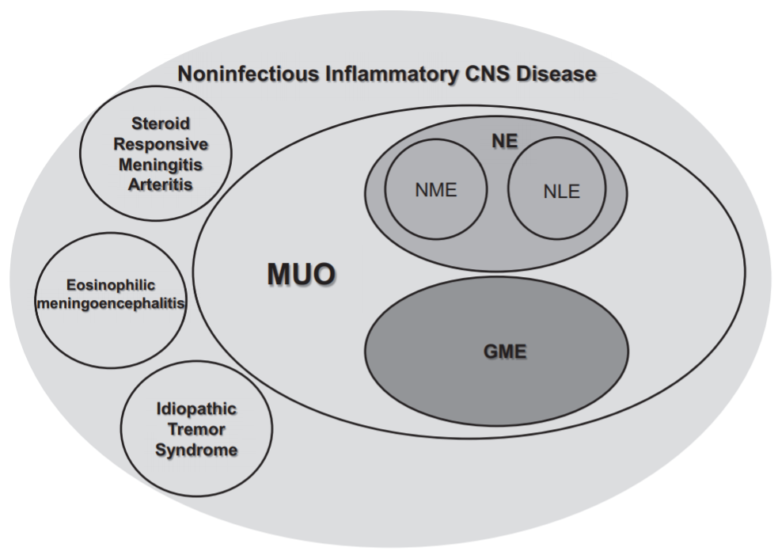
Encephalitis
Nonpurulent inflammation of the brain
vs suppurative inflammation of the brain associated with bacterial infection (cerebritis)
Causes:
Inflammatory:
  Meningoencephalitis of unknown etiology /origin (MUE/ MUO)
    Necrotizing meningoencephalitis (NME)
    Necrotizing leukoencephalitis (NLE)
    Granulomatous meningoencephalitis (GME)
    1 wk mortality rate of 26%
      Poor prognostic indicators included decreased mentation at presentation, presence of seizures, and increased percentage of neutrophils on CSF analysis
    Prospective studies show dogs alive at 3 months often have continued survival
  Eosinophilic meningoencephalitis (EME)
  Steroid responsive meningitis arteritis (SRMA)
Notes:
seizures, disorientation, behavioral changes, weakness, circling, loss of balance and spinal pain (particularly neck pain). Fever may or may not be present, and is typically absent.
EME and SRMA have distinct diagnostic considerations and so the remainder are under the umbrella of MUE/MUO’s
Commonly young to middle aged small breed dogs however 25% of dogs with MUE are > 15kgs or large breed dogs

Slide 8
Encephalitis
Nonpurulent inflammation of the brain
vs suppurative inflammation of the brain associated with bacterial infection (cerebritis)
Causes:
Inflammatory
Bacterial
Viral: canine distemper, Rabies, FIP, FeLV, FIV
Tick-borne: rocky mountain spotted fever, canine ehrlichiosis
Protozoal: toxoplasmosis and neosporosis
Fungal: crypto, blasto, histo, coccidio- mycoses, aspergillosis
Notes:
seizures, disorientation, behavioral changes, weakness, circling, loss of balance and spinal pain (particularly neck pain). Fever may or may not be present, and is typically absent.
EME and SRMA have distinct diagnostic considerations and so the remainder are under the umbrella of MUE/MUO’s
Commonly young to middle aged small breed dogs however 25% of dogs with MUE are > 15kgs or large breed dogs

Slide 9
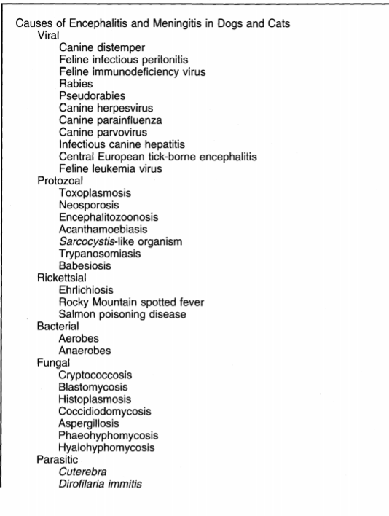
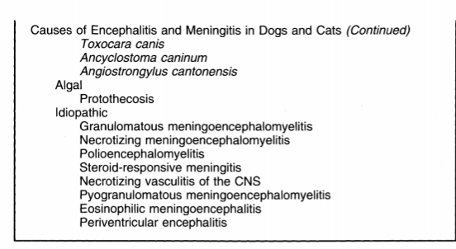
Canine Distemper & Feline Infectious Peritonitis are the two most common viral diseases.
Infectious etiologies are much more common than inflammatory in cats.

Slide 10
Definitive Diagnosis
Requires brain biopsy or necropsy.
Presumptive diagnosis on the basis of compatible findings on CSF and MRI/CT in a dog with a characteristic signalment and C/S
Rule out metabolic and infectious diseases (viruses, bacteria, protozoa, fungal, etc.)
15% of dogs diagnosed with GME die before treatment (Granger et al. 2010)
56% of dogs diagnosed with MUO die or are euthanized due to the disease. (Lowrie et al. 2013). 30% of affected dogs die within the first 3-7 days, while the large majority of dogs that die do so within the first 3 months. For those reasons, survival to 3 months is a positive prognostic indicator, and those that make it to one year often end up surviving for several more years.

Slide 11
Meningitis of Unknown Etiology
Inclusion criteria in the absence of histopathology:
> 6mo old
Multiple, single, or diffuse intra-axial hyperintensities on T2-weighted MRI images
Pleocytosis on CSF with >50% monocytes/lymphocytes
Ruled out infectious diseases
In one study, one week survival rate was 81% while one year survival rate was 60%
23- 50% of MUO dogs had seizures early on
23% of MUO dogs had post-encephalitic epilepsy (PEE), of which 21% were drug-resistant.
Seizures are prognostic:
Associated with shorter survival times
Seizures early on in course of disease were associated with higher-risk of developing PEE (+ hippocampal lesions on MRI). These dogs with PPE were younger and had lower survival times than those without PEE.
Notes:
“The long-term use of AED is recommended in case of an identifiable structural brain lesion or history of brain insult. The optimum type and duration of AED treatment for patients with ASS or PEE have not been established in either veterinary or human medicine. However, it has been reported in humans that aggressive control of ASS, particularly SE, plays a crucial role in the prevention of the development of drug-resistant epilepsy.
This high prevalence of both seizures and epilepsy has significant implications on the management and prognosis of dogs with MUO, as it carries the potential to provide an additional burden to an already unpredictable disease. Although some cases developed drug-resistant epilepsy, the vast majority (79%) of cases with PEE achieved satisfactory seizure control with AED treatment.”

Slide 12
Necrotizing meningoencephalitis
Signalment: predominantly young to middle aged small breed dogs
Pug encephalitis (MS)
  Fawn-colored female pugs and dogs <7 years old were more common than older individuals, males, and those of other colors.
  Genetic basis: susceptibility is associated with the dog leukocyte antigen (DLA) on chromosome 12. “Two identical copies of associated NME markers have a 12.75% risk of NME in their lifetime more than those with one copy or none.”
  Other breeds include Bichon, Maltese (genetic factors), Chihuahua, Yorkie (genetic factors), Pekingese, Frenchie, Brussels, Griffon, Shih -Tzu & Lhasa-Apso
Seizures are the most common C/S (+ brainstem signs in NLE/Yorkies)
Characterized by multifocal necrosis with mononuclear cell (lymphocytes, plasma cells, macrophages/histiocytes, aka nonsuppurative) infiltration in the meninges and perivascular spaces. Predilection for the white matter of the cerebrum
Form granulomas around blood cells
Notes:
Age ranges from 6mo to 10 yrs - mean age of onset in Pugs is 2.5 years
Pug encephalitis similar to atypical multiple sclerosis (MS) associated with a specific human leukocyte antigen class II genotype (Greer et al., 2010). - Canine Leukocyte Antigen Allele Class II (which encodes for the antigen presentation complex)
Progressive seizures, abnormal behavior, blindness, ataxia, and walking in circles.
A blood test is available to identify this gene defect and thus identifies dogs at risk for developing the disease (good screening tool), but the test does not specifically identify when an individual has the disease. A dog identified as having the gene defect associated with Pug dog encephalitis should not be used for breeding.

Slide 13
Necrotizing meningoencephalitis
CSF analysis:
antibodies against the Fibrillary Acid Glial (GFAP) protein have been used as a specific marker of this disease
predominance of lymphocytes, histiocytes and plasma cells and a significant concentration of proteins.
MRI:
Asymmetric necrosis that affects both cerebral hemispheres
Divided into cortex dominant and white matter dominant types (the latter of which represents necrotizing leukoencephalitis (NLE) which is common in Yorkies but can also occur in Chihuahuas & Frenchies).
Acute cases may not have necrotic changes so important to rule out distemper and document autoantibodies in CSF.
Severe cases may also have minimal necrosis
Notes:
“NME & NLE names are reflective of the anatomy affected
NLE can be slowly progressive”

Slide 14
Granulomatous meningoencephalitis
No specific breed predisposition however young adult, toy and terrier breeds overrepresented.
Young to middle aged (6mo to 12 yrs, mean 5 years old)
Female predisposition has been observed in the older literature but not in more recent articles
Underlying cause & genetic risk factors unknown
Rapidly progressive signs including neck pain, vestibular dysfunction, paralysis, and seizures so neuro exam reflects lesions in multiple areas.
Characterized by an accumulation of mononuclear cells (macrophages, lymphocytes) in the parenchyma and meninges of the brain (commonly brain stem) and spinal cord.
Mild lesions: lymphocytes are predominant around blood vessels, forming a perivascular cuff
Moderate to severe lesions: many epithelioid macrophages present
Notes:
Reticulosis refers to an abnormal increase in cells derived from, or related to, monocyte macrophages (i.e., histiocytes).
Accounts for 5-25% of all CNS disorders

Slide 15
Granulomatous meningoencephalitis
Lesions may be disseminated, focal, or ocular:
Cervical pain in either
Disseminated form:
  lesions distributed throughout the CNS (worst prognosis)
  predilection for the white matter of the cerebrum, cerebellum, caudal aspect of the brainstem, and cervical spinal segments
  at least two of these structures are involved: optic nerve, forebrain, cerebellum, brainstem, spinal cord, or meninges
  +/- fever

Slide 16
Granulomatous meningoencephalitis
Lesions may be disseminated, focal, or ocular:
The focal form: single granulomatous mass (often in the cerebrum) with smaller disseminated lesions.
  C/S suggestive of a single, space-occupying lesion (ddx: CNS malignant histiocytosis and primary CNS lymphosarcoma)
  chronic, gradually progressive signs, and can mimic C/S of a tumor
  Seizures common C/S
  Best survival
Ocular form (least common):
Acute onset of visual impairment
Unilateral or bilateral dilated pupils that are unresponsive to light stimulation as a result of optic neuritis.
Fundic exam may reveal a hyperemic, edematous disk (optic neuritis) +/- dilation of vessels and focal hemorrhage
May go one to develop the disseminated or focal form of the disease

Slide 17
Differentiating GME vs NME vs NLE
Anti-astrocyte autoantibody was recently identified in the cerebrospinal fluid (CSF) of dogs with GME & NME indicating a possible relationship between these two diseases and the autoantibody.
cause of or consequence of inflammation?
Pathologic features and lesion distribution distinguish amongst the three
NME: lymphocytic, plasmacytic, and histiocytic infiltration and extensive parenchymal necrosis restricted to the cerebral hemispheres.
NLE: necrosis of the brainstem in addition to cerebral lesions.

Slide 18
Eosinophilic Meningoencephalitis
Rare
Younger, male, large-breed dogs
Most common signs include mentation changes, seizures, proprioceptive deficits, visual deficits & reduced/absent menace response consistent with a diffuse forebrain neurolocalization. +/- vestibular signs
CSF: eosinophilic pleocytosis
MRI: most commonly diffuse cerebrocortical meningitis and cortical (polio)encephalitis
Can be associated with:
  Infectious diseases such as neospora, less commonly toxoplasma, angiostrongylus vasorum, prototheca, cryptococcus, distemper, rabies, and bacterial encephalitis.
  Non-infectious diseases including neoplasia, infarction, shunt placement, and trauma.
  If no cause is found, then it is considered EM of unknown origin.

Slide 19
Steroid Responsive Meningitis Arteritis
Dogs < 2yrs old and typically of larger breed (bermese, boxers, akitas, beagles, GSD)
Waxing and waning clinical signs of meningitis including fever, cervical pain, hyperesthesia and stiff gait. Less likely neurologic deficits.
2002 JVIM article found as many as 50% of dogs with IMPA and spinal pain had SRMA
CBC: leukocytosis +/- left shift
CSF: marked neutrophilic pleocytosis with increase in TP
  may be normal if chronic or recurrent so can measure IgA CSF & serum (ddx for inc levels is distempter virus)
Concurrent mild immune-mediated vasculitis
Tx: immunosuppression with steroids → treat long term and taper slowly over several months.
Px: if responds to treatment, prognosis is good

Slide 20
Treatment of Inflammatory Disease
Glucocorticosteroids are the MAINSTAY:
Prednisone
  2 mg/kg/day PO 4 weeks then 1mg/kg/day for 6 weeks then 0.5mg/kg/day for 6 weeks then 0.25mg/kg/day for 6 weeks then every 2 days for 6 weeks then every 3 days for 6 weeks
  Goal to taper to achieve the lowest dose possible to control signs but not cause glucocorticoid side effects
Mortality rate within 72 hours of diagnosis is 33% in one study
Prognosis for treatment with prednisone alone has a MST of 1 to 1215 days
  Another study of 15 dogs with focal signs and prednisone alone had a MST of 41 days (>3 to 1215 days) whereas dogs with multifocal signs had a MST of 8 days.
  Another study of corticosteroids alone reported a MST of 28 to 357 days.
When combined with an immunosuppressive agent, MST is extended to 26 to 2469 days.
  Another study reported a MST of 240 to 590 days.
Mortality risk factors related to MRI findings include effacement of the cerebral sulci and herniation of the foramen magnum.

Slide 21
Treatment of Inflammatory Disease
Cytosine arabinoside (cytarabine, cytosar) :
Most common immunosuppressive agent combined with prednisone
Intercalating agent that targets mitotically active (rapidly dividing) cells by inserting itself into DNA molecules causing premature chain termination.
Crosses BBB
Antineoplastic drug (wear gloves) with most common side effects of GI upset, myelosuppression, & hair loss.
  Monitor CBC 10-14 days after start of treatment then every 2-3 months during treatment.
Traditionally 50 mg/m2 SQ twice a day for 2 consecutive days then repeated every 3 weeks
  Believed to provide a slow and prolonged absorption of the drug whis is necessary to maximize the effect on rapidly dividing cells. However it is actually rapidly absorbed and depleted

Slide 22
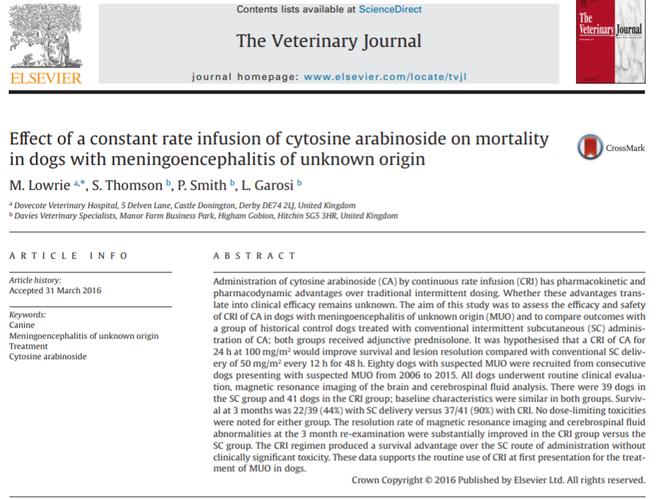
Treatment of Inflammatory Disease: CRI vs SQ Cytosar
Newer research shows improved survival with CRI (+ pred)
  sustained plasma concentration
  Found that a CRI of 100 mg/m2 for 24 hours had a 90% survival rate at 3 months compared to 44% survival rate with conventional SQ. Also had improved CSF and MRI results.
  No dose-limiting toxicities were noted for either group.

Slide 23
Other Treatments For Inflammatory Disease
Procarbazine
Cyclosporine
Leflunomide
Mycophenolate mofetil
Radiation therapy for focal form of GME (ddx CNS lymphoma)
Lomustine
Azathioprine
“COP”: cyclophosphamide, vincristine, prednisone

Slide 24
Other Treatments For Inflammatory Disease
Procarbazine
Antineoplastic drug with multiple sites of action
Adjunct therapy to prednisone or as a single agent
Inhibits incorporation of small DNA precursors as well as RNA and protein synthesis. Can also directly damage DNA through an alkylation reaction.
Lipid soluble and crosses the blood–brain barrier
Oral dose is 25 to 50 mg/m2 /day
Main side effect with higher doses is myelosuppression (30% in one study)
Monitor CBC once weekly for the first month, then monthly thereafter
Other side effects include hemorrhagic gastroenteritis (15% in one study), nausea, vomiting, and hepatic dysfunction.

Slide 25
Other Treatments For Inflammatory Disease
Cyclosporine
Immunosuppressive that suppresses T-cell–mediated immune responses through inhibition of synthesis of interleukin-2 and other cytokines. Suppresses activation of macrophages and monocytes.
  Suspect GME is a T cell–mediated, organ-specific, autoimmune disease.
Poorly crosses normal BBB but GME has perivascular infiltration and inflammation and so it likely has some therapeutic action
Give 1 hour before or 2 hours after feeding to maximize absorption.
Side effects include excessive shedding, gingival hyperplasia, and hypertrichosis. GI signs with overdose.

Slide 26
Other Treatments For Inflammatory Disease
Cyclosporine
If single agent therapy, can use starting dose of 6 mg/kg PO q12h, with a blood cyclosporine trough level target of 200 to 400 ng/ml.
  Blood cyclosporine trough level should be tested after 5 to 7 days and reevaluated together with CSF after 1 month and every 4 or 6 months thereafter.
Can also be added to ketoconazole as the latter has been shown to decrease the systemic clearance of cyclosporine in dogs through inhibition of hepatic cytochrome P450 enzymes.
  Starting dose of 5 mg/kg PO q24h of cyclosporine and 8 mg/kg of ketoconazole.
  Benefit of given once daily
  Not recommended if liver enzyme levels are elevated.

Slide 27
Other Treatments For Inflammatory Disease
Leflunomide
Anti-neoplastic, lipid-soluble nitrosourea compound
Alkylates DNA and RNA
Inhibits B and T cell proliferation, suppresses production of immunoglobulins, & interferes with cell adhesion.
Readily crosses the BBB
Most common side effects of bone marrow suppression (leukopenia and delayed thrombocytopenia) and GI upset.
Hepatotoxicity at high doses
Monitor chemistry at start of treatment then every three months thereafter.
Need more studies

Slide 28
Other Treatments For Inflammatory Disease
Mycophenolate mofetil
Lymphocyte specific immunomodulatory
Decreases the recruitment of inflammatory cells
Few studies combining it with prednisone
Side effects mainly include GI upset

Slide 29
Other Treatments For Inflammatory Disease
Radiation Therapy
Indicated in some cases of single GME (ddx neoplasia)
Lomustine
Azathioprine
“COP”: cyclophosphamide, vincristine, prednisone

Slide 30
Infectious Neurologic Diseases
Bacterial: Bacterial Meningitis, Diskospondylitis, Ehrlichia, RMSF
Protozoal: Toxoplasma, & Neospora
Parasitic: Cuterebra
Viral: Distemper, Rabies, FIP, FeLV & FIV
Fungal: Crypto, etc.

Slide 31
Bacterial Cerebritis, Meningitis, & Abscesses
Cerebritis = focal infection of the brain with pyogenic organisms
Uncommon in small animals
Bacteria may gain access to the brain:
  Secondary to direct extension from infections in the eye, ear, cribiform plate, tooth roots, sinuses, nasal passages, meninges, and vertebrae
  Via direct inoculation from trauma, bite wound, and surgery
  Via migration of foreign material or parasites
  Via hematogenous spread from extracranial sources (e.g. mediastinal abscess, bacterial endocarditis)
Cerebritis characterized by focal but poorly localized areas of scattered necrosis, edema, vascular congestion, and perivascular inflammatory infiltrates
Clinical signs reflect a progressively worsening focal brain lesion over 2-3 weeks (cerebritis --> abscess)

Slide 32
Bacterial Cerebritis, Meningitis, & Abscesses
Organisms: Staph, Strep, Pasteurella, Actinomyces, Nocardia, and Anaerobes (Bacteroides, Fusobacterium, Peptostrep, and Eubacterium)
Clinical signs: severe pain, fever, +/- vomiting, photophobia, nuchal rigidity, & depression
Clinical signs of abscessation reflect the location of the lesion
MRI: diffuse inflammation or ring-enhancing lesion (= abscess (esp if medial rum thinner or temporal) or neoplasia, infarc, granuloma, or healing hematoma)
Diagnosis via CSF:
Marked neutrophilic pleocytosis (often degenerate)
Intracellular bacteria
If on antibiotics → results can be normal, mononuclear, nondegenerate
Always culture (commonly negative)
Treat with early and aggressively with broad spectrum medications that cross BBB (cidals like TMS, metro, & baytril are better than chloramphenicol (static) which is better than penicillins (although the BBB may be disrupted in meningeal inflammation).
Adjust based on C & S
Relapse and/or permanent neurologic deficits are possible

Slide 33
Discospondylitis
Infection of the intervertebral disc space and adjacent vertebral endplates
Bacterial or fungal infection
Staph >> E.coli, Brucella canis (reportable & zoonotic), Strep, Klebsiella, Pseudomonas, Proteus, Candida, & Actinomyces
Most common fungal organism is Aspergillus (GSD are predisposed.)
Most often secondary to hematogenous spread (skin, mouth, heart, urinary tract, prostate)
But could also be from direct inoculation (bite, puncture, iatrogenic) or as a migrating foreign body
Chronic skin disease & immunosuppression (innate or iatrogenic) predispose
70% of dogs had a concurrent condition in 2005 JAVMA study

Slide 34
Discospondylitis
Middle-aged to older large breed male dogs
Great Danes, German Shepherds, Boxers, Rottweilers, Doberman Pinschers, and English Bulldogs
Rare in cats
Distribution of disease
Up to 40% of cases are multifocal
LS most common followed by TL and caudal cervical spine
Can spread to the CNS or form a discrete abscess & can compress spinal cord leading to paresis/paralysis & vertebral instability or fractures
Clinical Signs
Chronic & progressive
First sign is often back pain, stiff/stilted gait
May have systemic signs of decreased appetite, weight loss, lethargy, fever, leukocytosis

Slide 35
Discospondylitis
Diagnosis:
Spinal radiographs 2-7 wks after onset of signs
  Often IV disc space collapse with variable lysis & sclerosis of surrounding vertebral endplates
CSF tap
Blood & urine cultures
Brucella testing
No isolation of an organism found in 50-60% of cases
If poor response to antibiotics, test for fungal infections & aspirate disc site itself for culture
Prognosis depends on underlying cause:
Bacterial has good prognosis
  Brucella may not be entirely cleared but managed okay
Fungal has a poorer prognosis
Relapse can occur

Slide 36
Discospondylitis
Treatment:
Antibiotics for 6-12 months+
  The antibiotic should penetrate bone & be effective against organism(s)
    Ex: cephalosporin (e.g., cephalexin) or potentiated penicillin (e.g., Clavamox)
  Brucella:
    minocycline + gentamicin → have safer choice of doxycycline + enrofloxacin
    Reportable b/c zoonotic (good hygeine)
    Spay/Neurter
    Abortions in cattle
Antifungal (ie itraconazole) if indicated
Analgesia
Exercise restriction 4-6 wks+
Clinical signs should resolved in a couple days of starting treatment
Radiographs to monitor treatment @ 2mo + q3-4mo thereafter until lysis has been replaced with ankylosis & osseous proliferation. Some say to treat with abx 2 wks past radiographic resolution or once there is healing on 2 consecutive sets of radiographs.
Can surgically debride in severe, refractory cases

Slide 37
Other Bacterial Infections
Ehrlichia
Rocky Mountain Spotted Fever

Slide 38
Protozoal Disease: Toxoplasma
Toxoplasma gondii:
Obligate intracellular protozoan parasite infecting humans & animals
Cats are the definitive host
Asexual reproduction to produce tachyzoites & cyst-forming tissue bradyzoites.
Transmitted through ingestion of sporulated oocysts in uncooked meats or transplacentally
Organism forms tissue cysts in multiple organs that can persist for animal’s life (brain is one site).

Slide 39
Protozoal Disease: Toxoplasma
Toxoplasma gondii:
When kittens are transplacentally infected, they may be born as stillbirths or die within a few weeks.
Most clinical signs are seen when the latent tissue cysts are reactivated or recrudesce in cats > 3 months of age.
  Ocular lesions like chorioretinitis +/- uveitis in cats
  Respiratory, muscle, cardiac, pancreatic, & hepatic involvement
  Neurologic signs are not as common despite how frequent CNS lesions are seen.
    CSF may show a mixed pleocytosis and increased protein. May see tachyzoites.
    PCR & serology can be performed on CSF. Serology should be compared to serum
    Histopathology often reveals perivascular cuffing and necrotizing inflammation & granuloma formation within parenchyma. May see tissue cysts.
Diagnosis other than through CSF/brain:
  Positive IgM antibodies are most supportive of recent infection (up to 12 wks)
  IgG supports a more chronic infection
Treatment of choice is at least 12.5mg/kg clindamycin q12hrs for 4 wks.

Slide 40
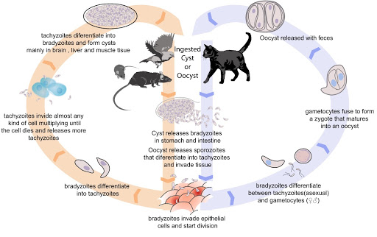
Protozoal Disease: Toxoplasma
Notes:
https://www.google.com/url?sa=i&url=http%3A%2F%2Fwww.abcdcatsvets.org%2Ftoxoplasma-gondii-infection-2%2F&psig=AOvVaw3Ageyc4xydyJI5dI8eqjq1&ust=1605400203163000&source=images&cd=vfe&ved=0CA0QjhxqFwoTCMjdkfnjgO0CFQAAAAAdAAAAABAD

Slide 41
Protozoal Disease: Neospora
Neospora caninum:
Morphologically similar to T. gondii but does not affect cats
Dogs are the only known definitive host but also serve as intermediate host.
Mainly transmitted through ingestion of infected tissues or transplacentally (latter common cause of abortion in cattle)
Can have localized or generalized disease with all organs being affected.
  Most common signs are neurologic and muscular disease
  Most severe clinical cases seen in young transplacentally infected puppies. 92% of cases are < 1yr old.
  Hind limbs more commonly affected than forelimbs. They can be in rigid hyperextension and paretic or even progress to plegia. Can become ascending.
  Can also see pneumonia, encephalitis, myocarditis, hepatitis, dysphagia, jaw paralysis, polymyositis causing muscle flaccidity and atrophy, and myonecrosis.

Slide 42
Protozoal Disease: Neospora
Neospora caninum:
Diagnosis:
  Elevated creatine kinase if polymyositis
  Same MRI, CSF, & histopath findings as toxoplasma
  May see tachyzoites in bronchial lavage or skin lesions
  IFA titers > 1:200+
  Proximity to livestock
  Affected littermates
Treatment of choice is at least 12.5mg/kg clindamycin q12hrs x 4wks.
  Not effective against encysted bradyzoites so infection is not completely cleared.
  Can use TMS
Prognosis is generally poor although improvement may occur
  Negative prognostic indicators include delayed time to treatment, muscle fibrosis, & pelvic limb hyperextension.

Slide 43
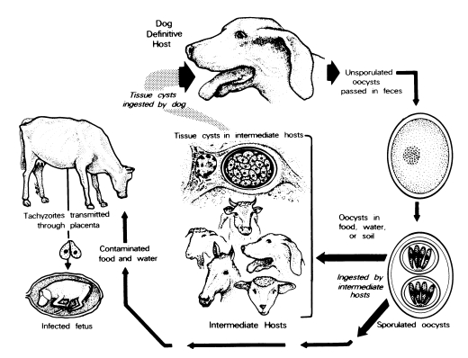
Protozoal Disease: Neospora
Notes:
https://www.parasitol.kr/journal/Figure.php?xn=kjp-41-1.xml&id=F1&number=376&p_name=1150_376
“The life cycle has 3 infectious stages: tachyzoites, tissue cysts, and oocysts. Tachyzoites and tissue cysts are the stages found in the intermediate hosts and they occur intracellularly (Dubey et al., 2002). Tachyzoites are approximately 6 × 2 μm (Fig. 1). Tissue cysts are often round or oval in shape, up to 107 μm long and are found primarily in the central nervous system (CNS). The tissue cyst wall is up to 4 μm thick and the enclosed bradyzoites are 7-8 × 2 μm.”

Slide 44
Parasitic Meningoencephalitis
Caused by aberrant migration of parasites like:
Cuterebra
Dirofilaria
Baylisascaris
Taenia
Ancylostoma
Toxascaris
Angiostrongylus
MRI often reveals intraparenchymal hemorrhage & focal or multifocal lesions of variable intensity with peripheral contrast enhancement. May see lesions where larvae have migrated.

Slide 45
Parasitic Infections: Cuterebra
Cuterebra (rodent botfly)
Rabbits & rodents are typical hosts
Aberrant migration occurs in atypical hosts such as dogs and cats
Fly larvae can access to the host through the eyes, ears, nose, and skin and then burrow into the subcutaneous tissue and can migrate throughout the body including the nasal passages and cribriform plate to the brain
  MRI: can see multifocal meningoencephalitis with malacia and hemorrhage. Can see the larva itself or the tunnel it has created
Most common time frame of infection is June to October, especially in outdoor animals

Slide 46
Parasitic Infections: Cuterebra
Clinical signs:
  History of upper respiratory signs may be seen in cats
  Acute onset of neurological dysfunction
    Forebrain lesion (seizures, abnormal mentation, circling, hemiparesis, and unilateral blindness)
    May also see head pressing, anorexia, lethargy, vestibular disease, tetraparesis, circling, cranial nerve deficits, abnormal postural reactions and reflexes, and other gait abnormalities.
    “Feline Ischemic Encephalopathy” may occur if there is cerebral infarction secondary to migration and toxin release
  But signs reflect anywhere the larva has caused damage during its migration like ocular, nasal passages and sinuses, dermal, and even respiratory lesions.

Slide 47
Parasitic Infections: Cuterebra
Clinical signs:
  Dogs:
    Dermal lesions common
    Can have concurrent liver enzyme elevations and report of PLN
    In dogs, yorkies are more likely to have side effects
      In one study most weighed <4.5 kgs, 50% had SIRS, 40% DIC
  Anaphylactic reaction if larva breaks off within atypical host
Treatment:
  Ivermectin
  Corticosteroids to prevent additional inflammatory damage during the treatment period.
  Diphenhydramine to mitigate type 1 hypersensitivity reactions from larval disruption

Slide 48
Parasitic Infections: Cuterebra
Treatment:
  Antibiotics (for example, enrofloxacin, 5 mg/kg, PO, q12h for 14 d) have also been administered in case of bacterial introduction (usually staph, strep) during larval migration
Prevention:
  Monthly preventative (fipronil, imidacloprid, moxidectin, milbemycin oxime, selamectin, or ivermectin)

Slide 49
Canine Distemper Virus
Single Stranded Morbillivirus (Paramyxovirus family)
Epitheliotropic
Initially infects respiratory system then spreads to skin, bladder, intestinal tract and through the CSF or blood brain barrier to the CNS.
  CNS lesions depending on age & immunity of host as well as virulence of virus strain
    commonly multifocal
    Primary demyelination in the white matter > grey matter.
    CSF: mononuclear pleocytosis
Two most common clinical forms:
  Acute encephalitis in young dogs (polioencephalomyelopathy). High mortality rate.
    Rapid onset of systemic illness: conjunctivitis, nasal discharge, cough, GI signs. Neuro signs can occur during/after systemic illness and includes seizures, abnormal behavior, blindness, vestibular disease, myoclonus, & paresis.
    Non-inflammatory neuronal and glial necrosis involving the cerebrum and thalamus.

Slide 50
Canine Distemper Virus
Two most common clinical forms:
  Chronic encephalitis in mature dogs due to persistent viral infection
      More likely to develop chronic, multifocal encephalitis with a predilection for white matter of the brainstem.
      Many of these dogs have an adequate vaccination history, and signs of systemic illness are often absent or transient.
      Slowly progressive visual impairment, gait deficits, vestibular dysfunction, +/- profound mentation & behavioral changes.
Diagnosis:
  Combination of clinical signs (ie myoclonus) and extraneural signs (pneumonia, enteritis, conjunctivitis, chorioretinitis, rhinitis, discolored teeth, hyperkeratosis of the nasal planum & foot pads) increase index of suspicion
  Can perform IFA & PCR on conjunctival smears, serum, and urine
  Viral inclusion bodies in conjunctival swab
  Positive CSF (if BBB intact) or serum antibody titers (CSF > serum = infection)
  CSF: lymphocytic pleocytosis (viral infection)
Notes:
“

Slide 51
Canine Distemper Virus
Variable Prognosis:
  Vaccine does not confer complete protection
  Neurologic form carries a poor prognosis, with no effective treatment other than supportive care (ie anti-seizure medications, antibiotics if pneumonia, etc.)
Treatment:
  Symptomatic
  Anti-seizure medications
  Antibiotics if secondary bacterial pneumonia
  IVF as needed
  Some recommend procainamide for myoclonus (controversial)
Notes:
“

Slide 52
Rabies
Lyssavirus
Epidemic reservoir in wildlife, with raccoons, skunks, bats, and foxes
Acute, progressive encephalitis in mammals
High mortality rate
Zoonotic
Introduced into bite wounds, open cuts in skin, or mucous membranes from saliva or other infectious material like neural tissue
Incubation period varies from 3-12 weeks
Shed through saliva several days before/during period of clinical signs
Clinical signs:
  Fever, lethargy, or GI in the beginning progressing to neurologic signs quickly.
  Cats: furious form of aggressiveness and frequent vocalization.
  Dogs: paralytic or dumb form of ataxia, limb paralysis, or dysphagia caused by paralysis of the jaw, tongue, or pharyngeal muscles.
Death anywhere from 1 to 7 days after onset of clinical signs.

Slide 53
Feline Infectious Peritonitis (FIP)
Mutant form of the feline enteric coronavirus that causes none to mild GI signs
More common in young cats, esp < 1yr old
Immune complexes are formed and deposited around vessels leading to vasculitis and inciting a pyogranulomatous inflammatory response.
Clinical signs:
  Fever, anorexia, weight loss, anterior uveitis, hyphema and retinal hemorrhage.
  Wet form:
    Protein-rich granulomatous effusions & phlebitis
  Dry form:
    More common to have insidious neurologic signs such as ataxia, paresis, vestibular dysfunction, depression, cerebellar signs, & seizures. Can also see hydrocephalus and increased intracranial pressure

Slide 54
Feline Infectious Peritonitis (FIP)
Diagnosis:
  Extraneural signs
  Elevated serum globulins and decreased albumin
  MRI: brainstem and fourth ventricle are commonly affected. ependymitis, choroiditis, meningitis, and hydrocephalus
  CSF: most useful antemortem test with high pleocytosis (neutrophils predominating) and markedly high protein concentrations
  Serum titers don’t differentiate between enteric virus and mutant FIP, and they can even be negative in acute fulminant disease or if immune complexes hide the antibodies.
Treatment:
  Prednisolone therapy at immunosuppressive dosages with neurologic signs to decrease CNS inflammation and for immunosuppression, but the prognosis is ultimately poor.

Slide 55
Feline Leukemia Virus (FeLV)
Refer to Infectious Diseases lecture

Slide 56
Feline Immunodeficiency Virus (FIV)
Refer to Infectious Diseases lecture

Slide 57
Fungal Disease: Cryptococcus
Cryptococcus neoformans
Saprophytic yeast-like fungi
Most common fungal infection involving the nervous system of dogs and cats as there is a predilection for the CNS.
  Cats: mild, nonsuppurative meningitis or encephalitis
  Dogs (usually < 4yrs old): granulomatous reaction in the brain and meninges.
Clinical signs:
  Neurological deficits can be acute or chronic and include seizures, obtundation, lethargy, ataxia, and vestibular dysfunction.
    Hydrocephalus may occur secondary to meningitis or obstruction of CSF pathways by the mass.
  Systemic signs are also common such as chorioretinitis, nasal and skin lesions, hilar lymphadenopathy, and renal, hepatic, and splenic infiltration so a full work up is indicated.

Slide 58
Fungal Disease: Cryptococcus
Diagnosis:
Clinical signs + positive serum latex agglutination (LA) test are suggestive of disease
Definitive diagnosis if CSF contains fungal organisms or has a positive CSF LA test
MRI: gelatinous pseudocyst
Treatment:
  Systemic disease can be successfully treated with azole antifungals, most commonly fluconazole.
    Prognosis is poorer with CNS involvement and abnormal mentation.
  Glucocorticoids helped reduce inflammation within the CNS

Slide 59
Fungal Disease:
Other fungal organisms sporadically infect the CNS including Blastomyces dermatidis, Histoplasmosis capsulatum, Aspergillus spp, & Coccidiodes immitis

Slide 60
Sources
Adamo PF, Adams WM, Steinberg H. Granulomatous Meningoencephalomyelitis in Dogs. Wisc Comp;2007.
Brown CM, Slavinski S, Ettestad P, et al. Compendium of Animal Rabies Prevention and Control. J Amer Vet Med Assoc 2016;248:5.
Burkert BA, Kerwin SC, Hosgood GL, et al. Signalment and clinical features of diskospondylitis in dogs: 513 cases (1980–2001). J Amer Vet Med Assoc 2005;227(2):268-275.
Cardy RJA, Cornelis I. Clinical presentation and magnetic resonance imaging findings in 11 dogs with eosinophilic meningoencephalitis of unknown aetiology. Jour Small Anim Pract 2018;59:422–431.
Coates JR, Jeffery ND. Perspectives on Meningoencephalomyelitis of Unknown Origin. Vet Clin Small Anim 2014;44:1157–1185.
Cooper JJ, Schatzberg SJ, Vernau KM, et al. Necrotizing Meningoencephalitis in Atypical Dog Breeds: A Case Series and Literature Review. J Vet Intern Med 2014;28:198–203.
Cornelis AB, Volk AH, Van Ham L, et al. Prognostic factors for 1-week survival in dogs diagnosed with meningoencephalitis of unknown aetiology. Vet J 2016;214:91–95.

Slide 61
Sources
Garosi L, Dawson A, Couturier J. Necrotizing Cerebellitis and Cerebellar Atrophy Caused by Neospora caninum Infection: Magnetic Resonance Imaging and Clinicopathologic Findings in Seven Dogs. J Vet Intern Med 2010;24:571–578.
Granger N, Smith PM, Jeffery ND. Clinical findings and treatment of non-infectious meningoencephalomyelitis in dogs: A systematic review of 457 published cases from 1962 to 2008. Vet J 2010;184: 290–297.
Higgins RJ, Dickinson PJ, Kube SA. Necrotizing Meningoencephalitis in Five Chihuahua Dogs. Vet Pathol 2008;45:336–346.
James FM, Poma R. Neurological manifestations of feline cuterebriasis. Can Vet J. 2010;51(2):213-215.
Kaczmarska A, José-López1 R, Czopowicz M. Postencephalitic epilepsy in dogs with meningoencephalitis of unknown origin: Clinical features, risk factors, and long-term outcome. J Vet Intern Med 2020;34:808–820.
Laveley, JA. Pediatric Seizure Disorders in Dogs and Cats. Vet Clin Small Anim 2014;44:275–301.
Lowrie M, Thomson S, Smith, P, et al. Effect of a CRI of cytosine arabinoside on mortality in dogs with meningoencephalitis of unknown origin. Vet J 2016;213:1-5.

Slide 62
Sources
Menaut P, Landart J, Behr S. Treatment of 11 dogs with meningoencephalomyelitis of unknown origin with a combination of prednisolone and cytosine arabinoside. Vet Record 2008;162:241-245.
Portero M, Martinez de Merlo E, Perez C. Cerebrospinal fluid and blood lactate concentrations as prognostic biomarkers in dogs with meningoencephalitis of unknown origin. Vet Jour 2019;254.
Silke H, Adams WH. MRI of Brain Disease in Veterinary Patients Part 2: Acquired Brain Disorders. Vet Clin Small Anim 2010;40:39–63.
Talarico LR, Schatzberg SJ.Idiopathic granulomatous and necrotising inflammatory disorders of the canine central nervous system: a review and future perspectives. J Small Anim Pract 2010;51:138–149.
Thomas, W. Inflammatory Diseases of the CNS. Clin Tech Small Anim Pract 1998;13(3):167-178.
Wang H, Birabayashi M, Chambers J, et al. Immunohistochemical studies on meningoencephalitis in feline infectious peritonitis. J Vet Med Sci 2018; 80(12):1813–1817.
Webb AA, Taylor SM, Muir GD. Steroid-Responsive Meningitis-Arteritis in Dogs with Noninfectious, Nonerosive, Idiopathic, Immune-Mediated Polyarthritis. J Vet Intern Med 2002;16:269–273.

Slide 63
Sources
Zapien JAT, Morales CH, Cedillo-Sánchez H, et al. Necrotizing meningoencephalitis or pug encephalitis report of a case. Open Access J Sci. 2018;2(4):282‒285.

