Slide 1
Immunology
Innate immunity
05/05/20
Cornell University
Tomas Boullhesen-Williams

Slide 2
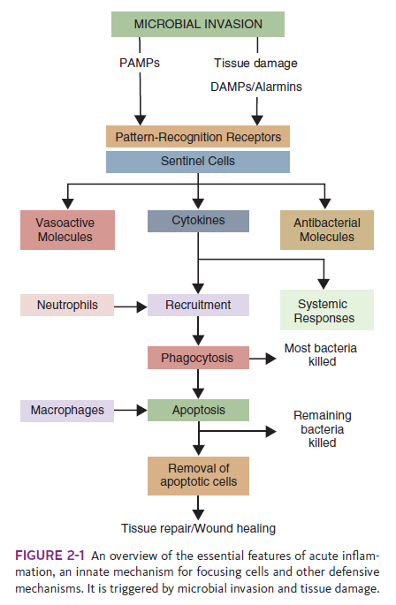
Innate immune system activated and recognizes alarm signals generated by invading microorganisms (exogenous signals) or by dead and dying cells (endogenous signals)
Exogenous signals - molecules produced by microbial invaders: pathogen-associated molecular patterns (PAMPs)
Endogenous signals - released from damaged, dead, or dying cells: damage-associated molecular patterns (DAMPs)

Slide 3
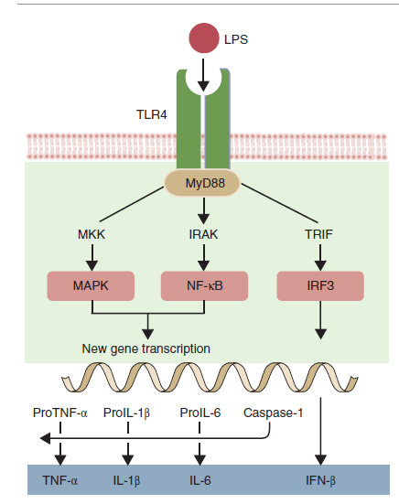
Toll-like Receptors
Expressed by many different cell types: expressed on sentinel cells located on or near the surface of the body. Sentinel cells
Transmembrane glycoprotein
When a PAMP binds to its corresponding TLR, signals are passed to the cell
Three major proteins:
  IL-1
  IL-6
  TNF-α
regulate the activities of cells involved in the defense of the body

Slide 4
PAMPS
conserved molecular structures (or patterns) that occur in a diverse range of potential microbial invaders
  Bacterial LPS: LPS links to MD-2 (myeloid differentiation factor-2), LPS-binding protein (LBP), and CD14
  Bacterial Peptidoglycans: Several PRRs can recognize these peptidoglycans, including some TLRs, NODs, and CD14
  Bacterial DNA
  Viral Nucleic Acids

Slide 5
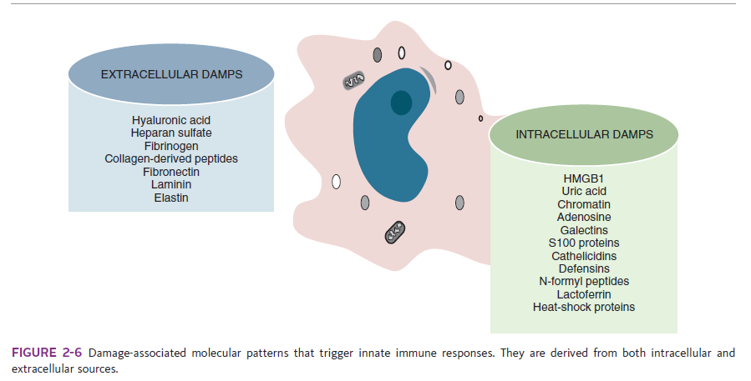
DAMPS or alarmins
molecules that escape from dead, dying, and damaged tissues
released when cells die (intracellular) or generated when connective tissue is damaged (extracellular)
potent antimicrobial properties. Others may recruit and activate cells
One of the most important intracellular DAMPs is called high mobility group box protein-1 (HMGB1).
  Normally binds DNA molecules and ensures that they fold correctly. However, HMGB1 is also a potent trigger of inflammation.
  HMGB1 also escapes from broken cells binds to both TLR2 and TLR4 and so sustains and prolongs inflammation
  causes fever, weight loss, anorexia, acute lung injury, arthritis, and even death.
  role in tissue
  It also has potent antimicrobial activity

Slide 6
Proinflammatory and Antimicrobial Mediators
TNF-α:
sentinel cells in response to TLR stimulation
First cytokine to be produced
release of chemokines and cytokines, promotes the adherence, migration, attraction, and activation of leukocytes
Transition from innate to adaptive immunity by enhancing antigen presentation and T cell activation
triggers changes in the vascular endothelial cells
Classic signs of inflammation and also amplifies and prolongs inflammation
Induces macrophages to increase its own synthesis together with that of IL-1
Can kill some tumor cells
Septic shock
Two TNF receptors: TNFR1 - most cells and TNFR2 - immune system cells

Slide 7
Proinflammatory and Antimicrobial Mediators
IL-1:
sentinel cells
2 types: IL-1α only acts on cells in direct contact with the Macrophage. IL-1β acts on nearby cells to initiate and amplify inflammation. Acts on vascular endothelial cells to make them adhesive for neutrophils
IL-1 acts on other macrophages to stimulate their synthesis of NOS2 and COX-2
responsible for sickness behavior
IL-1 activity is also regulated by IL-1 receptor antagonist (IL-1RA), regulator of IL-1 activity and inflammation. It reduces mortality in septic shock and graft-versus-host disease

Slide 8
Proinflammatory and Antimicrobial Mediators
IL-6:
macrophages, T cells, and mast cells.
Production is triggered by bacterial endotoxins, IL-1, and TNF-α
Affects both inflammation and adaptive immunity
Major mediator of the acute phase reaction and of septic shock regulates the transition from a neutrophil-dominated process early in inflammation to a macrophage-dominated process later

Slide 9
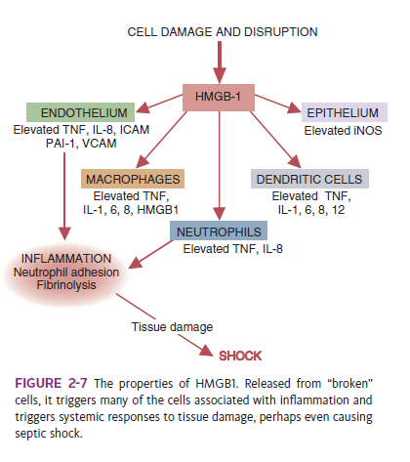

Slide 10
Proinflammatory and Antimicrobial Mediators
Chemokines
Inflammatory Mediators
Vasoactive Amines
Vasoactive Peptides
Vasoactive Lipids : leukotrienes and prostaglandins
Antimicrobial Molecules
  Peptides:
  Lysozyme

Slide 11
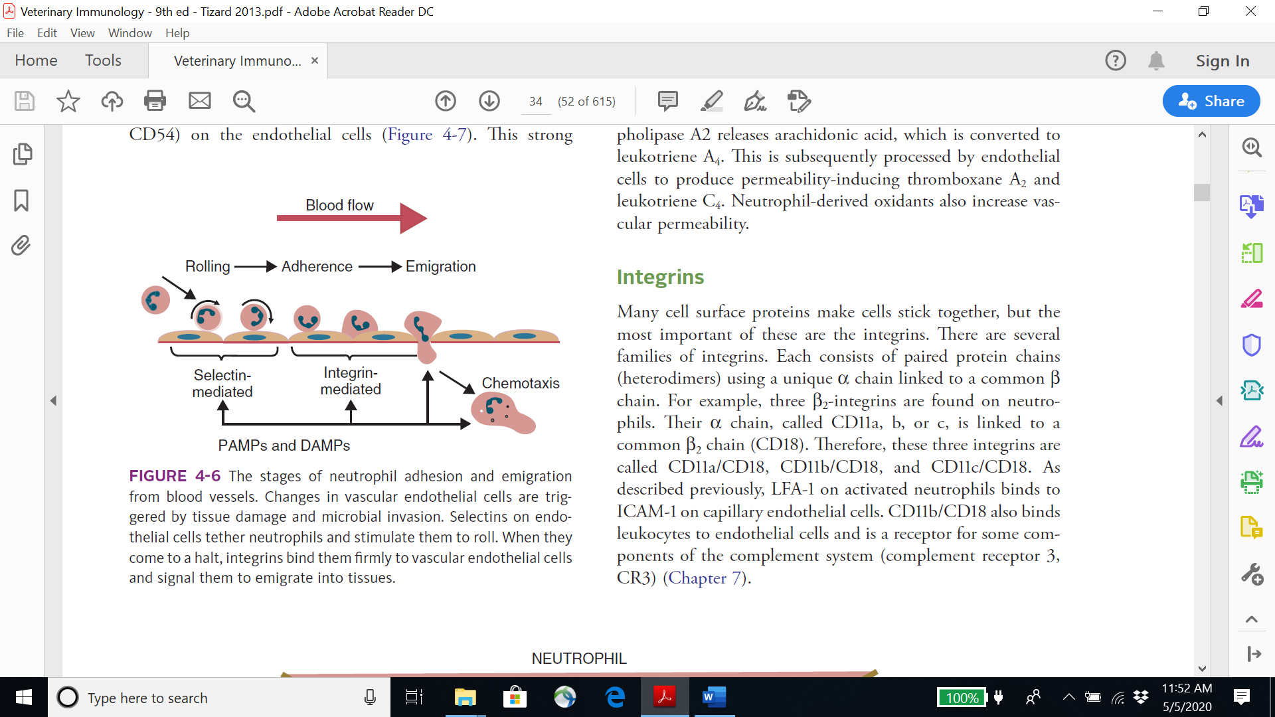
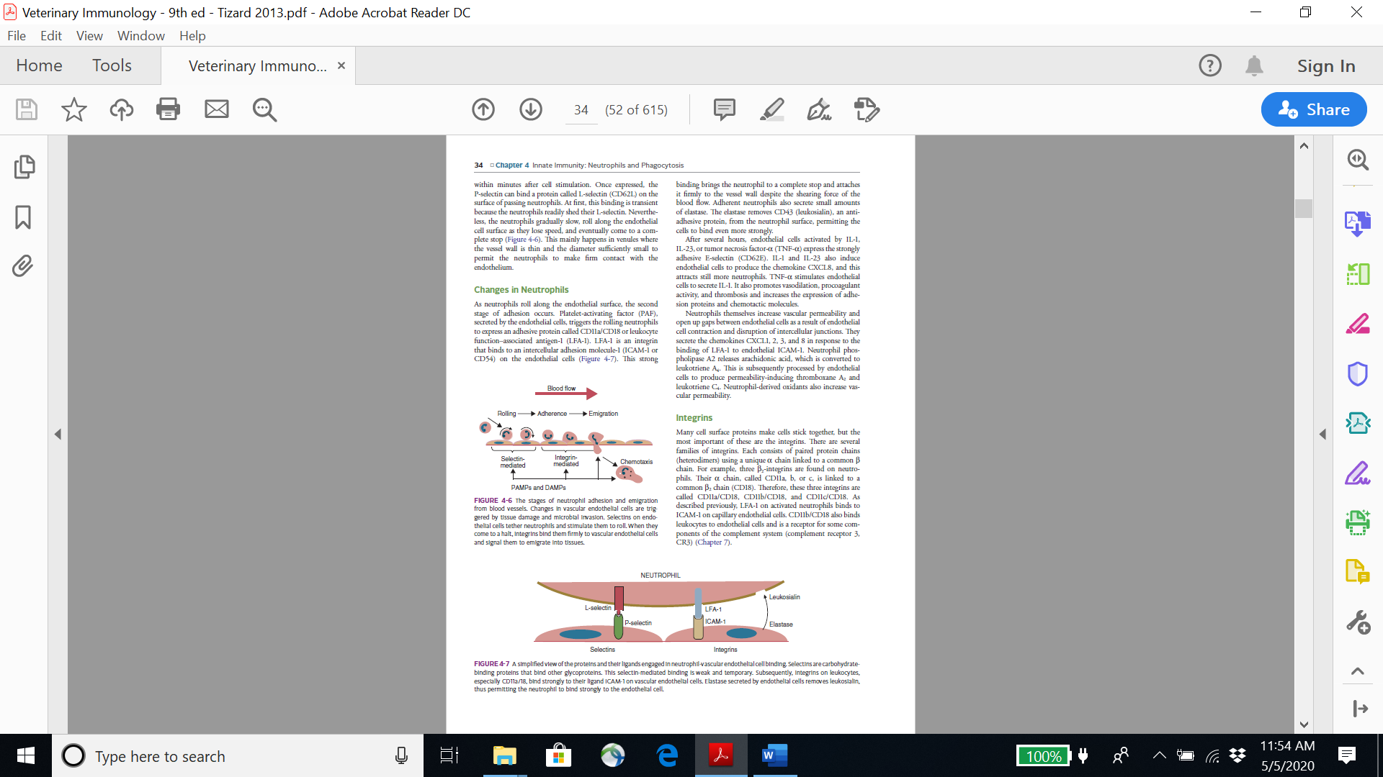
Neutrophils
production is regulated by a cytokine called granulocyte colony-stimulating factor (G-CSF)
P-selectin

Slide 12
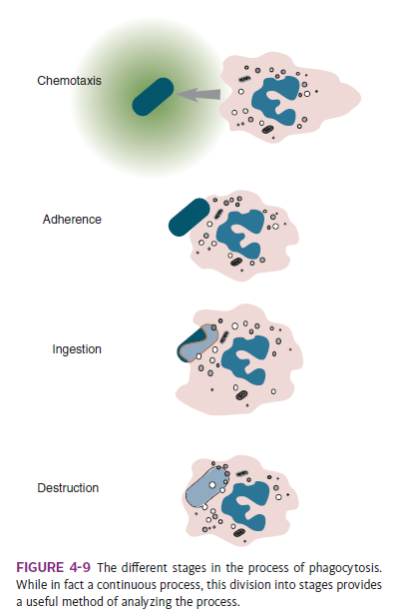
Neutrophils
Phagocytosis
1) Activation
2) Chemotaxis
3) Adherence and Opsonization
4) Ingestion
5) Destruction

Slide 13
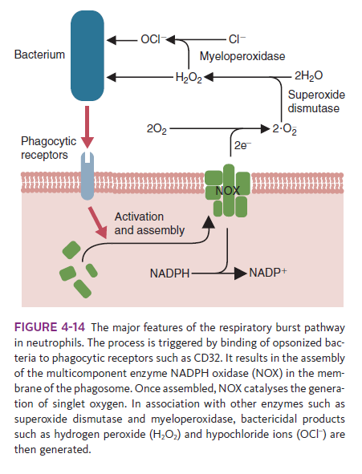
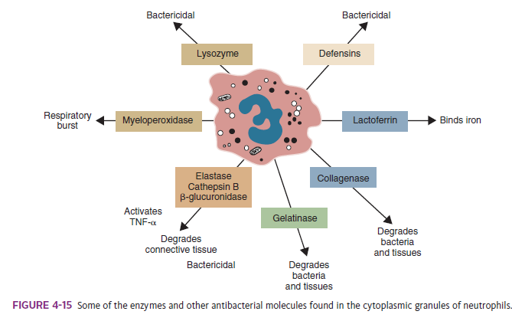
Neutrophils
Destruction
1) The Respiratory Burst
2) Lytic Enzymes

Slide 14
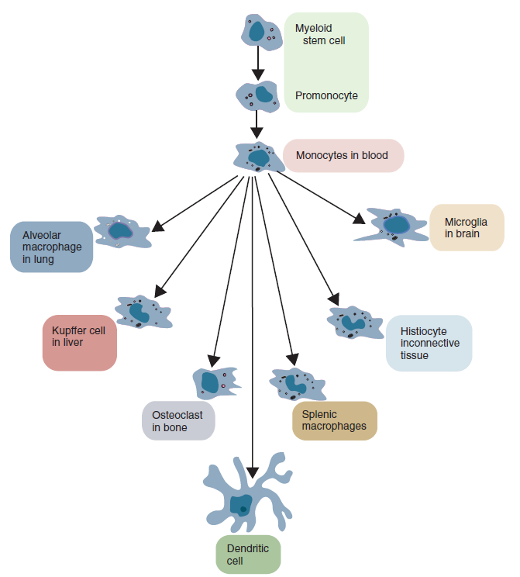
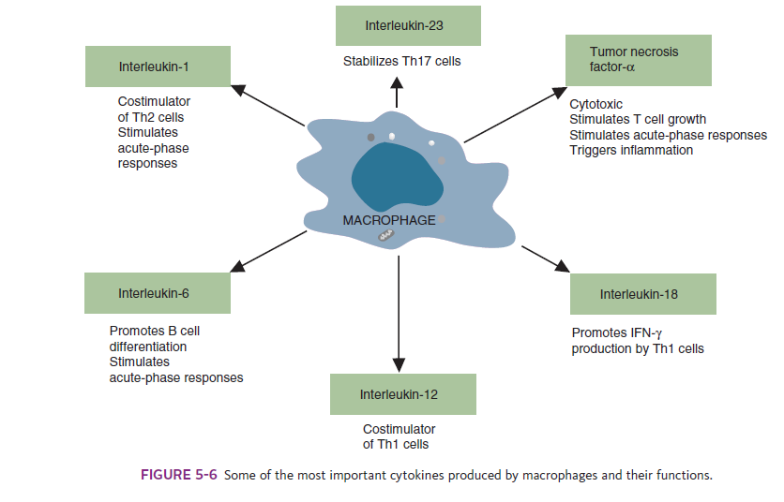
Macrophages

Slide 15
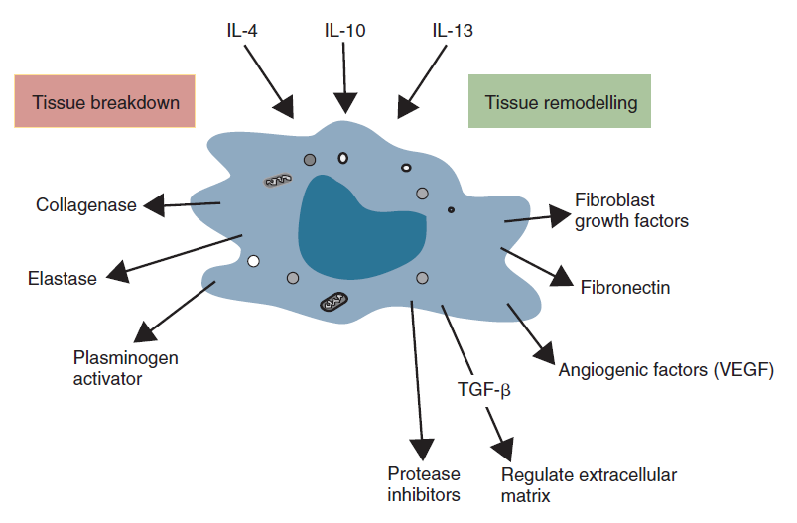
Macrophages

Slide 16
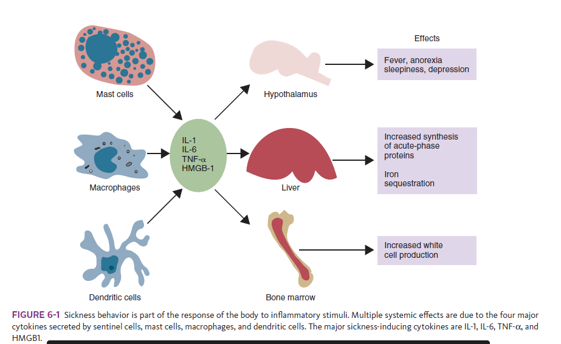
Systemic Responses to Inflammation
Sickness Behavior
Metabolic Changes
Acute-Phase Proteins
Soluble Pattern-Recognition Receptors
Iron-Binding Molecules

Slide 17
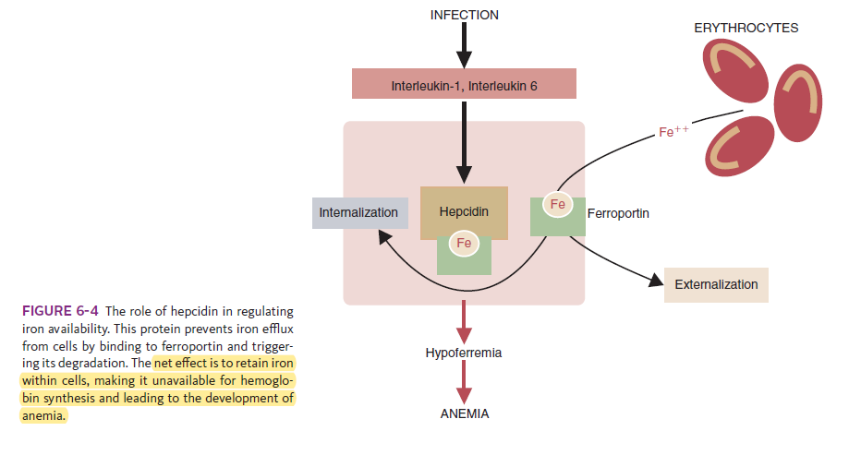
Systemic Responses to Inflammation

Slide 18
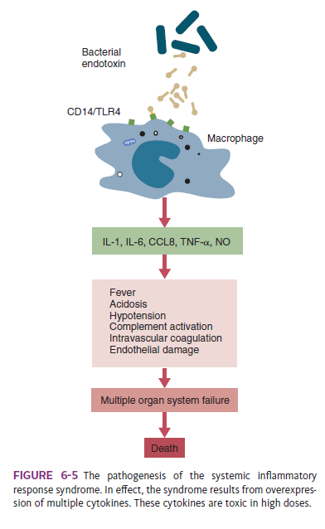
Systemic Inflammatory Response Syndrome
massive tissue damage → excessive amounts of cytokines, HMGB1, mitochondrial components, and oxidants → bloodstream and trigger SIRS
Released DAMPs activate sentinel cells → very large quantities of inflammatory mediators
TNF-α, IFN-γ, CXCL8, and IL-6 → trigger the activation of additional T cells and the release of additional cytokines, leading to even more cell destruction
cytokine storm- it’s real bad

Slide 19
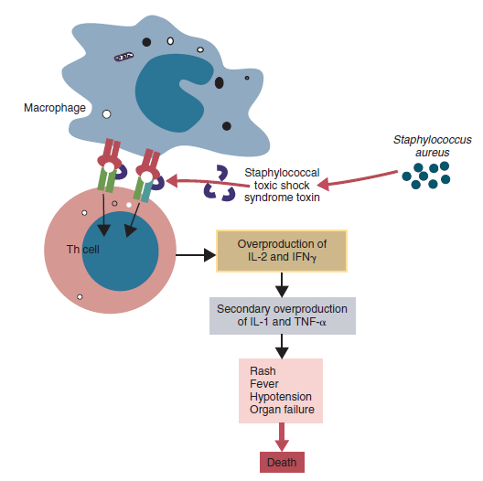
Bacterial Septic Shock
Severe infections, → HMGB1, TNF-α, IL-1β, IFN-γ, IL-6
NOS2 → NO and of COX-2 → PG and LT synthesis
Acidosis, fever, lactate release in tissues, hypotension, elevation of plasma catecholamines → tissue damage
Tissue damage + systemic inflammation + release of damaged cell fragments → TF gets expressed in excess → coag starts
Vascular endothelial cell apoptosis → detachment from the basement membrane
Activation of vascular endothelial cells → procoagulant
NO → vasodilation → hypotension + increased permeability
reduced AT synthesis + reduced fibrinolysis (increased synthesis of inhibitors of plasminogen activator)
MODS ensues - Oopsie

Slide 20
Innate Immunity: The Complement System
Three major steps are involved.
  Activation
  C3b generation
  Amplification
All steps carefully regulated
first step - three different mechanisms
  Alternative and lectin pathways - microbial carbohydrates
  Classical pathway - antibodies

Slide 21
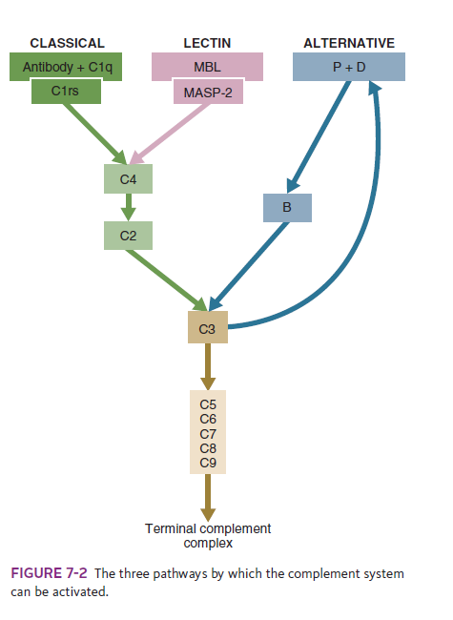
Innate Immunity: The Complement System

Slide 22
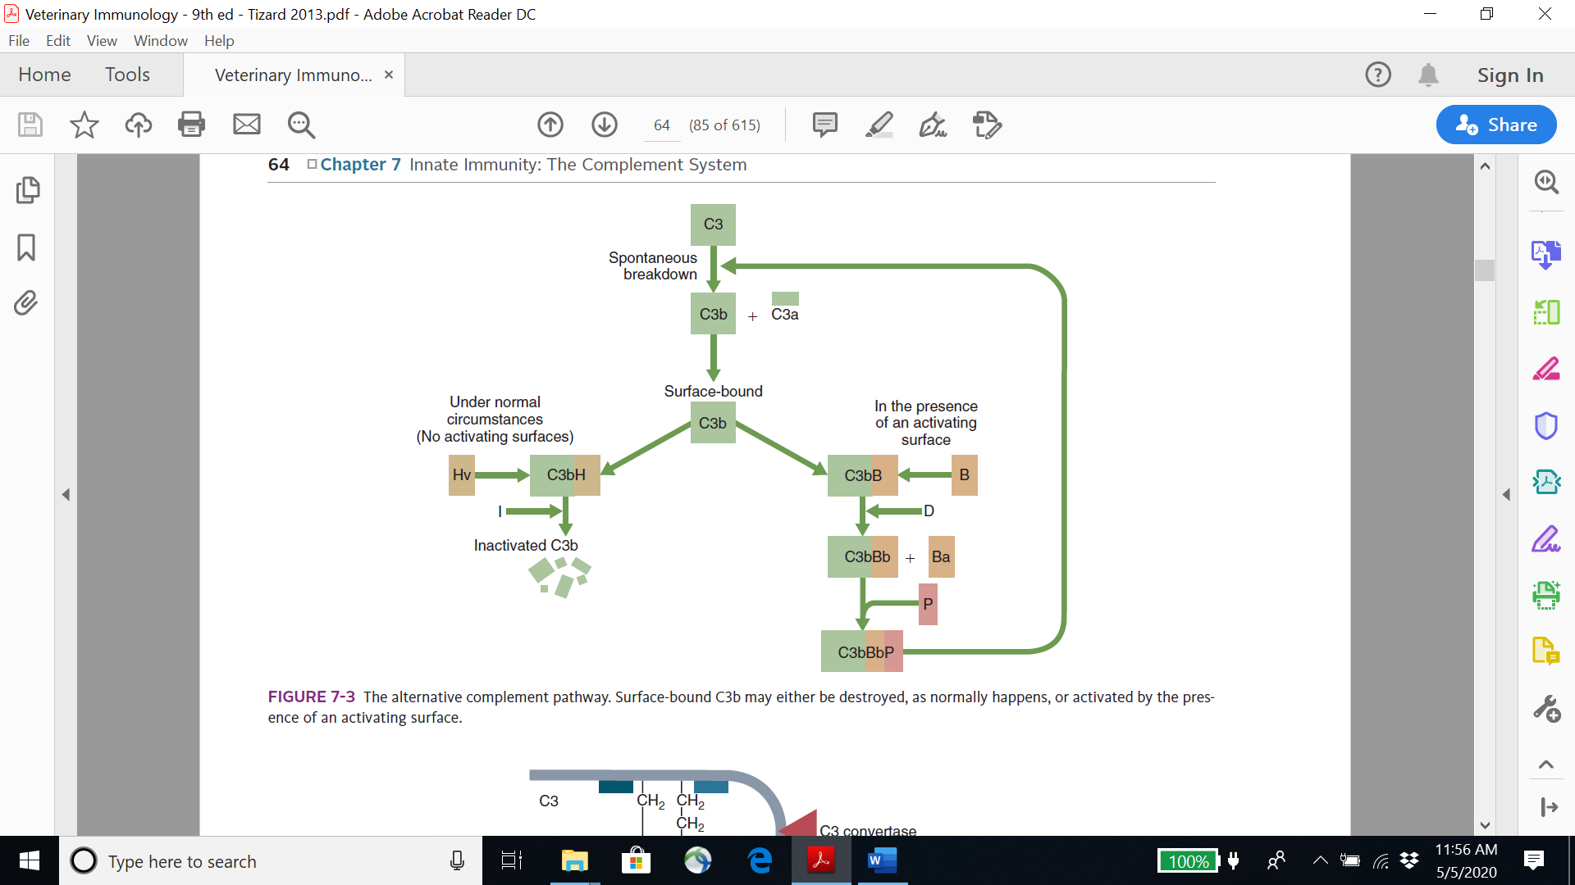
The Alternative Pathway
microbial cell walls interact with complement components in the bloodstream.
C3.
  C3: disulfide-linked heterodimer with α and β chains
  highly reactive thioester side chain

Slide 23
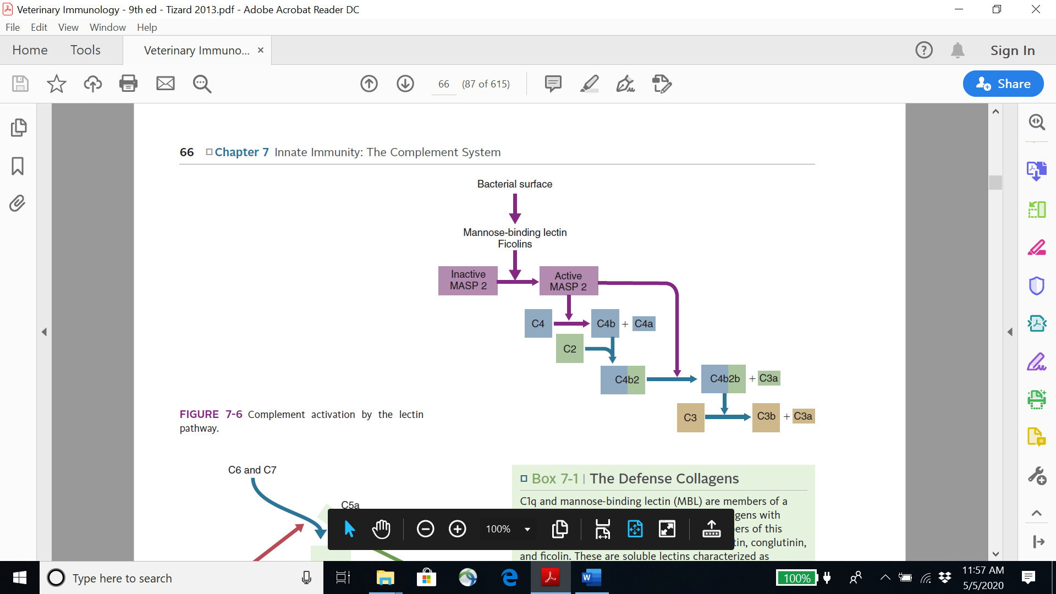
The Lectin Pathway
Triggered by PAMPs
MBL
It does not bind to mammalian glycoproteins
The MBL–MASP-2 pathway is ancient

Slide 24
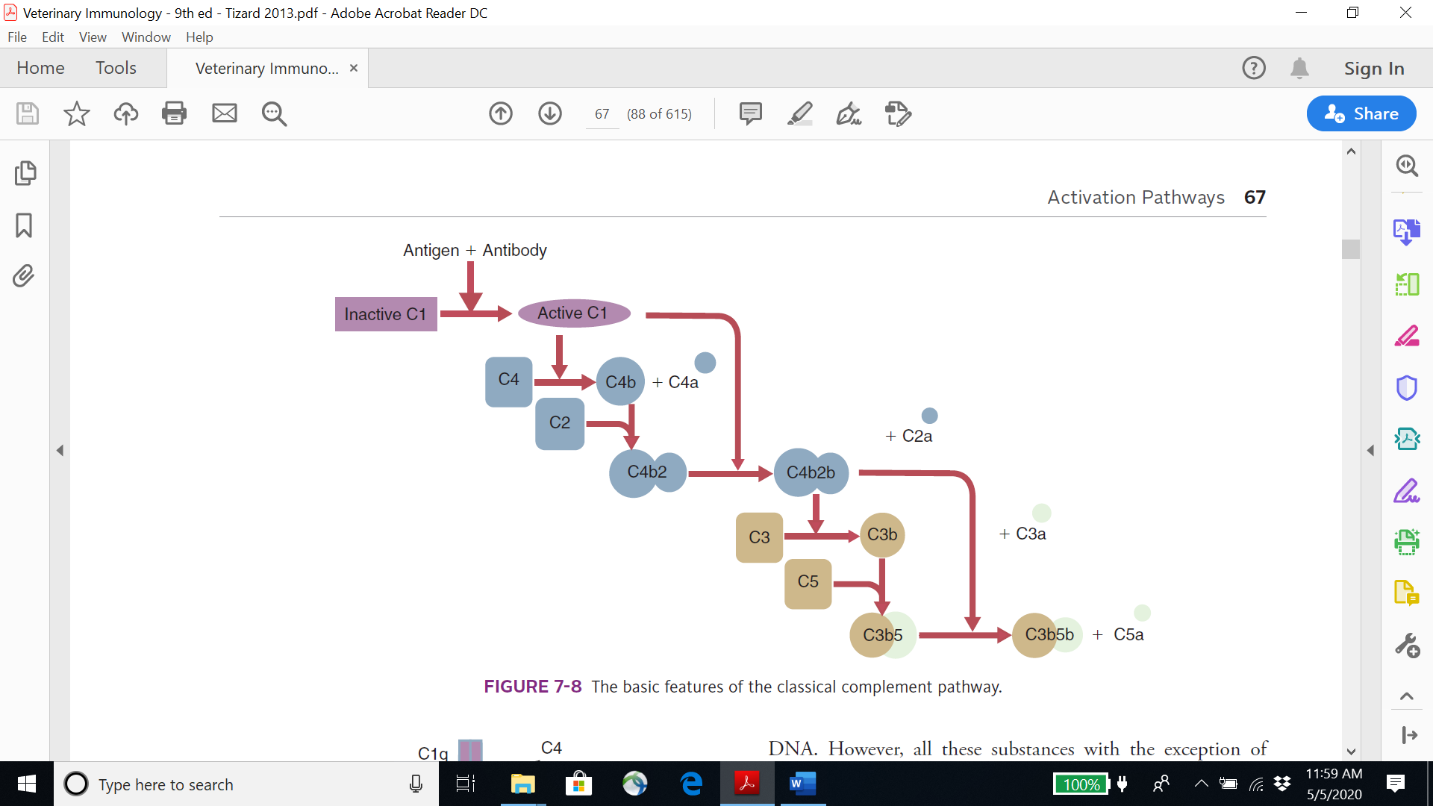
The Classical Pathway
Triggered by clusters of antibody

Slide 25
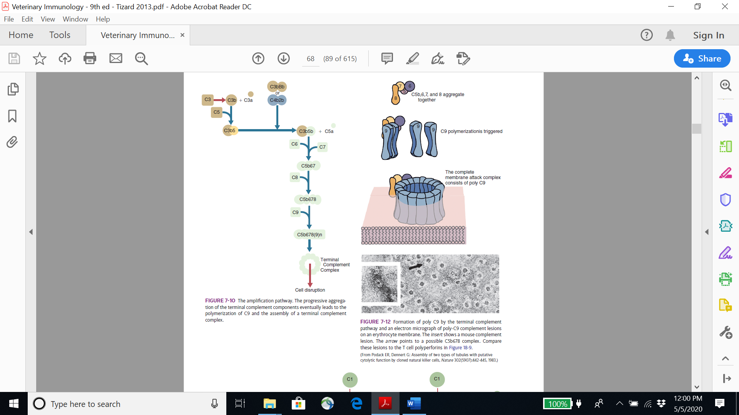
The Amplification Pathway

Slide 26
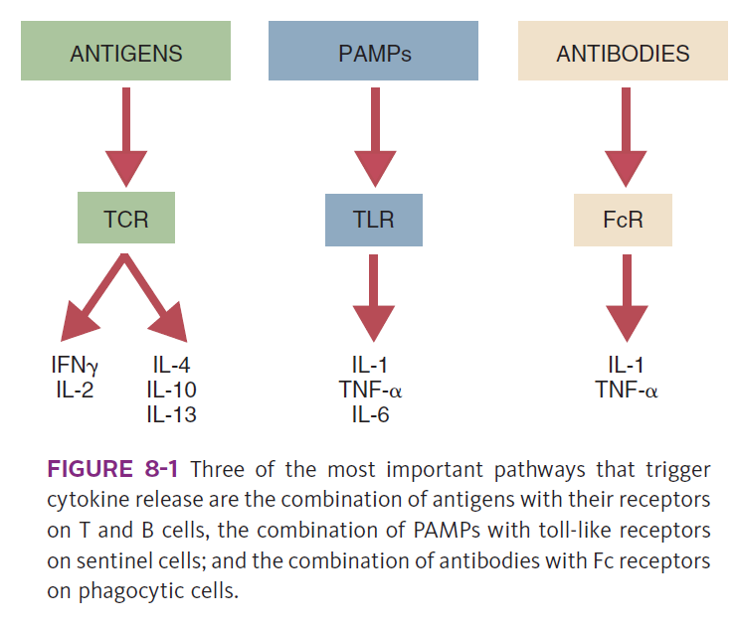
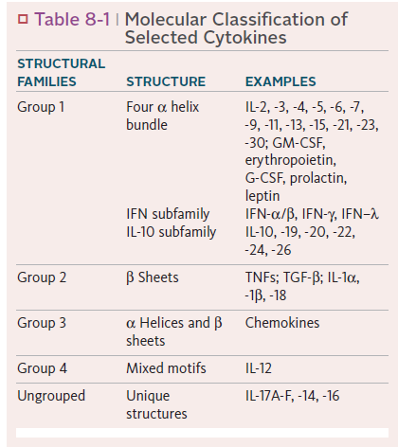
Cell Signaling: Cytokines and Their Receptors

Slide 27
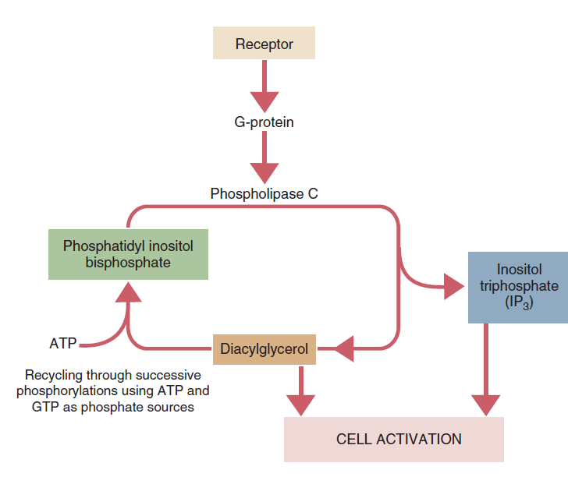

Slide 28
Sources:
- Tizard – Veterinary immunology (in box)

